Slide 1
FAIR and IFMIF liquid metal free surface target experiments at KALLA
L. Stoppel, Th. Wetzel,
4th High Power Targetry Workshop, May 3, 2011

Slide 2
Content:
Overview of liquid metal targets and investigation strategy
FAIR, IFMIF
Water experiment, validation of CFD, liquid-metal experiment
Water test facility - FIDES
Objects, design, test section, experimental results
Liquid metal test facility - ALINA
Objects, design, test section, experimental results
IFMIF test section
Design, Taylor-Goertler instability, measuring technique
Summary and outlook

Slide 3
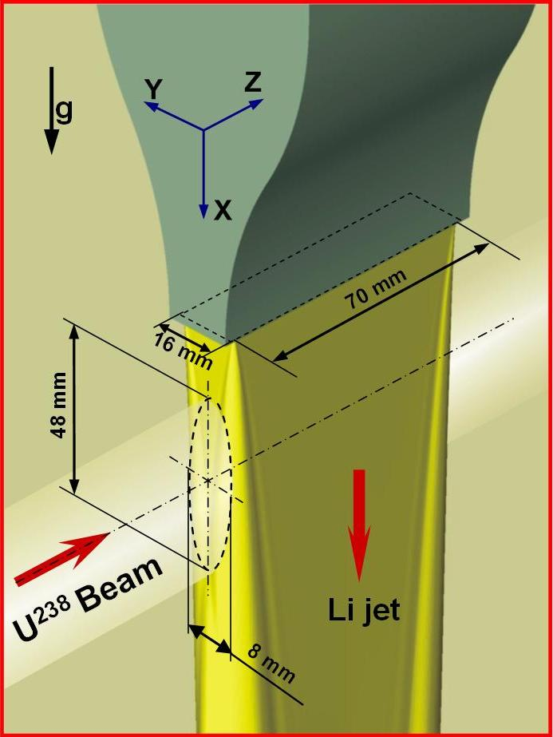
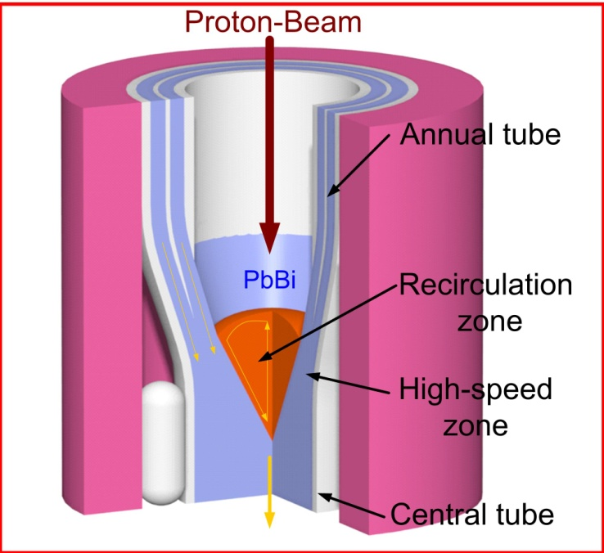
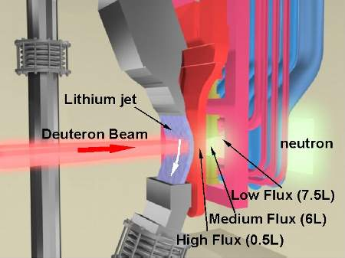
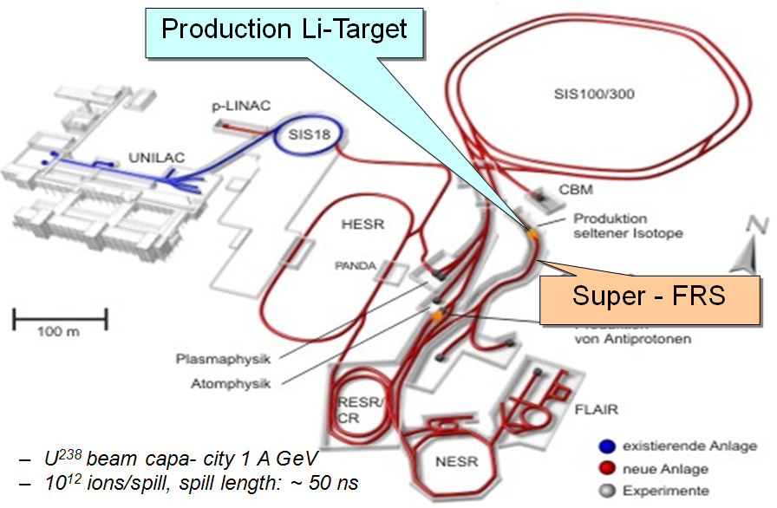
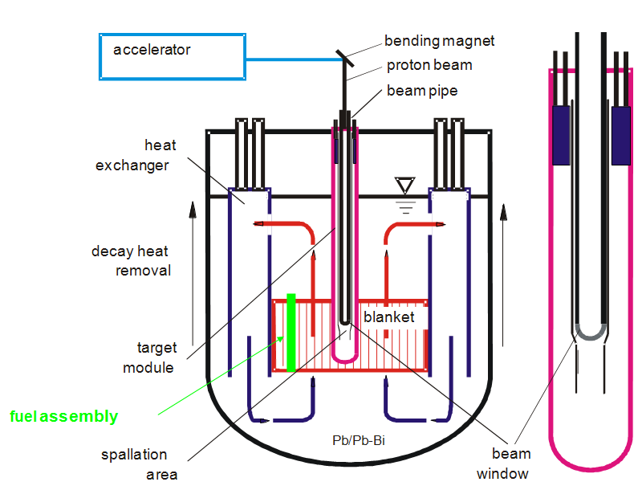
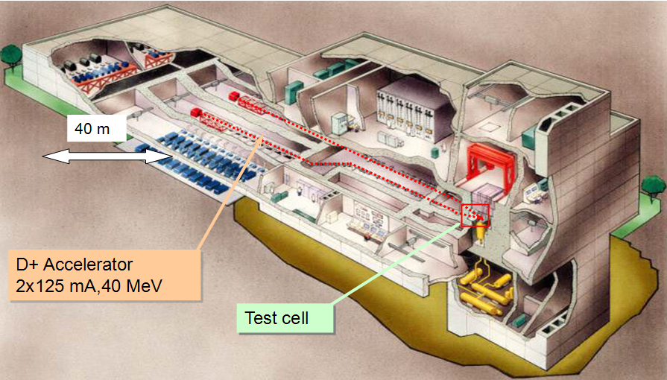
Overview liquid metal targets
Nuclear physics research
Lithium target
Facility for Antiproton
and Ion Research
(FAIR)
Transmutation
PbBi-Target
Accelerator Driven System for Transmutation
(ADS)
Fusion technology
Lithium target
International Fusion Material Irradiation Facility
(IFMIF)

Slide 4
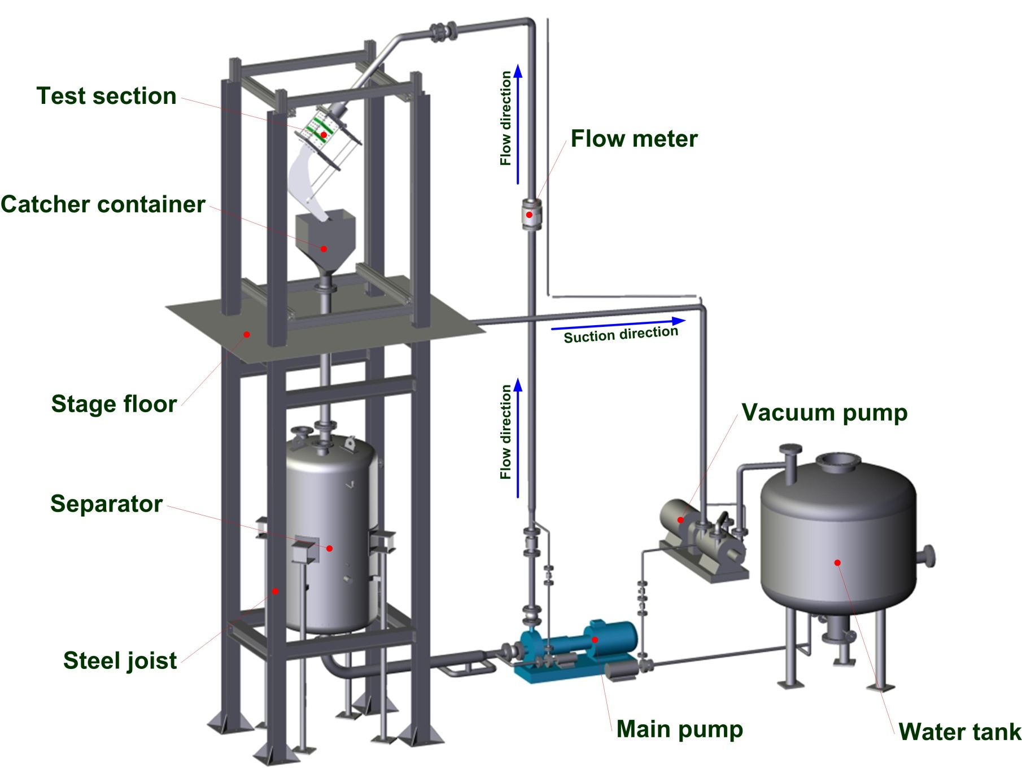
FIDES – water facility design
Facility Data:
total height ~ 7 m
medium - water
separator ~ 2.5 m³
water tank - 2.5 m³
flow rate – up to 60 m³/h
flow velocity:
in the pipe – max. 5 m/s
nozzle outlet – max. 20 m/s
Notes:
Aus dem Bild kann man schon erkennen, dass der Kern der Anlage wurde in letzten Jahr praktisch komplett neugebaut.

Slide 5
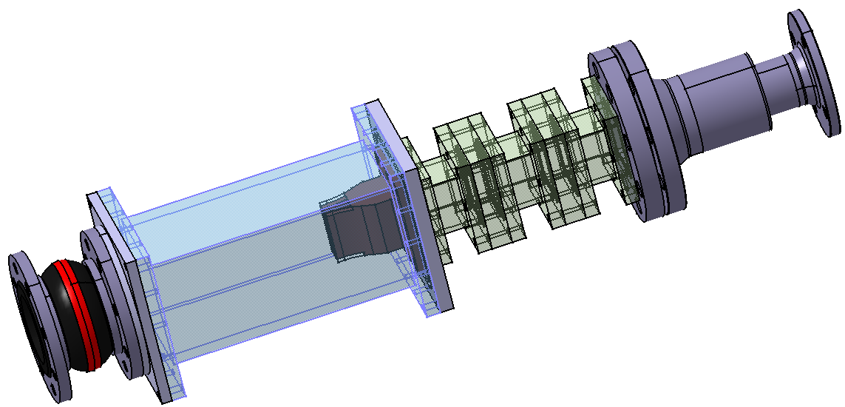
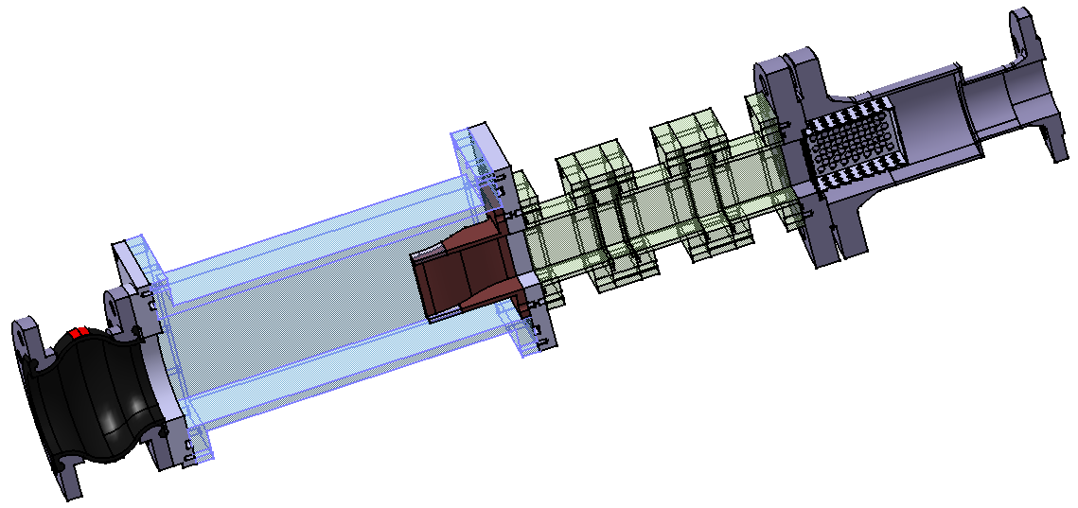
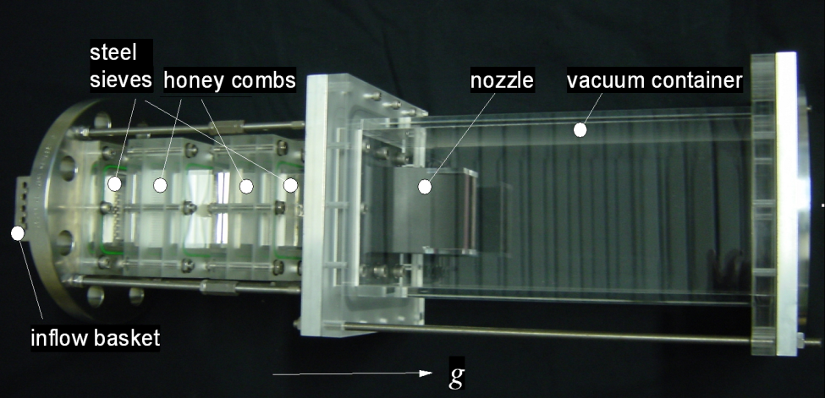
Water test section design (FAIR)
inflow basket
flow conditioner
nozzle
glass housing

Slide 6
Water-jet investigation (nozzle flow)
Quantitative analysis by means of LDA
Acquisition of viscous boundary layer
(minimized measurement volume)
Probe volume
λ, nm | δ_{x,},μm | δ_{y},μm | δ_{z},μm
488 | 56 | 56 | 353
514.5 | 59 | 59 | 372
δ_{z}
Z, w
Y, v
δ_{x}
δ_{y}
X, u

Slide 7
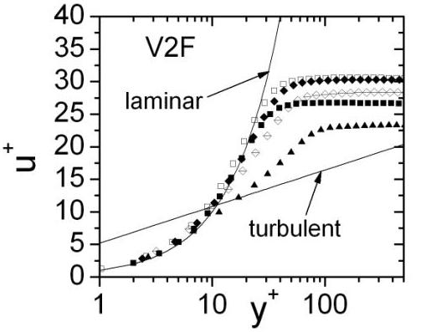
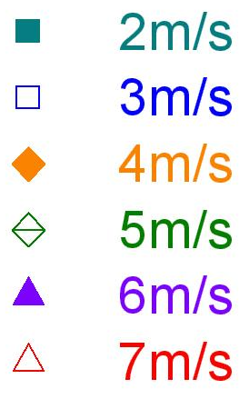
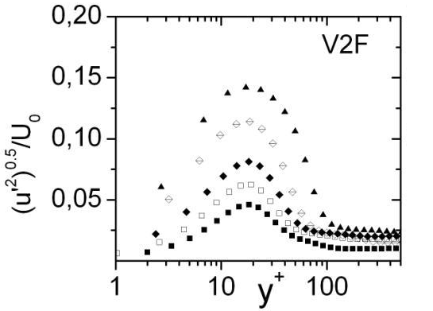
Water-jet investigation (nozzle flow)
Boundary layer velocity and turbulence intensity distribution
Experimental data
STAR-CD Calculation, S. Gordeev
y⁺=yU_{τ}/ν
U_{τ}=(τ_{w}/ρ)^{0,5}
τ_{w} – wall shear
stress

Slide 8
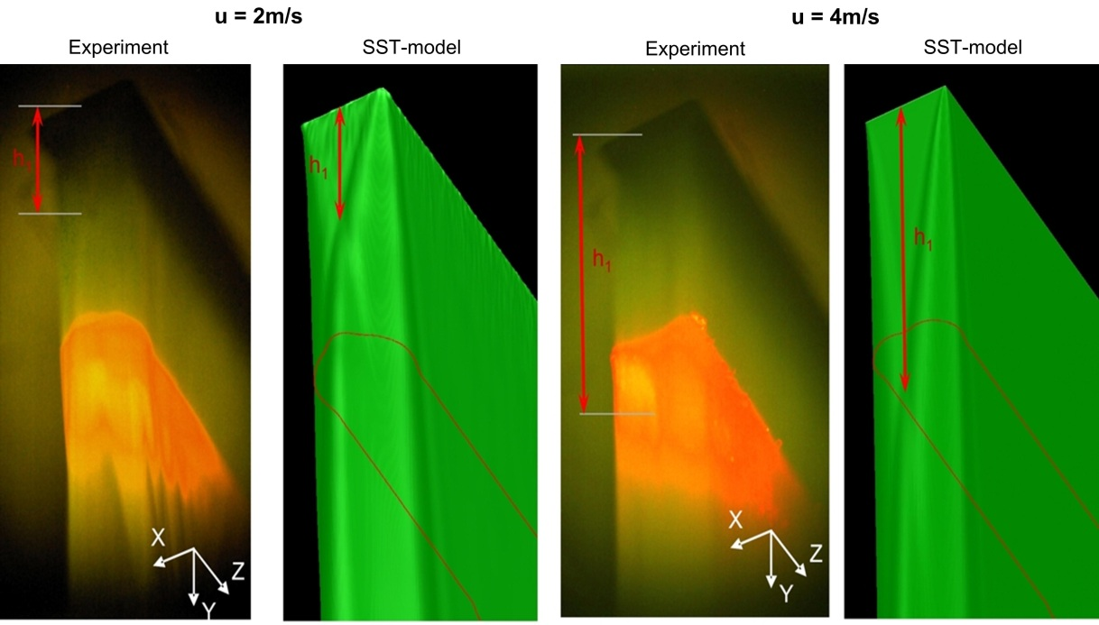
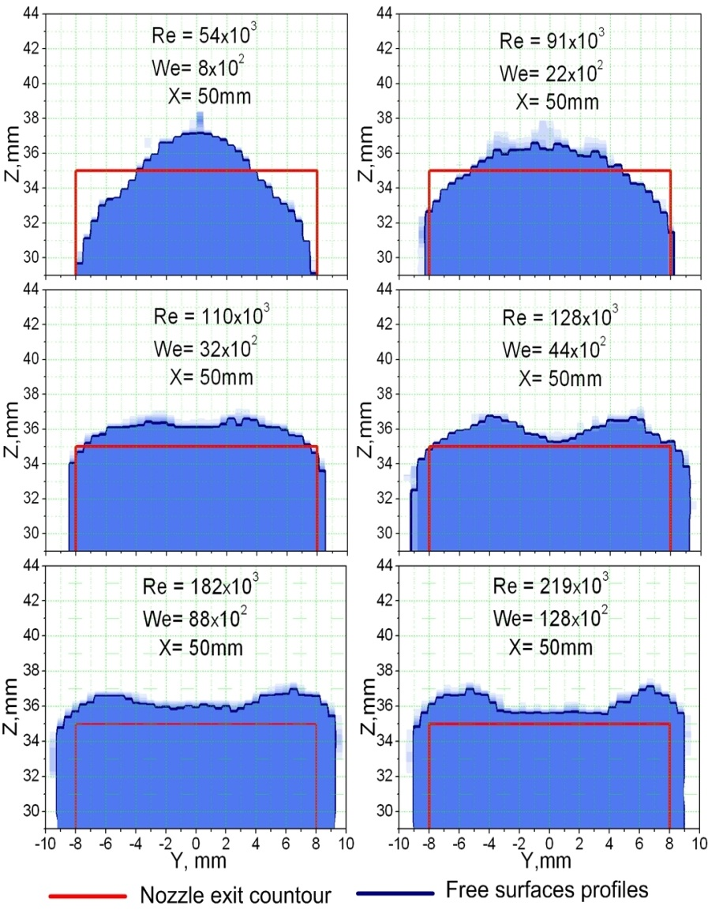
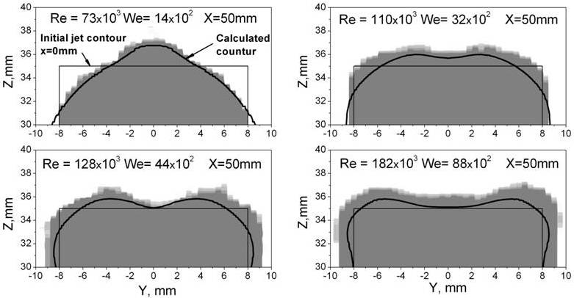
Water-jet investigation (free surface)
CFD-Calculation, S. Gordeev

Slide 9
The mission of the liquid metal ALINA-Facility
Experimental research on hydrodynamic phenomena of the free surface liquid metal flow (FAIR, IFMIF)
Thermal-hydraulic investigation of the systems with liquid metal flow
Design optimization and testing of new technological solution for liquid metal facilities
Developing and testing of new measuring techniques

Slide 10
3D-View of the experimental facility ALINA
Inventory:
Sump tank: 300 liter
Pipe line: 51 liter
Test section: 75 liter
Flow rate: 0.5…12 m³/h
Flow velocity:
up to 1.5 m/s (in the pipe)
up to 3.7 m/s (nozzle outlet)
Temperature up to 350°C
Thermal power: ~ 36 kW

Slide 11
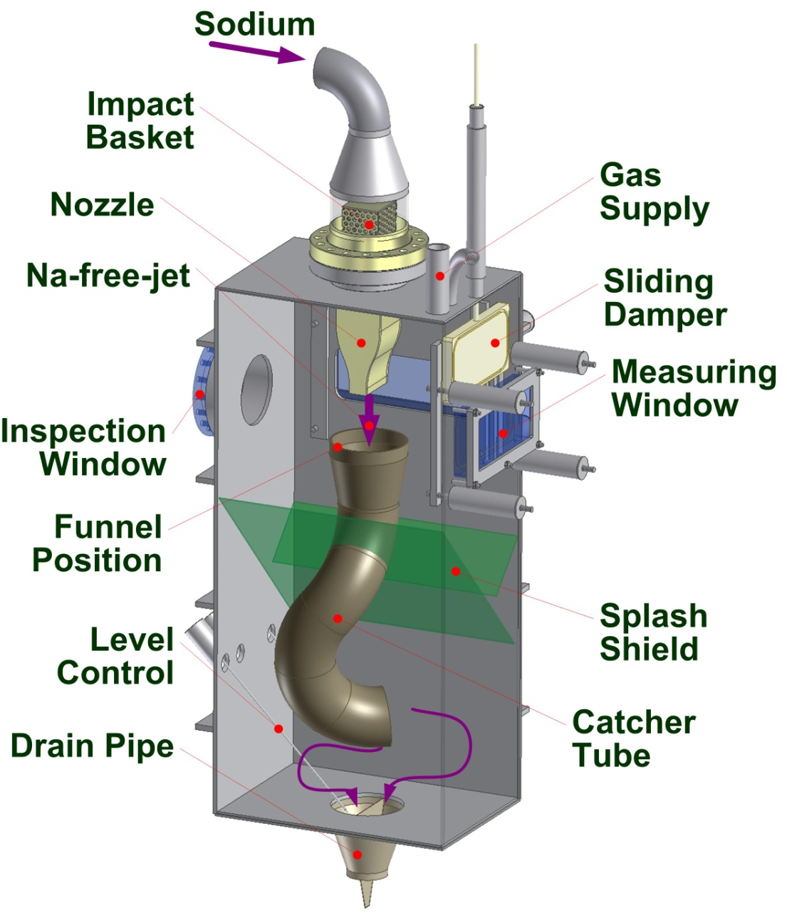
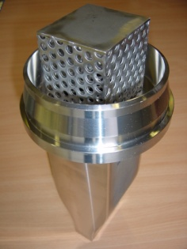
ALINA test section design (FAIR)
Test section assembly
Nozzle

Slide 12
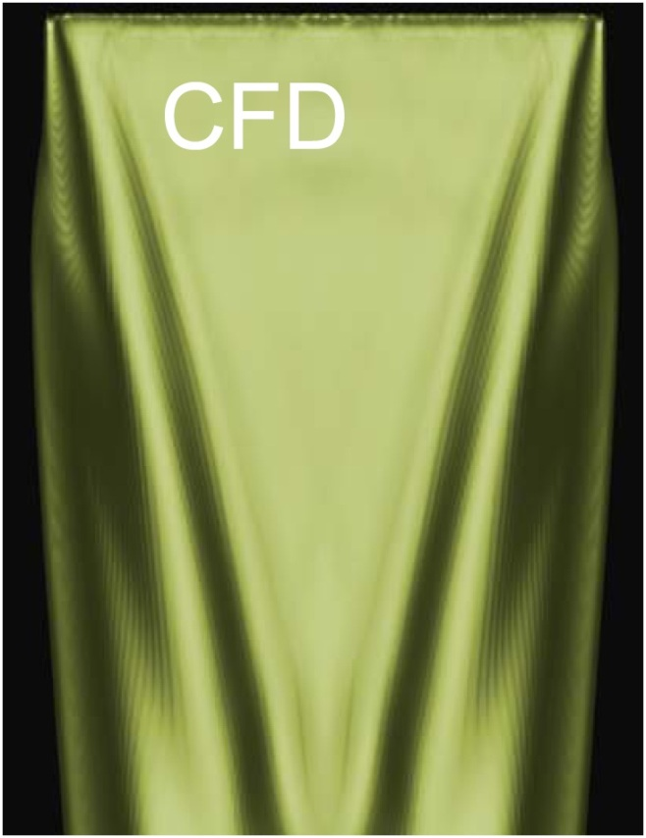
Lithium flow free surface
Example: liquid metal jet mean velocity U = 2.5 m/s at T=200°C
CFD-Calculation, S. Gordeev
exposure 1/30 sec
exposure 1/200 sec

Slide 13
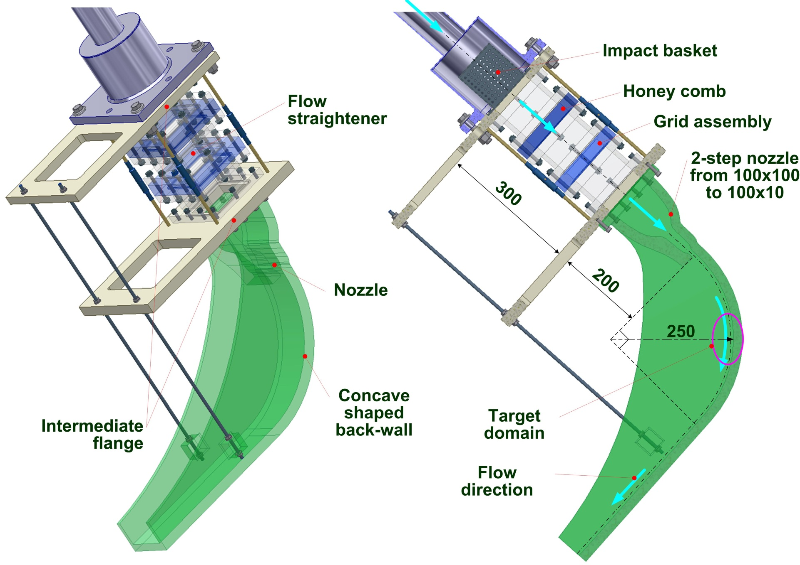
IFMIF water test section design

Slide 14
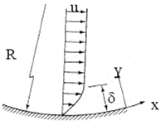
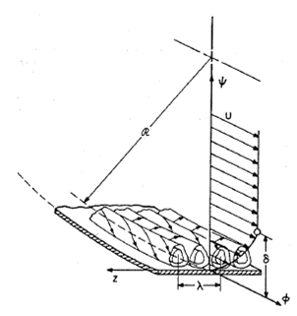
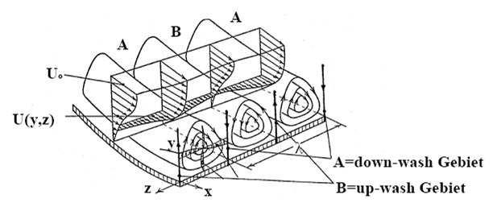
Taylor-Goertler instability
Investigation subjects:
Velocity distribution in the jet flow
Formation and development of Goertler vortices
Influence on the free surface
$$Go=\frac{U_{∞}∙θ}{θ}∙\sqrt{\frac{θ}{R}}=R_{θ}∙\sqrt{\frac{θ}{R}} { Go}_{cr}≈7$$
Goertler number as a critical stability parameter
Visualizing of Goertler vortices
Goertler vortices, Saric
Goertler vortices, Wortmann

Slide 15
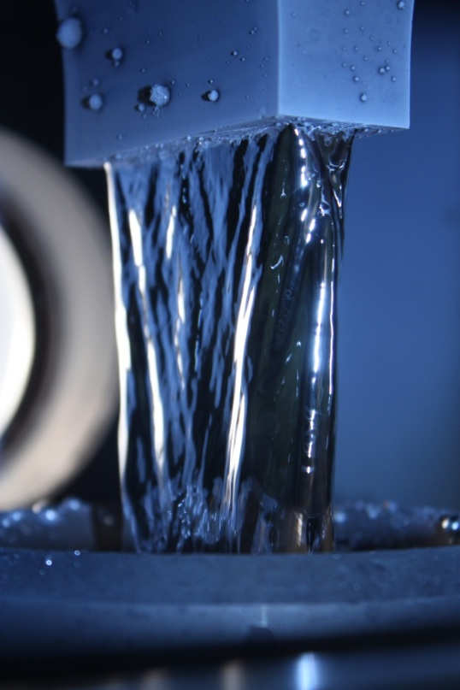
Summary
Experimental background for investigation of liquid metal free surface flows has been created:
Water test facility FIDES has been constructed
Liquid-metal facility ALINA was built and successfully tested
Facilities have been equipped by modern measuring technics.
FIDES-facility was improved and rebuilt to IFMIF-conditions
Outlook
Experimental investigation of:
Instabilities in the flow - Goertler vortices
Stability of the free surface
Flow conditioning
Application of High Speed PIV system (up to 1000Hz)

Slide 16
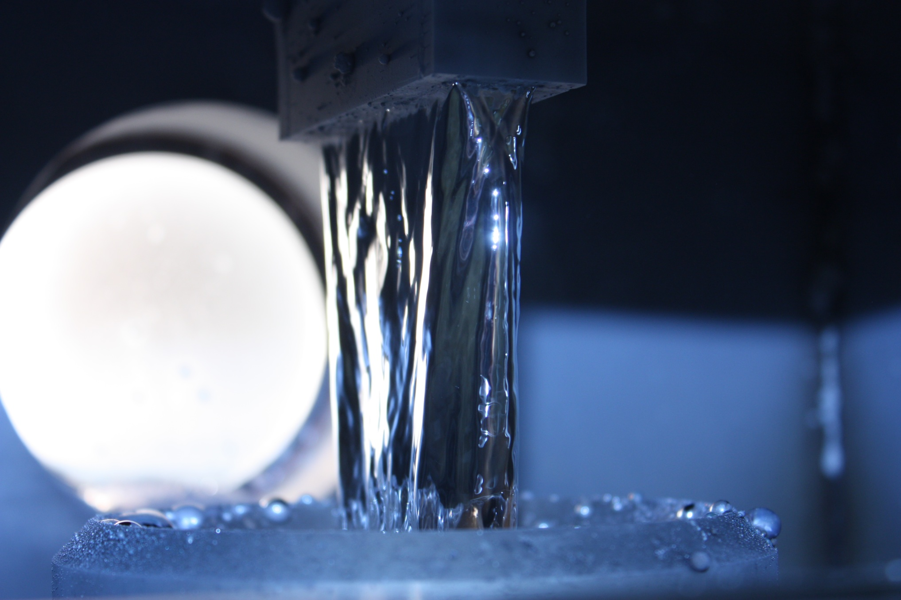
Thank you for your
Attention!

