Slide 1
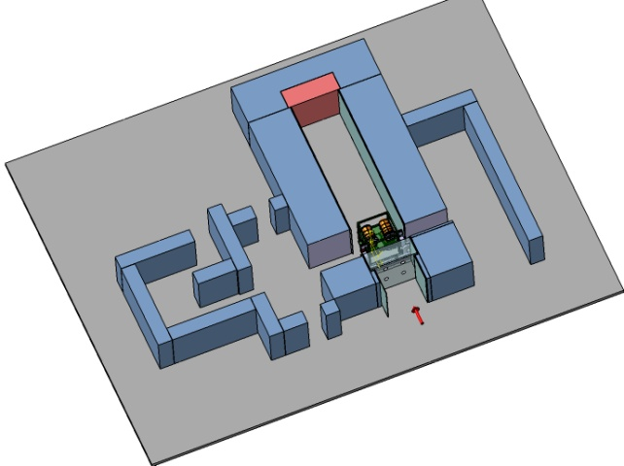
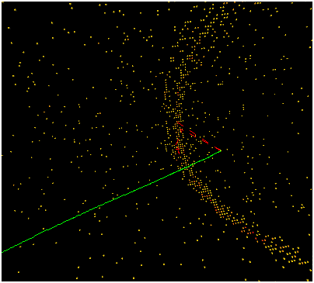
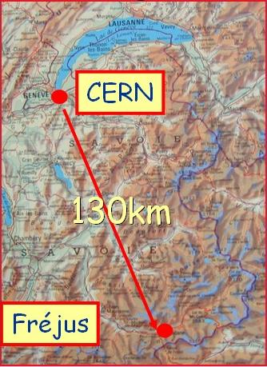
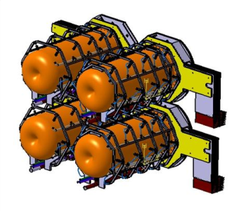
Optimization of the target and magnetic horn for the CERN to Fréjus neutrino beam
Nikolas Vassilopoulos, IPHC/CNRS, Strasbourg

Slide 2
Talk layout
Target Studies
Horn shape & SuperBeam Geometrical Optimization
Horn Thermo-mechanical Studies
Energy Deposition, Irradiation and Safety Studies

Slide 3
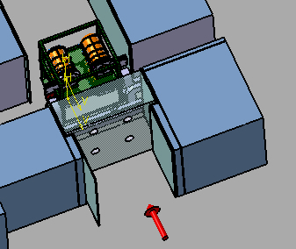
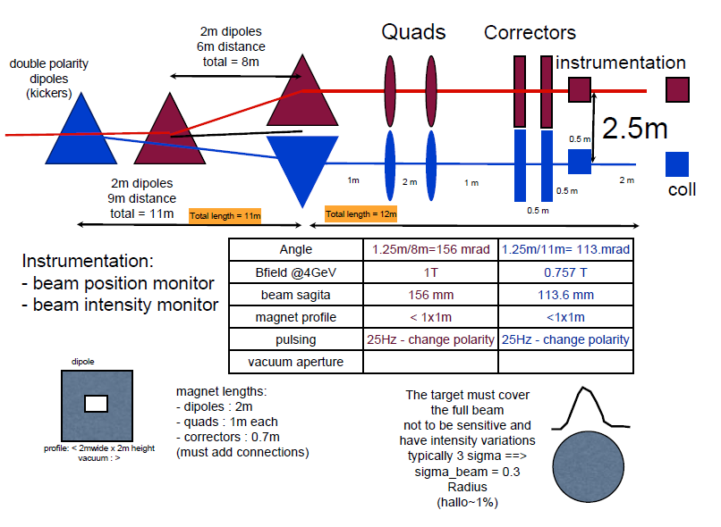
Proton Beam and Target/Horn Station
E_{b} = 4.5 GeV
Beam Power = 4MW -> 4x1-1.3MW
Repetition Rate = 50Hz -> 12.5Hz
Protons per pulse = 1.1 x 10¹⁴
Beam pulse length = 0.6ms
4-horn/target system in order to accommodate the 4MW
power @ 1-1.3MW, repetition rate @ 12.5Hz for each target
Ilias Efthymiopoulos/CERN

Slide 4
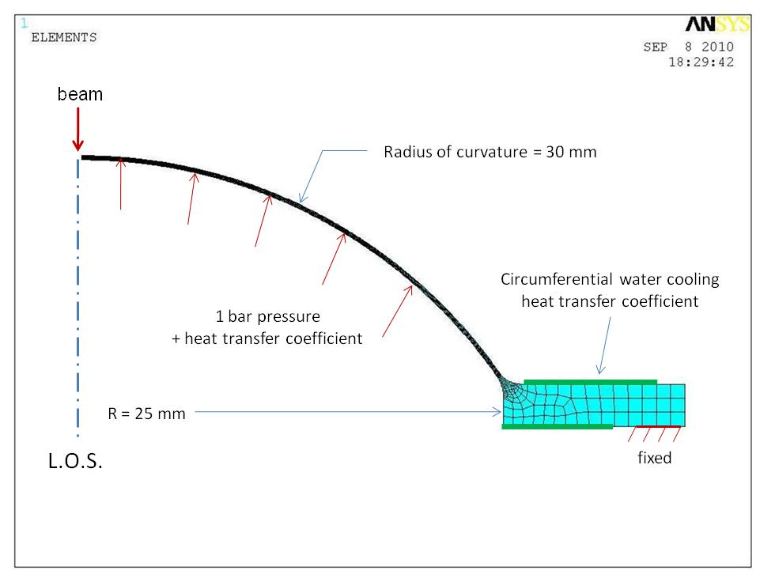
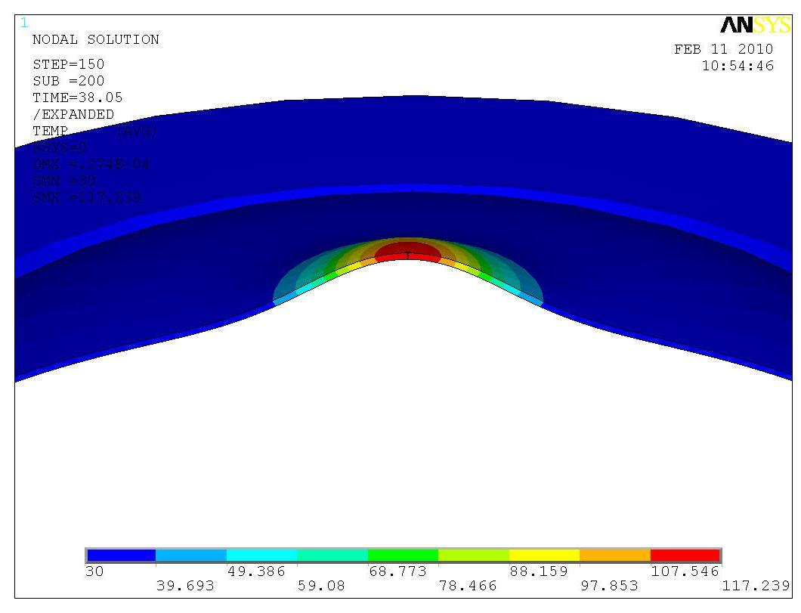
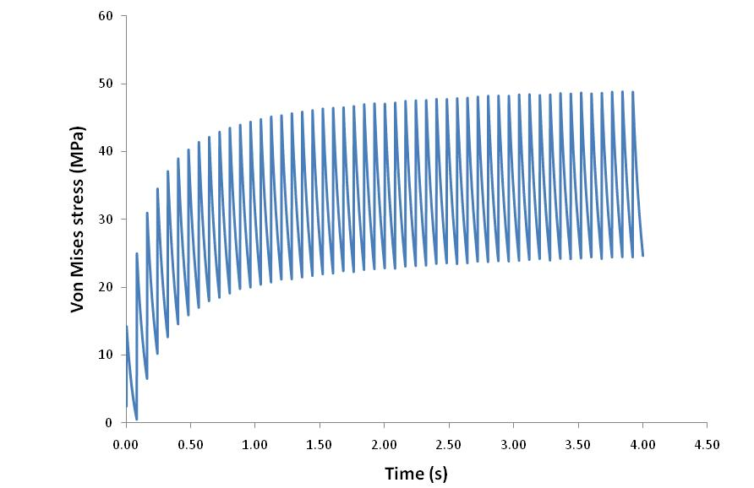
beam window
0.25 mm thick beryllium window
Circumferentially water cooled (assumes 2000 W/m²K)
Max temp ~ 180 °C Max stress ~ 50 MPa
(109ºC and 39 MPa using He cooling)
feasible
Matt Rooney

Slide 5
Important Issues for the engineering of the target
Heat Removal
Beam ≈ 60 – 120kW depending on Target Material/configuration
Thermal/mechanical stresses
long lived “quasi-static” stresses that generated by temperature variations within the target
inertial dynamic stress waves that are generated by the pulsed nature of the beam
Cooling
water
helium
peripheral vs transversal cooling
Neutron Production – heat load/damage of horn
Safety
Radiation resistance
Reliability
Pion yield
Chris Densham et al. @ RAL

Slide 6
from Liquid Targets to Static Packed one
EUROnu-WP2-note-11-01
favourable baseline for WP2

Slide 7
favourable methods

Slide 8
with peripheral cooling
Ottone Caretta/RAL
ruled out

Slide 9
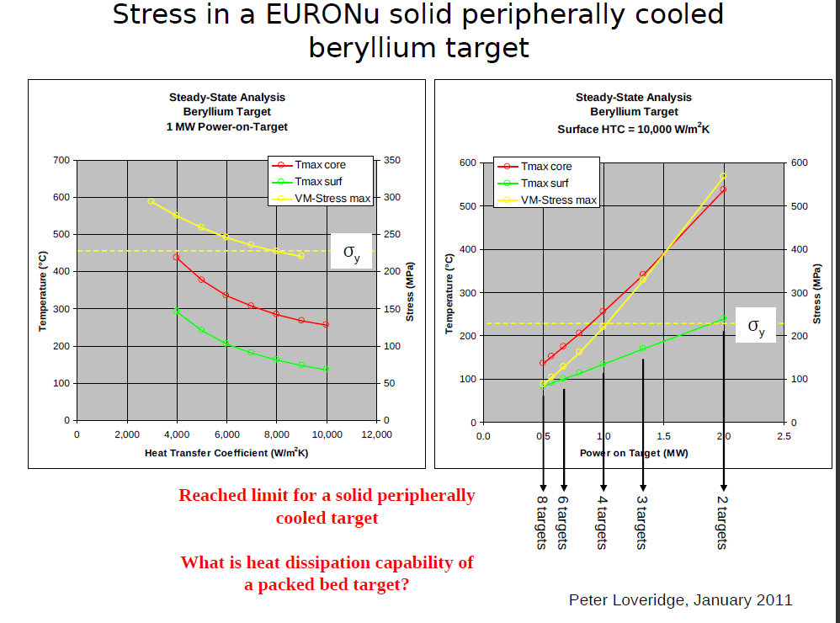

Slide 10
Packed bed Target
Why packed bed target with transversal cooling is the baseline option ?
Large surface area for heat transfer
Coolant able to access areas with highest energy deposition
Minimal stresses
Potential heat removal rates at the hundreds of kW level
Pressurised cooling gas required at high power levels
Bulk density lower than solid density
From a thermal and engineering point of view seems a reasonable concept where stress levels in a traditional solid target design look concerningly high

Slide 11
Tristan Davenne/RAL

Slide 12
Tristan Davenne/RAL

Slide 13
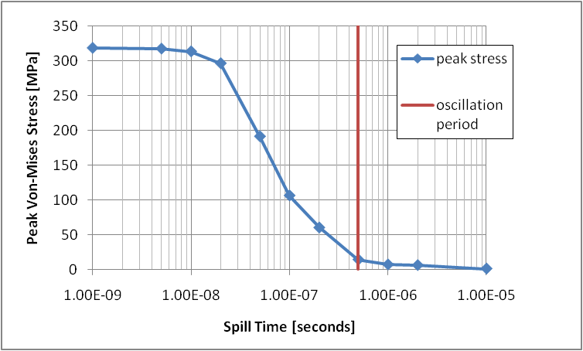
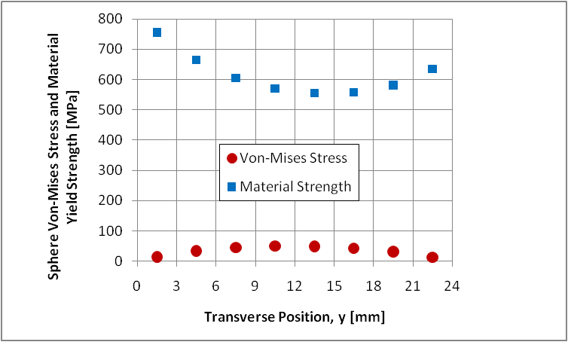
Stresses for the Packed bed target
EUROnu example, 24mm diameter cannister packed with 3mm Ti6Al4V spheres
Quasi thermal and Inertial dynamic components
ideally spill time > oscillation period
Tristan Davenne/RAL

Slide 14
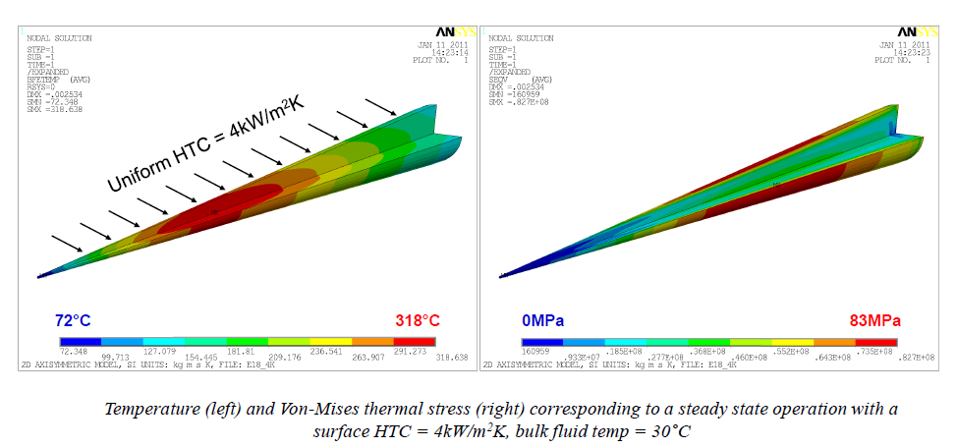
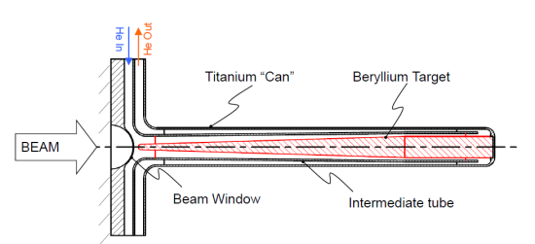
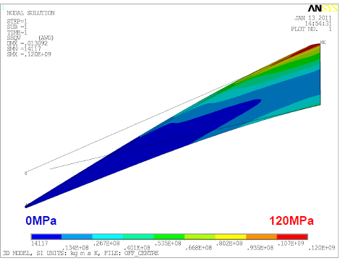
Alternative solution: pencil “closed” Be Solid target
Mike Fitton, Peter Loveridge/RAL
Pencil like Geometry merits further investigation
Steady-state thermal stress within acceptable range
Shorter conduction path to coolant
Pressurized helium cooling appears feasible
Off centre beam effects could be problematic?
Needs further thermo-mechanical studies

Slide 15
Horn Studies
details in WP2 notes @ http://www.euronu.org/
evolution of the horn shape after many studies:
triangle shape (van der Meer) with target inside the horn : in general best configuration for low energy beam
triangle with target integrated to the inner conductor : very good physics results but high energy deposition and stresses on the conductors
forward-closed shape with target integrated to the inner conductor : best physics results, best rejection of wrong sign mesons but high energy deposition and stresses
forward-closed shape with no-integrated target: best compromise between physics and reliability
4-horn/target system to accommodate the MW power scale

Slide 16
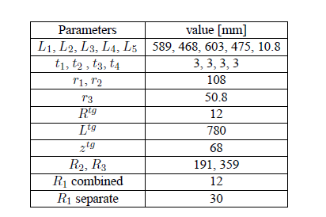
Horn Shape and SuperBeam geometrical Optimization
minimize λ, the δ_{cp}-averaged 99%CL sensitivity limit on sin²2θ₁₃
broad scan, then fix & restrict parameters then re-iterate for best horn parameters & SuperBeam geometry
A. Longhin/CEA

Slide 17
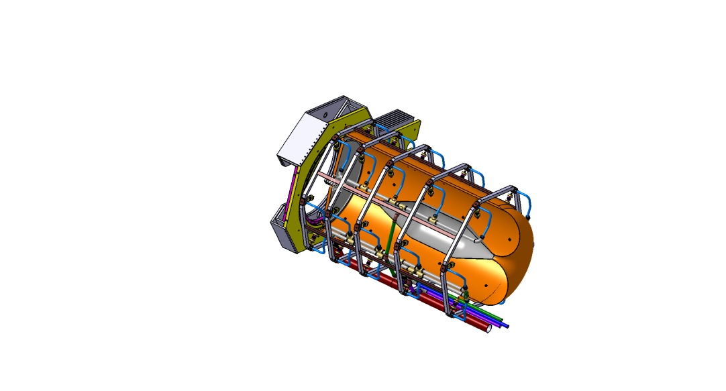
Horn Stress Studies
horn structure
Al 6061 T6 alloy; good trade off between mechanical strength, resistance to corrosion and electrical conductivity and cost
horn thickness has to be as small as possible for the best physics performance and to limit energy deposition from secondary particles but thick enough to sustain dynamic stress from the pulsed currents.
horn stress and deformation
magnetic pressure and thermal dilatation
COMSOL, ANSYS software
cooling
water

Slide 18
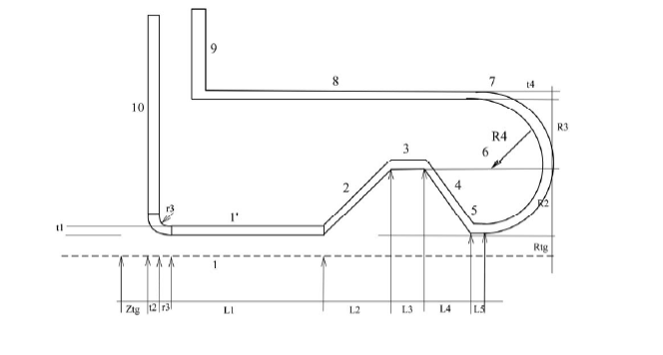
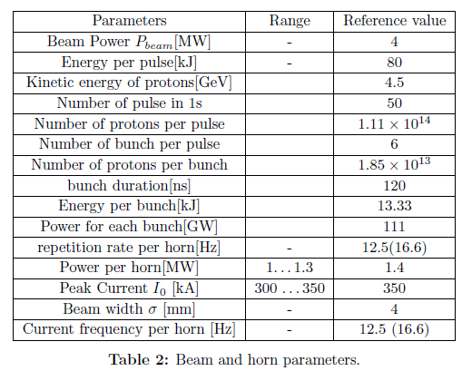
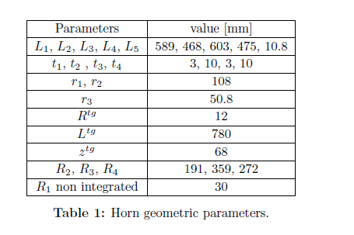
EUROnu scenario for 4-horn system

Slide 19
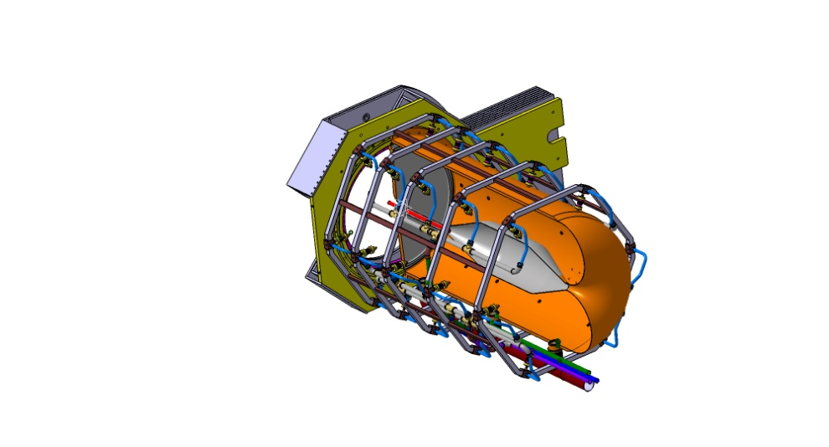
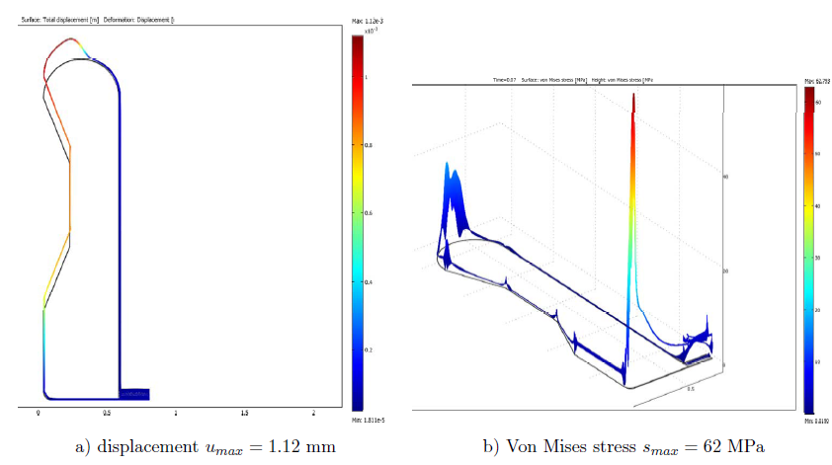
Stress Analysis for the SPL SuperBeam Horn I
B. Lepers/IPHC, P. Cupial , L. Lacny/Cracow Univ. of Tech.
Thermo-mechanical stresses:
secondary particles energy deposition and joule losses
T=60ms, τ₀=100μs, I_{rms}=10.1kA, f=5kHz (worst scenario, 1horn failed)
T_{Al} =60⁰C, {h_{corner} , h_{inner}, h_{horn/out} }= {6.5, 3.8, 0.1} kW/(m²K)
S_{max} = 62MPa
B. Lepers/IPHC

Slide 20
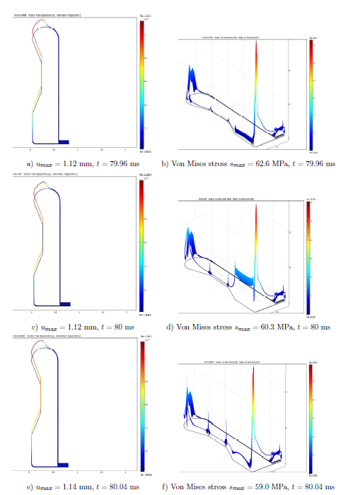
Stress Analysis II
Combined analysis of Thermo-mechanical and magnetic pressure induced stresses:
significant stress or the inner conductor especially, for the upstream corner and downstream plate inner part
high stress at inner conductor welded junctions
thermal dilatation contributes to longitudinal stress; displacement is low due to the magnetic pulse
maximum displacement at downstream plate
horn lifetime estimation: results have to be compared with fatigue strength data
more water-jet cooling might be applied
B. Lepers/IPHC
displacement and stress time evolution ,
peak magnetic field each T=80ms (4-horns)

Slide 21
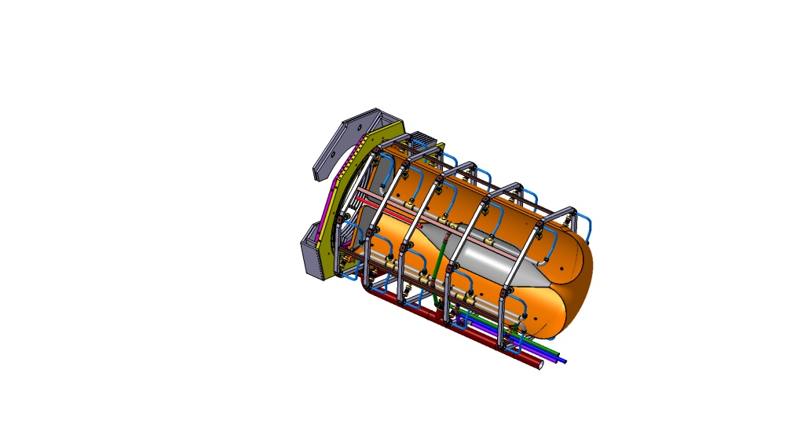
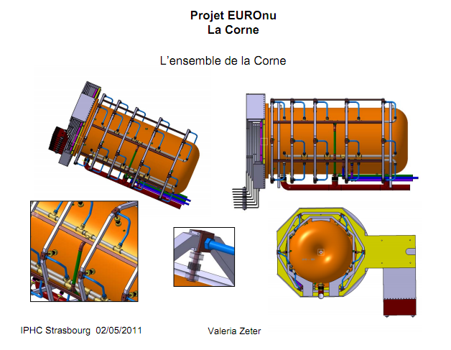
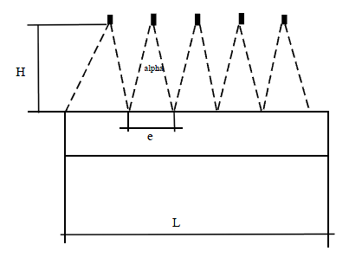
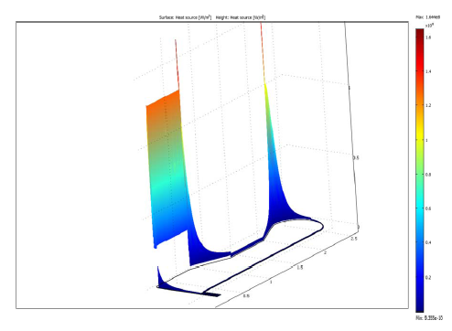
Cooling Studies
B. Lepers, V. Zeter, IPHC
power distribution on Al conductor
planar and/or elliptical water jets
flow rate between 60-120l/min
h cooling coefficient 1-7 kW/(m²K)
EUROnu-Note-10-06
design for 60⁰C uniform horn temperature:
{h_{corner} , h_{inner} , h_{outer/horn} }= {6.5, 3.8, 1} kW/(m²K)/longitudinal repartition of the jets follows the energy density deposition
30 jets/horn, 5 systems of 6-jets longitudinally distributed every 60⁰

Slide 22
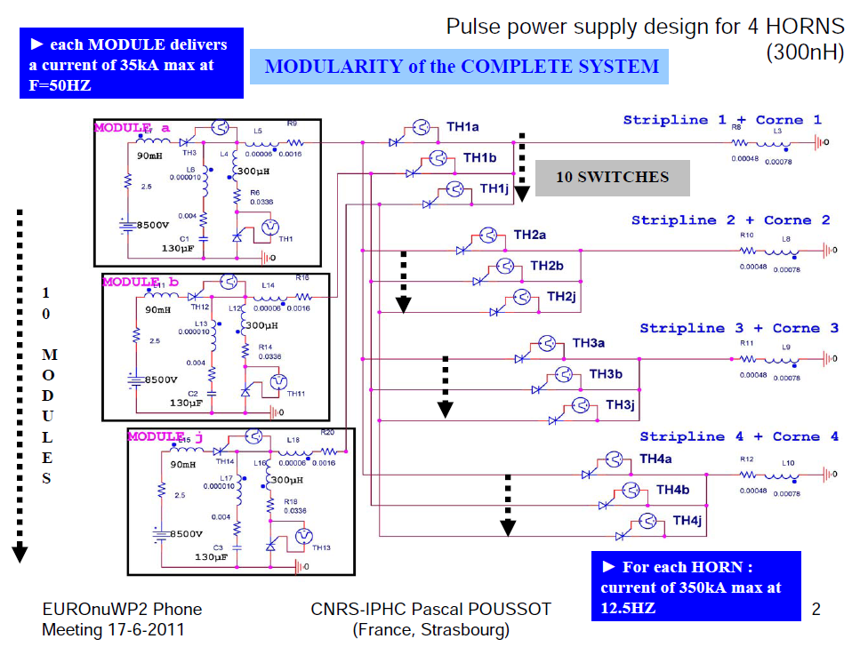
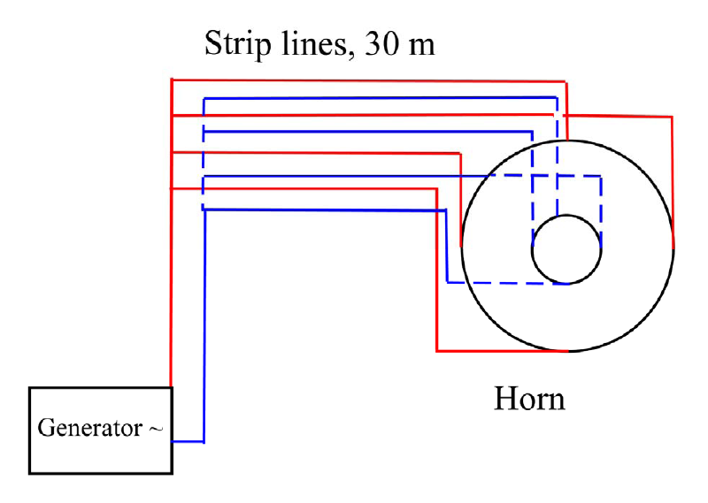
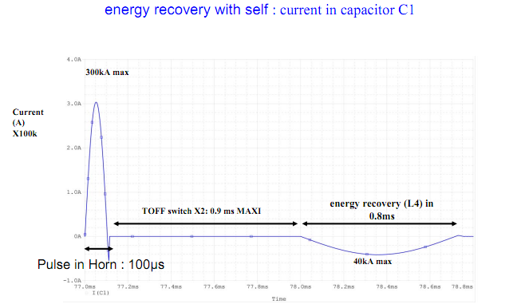
Power Supply Studies
P. Poussot, J. Wurtz/IPHC
horn focusing plateau
Energy recovery with an inductance L, switch and capacitor:
good energy recuperation 60%
best solution in terms of feasibility and cost
energy recovery

Slide 23
for Experimental Hall (Target/Horns, DT, Beam Dump), Safety Gallery, Maintenance Room, Waste Area

Slide 24
Safety II
beam dump
shielding
Design includes:
Proton Driver line
Experimental Hall
MW Target Station
Decay Tunnel
Beam Dump
Maintenance Room
Service Gallery
Power supply
Cooling system
Air-Ventilation system
Waste Area
spare area
target/horn station
decay tunnel (25 m)
hot cell
beam
horn power supply and electronics gallery

Slide 25
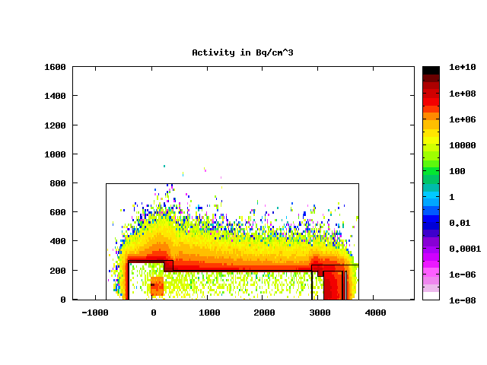
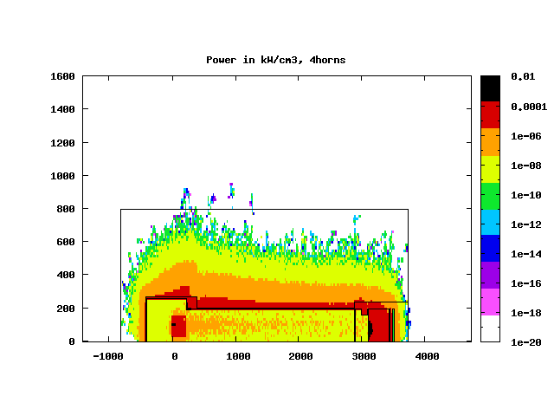
Energy deposition and Activation Studies FLUKA MC + FLAIR
rock: molasse @ CERN
concrete
ACTIVITY density in Bq/cm³
Fe shields, vessels
graphite
beam dump
He vessels:
T&H : L=8m, t_{Fe} =10cm , t_{concrete}=5.7cm
DT : L =25m, t_{Fe} =1.6cm , t_{concrete}=5.6cm
BD : L =8m, t_{Fe} =10-40cm , t_{concrete}=5.7cm
molasse
concrete
POWER density in kW/cm³
molasse
concrete
P_{tot} =3.4MW
energy is confined from concrete thickness
minimum activation of molasse rock
minimum/none effective dose to humans in other galleries
detailed tables of the radionuclides
water contamination from tritium is well kept under safety levels
Eric Baussan,
N. Vassilopoulos/IPHC

Slide 26
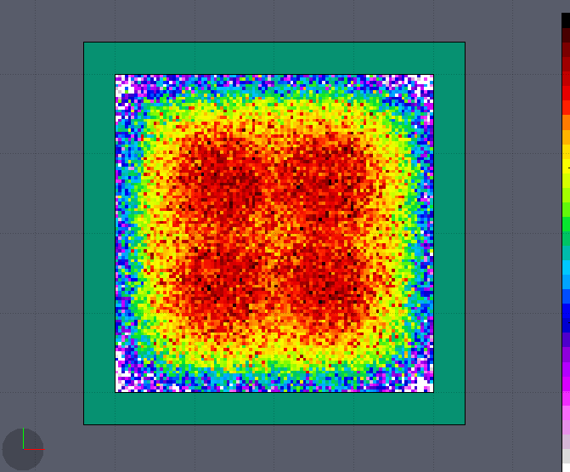
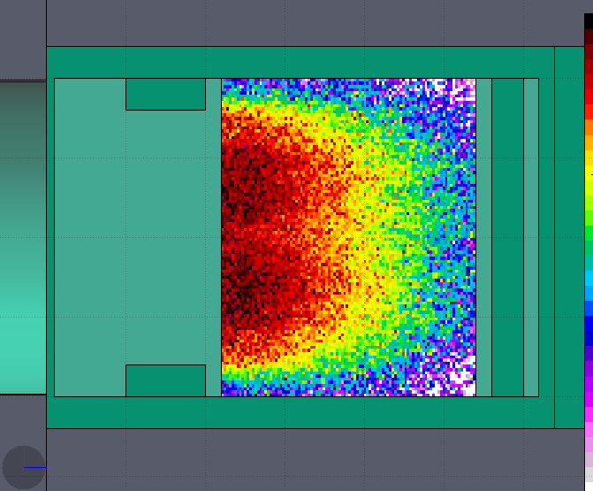
Energy Deposition in Beam Dump vessel
concrete:
t = 5.6m
L = 8.4m
He vessel + iron plates, water cooled
t_{Fe} = 10-40cm
L_{Fe}= 4m
upstream shield (iron plates), water cooled
t_{Fe} = 40cm
L_{Fe} = 1m
Graphite beam dump:
L = 3.2m, W = 4m, H = 4m
P = 530kW
downstream iron shield (iron plates), water cooled:
L_{Fe} = 40cm, W_{Fe} = 4m, H_{Fe} = 4m
P_{Fe} = 10.3kW
outer iron shields (iron plates), water cooled
L _{Fe}= 2m, W_{Fe} = 4.8m, H_{Fe} = 4.8m
P_{Fe} = 1.1kW
530kW

Slide 27
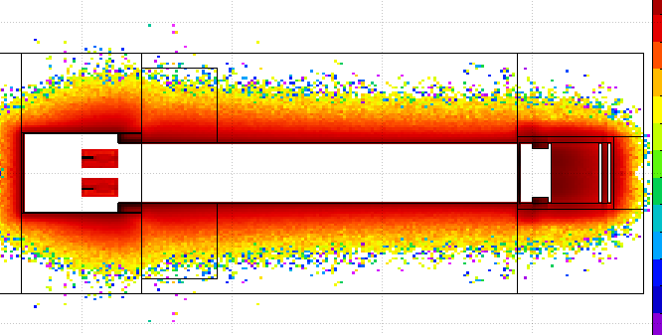
Activation in molasse (full 4horn simulation, medium stats: 10⁶ protons, 20% error)
molasse @ CERN
concrete
study set up:
packed Ti target, 65%d_{Ti}
4MW beam, 4horns, 200days of irradiation
minimum activation leads to minimum water contamination
concrete thickness determines the activation of the molasse
results:
of all the radionuclide's created ²² Na and tritium could represent a hazard by contaminating the ground water. Limits in activity after 1y=200days of beam:
Activity distribution
CERN annual activity constraints in molasse (for achieving 0.3mSv for the public through water) |  | SuperBeam, (preliminary)
²² Na | 4.2 x 10¹¹ Bq | - (to be investigated)
tritium | 3.1 x 10¹⁵ Bq | 6x10⁸ Bq

Slide 28
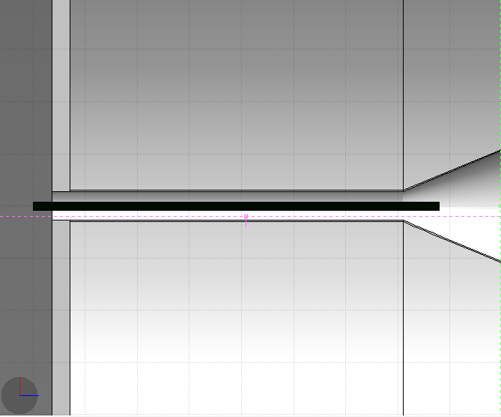
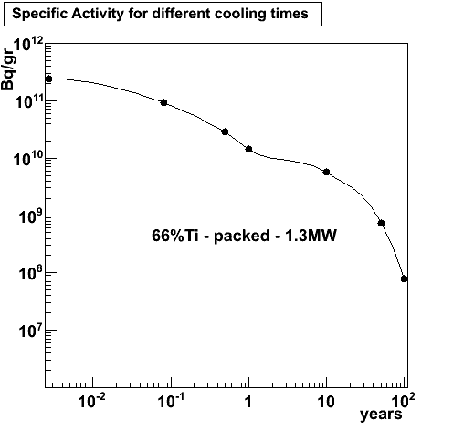
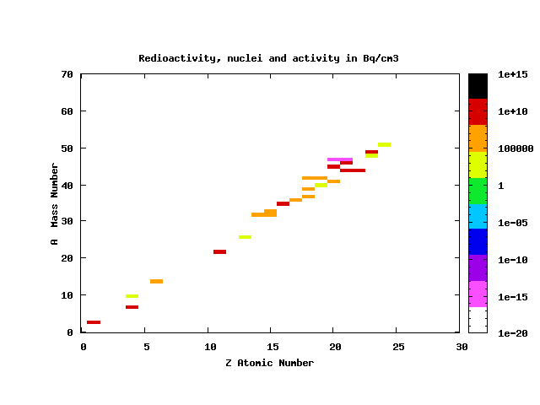
Target Activity at Storage Area
study set up:
packed Ti target, 65%d_{Ti}
1.3MW beam, 200days of irradiation
no other activation at storage area
Eric Baussan,
N. Vassilopoulos/IPHC

Slide 29
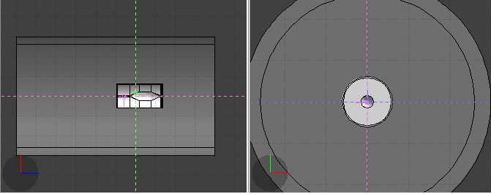
Dose Rates for target/horn at Storage/Service Area, I
radiation limits as in CNGS notes:
rates (e.g.):
at 60cm distance from the outer conductor (calculation of the rates using 20cmx20cmx20cm mesh binning through out the layout -> choose a slice of x-axis with 20cm thickness and 60cm away )
 | Limits per 12-months period (mSv)
 | Public | Workers
France | < 1 | < 20
Switzerland | < 1 | < 20
CERN | < 0.3 | < 20, if .gt. 2mSv/month report to Swiss authorities
z
x

Slide 30
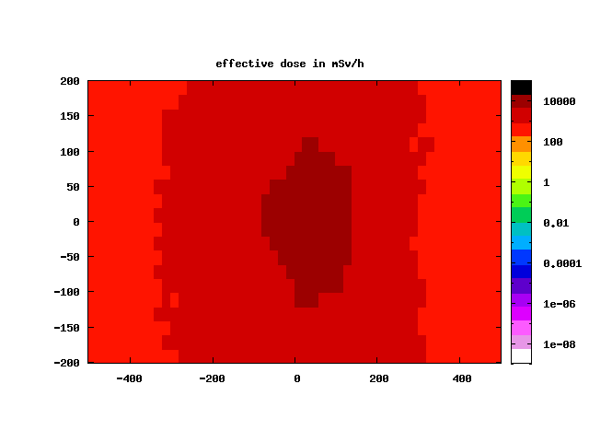
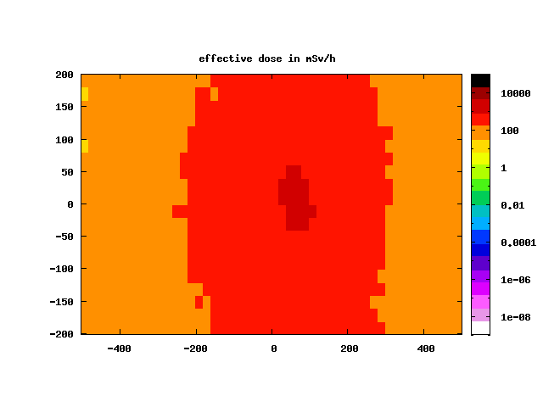
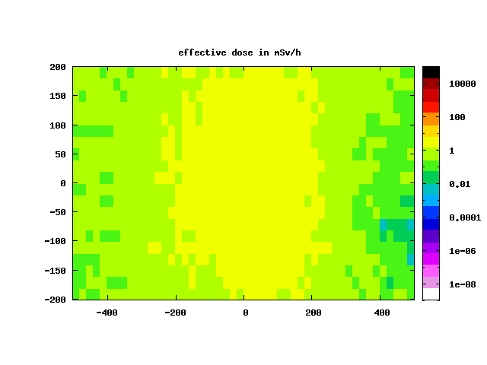
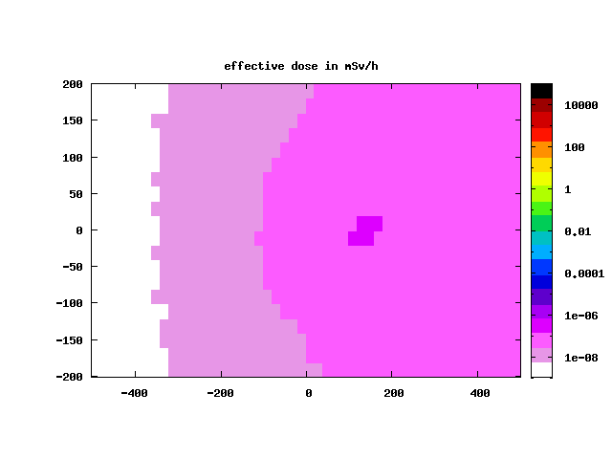
Dose Rates target/horn at Storage Area, II
1month
1year
> 1 Sv/h
> 50 mSv/h
palette in mSv/h
50years
100years
> 0.01 mSv/h
high effective dose rates for the target/horn system makes them inaccessible -> remote handling mandatory
Eric Baussan,
N. Vassilopoulos/IPHC

Slide 31
Conclusions
Horn with separated target baseline as result of dynamic and static stress analyses
4-horn system to reduce the 4MW power effects
Horn shape defined as forward-closed due to best physics results and reliability issues
Packed-bed Target is preferable in multi-Watt beam environment due to minimum stresses and high heat rate removal due to transverse cooling among others
Stress analysis support the feasibility of the target/horn design. Furthermore the power supply design looks feasible as well
Minimum activation in molasse rock for current secondary beam layout
High dose rates in Storage Gallery -> remote handling for repairs mandatory
to be continued ...
Thanks

Slide 33
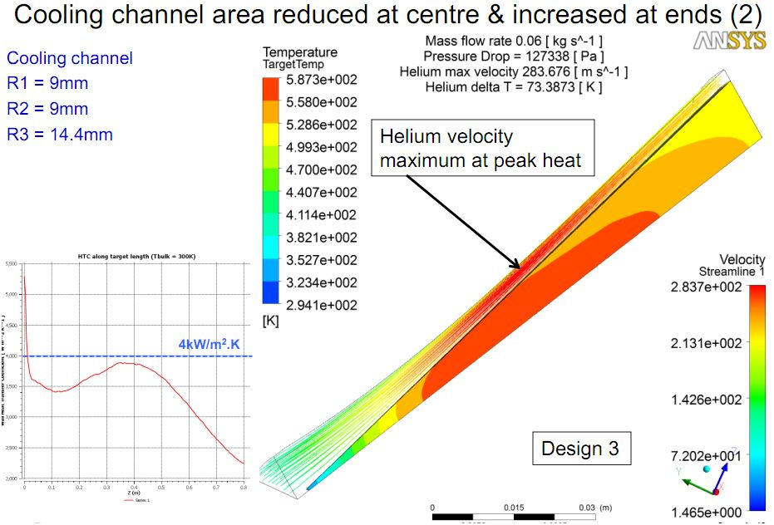
pen like target: cooling
looks feasible

Slide 34
considerations:

Slide 35
Horn shape and SuperBeam geometrical Optimization I
studies by A. Longhin,
EUROnu-WP2-10-04
parameterise the horn and the other beam elements
as decay tunnel dimensions, etc...
parameters allowed to vary independently
minimize the δ_{cp}-averaged 99%CL sensitivity limit on sin²2θ₁₃

Slide 36
Horn Shape and SuperBeam geometrical Optimization II
fix & restrict parameters then re-iterate for best horn parameters & SuperBeam geometry

Slide 37
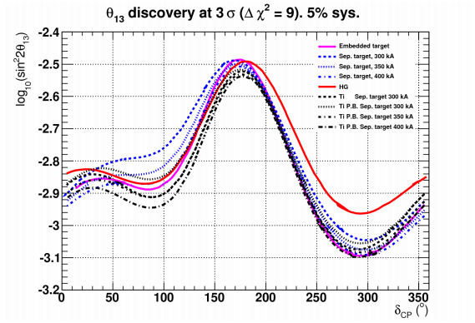
Physics Performance for different Targets I
Graphite Solid target, 2λ_{I}
Hg, 2λ_{I}
Integrated target, 2λ_{I}
excellent performance of packed bed Ti, d= 74%d_{Ti}
CERN to Frejus/MEMPHYS neutrino beam
any density reduction of packed could be recuperated increasing the horn current by 50, 100 kA

Slide 38
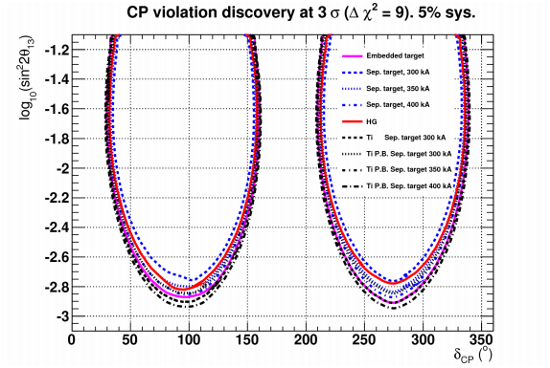
Physics Performance for different Targets II
Graphite Solid target, 2λ_{I}
Hg, 2λ_{I}
Integrated target, 2λ_{I}
excellent performance of packed bed Ti, d= 77%d_{Ti}
CERN to Frejus/MEMPHYS neutrino beam
any density reduction of packed could be recuperated increasing the horn current by 50, 100 kA

Slide 39
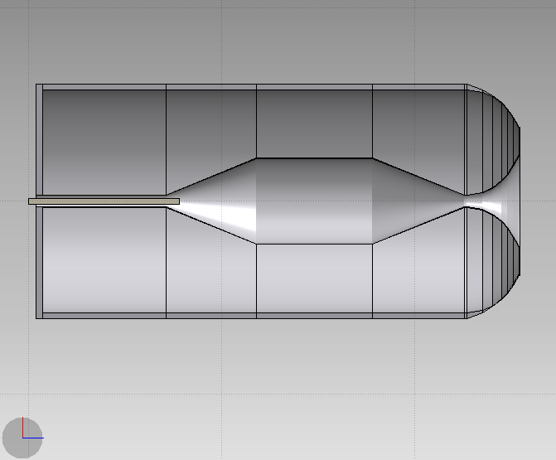
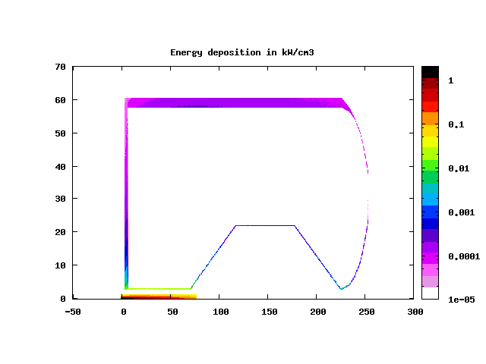
Energy Deposition from secondary particles on Horn, 1.3MW, Ti packed bed target FLUKA MC+FLAIR
target Ti=65%d_{Ti} , R_{Ti}=1.5cm
36kW, t=30mm
8.6kW, t=35mm
1.7kW
2.4kW
1.3kW
2.5kW
9.5kW
radial profile of power density kW/cm³
P_{tg} = 105kW
P_{h} = 62kW

Slide 40
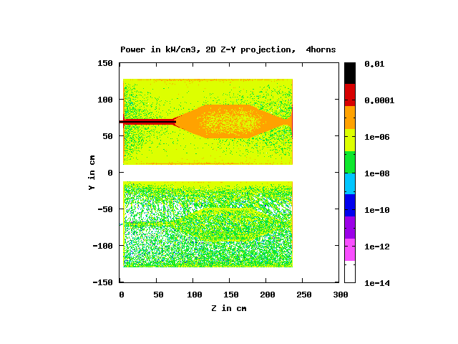
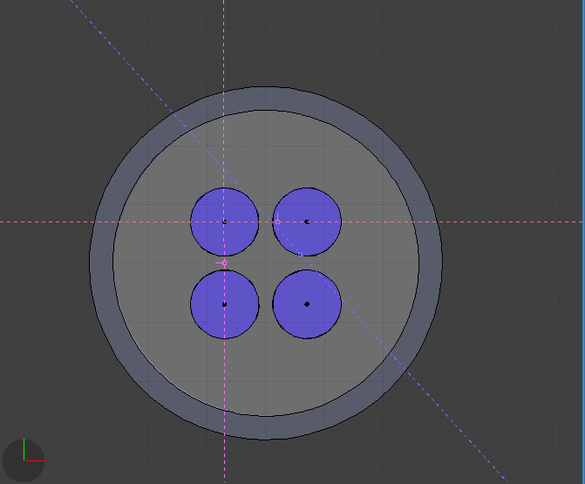
Energy Deposition on horns # 2,4, active horn is #1
1.3MW beam, 350kA, graphite target
shown upstream plates
E^{tot}_{h}= 14.4kW
2nd
1st
1st
3rd
4th
E^{tot}_{h}= 0.8kW
2nd or 4th
Power in kW for the horns next to the active one
total | inner | outer | plates
0.8 (5.5% of active horn) | 0.1 | 0.6 (50% of outer next to 1st) | 0.1

Slide 42
Energy deposition on SuperBeam Elements
Power density distributions in kW/cm³
concrete
P=530kW
P=3.4MW
DT Fe vessel | DT concrete | Gr Beam Dump
320kW | 720kW | 530kW
water |  | water
Gr beam dump

Slide 43
<doses> in longitudinal plane along beam axis after 200d of irradiation
1day
6months
Beam Dump
Beam Dump
Horns
Horns
DT area
DT area
palette in mSv/h
1year
10years
Beam Dump
Beam Dump
Horns
Horns
DT area
DT area
high dose rates along SuperBeam layout->remote handling mandatory for any part of the 4-horn system in target/horn station

