Slide 1
Neutron Irradiation Measurement for Superconducting Magnet Materials at Low Temperature
Tatsushi NAKAMOTO
KEK

Slide 2
Collaborators/Supporters
[KEK] M. Yoshida, M. Sugano, M. Iio, S. Mihara,
H. Nishiguchi, K. Yoshimura, T. Ogitsu, A. Yamamoto,
[Osaka Univ.] A. Sato, M. Aoki, T. Itahashi, Y. Kuno,
[KUR] Q. Xu, K. Sato, T. Yoshiie, Y. Kuriyama, Y. Mori,
[Fermilab] M. Lamm and Mu2e collaboration
[CERN] G.D. Rijk, E. Todesco, L. Bottura, L. Rossi.

Slide 3
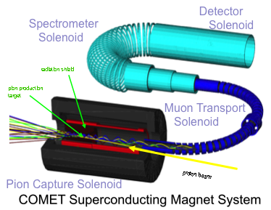
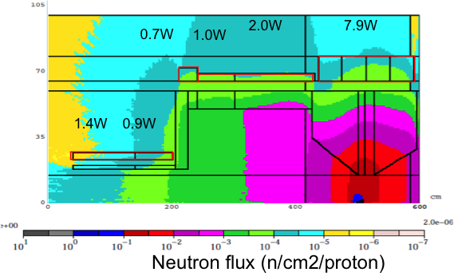
High Radiation Environment for SC Magnets
HiLumi LHC: 10²¹-10²² n/m²
COMET & Mu2e experiments (J-PARC, Fermilab)
Search for μ-e conversion
Pion capture solenoids w/ Al stabilized NbTi SC cable.
Same spec as ATLAS-CS.
Neutron fluence: > 10²¹ n/m²
>> ~10²² n/m² for HL-LHC
Phase-I (90mm bore)
Neutron irradiation effects at low temperature need be studied.

Slide 4
Why ρ of stabilizer? Why at low temperature?
Electrical resistivity ρ of stabilizers (aluminum, copper) is one of the most sensitive property in the SC magnet materials with respect to the radiation.
Induced resistivity is remarkable at LT.
Recovery effect starts at 20 K or higher.
The induced ρ by the radiation will compromise the quench stability and protection scheme. Coil temperature will be increased in the in-direct cooling magnets.
Anneal effect and full-recovery during warm-up to RT would be expected in aluminum, but only 80-90% recovery in copper (??).
Questions to be studied:
Samples from the practical SC wire/cable: RRR of 100 to 500.
Degradation may start even below 10²⁰ n/m² ?
Fluence threshold ?
Full recovery by full thermal cycle?
Accumulated resistivity after multiple irradiation?

Slide 5
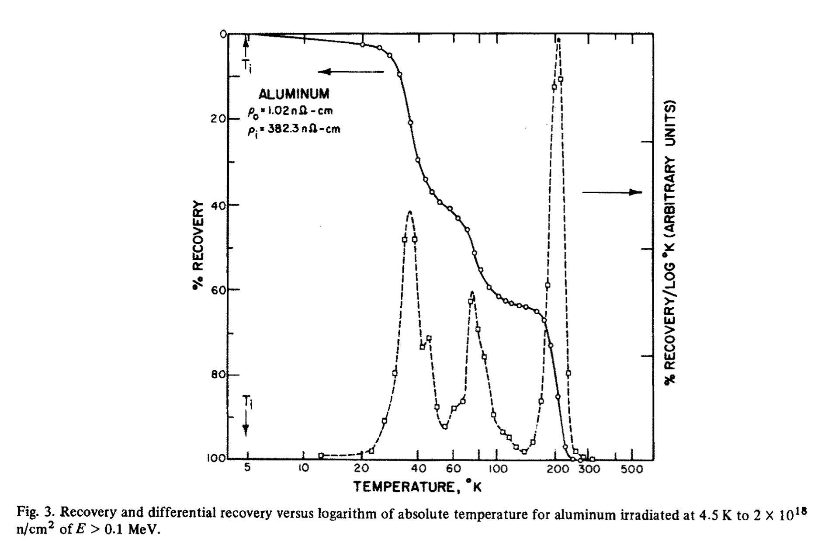
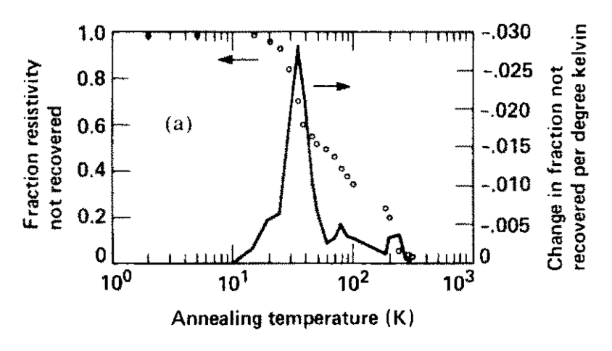
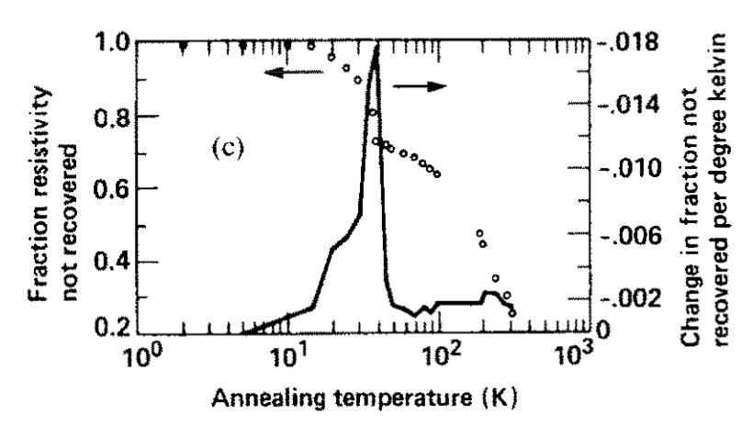
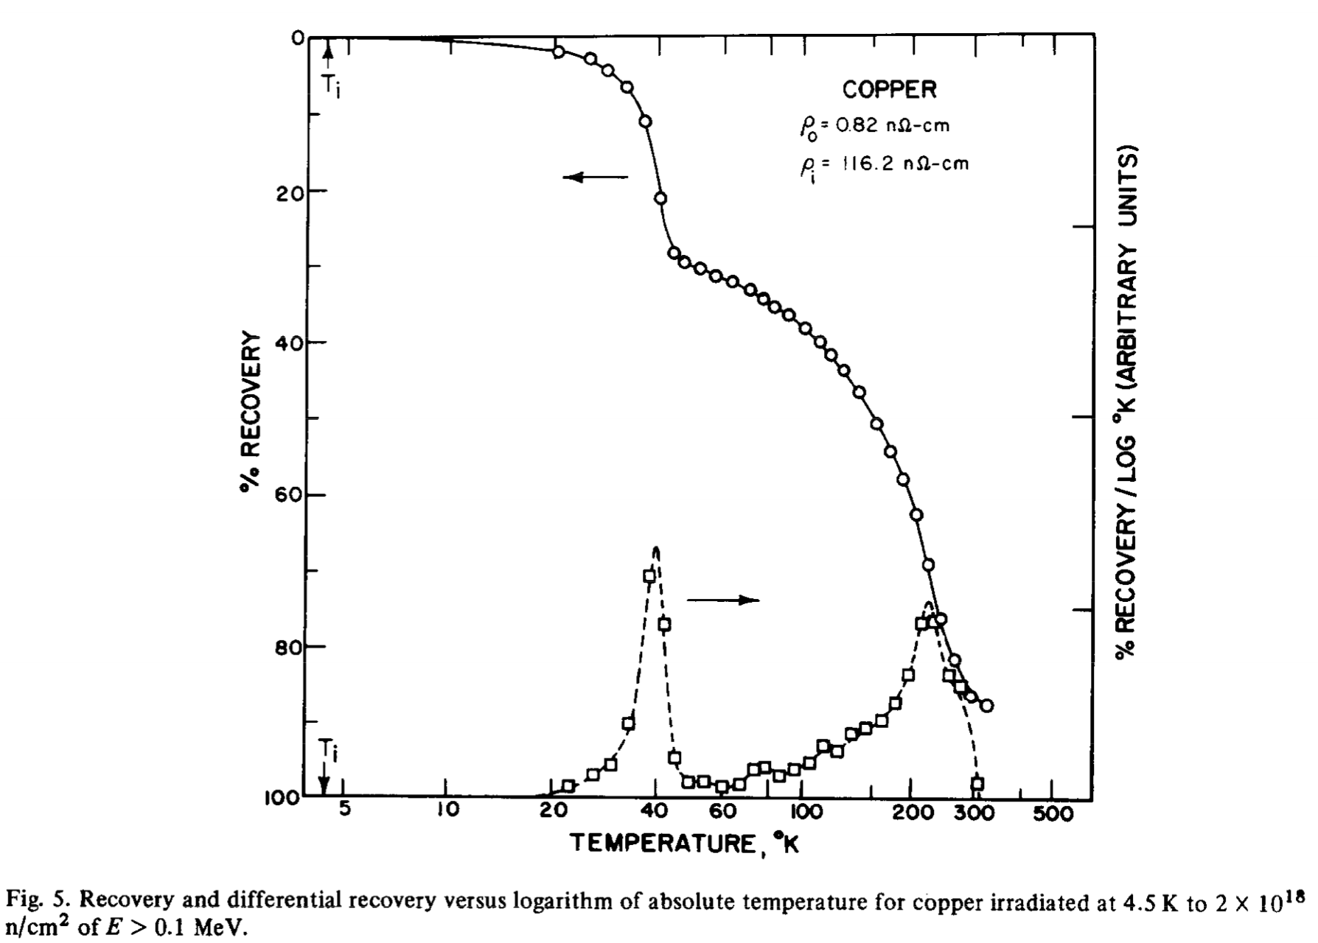
Previous Work in Literature: Δρ_{irr}
Neutron irradiation at 4K, and warm-up stepwise.
Horak et.al., J. Nucl. Materials, 49, p161 (1973&74)
Guinan et.al., J. Nucl. Materials, 133&134, p357 (1985)
Reactor n on Al
14MeV n on Al
ρ₀: 0.386
Δρ_{irr}: 0.336
(nΩm)
ρ₀: 0.0102
Δρ_{irr}: 3.823
(nΩm)
14MeV n on Cu
Reactor n on Cu
ρ₀: 0.098
Δρ_{irr}: 0.191
(nΩm)
ρ₀: 0.0082
Δρ_{irr}: 1.162
(nΩm)
80% recovery
fluence up to 1*10²¹ n/m²
RRR of ~100
90% recovery
fluence up to 2*10²² n/m² (En>0.1MeV)
RRR of ~2000
Double of resistivity observed at 10²¹ n/m².
Full recovery in Al expected by T.C.
Degradation in Cu will be accumulated even after T.C.

Slide 6
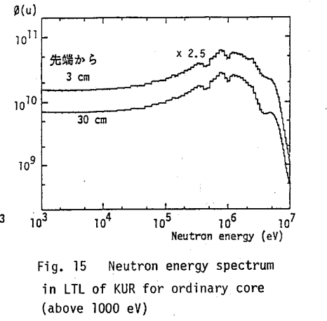
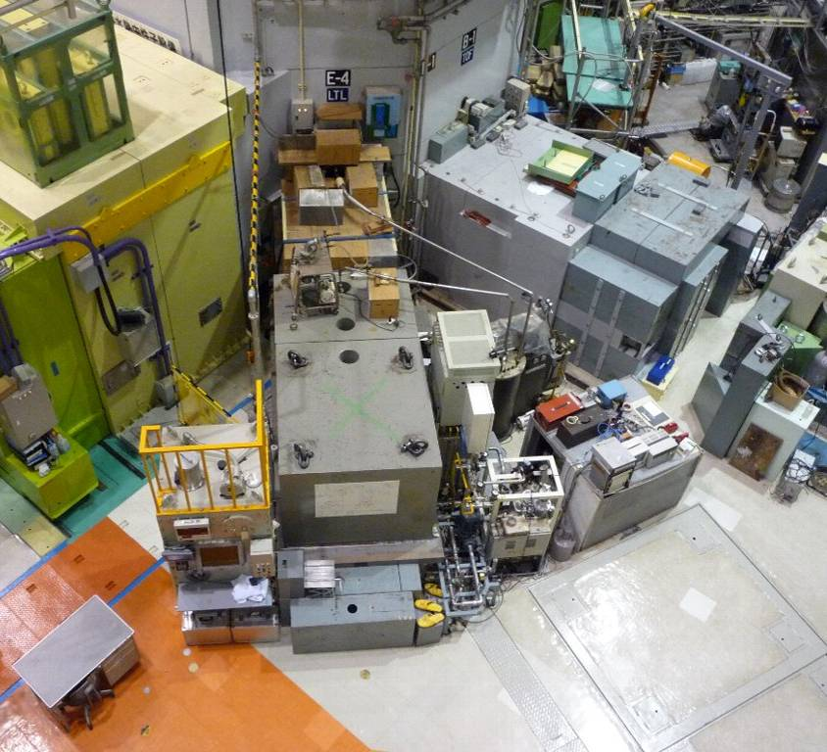
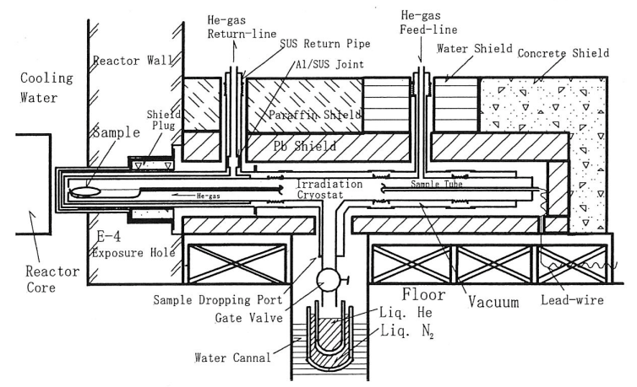
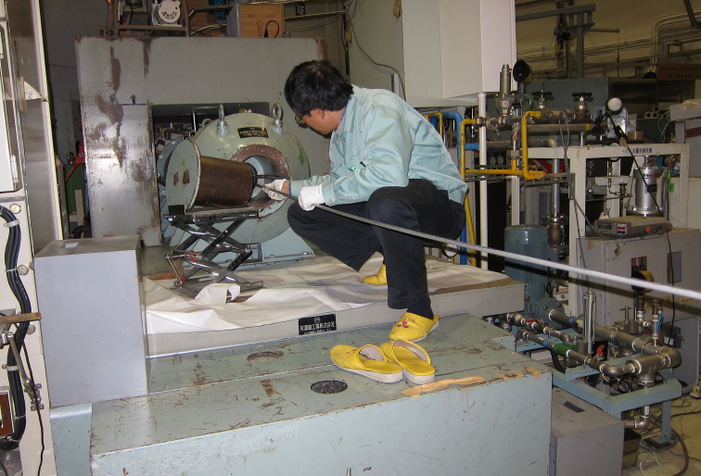
Neutron Irradiation at KUR
Kyoto Univ. Research Reactor Institute
５MW max. thermal power
Irradiation cryostat close to reactor core
Sample cool down by He gas loop: 10K – 20K
Fast neutron flux (En>0.1MeV): 1.4x10¹⁵ n/m²/s@1MW
0.1MeV
reactor
KUR-TR287 (1987)
M. Okada et al., NIM A463 (2001) pp213-219
Cryogenics

Slide 7
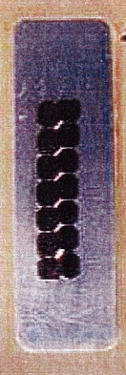
Sample and Measurement
Wire EDM
Aluminum:
Cut by EDM from Al stabilized NbTi cable.
5N Al + Cu(20ppm), Mg(40ppm) with 10% cold work. RRR of ~500.
1mmx1mmx70mm, L_{v-taps} =45 mm
Copper:
Provided by Hitachi Cable. Material for SC wire. RRR of ~300.
φ1mmx60mm, L_{v-taps} =32 mm
5N Aluminum (for reference):
Provided by Sumitomo Chemical. RRR of ~3000.
φ1mmx60mm, L_{v-taps} =32 mm
4 wire resistance measurement by nano-voltmeter: Keithley 6221+2182A
Thermometers: CERNOX CX-1050-SD, TC (AuFe-Chromoel)
Neutron fluence determined by Ni foil activation method.
Aluminum sample
Copper and 5N-Aluminum samples

Slide 8
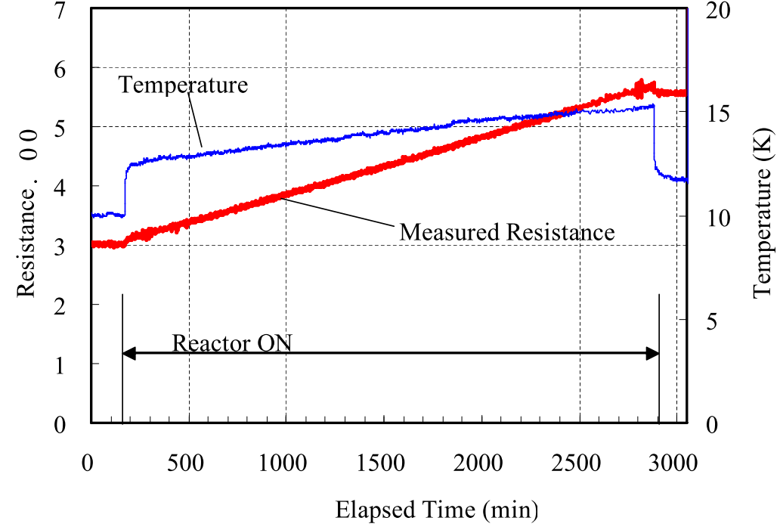
Result: Δρ_{irr} for Aluminum
M. Yoshida et al., ICMC2011
Resistance (μΩ)
Fast neutron exposure at 12K @1MW*45 hrs (Nov. 2010)
Resistance was measured in situ.
Resistance increased in proportional to neutron fluence in the range of 10¹⁹-10²⁰ n/m²
No threshold at low neutron fluence
Observed Δρ_{irr} = 0.056 nΩ.m for 2.3x10²⁰ n/m² (>0.1MeV)
Fairly good agreement with the previous work.
Present work: Δρ_{irr}/ Φ_{tot}= 2.4x10⁻²² nΩm³ (RRR 500, 2.3x10²⁰ n/m²)
Previous: Δρ_{irr}/ Φ_{tot}= 1.9x10⁻²² nΩm³ (RRR 2000, 2x10²² n/m²)

Slide 9
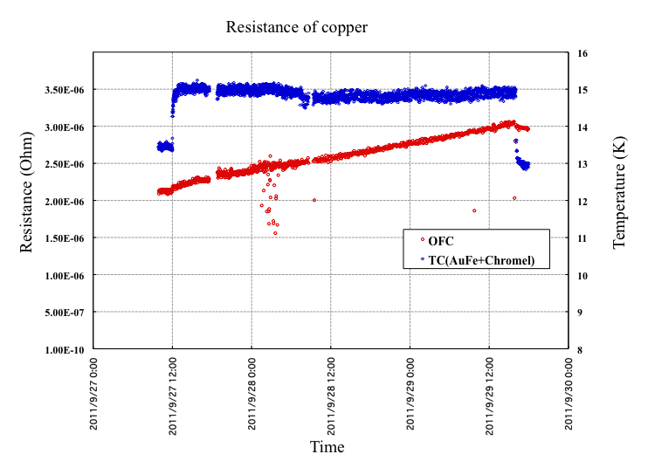
Result: Δρ_{irr} for Copper
*TC reading includes the offset of +1K.
Reactor ON
Fast neutron exposure at 14K @1MW*52 hrs (Sep. 2011)
Resistance increased in proportional to neutron fluence in the range of 10¹⁹-10²⁰ n/m²
No threshold at low neutron fluence
Observed Δρ_{irr} = 0.022 nΩ.m for 2.7x10²⁰ n/m² (>0.1MeV)
Agreed with the previous work within a factor of 2.
Present work: Δρ_{irr}/ Φ_{tot}= 0.82x10⁻²² nΩm³ (RRR 300, 2.7x10²⁰ n/m²)
Previous: Δρ_{irr}/ Φ_{tot}= 0.58x10⁻²² nΩm³ (RRR 2000, 2x10²² n/m²)

Slide 10
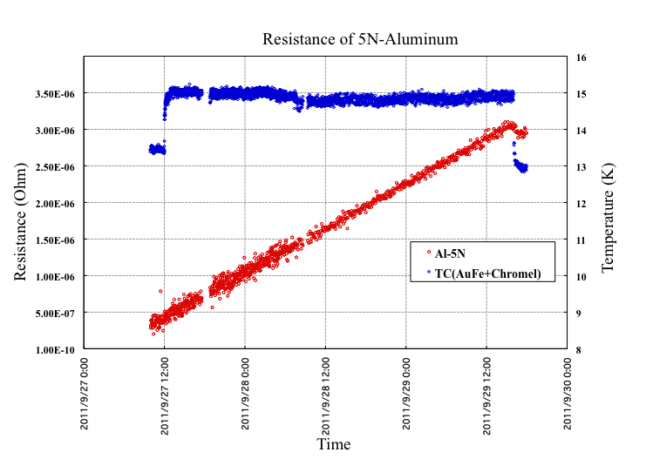
Result: Δρ_{irr} for 5N-Aluminum
*TC reading includes the offset of +1K.
Reactor ON
Fast neutron exposure at 14K @1MW*52 hrs (Sep. 2011)
Resistance increased in proportional to neutron fluence in the range of 10¹⁹-10²⁰ n/m²
No threshold at low neutron fluence
Observed Δρ_{irr} = 0.064 nΩ.m for 2.7x10²⁰ n/m² (>0.1MeV)
Agreed with the previous work within a factor of 2.
Present work: Δρ_{irr}/ Φ_{tot}= 2.4x10⁻²² nΩm³ (RRR 3000, 2.7x10²⁰ n/m²)
Previous: Δρ_{irr}/ Φ_{tot}= 1.9x10⁻²² nΩm³ (RRR 2000, 2x10²² n/m²)

Slide 11
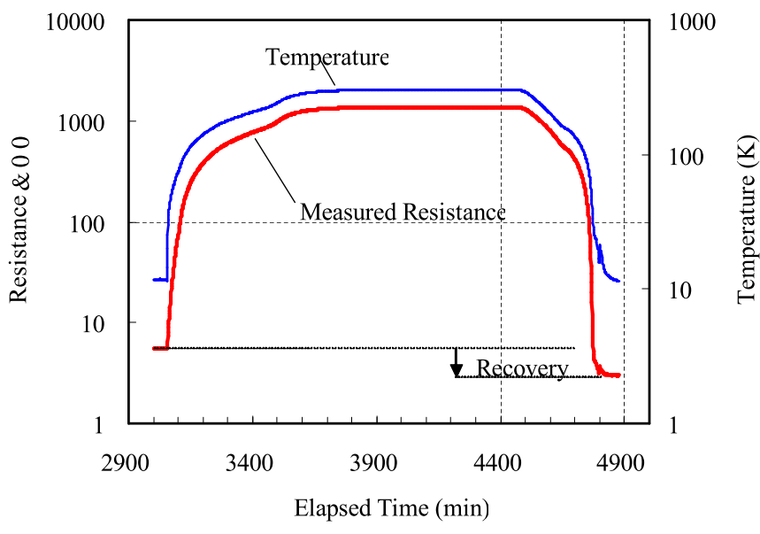
Result: Anneal and Recovery for Aluminum
Resistance (μΩ)
Reactor ON
A thermal cycle to RT right after the 1st irradiation (2.3x10²⁰ n/m²) in Nov. 2010.
Before irradiation: 3.0 μΩ @10K
After irradiation: 5.7 μΩ @12-15K
After TC: 3.0 μΩ @12K
Full recovery of Δρ_{irr} was confirmed.

Slide 12
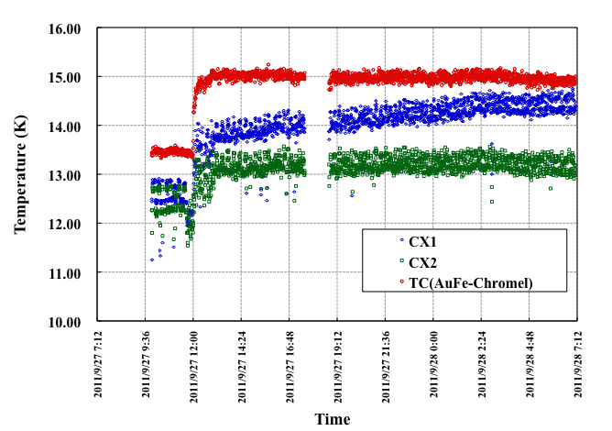
Result: Thermometers
Reactor Neutron
TC(AuFe-Chromel)
CX1
φ_{sample}
Samples
500mm
Sample rod
1/50 φ_{sample}
Reactor ON
CX2
2 Cernox sensors and TC (AuFe-Chromel) irradiated together with samples in Sep. 2011.
Sudden jump right after the reactor start is due to energy deposition by gamma rays and neutrons.
CX1 reading seems to drift with a rate of 1K/day while TC at the same position shows constant temperature.
Likely cause of temperature reading rise in CX1 was degradation.
Temperature rise in CX2 under low neutron flux is negligibly small.

Slide 13
Discussion
Materials | Aluminum |  |  |  | Copper
 | Horak | Guinan | Present | Present | Horak | Guinan | Present
RRR | 2286 | 74 | 450 | 3007 | 2280 | 172 | 319
T_{irr} (K) | 4.5 | 4.2 | 12 | 14 | 4.5 | 4.2 | 14
Netutron Source | Reactor | 14 MeV | Reactor | Reactor | Reactor | 14 MeV | Reactor
Φ_{tot} (n/m²) (>0.1MeV) | 2 x 10²² | 1-2 x 10²¹ | 2.3 x 10²⁰ | 2.7 x 10²⁰ | 2 x 10²² | 1-2 x 10²¹ | 2.7 x 10²⁰
Δρ_{irr}/ Φ_{tot} x10⁻³¹(Ωm³) | 1.9 | 4.09 | 2.4 | 2.4 | 0.58 | 2.29 | 0.82
Recovery by thermal cycle | 100% | 100% | 100% | TBD | 90% | 80% | TBD
Degradation rate (Δρ_{irr}/ Φ_{tot} ) seems to be higher in 14 MeV neutron irradiation. Evaluation using a common index such as DPA would be necessary.
Present work shows that difference in RRR of Al doesn't influence the degradation rate.
For copper, degradation rates (Δρ_{irr}/ Φ_{tot} ) are ranged from 0.58 to 2.29 10⁻³¹ Ωm³. What if SC cables with the initial RRR of 200 are irradiated to 10²⁰ or 10²¹ n/m²?
10²⁰ n/m² : RRR of 160 – 190
10²¹ n/m² : RRR of 50 – 120
Recovery by annealing in cooper sample and its multiple irradiation are planned in 2012.

Slide 14
Summary and Further Plan
Reactor neutron irradiation tests for SC stabilizers (Al, Cu) at low temperature have been carried out to study the degradation behavior. Recovery by annealing to RT have been also studied.
Irradiation of aluminum and copper samples up to 2-3 x 10²⁰ n/m² below 20 K showed that the degradation rates (Δρ_{irr}/Φ_{tot}) agreed with the previous work within a factor of 2.
Full recovery of resistivity degradation by annealing was confirmed in the aluminum sample.
For the copper sample, the recovery behavior during the repeated irradiation and annealing will be studied in 2012.
Cernox thermometers irradiated up to 2-3 x 10²⁰ n/m², which is 20 times as high as that for the previous work. The induced resistance per neutron fluence was consistent with the previous work.
Further neutron irradiation tests for other SC magnet materials will be made at KUR.

Slide 16
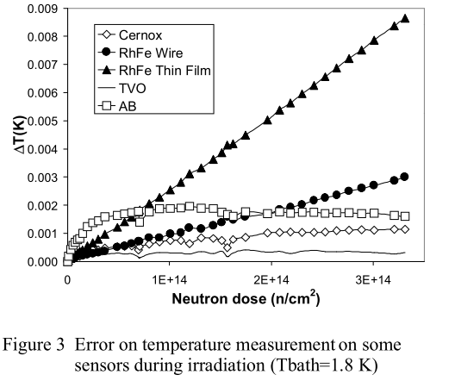
Why thermometers?
Irradiation effects of thermometer including Cernox studied for the LHC at 1.8 K. Fluence up to 10¹⁹ n/m².
What happens at the level of 10²⁰ or higher?
LHC Project Report 209
X60947
R₀=1960Ω @12K
ΔR/ΔT=-170 Ω/K
ΔR_{irr}=340 Ω @2*10²⁰ n/m²
R₀=12600 Ω
ΔR/ΔT=-12000 Ω/Κ
ΔR_{irr}=24 Ω @10¹⁹ n/m²
>> 480 Ω for 2*10²⁰

Slide 17
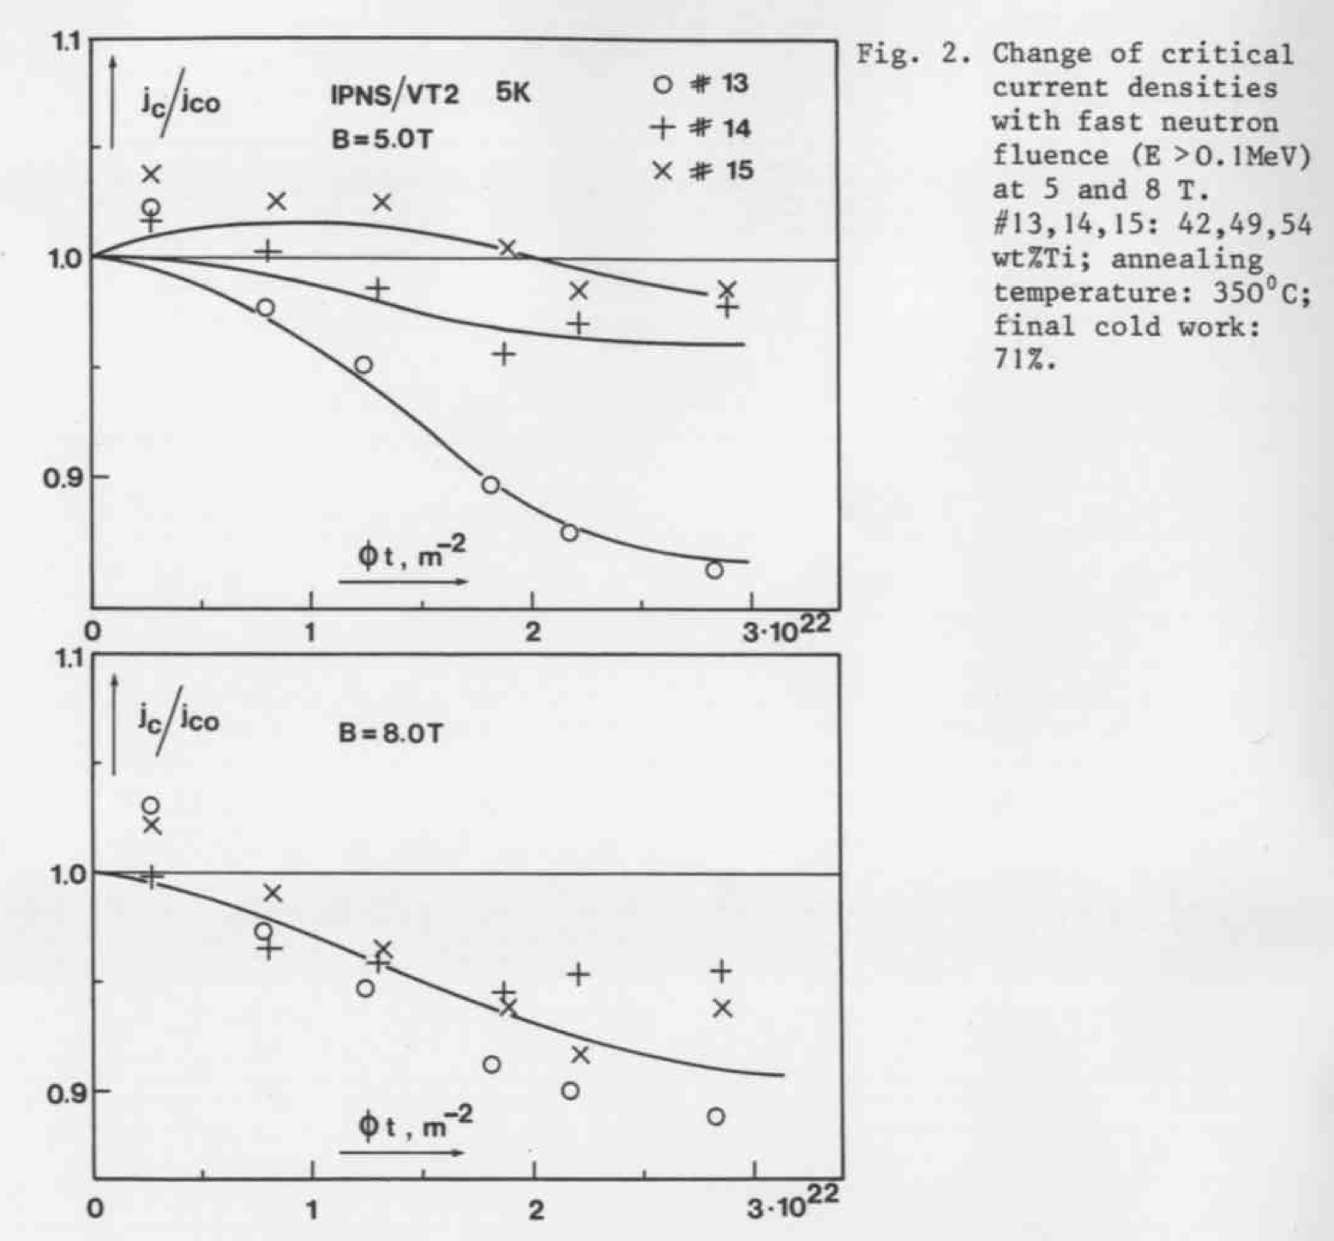
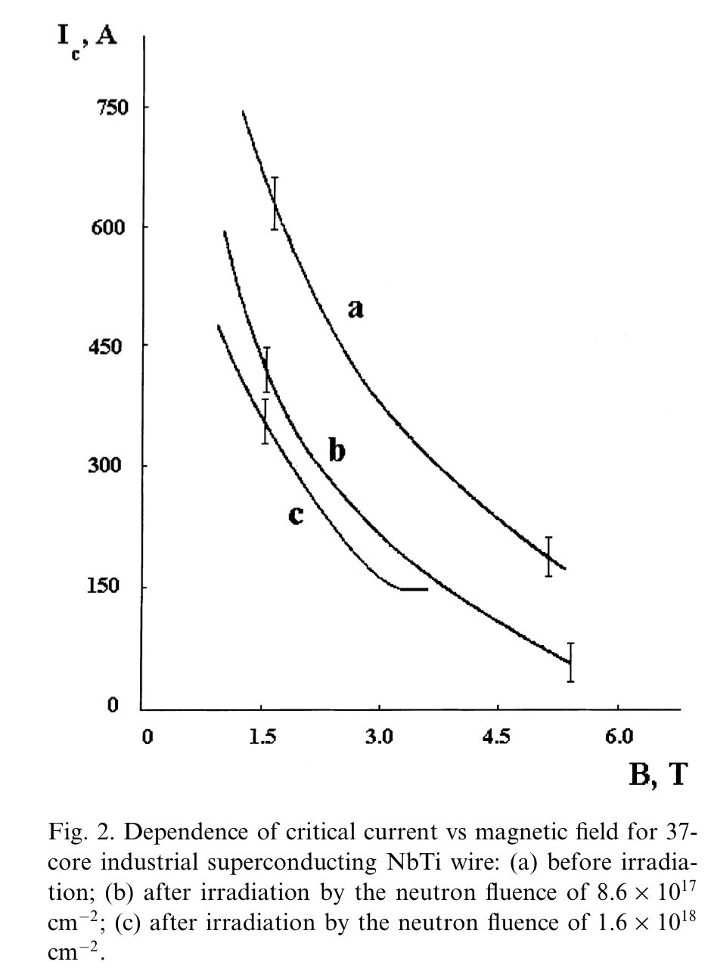
SC: NbTi (1)
Degradation on Tc: 0.15 K to 0.6 K @up to 10^23/m2
Adv. Cryo. Engineering, 32, p853 (1986)
J. Nucl. Materials, 271&272, p505 (1999)
20K
5K
Jc: < 10% reduction up to 10^22/m2
I: Significant reduction at 5T @ 10^22/m2

Slide 18
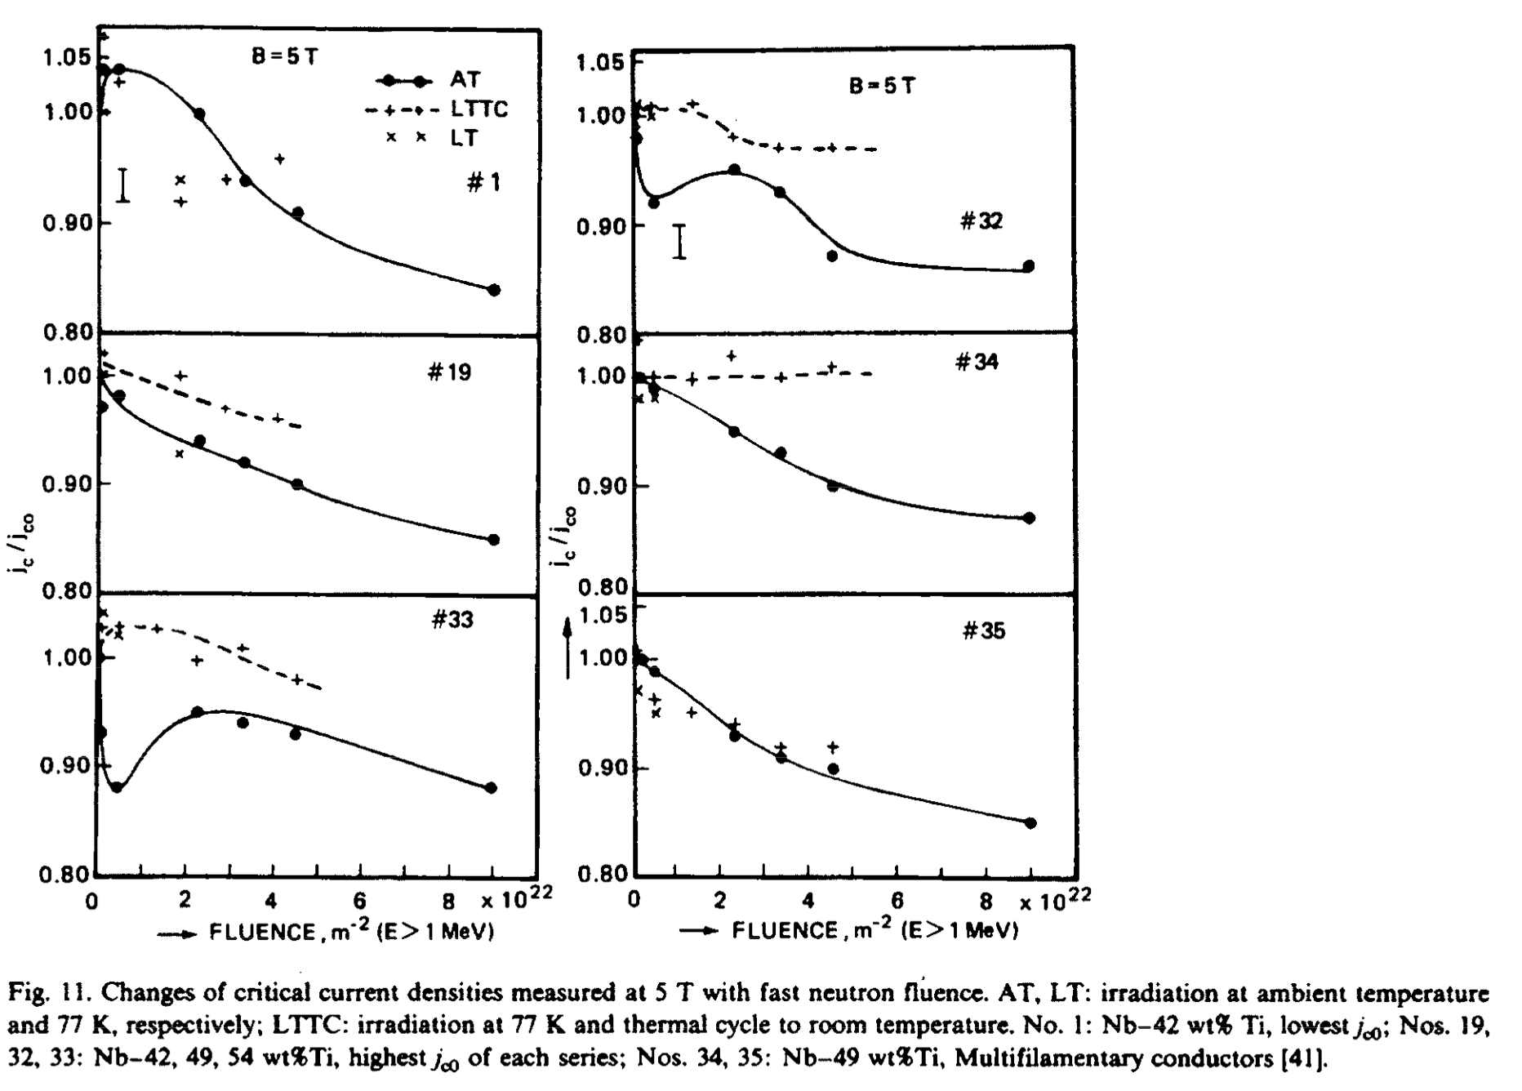
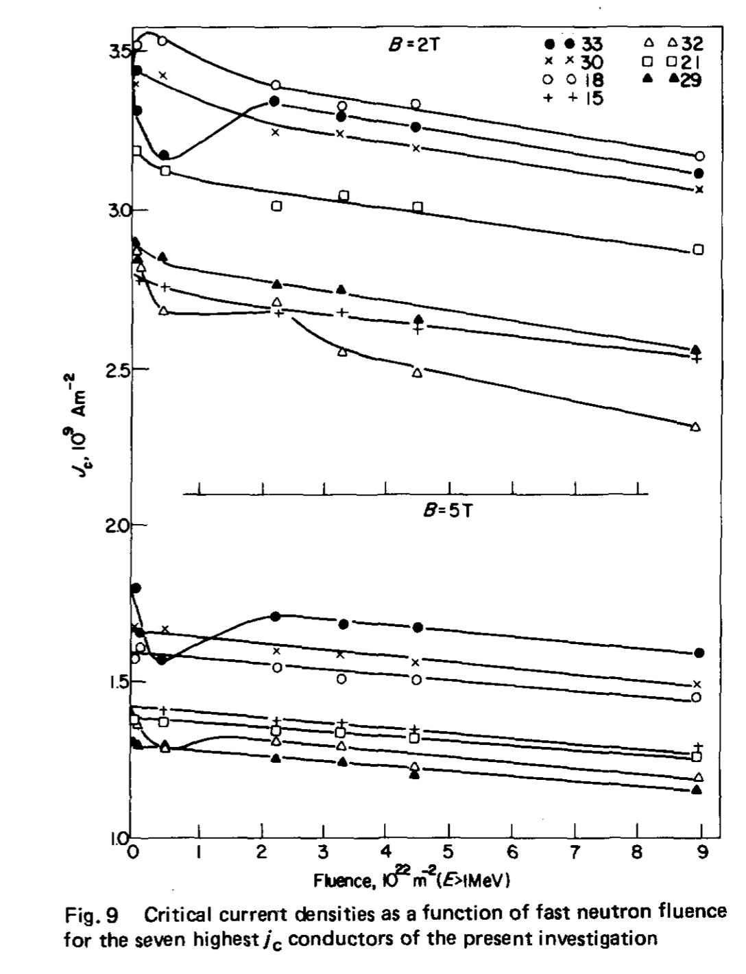
SC: NbTi (2)
RT, 77K w/ T.C.
RT
J. Nucl. Materials, 108&109, p572 (1982)
Cryogenics, 21, No.4, p223 (1981)
Jc: Drop and recovery observed to 10^22/m2.
10-20% reduction up to 10^23/m2.
Recovery by annealing to RT is observed.
NbTi would be OK up to 10^22/m2.

Slide 19
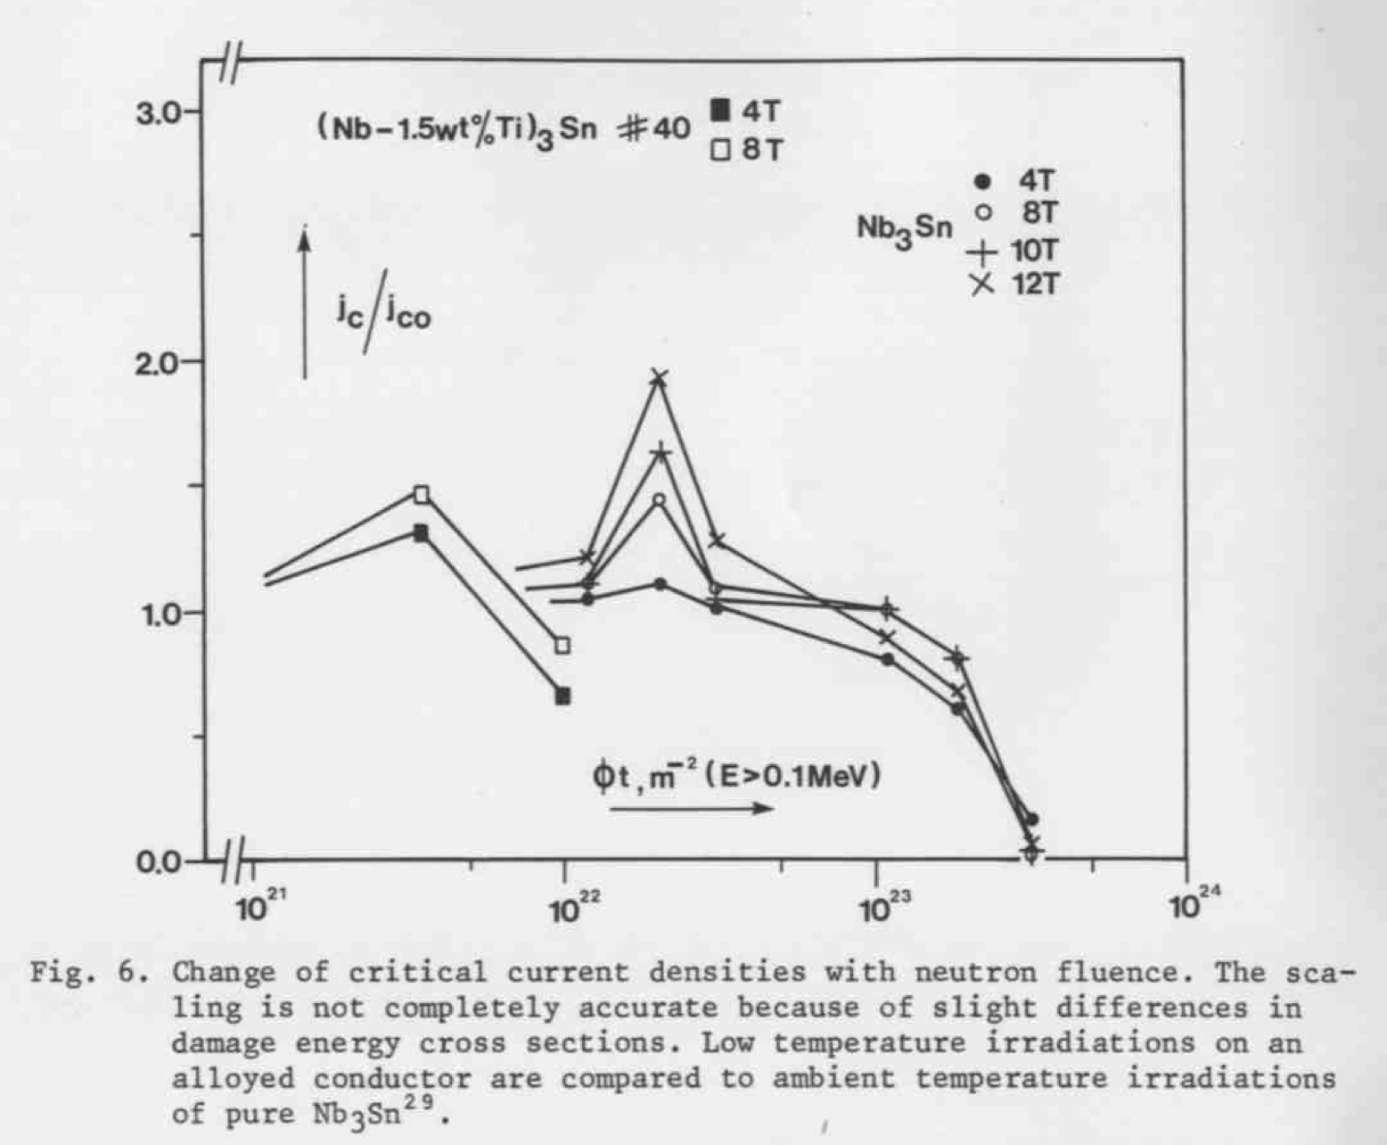
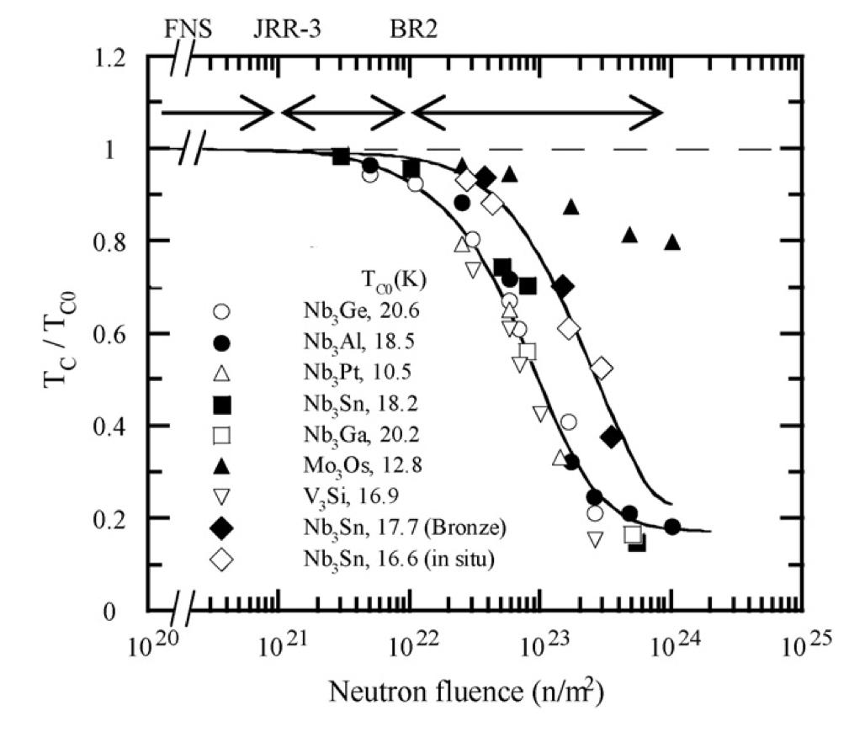
SC: Nb3Sn
Adv. Cryo. Engineering, 32, p853 (1986)
Fusion Eng. Design, 84, p1425 (2009)
RT
4K
Tc: -10% @ 10^22/m2.
-30% @ 10^23/m2.
Jc: Improvement bwn 10^22 and 10^23/m2.
Significant degradation beyond 10^23/m2.
NbSn would be OK up to 10^22/m2 as well.

Slide 20
Why is ρ of Stabilizer Important?
>> very concerned with quench protection.
Neutron irradiation test for stabilizers (copper, aluminum) is undoubtedly necessary.
minimum fluence to start of degradation
anneal effect on recovery
R&D of witness sample for the operation

