Slide 1
IRRADIATION EXPERIMENTS & FACILITIES AT BNL:
BLIP & NSLS II
Peter Wanderer
Superconducting Magnet Division, BNL
WAMSDO – November 14, 2011

Slide 2
Brookhaven Linac Isotope Producer (BLIP)
Schedule: ~ 6 months/year (during RHIC operation)
Principal task: isotope production for medical etc. use (proton beam, 117 MeV).
Simultaneous irradiation and isotope production by increasing beam energy, placing irradiation target ahead of isotope production target
  117 Mev → 140, 160, 180, 202 MeV
  Irradiation at room temperature
Alternative: irradiation target behind isotope target, for irradiation by neutrons and scattered protons.

Slide 3
Proton Beam Profile
90 mm
90 mm
Sample
The BLIP proton beam cross-section deduced from a gamma scan of the activation foil irradiated with the samples. The grid is in mm.
The position of the three 1 cm segments in the beam cross section
Section B sees a proton flux varying by less than ±5%

Slide 4
More BLIP info
Target holder interior dimensions ~ 100 mm wide, 100 mm high, 75 mm deep.
Two target holders per assembly.
Target assembly immersed in water for cooling (flow: 200 liters per minute).
Current user: LBNE – materials for Project X.
  Long Baseline Neutrino Experiment – Abandoned gold mine northwest of Fermilab (DUSEL)
  Measurements (yield strength, stress, CTE) in hot cell at BNL

Slide 5
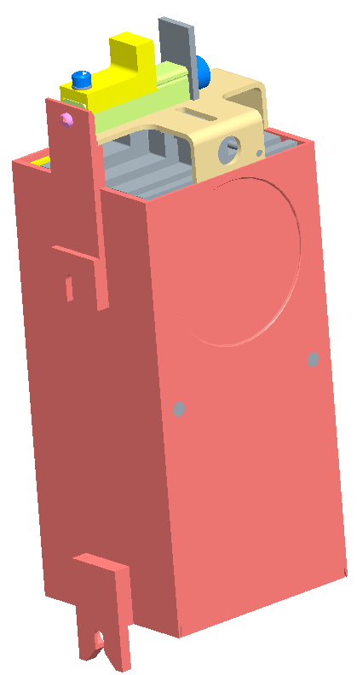
Added .437” of material to this surface
Windows machined integral to box
Basket mounts
Window & basket mounts moved up .437” relative to box mounts for improved beam alignment.

Slide 6
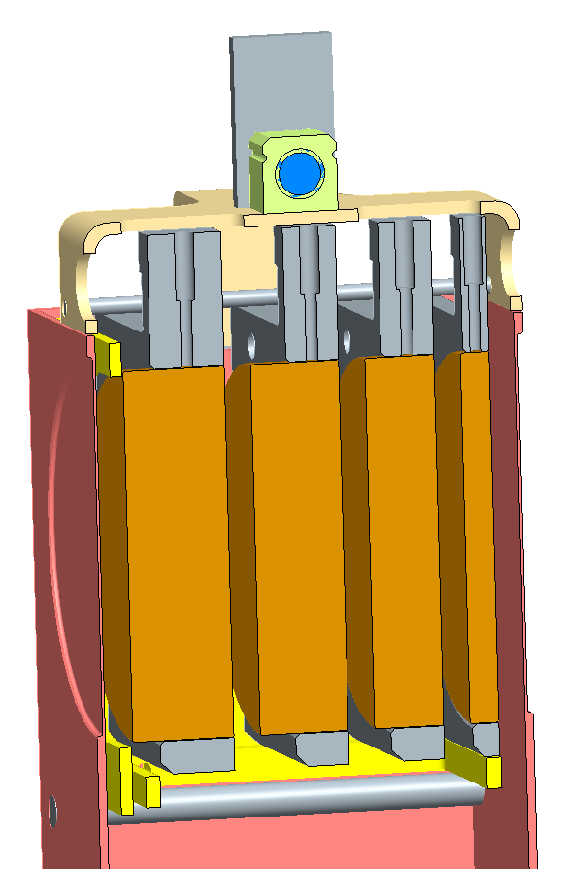
Windows machined integral to box

Slide 7
Sample and Irradiation Details of 4 mm wide YBCO conductor
7 cm long samples were mounted on five aluminum frames and inserted into the water-filled target tank of the Brookhaven Linac Isotope Producer (BLIP).
The irradiation was done at 142 MeV with a beam current of 40 μA, and different levels of proton flux were achieved by progressively removing the aluminum frames after specific times to give 2.5, 25, 50, 75, and 100 μA-hrs of irradiation.
100 μA-hrs is equivalent to a fluence of 3.4x10¹⁷cm⁻²

Slide 8
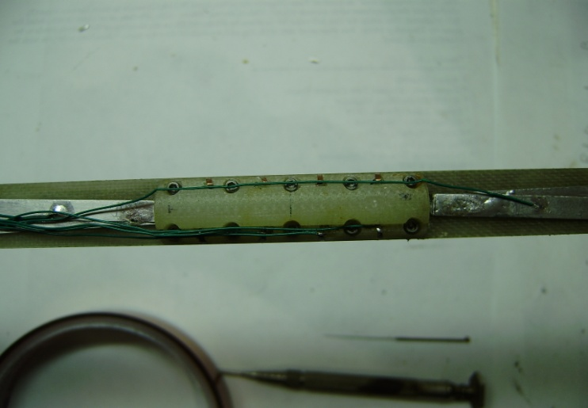

Experiment
Three 1cm sections of each conductor are measured.
YBCO samples are irradiated at the Brookhaven Linac Isotope Producer (BLIP) (G.Greene)
Levels of proton fluence are 2.5, 25, 100 mA hrs.
B is positioned to be at the center of the beam.
Open cryostat. Samples are directly cooled by LN2.
Magnetic field (0.25T, 0.5T,0.75T, 1.0T and 1.25T) are provided by a non-superconducting magnet.
HTS sample is under the G-10 cover
I
Voltage taps
Angle=0:
The normal to the tape plane is parallel to the external magnetic field
courtesy G.Greene and B.Sampson

Slide 9
Rel.dose=25
In actual FRIB system, estimated rel.dose would be ~10. rel.dose=25 is close to the actual dose.
I_{c} of rel.dose=25 was expected to be between I_{c} of rel.dose=100(highest) and rel.dose=2.5 (lowest).
However…
ASC
SuperPower

Slide 10
I_{c} vs magnetic field
ASC
SuperPower
As field increases, Ic decreases monotonically for any radiated samples.
Rel.dose=25 gives slightly higher Ic than rel.dose=2.5 in
some magnetic fields. This effect is clear in SuperPower sample but not in ASC sample.

Slide 11
Measured I_{c} at 77K, self field
Critical current (I_{c}) of samples was measured before and after irradiation at 77 K, self field.
I_{c} of all samples before radiation was ~100 A.
As radiation dose increases, I_{c} decreases monotonically
for both ASC and SuperPower YBCO samples
(courtesy G. Greene and W. Sampson)

Slide 12
YBCO and Nb₃Sn
YBCO (High Temperature Superconductor)
  Target cooled off to “no detectable radioactivity”. Had surface contamination. → Test in dewar in “clean” area, behind “caution” tape and sign (i.e., not in hot cell)
  Annealing varied with dose (low dose → no anneal)
  Not production material.
Nb₃Sn – ITER material
  Annealing at room temperature not significant.
Nb – “pure Nb has 600 ppm Ta – long-lived radioisotopes after irradiation.

Slide 13
PROPOSED ENDSTATION FOR NEW BNL LIGHT SOURCE, NSLS II
Endstation for radioactive materials
  30 – 80 keV monochromatic photons
  Beam diameter: 10 μm
  Techniques: Diffraction, imaging
Endstation for real-time, in situ studies w. photons
  1 MeV tandem for heavy ions
  200 kV accelerator for H, He
  Ion beam diameter: μm to mm
  Time resolution: μs to ms
Supporting infrastructure
Presentation to Advisory Committee 17 Nov.

Slide 14
Credits
BLIP: L. Mausner, A. Ghosh
YBCO measurements: R. Gupta, G. Greene, W. Sampson, Y. Shiroyanagi
NSLS II: A. Ghosh, L. Ecker

Slide 15
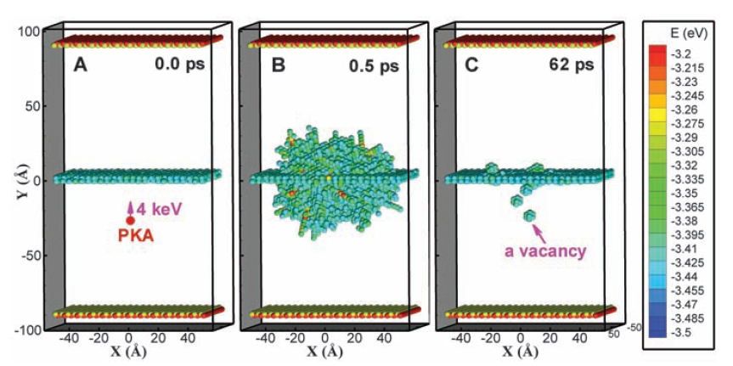


Real time and in-situ studies of Materials in a Radiation Environment (MRE)
MRE at NSLS II
Ion accelerators for in situ experiments of radiation effects and mesoscale microstructural changes due to radiation
Separate endstation for radioactive materials
Will enable studies of new materials for reactors, nuclear fuels and structural materials in high radiation environments
Data for verification of computer simulations, material performance during off-nominal conditions, and licensing
Examples of Science Areas & Impact
NUCLEAR STRUCTURAL MATERIALS: Role of interfaces in radiation resistant materials
Nuclear fuels: Characterization of spent fuel, metal fuels, and new synthesis routes for oxide fuels
national security: material characterization for nuclear forensics
Semiconductor fabrication: Understand the effect of doping induced defects on semiconductor performance
Displacement Cascade Near a Grain Boundary
Bai, et al. Science, 2010
Beamline Capabilities
Techniques: Diffraction, Imaging, Spectroscopy
Source: Damping or superconducting wiggler
Energy range: 10-90 keV
Time resolution: msec-µsec
Beam Size: > 1 µm

