Slide 1
MCNP Status
David Wootan
Pacific Northwest National Laboratory
February 18, 2015

Slide 2
MCNP – What Is It?
Monte Carlo particle transport code merging MCNP (<20 MeV for neutrons) and LAHET tracking high energy particles
Significant simulation tool for accelerator and other physics work: target design, isotope production, isotope destruction, accelerator driven energy systems proton and neutron therapy, imaging technology, shielding design, detection technology, neutrino experiment design, charged particle tracking in plasmas, single-event upsets in semiconductors, nuclear reactor analysis
Provides geometry-independent mesh tallies for visualization of flux, dose, energy deposition over continuous space volume without complicating particle transport through the geometry

Slide 3
MCNP Nuclear Data/Models
Tabulated nuclear data
< 20 MeV neutrons for most isotopes
< 150 MeV LA150 proton library cross sections: H, C, N, O, Al, Si, K, Ca, Cr, Fe, Ni, Cu, Nb, W, Hg, Pb, Bi
<150 MeV ENDF/B-VII proton: H, D, T, 3He, Li, Be, B, C, N, O, Al, Ca, Si, Cr, Fe, Ni, Cu, Nb, W, Au, Pb, Bi
For incident neutrons and protons,secondary reaction product cross sections and angle energy correlated spectra have generally been provided for neutrons, photons, protons, deuterons, tritons, 3He, and alphas
Intranuclear cascade/pre-equilibrium/evaporation models up to few GeV
BERTINI
ISABEL
CEM03.03
INCL
LAQGSM03.03

Slide 4
MCNP Data Treatment
All standard MCNP neutron libraries over their stated ranges (~0-20 MeV).
Neutrons in the ENDF70x libraries from 0.0 - 150.0 MeV in tabular range.
Neutrons from 1.0 MeV in the physics model regime.
Photons from 1 keV - 100 GeV.
Photonuclear interactions from 1.0 to 150.0 MeV in tabular range.
Photonuclear interactions from 1.0 MeV in the CEM physics model.
Electrons from 1 keV - 1 GeV.
Protons from 1.0 to 150.0 MeV in tabular range for 47 isotopes.
Protons from 1.0 MeV in the physics model regime.
Pions, muons, and kaons are treated only by physics models.
Light ions from 1 MeV/nucleon in the physics model regime.
Heavy ions from 3 MeV/nucleon in the LAQGSM physics model.

Slide 5
MCNP6 Particle Types and Ranges

Slide 6
MCNP Advantages
Advantages
Explicit modeling of complicated geometries
Can select physics treatment from available options
Monte Carlo tracking of particle interactions
Extensive cross section library for low energy reactions <20 MeV
Physics treatment for when cross sections are not available
Calculates statistical uncertainties
Widely used for reactor analysis
Same model can be used for shielding, activation studies
Can calculate damage energy directly
Mesh tally can provide spatial distributions independent of problem model
Can add more XSs using NJOY

Slide 7
MCNP Disadvantages
Disadvantages
Calculations can take time to obtain adequate statistics on small regions
Damage energy calculations do not include tabular XS contributions
May need separate calculations of low energy (<20 MeV) and medium to high energy contributions

Slide 8
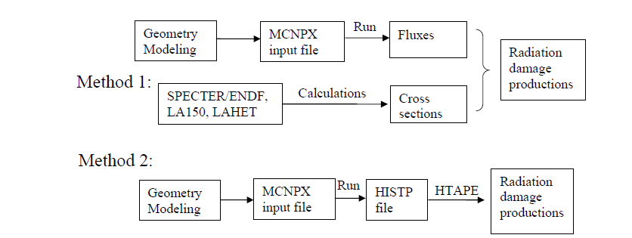
MCNP Methods for Calculating DPA
Two methods for calculating DPA with model of specific geometry
Method 1 - Calculate flux and fold with DPA XS
Method 2 - Calculate DPA directly with MCNP (HISTP/HTAPE)

Slide 9
MCNP Calculation of DPA Method 1
Calculation of neutron, proton spectrum at specific locations or for regular spatial mesh
Fold neutron and proton DPA XS with neutron and proton flux spectrum
Advantages
Straightforward, like other MCNP tallies, provides spatial distributions
Disadvantages
Limited to energy range and materials in libraries
ENDF XS < 20MeV
SPECTER limited to neutrons < 20 MeV
LA150 neutron and proton XS < 150 MeV
DXS DPA cross sections for neutrons, protons, H production, He production <3 GeV
Limited materials
Average DPA for cell or material or spatial distributions

Slide 10
MCNP Calculation of DPA Method 1
Neutron DPA
Tally neutron flux spectrum in MCNP as function of energy
Multiply by neutron DPA cross section for each material (spreadsheet)
Proton DPA
Tally proton flux spectrum in MCNP as function of energy
Multiply by proton DPA cross section for each material (spreadsheet)

Slide 11
MCNPX Calculation of DPA Method 1
$$DPA= \int{σdisp(E)\frac{d∅(E)}{dE}}dE$$
∅(𝑬): fluence (particles/cm²)
𝝈_{𝒅𝒊𝒔𝒑} $(E$): displacement cross section (barns)
DPA is calculated by folding displacement cross section with particle spectrum
Energy dependent particle spectrum (neutron, proton) calculated with transport model (MCNP)
Neutron spectrum folded with neutron DPA cross section,
Proton spectrum folded with proton DPA cross section
Main difference between proton and neutron displacement cross section is Coulomb interaction of charged particle at low energies

Slide 12
MCNP Calculation of DPA Method 1 DPA Cross Section
Cross sections can be based on traditional NRT or new methods such as Molecular Dynamics (MD), Binary Collision Approximation (BCA) or other simulations
IAEA Nuclear Data Section database DXS in ENDF/B format includes both NRT and MD-BCA DPA cross sections as well as gas production cross sections
Al, Ti, V, Cr, Fe, Ni, Cu, Zr neutron, proton < 3 GeV
ENDF/B-VII data processed with NJOY for neutrons <20 MeV
Model physics for >20 MeV
DPA cross section is sum of proton or neutron elastic scattering and nonelastic interactions
Gas (p,d,t,³He,⁴He) production in Cr, Fe, Ni, W neutron, proton < 3 GeV,

Slide 13
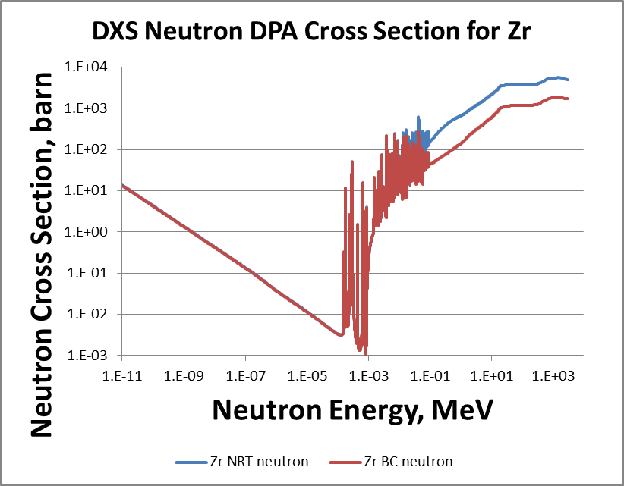
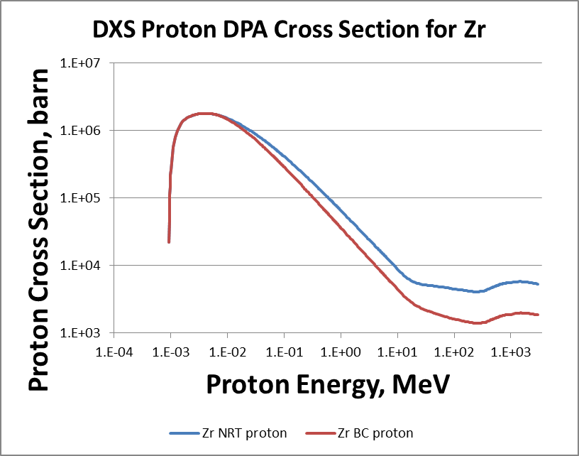
MCNP Calculation of DPA Method 1 DPA Cross Section
IAEA Nuclear Data Section database DXS includes both NRT and MD-BCA DPA cross sections
MD-BCA DPA are substantially lower than NRT

Slide 14
MCNP Calculation of DPA Method 1 DPA Cross Section
Neutron damage cross sections that can be used in MCNP
ASTM E693 for up to 20 MeV in Fe, steel
ENDF/B Evaluations up to 20 MeV for most isotopes
Neutron dosimetry file IRDF-2002 contains neutron damage cross sections up to 20 MeV for Si, GaAs, ASTM E722 electronic, Cr, Fe, Ni,

Slide 15
MCNP DPA Calculation Method 2
HISTP card included in input file produces history file of medium and high energy collision data
Low energy neutron and proton collisions utilizing the MCNPX libraries are not included
HTAPE3X INT=myinput OUTT=myoutput HISTP=file1
IOPT=16 damage energy spectra
Provides tables as function of input energy grid by cell or material and total
total recoil, elastic recoil, total damage, elastic damage
Provides mean values of recoiling fragments and damage energy per history and mean energy per recoil
IOTP = -16 multiplies damage energy spectra by flux

Slide 16
MCNP Calculation of DPA Method 2
Calculate neutron, proton transport at specific locations the same as method 1 but record histories on HTAPE file
HTAPE3X included with MCNP (from LAHET) reads HTAPE histories and calculates damage energy spectrum, which is converted to DPA
Advantages
Doesn’t require separate DPA XS
Includes most reaction mechanisms
Disadvantages
Only includes contributions from physics models
Tabulated XS contributions are not included
Can underestimate damage if <20 MeV contributions are significant
Interactions using tabulated cross sections are not recorded in HISTP file, only those based on physics models

Slide 17
Extension of MCNP 6.1 Cross Sections
Need to include gas-production and DPA dosimetry cross sections for a number of nuclides (Fe, Ti, W, C, Be, and others)
Current evaluations of ENDF/B do not contain this type of information
Evaluated files in ENDF format exist and are available

Slide 18
Current Effort
Obtained gas production and DPA dosimetry cross section files
Converted ENDF files to ACE format suitable for MCNP with NJOY 99.396 (latest update)
Reactions MT=203 to 207 represent gas production reactions
Currently working on modifying MCNP 6.1 and/or NJOY 99.396 to accommodate these new dosimetry cross sections
Neutron cross sections appear to work, but proton cross sections do not

Slide 19
Status
Main hurdles are represented by a potential non-compatible format produced by NJOY for these cross sections
Work is in progress to adapt the codes

Slide 21
Radiation Damage
Radiation damage in materials results from nuclear collisions and reactions which produce energetic recoil atoms of the host material or reaction products
These recoiling atoms generate electronic excitations in host material that displace additional host atoms – this is displacement damage
In metals this is the main process that leads to permanent damage, but generated He and H also contribute to radiation damage
Displacements per atom is routinely used to characterize irradiations
Only initial displacements of atoms from lattice sites are calculated
Many displaced atoms recombine with holes in the lattice, especially at elevated temperatures
Measure of total damage energy deposited in a material, and changes in physical and mechanical properties are fundamentally related to the available energy

Slide 22
NRT-DPA
In 1975 Norget, Torrens and Robinson proposed the NRT-DPA standard. Number of displacements = 0.8T_{d}/2E_{d}
0.8 factor was determined from binary collision models to account for realistic scattering
E_{d} is the minimum energy required to create a stable Frankel pair
NRT DPA has been widely used and has proven useful for correlating radiation damage phenomena
Comparing thermal and fast spectrum neutron irradiations
Comparing charged particle with neutron irradiation
While did not predict actual number of Frenkel pairs, provided means of correlation for steels and other mid-atomic weight metals

Slide 23
NRT-DPA
NRT-DPA has limitations
Some material property changes are sensitive to results of nuclear collisions
Others are more sensitive to ionization effects
Limited to metals, has been applied to compound materials like ceramics by mathematical weighting of separate elements
Does not account for recombination of atoms during cascade evolution
Cannot be directly measured or validated
Has no uncertainties/covariances
NRT DPA methodology incorporated into
ASTM E693 Standard Practice for Characterizing Neutron Exposures in Iron and Low Alloy Steels in Terms of Displacements Per Atom (DPA)
ASTM E521 Standard Practice for Neutron Radiation Damage Simulation by Charged Particle Irradiation

Slide 24
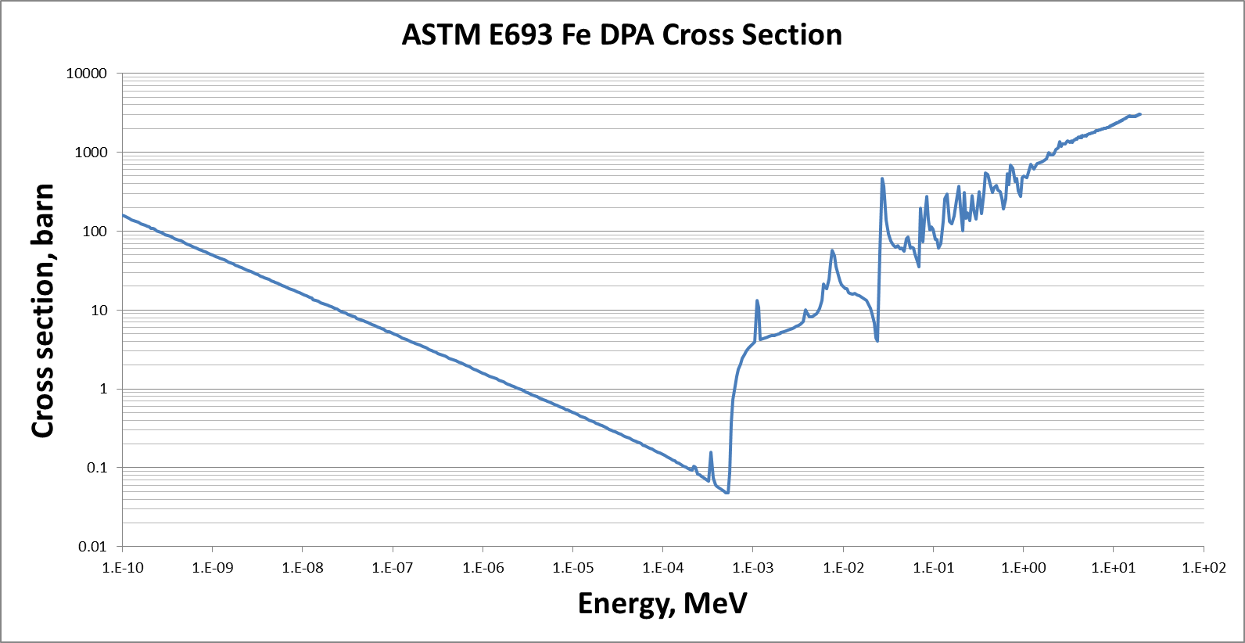
ASTM E693 Standard for DPA for Neutron Exposures in Iron and Low Alloy Steels
ASTM E693 Standard Practice for Characterizing Neutron Exposures in Iron and Low Alloy Steels in Terms of Displacements Per Atom
Specifies energy dependent neutron DPA cross section that is multiplied with neutron energy spectrum to calculate DPA

Slide 25
ASTM E521 Standard for Neutron Radiation Damage by Charged Particle Irradiation
ASTM E521 Standard Practice for Neutron Radiation Damage Simulation by Charged Particle Irradiation
Calculation of damage energy per atom per unit fluence for neutrons, light ions, heavy ions, and electrons
All possible reactions that transfer energy to an atom of the medium to displace it must be considered
Damage energy is converted to DPA using NRT model
N_{d} = 0 T < T_{d}
N_{d} = 1 T_{d} ≤ T < 2T_{d}/β
N_{d} = βT_{dam}/2T_{d} T ≥ 2T_{d}/β
β = 0.8, T_{d} = 40 eV

Slide 26
SPECTER Code for Calculating Neutron Damage
Simplified neutron damage calculations compared to MCNPX
Instead of calculating DPA in MCNPX, user inputs MCNPX calculated energy-dependent neutron spectrum to SPECTER, which calculates spectral-averaged displacements, recoil spectra, gas production, and total damage energy for 41 isotopes at the same time
Limited to neutron reactions
Includes elastic scattering, multiple (n,xn) reactions, (n,d), (n,t), (n,³He), (n,⁴He), (n,γ), β-decay
Limited to energy range from 10⁻¹⁰ to 20 MeV
Limited to ENDF/B-V nuclear data

