Slide 1
Free-Jet Code Benchmark
Yan Zhan
SUNY Stony Brook
July 11th, 2013

Slide 2
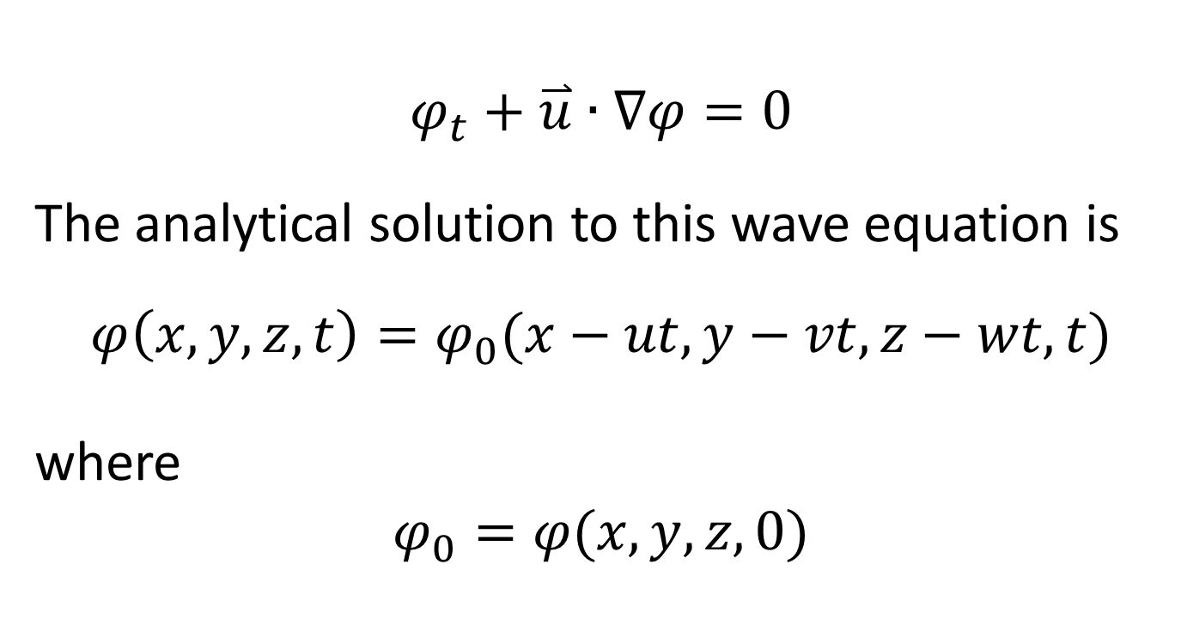
Level-Set Analytical Solution
$$φ_{t}+\overset{⃑}{u}∙∇φ=0$$
The analytical solution to this wave equation is
$$φ\left(x,y,z,t\right)=φ_{0}(x−ut,y−vt,z−wt,t)$$
where
$$φ_{0}=φ(x,y,z,0)$$

Slide 3
Analytical Solution
Analytical solution of level-set function for the following 2D problem, movement of a bubble with velocity u = v = 1, is
bubble initially centered at (-0.25, 0.25),
radius of the circle is 0.15,
box is just a window in a larger domain.
$$φ\left(x,y,t\right)=\sqrt{{\left(x−t+0.25\right)}^{2}+{\left(y−t−0.25\right)}^{2}}−0.15$$
(-0.5,0.5)
(0.5,0.5)
Test case inspired by sec. 5.1 of
http://puhep1.princeton.edu/~mcdonald/examples/fluids/rider_jcp_141_112_98.pdf
where periodic boundary conditions were u se
(-0.5,-0.5)
(0.5,-0.5)

Slide 4
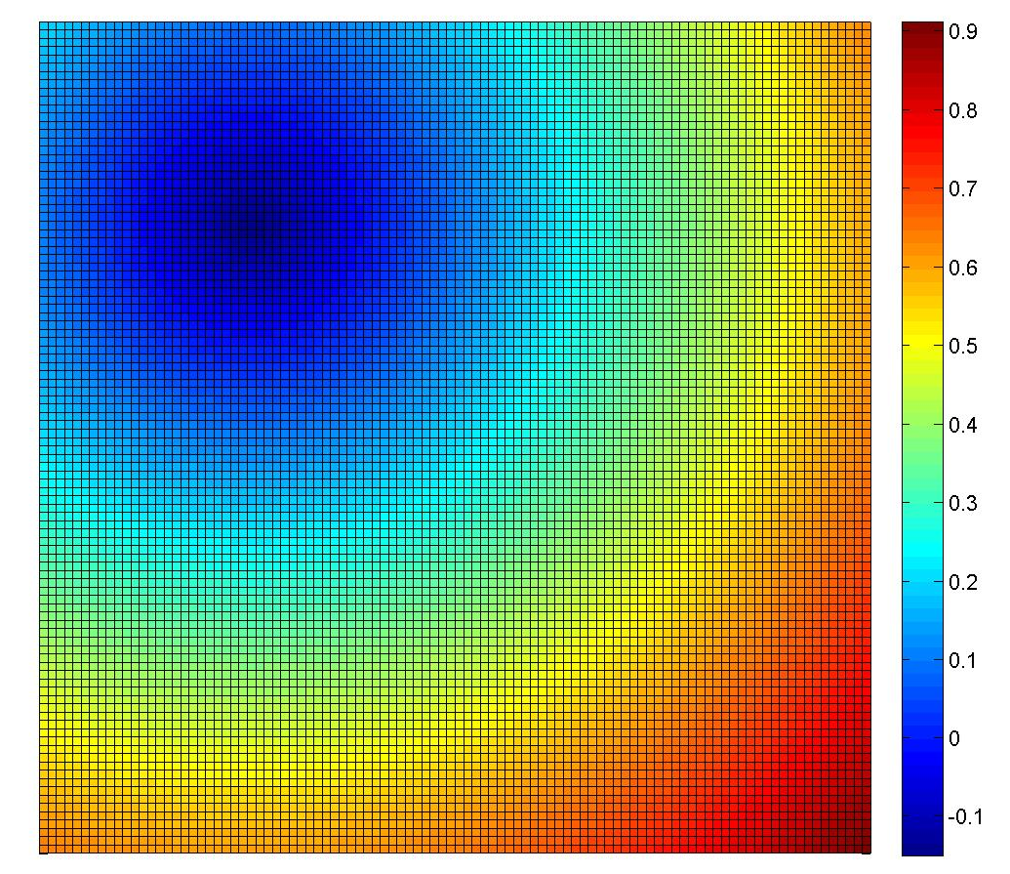
Comparison For Initial Level-Set Value which is negative inside the circle
Analytical solution plotted by Matlab
Numerical solution by level set code

Slide 5
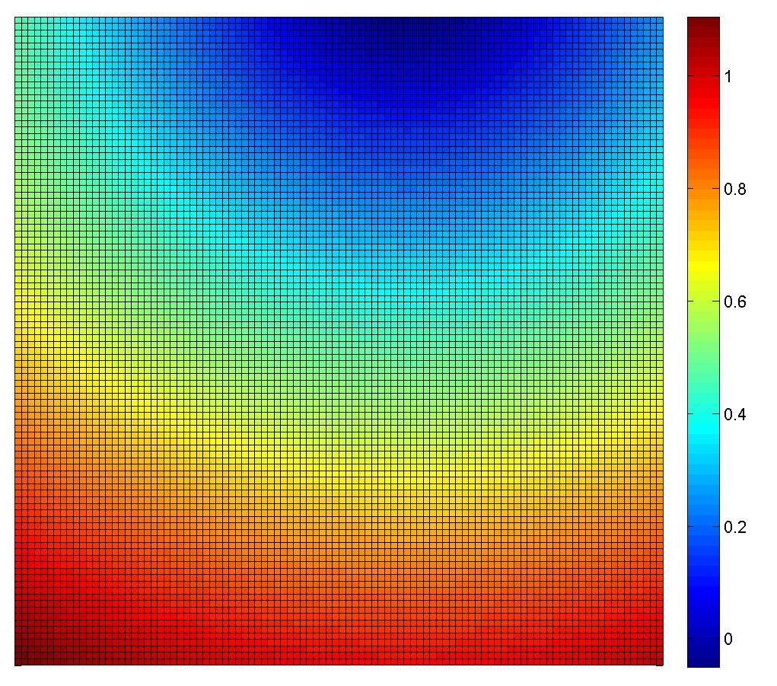
Comparison at t = 0.3 s
Analytical solution plotted by Matlab
Numerical solution by level set code

Slide 6

Comparison at t = 0.4 s
Analytical solution plotted by Matlab
Numerical solution by level set code

Slide 7
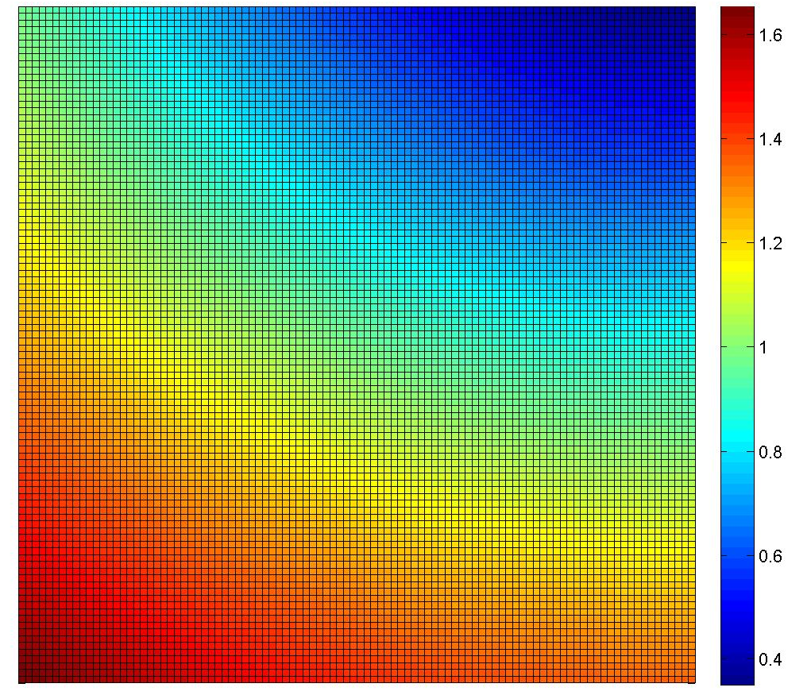
Comparison at t = 0.75 s

Slide 8

Comparison at t = 1.0 s

Slide 9
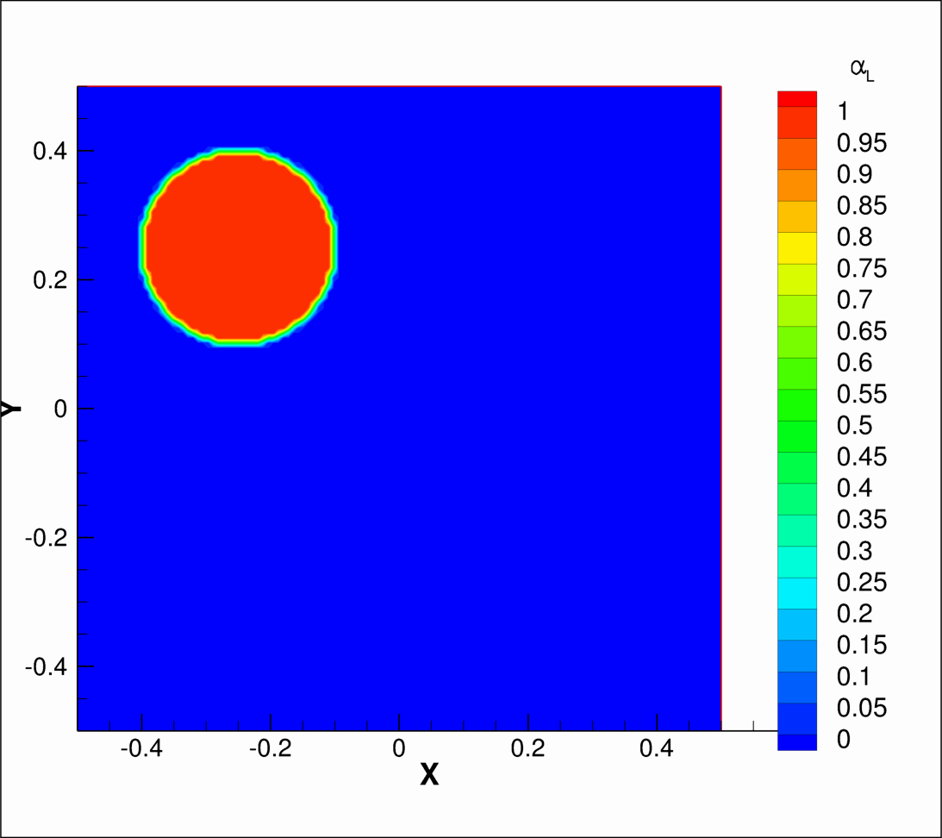

Movement of Two-Phase Circle Using Volume-of-Fluid Method (FLUENT)
[Click on image to watch video]
$$u=1.0$$

Slide 10
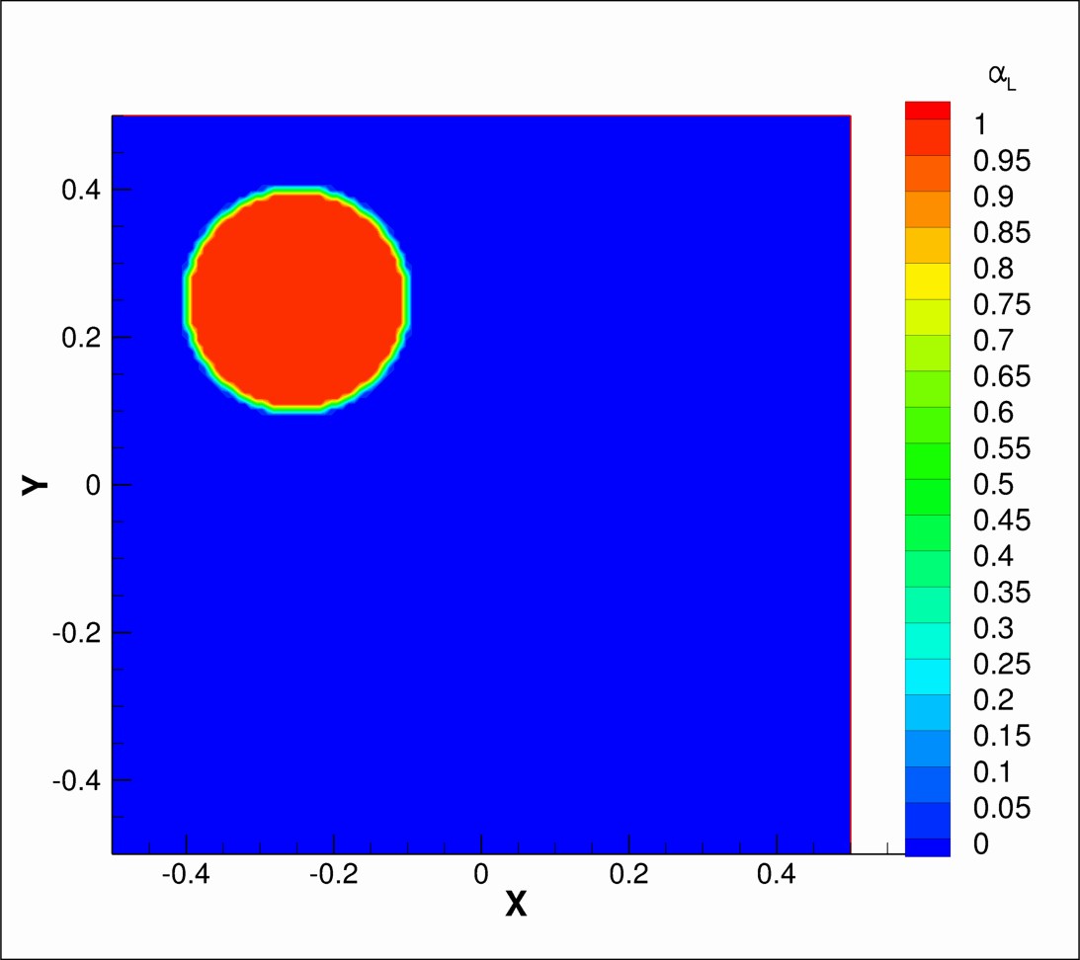

Movement of Two-Phase Circle Using VOF Method
$$v=−1.0$$

Slide 11
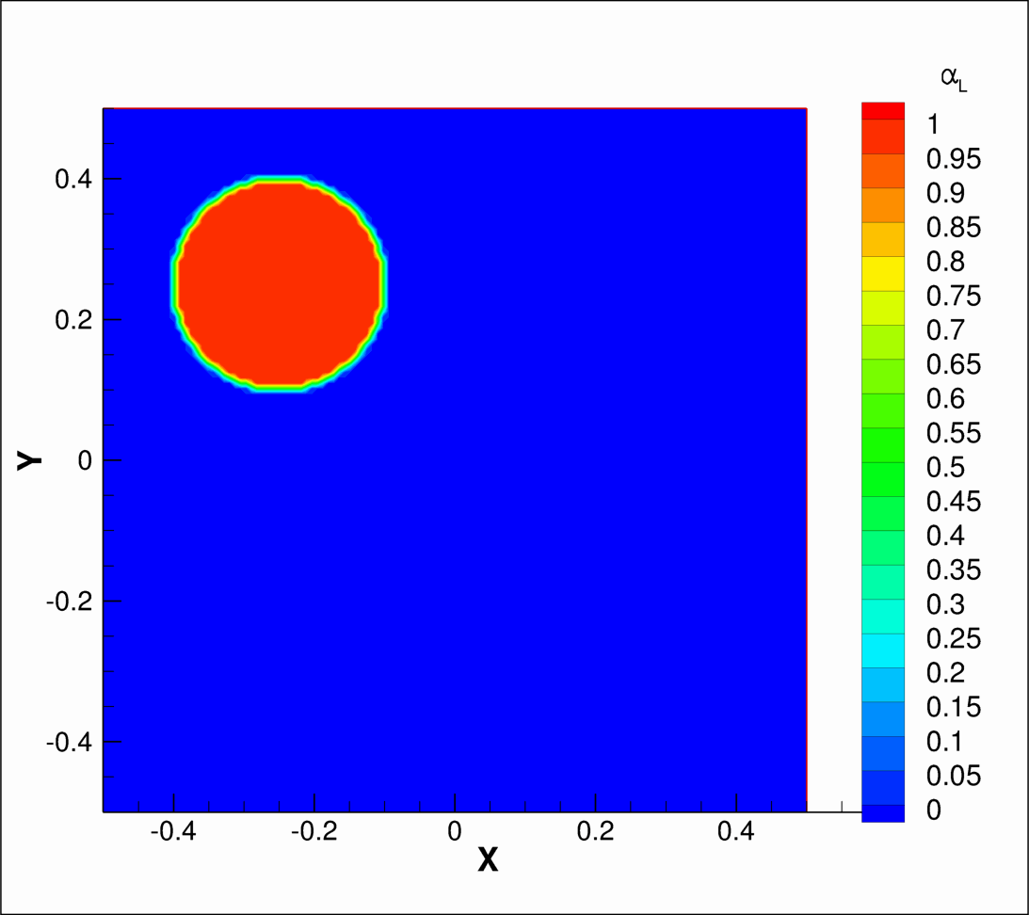

Movement of Two-Phase Circle Using VOF Method
$$u=1, v=−1$$

Slide 12
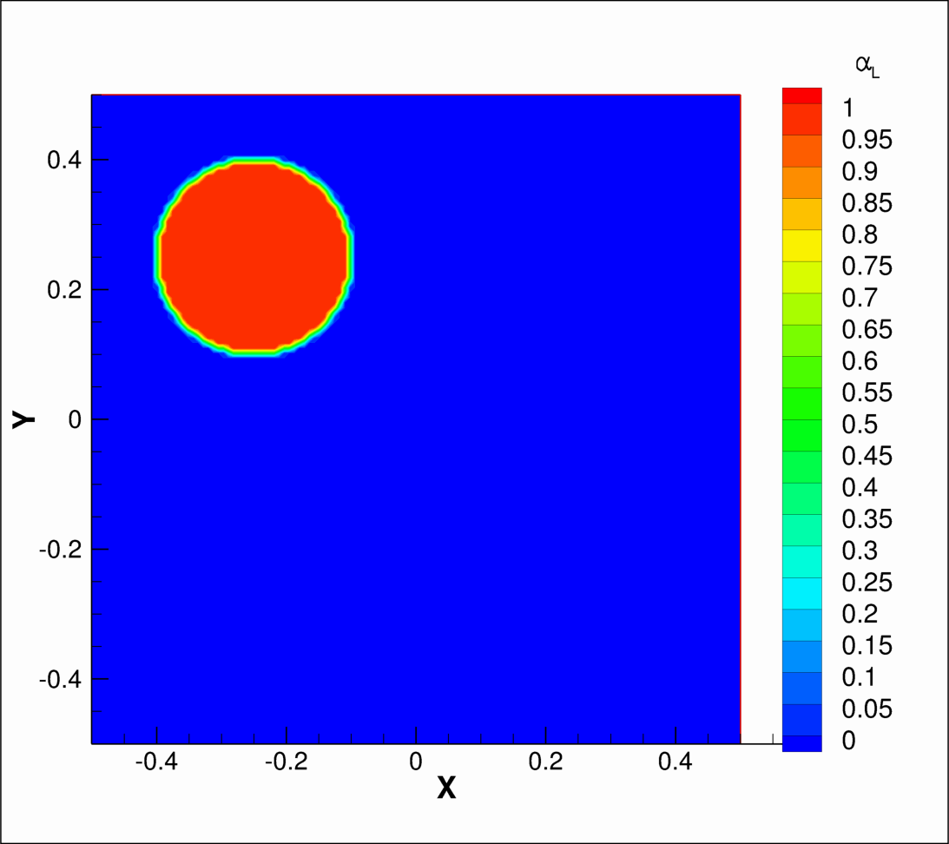

Movement of Two-Phase Circle Using VOF Method
Φ = stream function (not level-set function), typo: cos²(πx) should be cos²(πy) velocity: u = -∂ Φ/∂y, v = ∂Φ/∂x
$∅$ = $\sin^{2}(πx)\cos^{2}(πx)$

Slide 13
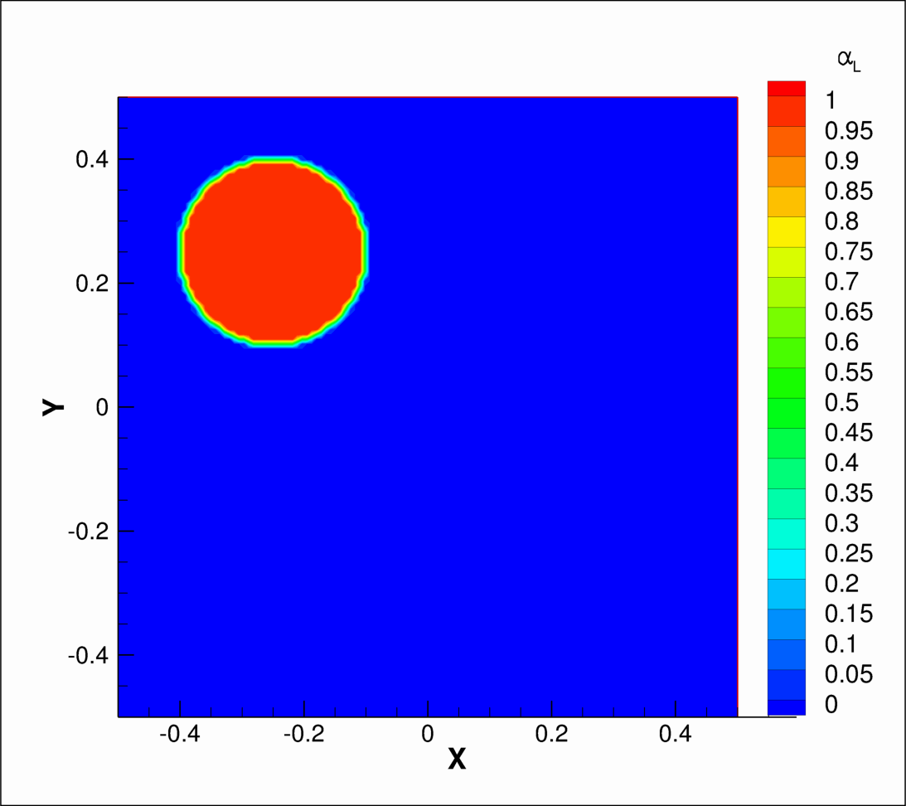

Movement of Two-Phase Circle Using VOF Method cos(πt/2.0) implies time oscillations/reversal
$∅$ = $\sin^{2}\left(πx\right)\cos^{2}\left(πx\right)cos⁡(πt/2.0)$

Slide 14
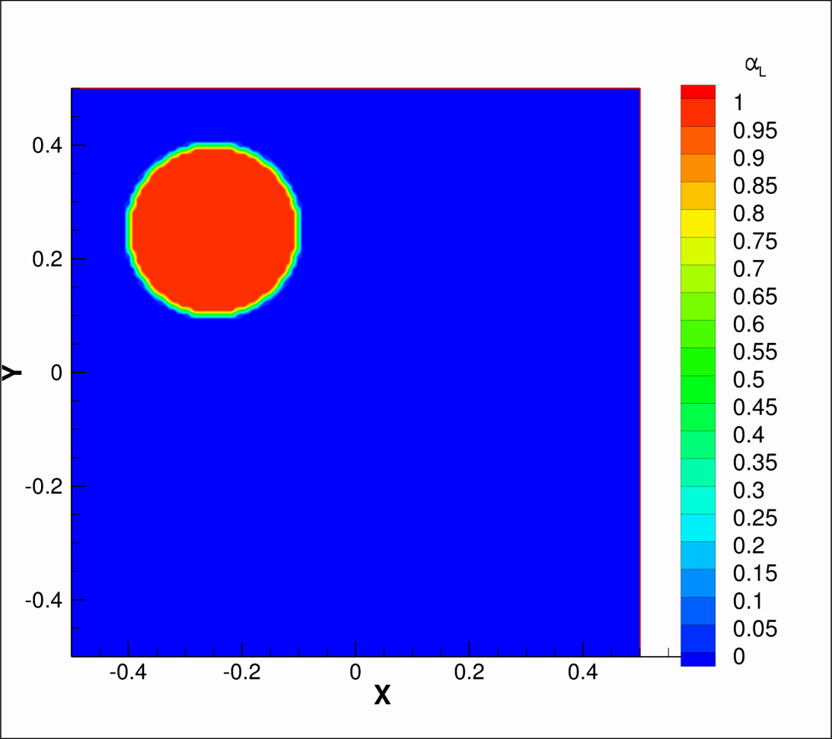

Movement of Two-Phase Circle Using VOF Method
$∅$ = $\sin^{2}\left(πx\right)\cos^{2}\left(πx\right)cos⁡(πt/6.0)$

