Slide 1
Free-Jet Code Benchmark
Yan Zhan
SUNY Stony Brook
Sep 5th, 2013

Slide 2
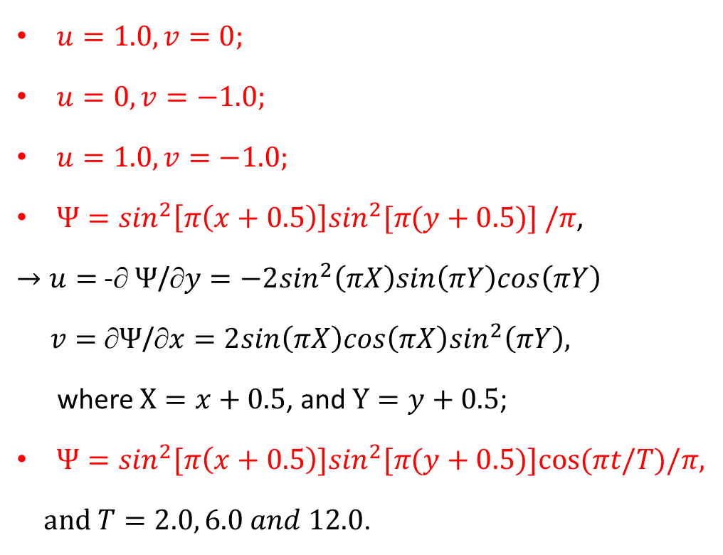
Five Different Forms Of Velocity Fields
(-0.5,0.5)
(0.5,0.5)
$u=1.0,v=0;$
$u=0,v=−1.0;$
$u=1.0,v=−1.0;$
$Ψ=\sin^{2}\left[π\left(x+0.5\right)\right]\sin^{2}[π(y+0.5)] /π$,
$→u=$ -∂ $Ψ$/∂$y=−2\sin^{2}\left(πX\right)sin\left(πY\right)cos\left(πY\right)$
$v=$∂$Ψ$/∂$x=2{sin\left(πX\right)cos\left(πX\right)sin}^{2}\left(πY\right),$
where $X=x+0.5$, and $Y=y+0.5$;
$Ψ=\sin^{2}[π\left(x+0.5\right)]\sin^{2}[π(y+0.5)]cos⁡(πt/T)/π$,
$and T=2.0, 6.0 and 12.0$.
Air
Water
Center: (-0.25, 0.25)
Radius: 0.15
(-0.5,-0.5)
(0.5,-0.5)
3 Methods: VOF, CLSVOF, LS

Slide 3
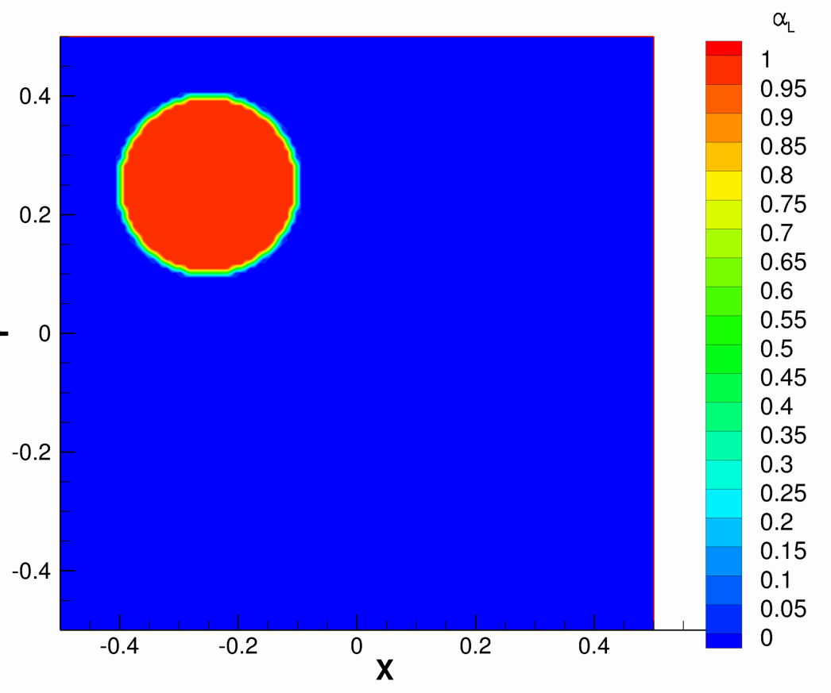

Movement of Two-Phase Circle Using Volume-of-Fluid Method (FLUENT)
[Click on image to watch video]
$$u=1.0$$

Slide 4
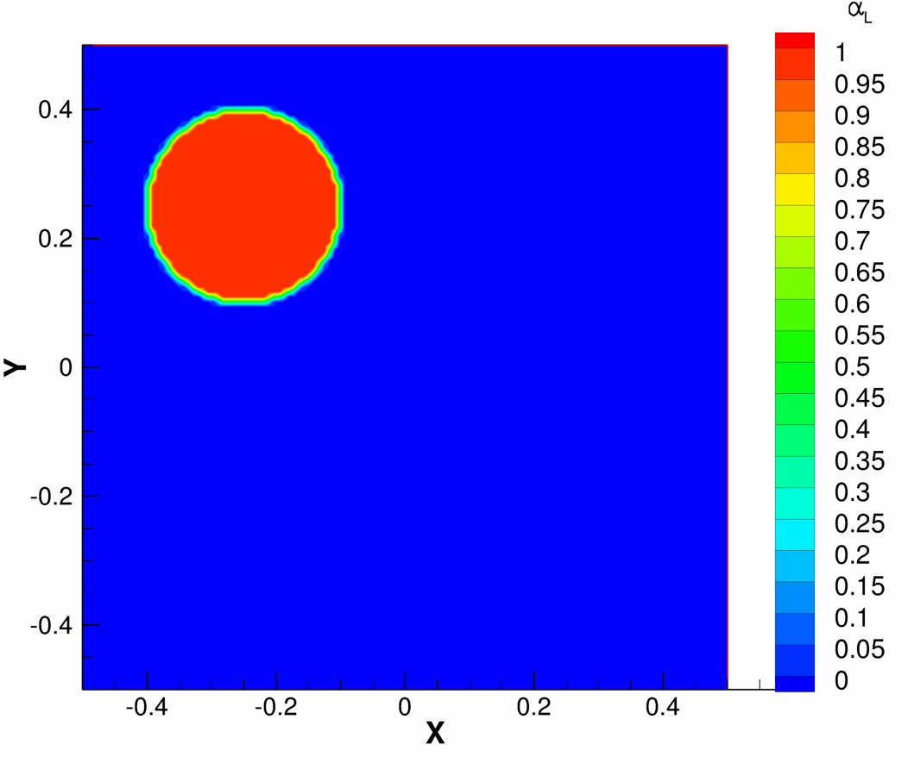

Movement of Two-Phase Circle Using Volume-of-Fluid Method (FLUENT)
[Click on image to watch video]
$$v=−1.0$$

Slide 5
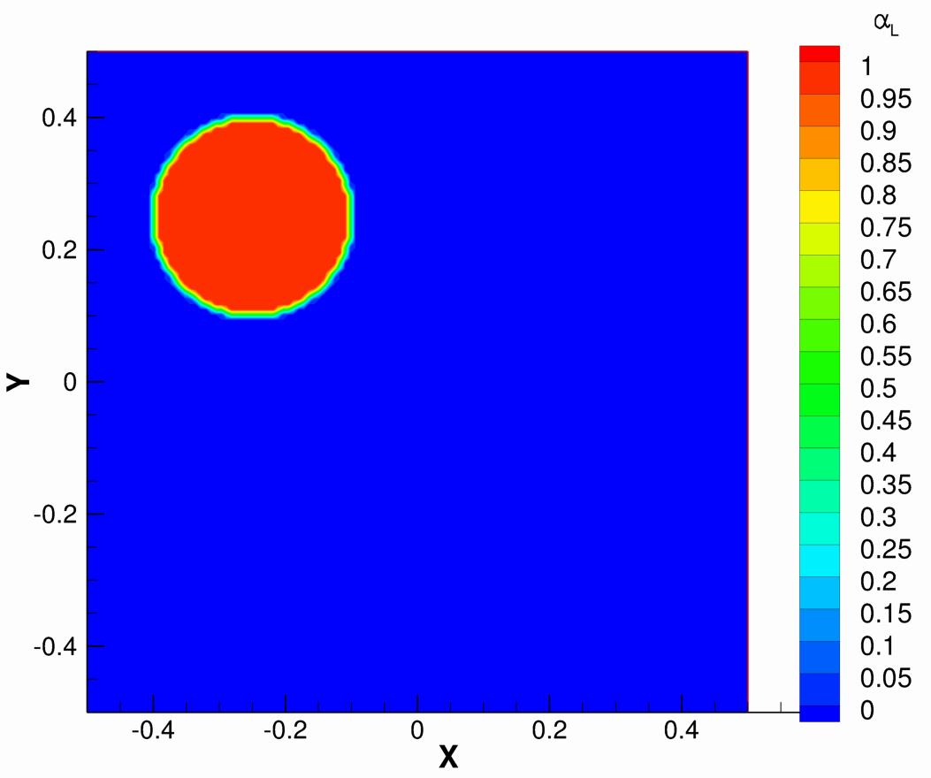

Movement of Two-Phase Circle Using Volume-of-Fluid Method (FLUENT)
[Click on image to watch video]
$$u=1, v=−1$$

Slide 6
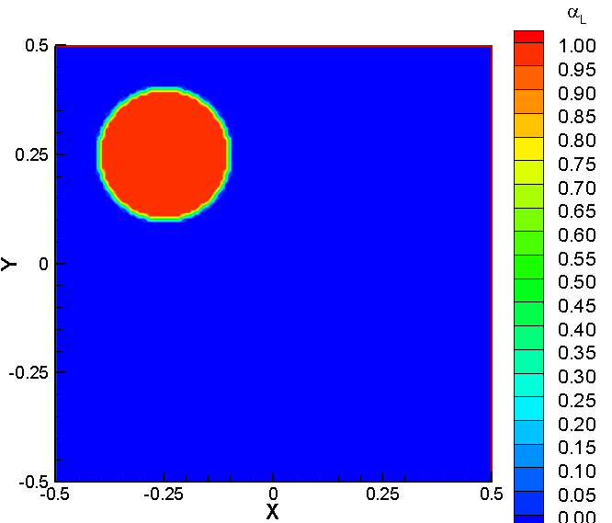
Movement of Two-Phase Circle Using Volume-of-Fluid Method (FLUENT)
[Click on image to watch video]
$Ψ=\sin^{2}\left(πx\right)\sin^{2}\left(πy\right)/π$, where $Ψ$ = stream function, velocity: u = -∂ $Ψ$/∂y, v = ∂$Ψ$/∂x

Slide 7
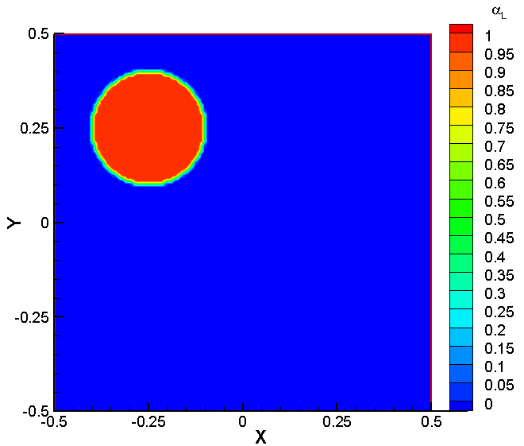
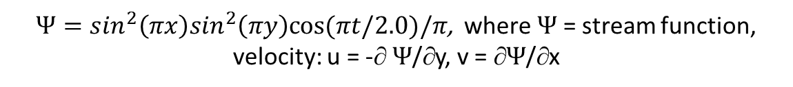
Movement of Two-Phase Circle Using Volume-of-Fluid Method (FLUENT)
[Click on image to watch video]
$Ψ=\sin^{2}\left(πx\right)\sin^{2}\left(πy\right)cos⁡(πt/2.0)/π$, where $Ψ$ = stream function,
velocity: u = -∂ $Ψ$/∂y, v = ∂$Ψ$/∂x

Slide 8
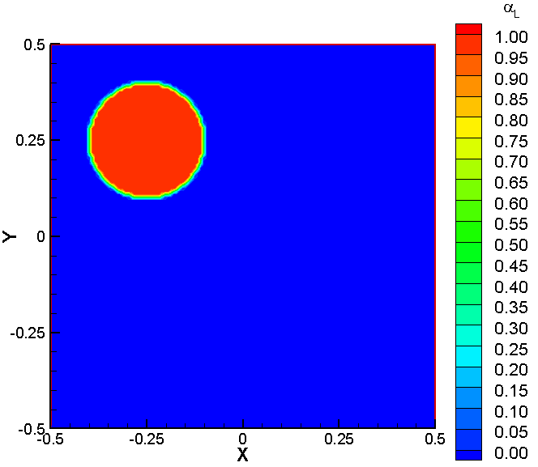
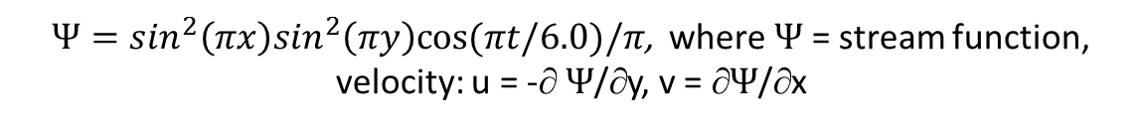
Movement of Two-Phase Circle Using Volume-of-Fluid Method (FLUENT)
[Click on image to watch video]
$Ψ=\sin^{2}\left(πx\right)\sin^{2}\left(πy\right)cos⁡(πt/6.0)/π$, where $Ψ$ = stream function,
velocity: u = -∂ $Ψ$/∂y, v = ∂$Ψ$/∂x

Slide 9
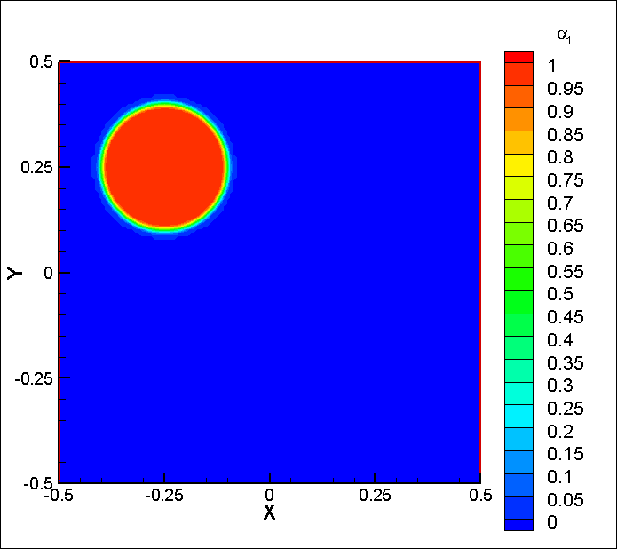
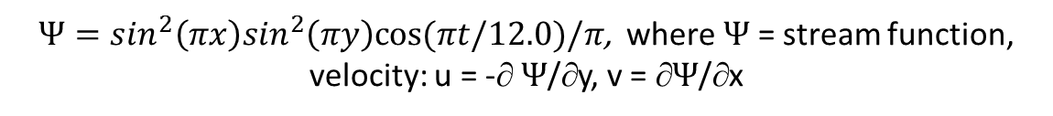
Movement of Two-Phase Circle Using Volume-of-Fluid Method (FLUENT)
[Click on image to watch video]
$Ψ=\sin^{2}\left(πx\right)\sin^{2}\left(πy\right)cos⁡(πt/12.0)/π$, where $Ψ$ = stream function,
velocity: u = -∂ $Ψ$/∂y, v = ∂$Ψ$/∂x

Slide 10
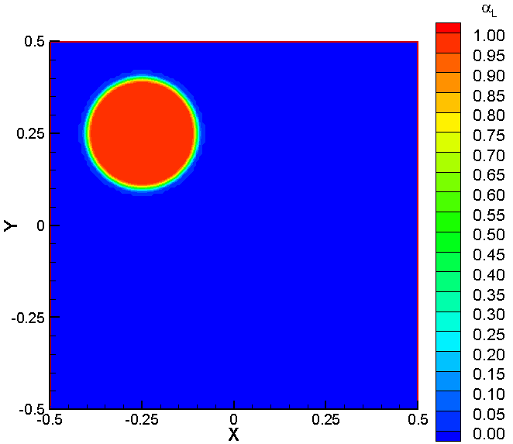
Movement of Two-Phase Circle Using CLSVOF Model (FLUENT)
[Click on image to watch video]
$$u=1.0$$

Slide 11
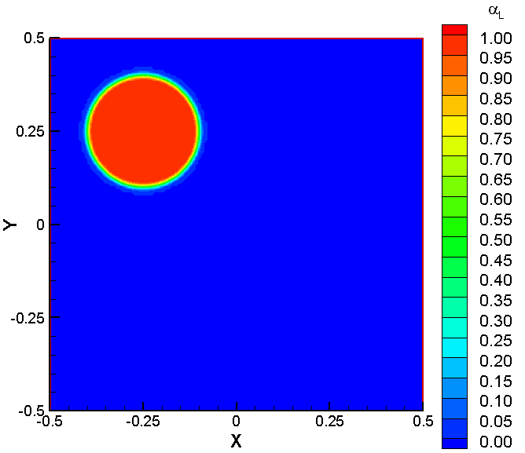
Movement of Two-Phase Circle Using CLSVOF Model (FLUENT)
[Click on image to watch video]
$$v=−1.0$$

Slide 12

Movement of Two-Phase Circle Using CLSVOF Model (FLUENT)
[Click on image to watch video]
$$u=1, v=−1$$

Slide 13

Movement of Two-Phase Circle Using CLSVOF Model (FLUENT)
[Click on image to watch video]
$Ψ=\sin^{2}\left(πx\right)\sin^{2}\left(πy\right)/π$, where $Ψ$ = stream function, velocity: u = -∂ $Ψ$/∂y, v = ∂$Ψ$/∂x

Slide 14
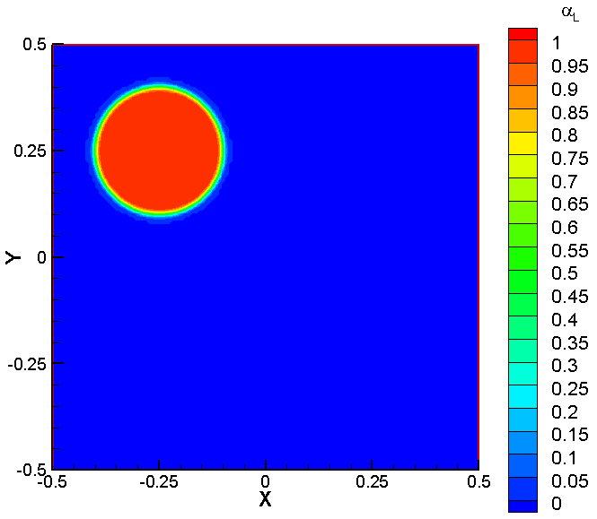
Movement of Two-Phase Circle Using CLSVOF Model (FLUENT)
[Click on image to watch video]
$Ψ=\sin^{2}\left(πx\right)\sin^{2}\left(πy\right)cos⁡(πt/2.0)/π$, where $Ψ$ = stream function,
velocity: u = -∂ $Ψ$/∂y, v = ∂$Ψ$/∂x

Slide 15
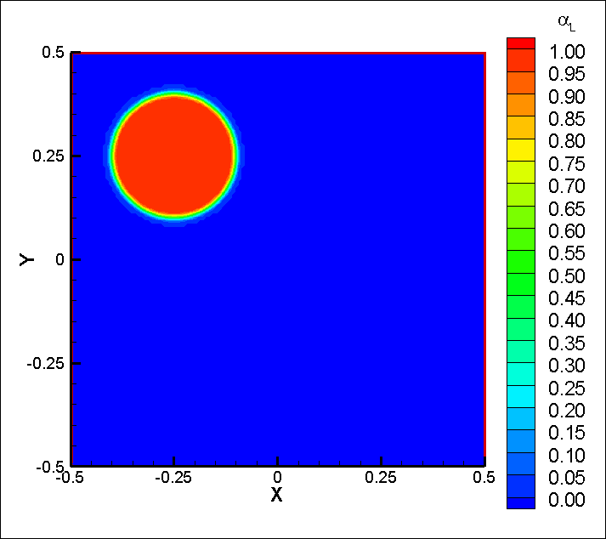
Movement of Two-Phase Circle Using CLSVOF Model (FLUENT)
[Click on image to watch video]
$Ψ=\sin^{2}\left(πx\right)\sin^{2}\left(πy\right)cos⁡(πt/6.0)/π$, where $Ψ$ = stream function,
velocity: u = -∂ $Ψ$/∂y, v = ∂$Ψ$/∂x

Slide 16
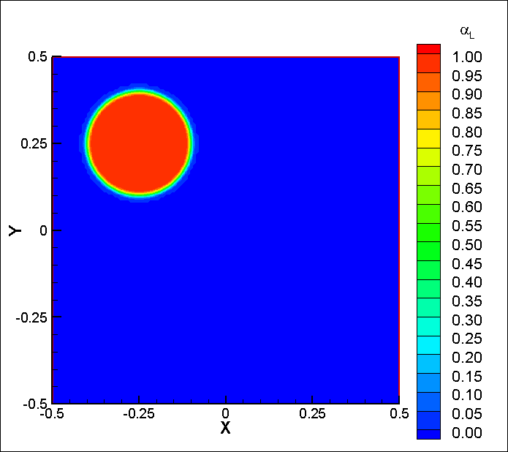
Movement of Two-Phase Circle Using CLSVOF Model (FLUENT)
[Click on image to watch video]
$Ψ=\sin^{2}\left(πx\right)\sin^{2}\left(πy\right)cos⁡(πt/12.0)/π$, where $Ψ$ = stream function,
velocity: u = -∂ $Ψ$/∂y, v = ∂$Ψ$/∂x

Slide 17
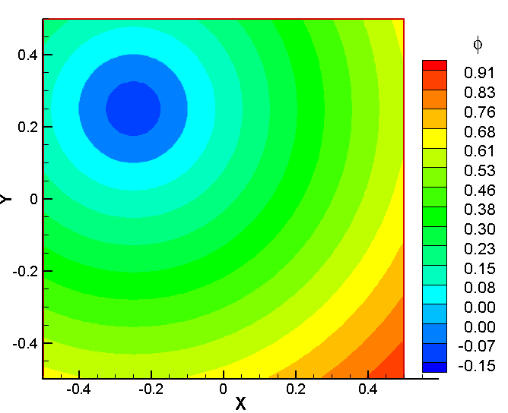
Movement of Two-Phase Circle Using Level Set Method
[Click on image to watch video]
$$v=−1.0$$

Slide 18
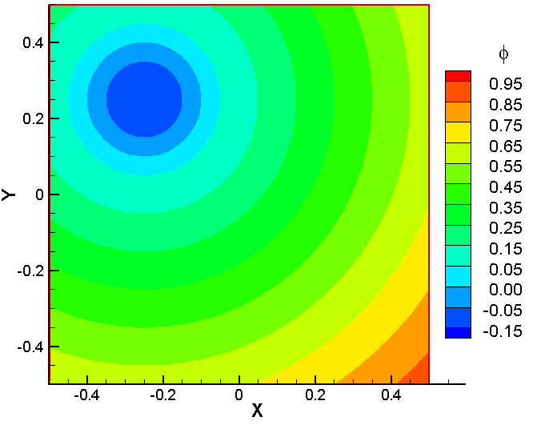

Movement of Two-Phase Circle Using Level Set Method
[Click on image to watch video]
$$u=1, v=−1$$

Slide 19
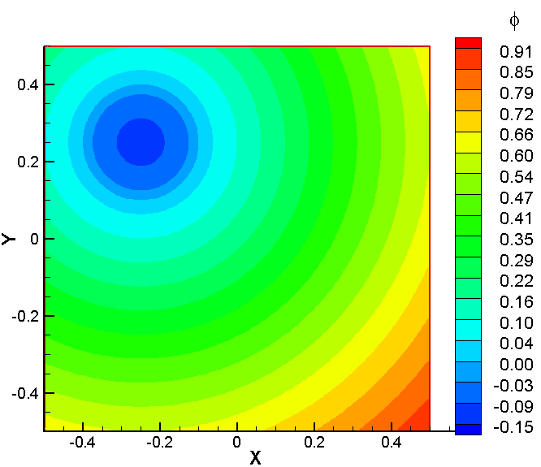
Movement of Two-Phase Circle Using Level Set Method
[Click on image to watch video]
$Ψ=\sin^{2}\left(πx\right)\sin^{2}\left(πy\right)/π$, where $Ψ$ = stream function, velocity: u = -∂ $Ψ$/∂y, v = ∂$Ψ$/∂x。

Slide 20
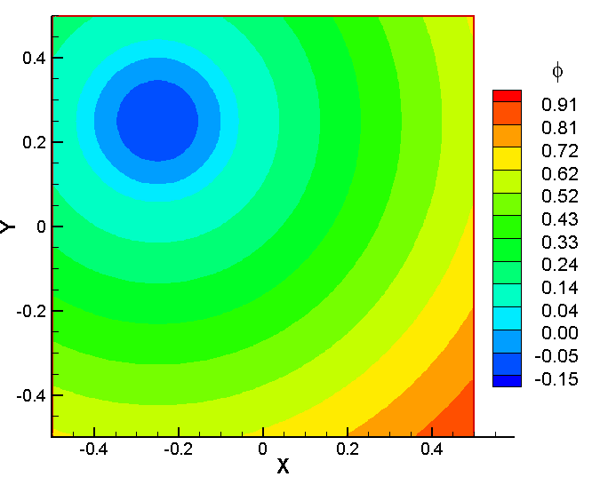
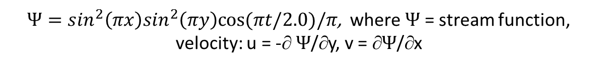
Movement of Two-Phase Circle Using Level Set Method
[Click on image to watch video]
$Ψ=\sin^{2}\left(πx\right)\sin^{2}\left(πy\right)cos⁡(πt/2.0)/π$, where $Ψ$ = stream function,
velocity: u = -∂ $Ψ$/∂y, v = ∂$Ψ$/∂x

Slide 21
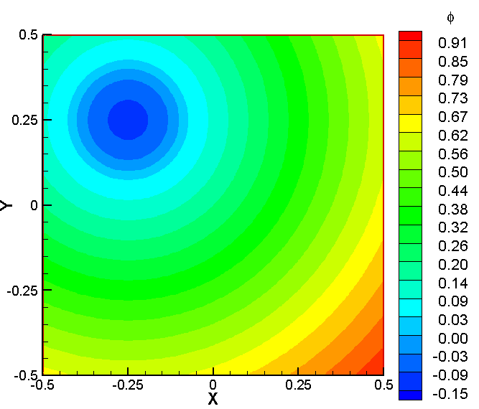
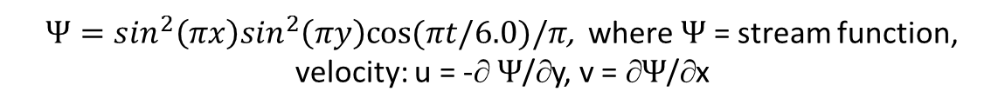
Movement of Two-Phase Circle Using Level Set Method
[Click on image to watch video]
$Ψ=\sin^{2}\left(πx\right)\sin^{2}\left(πy\right)cos⁡(πt/6.0)/π$, where $Ψ$ = stream function,
velocity: u = -∂ $Ψ$/∂y, v = ∂$Ψ$/∂x

Slide 22
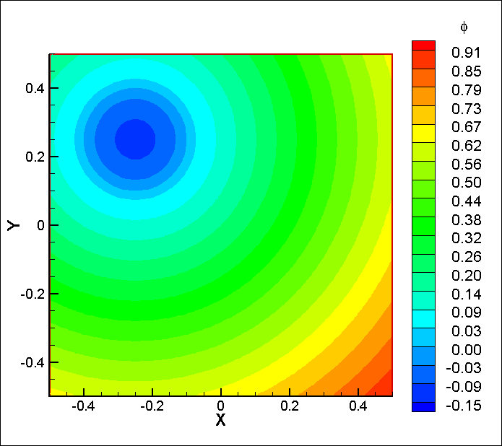
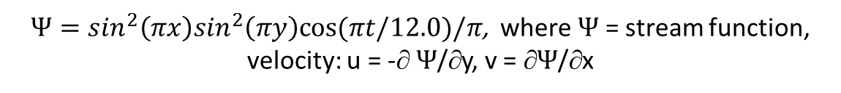
Movement of Two-Phase Circle Using Level Set Method
[Click on image to watch video]
$Ψ=\sin^{2}\left(πx\right)\sin^{2}\left(πy\right)cos⁡(πt/12.0)/π$, where $Ψ$ = stream function,
velocity: u = -∂ $Ψ$/∂y, v = ∂$Ψ$/∂x

Slide 23
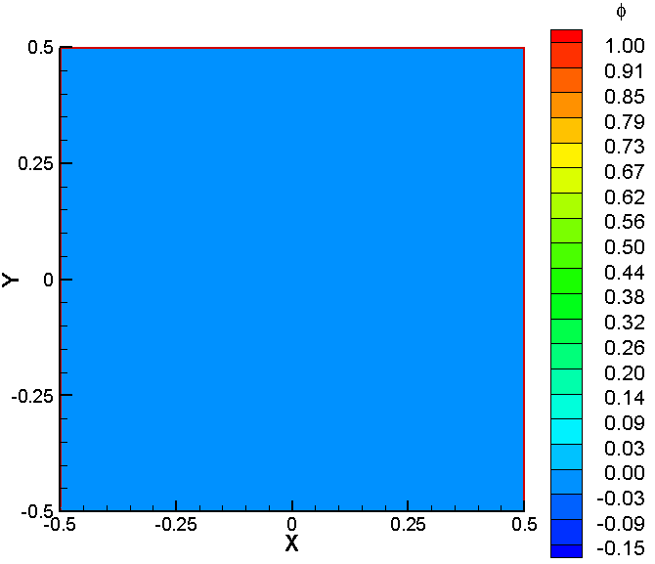
Movement of Two-Phase Circle Using CLSVOF Model (FLUENT)
[Click on image to watch video]
$$u=1.0$$

Slide 24
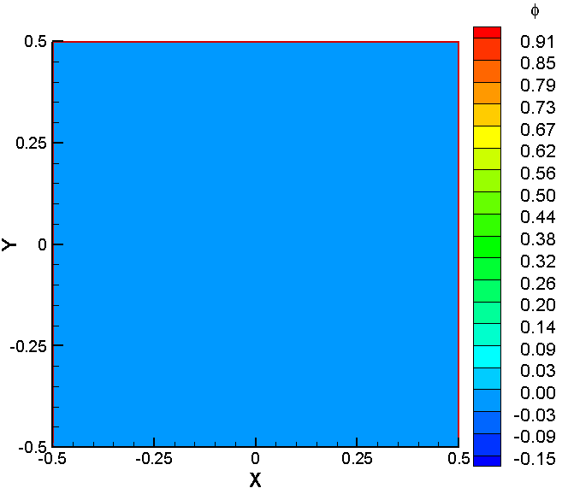
Movement of Two-Phase Circle Using CLSVOF Model (FLUENT)
[Click on image to watch video]
$$v=−1.0$$

Slide 25
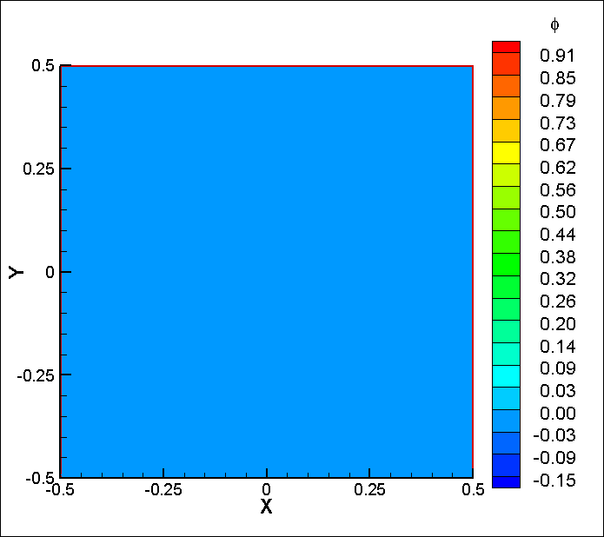
Movement of Two-Phase Circle Using CLSVOF Model (FLUENT)
[Click on image to watch video]
$$u=1, v=−1$$

Slide 26
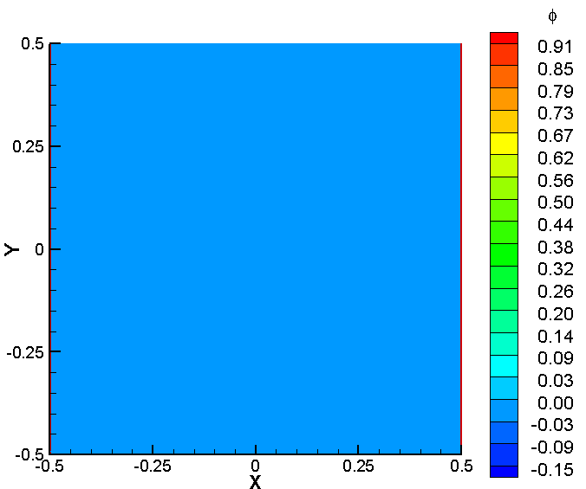
Movement of Two-Phase Circle Using CLSVOF Model (FLUENT)
[Click on image to watch video]
$Ψ=\sin^{2}\left(πx\right)\sin^{2}\left(πy\right)/π$, where $Ψ$ = stream function, velocity: u = -∂ $Ψ$/∂y, v = ∂$Ψ$/∂x

Slide 27
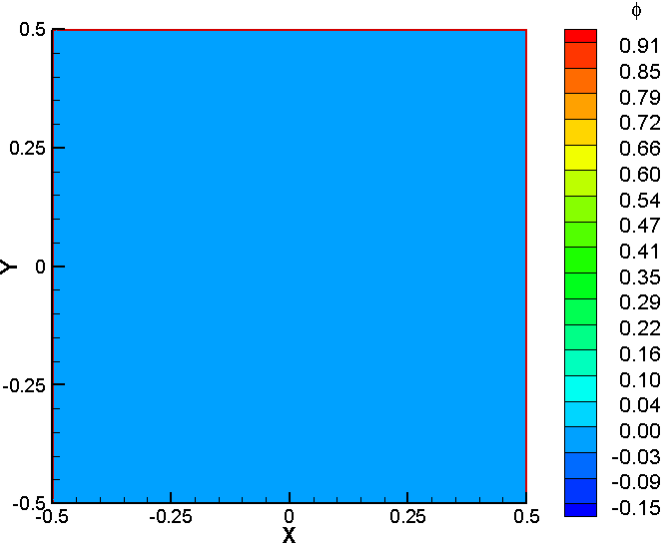
Movement of Two-Phase Circle Using CLSVOF Model (FLUENT)
[Click on image to watch video]
$Ψ=\sin^{2}\left(πx\right)\sin^{2}\left(πy\right)cos⁡(πt/2.0)/π$, where $Ψ$ = stream function,
velocity: u = -∂ $Ψ$/∂y, v = ∂$Ψ$/∂x

Slide 28
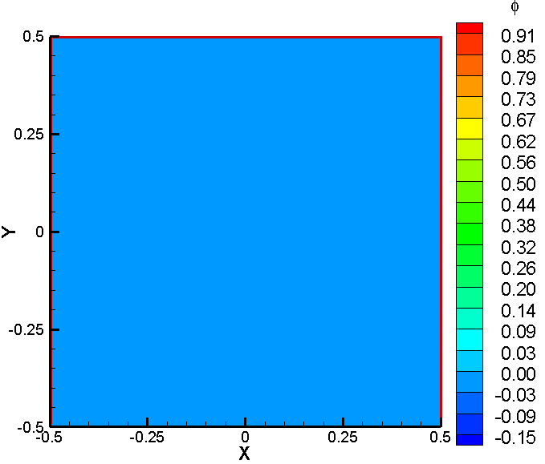
Movement of Two-Phase Circle Using CLSVOF Model (FLUENT)
[Click on image to watch video]
$Ψ=\sin^{2}\left(πx\right)\sin^{2}\left(πy\right)cos⁡(πt/6.0)/π$, where $Ψ$ = stream function,
velocity: u = -∂ $Ψ$/∂y, v = ∂$Ψ$/∂x

Slide 29
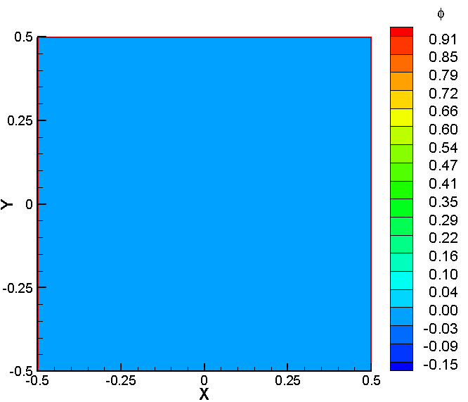
Movement of Two-Phase Circle Using CLSVOF Model (FLUENT)
[Click on image to watch video]
$Ψ=\sin^{2}\left(πx\right)\sin^{2}\left(πy\right)cos⁡(πt/12.0)/π$, where $Ψ$ = stream function,
velocity: u = -∂ $Ψ$/∂y, v = ∂$Ψ$/∂x

