Slide 1
2D Jet Simulation Updates
Jan.23rd 2014
Yan Zhan
SUNY Stony Brook

Slide 2
Problem 1: Water-Air Jet
An axis-symmetric water jet into still air with a mean bulk velocity of 4.5455 m/s (D = 0.01m, and Re = 50,000).

Slide 3
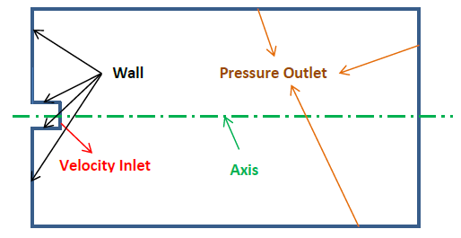
Boundary Conditions
Outflow

Slide 4
Jet Characteristics
Physical Characteristics
Numerical Characteristics
Determination of the mesh size:
Assume only primary breakup, the critical liquid Weber number is 10, then Δx_critical = 34.4μm
Diameter (D) | Velocity | Turbulent Intensity
0.0102108 m | 4.5455 m/s | u‘/U = 0.05
Phase | Density | Viscosity | Surface Tension
Air | 1.225 kg/m³ | 1.46×10⁻⁵ m²/s | 0.071 N/m
Water | 998 kg/m³ | 0.9×10⁻⁶ m²/s
$We≡\frac{ρu^{2}Δx}{σ}→Δx=\frac{10∗0.071}{998∗4.5455∗4.5455}=3.44∗{10}^{−5}$ m
Notes:
Jet primary breakup: Drop formation along the surface of jet.

Slide 5
Mesh
Halved (axis-symmetric) model with grid# of 822,000

Slide 6
Results (t = 0.0307s)

Slide 7
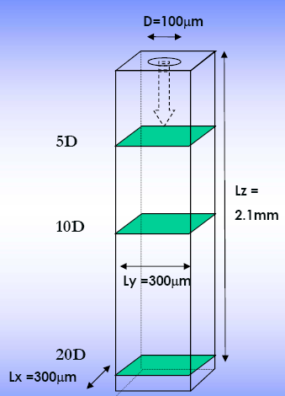
Problem 2: Menard’s Test^{[1]}
50D
20D
An axis-symmetric liquid jet into still gas with a mean bulk
velocity of 100 m/s (D = 100 μm, and Re = 5,800).
[1] T. Menard, etc., Coupling level set/VOF/ghost fluid methods: Validation and application to 3D simulation of the primary break-up of a liquid jet, International Journal of Multiphase Flow 33 (2007) 510–524

Slide 8
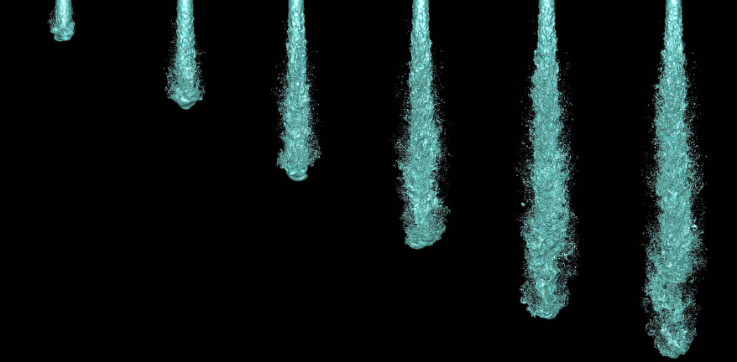
Menard’s Results^{[1]}
Jet development and penetration (dt = 2.5 μm)

Slide 9
Boundary Condition
50D
20D
Outflow

Slide 10
Jet Characteristics
Physical Characteristics
Numerical Characteristics
Determination of the mesh size:
Assume only primary breakup, the critical liquid Weber number is 10, then Δx_critical = 2.36 μm
Diameter (D) | Velocity | Turbulent Intensity
100 μm | 100 m/s | u‘/U = 0.05
Phase | Density | Viscosity | Surface Tension
Gas | 25 kg/m³ | 4x10⁻⁷ m²/s | 0.06 N/m
Liquid | 696 kg/m³ | 1.724×10⁻⁶ m²/s
$We≡\frac{ρu^{2}Δx}{σ}→Δx=\frac{10∗0.06}{696∗100∗100}=2.36∗{10}^{−6}$ m

Slide 11
Mesh
Halved (axis-symmetric) model with grid# of 1,146,880

Slide 12
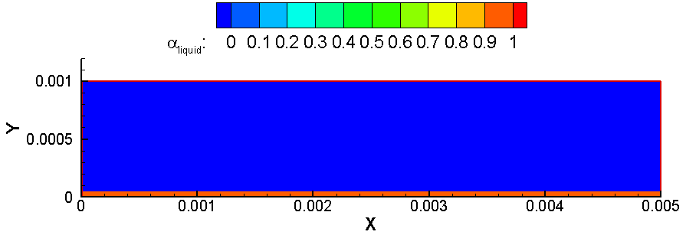
Results
Set Up 1 (t = 0 s):

Slide 13
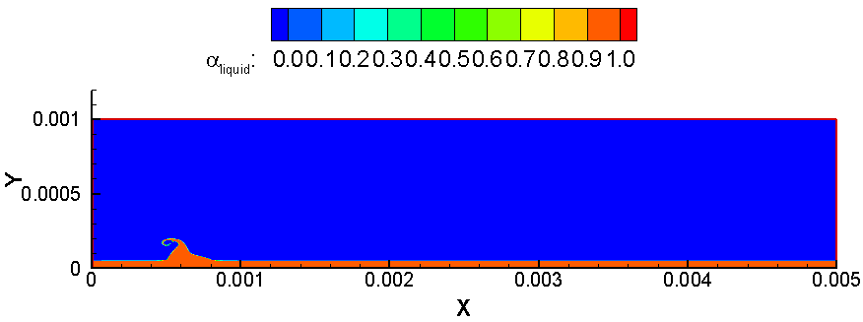
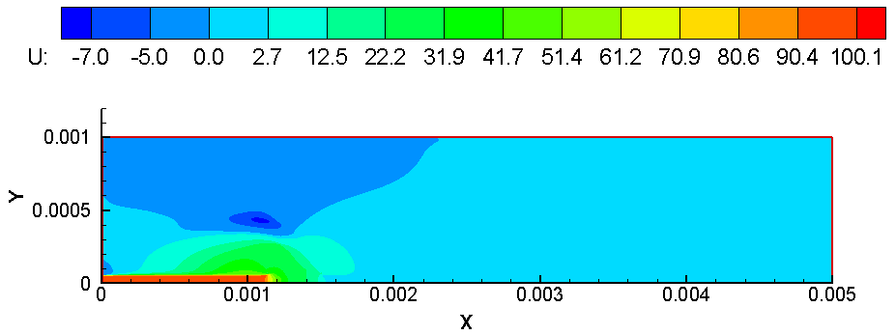
Results
Set Up 1 (t = 10 μs):

Slide 14
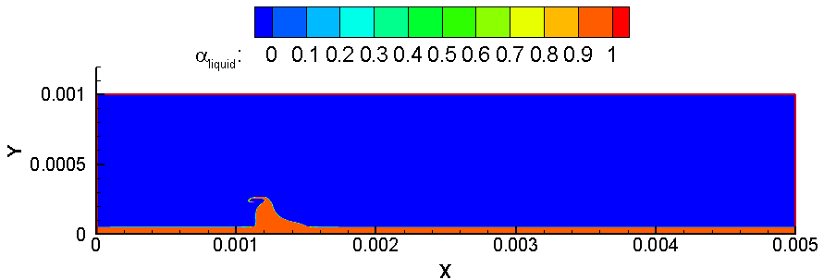
Results
Set Up 1 (t = 30 μs):

Slide 15
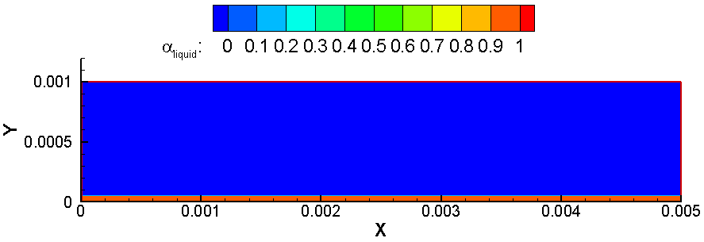
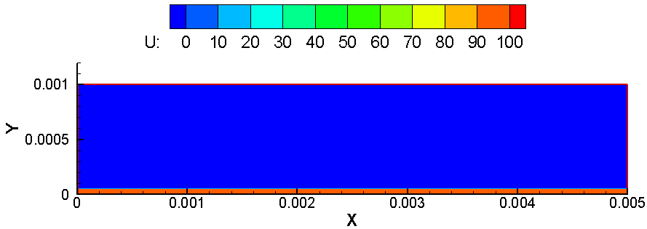
Results
Set Up 2 (iteration = 0 ):

Slide 16
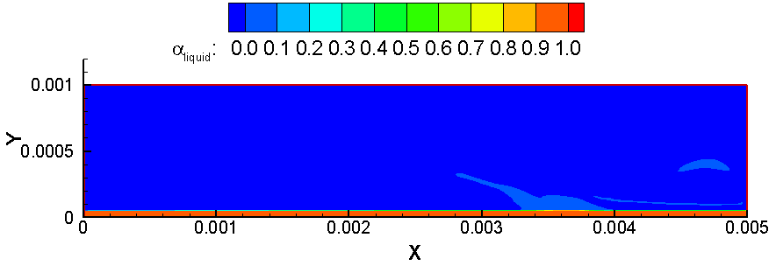
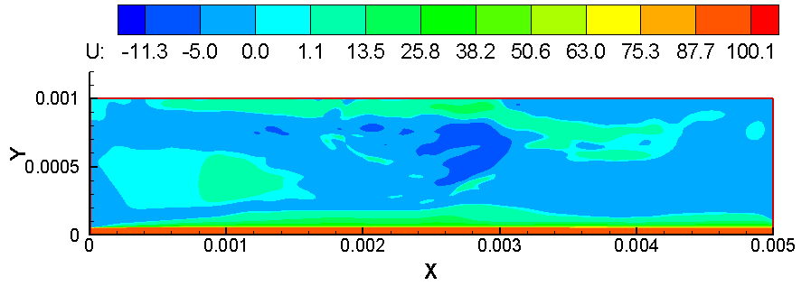
Results
Set Up 2 (iteration = 1500 ): :

Slide 17
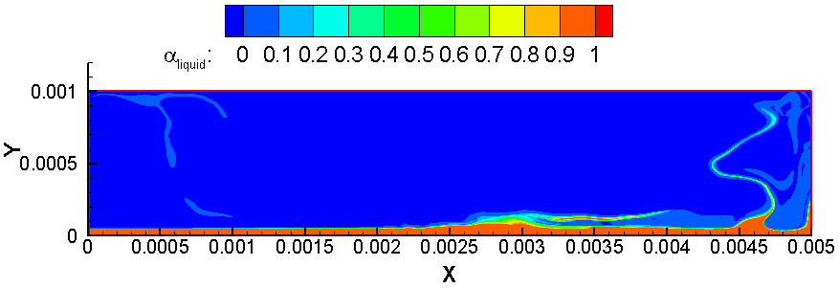
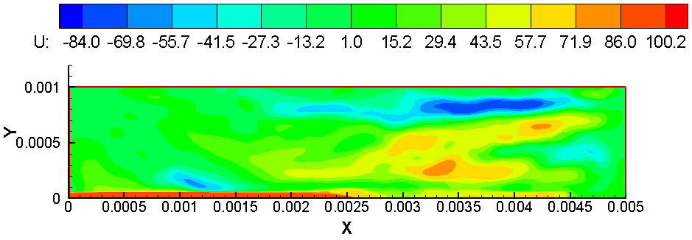
Results
Set Up 2 (iteration = 3500) :

Slide 18
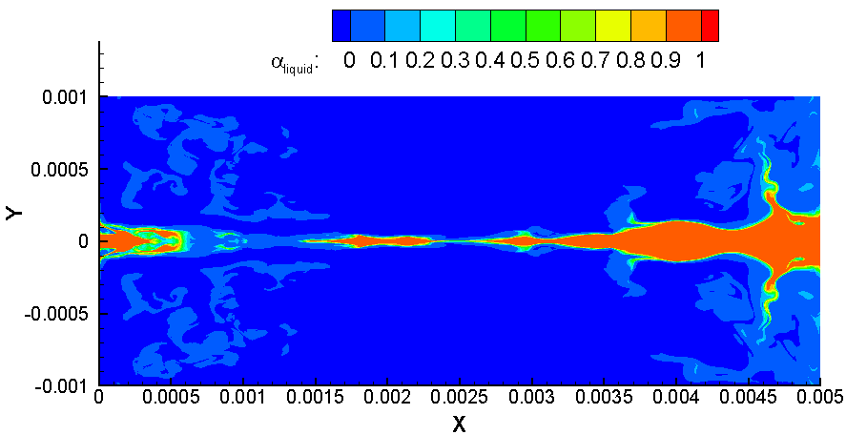
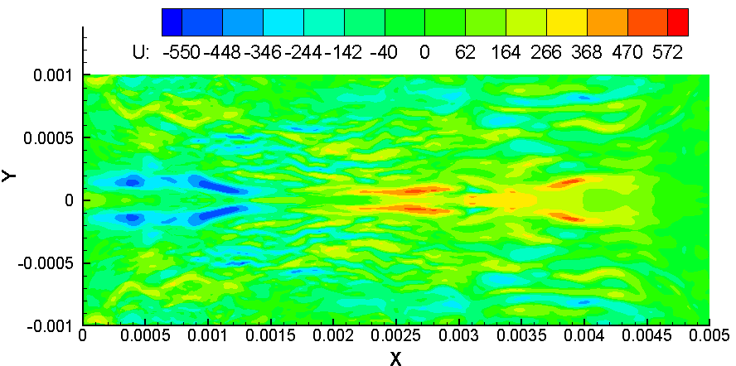
Results
Set Up 2 (iteration = 4500) :
Next:
Turn to Unsteady Simulation

Slide 19
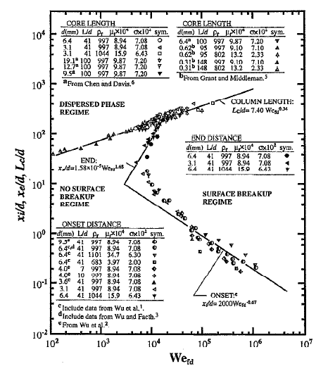
More Information
Considered Range:
Weber numbers (${We}_{fd}=ρ{du_{0}^{}}_{}^{2}/σ) :$
1.0X 10²- 1.1X1 0⁶;
Reynolds numbers (${Re}_{fd}=ρ_{f}{du_{0}^{}}_{}^{2}/μ_{f}$) : 3.4X10³-8.5X 10⁵ ;
Ohnesorge numbers (${OH}_{d}=μ_{f}/ρ_{f}dσ$) : 0.001-0.017.
[2] P-K Wu and G M Faeth, Onset and end of drop formation along the surface of turbulent liquid jets in still gases, Phys. Fluids, Vol. 7, No. 11, November 1995
Surface breakup regime map for turbulent liquid jets in still gases when aerodynamic effects are small (liquid/gas density ratios are larger than 500)^{[2]}

Slide 20
More Information
Problem # | $${We}_{fd}$$ | $${Re}_{fd}$$ | $${OH}_{d}$$ | $$x_{i}=2000{{We}_{fd} }^{−0.67}d$$ | $$x_{e}=1.58×{10}^{−5}{{We}_{fd} }^{1.68}d$$
Problem 1 | 2,904 | 50,000 | 0.001 | 9.568d | 10.387d
Problem 2 | 11,600 | 5,800 | 0.01857 | 3.783d | 106.4d
$$x_{i}:location of onset of turbulent breakup;$$
$$x_{e}:location of end of turbulent breakup.$$

