Slide 1
Updates: Two-Phase Jet Simulation
Yan Zhan
Feb. 13th 2014

Slide 2
Outlines
2D Simulation Of 1D Half-width Jet
3D Simulation Of 1D Half-width Jet
2D Simulation Of 3D Half-width Jet

Slide 3
Boundary Conditions & Mesh
L
wall
W
Pressure Inlet
axis
Velocity inlet
L
Velocity inlet
Wall
W
Pressure Inlet
Case | Width (W) | Length (L) | Grid # in x (Nx) | Grid # in y ( Ny) | Grid # in z ( Nz) | Total Grid # (Nt)
2D | 3D | 50D | 127 | 2120 | 1 | 269,240
 | 1D | 50D | 42 | 2120 | 1 | 89,040
3D | 3D | 50D | 40 | 100 | 2120 | 8,480,000

Slide 4
2D Simulation Of 1D Half-width Jet (Realizable k-e Model)
t = 5.6 ms

Slide 5
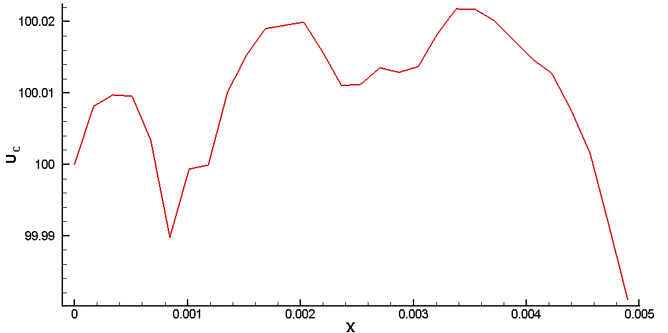
Results At t = 5.6 ms
Centerline Velocity ($U_{c}$)

Slide 6
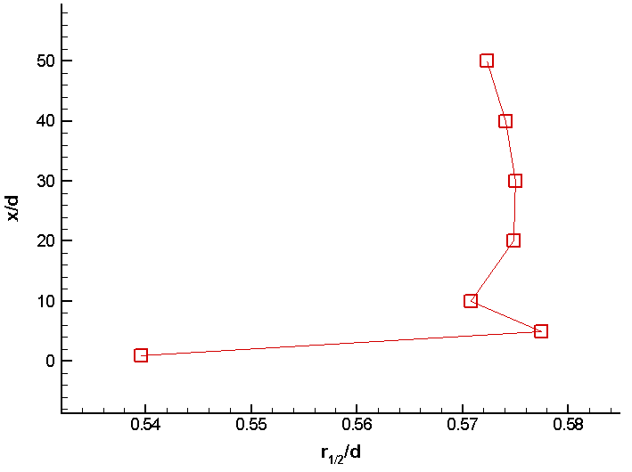
Results At t = 5.6 ms
Jet Half Width ( )
$x$/d | $r_{1/2}$/d
1 | 0.5396
5 | 0.57744
10 | 0.570829
20 | 0.574847
30 | 0.574978
40 | 0.574063
50 | 0.572267
Notes:
Half Width: Radial distance from the axis to the position at the which the absolute value of the axial velocity drops to half its value on the axis. The plot shows the relationship between jet half width and distance from the jet nozzle.

Slide 7
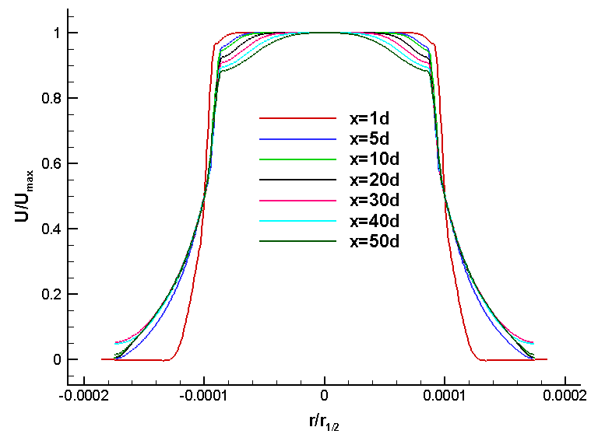
Results At t = 5.6 ms
Jet Self-similarity
Notes:
The plot shows the flow profile along the radial direction of the flow.

Slide 8
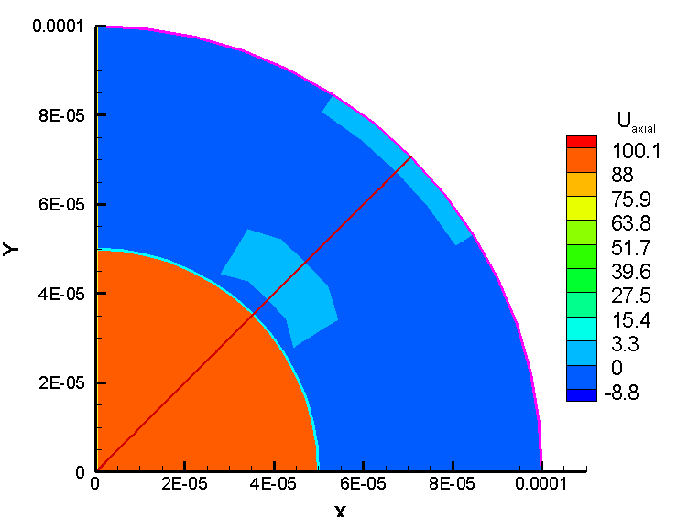
3D Simulation Of 1D Half-width Jet (Realizable k-e Model)
t = 1.75 ms

Slide 9
3D Simulation Of 1D Half-width Jet (Realizable k-e Model)

Slide 10
2D Simulation Of 3D Half-width Jet
Initialization (t = 0 s)

Slide 11
2D Simulation Of 3D Half-width Jet (click to watch the movie)
Laminar Model
(0 < t < 5.3 ms)

Slide 12
2D Simulation Of 3D Half-width Jet (click to watch the movie)

Slide 13
2D Simulation Of 3D Half-width Jet (click to watch the movie)

Slide 14
2D Simulation Of 3D Half-width Jet
t = 5.3 ms

Slide 15
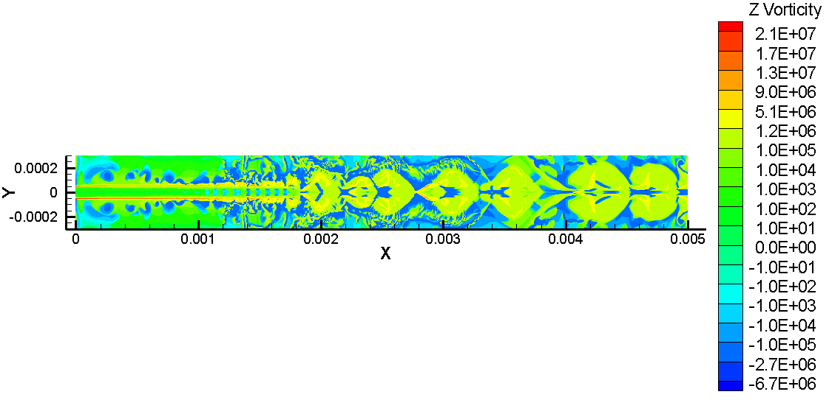
2D Simulation Of 3D Half-width Jet
t = 5.3 ms

Slide 16
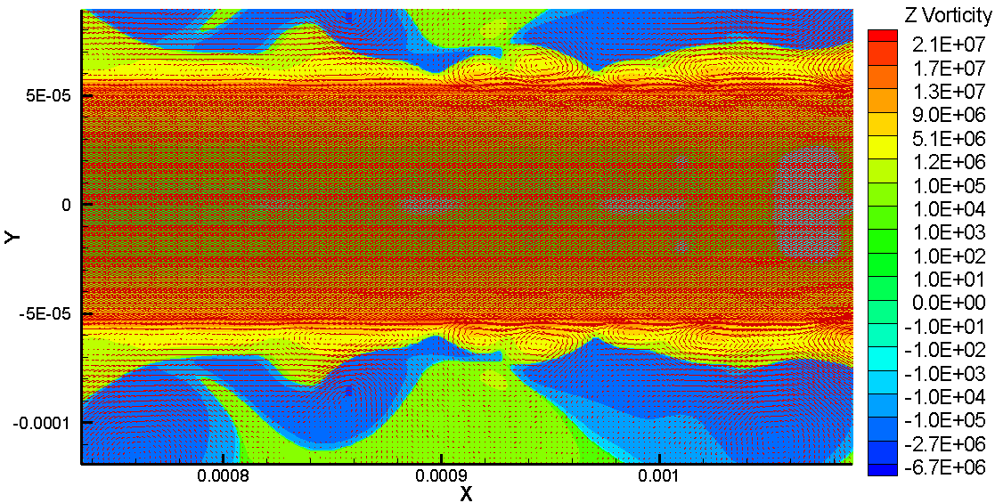
2D Simulation Of 3D Half-width Jet
t = 5.3 ms

Slide 17
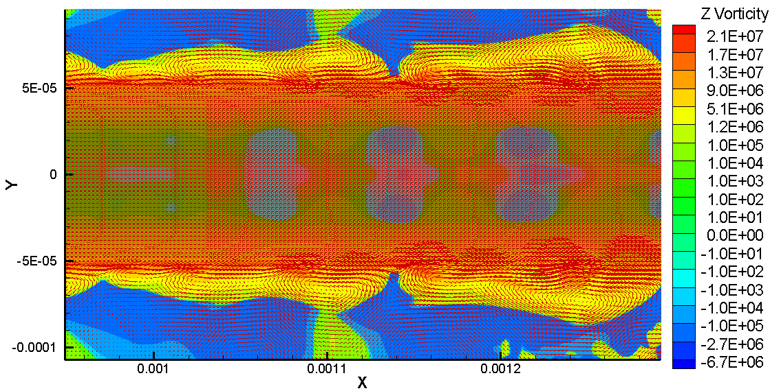
2D Simulation Of 3D Half-width Jet
t = 5.3 ms

Slide 18
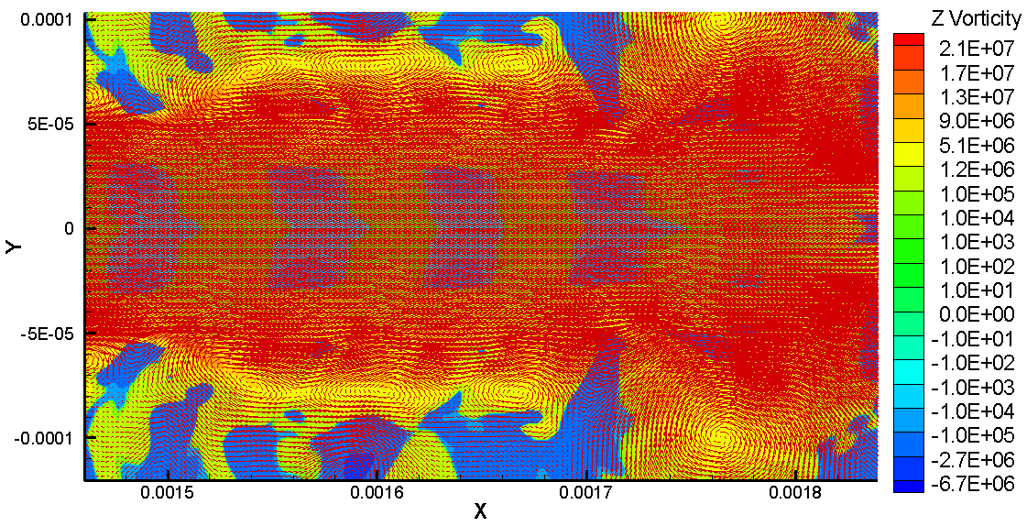
2D Simulation Of 3D Half-width Jet
t = 5.3 ms

