Slide 1
Implicit LES Simulation of Two-phase Turbulent Jet Flow
Feb. 27th 2014
Yan

Slide 2
Studied Problems
Implicit LES simulation on 2D mesh with radius = N-jet-diameters, for N = 3,5,7
VOF Multiphase Model
CLSVOF Multiphase Model
L
y
wall
W
Pressure Inlet
z
axis
Velocity inlet
Width (W) | Length (L) | Grid # in z (Nz) | Grid # in y (Ny) | Total Grid # (Nt)
3D | 50D | 2120 | 127 | 269,240
5D | 50D | 2120 | 212 | 449,440
7D | 50D | 2120 | 297 | 629,640

Slide 3
Results ---- 3-Jet-Diameter Case
Initialization (t = 0 s)
VOF
Z
Z

Slide 4
Results ---- 3-Jet-Diameter Case (click to watch the movie)
VOF
0 < t < 5.3 ms
Z
Z

Slide 5
Results ---- 3-Jet-Diameter Case (click to watch the movie)
Z

Slide 6
Results ---- 3-Jet-Diameter Case
VOF
t = 5.3 ms
Z
$location of onset of turbulent breakup$ ≈ 14 jet diameters
Z

Slide 7
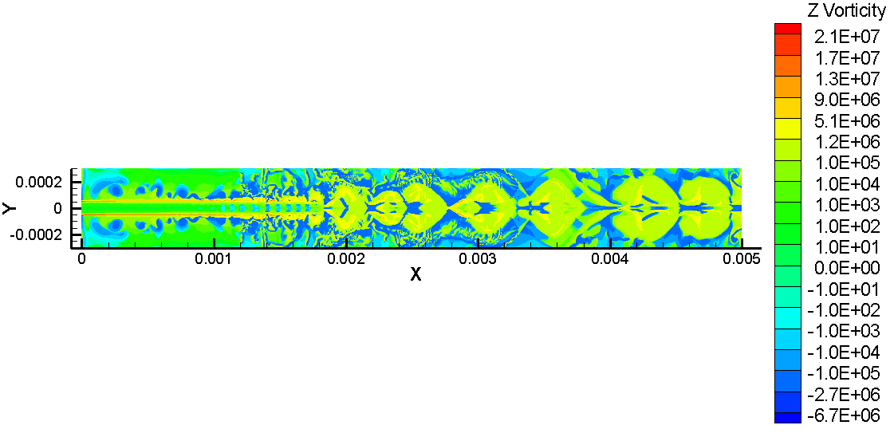
Results ---- 3-Jet-Diameter Case
VOF
t = 5.3 ms
Z

Slide 8
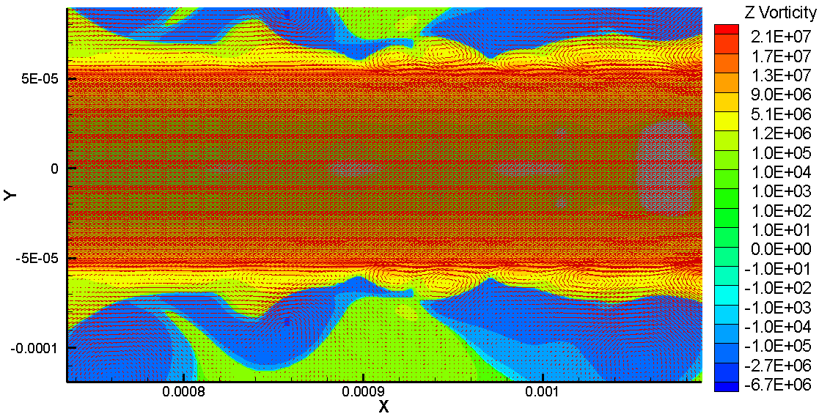
Results ---- 3-Jet-Diameter Case
VOF
t = 5.3 ms
Z

Slide 9
Results ---- 3-Jet-Diameter Case
Initialization (t = 0 s)
CLSVOF
Z
Z
Z
Z

Slide 10
Results ---- 3-Jet-Diameter Case (click to watch the movie)
CLSVOF
0 < t < 3.75 ms
Z
Z

Slide 11
Results ---- 3-Jet-Diameter Case (click to watch the movie)
CLSVOF
0 < t < 3.75 ms
Z

Slide 12
Results ---- 3-Jet-Diameter Case
CLSVOF
t = 3.75 ms
Z
$location of onset of turbulent breakup$ ≈ 1.6 jet diameters
Z

Slide 13
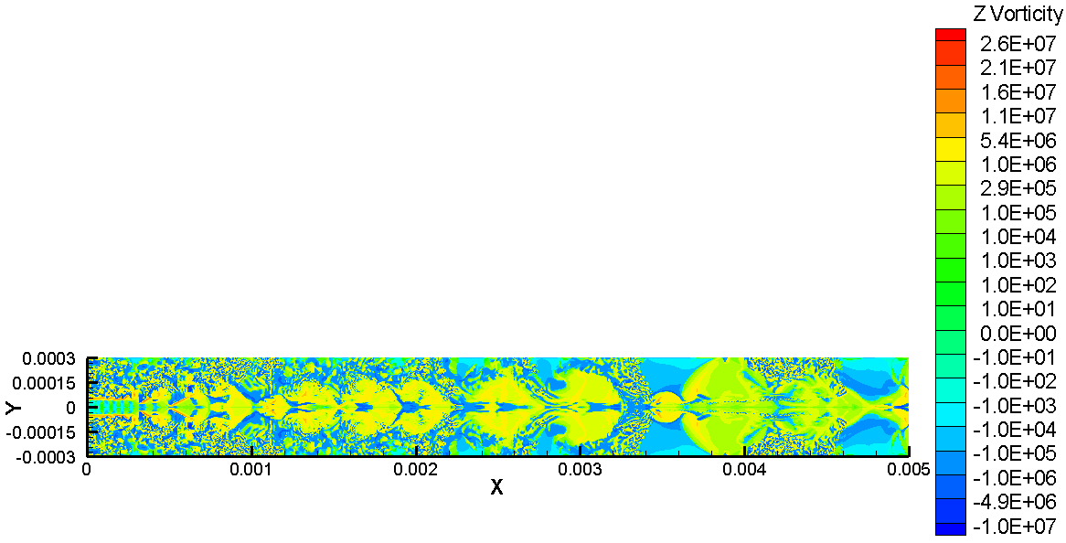
Results ---- 3-Jet-Diameter Case
CLSVOF
t = 3.75 ms
Z

Slide 14
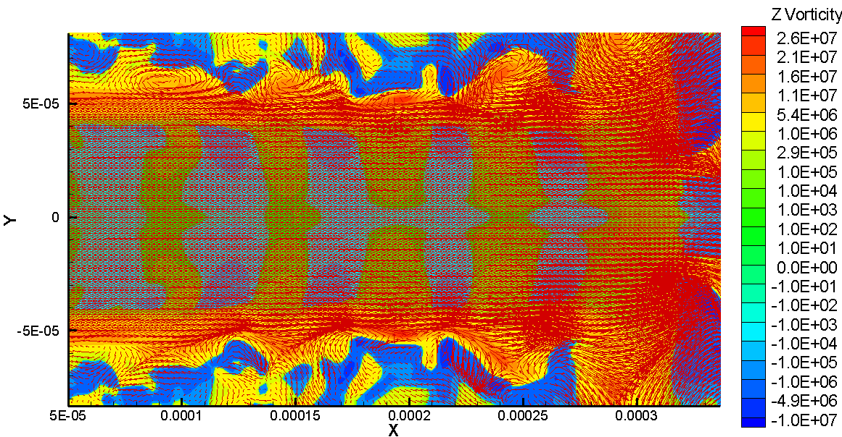
Results ---- 3-Jet-Diameter Case
CLSVOF
t = 3.75 ms
Z

Slide 15
Results ---- 5-Jet-Diameter Case (click to watch the movie)
VOF
0 < t < 3 ms
Z
Z

Slide 16
Results ---- 5-Jet-Diameter Case (click to watch the movie)
0 < t < 3 ms
Z

Slide 17
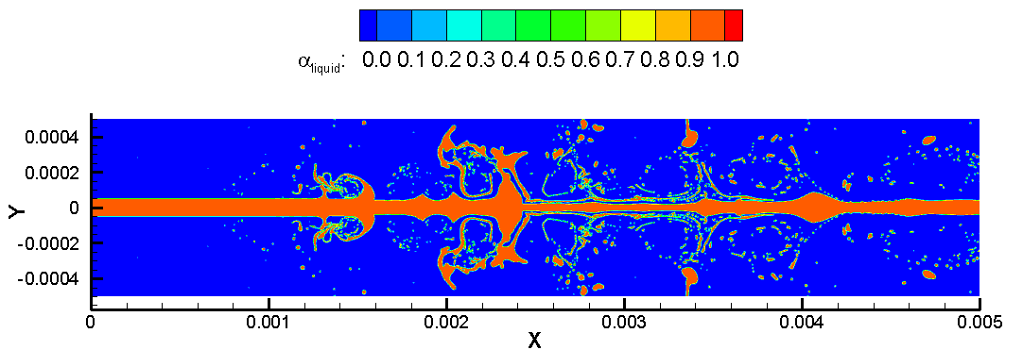
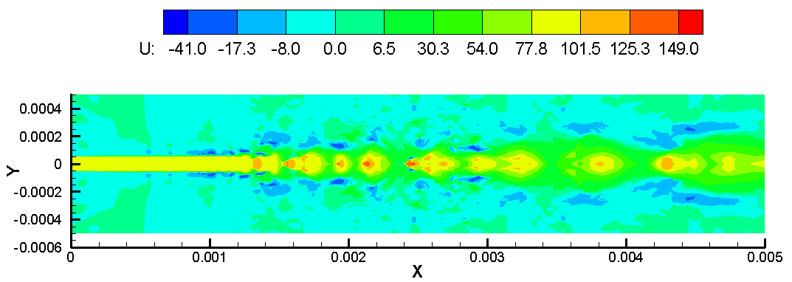
Results ---- 5-Jet-Diameter Case
VOF
t = 3 ms
Z
$location of onset of turbulent breakup$ ≈ 11.6 jet diameters
Z

Slide 18
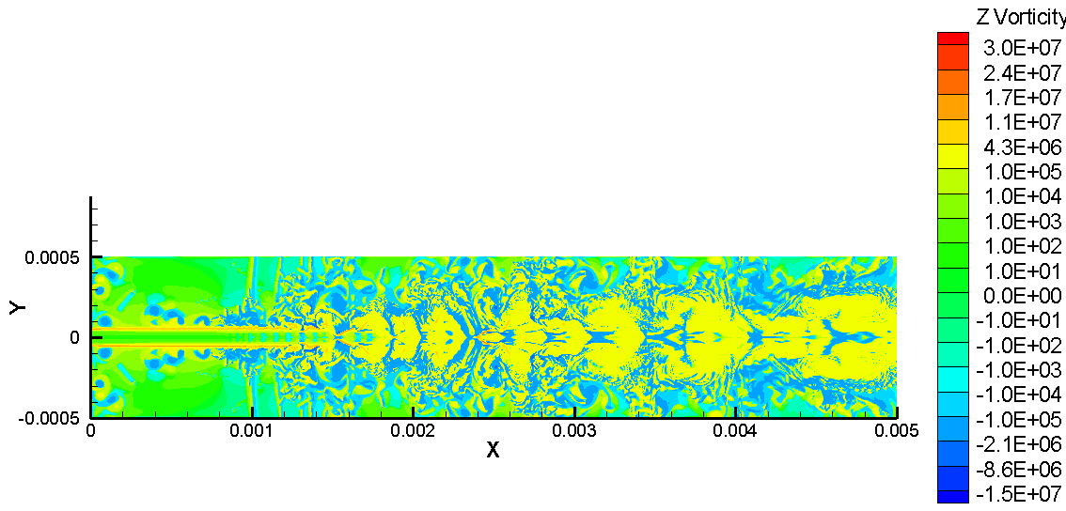
Results ---- 5-Jet-Diameter Case
VOF
t = 3 ms
Z

Slide 19
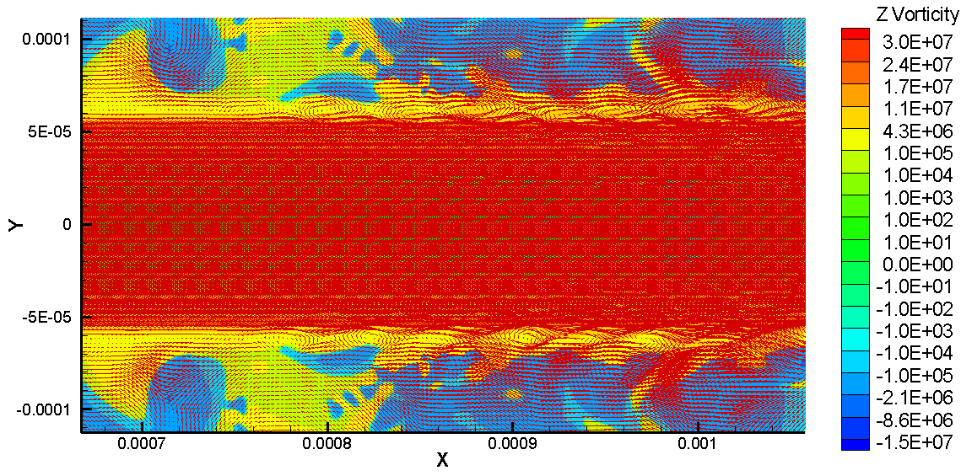
Results ---- 5-Jet-Diameter Case
VOF
t = 3 ms
Z

Slide 20
Results ---- 5-Jet-Diameter Case (click to watch the movie)
CLSVOF
0 < t < 3 ms

Slide 21
Results ---- 5-Jet-Diameter Case (click to watch the movie)
0 < t < 2.25 ms
Z

Slide 22
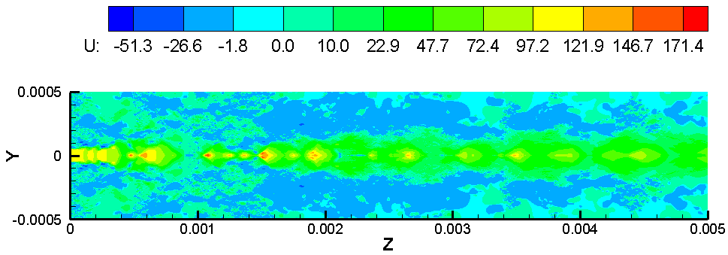
Results ---- 5-Jet-Diameter Case
CLSVOF
t = 3 ms
Z
$location of onset of turbulent breakup$ ≈ 0.4 jet diameters
Z

Slide 23
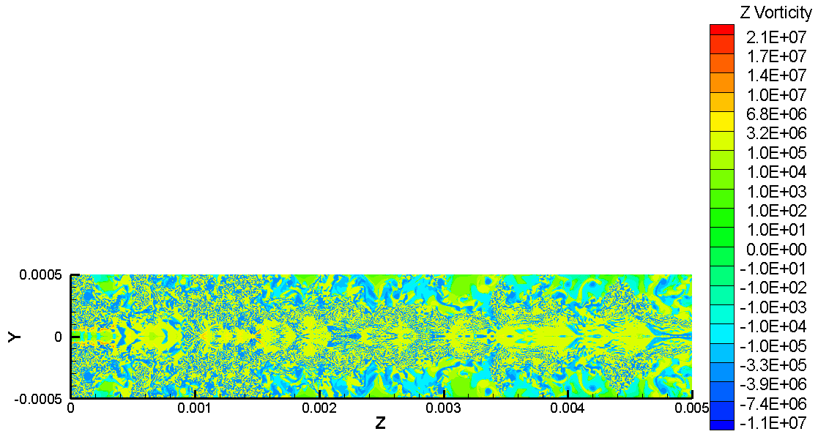
Results ---- 5-Jet-Diameter Case
CLSVOF
t = 3 ms

Slide 24
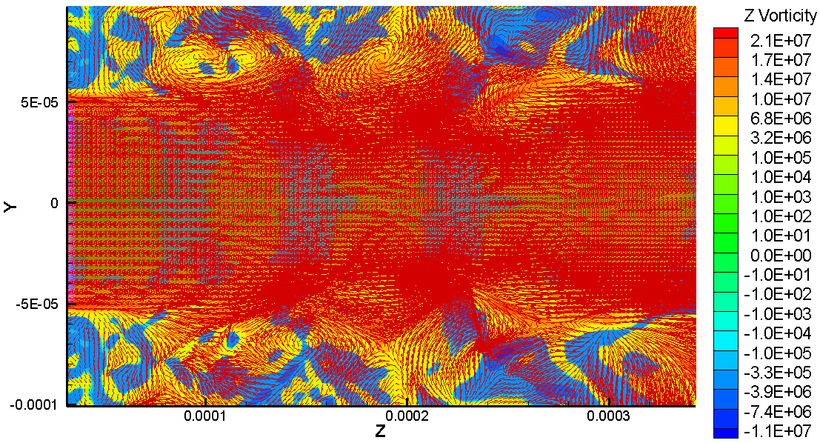
Results ---- 5-Jet-Diameter Case
CLSVOF
t = 3 ms
Z

Slide 25
Results ---- 7-Jet-Diameter Case (click to watch the movie)
0 < t < 1.75 ms
VOF

Slide 26
Results ---- 7-Jet-Diameter Case (click to watch the movie)
0 < t < 1.75 ms

Slide 27
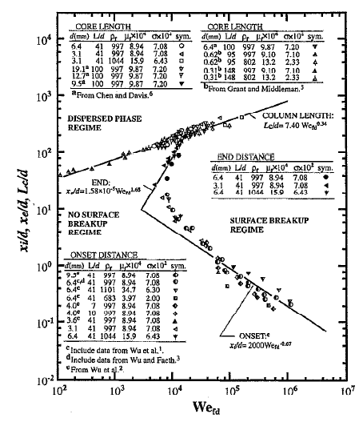
Hand Calculation
Considered Range:
Weber numbers (${We}_{fd}=ρ{du_{0}^{}}_{}^{2}/σ) :$
1.0X 10²- 1.1X1 0⁶;
Reynolds numbers (${Re}_{fd}=ρ_{f}{du_{0}^{}}_{}^{2}/μ_{f}$) : 3.4X10³-8.5X 10⁵ ;
Ohnesorge numbers (${OH}_{d}=μ_{f}/ρ_{f}dσ$) : 0.001-0.017.
[2] P-K Wu and G M Faeth, Onset and end of drop formation along the surface of turbulent liquid jets in still gases, Phys. Fluids, Vol. 7, No. 11, November 1995
Surface breakup regime map for turbulent liquid jets in still gases when aerodynamic effects are small (liquid/gas density ratios are larger than 500)^{[2]}

Slide 28
Hand Calculation
$${We}_{fd}$$ | $${Re}_{fd}$$ | $${OH}_{d}$$ | $$x_{i}=2000{{We}_{fd} }^{−0.67}d$$ | $$x_{e}=1.58×{10}^{−5}{{We}_{fd} }^{1.68}d$$
11,600 | 5,800 | 0.01857 | 3.783d | 106.4d
$$x_{i}:location of onset of turbulent breakup;$$
$$x_{e}:location of end of turbulent breakup,$$
d: jet diameter.
Case | $$x_{i}$$
3-Jet-Diameter VOF | 14d
3-Jet-Diameter CLSVOF | 1.6d
5-Jet-Diameter VOF | 11.6d
5-Jet-Diameter CLSVOF | 0.4d
7-Jet-Diameter VOF | Not Completed

