Slide 1
Simulation Of 2D Hg Jet Using
Implicit LES Method
Yan
March. 27th 2014

Slide 2
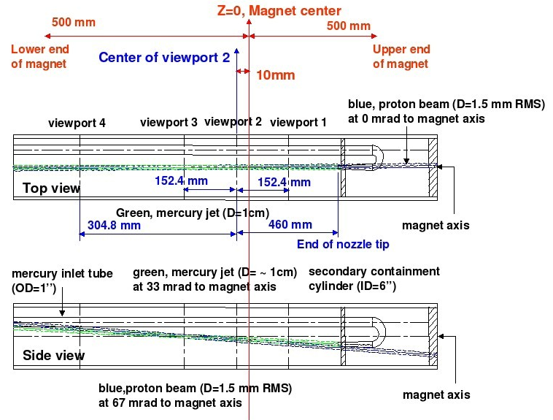
Problem Description
Sketch of the mercury free jet with MHD and energy deposition for the MERIT experiment

Slide 3
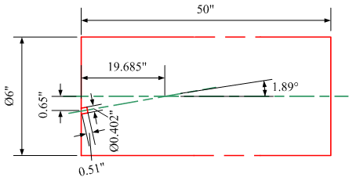
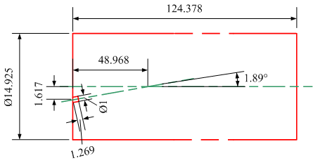
Numerical Calculation
(a)
(b)
The Side view of Hg Jet Flow Draft (a) In Dimension (b) Normalized By Jet Exit Diameter
  Determination of the mesh size:
Assume only primary breakup, the critical liquid Weber number is less than 10, then Δx < 0.89 μm. Then mesh grid number would be 2.444e+11 when mesh is uniform.
Phase | Density | Viscosity | Surface Tension
Air | 1.225 kg/m³ | 1.460735 m²/s | 0.4855 N/m
Mercury | 13456 kg/m³ | 1.1147×10⁻⁷ m²/s
Jet velocity = 20 m/s (fully developed), D_{h}= 0.0102108 m, Re_{Hg} = 1812785.017.

Slide 4

Numerical Calculation
Simplified Model For Preliminary Simulation
Grid number for halved model is 1,976,968 (width = 172, length = 11,494, Δx ≈ 4.437e-5 m).
One flow-through = 0.0255 s.
Velocity profile at the inlet
Notes:
http://geolab.larc.nasa.gov/APPS/YPlus/#REN
Operating pressure: (-1.341121, -0.1231579)
x=-0.07112101
y=-0.07367868~ -0.0634679 (center:-0.06857329)
d=0.0102108 m, u=20 m/s:
Re=13546*20*0.0102108/0.001526=1812785.017
X=0
Y=-0.0267208~ -0.01651 (center:-0.0216154)
dX=-0.07112101
dY=-0.04695789

Slide 5
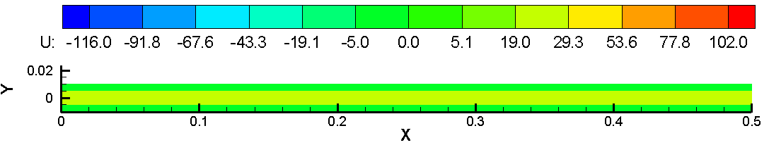
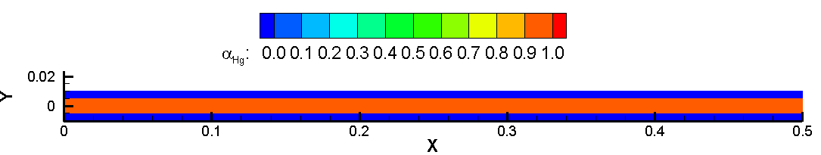
Results
[click to watch movie]
0 < t < 0.0225 s

