Slide 1
Discussion: 3 D Hg Jet Simulation
Yan Zhan
May 15, 2014

Slide 2
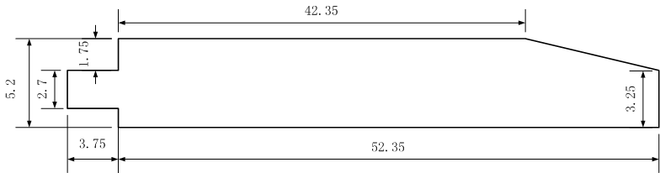
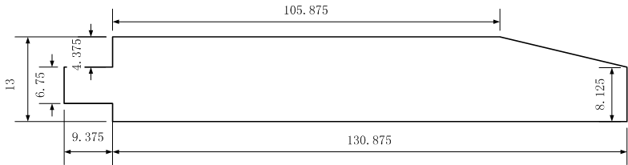
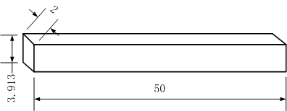
Simplification Of The 3D Hg Jet
dimensional model
(unit: inch)
Non-dimensional model
(normalized by D_{jet exit} )
Simplified model
(normalized by D_{jet exit} )

Slide 3
Boundary Conditions
Wall
Wall
Velocity Inlet
Pressure Outlet
X
symmetry
Z
Y
Normalized by D_{jet exit} ,which is 0.01 meter. No gravity in the model.
unit: meter
pipe simulation
u = U + sqrt(2k/3),
where k = ½( (u’)^2+(v’)^2+(w’)^2 )
x
Axial Velocity Contour At The Jet Inlet

Slide 4
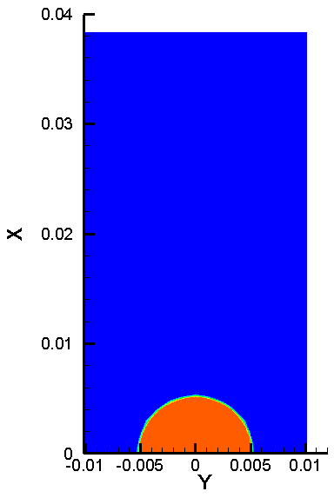
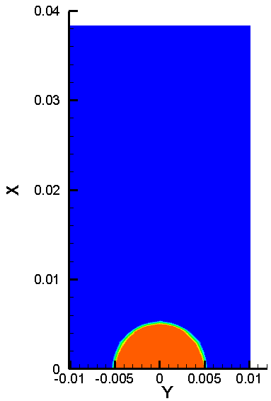
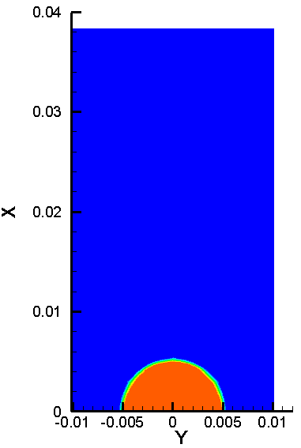



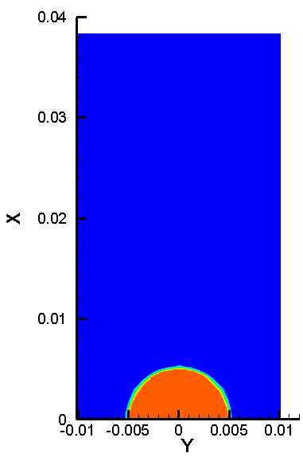
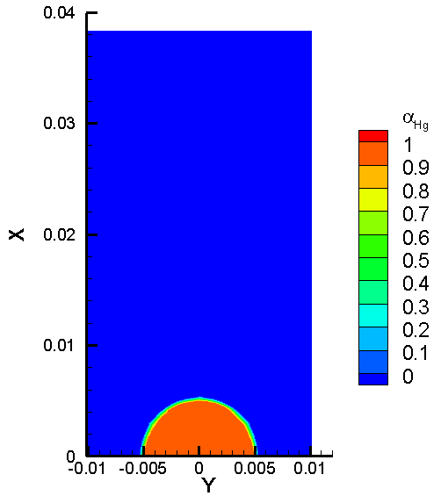
Results of α_{Hg} at t = 0 ms
(1) z = 0 cm
(2) z = 1 cm
(3) z = 5 cm
(4) z = 10 cm
(5) z = 15 cm
(6) z = 60 cm
(7) z = 30 cm
(8) z = 45 cm
Contour of α_{Hg} at
different z location:
(1)z= 0 cm (2)z = 1 cm
(3)z = 5 cm (4)z = 10 cm
(5)z = 15 cm (6)z = 20 cm
(7)z = 30 cm (8) z = 45 cm.
Note z = 30 and 45 cm
refer to the location
of viewport 2 and 3,
respectively.

Slide 5
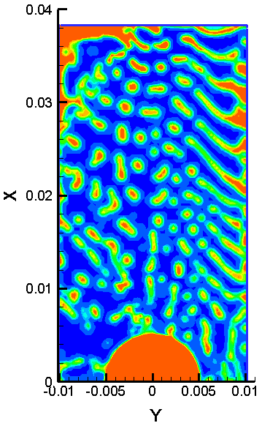
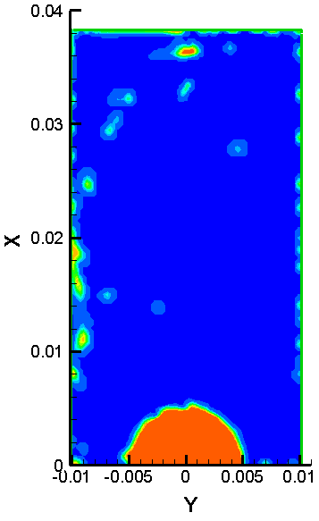
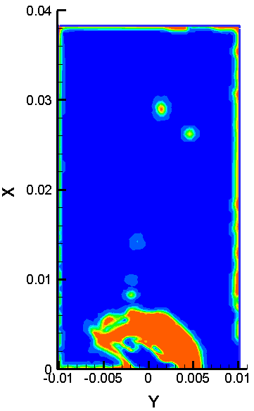
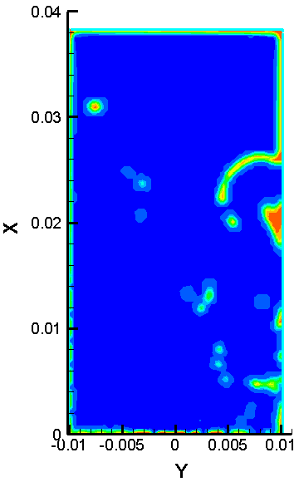
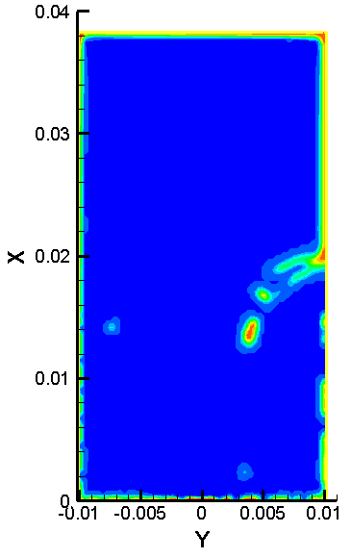
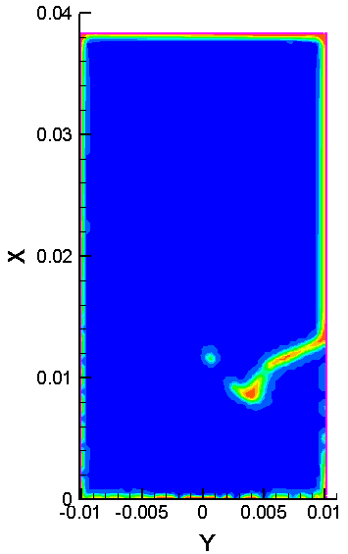
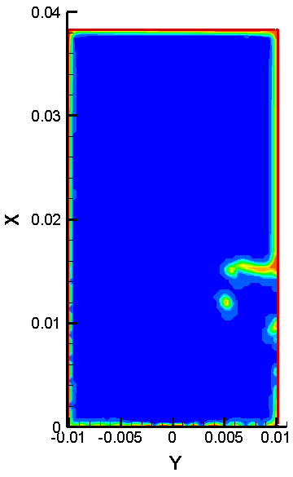
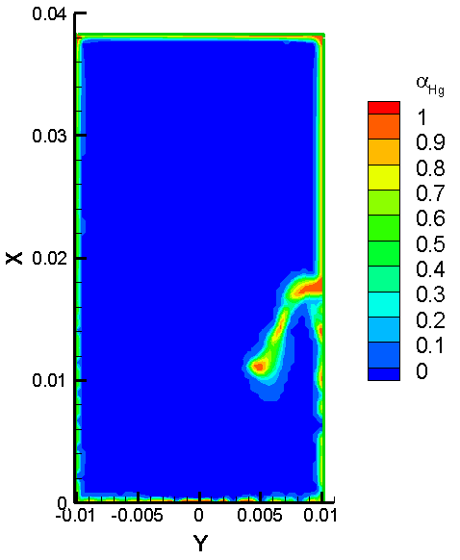
Results of α_{Hg} at t = 4.8 ms (1/5 time through)
(1)
(2)
(3)
(4)
(5)
(6)
(7)
(8)
Contour of α_{Hg} at
different z location:
(1)z= 0 cm (2)z = 1 cm
(3)z = 5 cm (4)z = 10 cm
(5)z = 15 cm (6)z = 20 cm
(7)z = 30 cm (8) z = 45 cm.
Note z = 30 and 45 cm
refer to the location
of viewport 2 and 3,
respectively.

Slide 6
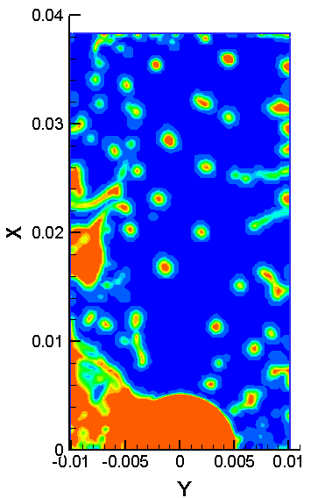
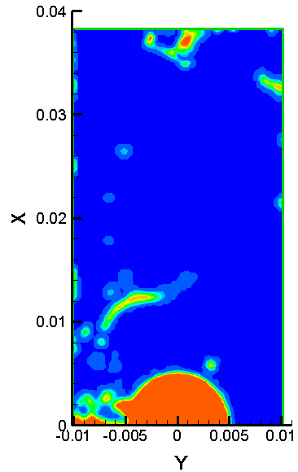
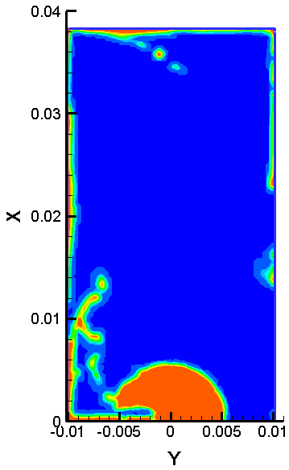
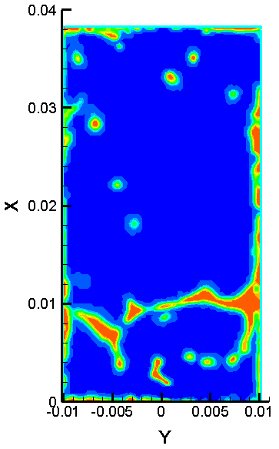
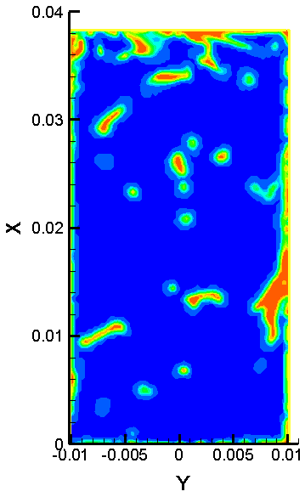
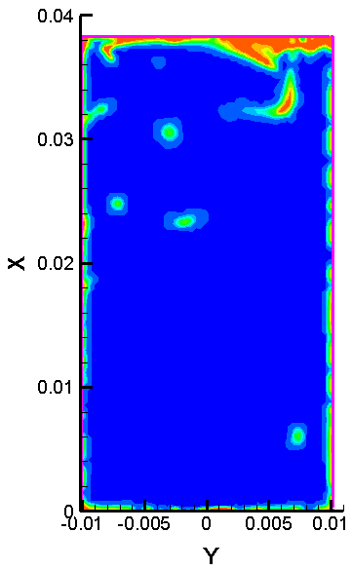
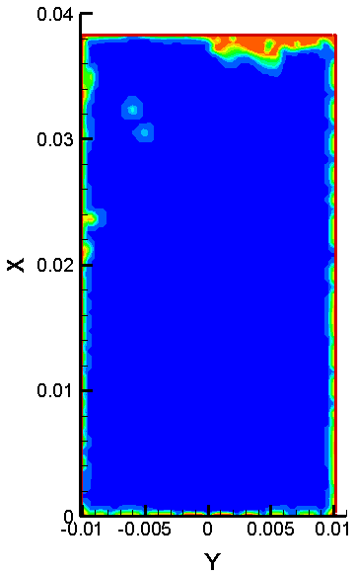
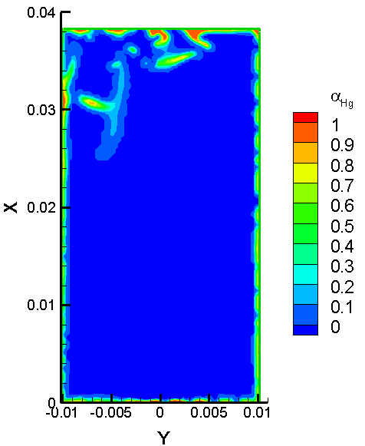
Results of α_{Hg} at t = 9.6 ms (2/5 time through)
(1)
(2)
(3)
(4)
(5)
(6)
(7)
(8)
Contour of α_{Hg} at
different z location:
(1)z= 0 cm (2)z = 1 cm
(3)z = 5 cm (4)z = 10 cm
(5)z = 15 cm (6)z = 20 cm
(7)z = 30 cm (8) z = 45 cm.
Note z = 30 and 45 cm
refer to the location
of viewport 2 and 3,
respectively.

Slide 7
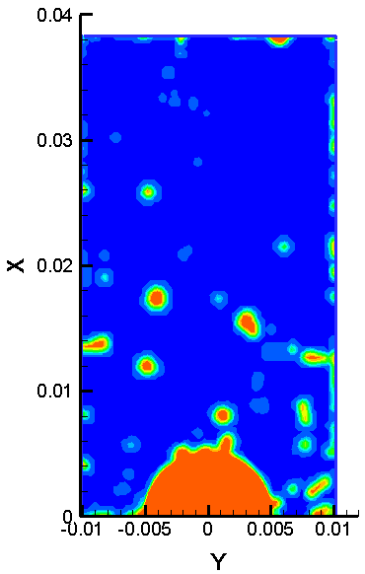
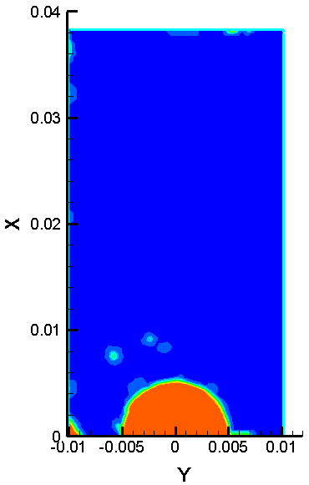
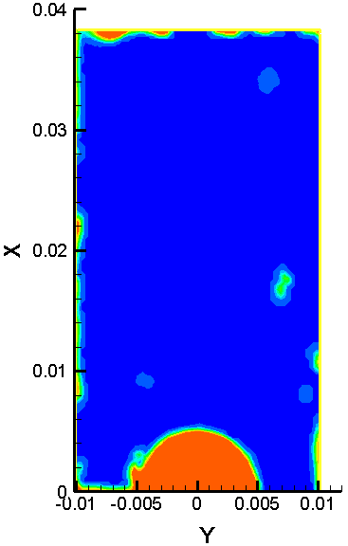
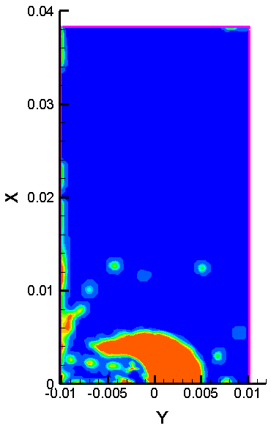
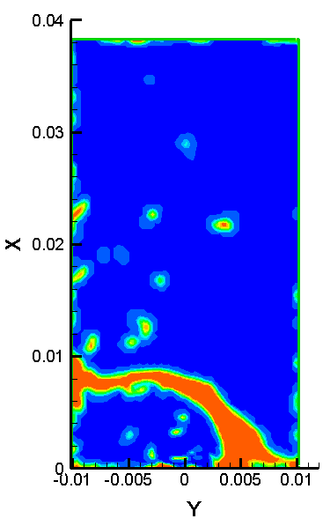
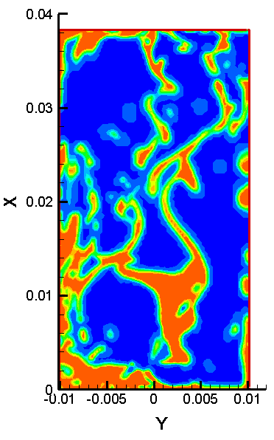
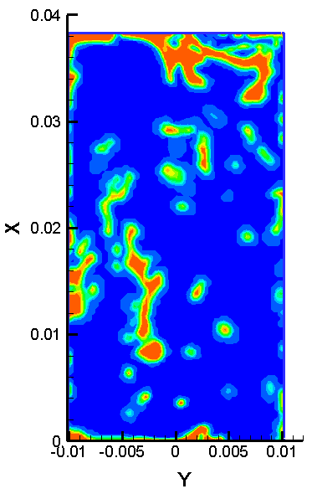
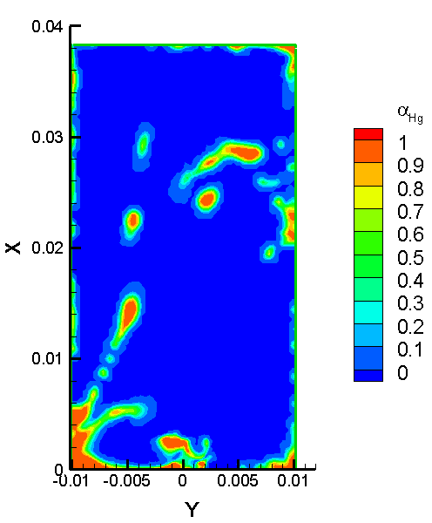
Results of α_{Hg} at t = 25 ms (one time through)
(1)
(2)
(3)
(4)
(5)
(6)
(7)
(8)
Contour of α_{Hg} at
different z location:
(1)z= 0 cm (2)z = 1 cm
(3)z = 5 cm (4)z = 10 cm
(5)z = 15 cm (6)z = 20 cm
(7)z = 30 cm (8) z = 45 cm.
Note z = 30 and 45 cm
refer to the location
of viewport 2 and 3,
respectively.

