Slide 1
Discussion: 3 D Hg Jet Simulation
Yan Zhan
May 17, 2014

Slide 2
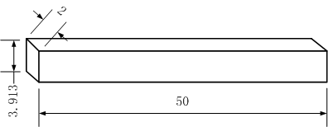
Simplification Of The 3D Hg Jet
dimensional model
(unit: inch)
Non-dimensional model
(normalized by D_{jet exit} )
Simplified model
(normalized by D_{jet exit} )

Slide 3
Boundary Conditions
Wall
Wall
Velocity Inlet
Pressure Outlet
X
symmetry
Z
Y
Normalized by D_{jet exit} ,which is 0.01 meter. No gravity in the model.
unit: meter
pipe simulation
u = U + sqrt(2k/3),
where k = ½( (u’)^2+(v’)^2+(w’)^2 )
X
Y
Axial Velocity Contour At The Jet Inlet

Slide 4
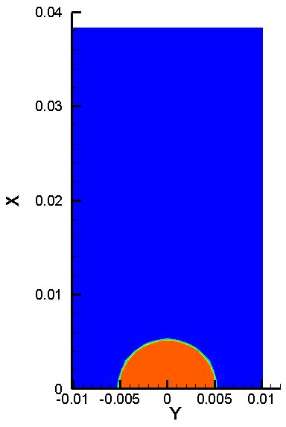
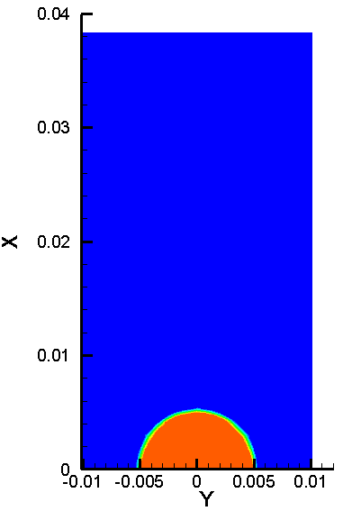
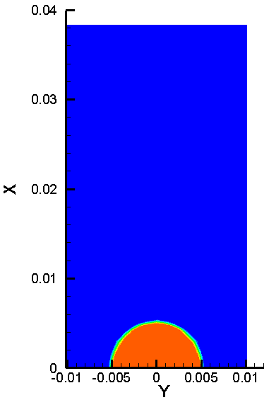
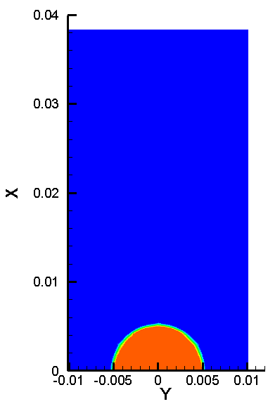
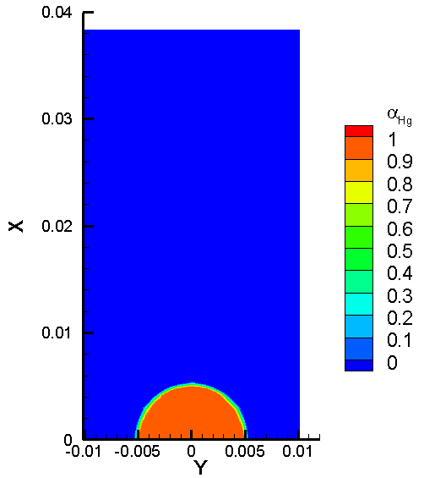
Results of α_{Hg} at t = 0 ms
z= 0 cm
z = 1 cm
z = 5 cm
z = 10 cm
z = 15 cm
z = 20 cm
z = 30 cm
z = 45 cm

Slide 5
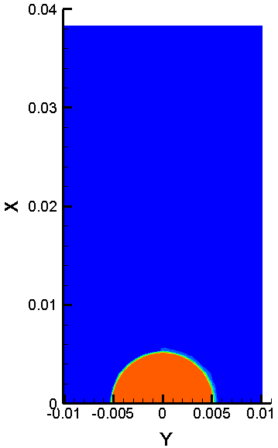
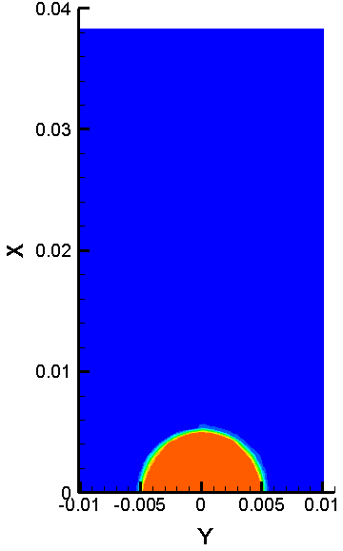
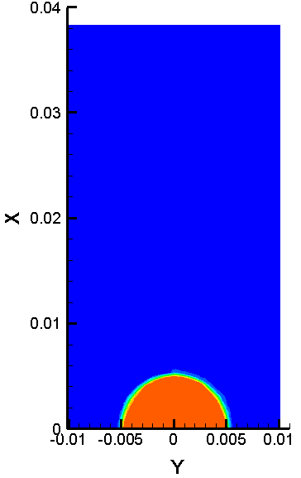
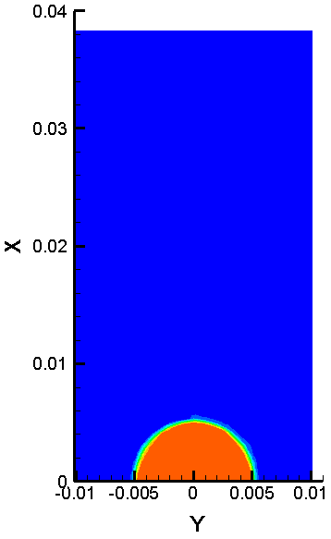
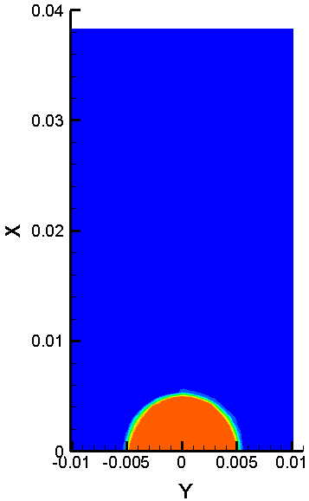
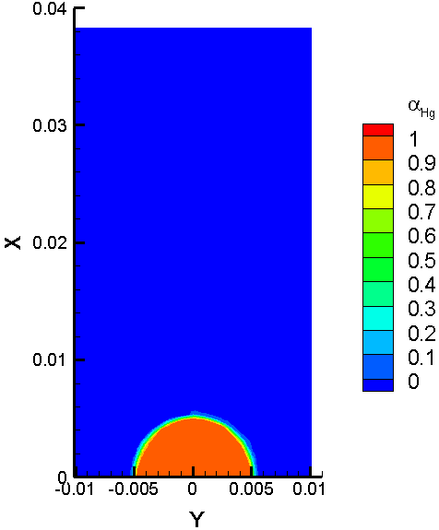
Results of α_{Hg} at t = 0.2 μs (one time step)
z= 0 cm
z = 1 cm
z = 5 cm
z = 10 cm
z = 15 cm
z = 20 cm
z = 30 cm
z = 45 cm

Slide 6
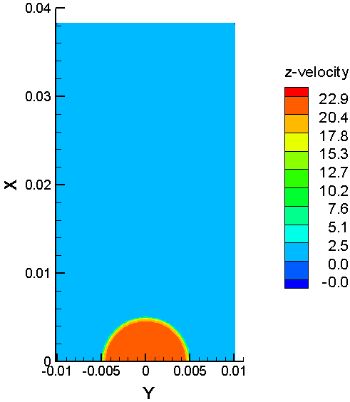
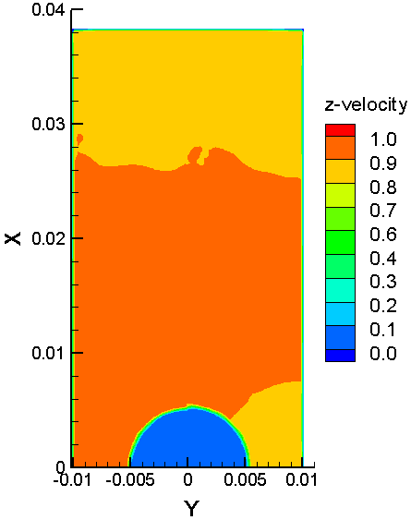
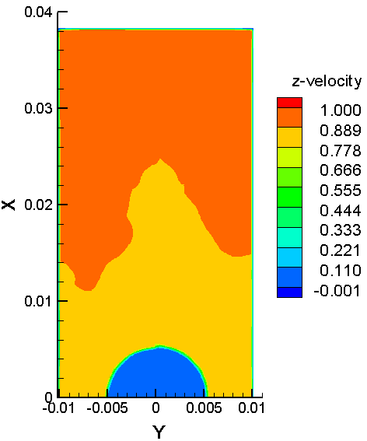
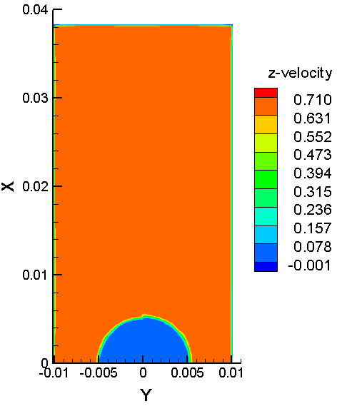
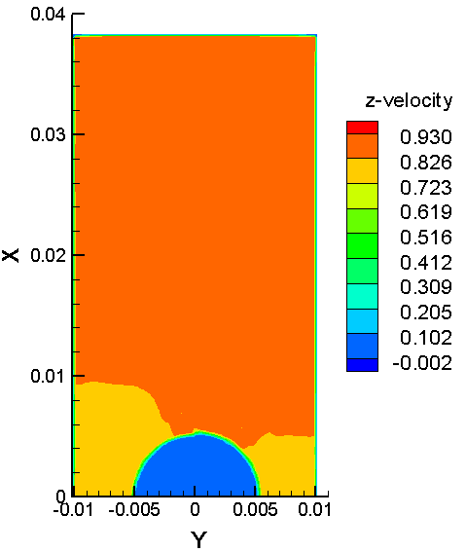
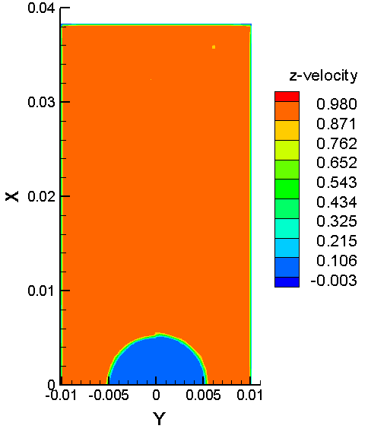
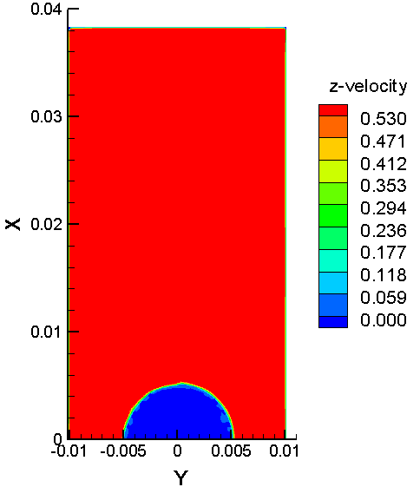
Results of u_{z} at t = 0.2 μs (one time step)
z= 0 cm
z = 1 cm
z = 5 cm
z = 10 cm
z = 15 cm
z = 20 cm
z = 30 cm
z = 45 cm

Slide 7
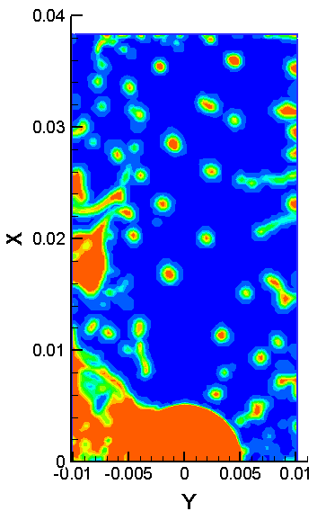
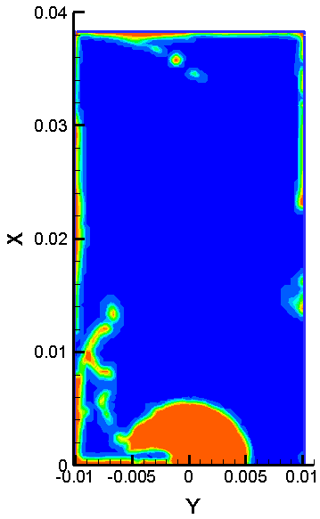
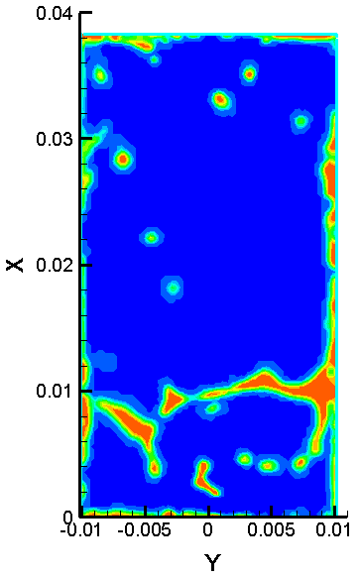
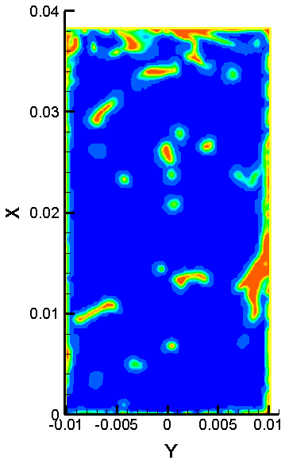
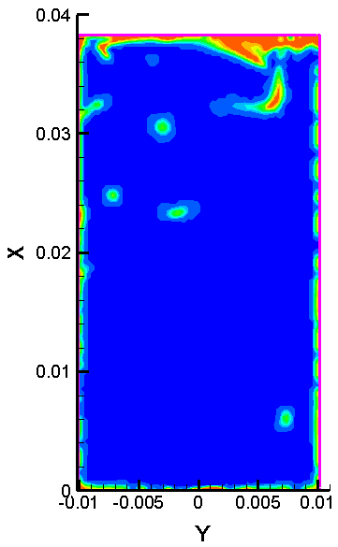
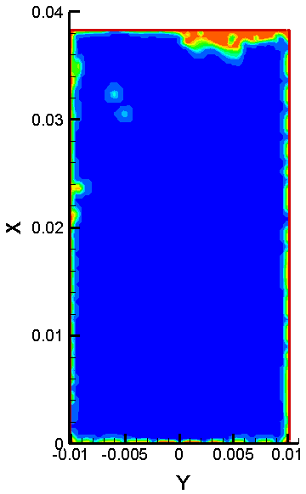
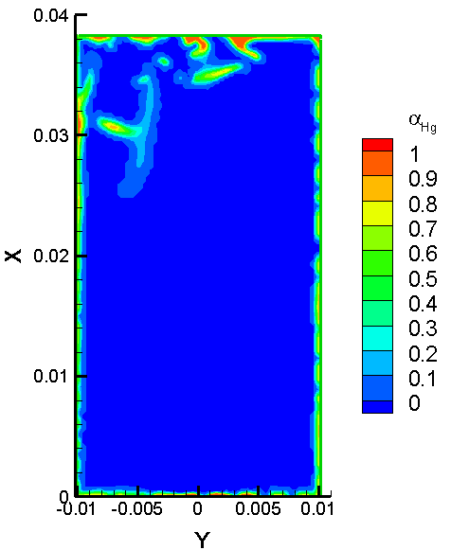
Results of α_{Hg} at t = 9.6 ms
z= 0 cm
z = 1 cm
z = 5 cm
z = 10 cm
z = 15 cm
z = 20 cm
z = 30 cm
z = 45 cm

Slide 8
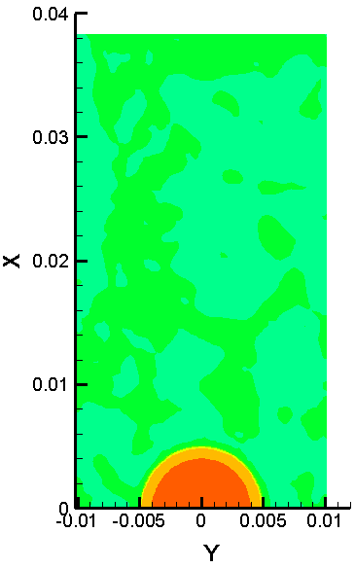
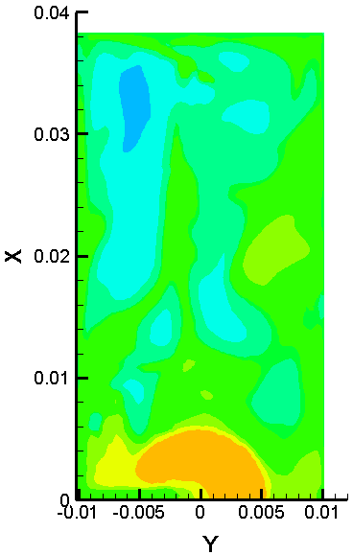
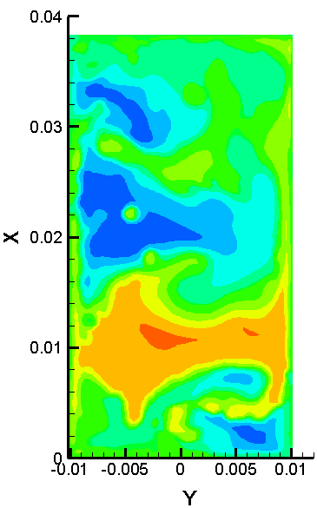
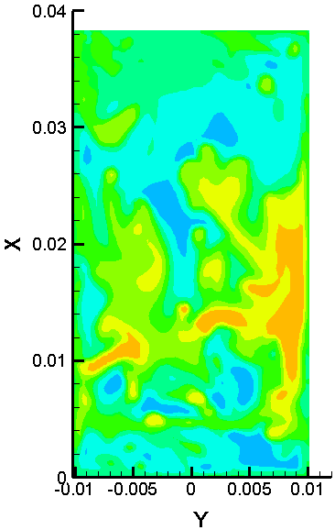
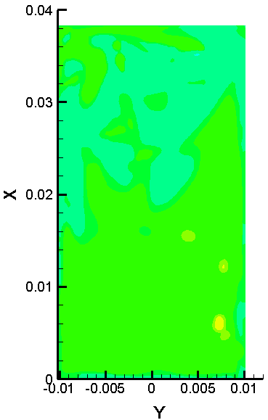
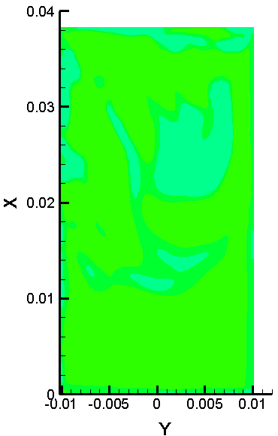
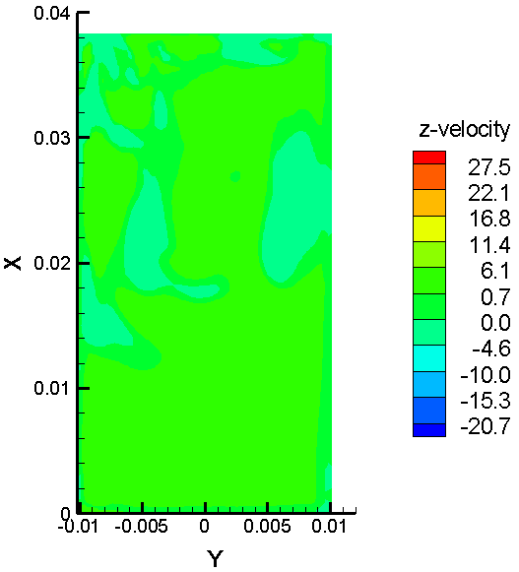
Results of u_{z} at t = 9.6 ms
z= 0 cm
z = 1 cm
z = 5 cm
z = 10 cm
z = 15 cm
z = 20 cm
z = 30 cm
z = 45 cm

Slide 9
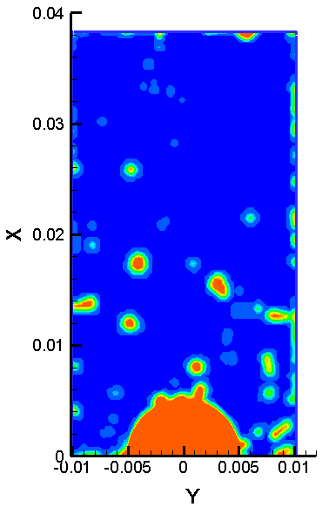
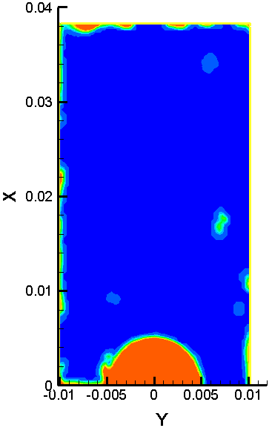
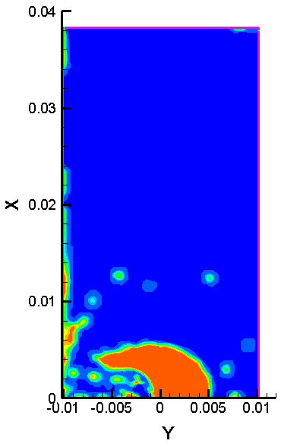
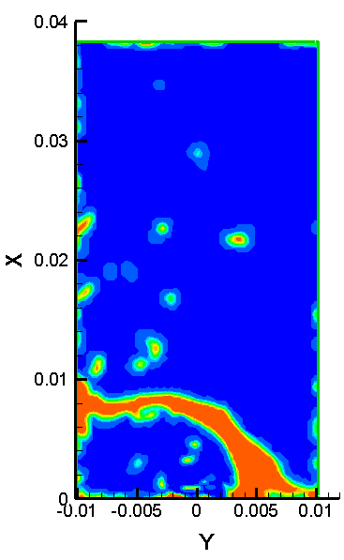
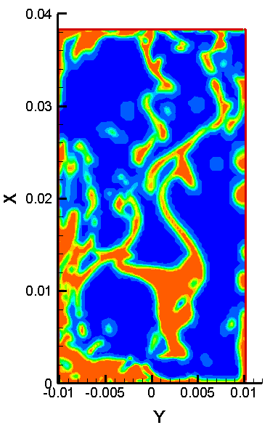
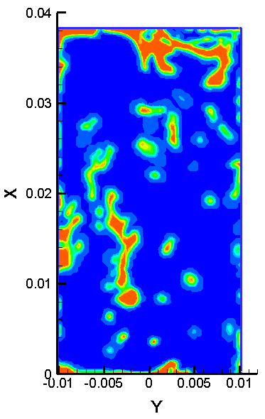
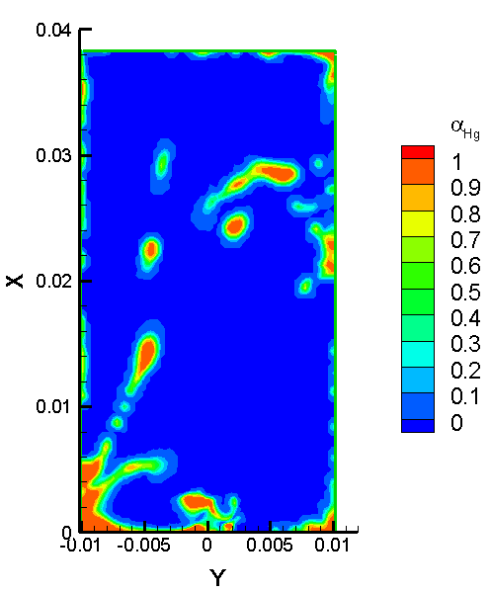
Results of α_{Hg} at t = 25 ms (one time through)
z= 0 cm
z = 1 cm
z = 5 cm
z = 10 cm
z = 15 cm
z = 20 cm
z = 30 cm
z = 45 cm

Slide 10
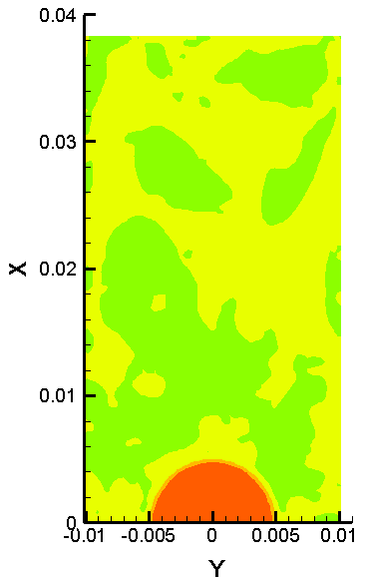
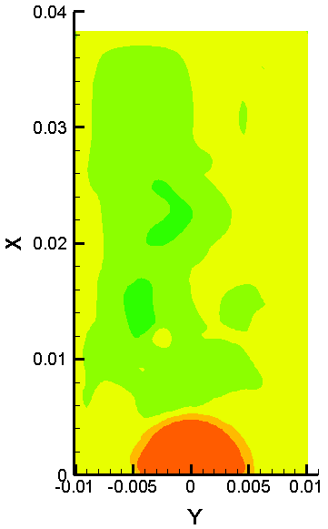
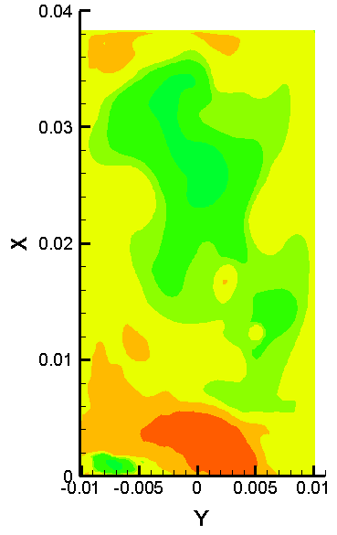
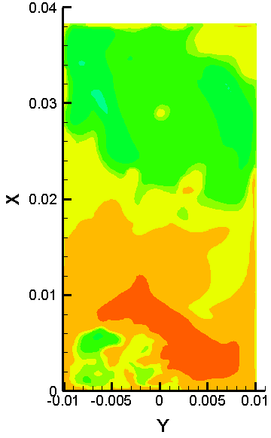
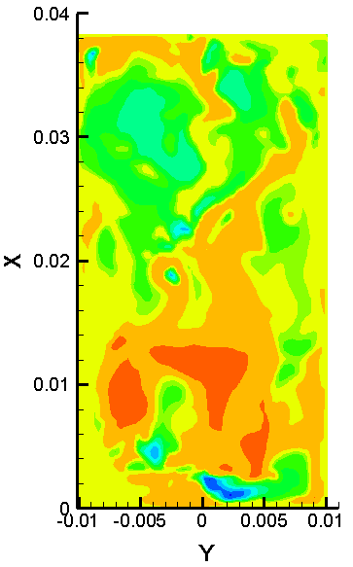
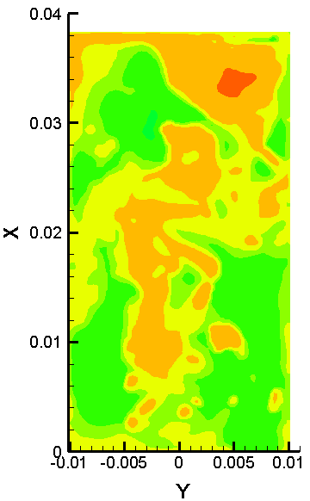
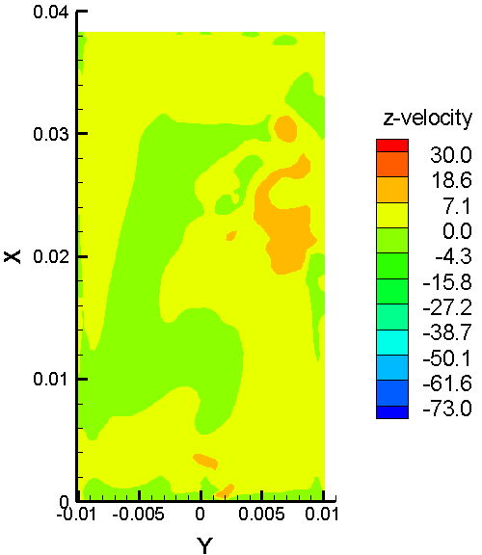
Results of u_{z} at t = 25 ms (one time through)
z= 0 cm
z = 1 cm
z = 5 cm
z = 10 cm
z = 15 cm
z = 20 cm
z = 30 cm
z = 45 cm

Slide 11
Results of x-vorticity at t = 25 ms (one time through)

