Slide 1
3D Hg Jet Simulations
Yan Zhan
July 11, 2014

Slide 2
Outline
3D Hg Jet Simulations (~ 100 ms each = 4 flow-thru times)
Cases 1 and 2 were half models, symmetric about the x-axis.
Ellipse Fitting
Case # | Inlet Conditions
1 | Outlet conditions of 0° bend pipe without a weld
2 | Outlet conditions of 90°/90° bend pipe without a weld
3 | Outlet conditions of 90°/90° bend pipe with a 30° weld

Slide 3
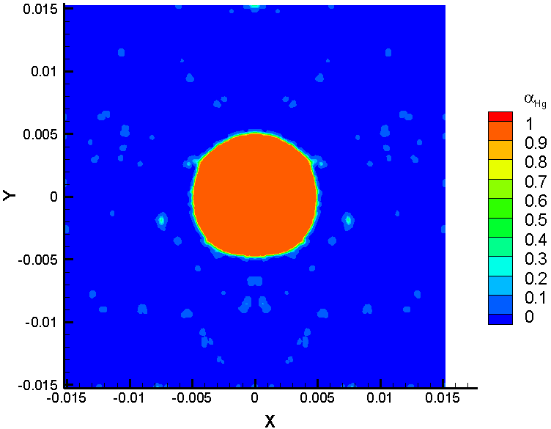
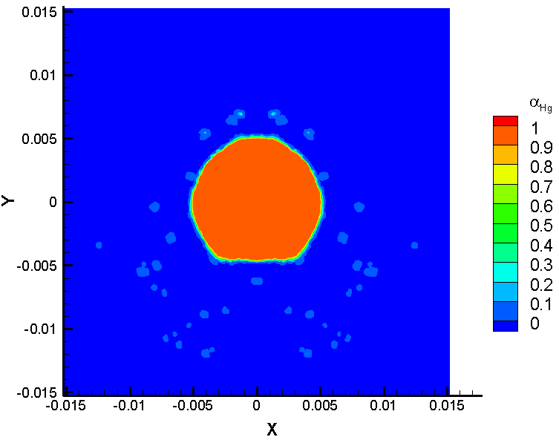
3D Hg Jet Simulations_Case 1
α_{Hg} at z = 30 cm
(a)
(b)
fitting at z = 30 cm
α_{Hg} at z = 45 cm
fitting at z = 45 cm
(d)
(c)

Slide 4
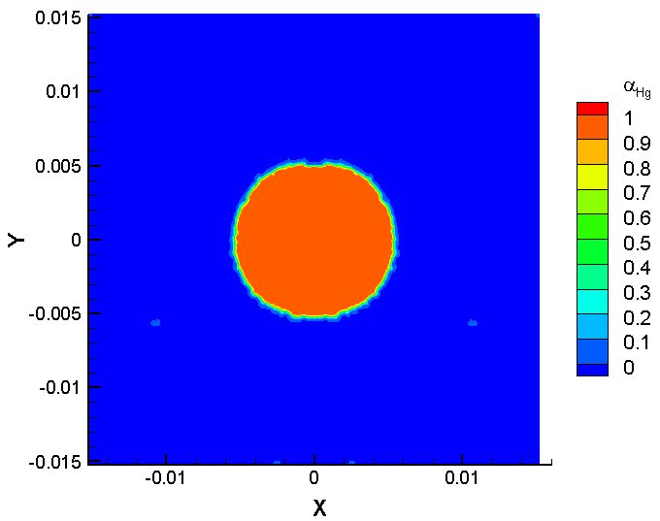
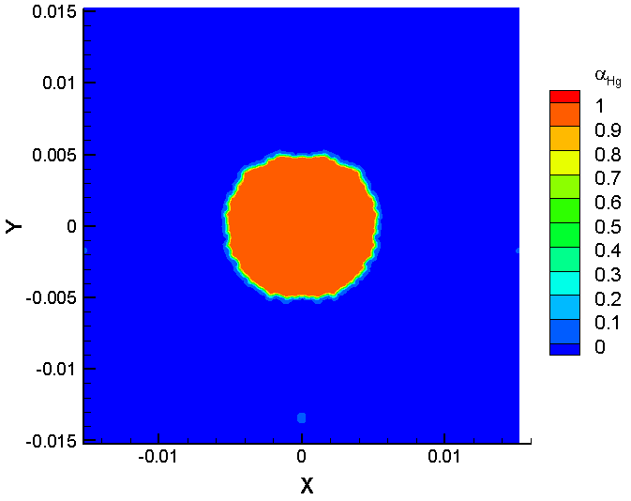
3D Hg Jet Simulations_Case 2
α_{Hg} at z = 30 cm
(a)
(b)
fitting at z = 30 cm
α_{Hg} at z = 45 cm
fitting at z = 45 cm
(d)
(c)

Slide 5
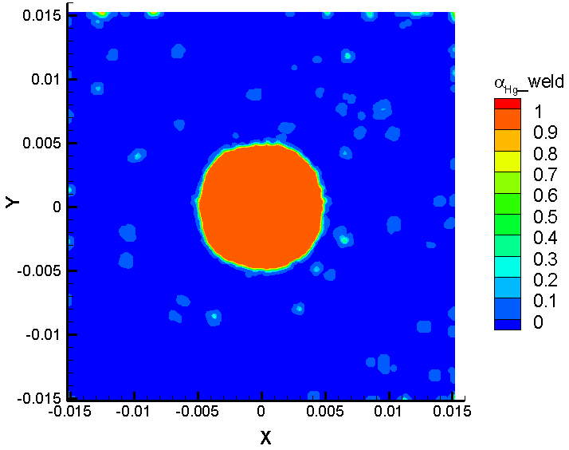
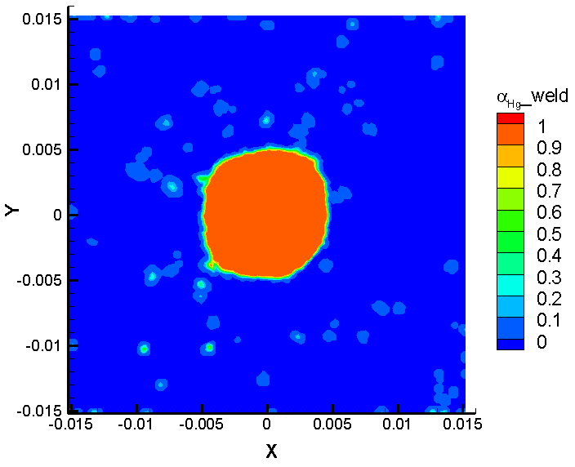
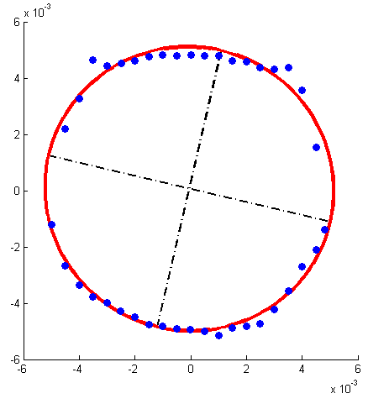
3D Hg Jet Simulations_Case 3
α_{Hg} at z = 30 cm
(a)
(b)
fitting at z = 30 cm
α_{Hg} at z = 45 cm
fitting at z = 45 cm
(d)
(c)

Slide 6
Ellipse Fitting
 | a | b | θ | x_{c} | y_{c} | ellipticity
Case 1 at z = 30 cm | 0.0052 | 0.005 | 0° | -4.7583e-05 | 1.1963e-04 | 0.038462
Case 1 at z = 45 cm | 0.0051 | 0.005 | 0° | -8.5702e-07 | 5.3878e-05 | 0.019608
Case 2 at z = 30 cm | 0.0055 | 0.0053 | 0 | -1.6004e-07 | -5.3676e-06 | 0.036364
Case 2 at z = 45 cm | 0.0054 | 0.0051 | 0° | -5.3034e-08 | -3.685e-05 | 0.055556
Case 3 at z = 30 cm | 0.0051 | 0.005 | 153.753° | -1.4746e-05 | -2.8267e-05 | 0.019608
Case 3 at z = 45 cm | 0.0052 | 0.005 | 13.167° | -6.2409e-05 | 5.6855e-05 | 0.03846
Note: (x_{c},y_{c}) is the ellipse center,
Ellipticity = (major axis – minor axis) / major axis = (a – b) / a
The symmetry about the x-axis in cases 1 and 2 forces angle θ to be zero.
y
y
a
b
a
b
a
b
b
a
θ
θ
x
x

