Slide 1
Numerical Validations of the CLSVOF Model
Yan Zhan
July 18th 2014

Slide 2
Outline
Droplet movement due to a constant velocity field
(u=1 m/s,v=0 m/s), (u=0,v=-1 m/s),(u=1 m/s,v=-1 m/s)
Droplet deformation due to a vortex velocity field
= stream function
$$Ψ=\sin^{2}(πx)\sin^{2}(πy)cos⁡(πt/T)/π$$
T (sec) | Mesh Grids | Method
2 | 128*128 256*256 512*512 | Developed CLSVOF Method
6 | 128*128 256*256 512*512 | Developed CLSVOF Method FLUENT CLSVOF Method Nichita’s Simulation*
12 | 128*128 256*256 512*512 | Developed CLSVOF Method
(0,1)
(1,1)
Air
Center: (0.5, 0.75)
Radius: 0.15
Water
(0,0)
(1,0)
* B.A. Nichita, An Improved CFD Tool to Simulate Adiabatic and Diabatic Two-Phase Flows, EPFL 2010
http://puhep1.princeton.edu/~mcdonald/examples/fluids/nichita_thesis_10.pdf
? “Droplet” may be just an imaginary surface in a single fluid ? (KTM)

Slide 3
Droplet movement due to a constant velocity field — u = 1 m/s, v = 0 m/s
t=0
(b)
t=0.25 s
(a)
Units for x and y: m
t=0.5 s
(d)
t=0.75 s
(c)

Slide 4
Droplet movement due to a constant velocity field — u = 1 m/s, v = 0 m/s
(a)
t=0
(b)
t=0.25 s
Units for x and y: m
(c)
t=0.5 s
(d)
t=0.75 s

Slide 5
Droplet movement due to a vortex velocity field — u = 1 m/s, v = 0 m/s
t=0
t=0.25 s
(a)
(b)
Units for x and y: m
t=0.5 s
t=0.75 s
(c)
(d)

Slide 6
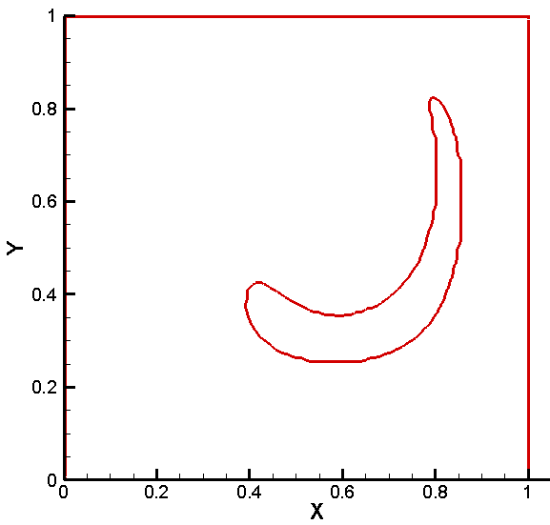
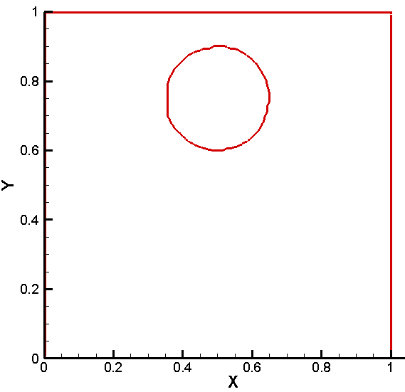
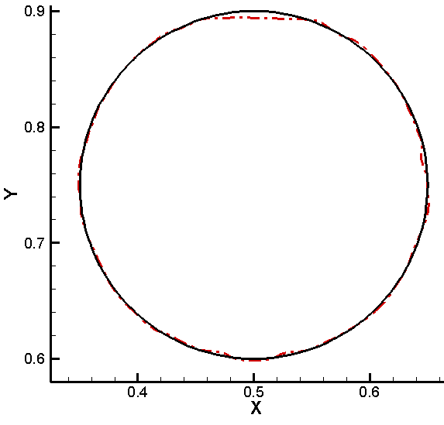
Droplet movement due to a vortex velocity field — coarse_T=2 s
t=0
t=T/2
(a)
(b)
Units for x and y: m
(c)
t=T
Initial and final interface comparison
(d)

Slide 7
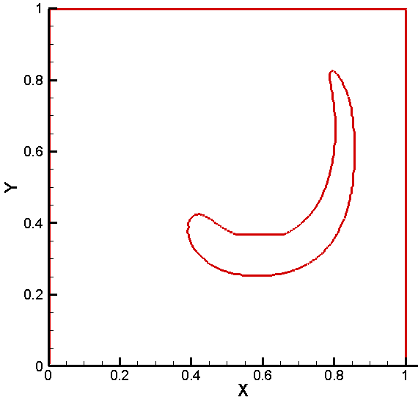
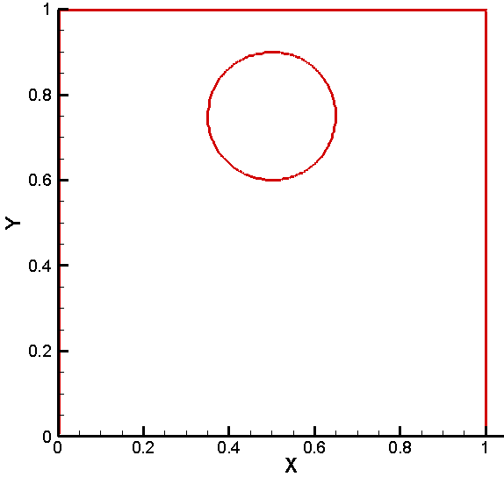
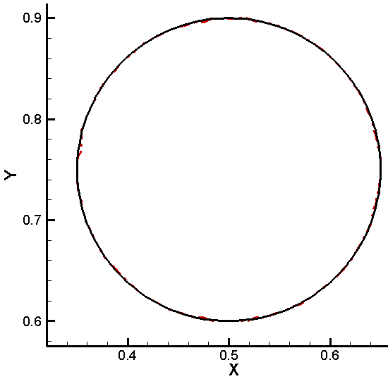
Droplet movement due to a vortex velocity field — medium_T=2 s
t=0
t=T/2
(a)
(b)
Units for x and y: m
t=T
(d)
Initial and final interface comparison
(c)

Slide 8
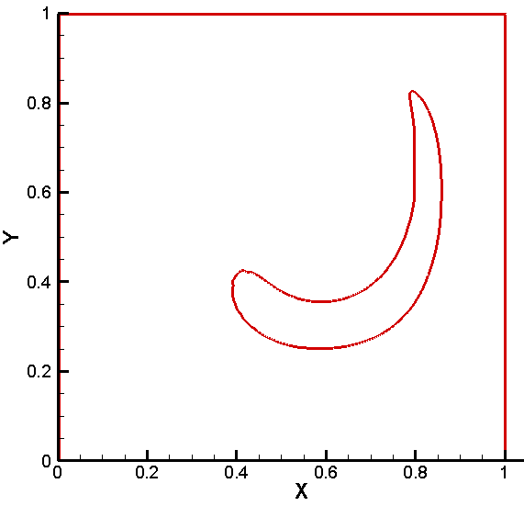
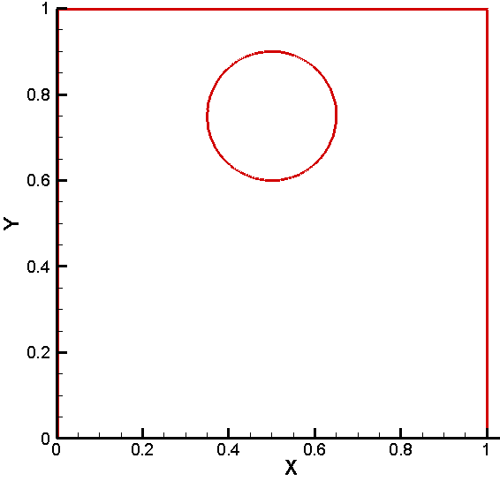
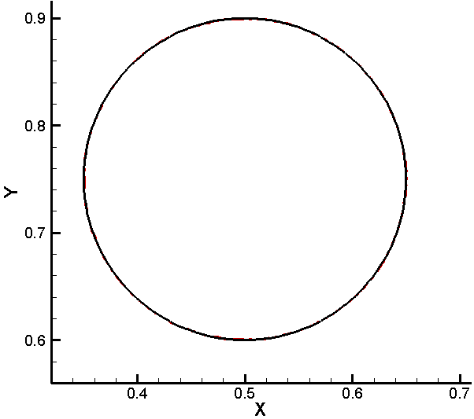
Droplet movement due to a vortex velocity field — fine_T=2 s
t=0
(b)
t=T/2
(a)
Units for x and y: m
(c)
t=T
(d)
Initial and final interface comparison

Slide 9
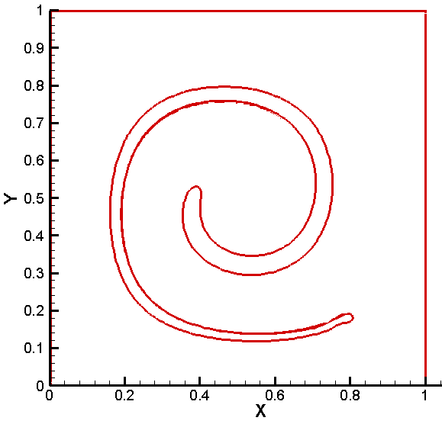
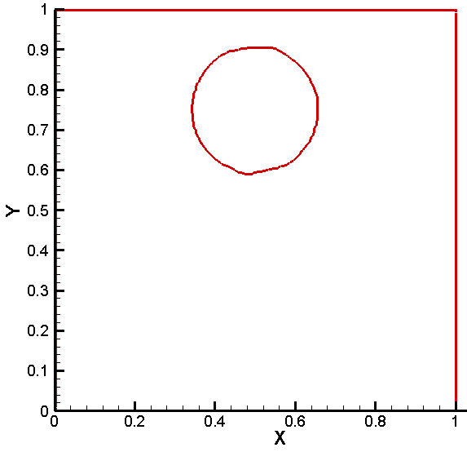
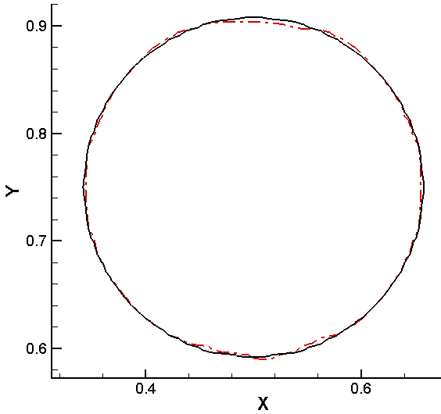
Droplet movement due to a vortex velocity field — coarse_T=6 s
t=0
t=T/2
(a)
(b)
Units for x and y: m
t=T
Initial and final interface comparison
(c)
(d)

Slide 10
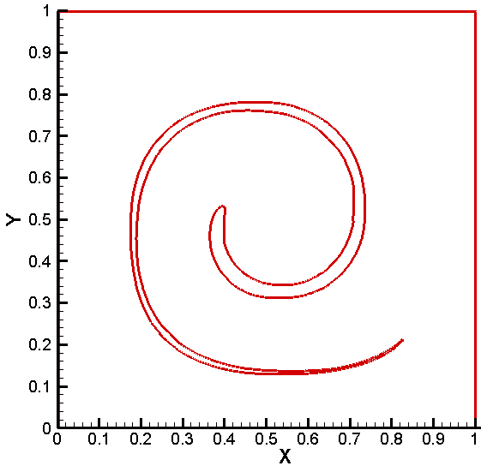
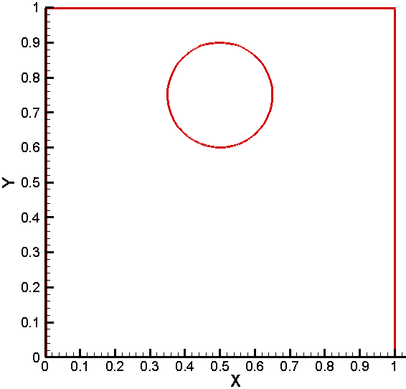
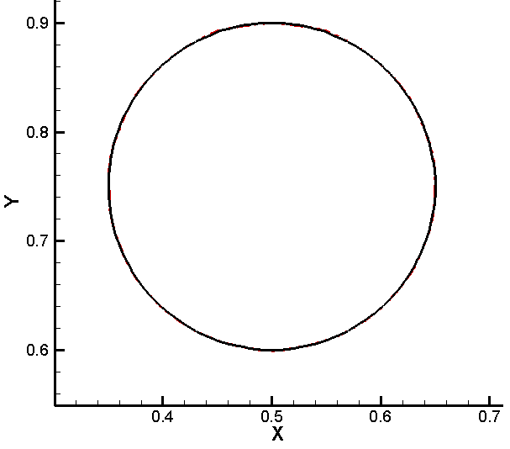
Droplet movement due to a vortex velocity field — fine_T=6 s
t=0
t=T/2
(a)
(b)
Units for x and y: m
t=T
Initial and final interface comparison
(c)
(d)

Slide 11
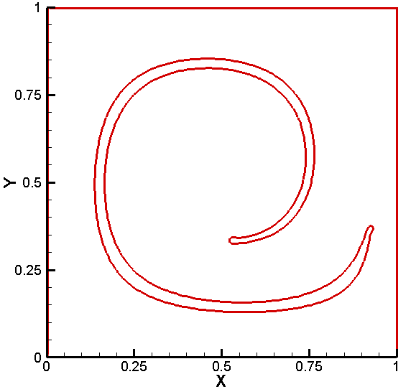
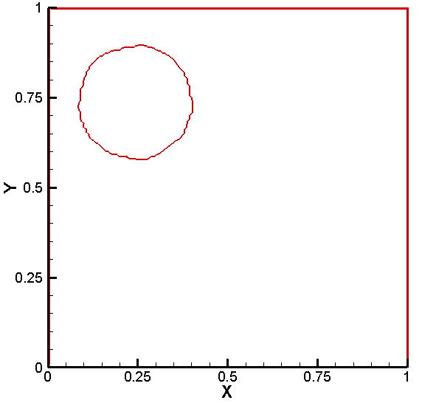
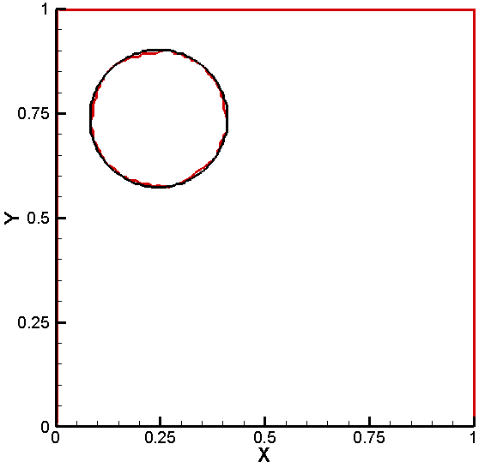
Droplet movement due to a vortex velocity field — FLUENT_coarse_T=6 s
t=0
t=T/2
(a)
(b)
Units for x and y: m
(c)
t=T
Initial and final interface comparison
(d)

Slide 12
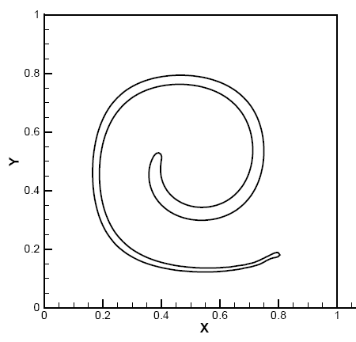
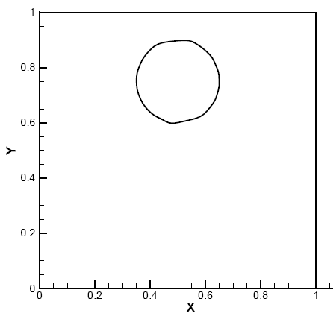
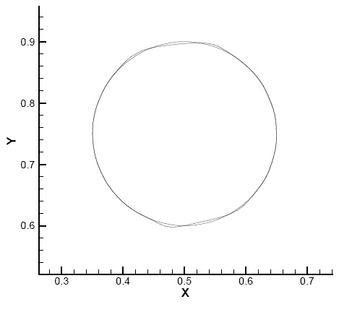
Droplet movement due to a vortex velocity field — Nichita_coarse_T=6 s
(a)
t=0
t=T/2
(b)
Units for x and y: m
t=T
Initial and final interface comparison
(c)
(d)

Slide 13
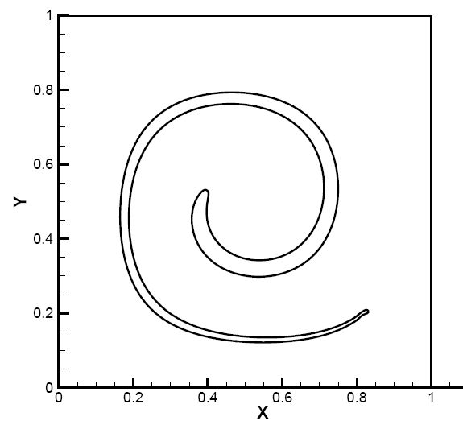
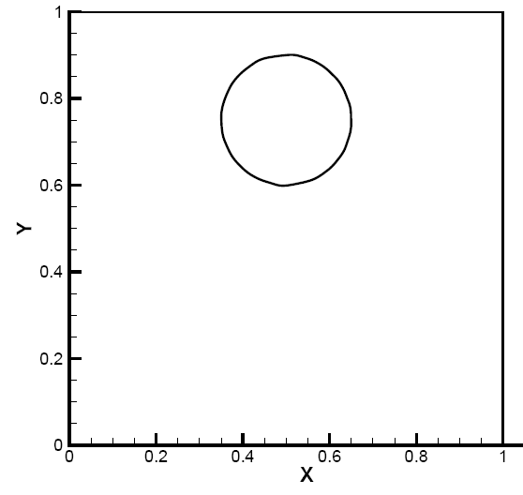
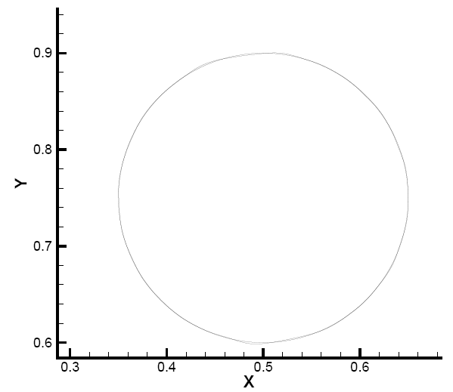
Droplet movement due to a vortex velocity field — Nichita_medium_T=6 s
(a)
t=0
(b)
t=T/2
Units for x and y: m
(c)
t=T
(d)
Initial and final interface comparison

Slide 14
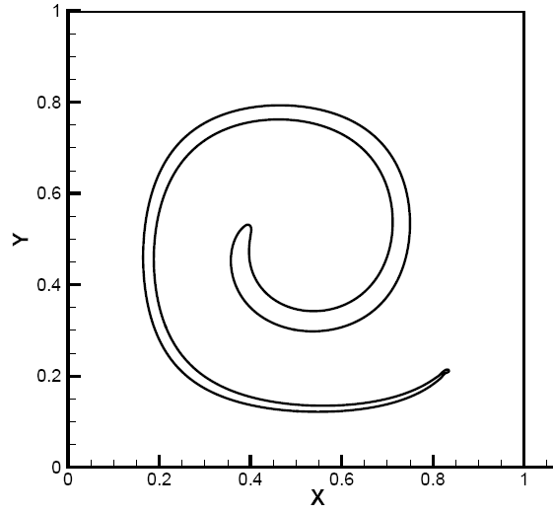
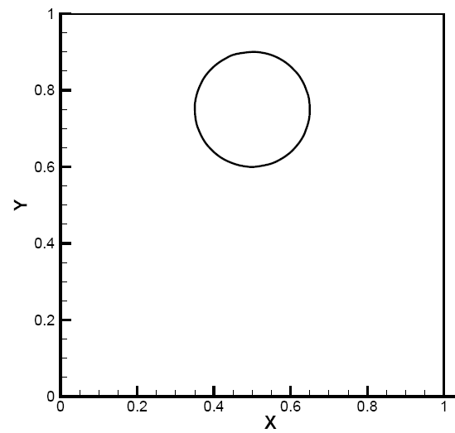
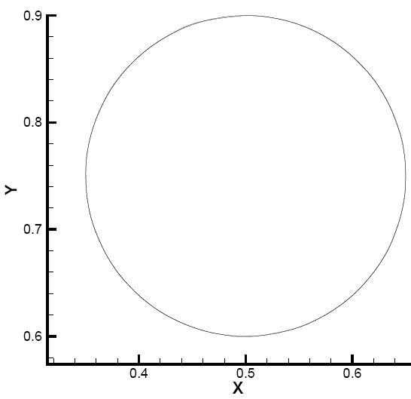
Droplet movement due to a vortex velocity field — Nichita_fine_T=6 s
t=0
t=T/2
(a)
(b)
Units for x and y: m
(c)
t=T
(d)
Initial and final interface comparison

Slide 15
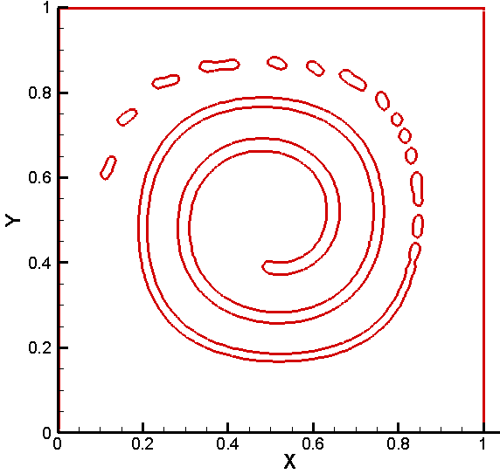
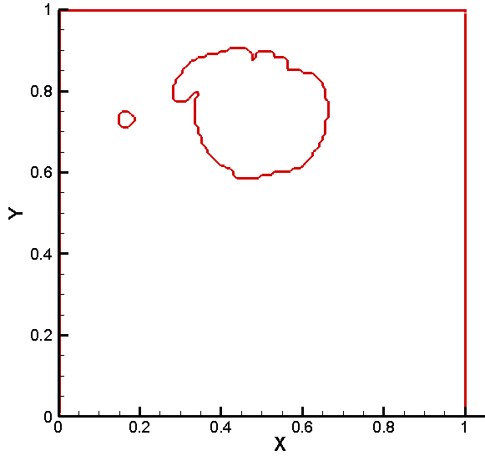
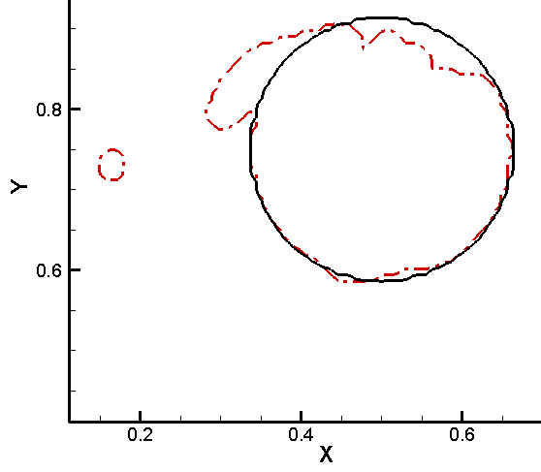
Droplet movement due to a vortex velocity field — coarse_T=12 s
t=0
t=T/2
(a)
(b)
Units for x and y: m
(c)
t=T
(d)
Initial and final interface comparison

Slide 16
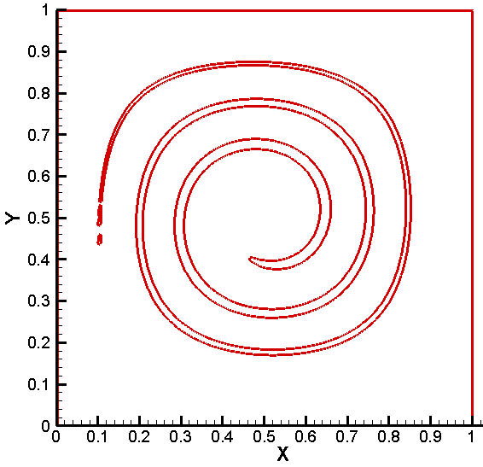
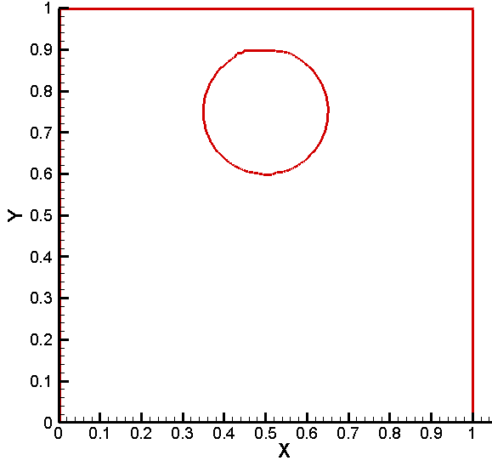
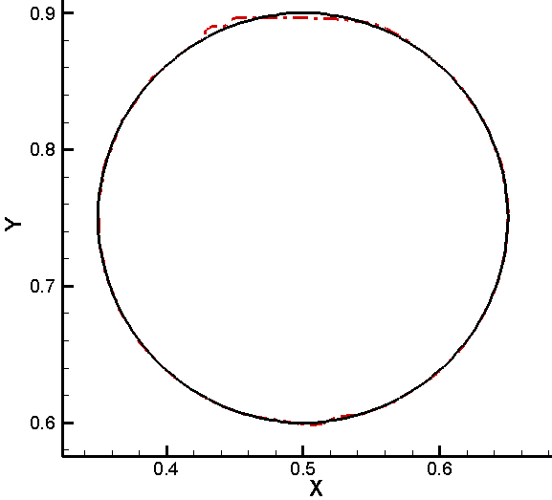
Droplet movement due to a vortex velocity field — fine_T=12 s
t=0
t=T/2
(a)
(b)
Units for x and y: m
(c)
t=T
Initial and final interface comparison
(d)

