Slide 1
Some Thoughts on Reduced Density Targets and Pion Absorption
J. R. J. Bennett
Rutherford Appleton Laboratory, Chilton, Didcot, Oxon, OX11 0QX
2nd Oxford-Princeton High-Power Target Workshop, 6-7 November 2008, Princeton

Slide 2
With particular thanks to
John Back, Stephen Brooks and Goran Skoro for computer calculations and discussions

Slide 3
John Back calculated the yield from a 50% density tungsten powder target. Presented at Oxford-Princeton Workshop, May 2008. In fact John had done a similar calculation in May 2007 and the significance of the result had eluded me at the time.

Slide 4
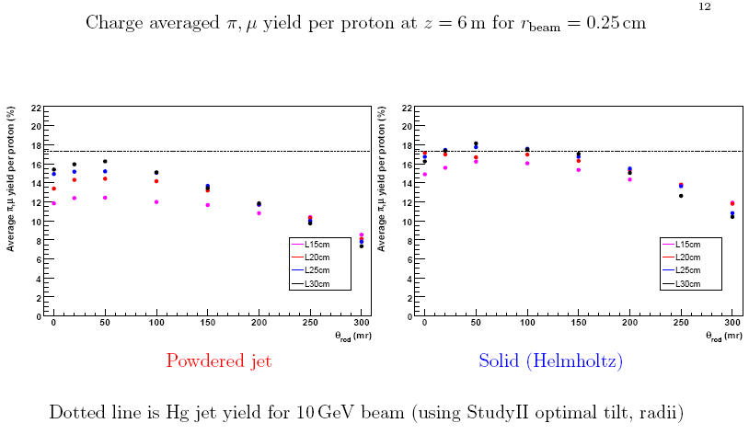

Slide 5
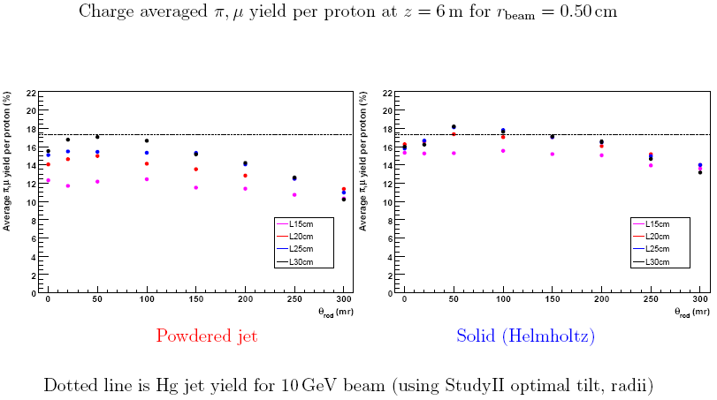

Slide 6
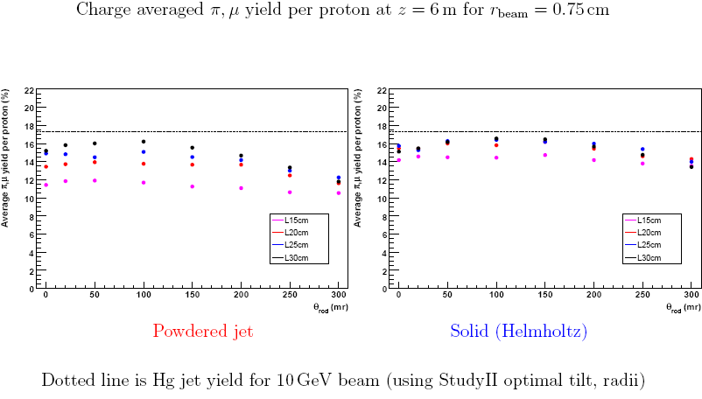

Slide 7
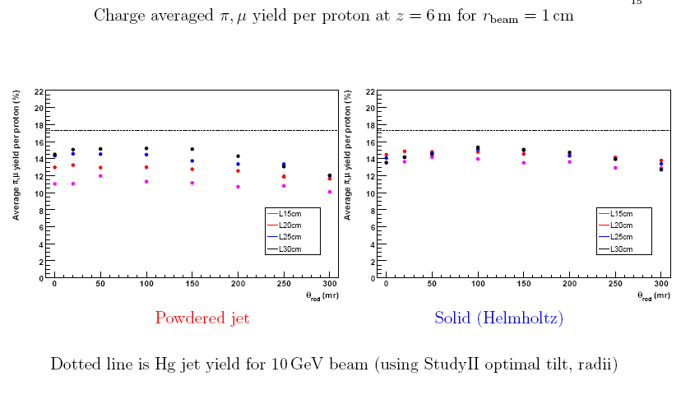

Slide 8
Surprising Result:-
The tungsten powder jet has a good yield – slightly smaller than the solid target.
Getting larger as the target and beam radius increases. Almost equal at r = 1 cm.
Why Surprising?
Inherently I expected the yield to vary as the target density and I assumed that the pion absorption was not large.

Slide 9
A Simple Model for Pion Yield from the Target
Assume that the number of pions produced per proton hitting the target is p and that the fraction of pions absorbed in the target is a. Then, the yield of pions for a solid target is,
Y = p(1-a)
and for a target of the same geometry and material but density f, is,
Y_{f} = fp(1-fa)
The ratio,
R =Y_{f}/Y=f(1-fa)/(1-a)
is shown in the next slide as f varies.
N.B. No magnetic field. Acceptance not included.

Slide 10
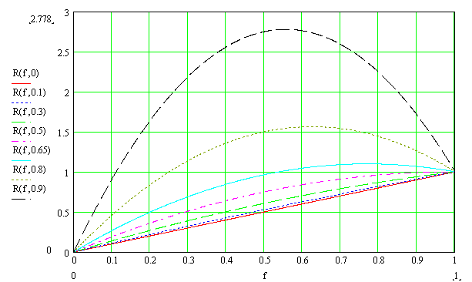
Graph of the yield ratios, R = Y_{f}/Y for various target densities, f, and absorptions, a. Absorption of a = 0.5-0.65 would seem to fit John Back’s calculations.

Slide 11
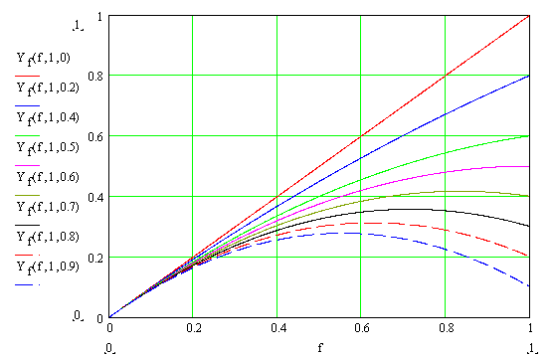
Yield as a function of target density, f, for different absorptions, a.

Slide 12
Now calculate the yields using MARS.
Goran Skoro has done this for me.
The next slide shows the MARS calculation superimposed on my simple model.
N.B.
No magnetic field.
Yields are from the target surface, not downstream.

Slide 13
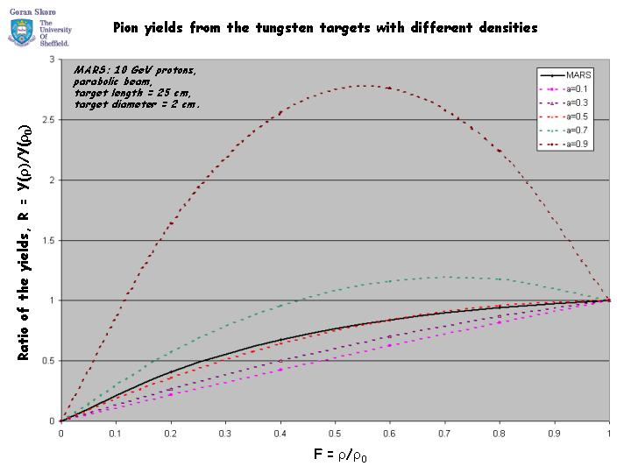
Goran Skoro

Slide 14
So it looks like a good fit to the model, with absorption,
a = ~0.5.
Again Large Absorption!!
So it looks like absorption is around 0.5 from both John and Goran’s results.

Slide 15
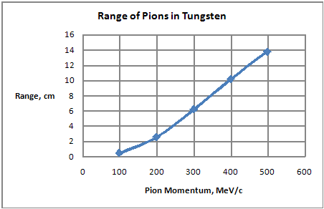
The range of pions in tungsten in the momentum range 100-500 MeV/c is shown below.

Slide 16
The pions of low momentum will only get out of the target if they have a short path length within the target. So absorptions of 0.5 are realistic.
So, I ask:- What is the origin of the usefully accepted pions:
From where do the pions originate?
With what momenta?
With what angles?
Perhaps knowing the answers will enable us to optimise the target density and geometry for maximum useful yield.

Slide 17
Stephen Brooks has made some plots of:
Number of pions emerging from the target surface versus the angle.
Number of pions emerging from 1 cm long bins along the axis of the surface of the target. Also included at z = 20 cm are the pions emerging from the end of the target cylinder. In terms of pion density at the surface, the pion density is twice as high from the end of the target as the best density from the cylindrical part of the target.
Number of pions emerging from the target as a function of angle within 1 cm long axial bins.
Number of pions emerging from the target as a function of momentum versus 1 cm long axial bins.
N.B. In all cases there are 100,000 protons hitting the target. The number emerging from the target and the number accepted into the cooling channel (the useful pions) are shown.

Slide 21
Stephen Brooks
Graph of the peak angle of the angular distribution of useful pions versus axial position, z (1 cm bins).
The peak no. of pions is approximately constant with z, but at the end is 3 times higher.

Slide 22
The number of useful pions produced per 100,000 protons at different axial positions along the target versus their momenta, MeV/c.

Slide 23
Stephen Brooks
The peak of the useful pion distribution is at an momentum of ~250 MeV/c for all values of axial positions, z.

Slide 24
Summary
Pion Absorption is significant in the target. About half the pions are absorbed.
Reduced Density Targets can have high yields ~equal to the solid.
It may be possible to tailor the target geometry to maximise the pion yield.
There are advantages in having a lower density target:
a. The energy dissipated is reduced, lowering the stress, the temperature and lengthening life.
b. It will be possible to reduce the target diameter (because the power is reduced and less surface area is required for radiation cooling) thereby decreasing the absorption in the radial direction and increasing the yield.

Slide 25
b. (continued)
However, if a is less than 0.5 then it is always an advantage to have the maximum density. There is probably an optimum which needs to be investigated using MARS etc. - including varying the diameter, density and radius over the target geometry.
c. It will be possible to make a target from thin tungsten foil discs, enhancing the thermal emissivity and further reducing the temperature of radiation cooled targets and/or reducing the target diameter.
Alternatively the target could be made from foamed metal – but the thermal conductivity is not so good as discs in the radial direction!

