Slide 1
Comments on Emittance Calculations
“Accelerator physics—a field where often work of the highest quality is buried in lost technical notes or even not published.”
—Etienne Forest, J. Phys. A: Math. Gen. 39, 5321 (2006)
http://kirkmcd.princeton.edu/examples/accel/forest_jpa_39_5321_06.pdf
K.T. McDonald
Princeton U.
(April 8, 2011)

Slide 2
Overview
A major challenge of a muon collider is “cooling” of the muon beam = reduction of its volume in 6-d phase space.
If/when we succeed in devising a sound concept for this, we will surely know it.
Along the way, we need to evaluate our conceptual progress, for which estimates of 6-d phase volume are helpful.
This leads to several general questions:
What is phase space? What coordinates can/should we use to describe it?
How should we account for effects of electromagnetic fields on the beam?
Under what kinds of beam manipulations is phase volume invariant?
How can we estimate phase volume numerically?
Can we describe the evolution of phase volume from the initial pion beam to the decay muon beam?

Slide 3
Hamiltonian Phase Space
The best succinct reference is Chap. 8 of Mechanics by Landau and Lifshitz.
The concept of phase space arises in the context of Hamiltonian dynamics, where a particle in 3-space is described by 3 “spatial” coordinates, q₁, q₂, q₃ and their conjugate momenta p₁, p₂, p₃ and an independent variable I will first call t. The equations of motion are
where L_{t}(q₁,p₁,q₂,p₂,q₃,p₃) is the Lagrangian and H_{t}(q₁,p₁,q₂,p₂,q₃,p₃) is the Hamiltonian of the system.
Phase space is the space of the (canonical) coordinates, (q₁,p₁,q₂,p₂,q₃,p₃).
For a particle of mass m and charge e in an electromagnetic field that can be deduced from a scalar potential V and a vector potential A (in some gauge) , the Lagrangian is
independent
of the gauge!

Slide 4
Use of z as the Independent Variable
Along the beamline, we measure particles at fixed position, say z, rather than at a fixed time t. So it would be preferable to have a formalism in which z, rather than t, is the independent variable. This was considered by Courant and Snyder, Ann. Phys. (NY) 3, 1 (1958), Appendix B.
http://kirkmcd.princeton.edu/examples/accel/courant_ap_3_1_58.pdf
It turns out that if we take the momentum conjugate to coordinate t as p_{t} = -H_{t} = -E = -E_{mech} – eV, then the system is described by the Hamiltonian H_{z},
For what it’s worth, the equation of motion for p_{t} can be rewritten as
The transformation from coordinates (x,p_{x},y,p_{y},,z,p_{z}) to (x,p_{x},y,p_{y},,t,p_{t}) is a canonical transformation (i.e., from one set of canonical coordinates to another, such that a Hamiltonian exists for both sets of coordinates).
Of course, evolution in time under Hamiltonian H_{t}, or evolution in z under Hamiltonians H_{z}, is also a canonical transformation.
http://kirkmcd.princeton.edu/examples/hamiltonian.pdf

Slide 5
Liouville’s Theorem
A famous theorem, attributed to Liouville, is that Hamiltonian phase volume is invariant under canonical transformations. Liouville actually knew nothing about Hamiltonians or phase space. See D. Nolte, The Tangled Tale of Phase Space, Physics Today, 63, no. 4, 32 (2010),
http://kirkmcd.princeton.edu/examples/mechanics/nolte_pt_63_4_32_10.pdf
A consequence of Liouville’s theorem is that phase volume is invariant under evolution in time of a Hamiltonian system.
Similarly, phase volume is invariant under evolution in z of a Hamiltonian system, if z is used as the independent variable.
Since the transformation from t to z as the independent variable is a canonical transformation, phase volume is the same in either coordinates (x,p_{x},y,p_{y},,z,p_{z}) or (x,p_{x},y,p_{y},,t,p_{t}).
Also, a gauge transformation is a canonical transformation, so phase volume is gauge invariant.
A corollary of Liouville’s theorem is that the sums of subvolumes, dq₁dp₁ + dq₂dp₂ + dq₃dp₃ and dq₁ dp₁ dq₂ dp₂ + dq₃ dp₃ , are also invariant under canonical transformations.
For a beam of n particles, Liouville’s theorem applies to the 6n-dimensional phase space if particle interactions are considered (and a Hamiltonian for the entire system exists), while if the particles are considered to be noninteracting, it applies to the set of n particles in 6-d phase space.

Slide 6
Swann’s Theorem
A lesser known theorem is due to W.F.G. Swann, Phys. Rev. 44, 224 (1933), in what is probably the first paper ever to apply Liouville’s theorem to a “beam” of charged particles,
http://kirkmcd.princeton.edu/examples/accel/swann_pr_44_224_33.pdf
Swann’s theorem states the phase volume is the same when p = p_{mech} + eA/c whether one uses the canonical coordinates (x,p_{x},y,p_{y},,z,p_{z}) or the more intuitive coordinates (x,p_{mech,x},y,p_{mech,y},,z,p_{mech,z}).
Similarly, phase volume is the same whether one uses the canonical coordinates (x,p_{x},y,p_{y},,t,-E) or the coordinates (x,p_{mech,x},y,p_{mech,y},,t,-E_{mech}).
Thus, we have the freedom to describe our beam in 4 different coordinate systems, and to use any gauge whatsoever, and the phase volume of the beam will be the same (if the beam can be described by a Hamiltonian and the particles are noninteracting).
In practice it is not easy to calculate the phase volume associated with a bunch of particles. We use some numerical approximation. Clearly, we desire to use that coordinate system, and that gauge, for which our numerical approximation to phase volume is the best.
There seems to be no theorem that explains what is the best strategy to deal with this issue.

Slide 7
RMS “Invariant” Emittance
Our estimate of the phase volume of the bunch is the rms “invariant” emittance,
If motion in different indices i is decoupled, we consider the subemittances,
These “invariant” emittances are actually invariant only under “linear” (canonical) transformations.
Unfortunately, propagation of a beam across a field-free drift region is “nonlinear” (even though the particles move along straight lines).
For a beam with <p_{z}> = p₀ and initial rms quantities σ⊥, σ_{p⊥}, σ_{z}, σ_{pz}, the emittances vary with time as
http://kirkmcd.princeton.edu/examples/growth.pdf

Slide 8
Emittance Growth for Pions in a Drift Region
The emittances grow quadratically with t or z, and the emittances with z as the independent variable grow more rapidly than those with t as the independent variable.
The integrations in t and z were analytic in this and the next slide.

Slide 9
Stabilization of Transverse Emittance by an Axial Magnetic Field
At 10 T, the transverse emittance for this example is completely stabilized by an axial magnetic field. It makes no difference whether canonical momentum p or mechanical momentum p_{mech} is used in the calculation of ε⊥, although ε_{x} = ε_{y} are large when using p (but do not grow with t or z).
Is this effect documented in the literature?

Slide 10
Stabilization of Transverse Emittance by an Axial Magnetic Field, Cont’d.
The stabilization occurs for (J.S. Berg, 2013).
An argument for this result is that if the diameter 2c p⊥/eB_{z} of the helical trajectory of a charge e with transverse momentum p⊥ ≤ σ_{p⊥} in a uniform axial magnetic field B_{z} is less than the rms radial extent σ⊥ of the bunch, the bunch does not appear to grow radially as it propagates, and the rms measure of transverse emittance remains invariant with time/distance.
See also, http://kirkmcd.princeton.edu/mumu/target/Sayed/140129/SolTaper-140129_k9.pdf

Slide 11
Eigenemittances aka Courant-Snyder Invariant Eigenvalues
A. Dragt argues that we learn more if we calculate the so-called invariant eigenemittances.
These are the absolute values of the 3 distinct eigenvalues, λ₁, λ₂, λ₃, of the matrix
Any function of the λ₁, λ₂, λ₃ is also invariant under “linear” transformations,
Examples:
If the x-y and z motions are decoupled, the method of eigenemittances reveals that
are invariant under “linear” transformations. (|λ₁| and |λ₂| are listed on slide 9.)
Even if x, y and z are coupled, there is no “emittance exchange” between ε⊥ and ε_{z} under “linear” transformations, if the emittances are defined in terms of eigenemittances.
Perhaps we should check for “cooling” of the λ₁, λ₂, λ₃ as well as of the emittances.

Slide 12
A Beam of Pions and Muons
Before we have a muon beam we have a pion beam.
Presumably, the pion beam has a phase volume/emittance which has some relation to the phase volume/emittance of the muon beam it decays into.
To date, we largely ignore the phase volume/emittance of the pion beam, although this can be manipulated in the target/decay region. Indeed, the magnetic taper from 20 down to 1.5 T provides a coupling of longitudinal and transverse phase space.
The decay of pions to muons is not describable by a Hamiltonian, and phase volume is altered during the decay.
Somewhat unintuitively, the decay “heats” rather than “cools” the phase volume although energy is lost during the decay.
For example, the decay of the pion bunch considered on slides 8 and 9 roughly triples the transverse and longitudinal emittances, both in zero field and in 10-T field. However, the initial emittance of this bunch is smaller than that we will consider for a muon collider.
It is an open question whether there could be favorable coupling between a tapering magnetic field in the decay region and the unwanted emittance growth during π → μ decay.
B. Autin made some comments on emittance growth during π → μ decay in
http://kirkmcd.princeton.edu/examples/accel/autin_nim_a503_363_03.pdf

Slide 13
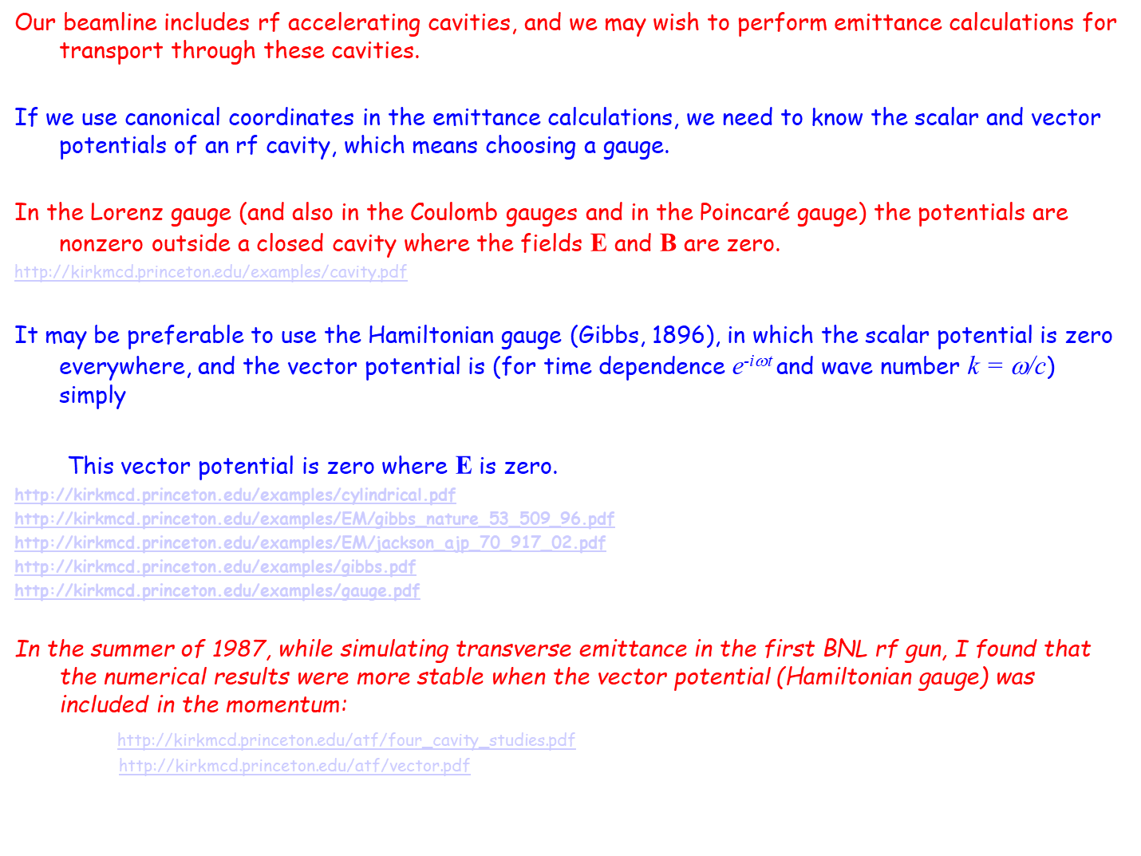
Emittance Calculations Including RF Cavities
Our beamline includes rf accelerating cavities, and we may wish to perform emittance calculations for transport through these cavities.
If we use canonical coordinates in the emittance calculations, we need to know the scalar and vector potentials of an rf cavity, which means choosing a gauge.
In the Lorenz gauge (and also in the Coulomb gauges and in the Poincaré gauge) the potentials are nonzero outside a closed cavity where the fields E and B are zero.
http://kirkmcd.princeton.edu/examples/cavity.pdf
It may be preferable to use the Hamiltonian gauge (Gibbs, 1896), in which the scalar potential is zero everywhere, and the vector potential is (for time dependence e^{-iωt} and wave number k = ω/c) simply
This vector potential is zero where E is zero.
http://kirkmcd.princeton.edu/examples/cylindrical.pdf
http://kirkmcd.princeton.edu/examples/EM/gibbs_nature_53_509_96.pdf
http://kirkmcd.princeton.edu/examples/EM/jackson_ajp_70_917_02.pdf
http://kirkmcd.princeton.edu/examples/gibbs.pdf
http://kirkmcd.princeton.edu/examples/gauge.pdf
In the summer of 1987, while simulating transverse emittance in the first BNL rf gun, I found that the numerical results were more stable when the vector potential (Hamiltonian gauge) was included in the momentum:
http://kirkmcd.princeton.edu/atf/four_cavity_studies.pdf
http://kirkmcd.princeton.edu/atf/vector.pdf

