Slide 1
HiRadMat at CERN SPS:
A dedicated in-beam test facility
http://cern.ch/hiradmat
Adrian Fabich
5th High Power Targetry Workshop
FNAL, 20th-23rd May 2014

Slide 2
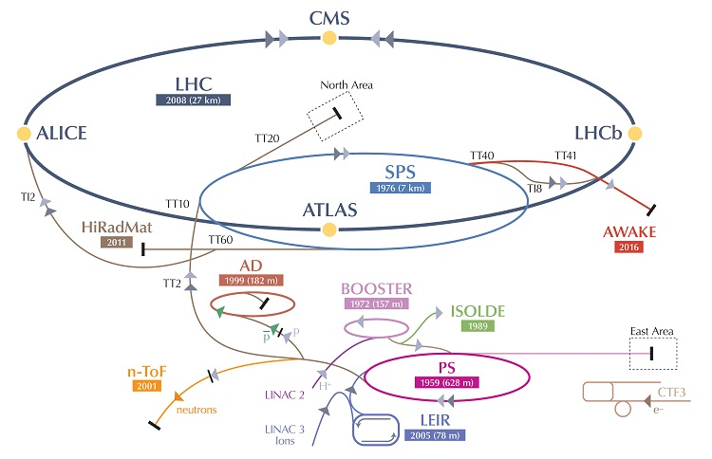
Contents
Motivation and parameters of HiRadMat
Facility layout
Former experiments
Present upgrade
Future proposals

Slide 3
Motivation
Initiated for LHC component testing (proposed by R. Assmann), it can also be used for other accelerator studies and applications.
High-Radiation to Materials
Dedicated facility
Moving away from ad-hoc set-ups (e.g. in LHC)
Studying the impact of intense pulsed beams on materials
  material damage
  material vaporization
  Thermal management
  Mechanical radiation damage to materials - Thermal shock - beam induced pressure waves
Application areas:
  materials R&D
  high-power targetry
  benchmark tests
  (survival of) beam line components (windows, coating, vacuum)
  …

Slide 4
SPS beam parameters to HiRadMat
LHC injection like beam
Annual intensity budget limited to ~10¹⁶ pot.
  Environmental RP aspects
  Limited SPS beam time
  Enabling experimenters’ access
“Single-shot” experiments

Slide 5
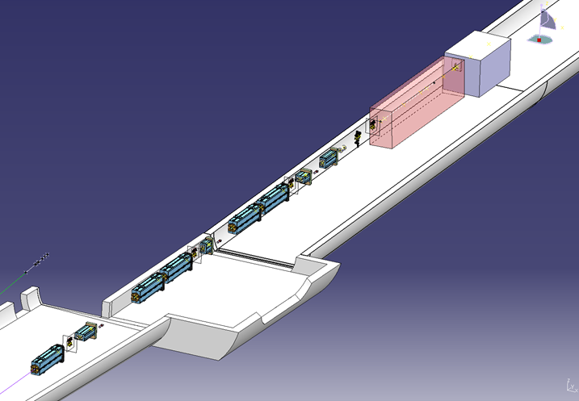
Layout Experimental Area (1)
TJ7 + TNC
Old T9 target
(modified to beam dump)
Irradiation Area
TT66
TNC
TJ7

Slide 6
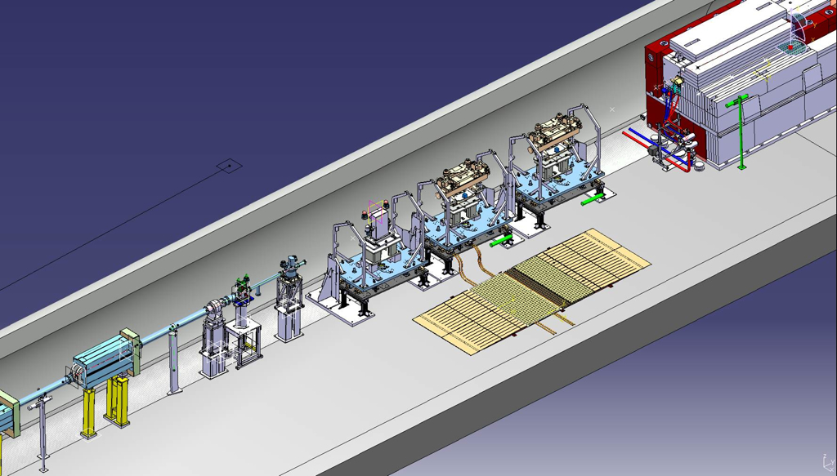
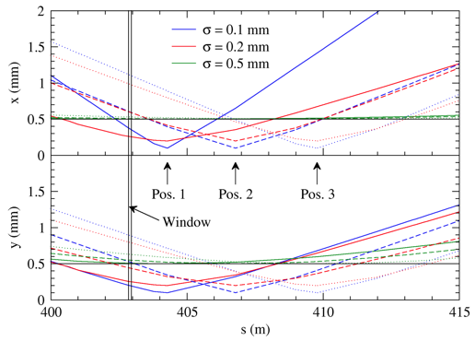
Layout Experimental Area (2)
3 test stands for experiments
- Remote installation of normed support tables
- Standard connections for general infrastructure

Slide 7
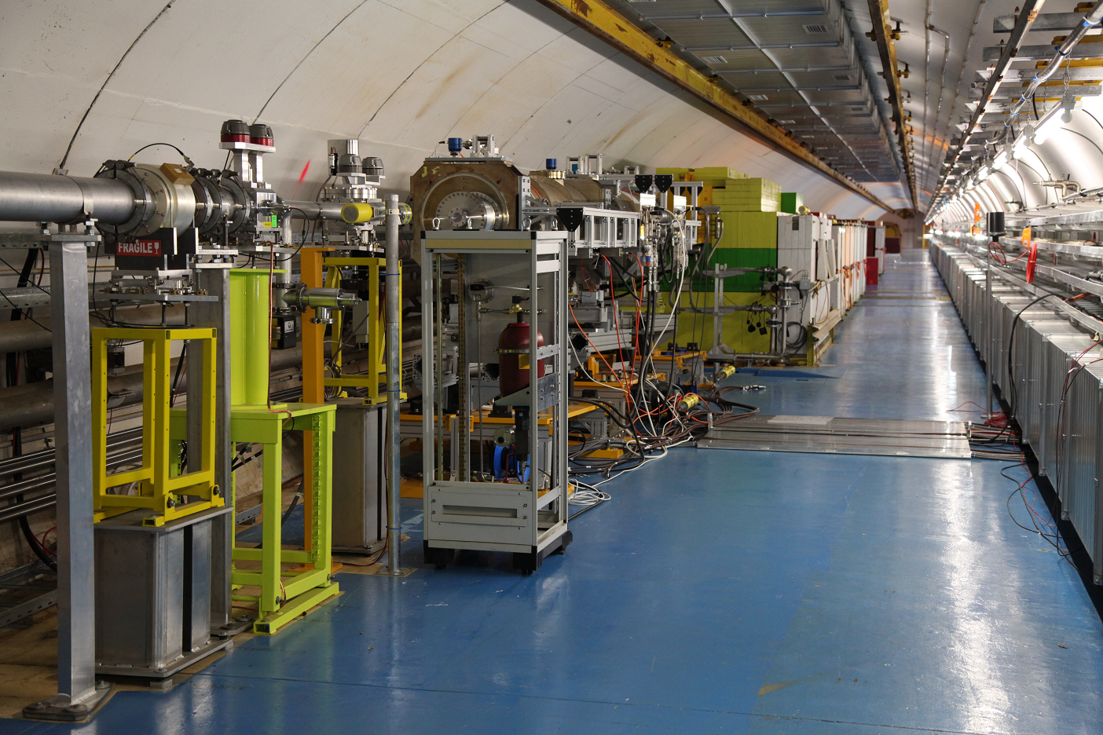
Target area
Experimental setup
beam
Beam monitors
Cool-down zone
dump

Slide 8
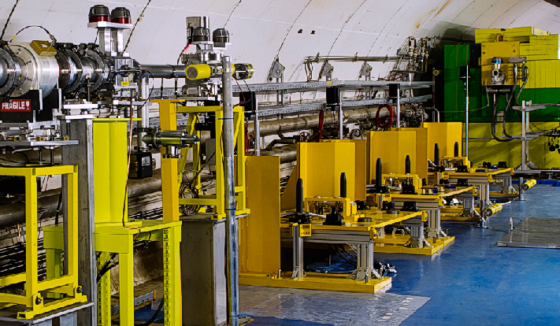
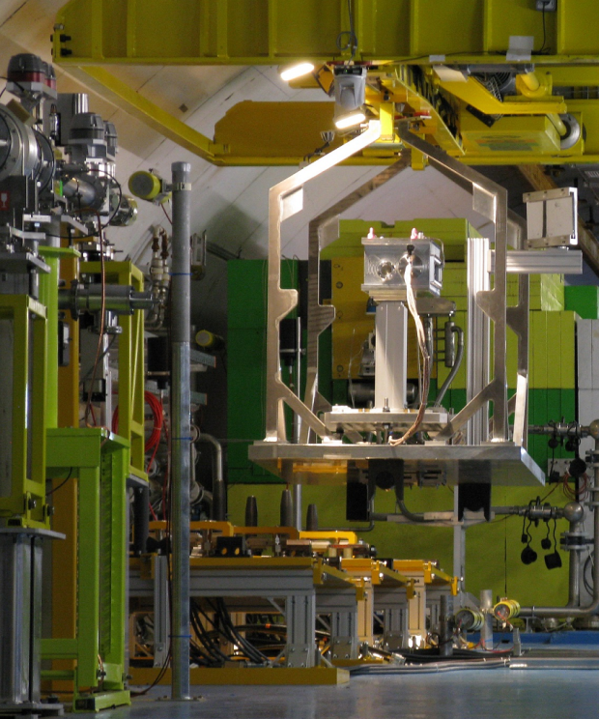
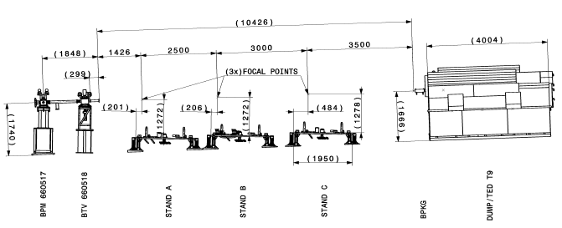
Remote handling
Equipped with automatic connections
  Signals
  Power
  Water

Slide 9
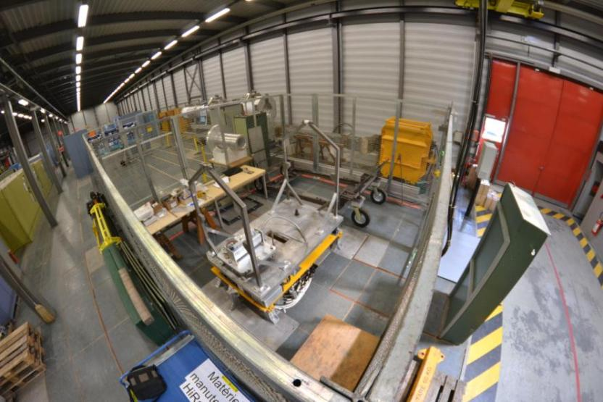
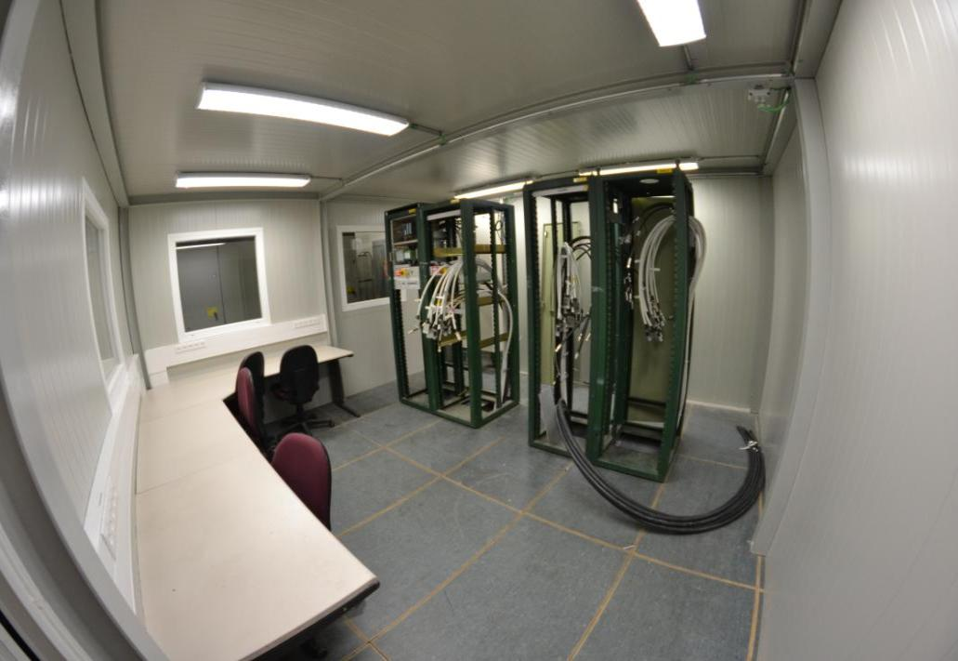
Facility services
Provision of dedicated irradiation infrastructure
Preparation lab at surface
  Same interfaces as in the tunnel
Control room
Irradiation position
  Standardized installation (remote)
  General supplies (water, electricity,
  cabling)
  Beam monitoring
Observation tools
  Camera, LDV, BLMs (diamond)
Application/logistics/installation at CERN
Surface lab
Control room

Slide 10
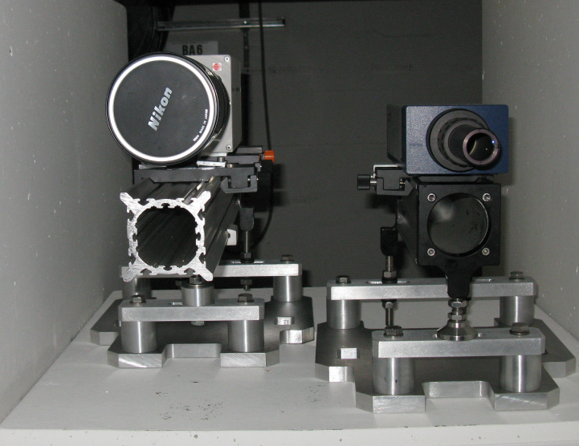
Measurement tools
With the expertise of various groups at CERN
Laser-Doppler vibrometer
  Measuring surface velocities of several m/s
  tens of MHz sampling
Optical high-speed recording
  High-speed camera with several kHz frame rate
Diamond detectors, strain gauges, temperature sensors, microphones …
Transverse beam monitoring
  High precision (< 0.1 mm) alignment to experimental tables
  Based on pCVD diamond detectors
Fast camera LDV
LDV

Slide 11
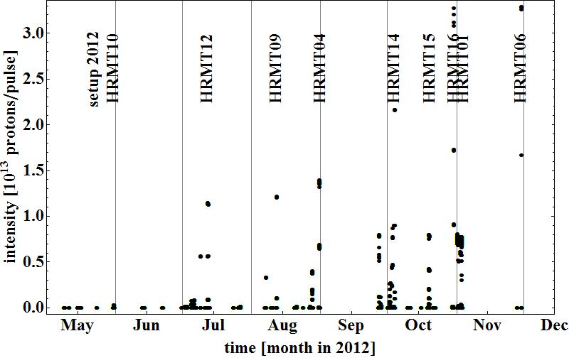
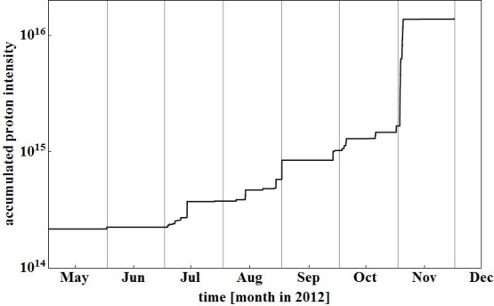
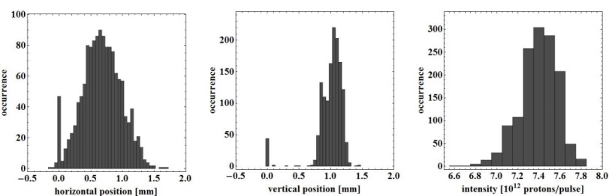
Start-up 2011/2012
2011: commissioning (project leader I. Efthymiopoulos)
2012: first year of operations
  9 experiments completed successfully
  On average every 4 weeks
  1.4*10¹⁶ pot
2012: only 48 hours of SPS cycling with destination HiRadMat

Slide 12
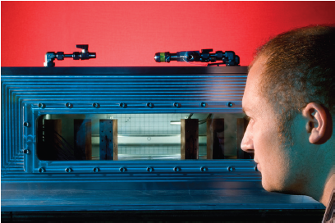
Experiments in 2012
​RIB target R&D
LHC transfer collimator (2x)
BLM validation
RP benchmarking
Crystal collimation
See http://cern.ch/hiradmat for links
Powder target
(HRMT10)
RAL
C. Densham

Slide 13
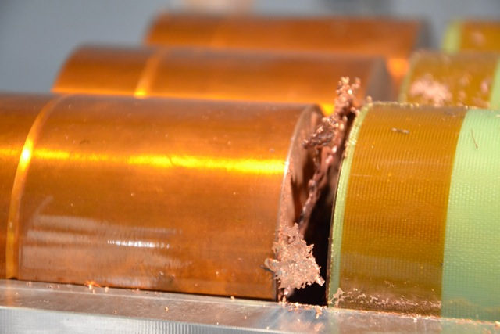
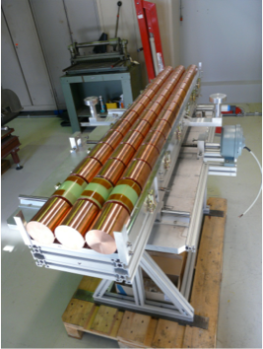
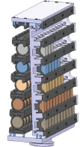
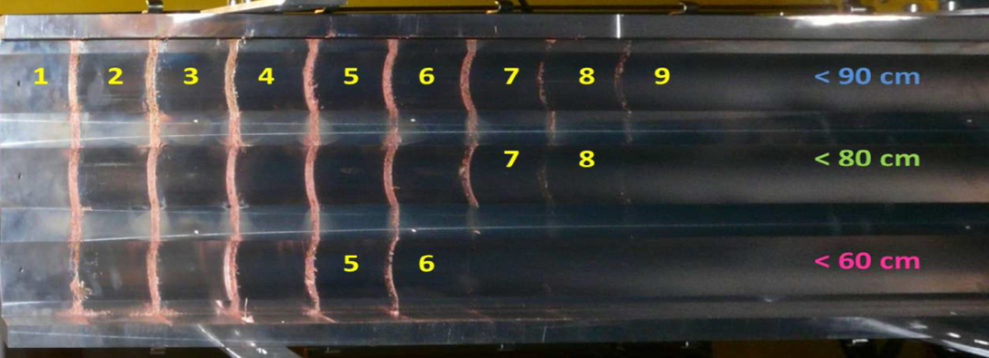
Material/collimator tests
See http://cern.ch/hiradmat for links
Beam tunnelling
(HRMT12)
TE/MPE
R. Schmidt
Collimator
Materials
(HRMT14)
EN/MME
A. Bertarelli

Slide 14
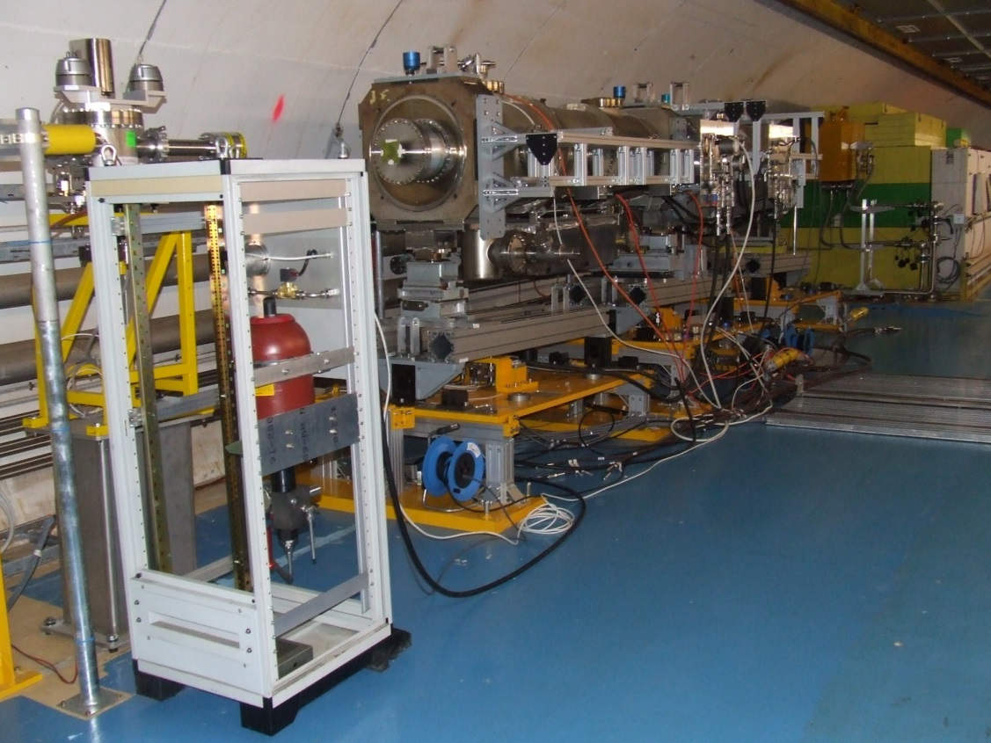
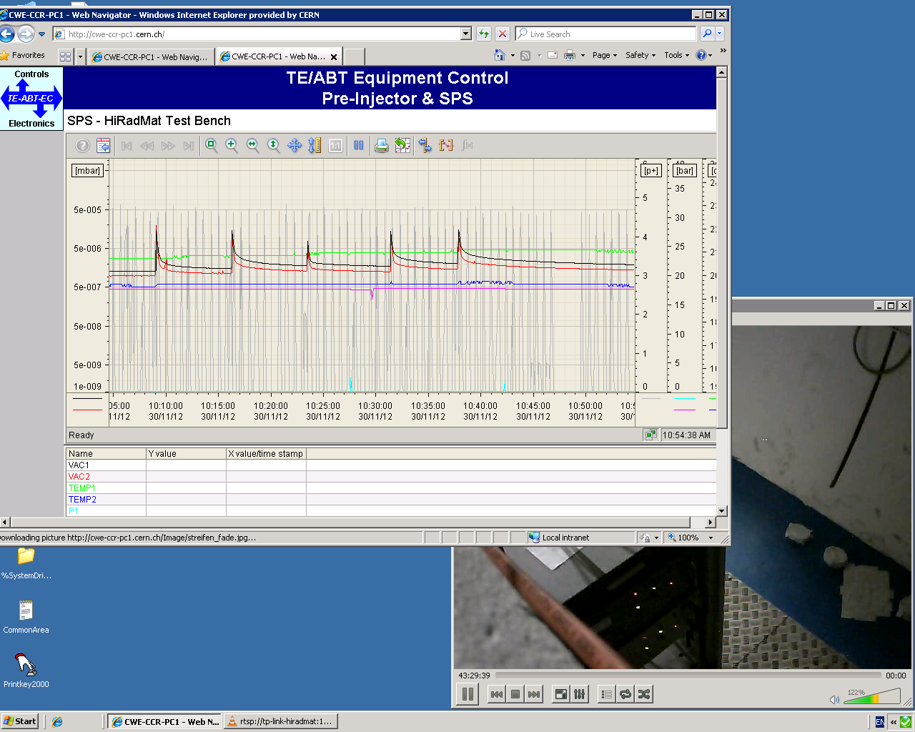
TPSG4 - 2012
Robustness test of a beam septum protection collimator; 9 m long experimental installation
J. Borburgh, CERN TE

Slide 15
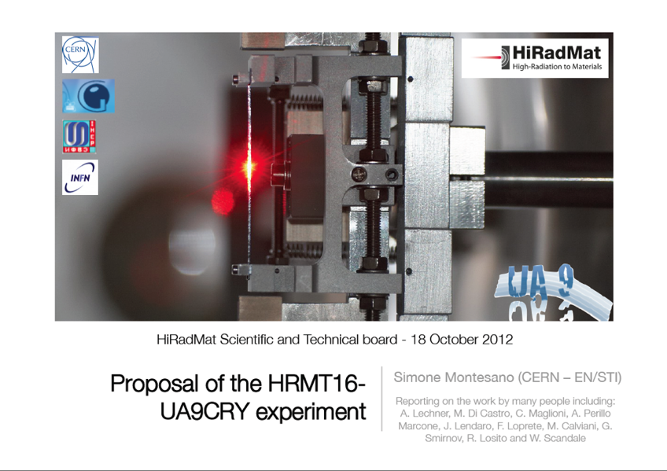
Crystal collimators

Slide 16

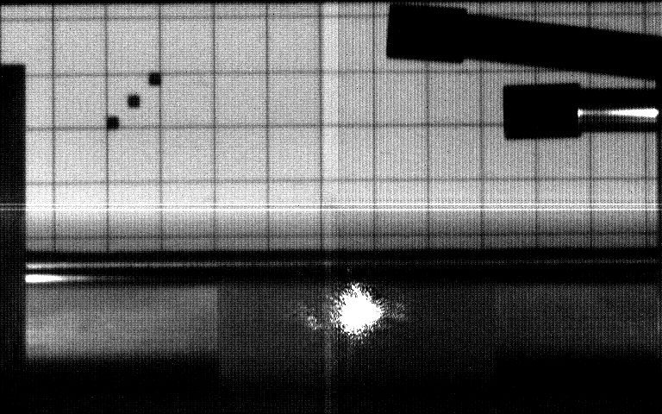
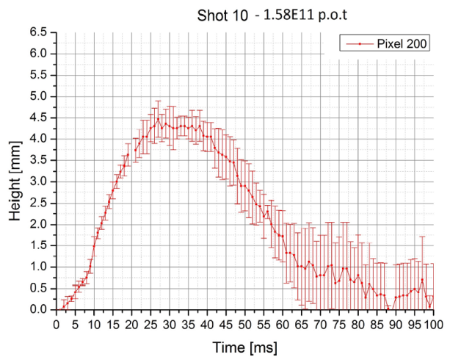


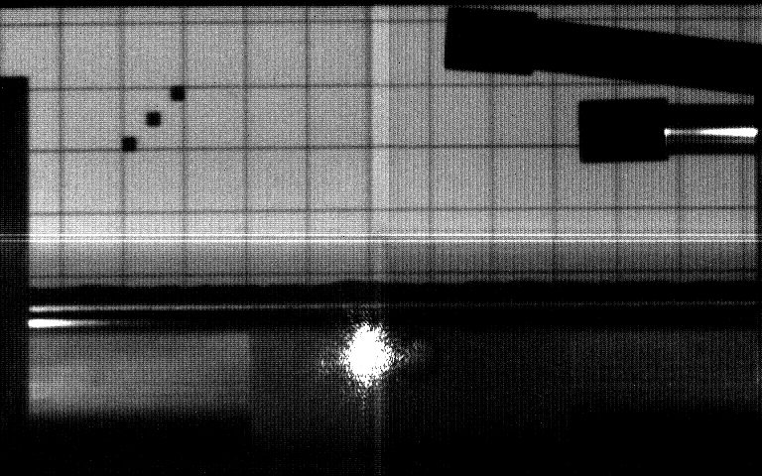
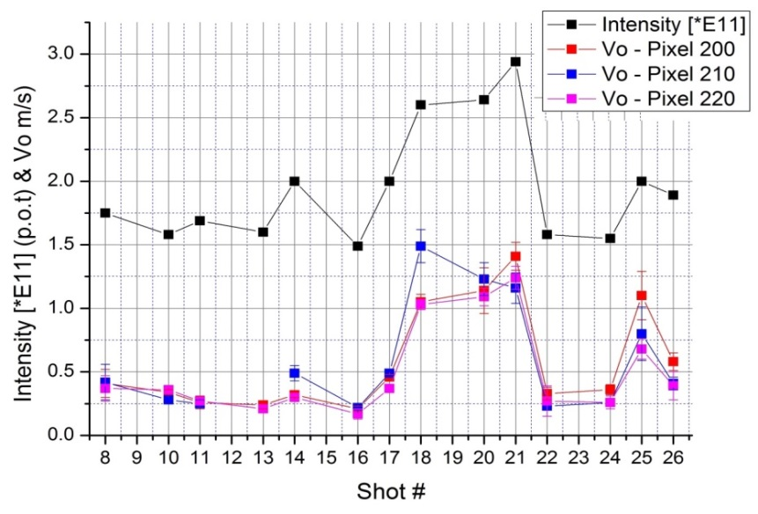
A feasibility experiment of a W-powder target (HRMT-10)
1 cm
1.75E11 p.o.t: First significant disruption
Pressure Sensor
Pressure Sensor
Beam
LDV spot
Recording :2000 fps
Video: 10 fps
1.85E11 p.o.t: Different reaction of the powder. Due to the increased surface roughness.

Slide 17
Facility upgrades
Based on experience gained during 2012:
Extending the general infrastructure
  Additional cabling for signals, vacuum and 220V; to be installed in autumn 2013
Adding a beam position monitor
  High precision alignment to experimental tables
  Based on pCVD diamond detectors
Removal of remaining experiments from tunnel

Slide 18
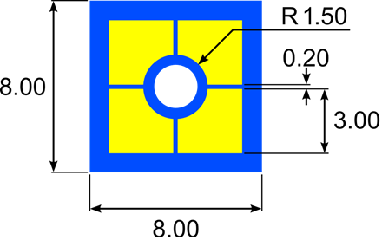
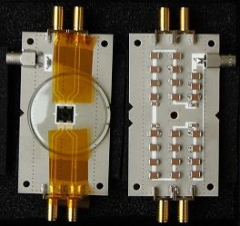
Beam position
Present BPM at about 5 m upstream of experiment provides limited position precision
Requirements:
  Online measurement
  Single bunch resolution
  0.1 mm transverse beam position
    precision at experiment
  Beam sigma measurement
  Full intensity range (up to 10¹⁴ p⁺/pulse)
Using diamond detectors
Placed just upstream of experiment
Measuring beam halo
Au electrode
diamond

Slide 19
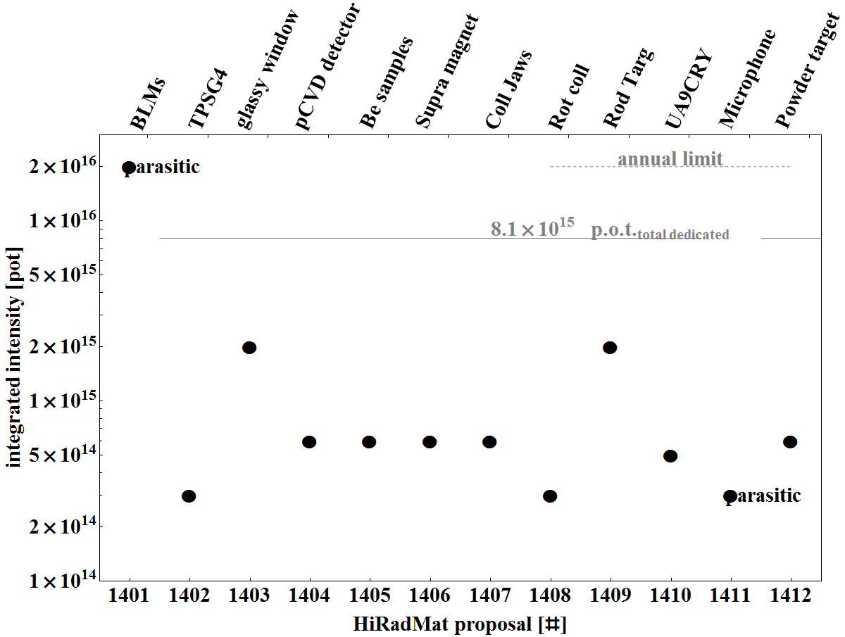
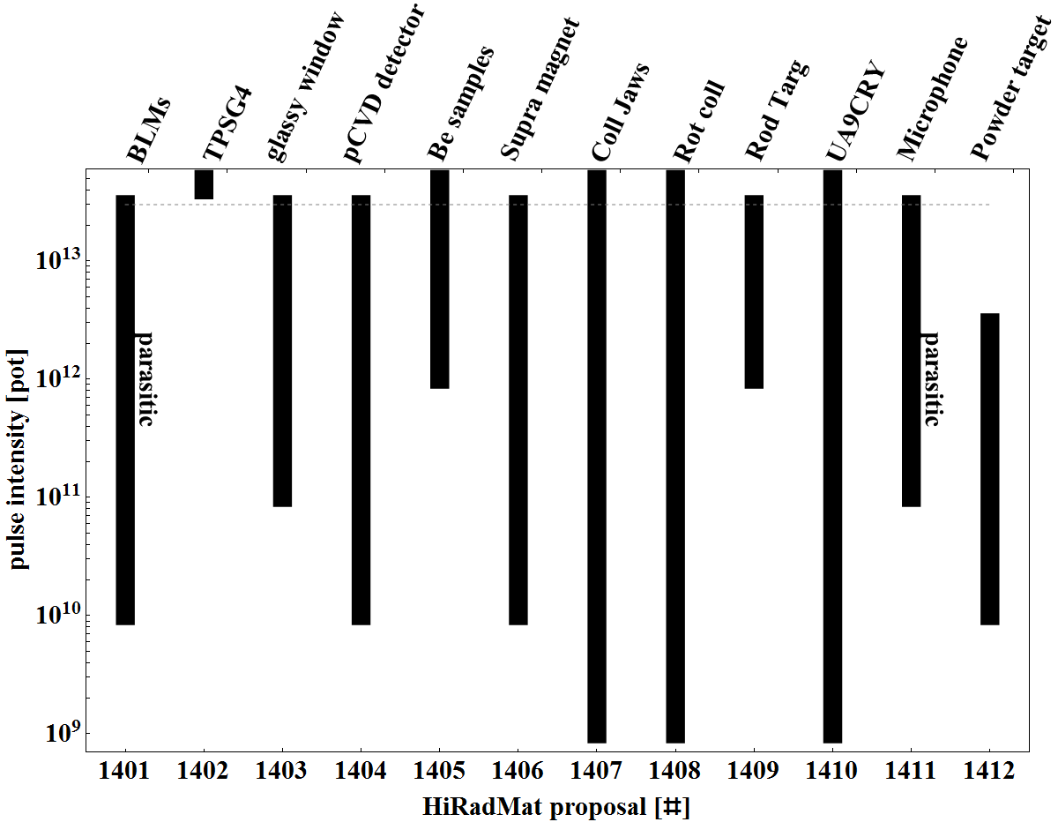
Proposals 2014/2015
Call for proposals in spring 2014
  12 applications
Beam run 2014/15 allows about 12 beam slots

Slide 20
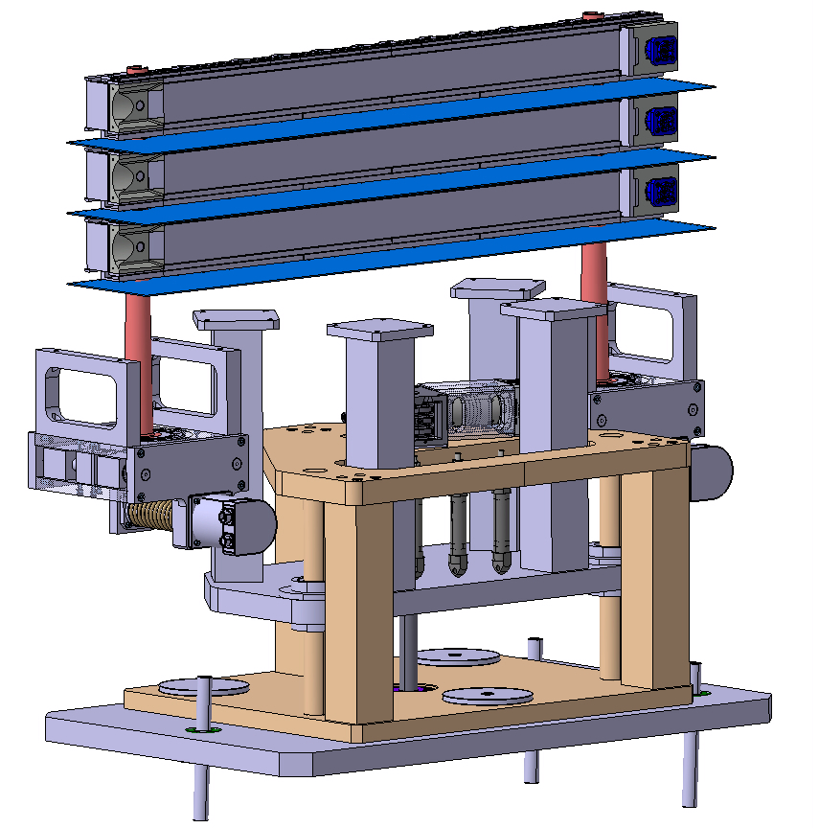
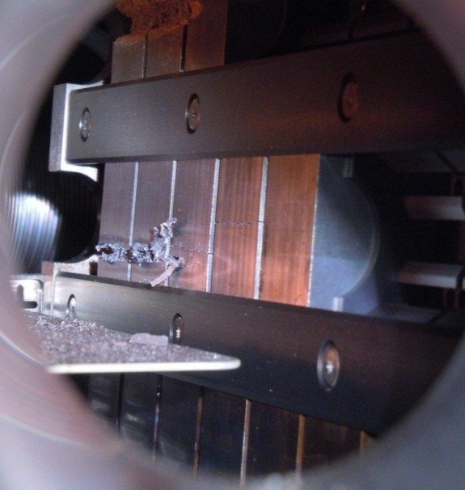
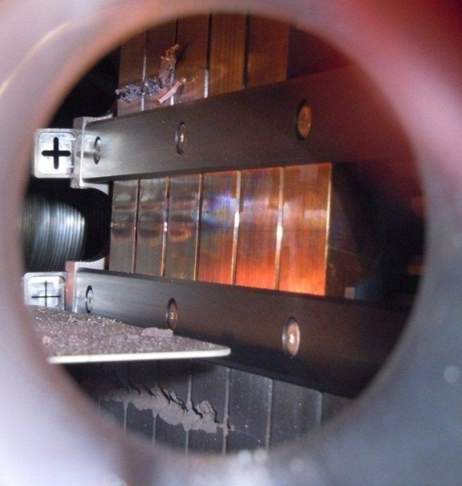
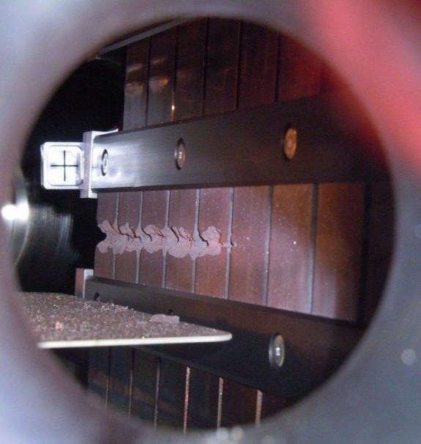
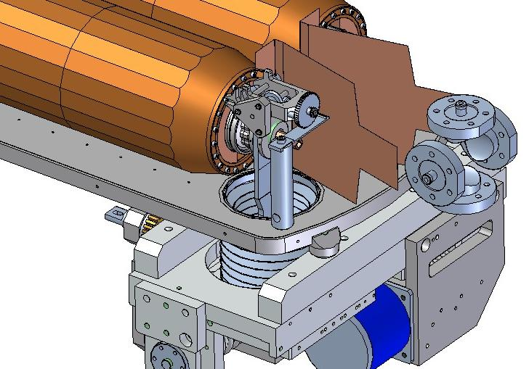
Collimators
  Molybdenum, 72 & 144 bunches
  Glidcop, 72 bunches (2 x)
A. Bertarelli CERN MME
S. Redaelli CERN ABP
et al.
  Molybdenum-Copper-Diamond 144 bunches
SLAC

Slide 21
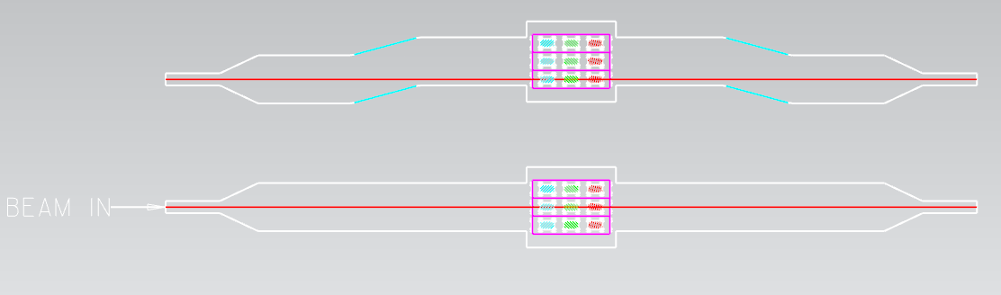
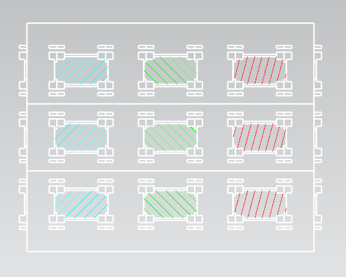
Beryllium specimen
P. Hurh (FNAL), C. Densham (RAL) et al.
Multiple samples exploiting long interaction length in beryllium.
Samples include:
Different commercial grades of Be
Thick & thin windows

Slide 22
Powder target
Start
Sample #1
Small grains
Open Trough
Vacuum
2x10¹¹ ppp
Vacuum
2x10¹² ppp
Helium
2x10¹¹ ppp
Eruption ?
N
Eruption ?
N
Eruption ?
N ?
Sample #2
Large grains
Open Trough
Y
Y
Y
Vacuum
Same beam
Helium
2x10¹¹ ppp
Sample #3
Small grains
Open Trough
Helium
2x10¹¹ ppp
Option ‘A’
Higher Intensity
Option ‘B’
Vary the Beam Posn.
Sample #4
Large grains
Closed Tube
Vary intensity and monitor container wall with LDV
C. Densham (RAL) et al.
End

Slide 23


pbar target
Pulse intensity ~1-5*10¹² p/pulse
Spot size: 1x1 mm² → 1.5x1.5 mm²
Total number of medium-high intensity pulses: ~300-400
  Ramp-up approach
  Other ~200 low intensity pulses could be anticipated
Integral intensity ~2*10¹⁵ POT
Beam alignment/stability:
  Maximum shift pulse-by-pulse ~100 μm
    Important to have it guaranteed, not only monitor
  Monitor beam asymmetry ~100 μm

Slide 24

Procedure for Experiments
Submit application for HiRadMat beam time
  Application = scientific interest (1-2 pages), pulse list, installation sketch, preliminary safety documents
Initial discussion with Facility Management
  feasibility of installation, compatibility with existing infrastructure
Review by HiRadMat Scientific Board
  Evaluates the scientific merit of the proposed experiments, the proposed online measurements during beam time, the post-irradiation analysis plans and the expected results to the interest of the scientific community.
  Distribute the financial support granted from the European community within EuCARD2-TransnationalAccess
  travel and accommodation subsistence to HiRadMat users
From beam slot to scheduled beam time - HiRadMat Technical Board
  safety review : interview with safety officials, analysis of the submitted safety file (includes dismantling!)
  beam review : interview with beam operations and CCC
  technical review : interview with HiRadMat technical coordination
positive recommendation of all above, validates the beam slot allocation to the schedule
Beam time
Dismantling - analysis of results - publications

Slide 25
Summary
HiRadMat is a young facility with growing interest due to its uniqueness from various fields in Accelerator R&D and beyond.
First year (2012) of operations: 9 experiments successfully completed
Beam returns in October 2014
The facility is available to the world-wide community.

