Slide 1
Neutrino Factory Mercury Flow Loop
V. Graves
C. Caldwell
IDS-NF Videoconference
March 9, 2010

Slide 2
Flow Loop Review
1 cm dia nozzle, 20 m/s jet requires 1.57 liter/sec mercury flow (94.2 liter/min, 24.9 gpm).
MERIT experiment showed that a pump discharge pressure of ~40 bar gauge required to produce the desired jet.
  Reference: SNS nominal flow 1440 liter/min (380 gpm), 7 bar gauge pump discharge pressure, ~1400 liters total Hg inventory
Basic flow scheme
  Pump → Nozzle → Jet/Beam Dump → Heat Exchanger → Pump

Slide 3
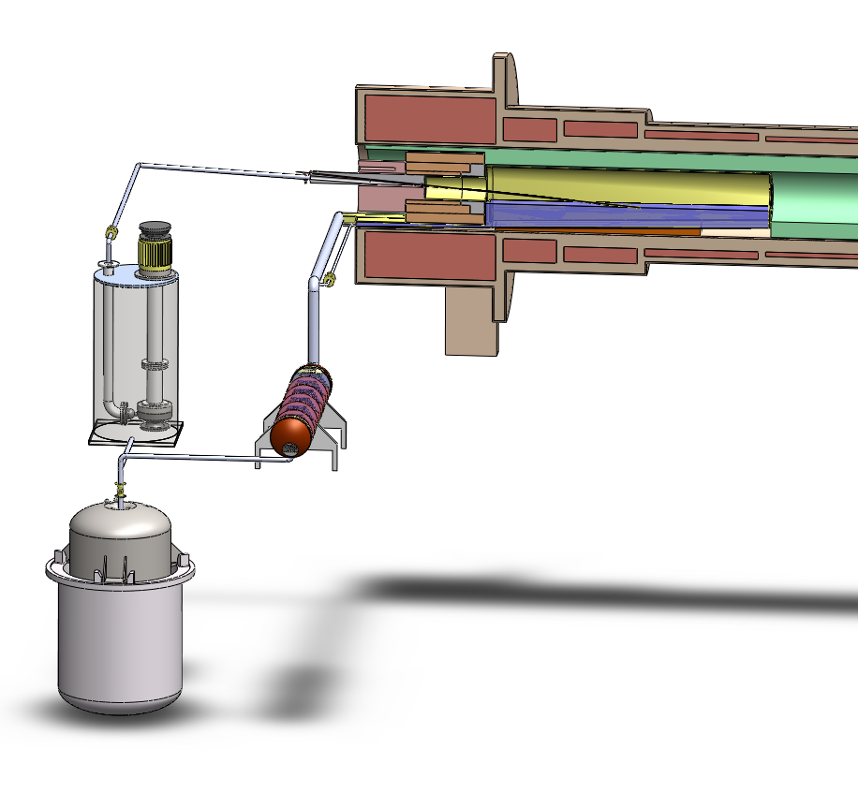
Hg Flow
Overflow Mercury Drain
Minimize pressure drops through piping by increasing diameter
  2" nozzle supply piping transitioning to 1 cm nozzle
Actual NF Hg inventory may reach SNS volumes
  ~500 liters in the half-length beam dump shown
Mercury Pump
Beam Dump
Gravity Drain Flow Control Valve
Heat Exchanger
Storage Tank

Slide 4
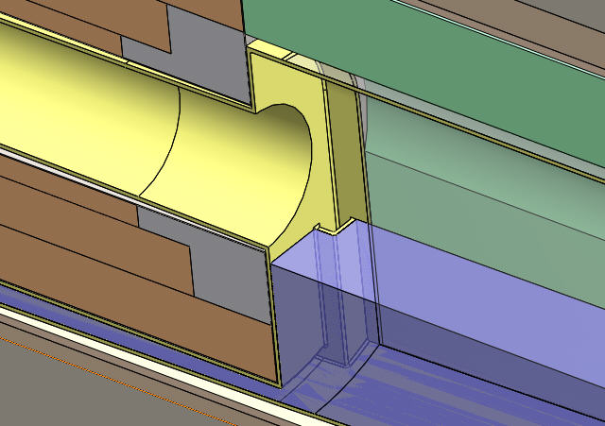
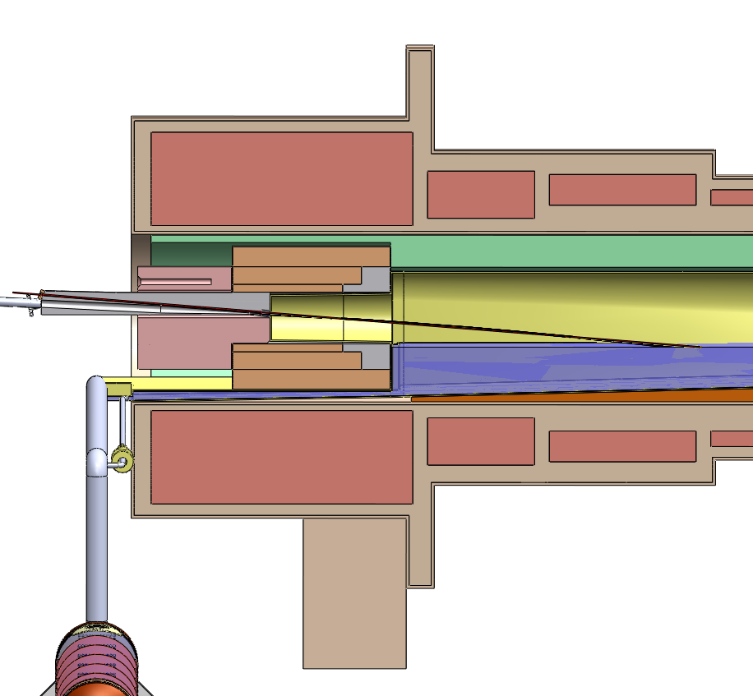
Gravity Drain Requires Flow Control
Bulk flow exits dump via overflow drains
Gravity drain intended to remain closed until end-of run, but this liquid becomes static
Decay heating requires gravity drain to have flow control
Proton Beam
Mercury Jet
Mercury Overflow
Gravity Drain Flow Control
WC Shielding
Overflow drains

Slide 5
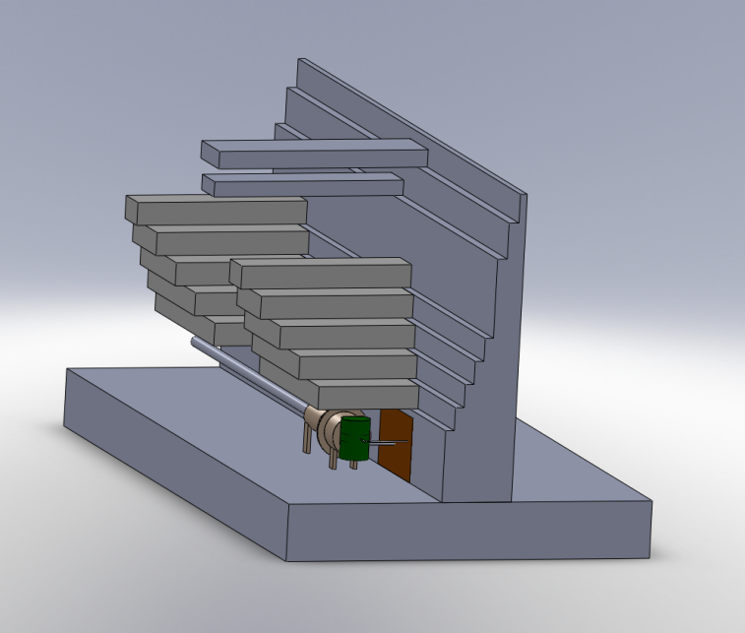
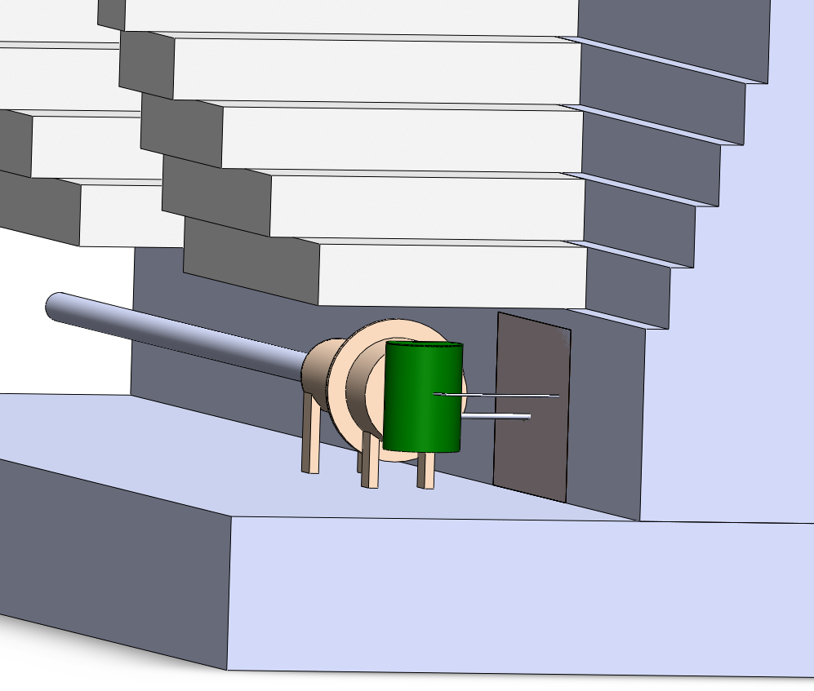
Target Building
Based on Study 2 concept
Mercury loop "hot cell" will probably extend into magnet chase
  Could require double containment of mercury
  Chase will certainly have a drain back into hot cell
Decay Channel Cryostats
Main Cryostat (Target Region)
Core Vessel
Mercury Process Hot Cell

Slide 6
Heat Removal
Element/Compound | Density (g/cm^3)
Hg | 13.5
W | 19.3
WC | 15.8
From Study 2, the mercury jet/pool receive < 10% of beam energy; bulk goes into WC shielding
  Currently assumed to be WC spheres cooled by water
  Much larger heat exchanger needed to cool shielding
Considering that both W and WC must be water-cooled, their effective densities will approach that of Hg.
Consequently, IF a Hg target is selected, the infrastructure will be in place to support use of Hg as a solenoid shield.
  Would probably be a separate loop due to vastly different flow/pressure requirements, but could share a storage tank

Slide 7
Future Work
  Continue development of Target Building infrastructure conceptual design
  Look further into the mechanics of the region upstream of the nozzle
    Remote maintenance / assembly / disassembly
    Mercury flow

