Slide 1
20to2T5m120cm4pDL Concept Update
Van Graves
June 6, 2014

Slide 2
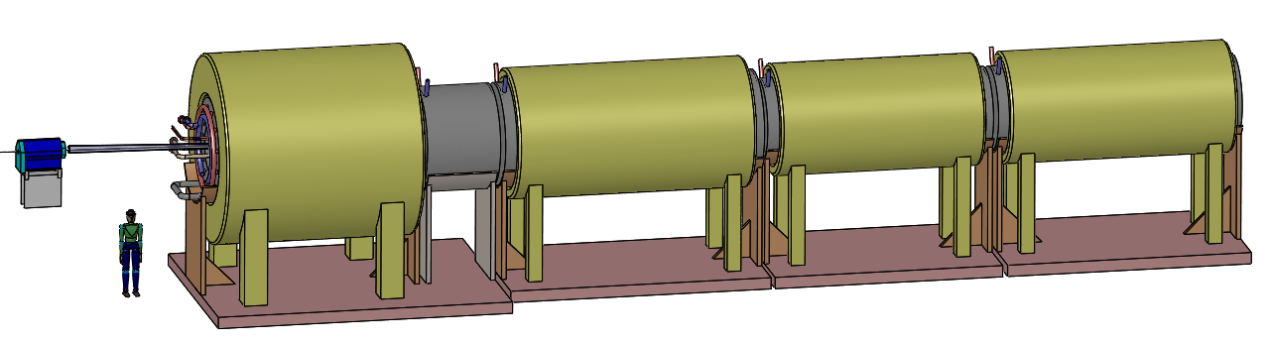

Slide 3
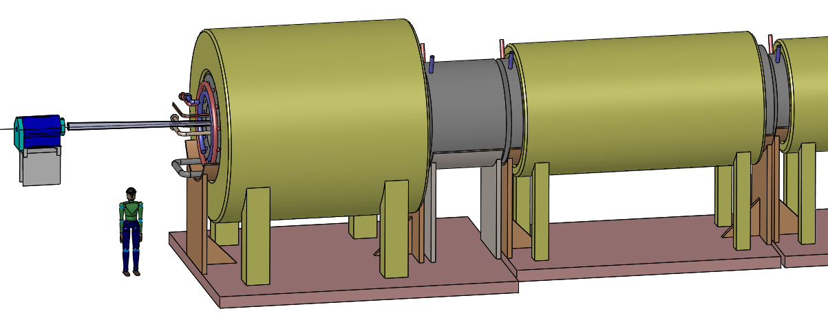

Slide 4
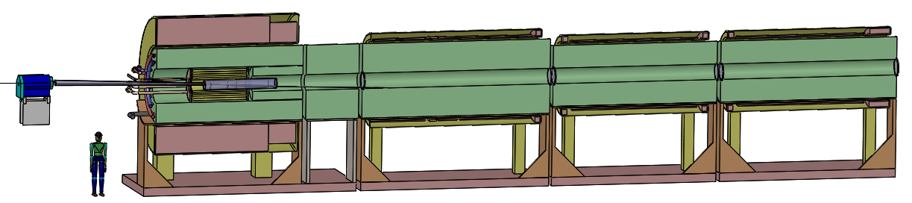

Slide 5
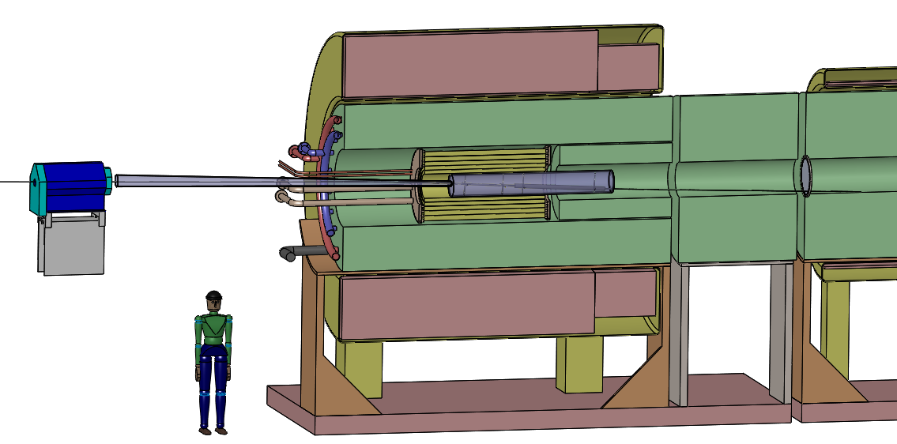

Slide 6
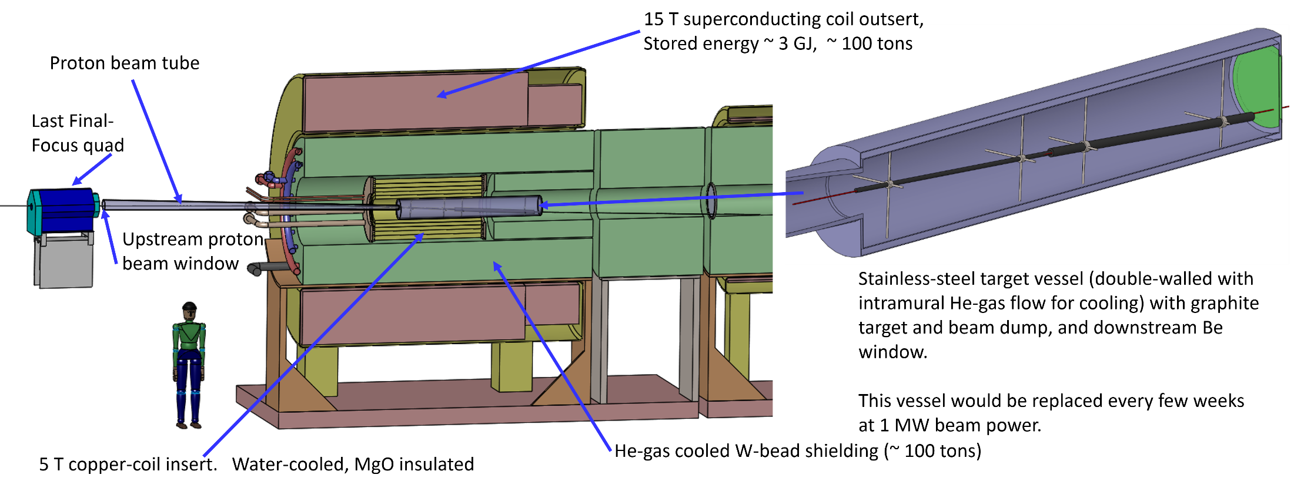
This page is a single image, not editable

Slide 7
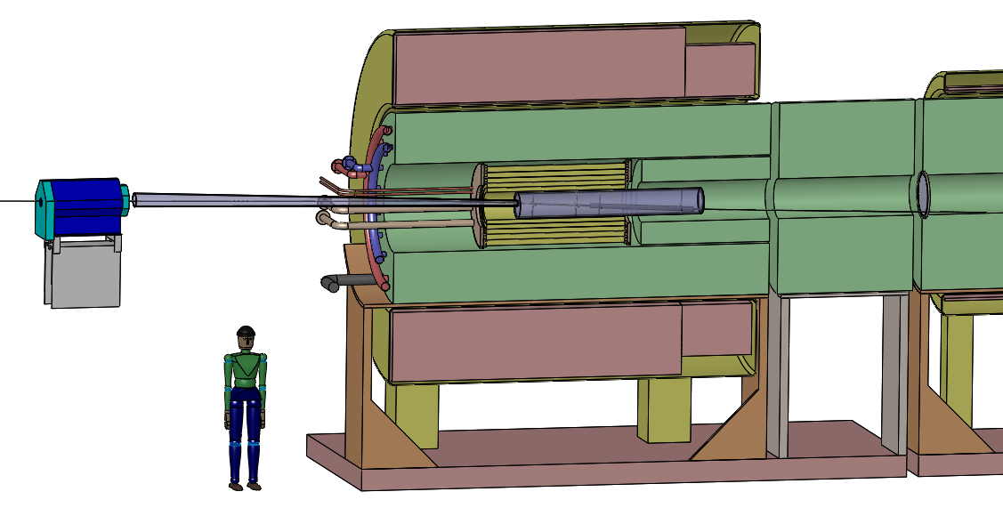
This page is editable
15 T superconducting coil outsert,
Stored energy ~ 3 GJ, ~ 100 tons
Last
Final-Focus quad
Proton beam tube
Upstream proton beam window
5 T copper-coil insert, Water-cooled, MgO insulated
Target/dump vessel
He-gas-cooled W-bead shielding (~ 100 tons)

Slide 8
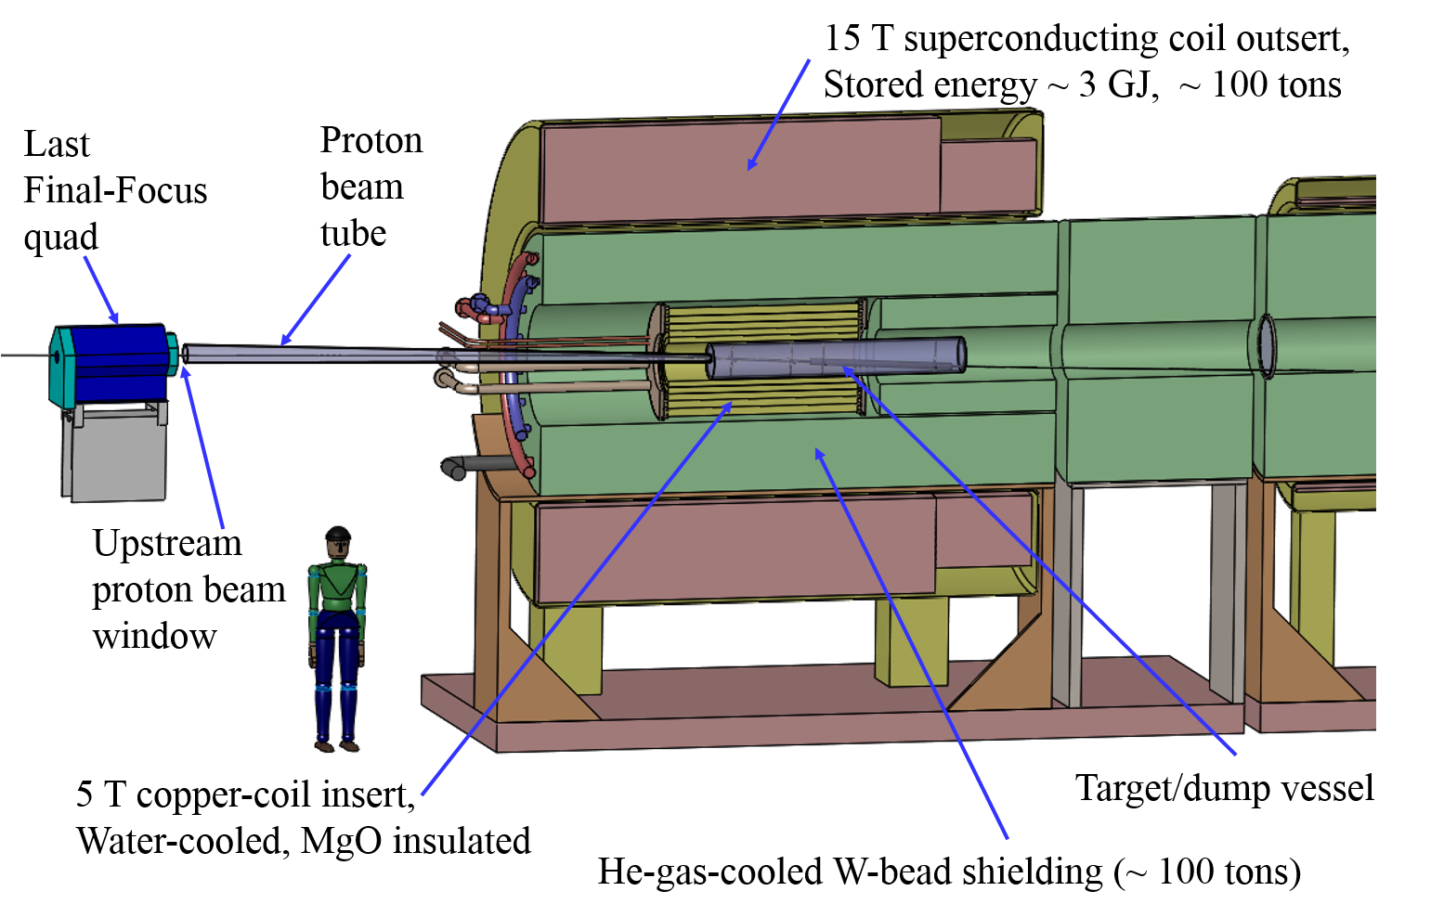
This page is a single image, not editable

Slide 9
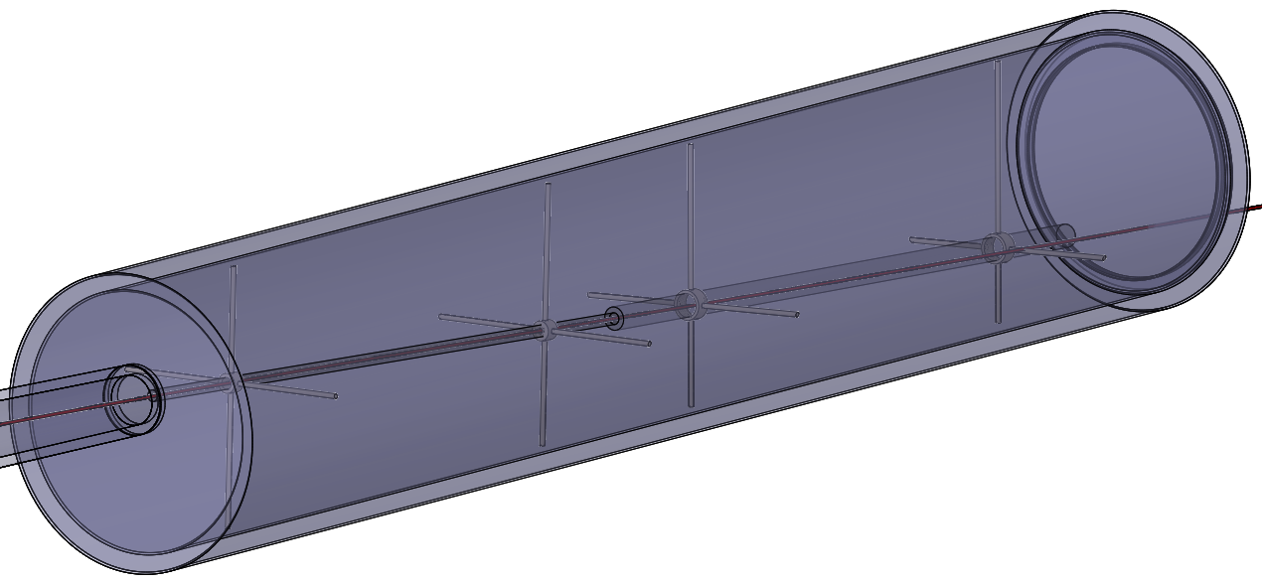
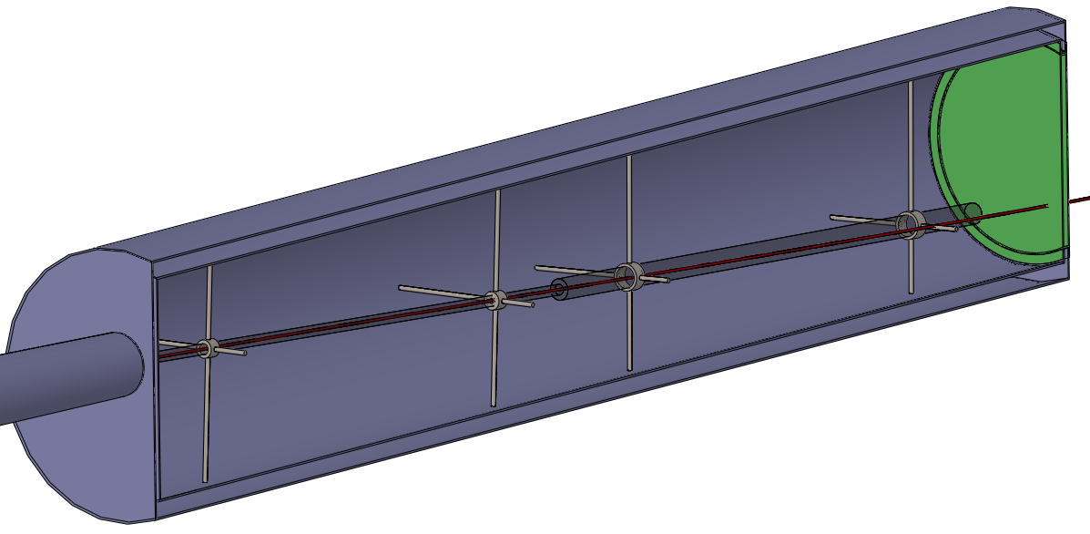

Slide 11
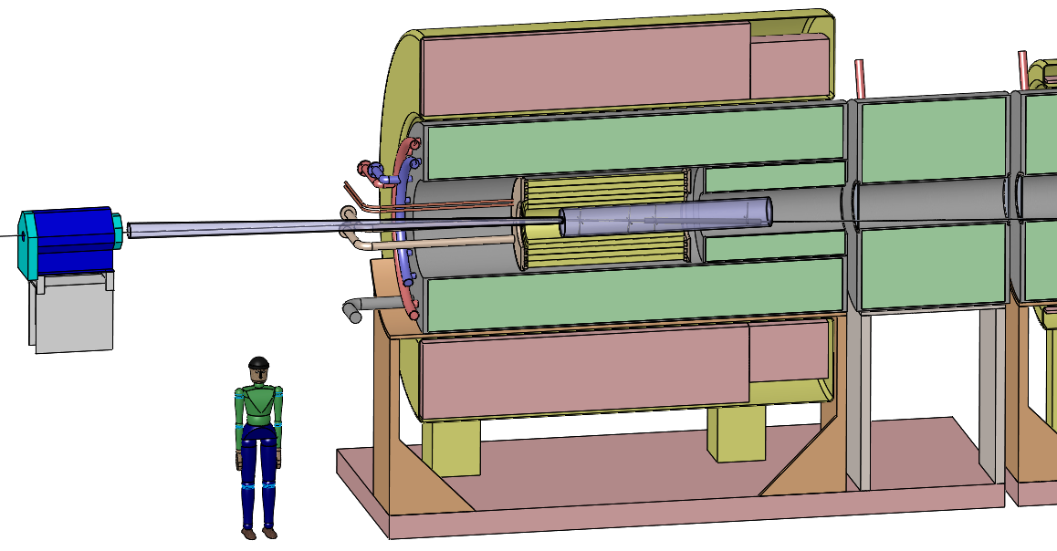

Slide 12
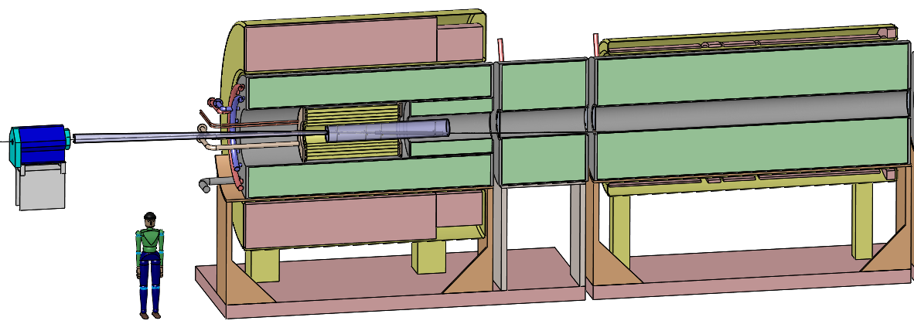

Slide 13
This page is editable
15 T superconducting coil outsert,
Stored energy ~ 3 GJ, ~ 100 tons
Proton beam tube
Last
Final-Focus quad
2nd magnet module, 5 SC coils
Be window, r = 23 cm
Upstream proton beam window
Target/dump vessel
5 T copper-coil insert, Water-cooled, MgO insulated
He-gas-cooled W-bead shielding (~ 100 tons)

Slide 14
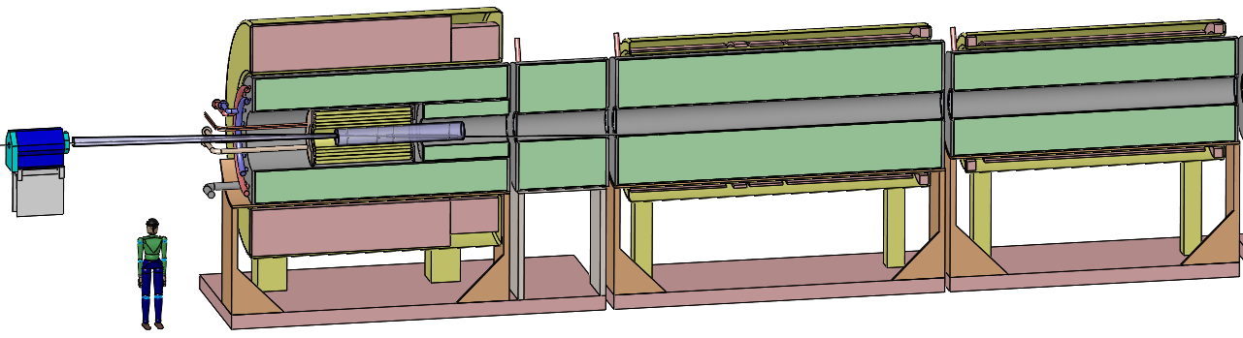

Slide 15
This page is editable
15-T superconducting coil outsert,
Stored energy ~ 3 GJ, ~ 100 tons
Proton beam tube
Transition magnet module, 5 coils, 5 m long, 2-T final field
2-T magnet modules, 6 coils,
5-m long, 23-cm-radius bore
Last Final-Focus quad
Upstream proton beam window
He-gas cooled W-bead shielding (~ 100 tons/module)
5-T copper-coil insert. Water-cooled, MgO insulated

Slide 16
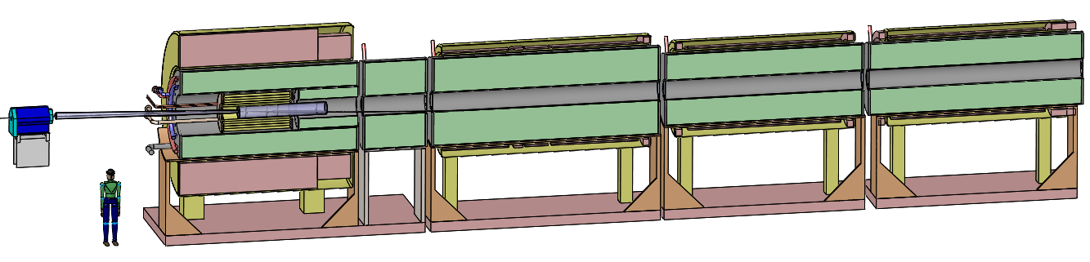

Slide 17
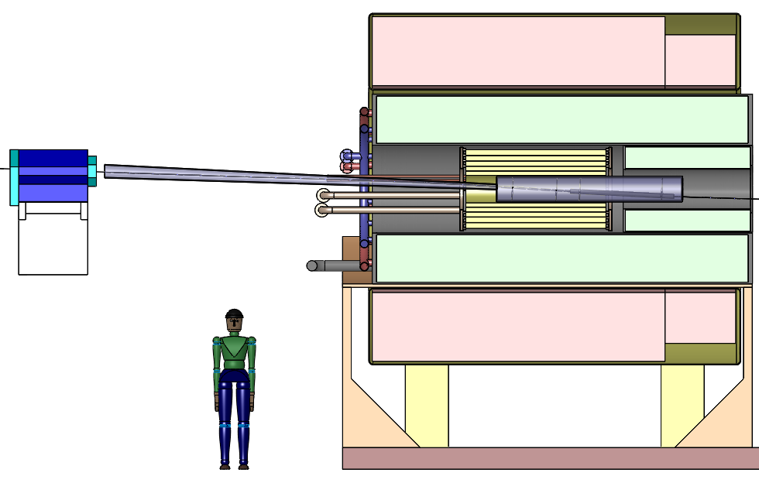

Slide 18
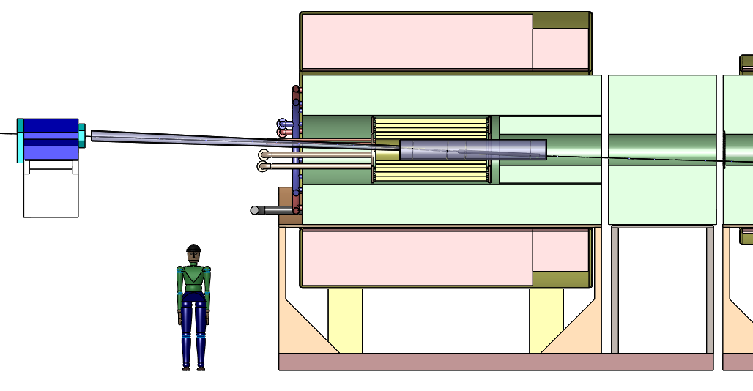

Slide 19
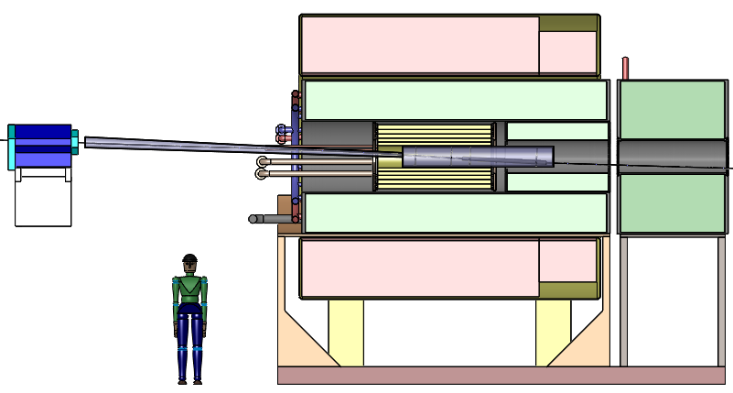

Slide 20
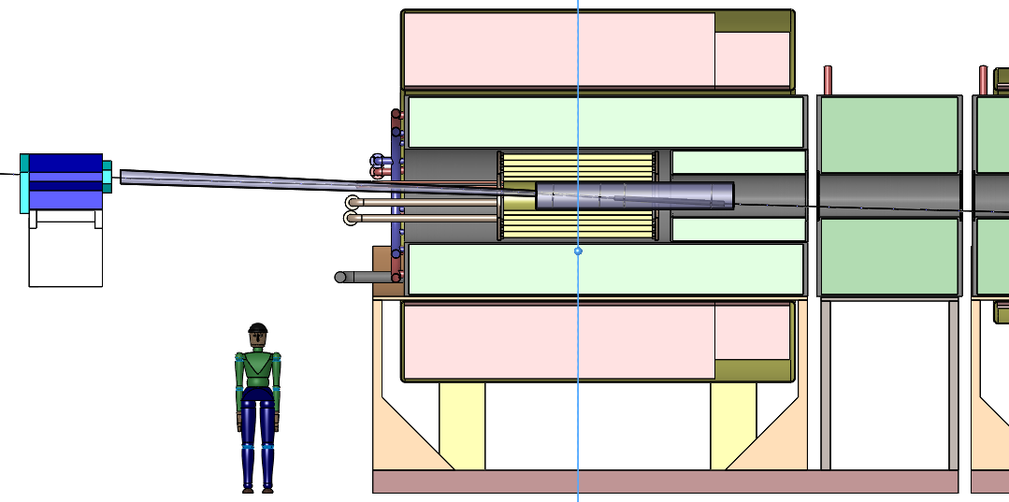
Z=0

Slide 21
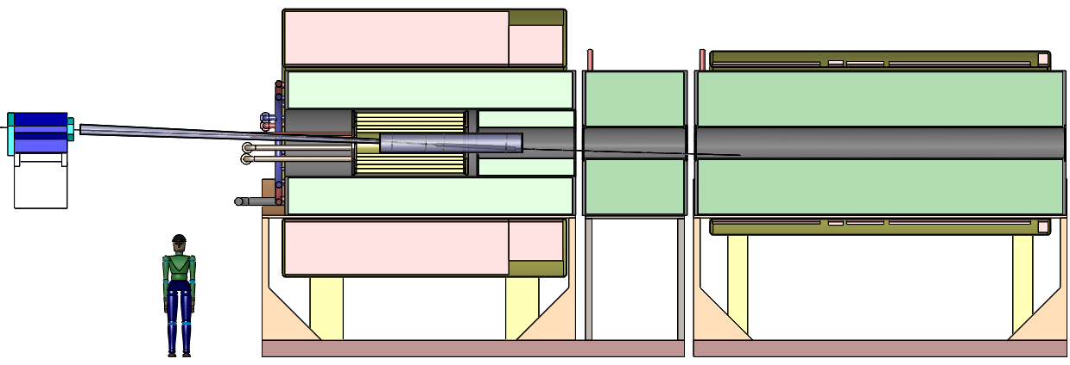

Slide 22
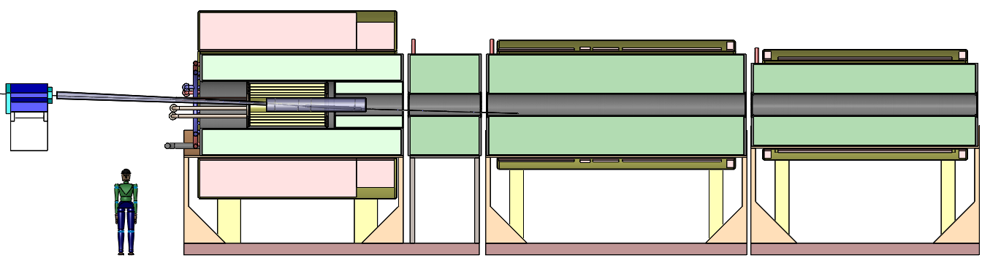

Slide 23
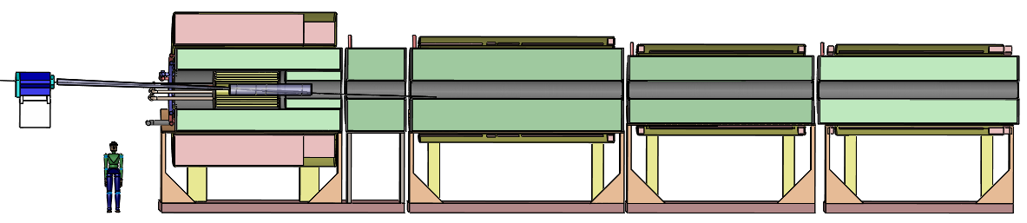

Slide 24
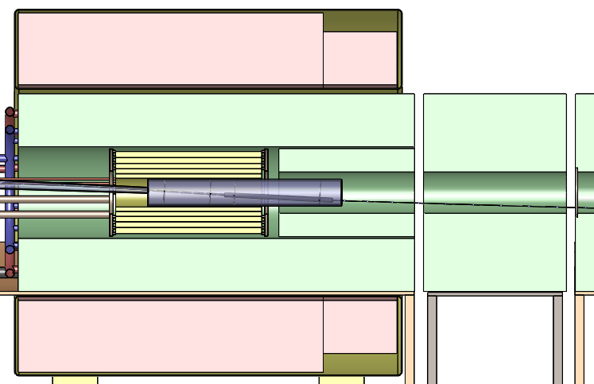

Slide 25
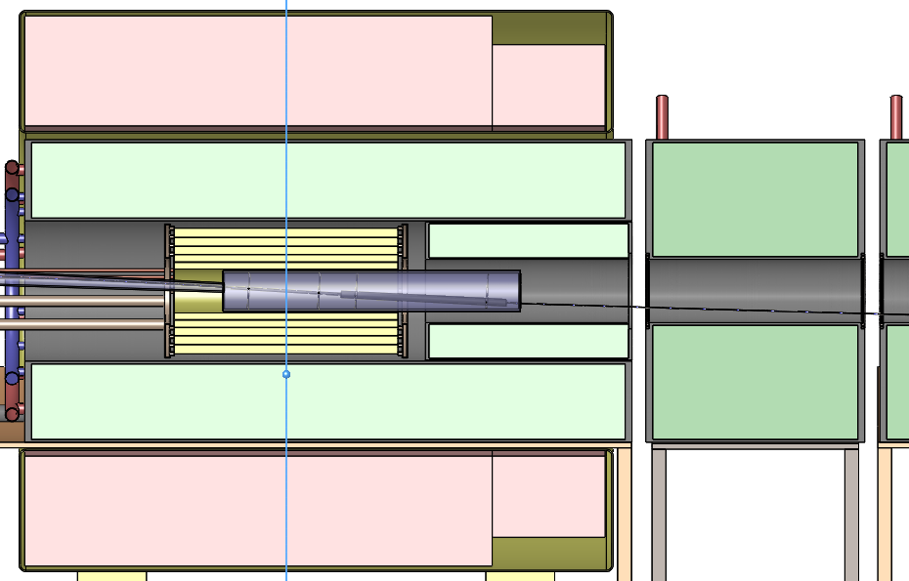
Z=0

Slide 26
Z=0

Slide 27
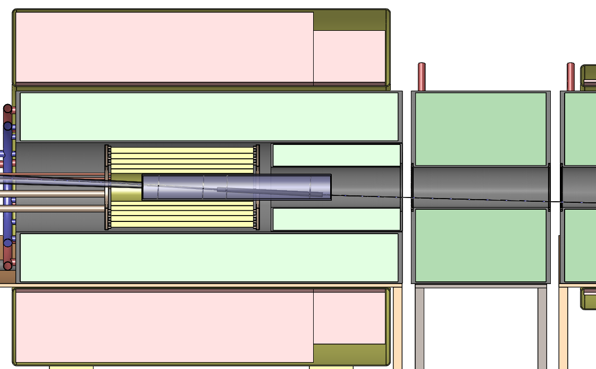

Slide 28
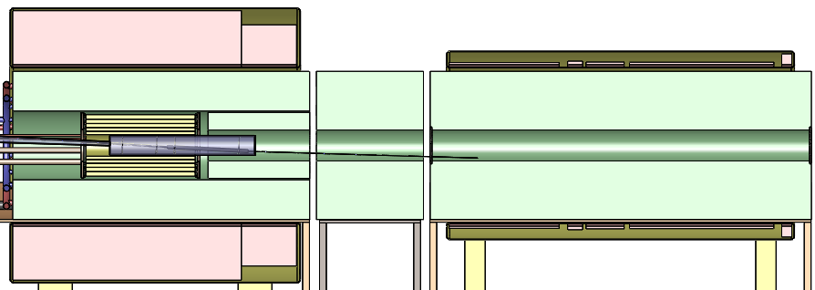

Slide 29
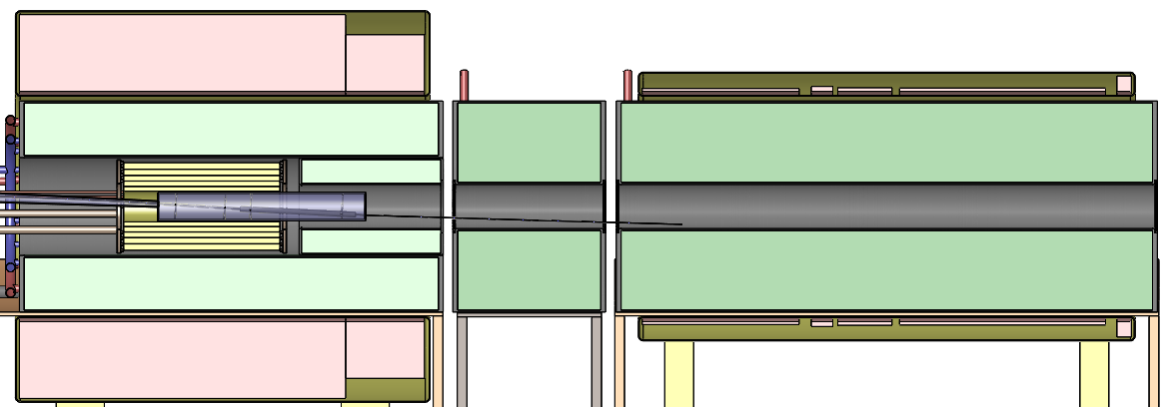

Slide 30
2nd magnet module

Slide 31
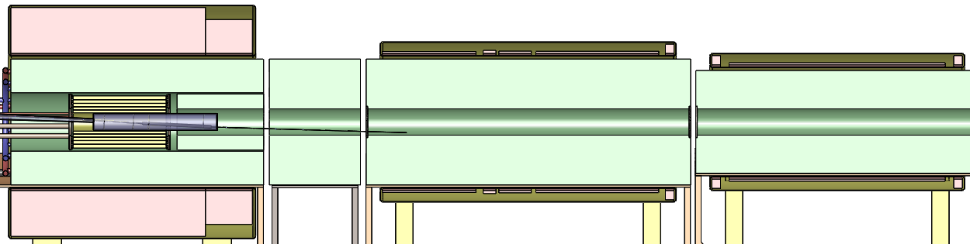

Slide 32
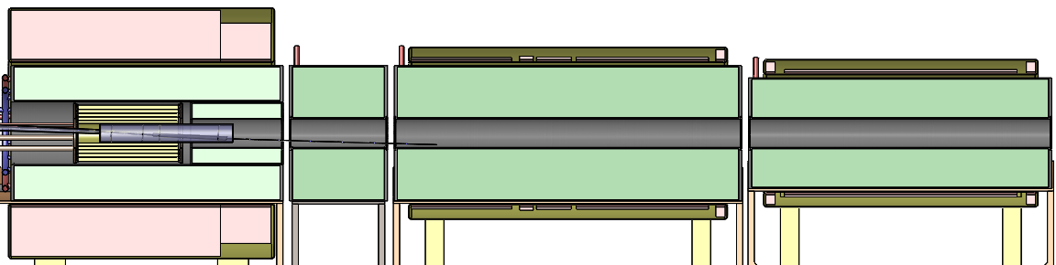

Slide 33
3rd magnet module

Slide 34
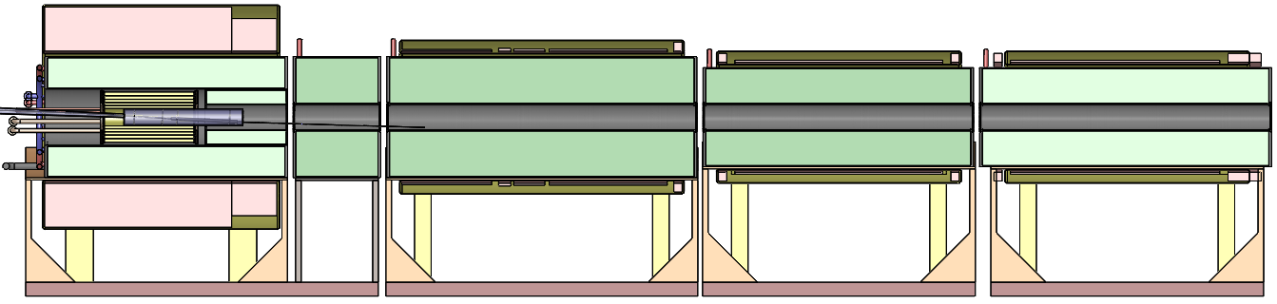

Slide 35
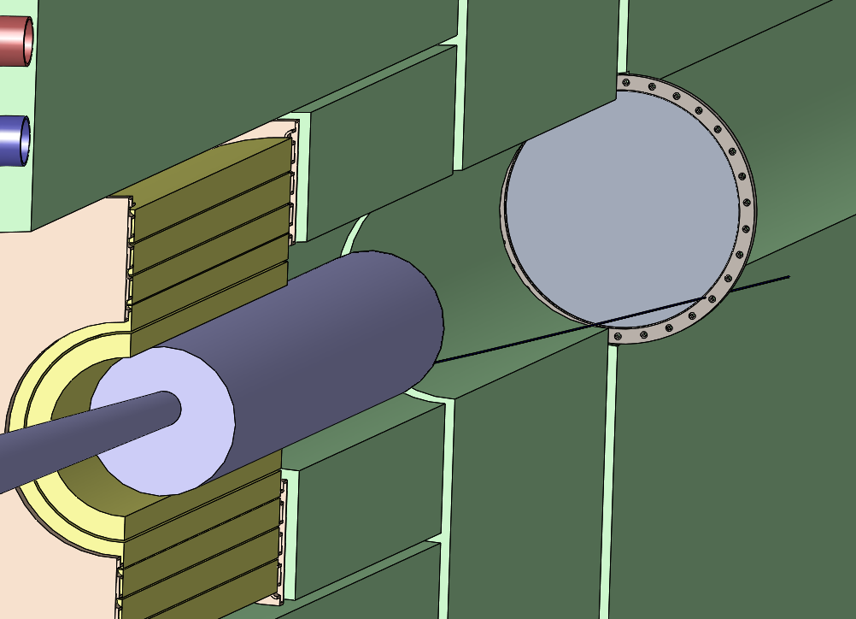

Slide 36
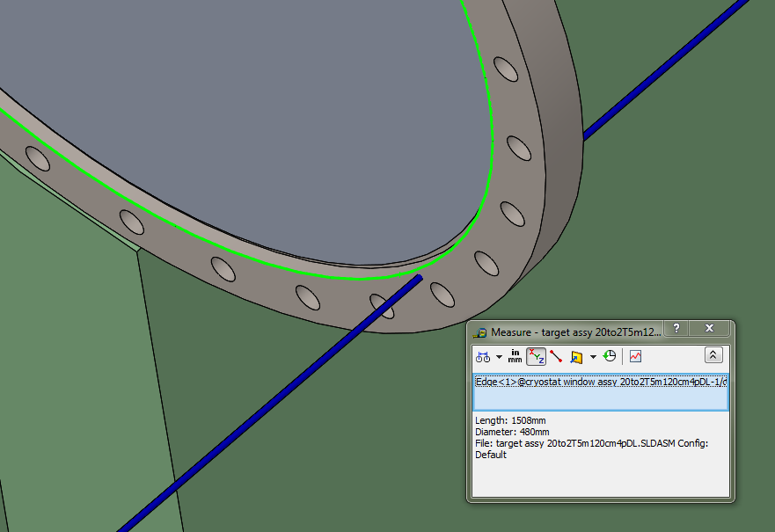

Slide 38
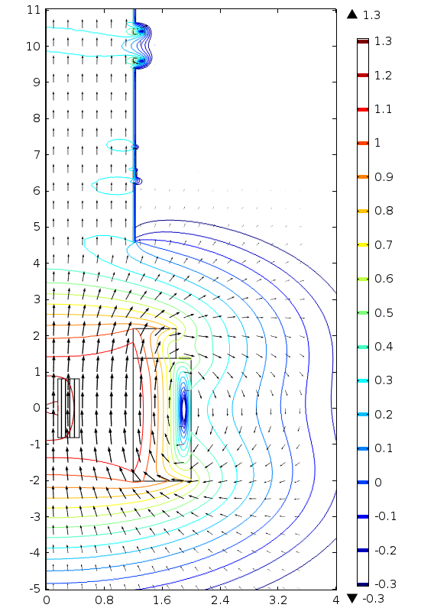

Slide 39
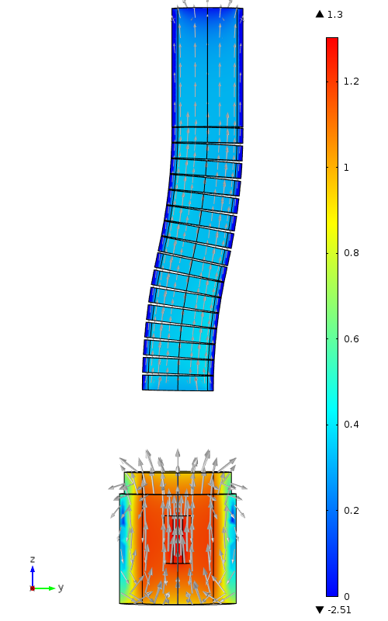
y
z

