Slide 1
Shield Module Design Considerations
Adam Carroll
Van Graves
July 3, 2014

Slide 2
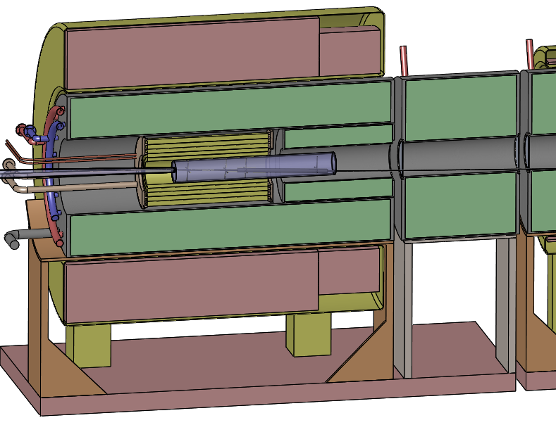
Overview
Capability to remotely remove and reinstall the shield modules is required
Shield module concept is He-cooled tungsten spheres
Current shield modules weigh up to 200 tons
Cradle needs to be sized to support shielding
SC1
SC2
Tungsten Shielding
Cradle

Slide 3
20to2T5m120cm4pDL Shielding Module Volumes
Module | Volume (m^3) | Weight (MT)* | Weight (ton)
1 | 13.16 | 152.0 | 167.6
2 | 0.89 | 10.3 | 11.9
3 | 7.45 | 86.0 | 95.0
4 | 20.57 | 237.6 | 262.0
5 | 11.75 | 135.7 | 150.0
6 | 12.61 | 145.6 | 160.5
*Assuming density of 19,250 kg/m^3, packing factor of 60%
1
2
3
4
5
6

Slide 4
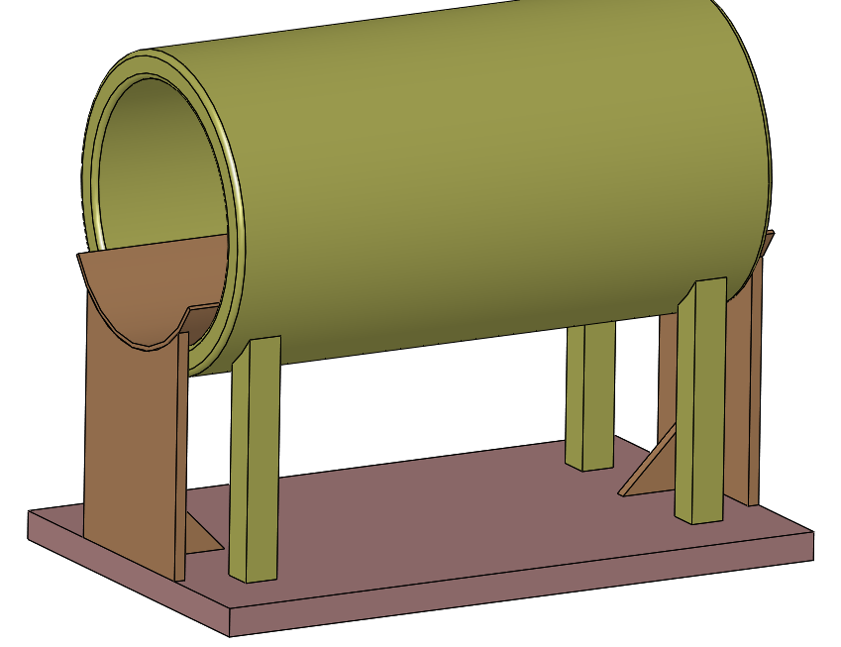
Shield Supports
Current concept is simple stand integrated with cryostat
Provides curved shelf to support shield weight without transferring load to cryostat
Mounted to base platform that can be moved laterally out of beam line
Some design considerations
Inter-coil forces
Shielding module support & removal
Stability under weight
Space requirements
Shorter preferred in height and along beam axis
Shelf thickness: 40mm
Leg footprint: 100mm X 1600mm

Slide 5
Translating the shielding
Options for shield module extraction
Sliding material, low friction material to reduce force required to drag shielding
Best materials not radiation tolerant
Steel on steel: µ_{s} = 0.5 – 0.8
Steel on brass: µ_{s} = 0.35
Tracked wheels, removes significant shielding space, difficult due to high weights, may be possible
Rollers, removes significant shielding space, but rad-hard and reliable
Lubricants likely not allowed
Rollers considered for this presentation
Shielding

Slide 6
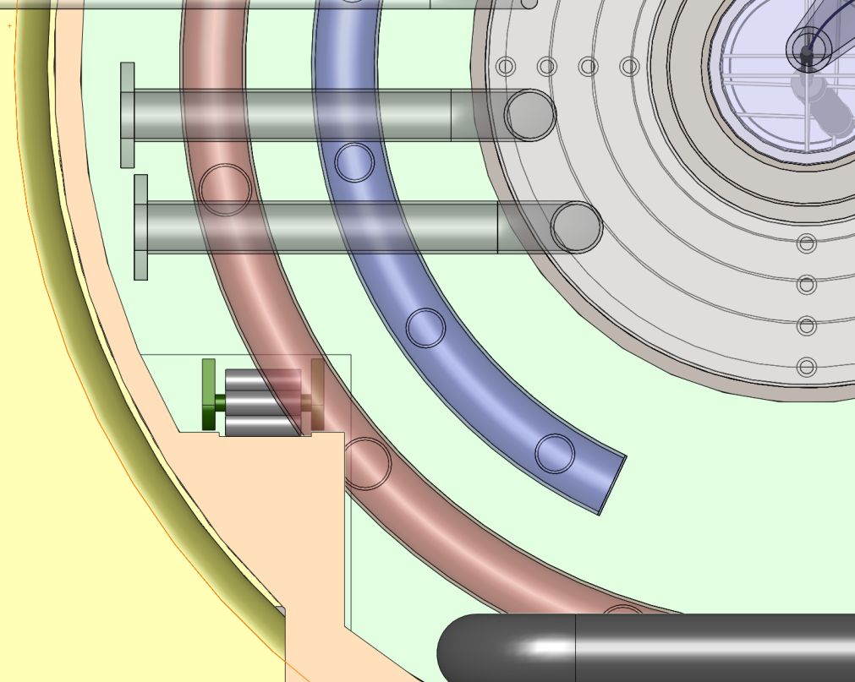
Shielding Cut Away for Roller
Shielding cutaway required to allow space for rollers
Potentially could be optimized to provide more shielding, but a significant localized shielding reduction will always be required
60 cm
31 cm

Slide 7
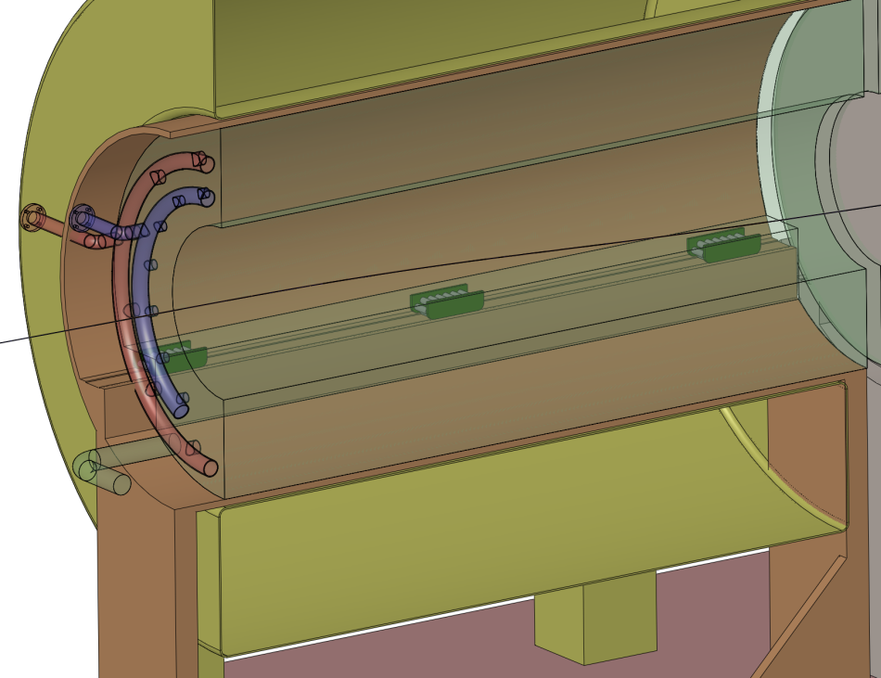
Rollers
High weight capacity required
First concept is commercially available hardware with adequate capacity
Minimum of three pairs required
Continuous line of rollers reduces stress on cradle (see two slides forward for comparison)
Hilman Rollers

Slide 8
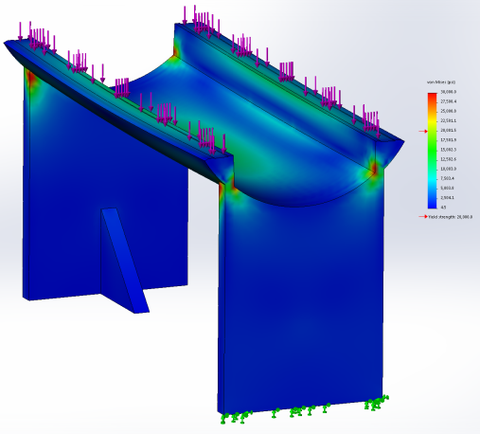
Cradle Stress
Initial cradle design with the addition of a track is insufficient to support the weight of the shield.
Transforming the cradle into a tube significantly improves its strength.

Slide 9
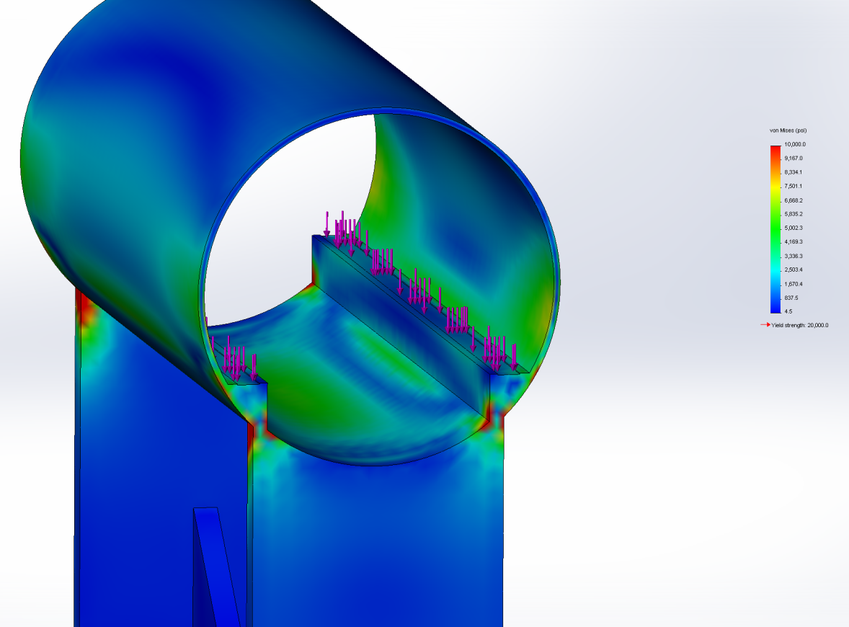
Cradle Stress
Continuous rollers produce lower stress on cradle
Other potential worse case loading situation may occur as the shield module is extracted, those situations will need to be considered to continue the conceptual design
Max Stress ~15ksi
Max Stress above yield
Continuous
Three Pair
Note: images don’t use same scale

Slide 10
Cradle Buckling
Buckling of the cradle was analyzed
~55x load factor calculated
Buckling not a concern in current concept
Horizontal forces from inter-coil attraction/repulsion not considered

Slide 11
Conclusions
Remotely handling the shielding modules is a significant challenge
Rollers are an option, optimization to reduce shielding loss required
Cradle requires some strengthening to handle the shielding load
Extraction procedure and tooling concepts need to be developed
Smaller shielding modules beneficial from remote handling perspective
One shield per coil, one coil per cryostat
Cryostat performance must be considered
More utility connections required
Increases number of inter-coil forces if each coil is in its own cryostat
More and/or larger gaps between cryostats

