Slide 1

The Front End

Slide 2
Outline
Define Front End
Major Sub-systems
Key Challenges
Future R&D Activities

Slide 3
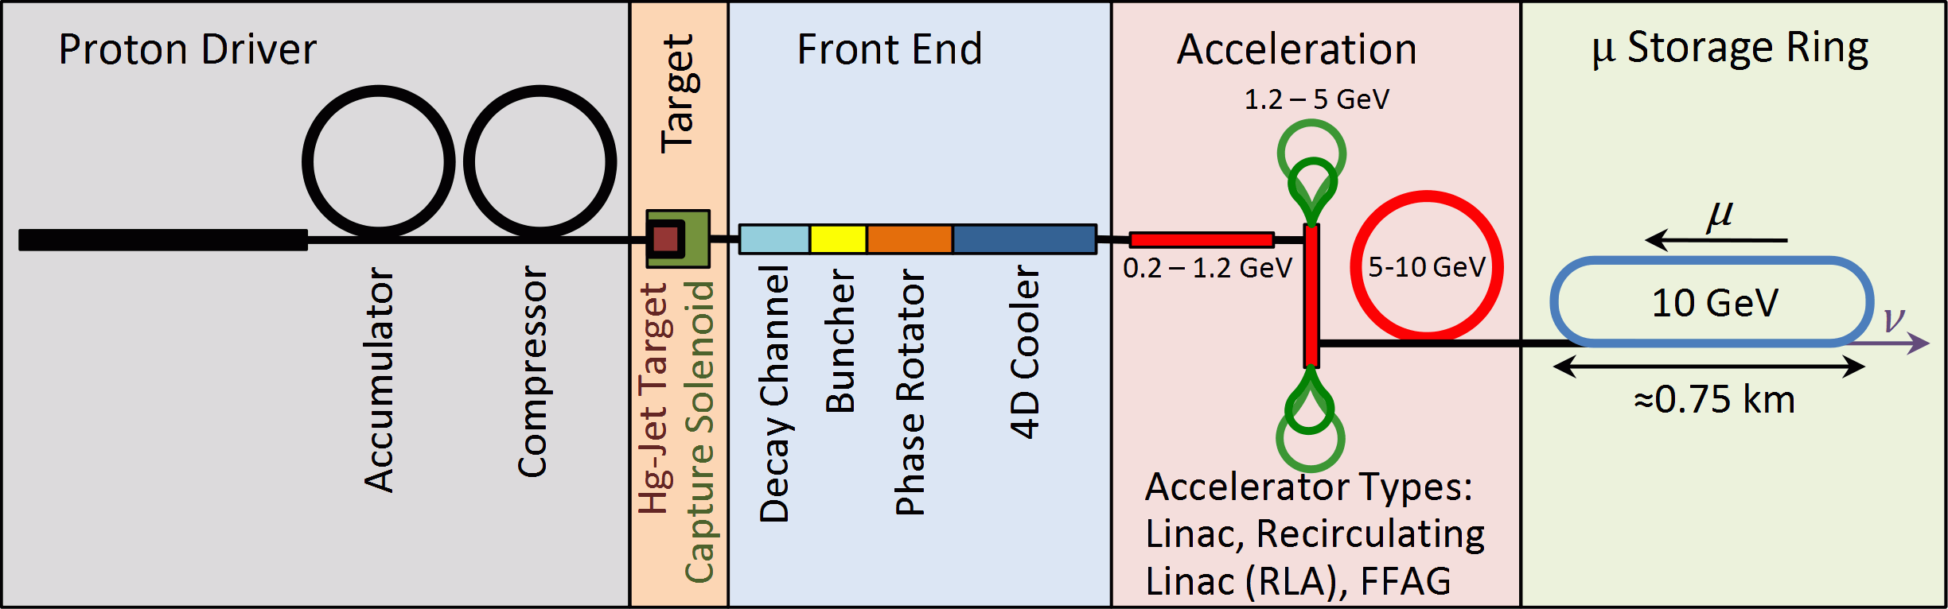
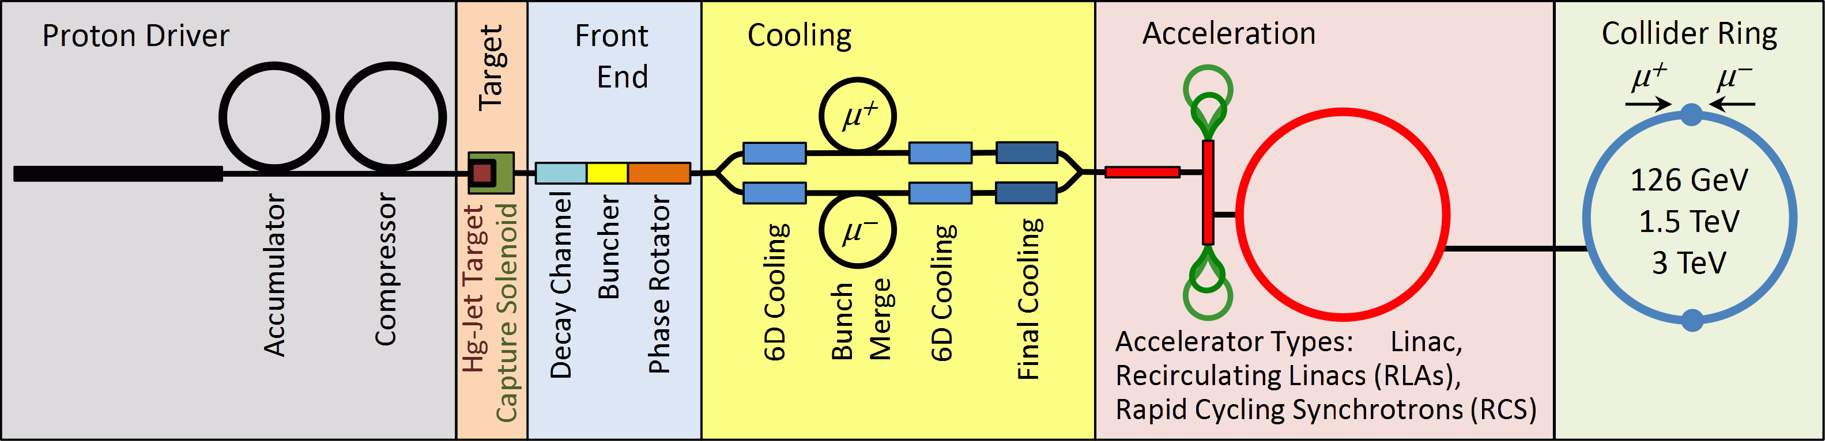
The Muon Collider/Neutrino
Factory Front End
The Front End is that portion of the facility following the proton driver and target which delivers muons to the Muon Collider 6d cooling system or the Neutrino Factory acceleration system.
The proton source will have different bunch structures.
Neutrino
Factory
(with 4D cooler)
Muon
Collider
(no 4D Cooler)

Slide 4
The Major Front End Sub-Systems
Drift/Decay Channel (π→μ)
Buncher
Rotator
4D Cooler
Target
Front End
p
π→μ
FE Target
Solenoid
Drift
Buncher
Rotator
Cooler
18.2 m
~65m
~33m
~42 m
~75 m

Slide 5
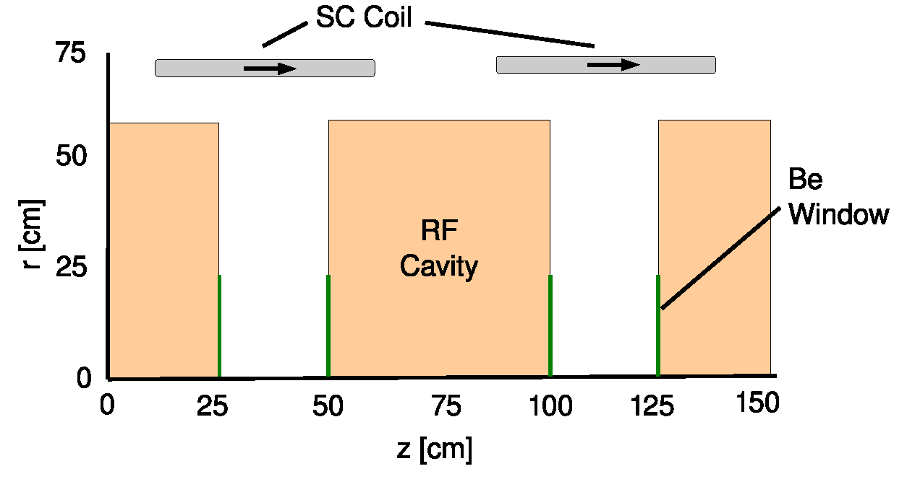
Key Buncher/Rotator Parameters
Buncher
37 rf cavities
320 to 233.6 MHz (13 frequencies)
7.5 MV/m Peak rf gradient
24 MW Peak rf power (MC: 0.12 MW avg)
1.5T Peak magnetic field
33 m total length
Rotator
56 rf cavities
230 to 202.3 MHz (15 frequencies)
12 MV/m Peak rf gradient
140 MW Peak rf power (MC: 0.7 MW avg)
1.5 T Peak magnetic field
42 m total length

Slide 6
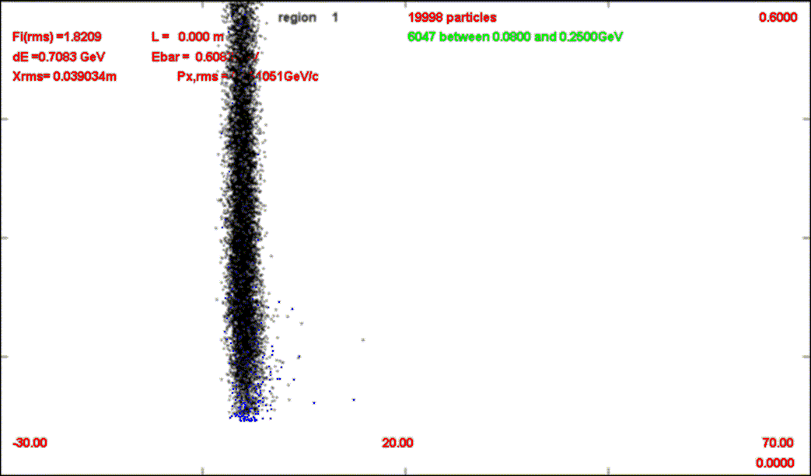
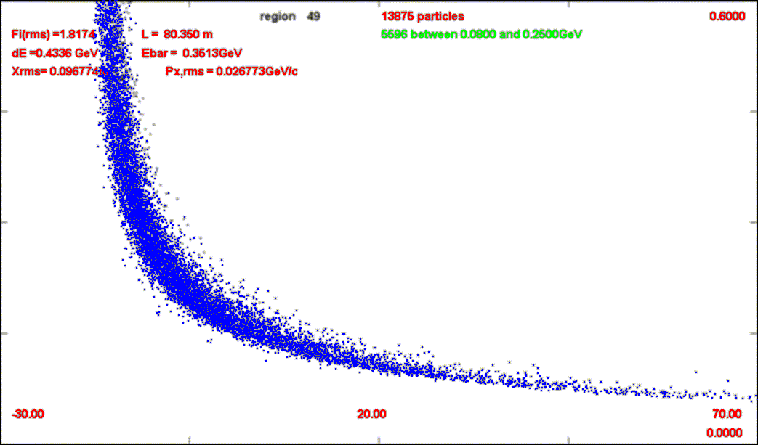
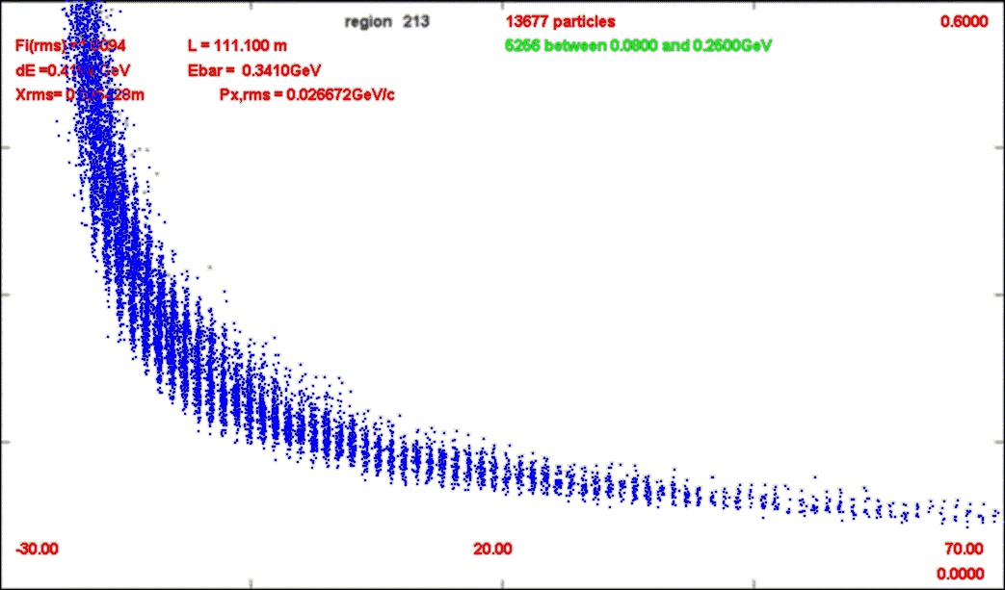
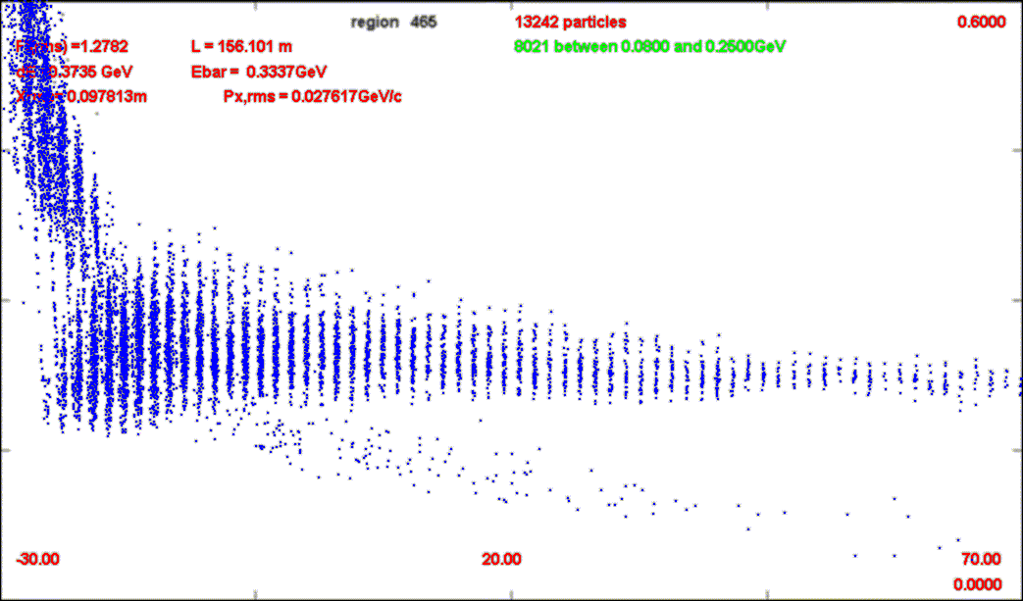
The Buncher/Rotator
Target
Drift
Pion/Muon Kinetic Energy
Rotator
Buncher
cτau

Slide 7
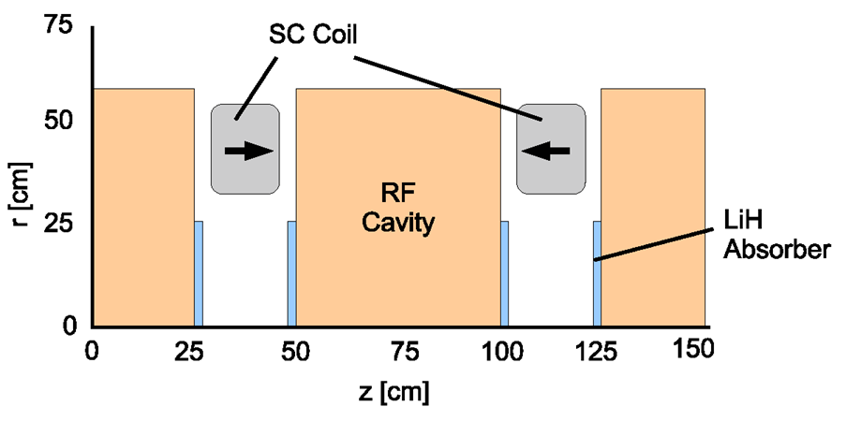
The Cooler
100 rf cavities
201.25 MHz
15 MV/m peak rf gradient
400 MW peak rf power (NF: 8 MW avg)
2.8T peak magnetic field

Slide 8
Front End Challenges
Buncher/Rotator/Cooler
Shielding of beam line components
Performance of rf cavities in magnetic field
Engineering constraints

Slide 9
Front End Challenges-
Beamline Shielding
Buncher
Buncher
J.C. Gallardo
Rotator
Rotator
Cooler
Cooler
Mitigation Strategies
Upstream bent solenoid
Beryllium “beam stop” plugs

Slide 10
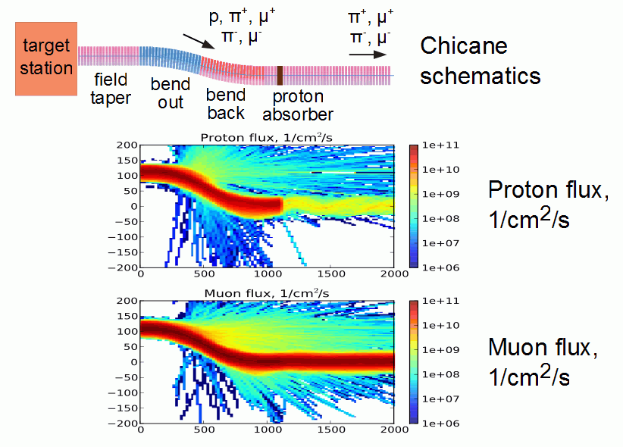
Bent Solenoid Chicane
10m
P. Snopok
2 X 12.5º
^{L = 10m}

Slide 11
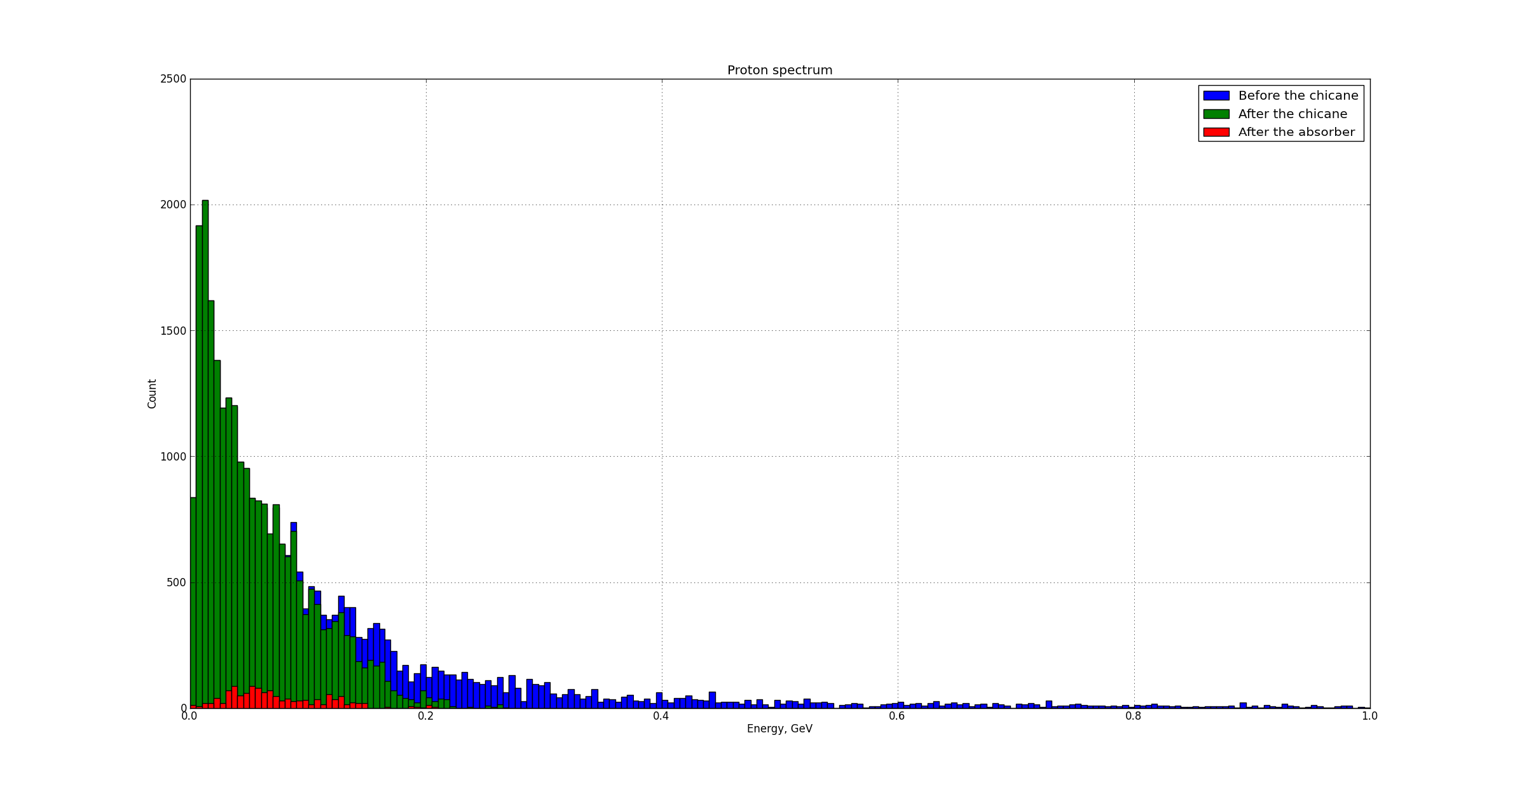
Proton Removal
Stacked plot of protons entering into the Chicane
Blue: Removed by the chicane Green: Removed by absorber Red: Survive
Proton beam power reduced by 99%

Slide 12
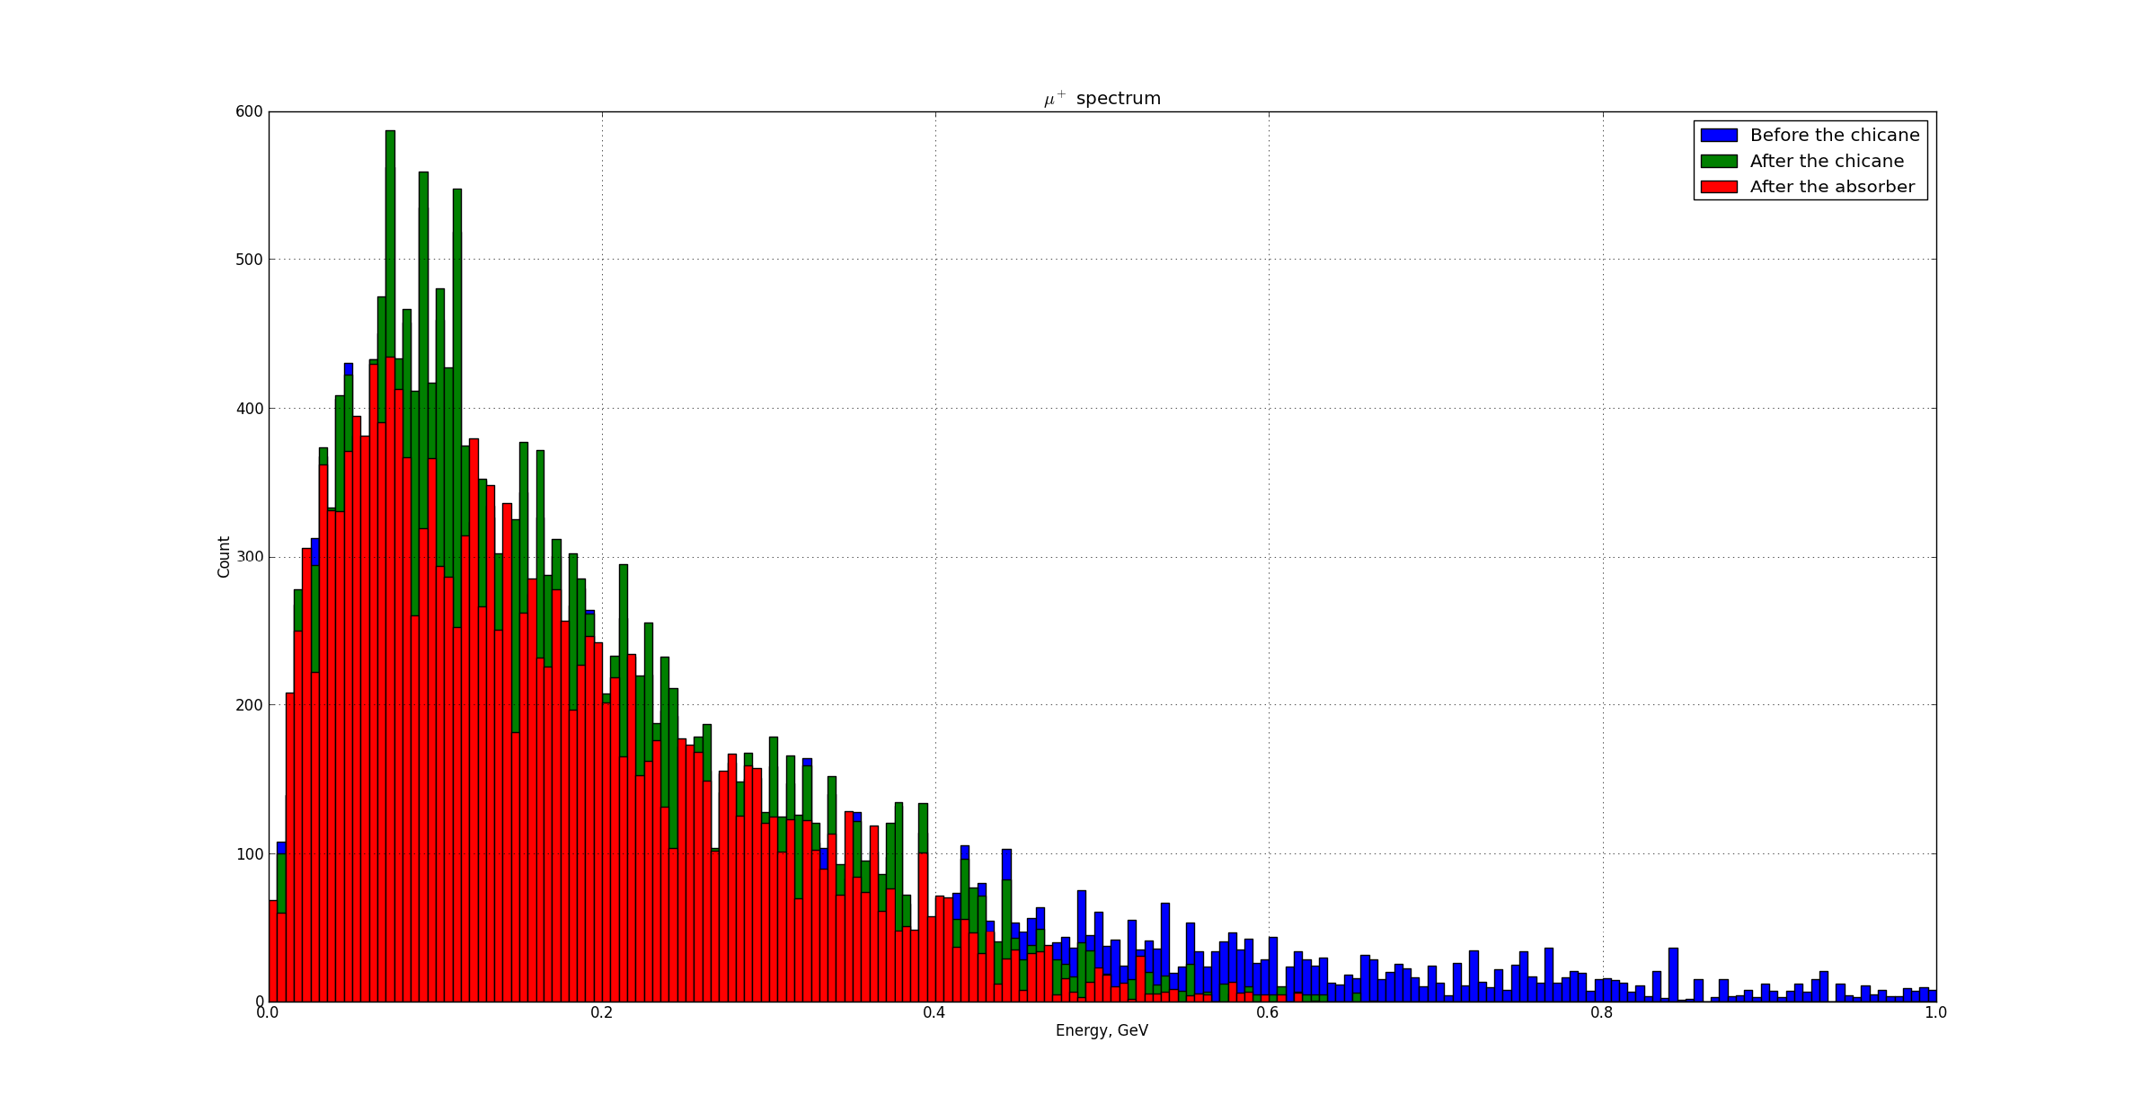
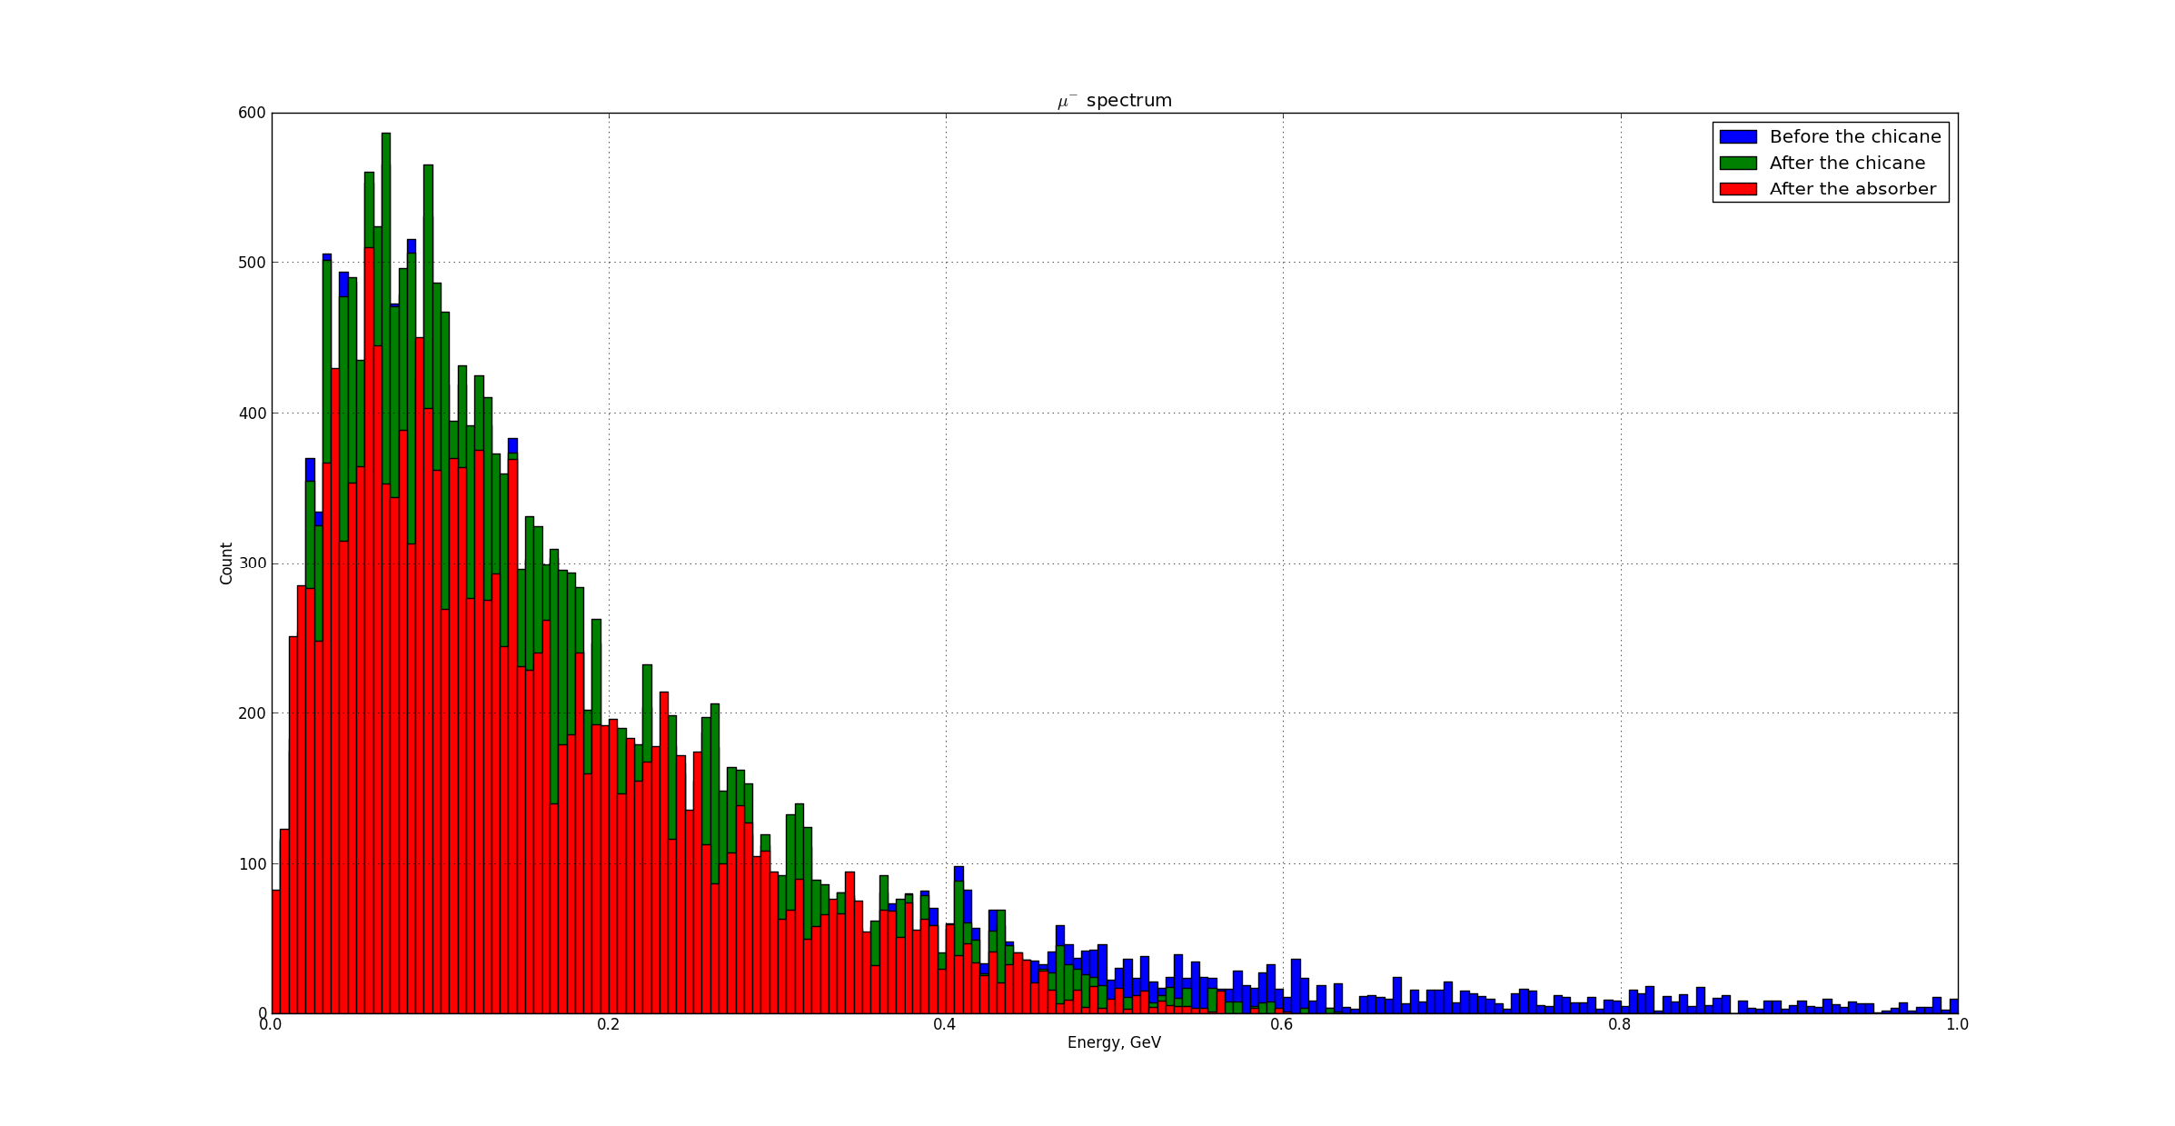
Muons through the Chicane
μ⁺
μ⁻
Muon Front End throughput reduced by 10-15%

Slide 13
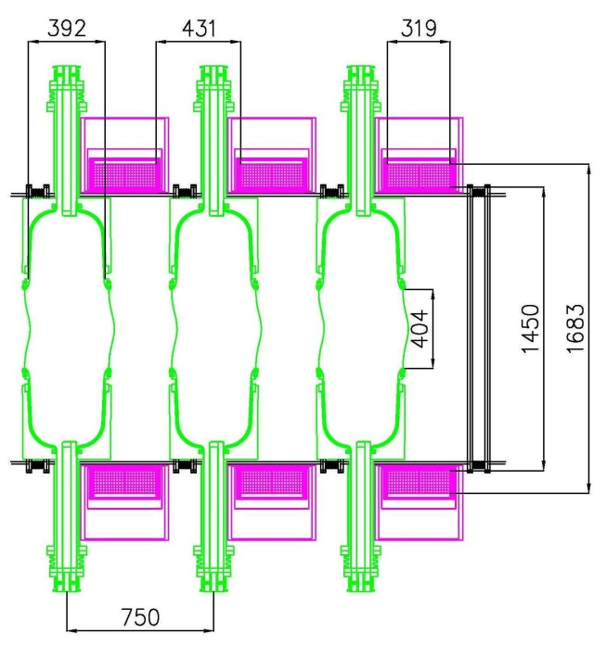
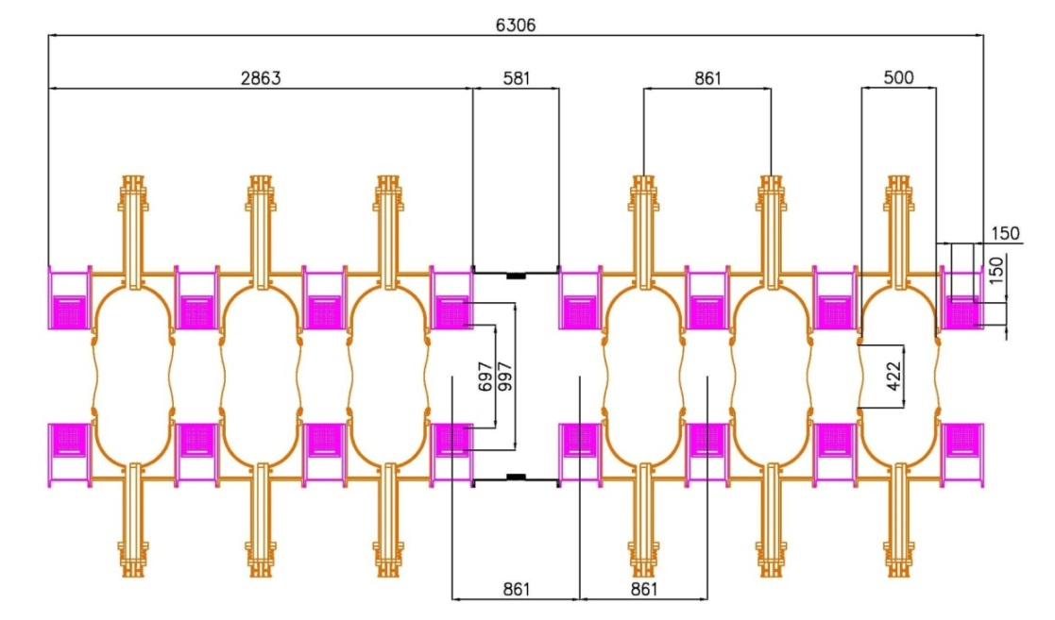
Engineering challenges
Rotator
Cooler
N. Bliss, IDS-NF Meeting (April, 2012)
IFD-NF Engineering studies:
  Increase the gap between coils in buncher & rotator
  Increase cooler cell length from 75 cm to 86 cm
  Have one “empty” cell after a series of cavities

Slide 14
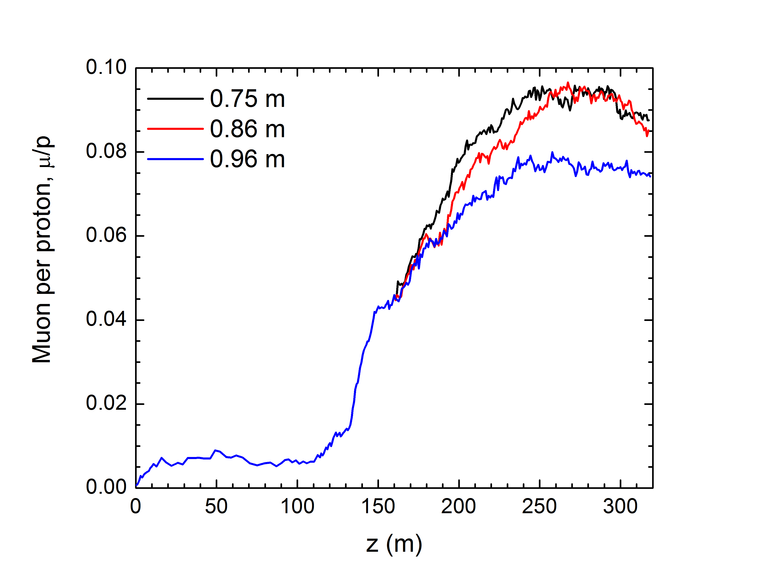
Increasing the cell length
D. Stratakis
Acceptance plot
ε_{T} = 30mm
ε_{L} = 150mm
Simulations show that it is safe to increase the cooler cell to 86cm without loss of performance.
Beyond that point, performance is reduced

Slide 15
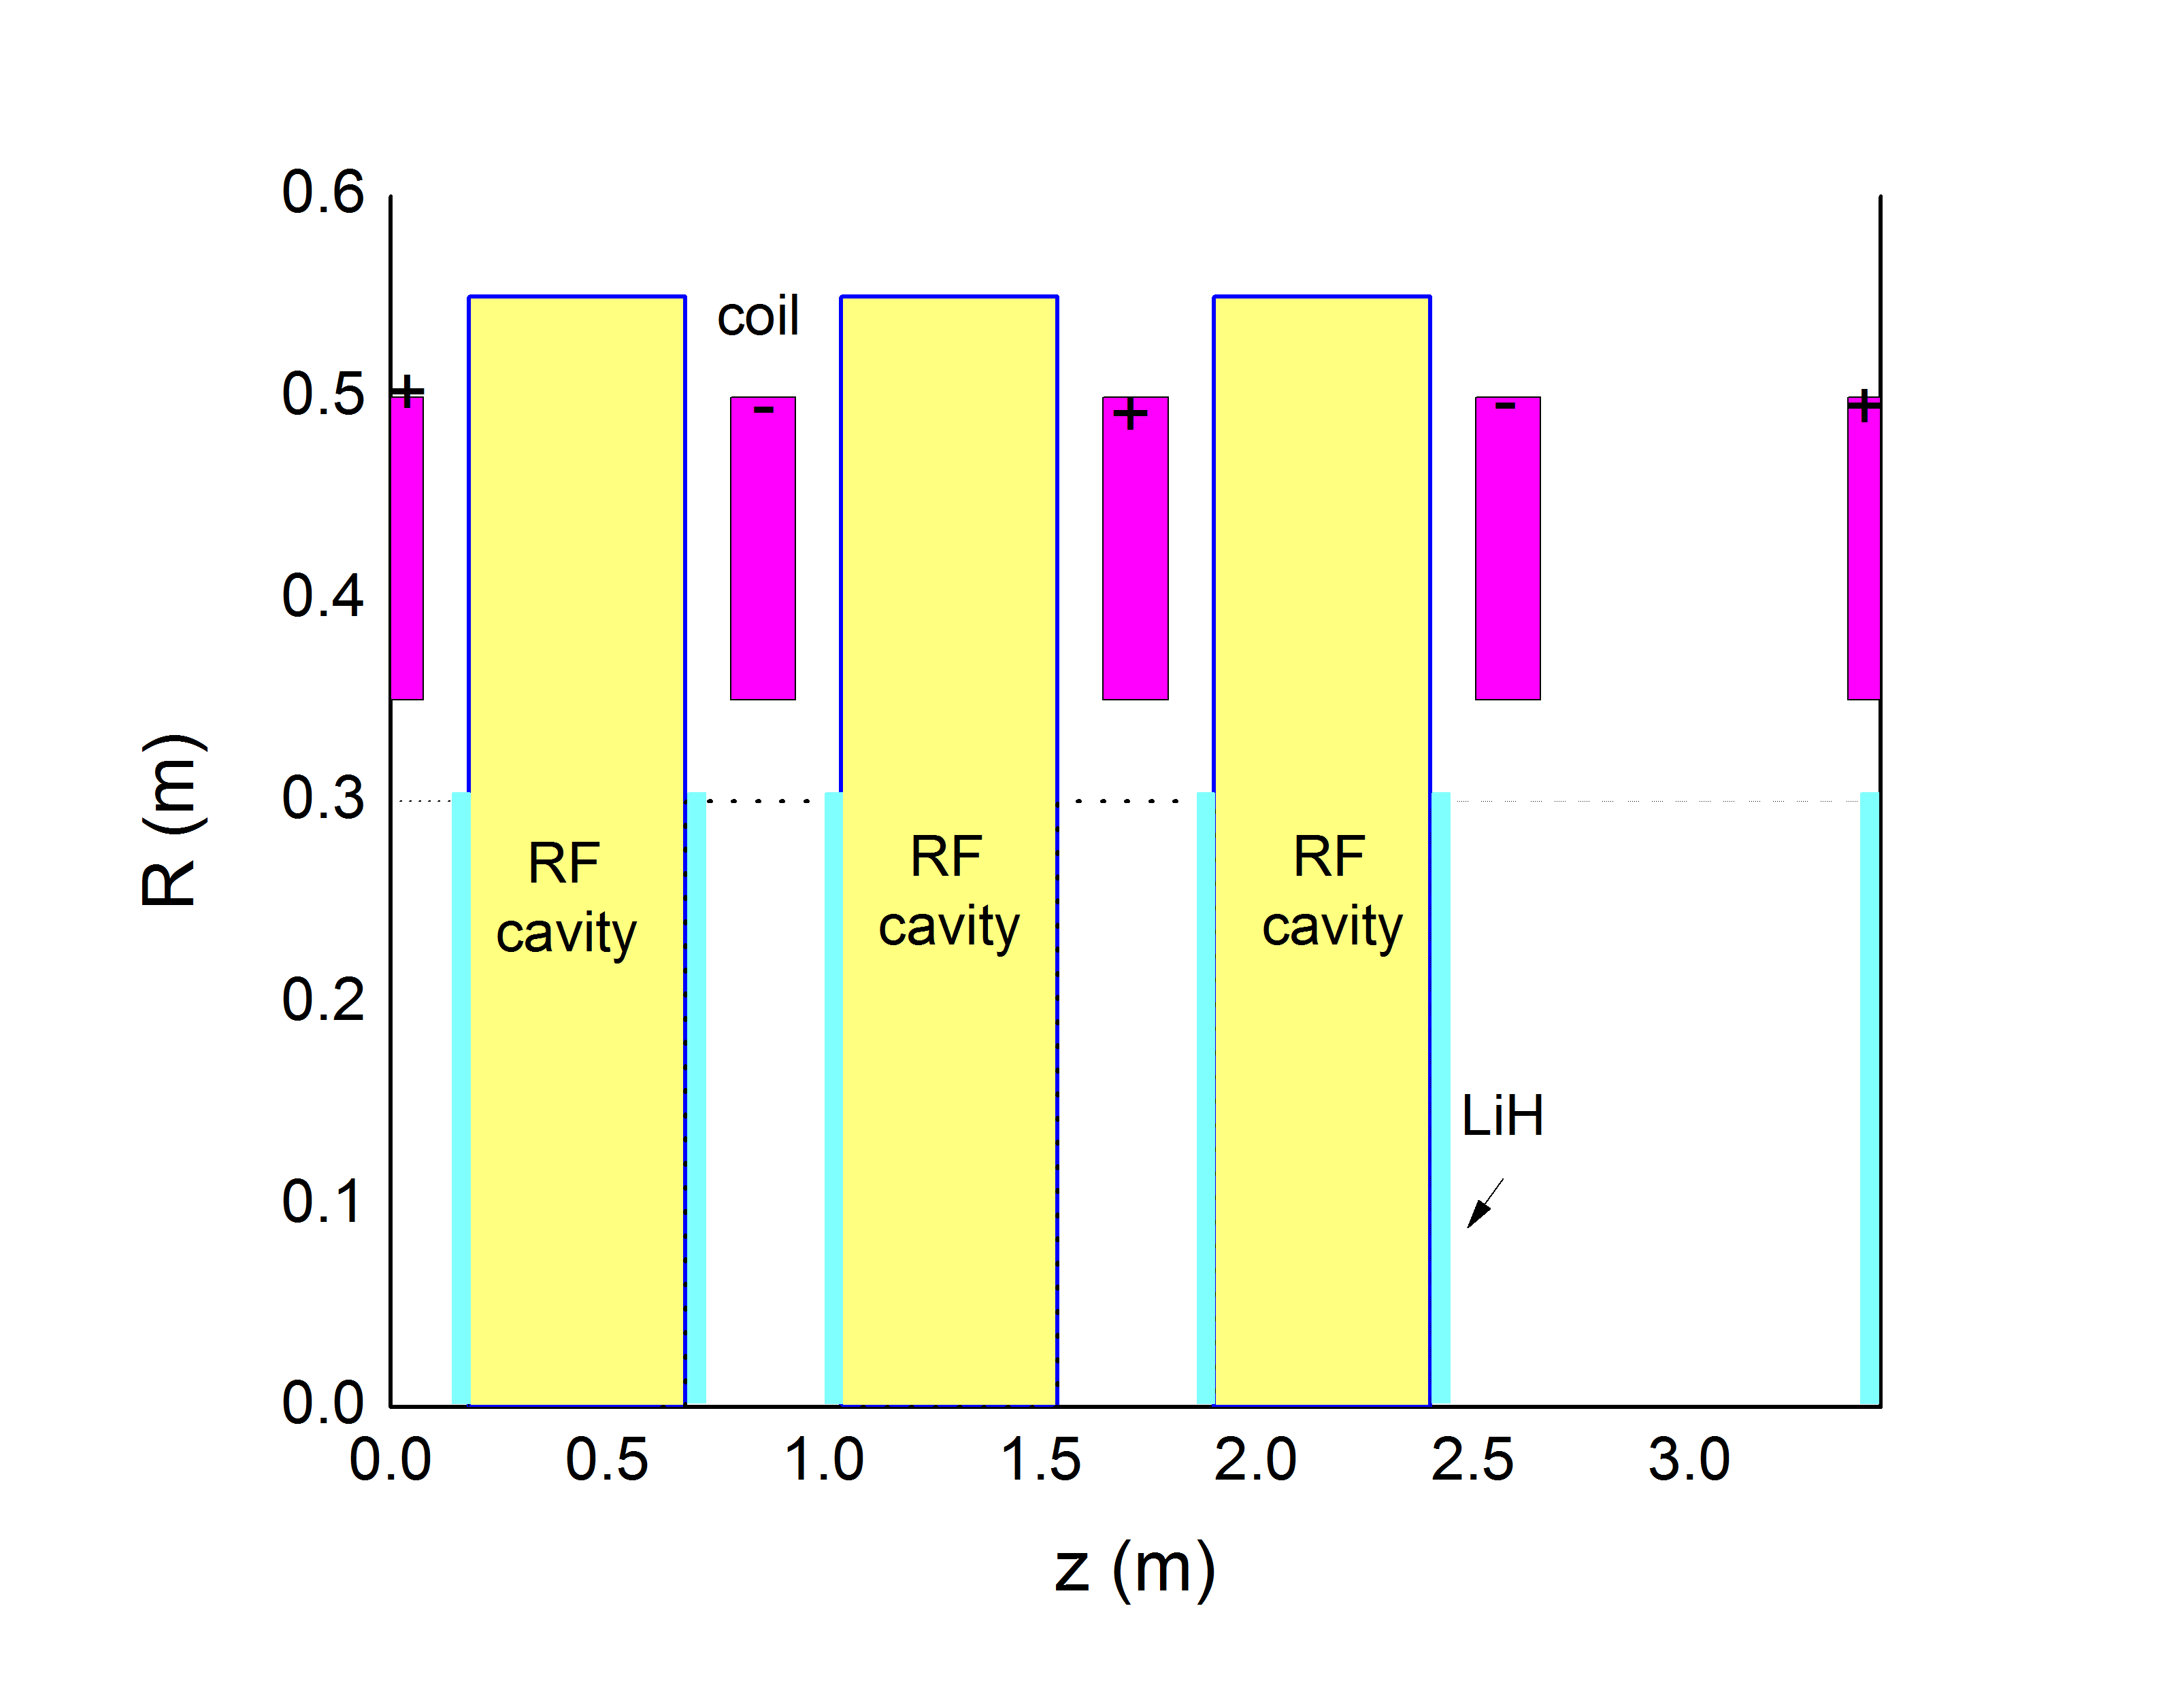
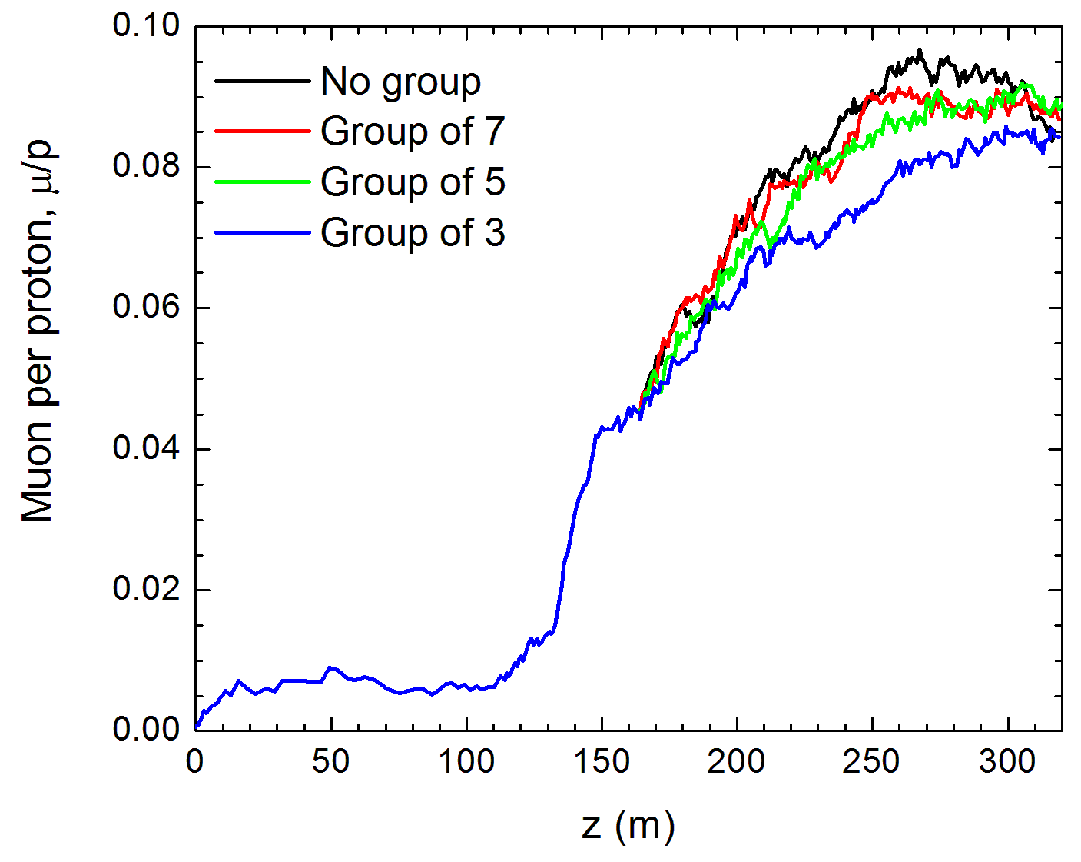
Adding a gap between cavities
D. Stratakis
Group of 3
There is a loss of ~5% if empty cell is after 5 or more cavities. Loss is ~12% for groups of 3

Slide 16
Front End
Challenges- RF
D. Neuffer
Machine performance reduced
μ/p ratio reduced with rf gradient limitations
Mitigation Strategies:
Beryllium walled cavities
Bucked Coil Lattices
High Pressure (GH₂ filled) rf cavities
30% performance loss with
factor 2 gradient reduction

Slide 17
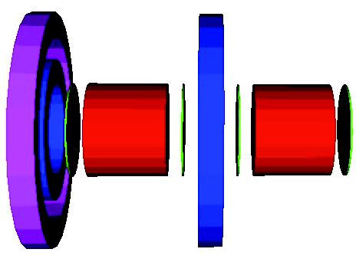
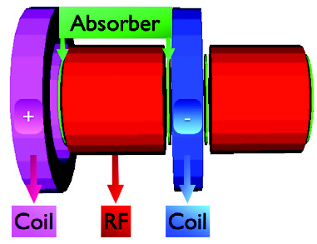
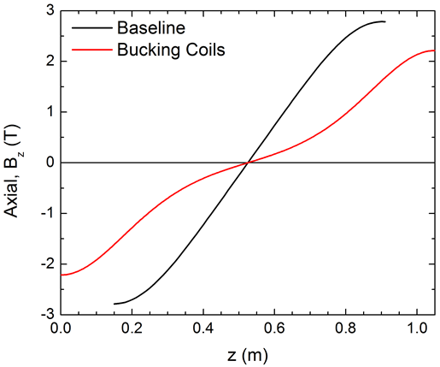
Bucked Coils
Axial field reduced at rf cavity walls

Slide 18
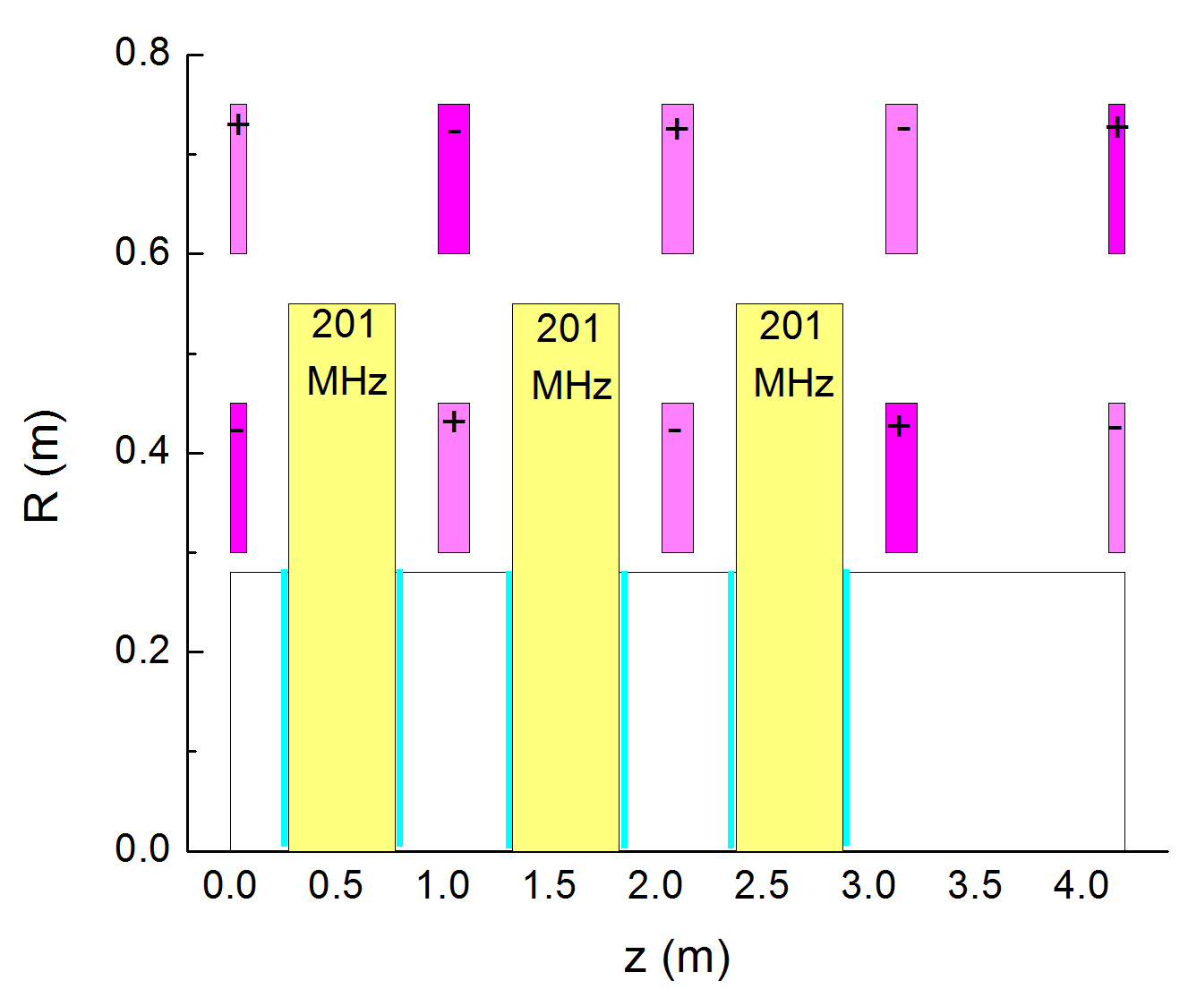

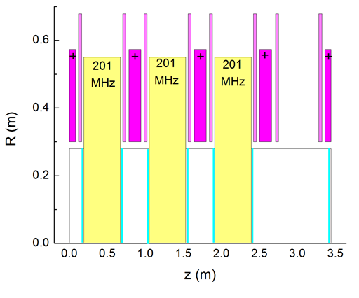
Bucked Coils for the Cooler
A. Alekou
Radial BC (RBC)
Baseline

Slide 19
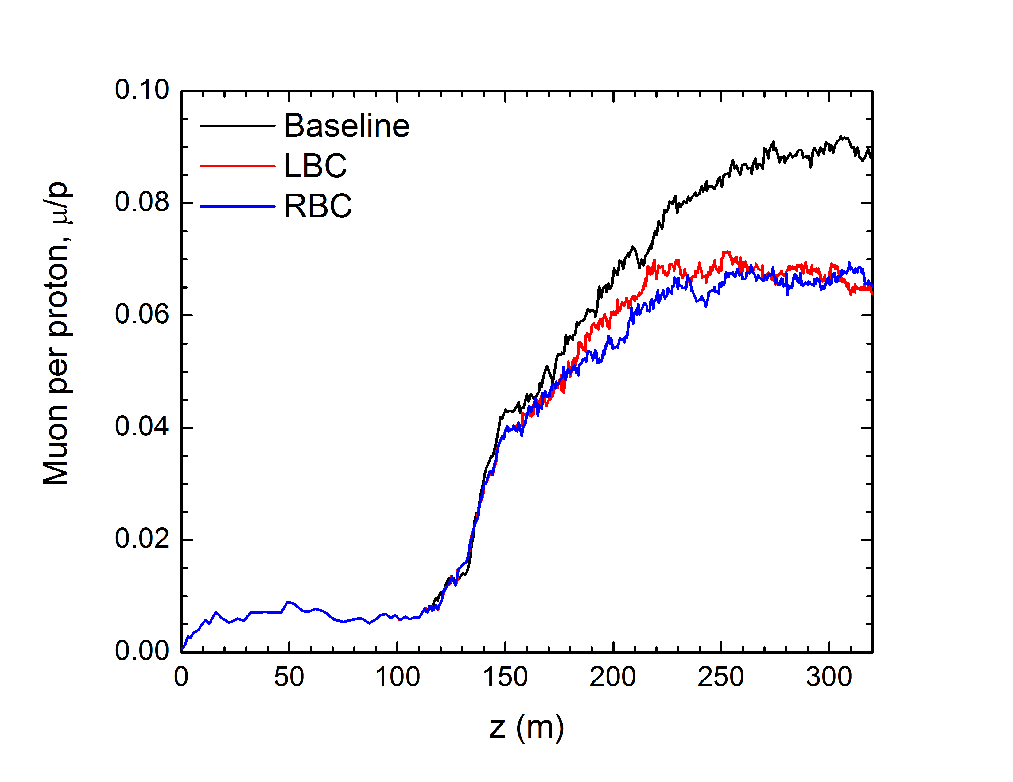
ICOOL Simulations
COOLER
ROTATOR
BUNCHER
Similar results for both LBC and RBC schemes
20% less muon per protons compared to baseline

Slide 20
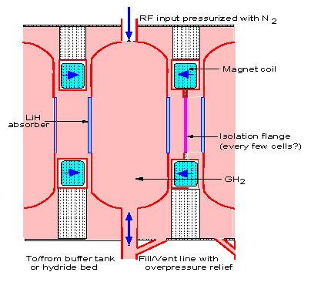
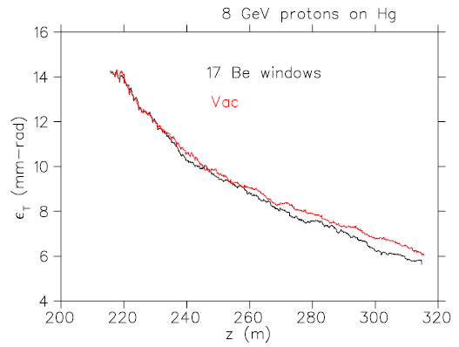
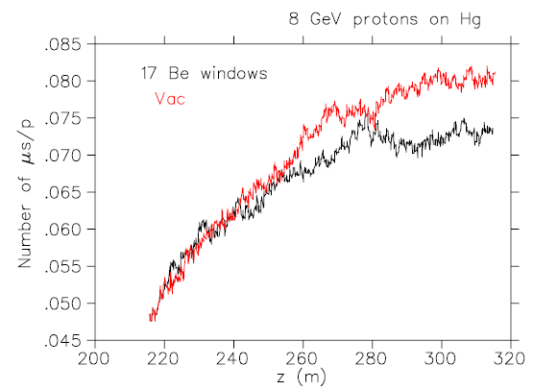
High Pressure Gas RF
Simulation considers:
34 atms GH₂
LiH absorbers
Be Isolation windows
15 MV/m rf gradients
J.C. Gallardo
M. Zisman
8% Reduction
εT Red: Vacuum rf Black: HPRF Downstream Acceptance

Slide 21
Target Taper
H. Sayed
If Target system goes from 20T to 15T peak field then end field goes from 1.5 T to 1.8T in order to maintain performance

Slide 22
FY 13 R&D Activities
Integrate Chicane into Decay region
Respond to new Target taper 15T→1.8T
  Set Decay channel, Buncher, Rotator to 1.8T
  Establish new matching section into Cooler
  Re-optimize Front End parameters
  Evaluate Front End performance levels
Support IDS-NF RDR activities

Slide 23
FY 14 & 15 R&D Activities
Optimize Front End for Muon Collider
Respond to rf cavity technology results
Support MAPFP1 activities

Slide 24
Summary
A Front End baseline has been established
Optimization studies have resulted in a 0.08 μ/p throughput ratio for 8 GeV incoming protons
Key Front End challenges
  Performance of rf cavities in magnetic field
  Energy deposition along Front End channel
Mitigation strategies have been developed to address these challenges

