Slide 1


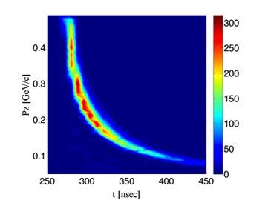
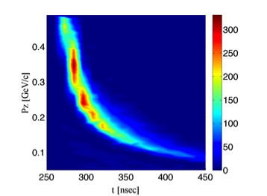
IMPACT OF THE INITIAL PROTON BUNCH LENGTH
ON THE PERFORMANCE OF THE MUON FRONT END
H.K. Sayed,^{*1} H.G Kirk,¹ J.S. Berg,¹ K.T. McDonald²
¹ Brookhaven National Laboratory, Upton, NY
² Princeton University, Princeton, NJ
TUPBA10
NAPAC’13
INTRODUCTION
The dependence of the performance of the Front End of a Muon Collider/Neutrino Factory on the proton-driver bunch length is explored. We consider proton kinetic energies of 3 and 8 GeV. Previously, a drive-beam bunch length of 2 ns was considered for 8 GeV beam energy; however achieving such short bunch lengths for a 3-GeV drive beam is difficult due to space charge effects. The performance of the Front End based on longer proton-bunch lengths is discussed.
LONGITUDNAL PHASE SPACE & CAPTURE EFFECIENCY
Pion beams with different bunch length varying from 2 to 10 ns off the pion-production target.
CAPTURE SOLENOID PROFILE
Pions are generated with wide transverse momentum spread. As the pions move through the “tapering” solenoid field beyond the target they develop a correlation between the longitudinal velocity and the initial transverse momentum.
TARGET CAPTURE SOLENOID
Number of positive muons within the accelerator-chain acceptance vs. the target solenoid taper length at three different bunch lengths of 2, 5, 8 ns.
Defines the time spread of the captured beam
EFFECT OF CAPTURE SOLENOID TAPER ON LONGITUDNAL PHASE SPACE
SHORT TARGET SOLENOID TAPER L= 4 m
SHORT TARGET SOLENOID TAPER L= 40 m
Number of positive muons within the accelerator chain acceptance vs. the initial proton bunch length for 8-GeV proton beam on a Hg-jet target.
The tracking study was done for different target solenoid taper lengths of 6, 20, 40 m.
The short taper loses its advantage gradually as the bunches get longer.
Short taper loses advantage to long adiabatic tapers
Time spread increases with the target solenoid taper length
CAPTURE EFFECIENCY OF THE BUNCHER & ROTATOR OF THE MUON FRONT END
Muon yield after the transverse Ionization Cooling Channel within the acceptance of the following accelerator chain vs. the target solenoid taper length. Optimum yield is at taper length of 4-6 m.
Number of positive muons within the accelerator-chain acceptance versus the initial proton bunch length for 3-GeV proton beam on a C target. The tracking study was done for a target solenoid peak field of 15 T, taper length of 4 m, and end field of 2.5 T. For this case the loss is ~ 5% per 1 ns increase in bunch length.
*Email: hsayed@bnl.gov
Work supported in part by US DOE Contract No DE-AC02-98CHI10886.

