Slide 1
Radiation Protection and Licensing
K. Vaziri,
FNAL Radiation Physics Team
Proton Accelerators for Science and Innovation Workshop
High Power Targets and Machine/Detector Interface Working Group
Jan. 13, 2012

Slide 2
Radiation Protection and Licensing
Contents:
Regulatory Requirements
Shielding for prompt dose
Shielding for residual dose
Handling activated air
Tritium control and ground-water protection
Radioactive component storage
Repair/replace philosophy
Remote Handling capabilities
Alignment and Stability
Radioactive off-gas (especially for liquid metal targets)
Use of Monte Carlo Simulation Codes
Conclusion
January 13, 2012 Radiation Protection and Licensing
2

Slide 3
Regulatory Requirements
In addition to the conventional safety regulations and permits here are some specific radiological regulation from Fermilab’s contract:
10 CFR 1021 (DOE NEPA rules)
10 CFR 835 (Occupational radiation protection - applicable and enforceable portions
35 IAC (State of IL environmental regs - applicable and enforceable portions)
40 CFR (Federal environmental regs - applicable and federally-enforceable portions)
49 CFR Transportation ( Hazardous material Onsite & Offsite applicable portions)
Atomic Energy Act of 1954 [amended], 42 USC 2011 et seq.
Clean Air Act Amendments 1990, 42 USC 7401 et seq., and Illinois State Implementation Plan, 40 CFR 52 Subpart O
Clean Water Act, 33 USC 1251 et seq.
DOE Order 420.2B Safety of Accelerator Facilities
DOE Order 458.1 Radiation Protection for the Public and Environment (100 mrem)
DOE-STD-1196-2011 (April 2011)Derived Concentration standards Table and dose limits to the public
Need permit for radioactive air emissions, discharge to surface waters, ground water and sanitary sewers.
Regulatory standards can only get tighter: In design, practice
As Low As Reasonably Achievable (ALARA).
January 13, 2012 Radiation Protection and Licensing
3
Notes:
MW, HE facilities produce a lot of HE muons, which are much more penetrating than hadrons. Small radiation issues such as dose offsite, and dose to aviators, and even neutrino dose will become significant.
For NuMI neutrino dose had to be explicitly calculated and accounted for. The muon collider neutrino dose becomes significant safety issue, and shielding is out of question! Here design becomes important.
Trace material, impurities in shielding: carbon in steel is responsible for large neutron production.
Sodium in concrete results in Na-22 production half life 2.6 years, positron and gamma emitter. copper content. From copper one easily makes Co-60 copiously from thermal neutron capture and from nickel it can also be made by other nuclear reactions. Co-60 is especially nasty because it decays by emitting rather high energy gamma rays (more dose per decay) and has a 5.3 year half life

Slide 4
Shielding for Prompt Radiation
Protect against dose to public and workers (and equipment)
Direct and sky-shine
Indirect,
surface and groundwater
Air emissions
Radio-activated material
Biota
Shielding against:
Charged hadrons
Neutral hadrons
Secondary Muons
Secondary Neutrinos!
Shielding material:
- Concretes, soil and marble
- Steel
- Polyethylene and borated polyethylene
- Tungsten, lead and DP
- exotic mixtures; poly-concrete and poly-tungsten…
Trace Impurities: carbon, sodium, copper, nickel, chemically toxic
January 13, 2012 Radiation Protection and Licensing
4
Notes:
MW, HE facilities produce a lot of HE muons, which are much more penetrating than hadrons. Small radiation issues such as dose offsite, and dose to aviators, and even neutrino dose will become significant.
For NuMI neutrino dose had to be explicitly calculated and accounted for. The muon collider neutrino dose becomes significant safety issue, and shielding is out of question! Here design becomes important.
Trace material, impurities in shielding: carbon in steel is responsible for large neutron production.
Sodium in concrete results in Na-22 production half life 2.6 years, positron and gamma emitter. copper content. From copper one easily makes Co-60 copiously from thermal neutron capture and from nickel it can also be made by other nuclear reactions. Co-60 is especially nasty because it decays by emitting rather high energy gamma rays (more dose per decay) and has a 5.3 year half life

Slide 5
Shielding for Residual Radiation
Very high radioactivation levels (modularize as much as possible)
Mostly gamma emitters (after a few minutes)
Marble effective for shielding residuals in place.
High density material for shielding saves space, but not weight; shield boxes used for transport weigh many tons.
Weight considerations may lead to nested coffins or plans for local storage.
Need shielded repair cells
Need remote handling capability
Problems during lifting and moving are difficult to handle.
Both short term and long term storage should be considered carefully and designed sufficiently.
Disposal of highly activated objects is very costly! (waste volume reduction)
D&D have to be thought up at design stage, don’t want to leave an expensive environmental problem behind.
January 13, 2012 Radiation Protection and Licensing
5

Slide 6
Handling activated air
Characterization and monitoring needed for prompt dose to workers and offsite release.
Required to account for all air releases.
NESHAP requirements
For workers implement:
Real time monitoring
Implement cooling period (delay&ventilation)
Release of activated air:
Immediate release/almost no decay
Decay in transit to release point
Trap and contain to decay out
January 13, 2012 Radiation Protection and Licensing
6

Slide 7
Tritium (and other radioactive contaminants)
H-3 is produced in air, shielding, outside shielding and in the cooling systems.
Readily exchanges with hydrogen in H₂O to form tritiated water, HTO.
Ground and surface water protection.
Shielding
Isolation (diffusion and advection)
Containment (lifetime buildup in shielding and cooling loops)
Disposal (at above surface levels concentrations.)
For groundwater need to know the hydrogeology of the location.
January 13, 2012 Radiation Protection and Licensing
7
Notes:
State and Federal EPA (+additional State and local requirements)
Illinois Ground Water Protection Act, 415 ILCS 55/1 et seq.
Recommended standards for Water Works, Great Lakes Upper Mississippi R. Bd. of State Public Health & Environmental Managers (1992)
Safe Drinking Water Act, 42 USC 300f et seq.
Standard Methods for the Examination of Water and Wastewater, 18th Ed., APHA (1992)
City Code of Warrenville, IL Title 7, Chapter 4, sewer/sewerage ordinance

Slide 8
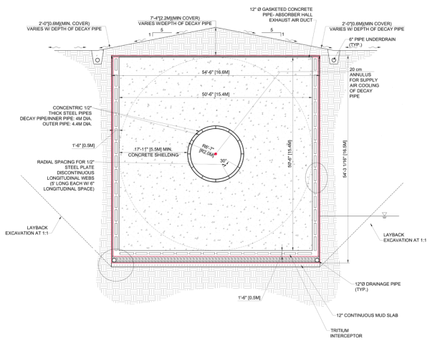
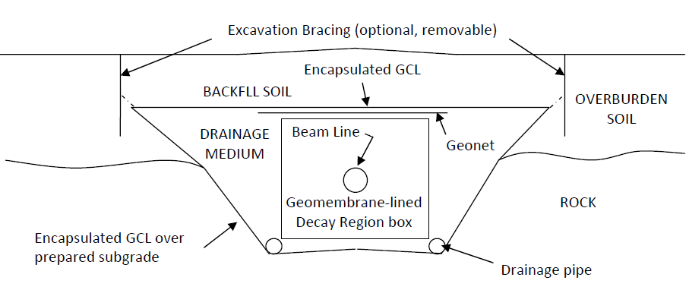
R&D of Ground-water Protection Methods
1) e.g. Geo-membranes for LBNE
- Material properties
Life time
Radiation damage studies
Alternative material
Collective knowledge
(e.g. liners used in nuclear power industry?)
January 13, 2012 Radiation Protection and Licensing
8

Slide 9
Radioactive component storage
Need sufficiently shielded and contained:
Short term (cool down for repair, transportation or later use)
Long term (cool down for repair, disposal or future use)
Containment (toxic, highly radioactive, Contaminated)
Protection in storage considerations: - environmental
- primary contamination
- hot particles
- Secondary due to natural erosion
January 13, 2012 Radiation Protection and Licensing
9

Slide 10
Repair and Replace Philosophy
Install&forget: expensive and nature is never that kind.
Replace:
have to have spares to save down time
or if economically possible or repair is not possible.
Repair considerations:
Assess hazards, develop shielding and specialized tools.
Repair time, cost and dose to workers needs to be optimized.
January 13, 2012 Radiation Protection and Licensing
10

Slide 11
Repair Cell and Remote Handling capabilities
Requirements:
Need area with crane coverage and work cell with sufficient space and shielding
Shielded cell with through-the-wall manipulators
lead glass shield window(s)/TV cameras
shield plugs in ceiling for long-reach-tool access
Area to separate components from modules to connect new components to “hot” modules, survey, and adjust alignment
Remote Handling systems shall be integrated into the infrastructure of the complex
Contamination controls
Component replacement:
Module with component removed and placed into hot storage remotely for cool down period or next scheduled outage.
Module with component attached taken from hot storage and placed remotely into a shield cask.
Waste volume reduction
Layout area to provide most efficient component handling
January 13, 2012 Radiation Protection and Licensing
11

Slide 12
Alignment and Stability
For high intensity beam-lines are designed
To minimize beam loss
To protect devices
Shielding design may depend on maximum credible beam loss
At high intensities, where the beam has a long lever arm (neutrinos 1200 km away), misalignment will cost beam time.
Need relatively easy realignment capability.
Need real-time alignment verification (BLM etc.)
For devices that get highly radioactive, best to built self-alignment into the system as much as possible (alignment pins etc.)
January 13, 2012 Radiation Protection and Licensing
12

Slide 13
Radioactive off-gas (especially for liquid metal targets)
All targets, solid, liquid or gas, down to He, interacting with HE proton beam produce H, D, T. More Isotopes if higher mass.
Hydrogen isotopes in target containers can cause explosion.
Cooling systems, exposed to beam, also release hydrogen.
Chemically toxic targets, specially liquid, at high power beam
facilities require elaborate (expensive) containment, circulation,
cooling, handling, repair and disposal facilities, plans and procedures.
Extensive knowledge of physical and chemical properties of the target material needs to be learned, some through R&D.
Example of SNS mercury target next.
January 13, 2012 Radiation Protection and Licensing
13

Slide 14
SNS Liquid Hg Target
1. Mercury Containment requirements
No leaks outside the hot cell. Inside the cell, leaks are assumed.
2. Hot Cell / Remote Handling
All mercury target and components must be contained, maintained, and packaged for off-site disposal inside hot cell.
3. Ventilation / Filtration
Mercury vapor must be removed from the cell exhaust prior to subsequent conventional particulate filtration (HEPA).
4. Waste Handling
All hot cell and ventilation system waste will be mercury contaminated. Activated mercury contaminated waste must be fully contained.
Disposal options of SNS mercury “mixed waste” are VERY limited.
5. Water Cooling System
The SNS process mercury is cooled with a secondary water cooling system.
6. Mercury Target Safety Considerations
Accelerator safety order requires hazard and accident analyses to ensure workers, the public, and the environment are protected against hazards such as mercury toxicity and radioactivity.
.
January 13, 2012 Radiation Protection and Licensing
14

Slide 15
Further Practices and R&D
Sampling of shielding materials around existing facilities to develop/validate tritium transport models (e.g. coring of decay pipe concrete in NuMI)
Analyze residuals activity for the radioisotope composition.
Study to measure composition of target hall air (radio-chemical analysis) and relate to various parameters (humidity, beam intensity...)
Validation/benchmarking of simulation specific to the facility.
Build sampling elements into your experiment.
January 13, 2012 Radiation Protection and Licensing
15

Slide 16
Use of Monte Carlo Simulation Codes
For prompt dose and residual activity Monte Carlo codes Need:
Exact composition of material
Exact geometry
Excitation function for all elements, for all secondary and primary particles and for all reaction channels! (slows down the simulations)
Decay chains for all radioactive species! (slows down the simulations)
(Target depletion, swelling, beam induced thermo-mechanical and dynamic effects such as diffusion of radionuclides in material are not in the existing Monte Carlo codes. These effects have to be taken into account separately)
January 13, 2012 Radiation Protection and Licensing
16

Slide 17
Conclusion
Need to measure G-number for the formation of various caustic chemicals (e.g. nitrides & ozone) in air as a function of temp., humidity & pressure.
Not all nuclear reactions measurements data needed for Monte Carlo simulations exist. Some are calculated theoretically.
Need radiation damage data to fine tune simulation codes. Extant data rather old and not complete.
Need diffusion coefficients for H,d,T, He-3, He-4 in metals and other common shielding materials.
Need data on the mobility of Na-22 and Be-7 in air and on surfaces
Study of radio-chemical implications (including off-gasses) of possible liquid metal targets/cooling (Hg, LBE, Lithium)
Need quantifiable radiation induced corrosion data.
January 13, 2012 Radiation Protection and Licensing
17

