Slide 1
Muon Collider 2011
June 27 – July 1, 2011 , Telluride, Colorado
Simulation of High-Intensity
Mercury Jet Targets
Roman Samulyak, Tongfei Guo
AMS Department, Stony Brook University
and
Computational Science Center
Brookhaven National Laboratory

Slide 2
Mercury Target Simulation Program
FronTier MHD, a 3D code with explicitly tracked interfaces of multiphase / free surface fluids has been developed and used for mercury target simulations. New SPH code is in progress
Compressible and incompressible MHD regimes
Homogenized and discrete bubble models for cavitation
Realistic equation of states
Simulation studies focus on
Distortion of mercury jets entering solenoid magnets
Disruption of mercury targets interacting with proton pulses
Benchmark with MERIT experimental data
Studies of the muon collider vs. neutrino factory targets
FronTier simulation of high speed jet cavitation and breakup

Slide 3
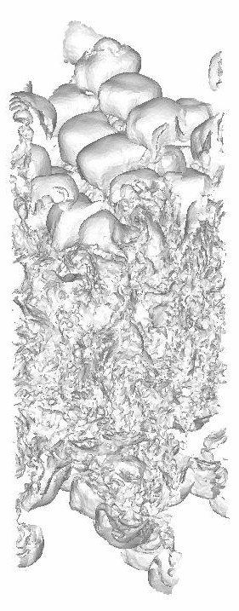
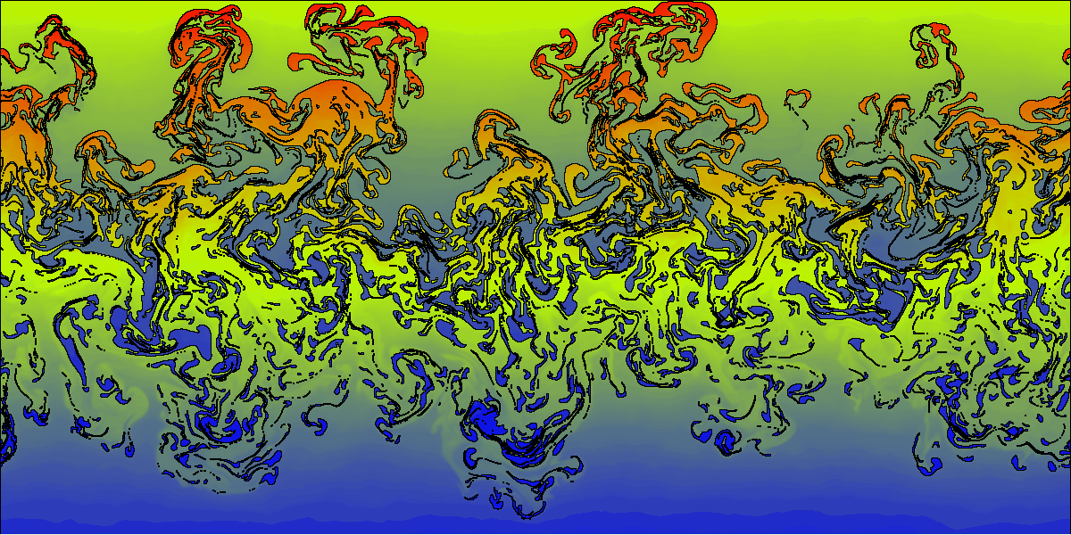
The FronTier Code
FronTier is a parallel 3D multiphysics code based on front tracking
Explicit tracking of material interfaces in free surface / multiphase flows
Physics models include
Compressible fluid dynamics
MHD
Flow in porous media
Realistic EOS models, phase transition models
Exact and approximate Riemann solvers
Adaptive mesh refinement
Turbulent fluid mixing.
Left: 2D
Right: 3D (fragment of the interface)

Slide 4
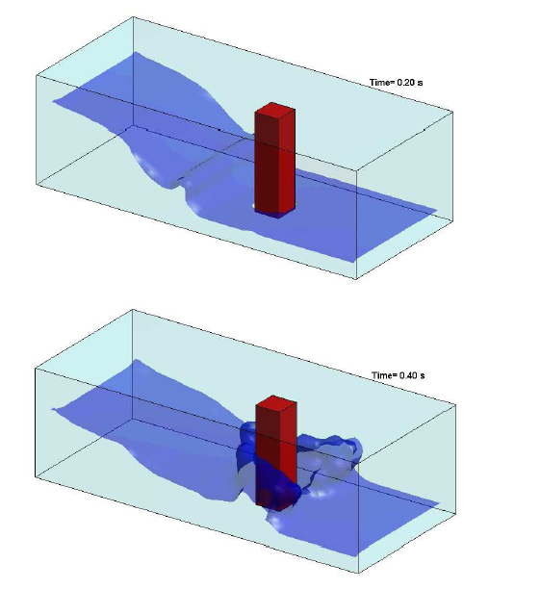
New Smoothed Particle Hydrodynamics (SPH) Code
A new code for free surface / multiphase MHD flows is being developed based on SPHYSICS from U. of Manchester
SPH is a Lagrangian method based on particles
Several smoother particle kernels, Riemann solvers, MUSCL-based schemes
Advanced time stepping (Predictor-corrector, Verlet scheme, symplectic schemes)
Easily adaptable to GPU architectures
Complementary code to FronTier

Slide 5
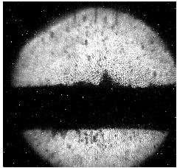
MHD Simulation of the mercury jet interaction with proton pulses
Performed simulations of initially cylindrical and elliptical jets interacting with proton pulses in magnetic fields
Simulations predicted cavitation and surface filamentation
Magnetic field reduced the amount of cavitation and velocity of filaments
Reasonable agreement with MERIT experiments on disruption velocities
0T
5T
10T
15T
Mercury jet surface at 150 microseconds after the interaction with 12 teraproton pulse
Image from MERIT experiment, B=10T

Slide 6
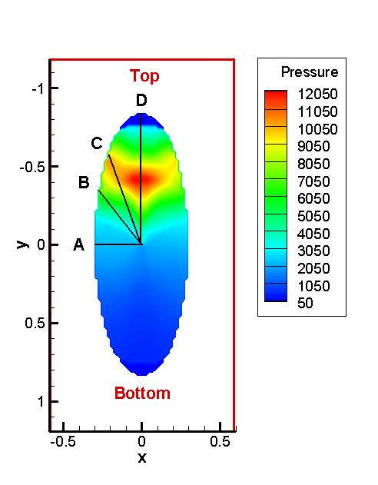
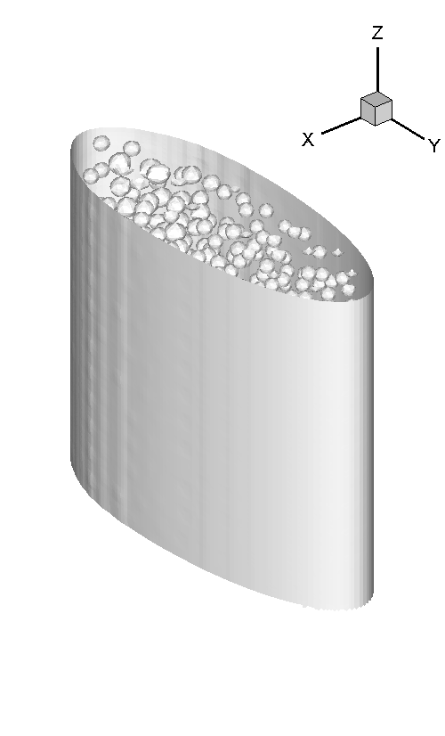
Cavitation and growth of surface filaments
To obtain the expansion velocity along the jet surface, we evaluate the expansion length in 4 typical positions. 14 GeV, 10 teraproton beam was used for energy deposition calculation

Slide 7
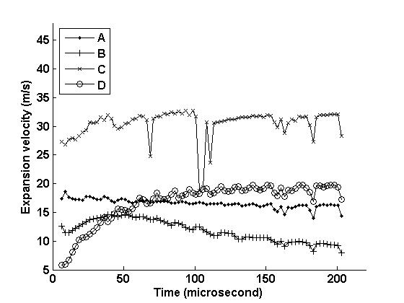
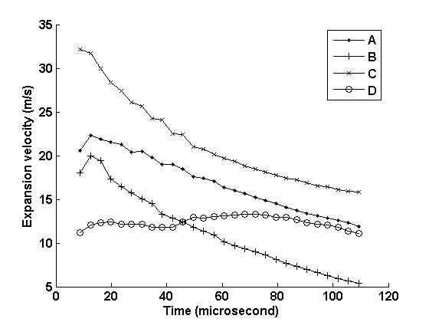
No magnetic field
Growth of surface filaments
B=10T

Slide 8
Muon Collider vs Neutrino Factory
Beam: 8 GeV, 4 MW, 3.125e15 particles/s, r.m.s. rad = 1.2 mm
Muon Collider:
15 bunches / s
66.7 ms interval
208 teraproton per bunch
Neutrino Factory:
150 bunches / s
6.67 ms interval
20.8 teraproton per bunch
Maximum pressure (estimate):
Muon Collider: Pmax = 110 kbar
Neutrino Factory: Pmax = 11 kbar

Slide 9
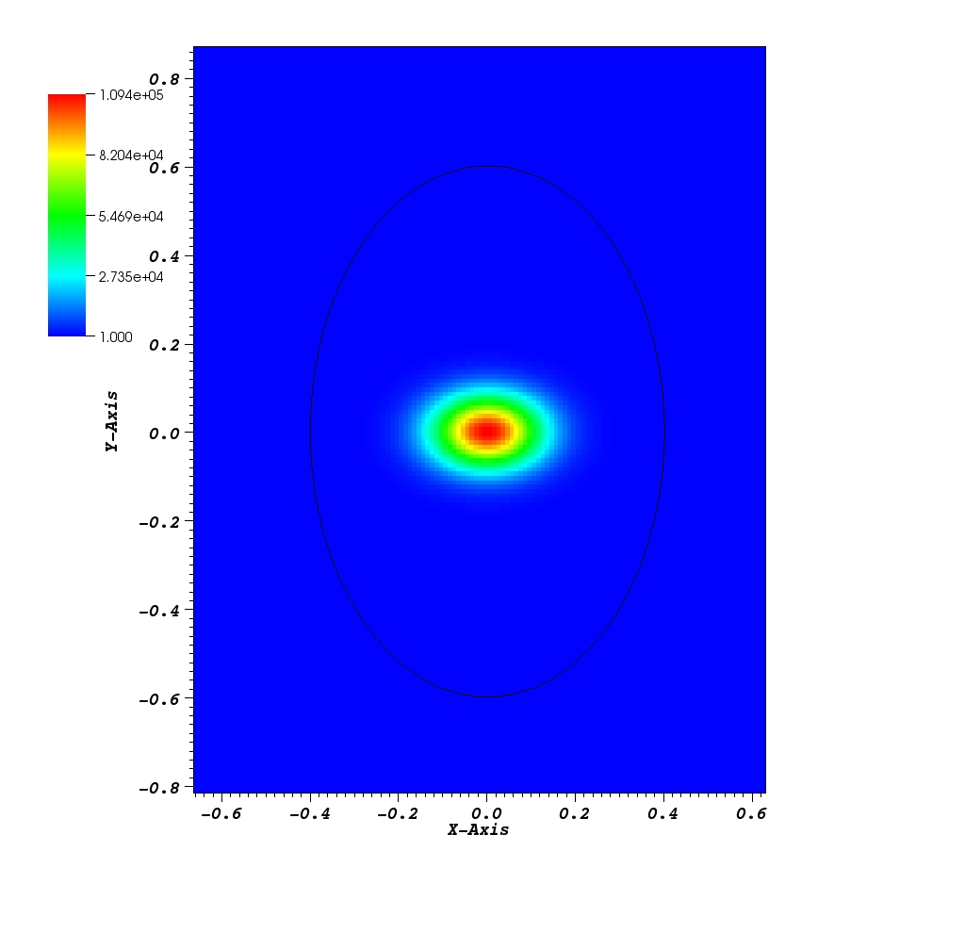
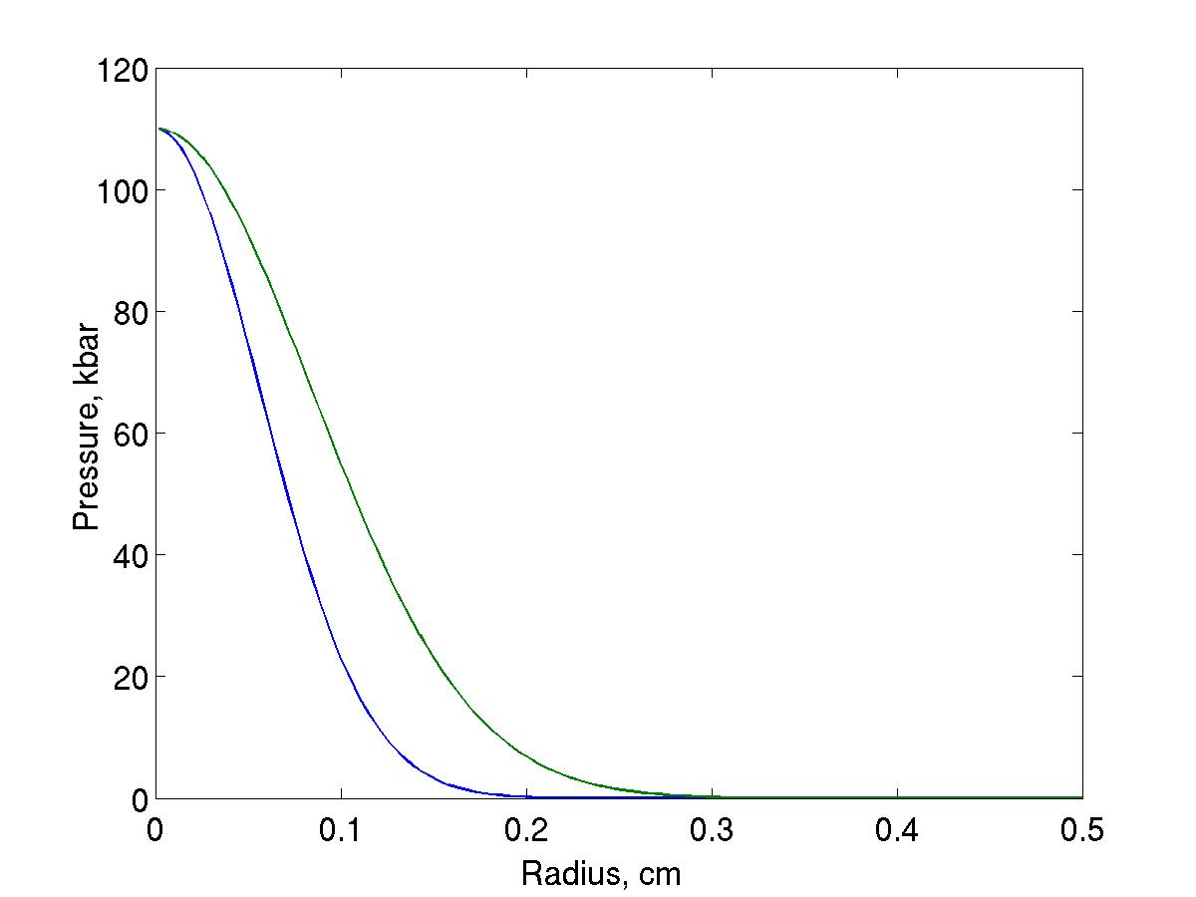
Muon Collider
Jet disruption velocity: 103 m/s

Slide 10
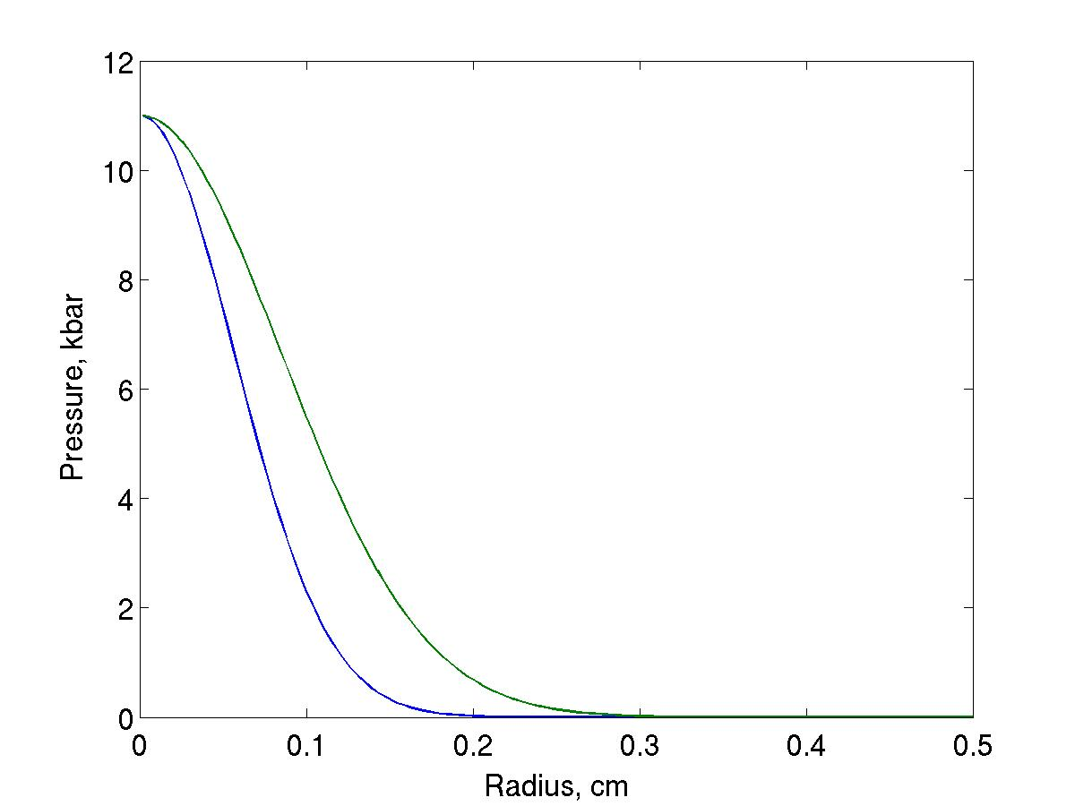
Neutrino Factory
Jet disruption velocity: 25 m/s

Slide 11
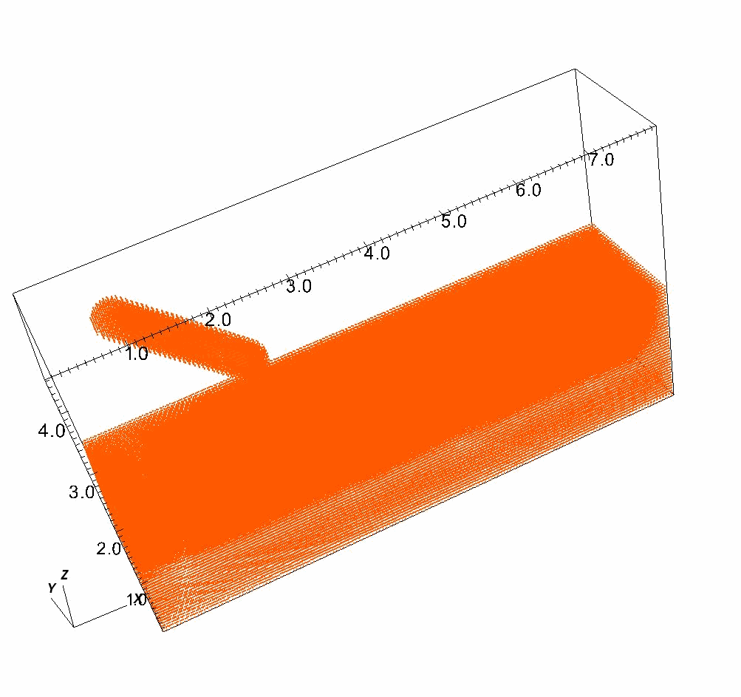
SPH simulation of mercury jet dump (3D)

