Slide 1
Target R&D
Scope of the effort
Progress since last Review
Key technology challenges
R&D plans
Personnel
Kirk T McDonald
Princeton University
Feb. 19, 2014

Slide 2
Scope of the Target R&D Effort
Provide a Target System scenario for Phase 1 operation at 1-MW beam power with a relatively conventional technology (such as a carbon target),
  With an upgrade path to later operation at 4 MW.
Identify and address the technology issues associated with the dissipation of up to 4-MW beam power in the Target System.
To accomplish these goals, several types of effort are required:
Hardware R&D to validate concept of liquid metal jet target [MERIT expt], and assess radiation damage to target materials [at BLIP facility] (2001-07) .
Optimize particle production by candidate targets (via geometry of the target).
Optimize capture of the secondary particles (taking into account constraints from downstream system in the Front End and beyond).
Conceptual design of the Target System magnets (which must survive high radiation dose).
Conceptual mechanical design of the target, beam dump, beam pipes/windows, W-bead shielding, magnet cryostats, chicane, cooling and power services.
Model the energy deposition (radiation dose) in the Target System.
Model issues particular to use of a liquid target at high beam power.
These efforts are inter-related, and are accomplished in an iterative process.

Slide 3
Target R&D Accomplishments since the August 2012 MAP Review
Supporting documentation at http://www.hep.princeton.edu/~mcdonald/mumu/target/
Date | Description
FY12 Q4 | IDS-NF target-system concept “frozen.” [so-called configuration IDS120k]
FY12 Q4 | Target System design with short taper via global optimization of Front End. (Proc. NuFact’12) [Short taper favored]
FY13 Q1 | Energy deposition studies with azimuthal dependence [Minor hotspots identified due to asymmetric mercury module]
FY13 Q1 | Particle production studies with MARS15(2012) using multiprocessing [MARS too slow on single processor for timely results]
FT13 Q1 | Preliminary cost estimate of Target System magnets (for IDS-NF RDR]
FY13 Q2 | Target System presented at the Snowmass Workshop on Frontier Capability (BNL, Apr 2013)
FY13 Q2 | Effect of transverse beam emittance on particle production (IPAC13, THPFI069) [Falloff with increase above baseline of 5 μm]
FY13 Q2 | Mercury handling system concept for IDS-NF RDR (IPAC13, THPFI092)
FY13 Q2 | ANSYS FLUENT simulations of Hg delivery pipe with weld-bead perturbation. [Effect is minor in the simulations]
FY13 Q2 | (Massive) magnetic shield from target solenoid for conventional quads in Final Focus
FY13 Q2 | Comparison of particle production between FLUKA and MARS (for IDS120j) [Discrepancies at 3-6 GeV]
FY13 Q3 | Section contributed to the IDS-NF RDR, The Target System
FY13 Q3 | Completion of baseline conceptual design for 4-MW, 8-GeV beam (including Ga option).
FY13 Q4 | Effect of proton bunch length on Front End performance (NAPAC13, TUPBA10) [Falloff ~ 5% per ns]
FY13 Q4 | FY13 MAP Technology Development: Target and Absorbers Summary
FY13 Q4 | Optimization of particle production with 3-GeV proton beam. [MARS15(2012) claims C better than Hg at 3 GeV]
FY14 Q1 | Preliminary Target System concept for 6.75-GeV proton beam. [Using MARS15(2014), claimed to be better for 3-6 GeV]

Slide 4
Target System Evolution
Snowmass’96 Muon Collider Report
  4-MW, 24-GeV proton beam:
  Mercury jet in a 20-T field.
Neutrino Factory Study1 (2000)
  1.5-MW, 24-GeV proton beam:
  Radiation-cooled graphite target in a 20-T field.
IDS-NF IDR (2011) & RDR (2014)
  4-MW, 8-GeV proton beam
  Mercury jet in a 20-T field.
August 2013 MASS recommendation:
  1-MW, 3-GeV proton beam:
  Solid target in a 20-T field .
  Upgrade path to possible 4-MW proton beam (liquid-metal jet in a 15-T field).
Dec 2013 updated MASS recommendation:
  1-MW, 6.75-GeV proton beam
  Solid target in a 20-T field
Concepts exist for all of these Target Systems.

Slide 5
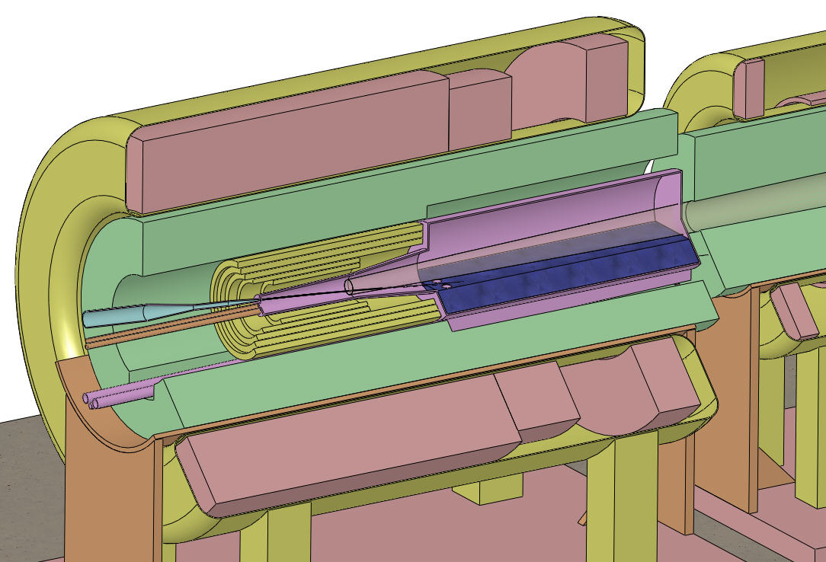
Target and Capture Topology: Solenoid
Superconducting magnets
Desire ≈ 10¹⁴ μ/s from ≈ 10¹⁵ p/s (≈ 4 MW proton beam).
R.B. Palmer (BNL, 1995) proposed a 20-T solenoidal capture system.
Low-energy π's collected from side of long, thin cylindrical target.
Solenoid coils can be some distance from proton beam.
≥ 10-year life against radiation damage at 4 MW, with sufficient shielding.
Liquid (mercury or Ga or Pb-Bi) jet target replaced every pulse (or graphite target replaced often).
Proton beam readily tilted with respect to magnetic axis.
⇒ Beam dump (mercury pool) out of the way of secondary π's and μ's (or additional graphite block as beam dump).
IDS-NF Target Concept:
Tungsten beads,
He-gas cooled
Proton beam and
mercury jet
Be window
Mercury collection pool
with splash mitigator
Resistive magnets
IDS120k
Shielding of the superconducting magnets from radiation is a major issue.
Magnetic stored energy ~ 3 GJ!
5-T copper magnet insert; 15-T Nb₃Sn coil + 5-T NbTi outsert.
If liquid target, desirable to replace the copper magnet by a 20-T HTC insert (or use only 15-T Nb coil).

Slide 6
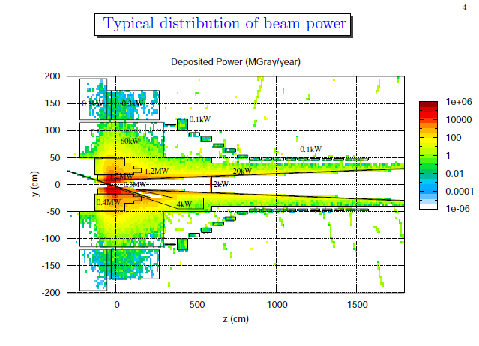
Primary Challenge:
High Level of Energy Deposition in the Target System
Power deposition in the superconducting magnets and the He-gas-cooled tungsten shield inside them, according to a FLUKA simulation.
Approximately 2.4 MW must be dissipated in the shield.
Some 500 kW flows out of the target system into the downstream beam-transport elements.
Total energy deposition in the target magnet string is ~ 1 kW @ 4k.
Peak energy deposition is about 0.1 mW/g = limit for ~ 10 year lifetime against radiation damage
(“ITER limit”).
SC coils
W shield
Target
Ex: 4 MW with Hg target (IDS120h)
(J. Back, N. Souchlas)
Energy Deposition Summary:
10-15% in target itself (less with low-Z)
70% into W shielding (or SC coils if no shielding)
15-20% into chicane downstream

Slide 7
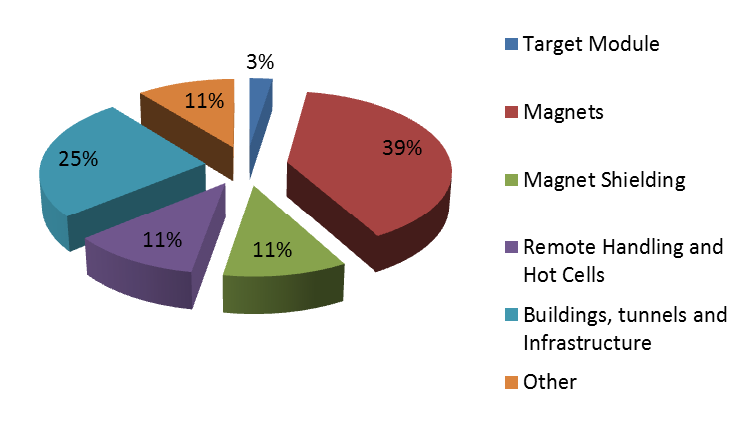
Target System Cost Drivers
An Hg target costs only a few % of the Target System. A carbon target would cost ~ 0.1%.
Infrastructure costs are ~ 50%.
(A. Kurup, IDS-NF = International Design Study for a Neutrino Factory)

Slide 8
Challenge: Target-Material Options
Long, thin target;
  Need for low-energy muons (from pion decay) ⇒ useful pions exit the side of the target.
Cooling a solid target with a liquid disfavored;
  “Thermal shock” to liquid by the ns-long proton pulses ruptures the coolant pipe.
“Pebble bed” solid target cooled by He-gas flow;
  Requires near-supersonic flow rate at 1-MW beam power.
  Used (with subsonic gas flow) for radiation shielding of the superconducting coils in the Target System.
Radiation-cooled solid target would melt unless carbon (in He gas to suppress sublimation);
  A carbon target is the present baseline for 1-MW operation.
  Carbon target may need to be replaced every 4-5 weeks @1-MW due to radiation damage.
Moving/rotating solid target;
  Not compatible with solenoid magnets/shielding around the target.
Flowing liquid target is viable @ 4-MW for free-liquid-jet target (not in pipe);
  Liquid collected in a pool that serves as the proton beam dump.
  Gallium, mercury, Pb-Bi eutectic alloy are possible liquid metals.
Flowing tungsten powder in a pipe behaves much like a liquid;
  Issues of “shock” damage and erosion to the pipe.
The above issues were clarified by R&D largely completed ~ 5-10 years ago.

Slide 9
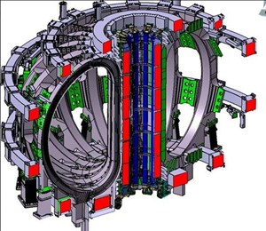
Challenge: Large Cable-in-Conduit Superconducting Magnets
(with ~ 3 GJ total stored energy)
Technology pioneered by ITER Central Solenoid:
13 T peak field, 6.4 GJ stored energy
The high heat load of the target magnet requires Nb₃Sn cable-in-conduit technology, more familiar in the fusion energy community than in high energy physics.
The conductor is stabilized by copper,
as the temperatures during conductor fabrication comes close to the melting point of aluminum.
The conductor jacket is stainless steel, due to the high magnetic stresses.
A high-temperature superconducting insert of 6+ T is appealing for our application – but its inner radius would also have to be large to permit shielding against radiation damage.

Slide 10
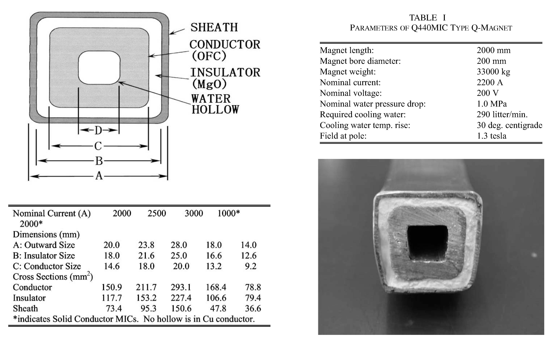
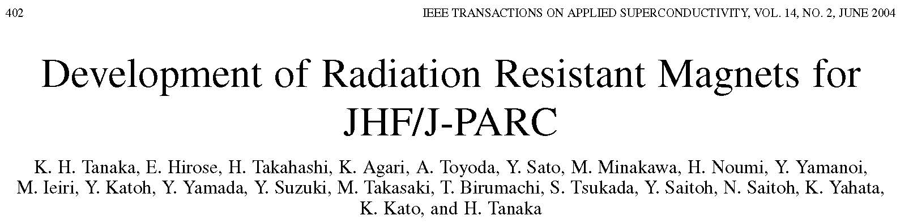
Challenge:
Copper Conductor for Radiation-Resistant Magnets
Organic insulation cannot be used in copper coils in the Target System (or Decay Channel).
Radiation-resistant conductor with MgO (or spinel) insulation has been developed at KEK/JHF.
FRIB application: Chouban, Green & Zeller, IEEETAS 22, 4003601 (2012)

Slide 11
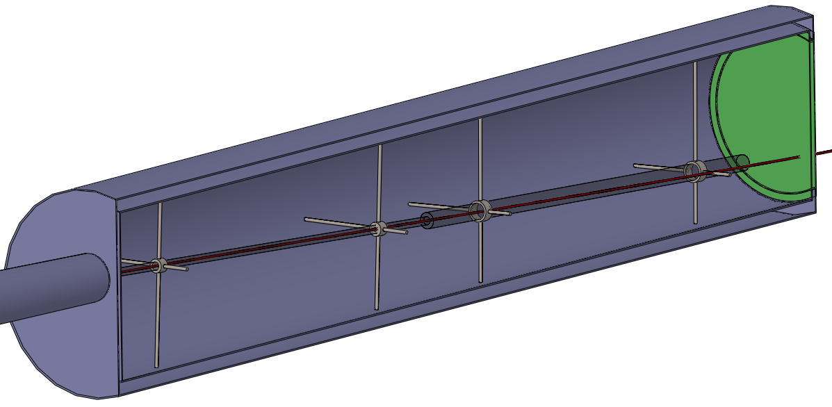
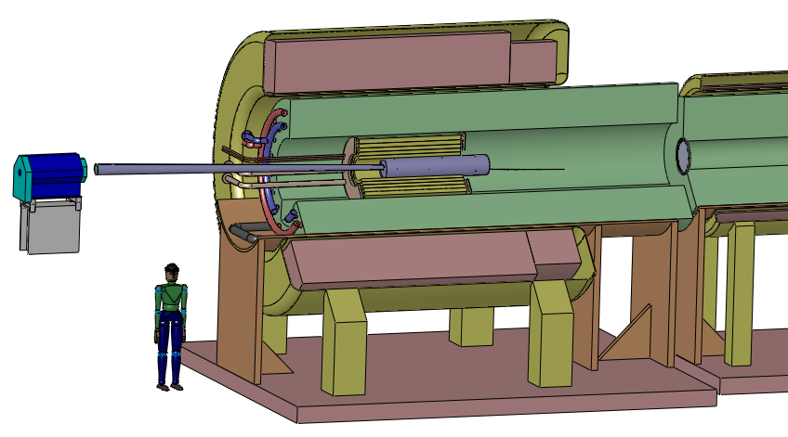
Target R&D Status
Past studies of Target Systems for 1.5- and 4-MW beam power permit rapid progress on a scenario for 1-MW @ 6.75 GeV.
Yield from a 75-cm-long carbon target @ 6.75 GeV is about 80% that of a Hg target;
  (90% of a Ga target), with π⁺/π⁻ ~ 1.27 (π⁻/π⁺ ~ 1.21 for Hg, π⁺/π⁻ ~ 1.03 for Ga).
A 75-cm-long carbon rod immediately following the target rod may serve as a beam “dump” (needs further study).
A preliminary layout of a carbon target inside
a 20-T capture solenoid has been generated.
Next steps: simulate energy
deposition to determine viable
shielding scenario for the
superconducting coils
(including the chicane).
W-bead shielding
15-T SC coil
5-T Cu coil
Carbon target module

Slide 12
Target R&D Goals FY14-16
(through the Front End IBS Process)
The main goal is to develop a Target-System scenario for Phase 1 of MASS (6.75 GeV, 1 MW);
  Retain an upgrade path to 4-MW, possibly with different beam energy and/or liquid-metal-jet target.
A carbon target (graphite, radiation cooled in He-gas atmosphere) is the baseline option at 1 MW.
  A carbon target is viable at 4 MW, if replaced ~ weekly.
  Effort should be made to determine whether this could be done via remote handling in ~ 1 shift.
Target R&D in FY16-20 will emphasize conceptual engineering with little/no hardware testing.

Slide 13
Target R&D Personnel & Effort
Target System effort is in support of Front End design, and is part of the accounting presented earlier by D. Stratakis.
Personnel | Institution | Task
HG Kirk | BNL | L1 Management
KT McDonald | Princeton U | L2 Management
X Ding | UCLA | Target geometry optimization
RJ Weggel | PBL | Magnet and shield conceptual design
VB Graves | ORNL | Mechanical layout, target handling design
N Souchlas | PBL | Energy deposition simulation
S Striganov | FNAL | Energy deposition simulation
HK Sayed | BNL | Global optimization with Front End
Y Zhan | Stony Brook | Mercury nozzle simulations
RV Samulyak | Stony Brook | Simulations of beam-jet interaction
2.2 FTE (and 5.5 FTE-yr) through the Initial Baseline Selection process (April 2016 for the Front End), i.e., for 2.5 years,

