Slide 1
Power Deposition in Graphite Targets
of Various Radii
K.T. McDonald, J. Back, N. Souchlas
July 10, 2014

Slide 2
The Issue
“Thermal shock” by pulsed beams incident on solid targets will be greatest at the point of peak energy/power deposition (and greater for beams of lower duty cycle).
In large targets (beam dumps/hadron calorimeters), the longitudinal profile of energy deposition has a “shower maximum” ~ 1 pion interaction lengths into the target.
Where is the peak energy deposition in a “pencil” graphite target, of radius ~ 8 mm, as considered for a Muon Collider/Neutrino Factory?
Facts: graphite density ~ 1.8 g/cm³,
dE/dx = 1.5 MeV/(g/cm²),
pion interaction length ~ 72 cm,
radiation length ~ 24 cm.
The studies were done for a 4-MW beam of 6.75-GeV-kinetic-energy protons.
The studies reported here were done with MARS15(2014), and FLUKA(2011).

Slide 3
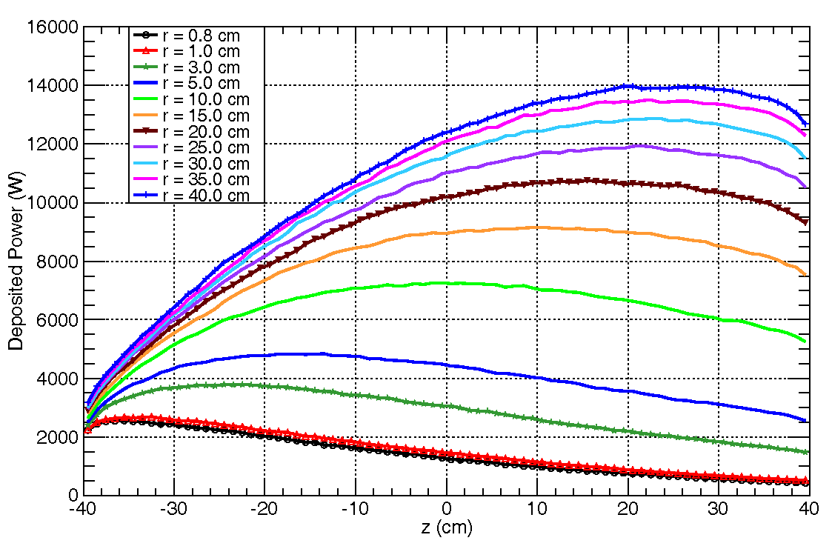
Target at 0°
For a first study, we consider graphite targets at 0 to the magnetic axis, in 0- and 20-T uniform magnetic fields.
The plots show the total power deposited in 1-cm-thick disks, for target of various radii.
Largest power deposition only 4 cm into a “pencil” target, but at ~ 60 cm in targets
with large radius.
dE/dx only deposits about 1870 Watts in 1 cm of graphite, for a 4-MW beam.
B = 0 T, MARS
B = 0 T, FLUKA

Slide 4
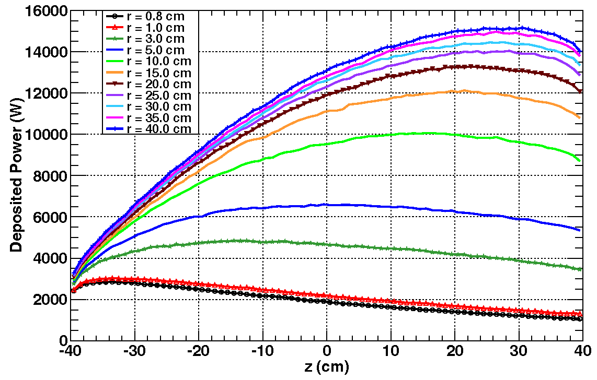
Target at 0°, II
B = 20 T, MARS
B = 20 T, FLUKA
FLUKA indicates 5-10% more power deposition in this comparison.
The FLUKA beam is parallel, with rms radius = 2 mm, while the MARS beam is focused with spot rms radius of 2 mm and β* = 80 cm.

Slide 5
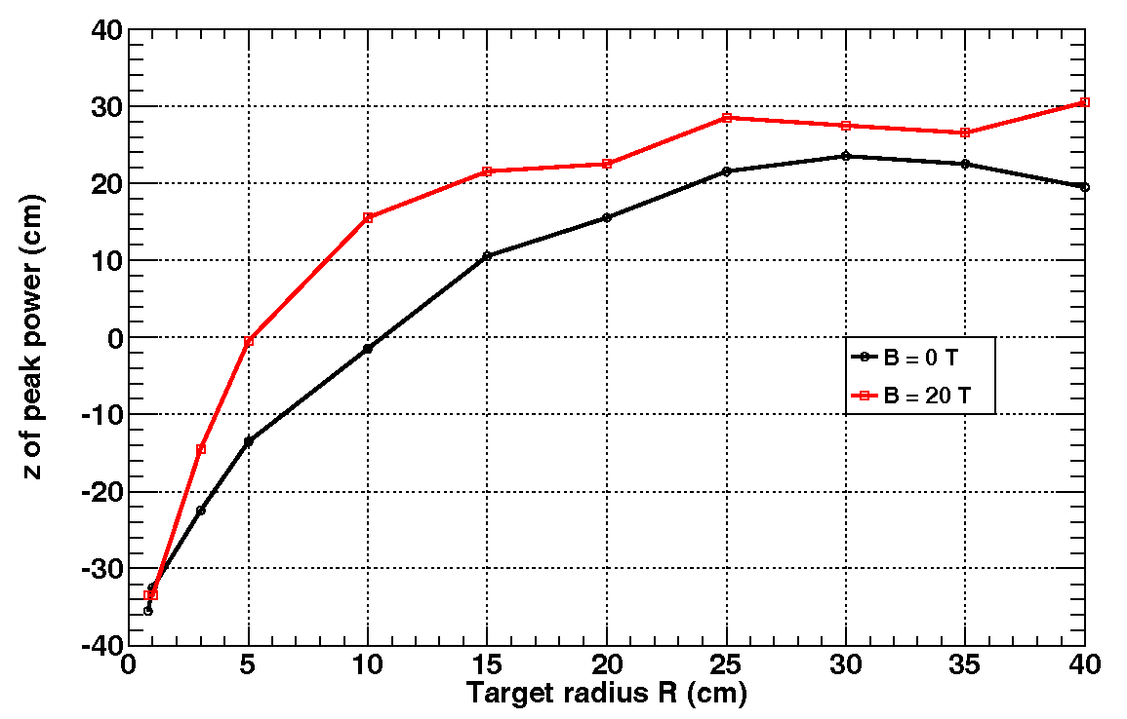
Target at 0°, III
The z-coord. of the target slice with peak power density is constant for radii > 30 cm.
MARS
FLUKA

Slide 6
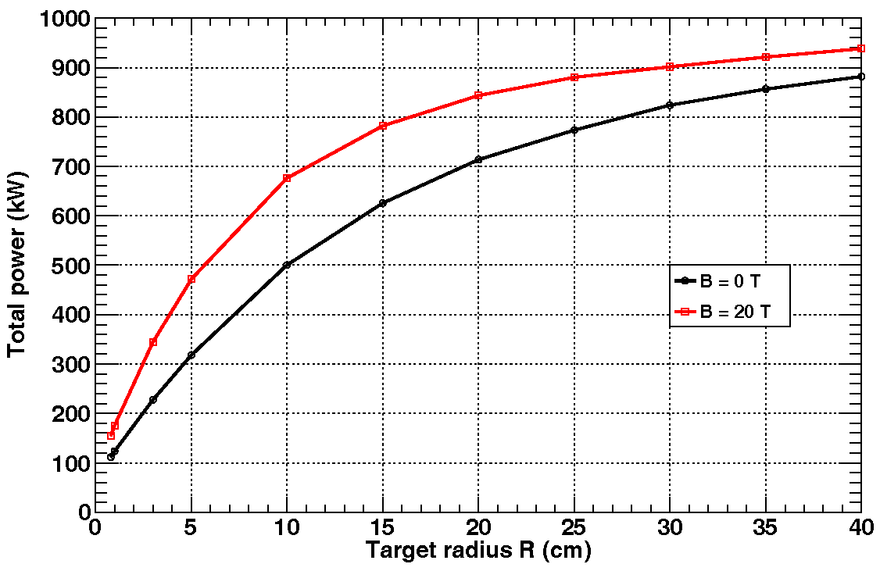
Target at 0°, IV
The total power absorbed in the target increases from ~ 150 kW in a “pencil” target (length = 80 cm, radius = 8 mm) to about 1 MW (out of 4 MW) in a target of 80 cm length and 40 cm radius.
MARS
FLUKA

Slide 7
Target at 0°, V
We now want to locate the coordinates of the point with peak local power deposition.
A study not shown confirmed that this point has coord. r = 0.
To find the z coord., we plot the power deposition vs. z in a cylinder with r = 1 mm.
The curves are essentially independent of the target radius (for r_{target} > 8 mm).
B = 0 T
MARS
B = 20 T
MARS

Slide 8
Target at 0°, VI
The z-coord. of the point with peak local power deposition is 2-3 cm into the target, independent of the target radius, as shown in the left figure below.
The peak local power deposition is about 3600 W/g for 0 magnetic field and 4-MW beam power, and about 3400 W/g for 20 T field, as shown in the right figure below.
For 60-Hz beam structure, the peak energy deposition is only about 60 J/g
(and 240 J/g for 15-Hz beam structure), for 4-MW beam power.
MARS
MARS

Slide 9
Target at 65 mrad
Trajectory of the central proton ray for 65-mrad tilt and 20-T field.
The y-coord. of the beam at any z inside the target is essentially the same as the y-coord. of the center of the target.
But, the beam enters the target offset in x by ~ 4.3 mm from the target center.
⇒ Peak energy deposition likely offset from the target center.

Slide 10
Target at 65 mrad, II
The peak energy deposition is 3598 J/g (~ same as for the 0° case),
and occurs for (x,y,z) = (-0.35, 2.85, -37.5) cm (2.5 cm into the target).
Power deposition in the target slice -4 mm < x < 3 mm.

Slide 11
Power Deposition Due to dE/dx
The peak power deposition of 3600 W/g occurs about 37 cm from the center of the target.
The rms radius there is σ_{r} = 0.2 [1 + (37/80)²]^{1/2} ~ 0.22 cm, for β* = 80 cm,
Effective area of a Gaussian beam = 2π σ_{r}² ~ 0.30 cm².
A 4-MW beam of 6.75-GeV protons has
N = 4 ⋅ 10⁶ J/s / (6.75 ⋅ 10⁹ eV ⋅ 1.6 ⋅ 10⁻¹⁹ J/eV) ~ 3.7 ⋅ 10¹⁵ p/s.
dE/dx in graphite is 1.5 MeV/(g/cm²).
The power deposition due to dE/dx at 3 cm into the target is
N ⋅ dE/dx / Area = 3.7 ⋅ 10¹⁵ /s ⋅ 1.5 ⋅ 10⁶ eV/(g/cm²) ⋅ 1.6 ⋅ 10⁻¹⁹ J/eV / 0.30 cm²
~ 2950 W/g.
This suggests that the peak power deposition (in our “pencil” target) is only about 1.2 times that due to dE/dx.

Slide 12
Thermal Issues for Solid Targets
When beam pulse length t is less than target radius r divided by speed of sound v_{sound}, beam-induced pressure waves (thermal shock) are a major issue.
Simple model: if U = beam energy deposition in, say, Joules/g, then the instantaneous temperature rise ∆T is given by ∆T = U /C, where C = heat\ capacity in Joules/g/K.
The temperature rise leads to a strain Δr/r given by ∆r/r = α ∆T = α U/C,
where α = thermal expansion coefficient.
The strain leads to a stress P (= force/area) given by P = E ∆r/r = E α U/C,
where E = modulus of elasticity.
In many metals, the tensile strength obeys P ≈ 0.002 E, α ≈ 10⁻⁵, and C ≈ 0.3 J/g/K,
in which case U_{max} ≈ P C / E α ≈ 0.002 ∙ 0.3 / 10⁻⁵ ≈ 60 J/g.
Graphite @ 1400° C: P = 42.4 Mpa, E = 7.2 Gpa, α = 4.8 × 10⁻⁵, C = 1.4 J/g, U_{max} ≈ 1700 J/g.
(α ≈ 1 × 10⁻⁵ for carbon-carbon composite)
[A nickel target at FNAL has operated with U_{max} ≈ 1500 J/g.]
These arguments are from A Short Course on Targetry, KTM,
NuFact03 Summer Institute

Slide 13
How Much Beam Power Can a Solid Target Stand?
What is the maximum beam power this material can withstand without cracking, for
a 6.75-GeV beam at 15 Hz with area 0.3 cm²?
Ans: MARS15 indicates that the peak energy deposition in a
“pencil” target is about 1.2 times that of dE/dx,
⇒ 1.8 MeV/(g/cm²) for graphite.
Now, 1.5 MeV = 2.9 ∙ 10⁻¹³ J, so 1500 J/g requires a proton beam
intensity of (1500 J/g)/(2.9 ∙ 10⁻¹³ J⋅cm²/g) ≈ 5 ∙ 10¹⁵/cm².
P_{max} ≈ 15 Hz ∙ (6.75 ⋅ 10⁹ eV) ∙ (1.6 ∙ 10⁻¹⁹ J/eV) ∙ (5.⋅ 10¹⁵ /cm²) ∙ 0.3 cm² ≈ 2.5 ⋅ 10⁷ J/s
= 25 MW.
If graphite cracks under singles pulses of > 1500 J/g, then “safe” up to 25-MW beam power @ 15 Hz and 6.75 GeV kinetic energy. (And would be “safe” up to 125 MW-beam power with a carbon-carbon target.)

