Slide 1
Shielding of the Final Focus Quads
K.T. McDonald, N. Souchlas
August 1, 2014

Slide 2
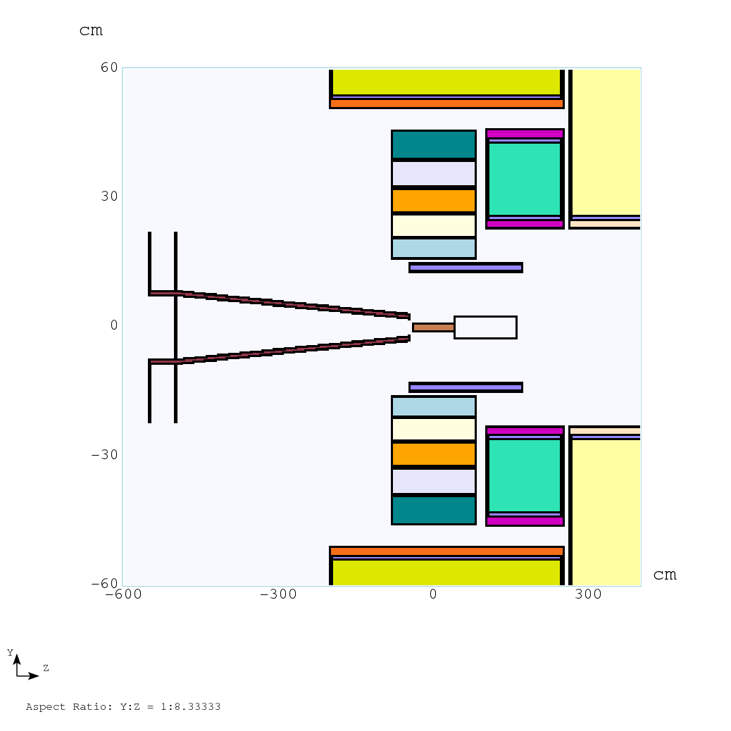
Shielding of the Final Focus Quads (N. Souchlas)
Fringe field of the 20-T Target System solenoid is still 1 T at z = -5 m, the possible location of the last Final-Focus quad, ⇒ Use superconducting quads,
⇒ Must shield against radiation from the target.
MARS15 study (for 0 tilt angle of the beam) indicates that a ~ ½”-thick SS beampipe provides the needed shielding (reducing the power deposition from a 4-MW beam to < 0.1 mW/g,
Downstream face of last Final Focus Quad
Target
Upstream face of last Final Focus Quad
Beampipe
Ti(?) beam window

Slide 3
Upstream End of Quad
1.25.cm-thick beampipe of outer radius ~ 8 cm at z = - 500 cm provides enough shielding for quad coils with 12 < r < 15 cm.

Slide 4
Downstream End of Quad
1.25.cm-thick beampipe of outer radius ~ 8 cm at z = - 500 cm provides enough shielding for quad coils with 12 < r < 15 cm.

