Slide 1
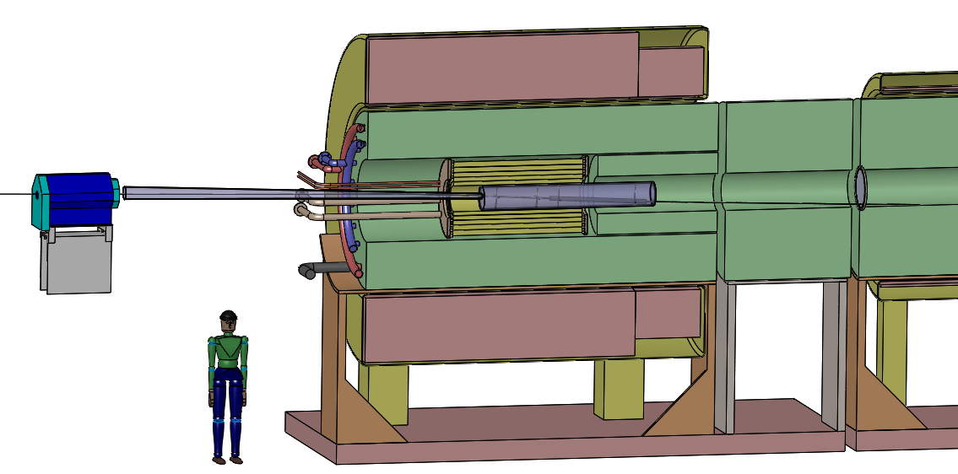
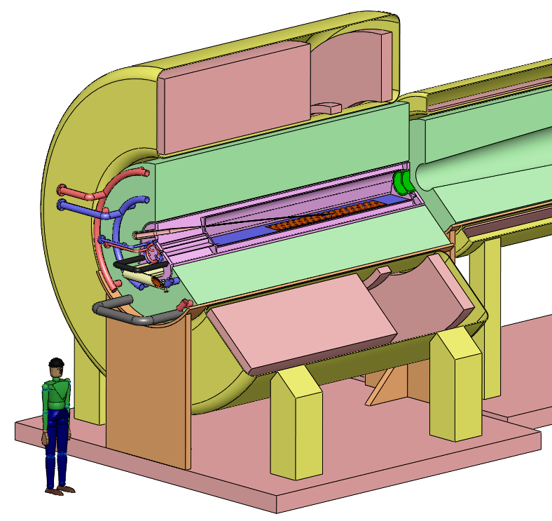
Should the JINST Target Report Include an Updated Mercury Target Configuration?
Present studies are for a carbon target in a 20-T solenoid, with a fast taper over 5 m down to 2 T.
The proton beam has 6.75 GeV.
20to2T5m4PDL
The last Hg target configuration was that of Oct. 31, 2013, with a 15-T solenoid and a slightly different taper.
IDS120_15-1.5T7m3+4
Hg particle production studies were only performed for a 20-T solenoid, a slower taper, for 8 GeV, and with an older MARS version.

Slide 2
Proposal for an Update of Hg Target Studies
An Hg-target option for 2 or 4 MW is formally part of the MASS, but no work has been done on this in the last ~ 18 months.
Older Hg-target studies are for 8-GeV protons rather than 6.75, for a 20-T solenoid rather than 15, for a longish taper, and with an older version of MARS.
It seems preferable for our “archival” record that the Hg target scenario be updated to match better the present vision of 15-T solenoid, short taper, and have particle production simulated with the latest MARS version.
Such an effort would require modest consultation with Van Graves and Bob Weggel to verify details of an updated configuration, followed by ~ 3 weeks of particle-production simulation by Xiaoping Ding.
We might also add a survey of C and Hg particle production vs beam energy
Particle-production simulations for the 6.75-GeV, C-target scenario are essentially complete (unless small inconsistencies emerge in a C-Hg comparison.

