Slide 1
Modeling Pion Production at 3 GeV
How to Compare Particle Production at Different Beam Energies
In the staging scenarios, we consider various proton beam energies and beam powers.
We have come to desire particle production rates quoted in a manner that scale simply with beam power.
Beam Power = Protons/s × Beam Energy;
So, if we are interested in, say, “useful” muons per beam power, this is equivalent to
(“useful” muons/s) / (proton/s) / beam energy.
In the following we abbreviate this to
Muons / proton / GeV

Slide 2
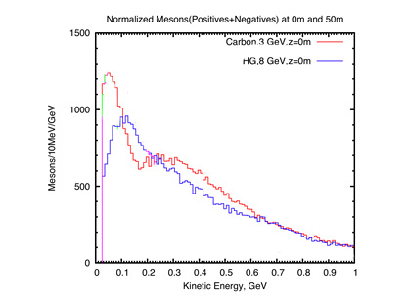
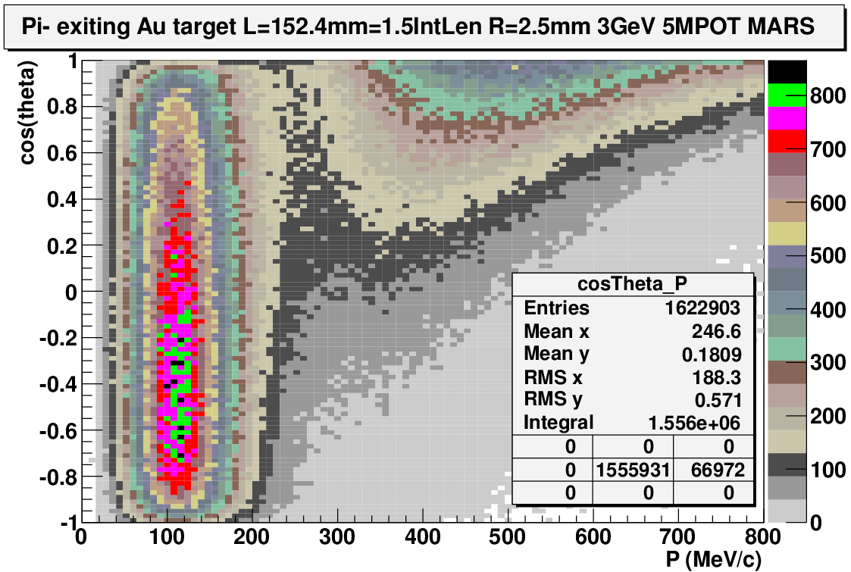
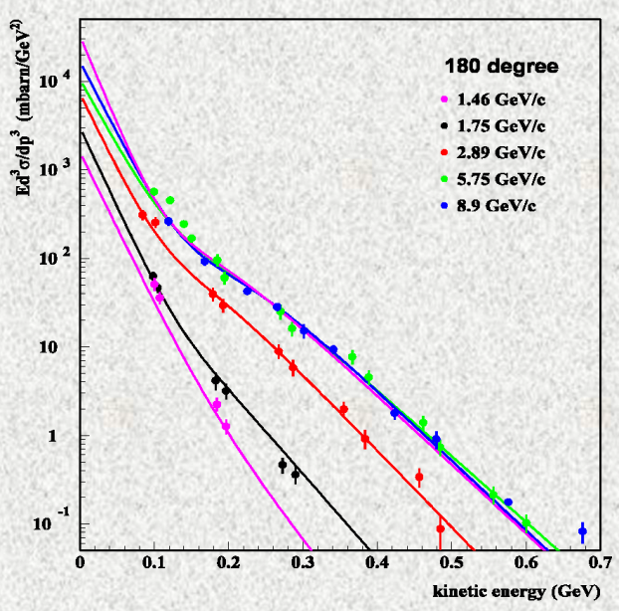
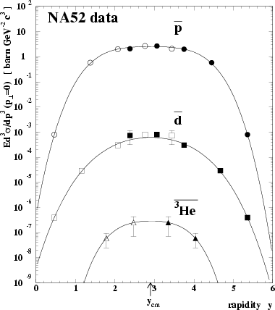
Soft-Pion-Production Modeling Issues
MARS15 simulation (X. Ding) with 3 GeV protons and C target shows large production of soft pions (and 2nd peak at 300 MeV KE). Are these features real?
3 GeV
MARS
Au: Pi-
5MPOT
MARS15 simulation (C. Yoshikawa) shows peak of backward π⁻ with P ~ 120 MeV/c independent of angle.
MARS15 model of invariant cross section does not seem to have the required drop-off at low KE (from symmetry of the production cross sections with P_{z} in the center of mass frame). From Mokhov (1012):
http://accelconf.web.cern.ch/accelconf/HB2012/talks/weo3c05_talk.pdf
p + Pb
Collisions plotted vs. KE
Pb + Pb
collisions plotted vs. rapidity y
http://iopscience.iop.org/1367-2630/5/1/301/fulltext/

Slide 3
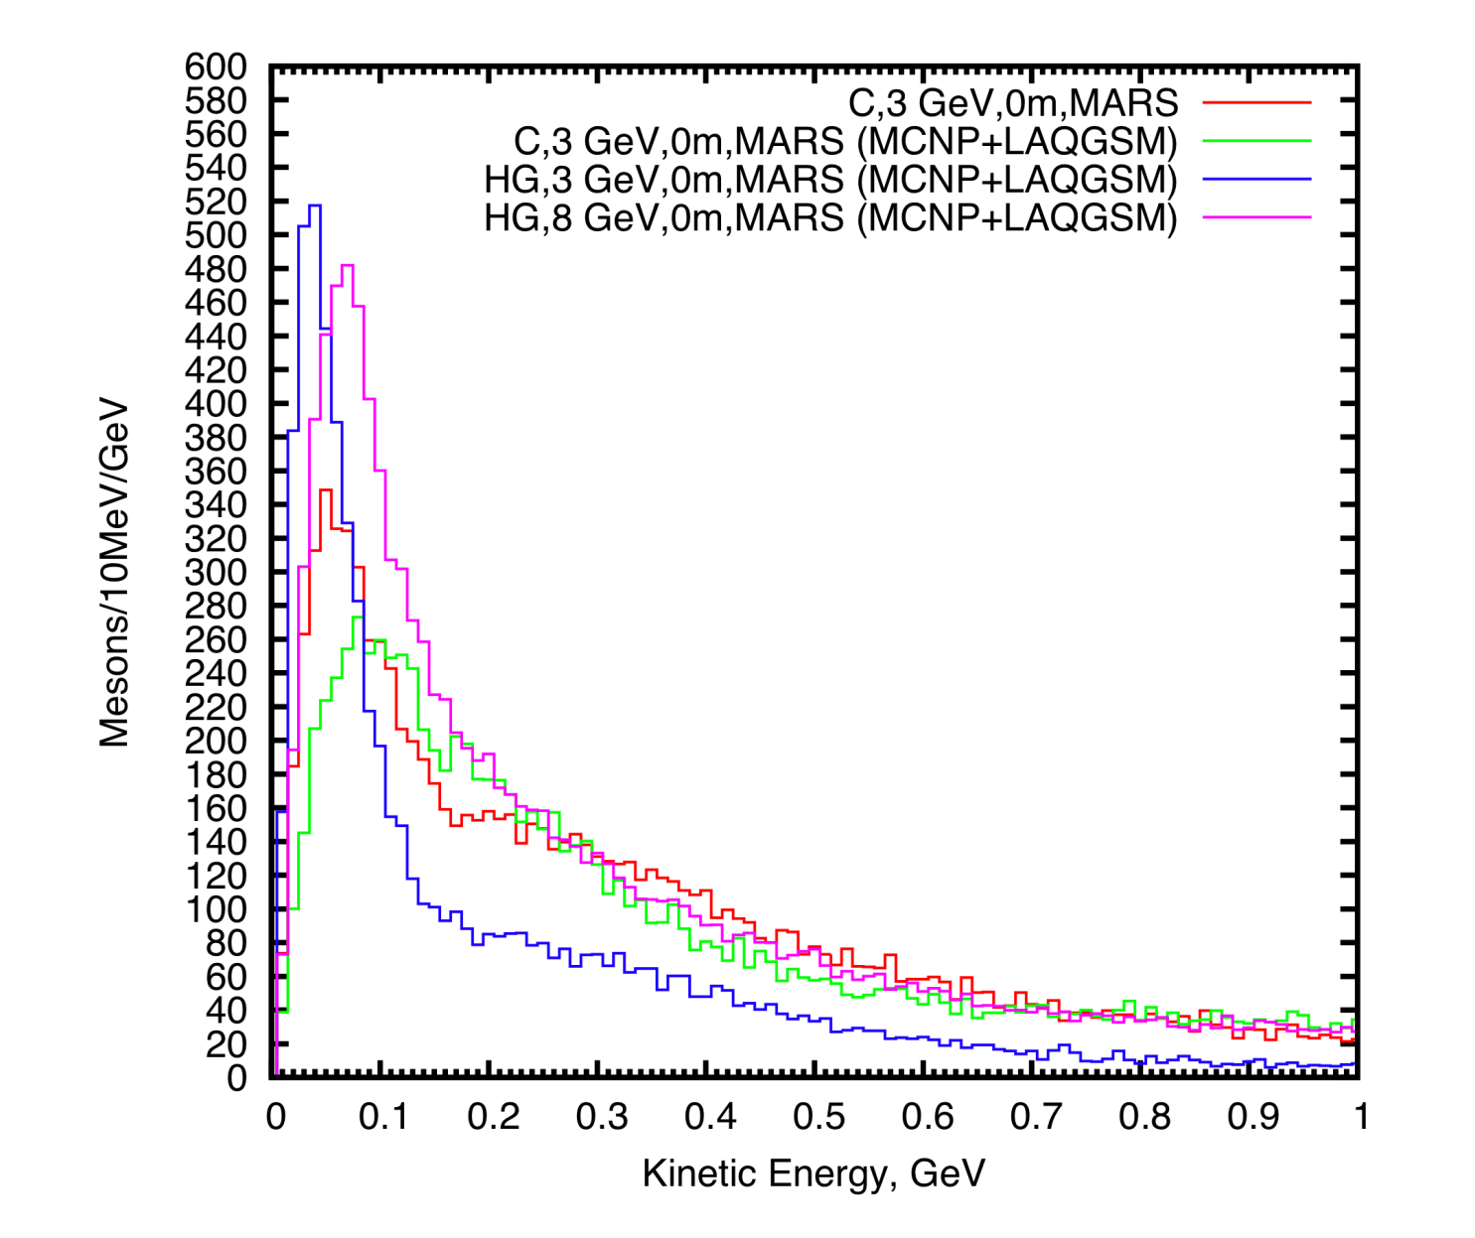
LAQGSM Mode ⇔ Better MARS Model below 5 GeV
Pion production @ 3 GeV via MARS in LAQGSM mode seems much more plausible than when not in this mode.
As reported previously, pion production off Hg target is lower at 3 GeV than at 8 GeV by almost a factor of 2.
Pion production off C target at 3 GeV is about ¾ that off Hg target at 8 GeV, but greater than that off Hg at 3 GeV.
Pion production off C target at 3 GeV and 1 MW is about 1/5 that off Hg at 8 GeV and 4 MW.
Hg, 8 GeV
C, 3 GeV, in LAQGSM MODE
C, 3 GeV, not in LAQGSM Mode
Hg, 3 GeV
X. Ding: http://puhep1.princeton.edu/~kirkmcd/mumu/target/Ding/ding_130905.pdf

Slide 4
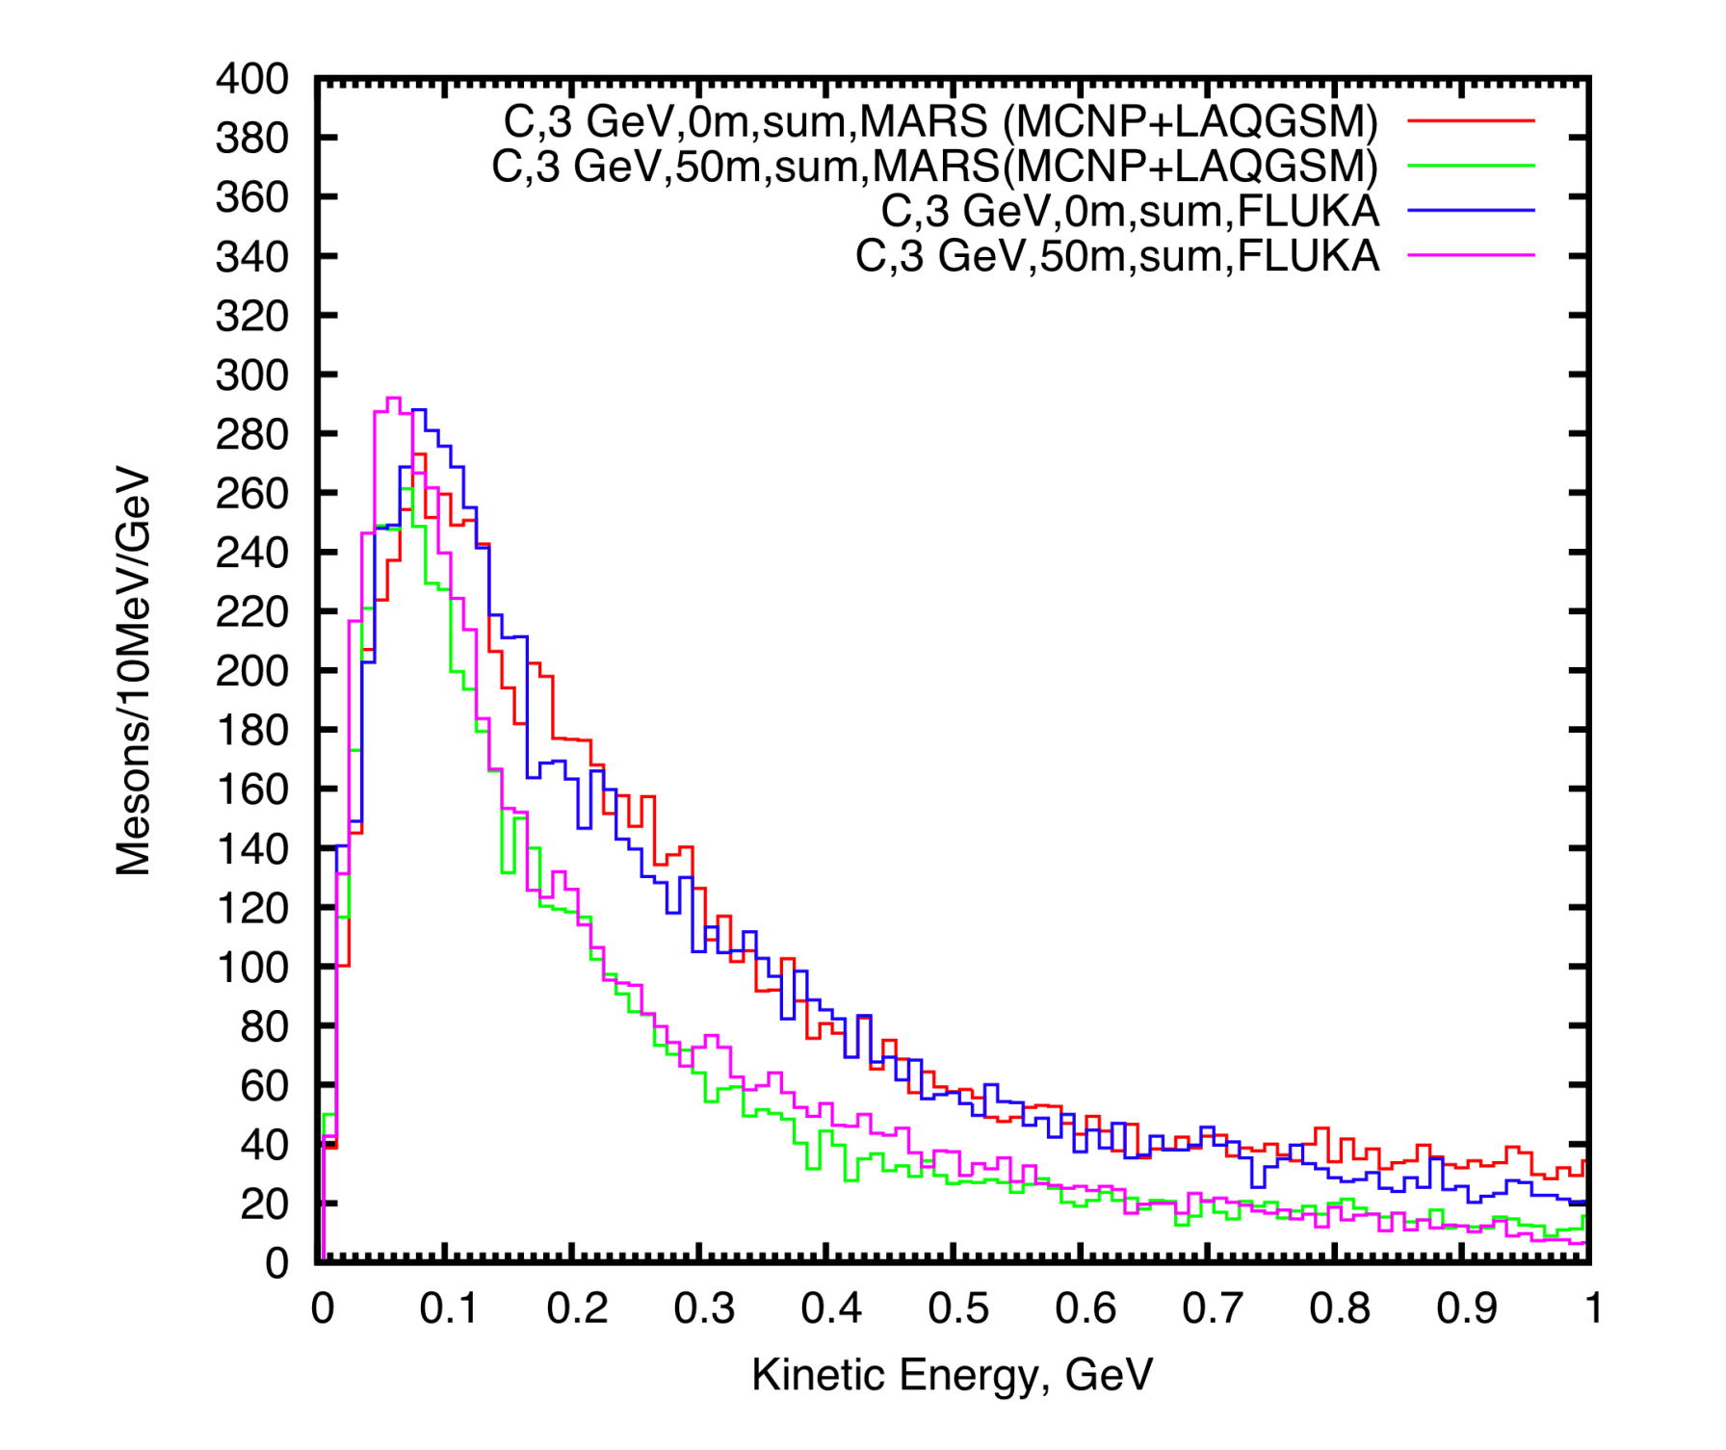
MARS in LAQGSM Mode Agrees Well with FLUKA @ 3 GeV

Slide 5
Summary
Models of particle production below 5 GeV are delicate, but MARS in LAQGSM Mode seems robust enough for us to proceed.
At 3 GeV, a carbon target is favored over a mercury one in terms of rate alone (and a carbon target is very viable in a 1 MW beam).
Pion/muon production at 3 GeV, 1 MW with a carbon target will be about 1/5 that with a mercury target at 8 GeV and 4 MW.
Delivering a short pulse in a single proton beam will be difficult at 3 GeV, so we may need to consider multiple beams (onto a single target).
Optimization for the configuration of carbon target, capture solenoid magnets, and possible multiple proton beams should begin now.

