Slide 1
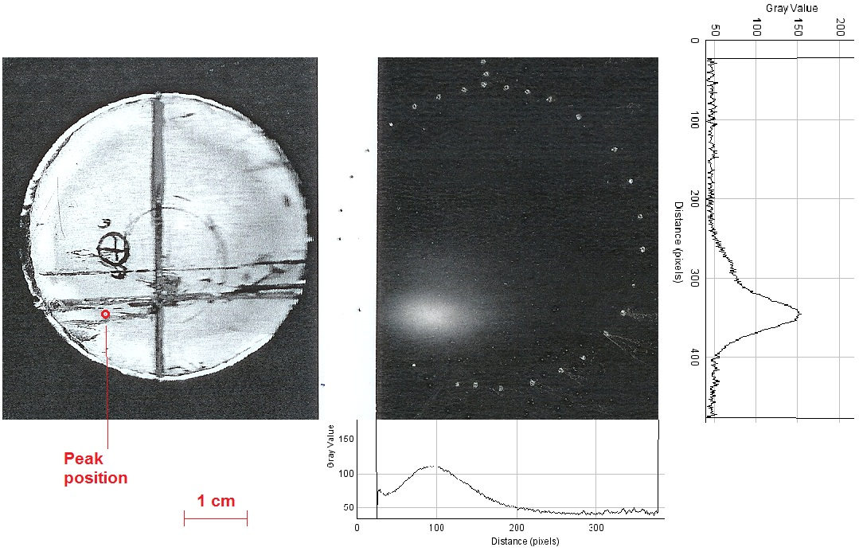
MERIT Autoradiographs
P. Thieberger, BNL
(Dec. 21, 2011)

Slide 2
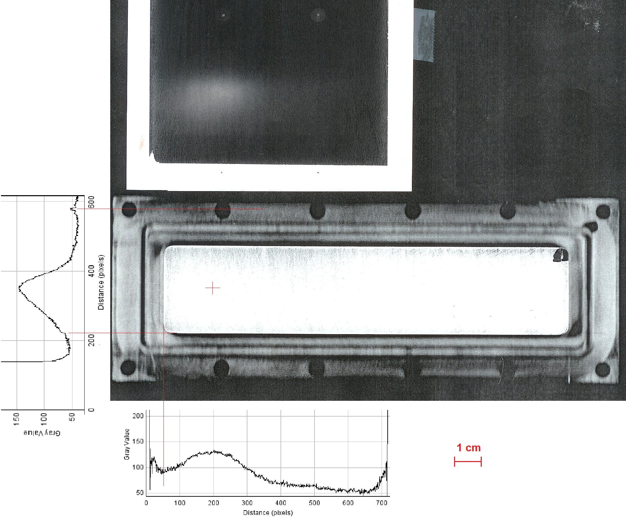

Slide 3
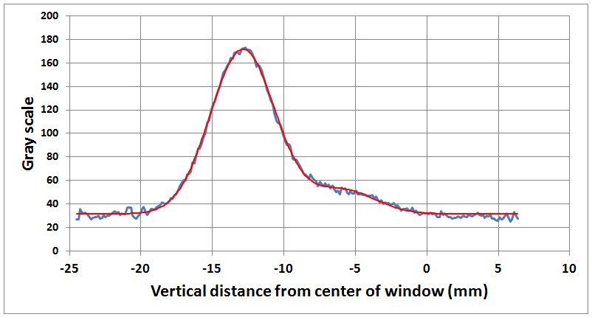
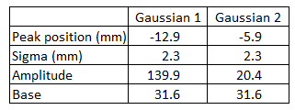
Fit of the vertical beam profile on the round window with two Gaussians of equal widths.
The calibration is 200 pixels per inch.

Slide 4
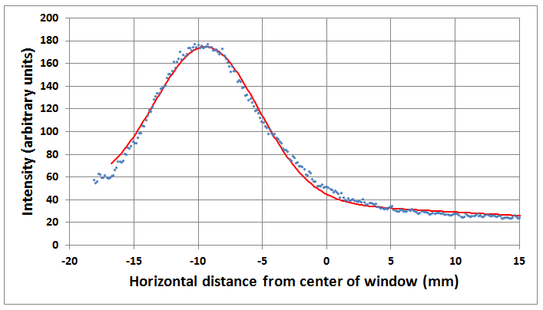
Gaussian fit to the horizontal beam profile on the round window
Peak position -9.4 mm
Amplitude 133.3 intensity units
Sigma 4.1 mm
Base 35.5 intensity units
Slope -0.63 intensity units/mm

Slide 5
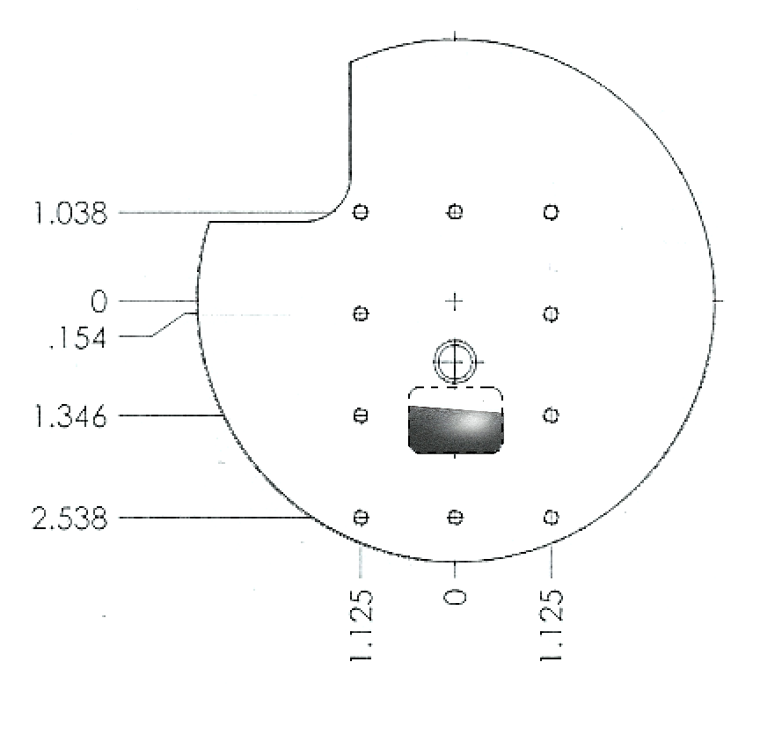
Beam spot looking upstream, as the auto-radiography was recorded

Slide 6
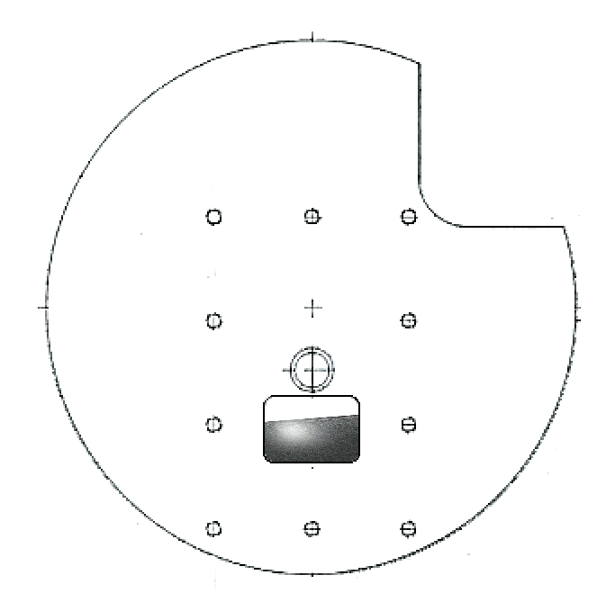
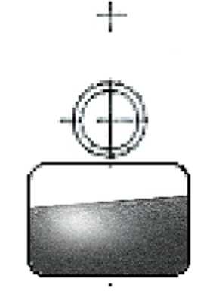
Beam spot looking downstream. The white border of the Polaroid film prevented the recording of the upper tail of the profile

Slide 7
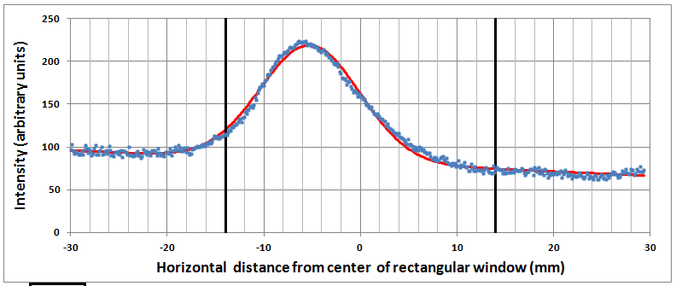
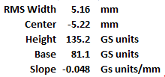
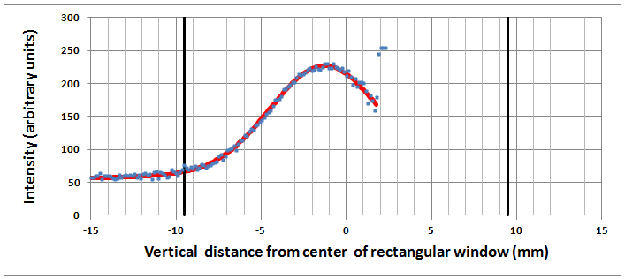
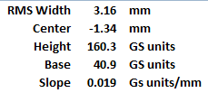
Fitted beam profiles
Horizontal
Vertical

