Slide 1
Target Magnets & Shielding
Bob Weggel
Particle Beam Lasers, Inc.
Magnet Optimization Research Engineering, LLC.
March 5, 2012

Slide 2
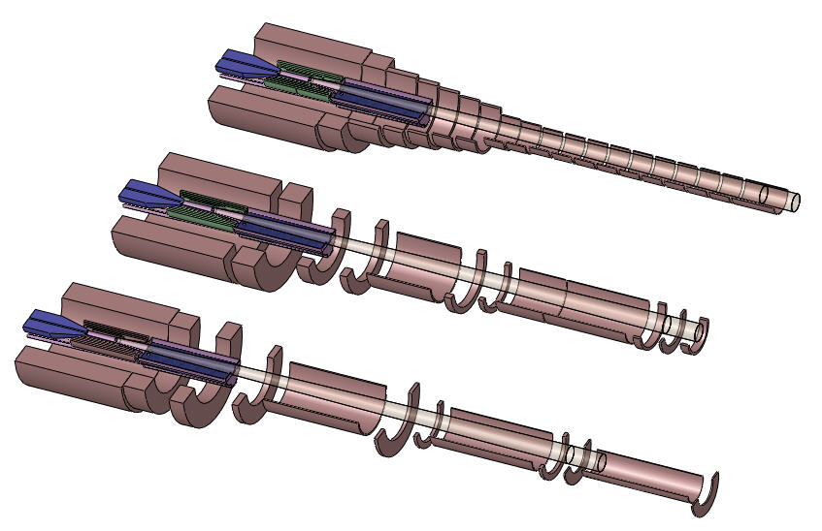
Isometric View of Three Target-Magnet Designs
Design IDS120h (top), IDS120i (middle) & IDS120j (bottom) [courtesy Van Graves]

Slide 3
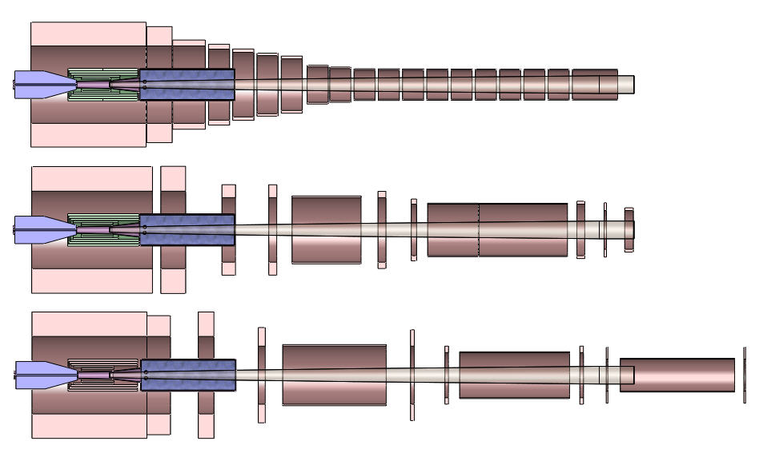
Cross Sections of Target-Magnet Designs [courtesy Van Graves]
IDS120h: I.R.’s step down gradually from 120 cm to 45 cm; minimal gaps between coils
IDS120i: Large gaps between cryostats; I.R.’s = [120, 100, 80, 60] cm; gaps at [3, 9, 15] m
IDS120j: 3 coils per cryostat; I.R.’s = [120, 90, 70, 50] cm; gaps at [4,10,15] m; z_{max} = 20 m

Slide 4
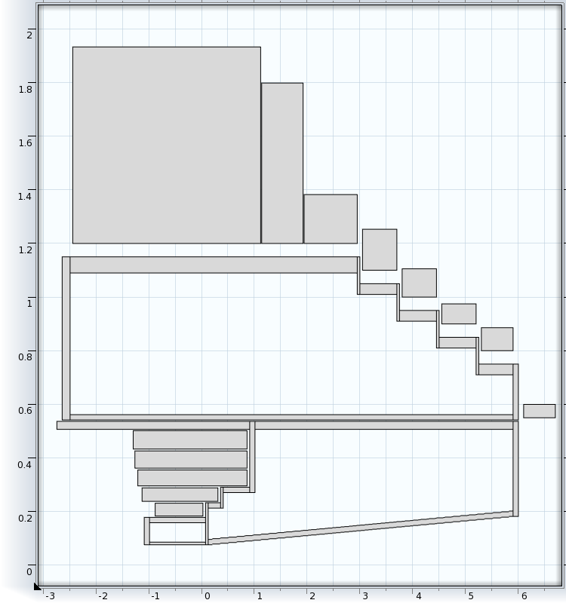
Cross section of Coils & Shielding Vessels of IDS120h
Tubes & flanges: = 7.85 g/cm³; shielding = 10 g/cm³; Outer ≈ 30 tons/m; Inner ≈ 8 tons/m.

Slide 5
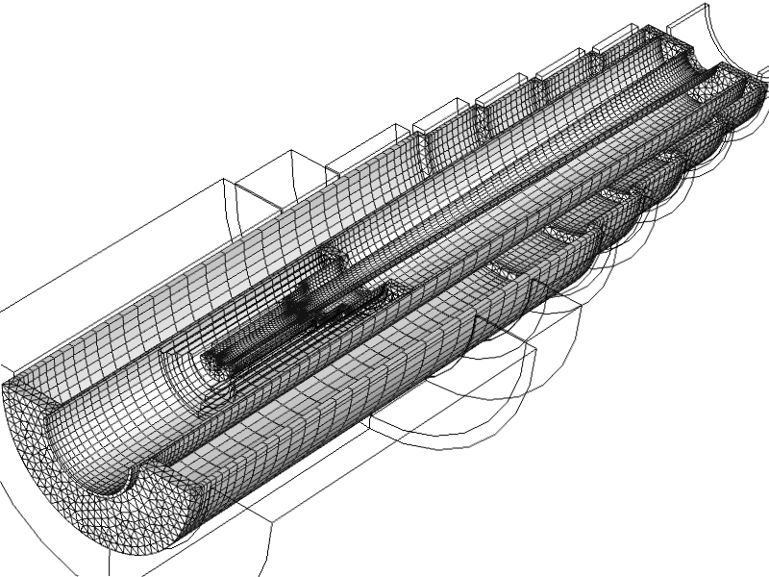
Isometric View of Meshed Shielding Vessels of IDS120h

Slide 6
Sag of Shielding Vessel vs. Length L & Wall Thickness t
O.R._{max} = 114 cm; I.R._{min} = 60 cm; γ = 7.85 g/cm³; γ_{shielding} = 10 g/cm³; t_{in} = ½t_{out}; ~30 tons/m.
With t_{out} = 4 cm, t_{in} = 2 cm & L = [6, 7, 8, 9] m, sag_{FEM} = [1.5, 2.5, 4.1, 6.4] mm→ Limit L to 8 m.

Slide 7
Sag of Shielding Vessel vs. Length L & Wall Thickness t
O.R._{max}= 58 cm; I.R. _{min} = 16 cm; t_{out} = 4 cm; t_{in} = 2 cm; γ = 7.85 g/cm³; γ_{shielding} = 10 g/cm³;
~8 tons/m. When L = [6, 6½, 7, 7½, 8] m, sag = [2.0, 2.9, 4.0, 5.4, 8.0] mm → Limit L to 7 m.

Slide 9
Normalized Maximum Hoop Stress σ* ≡ σ_{max} / (B₁ j₁ a₁)
a₁ ≡ I.R. of coil; a₂ ≡ O.R. of coil; B₁ ≡ B(r=a₁), B₂ ≡ B(r=a₂); j₁ ≡ current density

Slide 10
On-Axis Field Profile B(z)of Target Magnet IDS120j
<B(z)> = 20 T over the 75-cm length centered at z = −37.5 cm. B(z=15 m) ≈ 1.5 T.

Slide 13
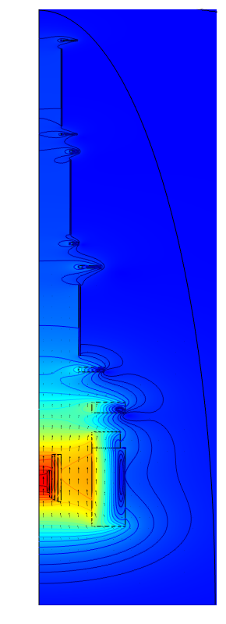
Field Magnitude |B| ≡ (B_{r}²+B_{z}²)^{½} of Target Magnet IDS120j
Maximum field = 20.4 T; contours at 1.5 T and integer values from 1 T through 20 T

Slide 14
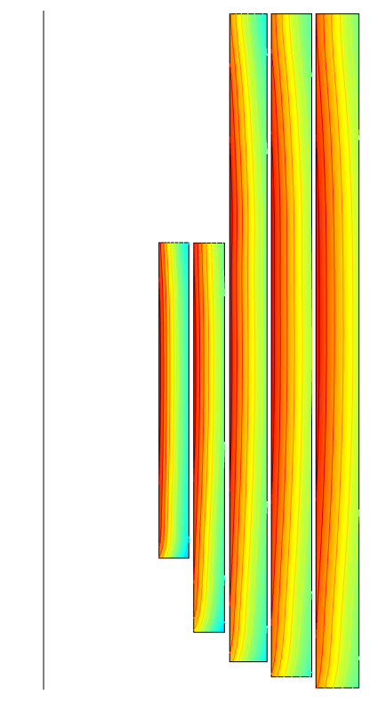
Hoop Strain σ_{hoop} in Magnet of Copper Hollow Conductor
700-MPa coil banding limits σ_{hoop} in each coil to 0.35%; contour interval = 0.02%.

Slide 15
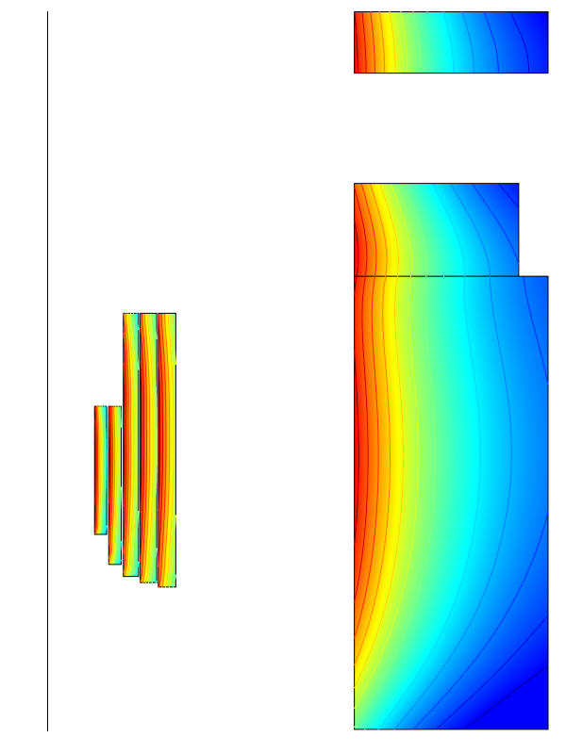
σ_{hoop} in Copper & Nb₃Sn Magnets (Most-Upstream Cryostat)
Maximum hoop strain in each coil is 0.35%; contour interval = 0.02%.

Slide 16
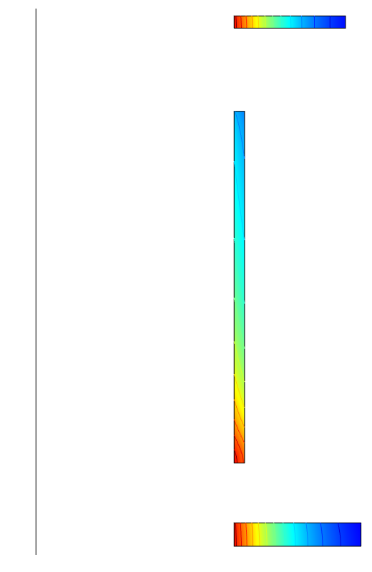
σ_{hoop} in Coils of Cryostat #2 (NbTi Conductor)
Maximum hoop strain in each coil is 0.35%; contour interval = 0.02%.

Slide 17
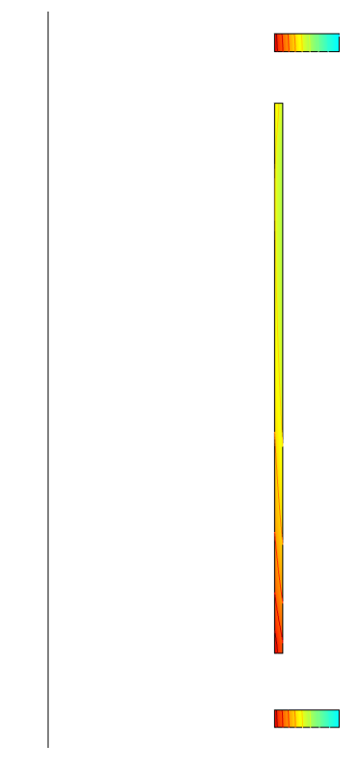
σ_{hoop} in in Coils of Cryostat #3 (NbTi Conductor)
Maximum hoop strain in each coil is 0.35%.

Slide 18
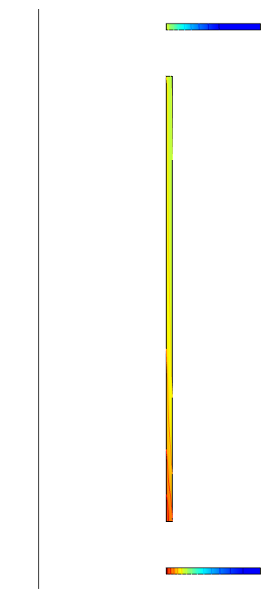
σ_{hoop} in Coils of Cryostat #4 (NbTi Conductor)
Maximum hoop strain in two upstream coils = 0.35%; max.(σ_{hoop}) in downstream coil also is 0.35% if one adds an identical set of coils downstream.

Slide 19
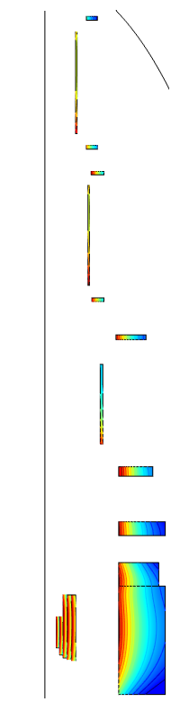
Target Magnet “DS120j5”: Optimized I.R. of Flanking Coils
I.R.’s of coils in cryostats #2-#4 are [120, 90, 116] cm, [76, 70, 75] cm & [67, 50, 67] cm.

Slide 20
On-Axis Field Profile B(z)of Target Magnet IDS120j5
Maximum field error is nearly 30% less than in design IDS120j.

