Slide 1
SNS Target R&D
Transformative Hadron Beamlines Workshop
21-23 July 2014 Brookhaven National Laboratory
Presented by
Mark Wendel
Notes:
8:45 AM to 9:30 AM – including Q&A
Roughly 35 slides should do it
Views and opinions expressed herein are my own, un-blessed by SNS, ORNL or DOE management.

Slide 2
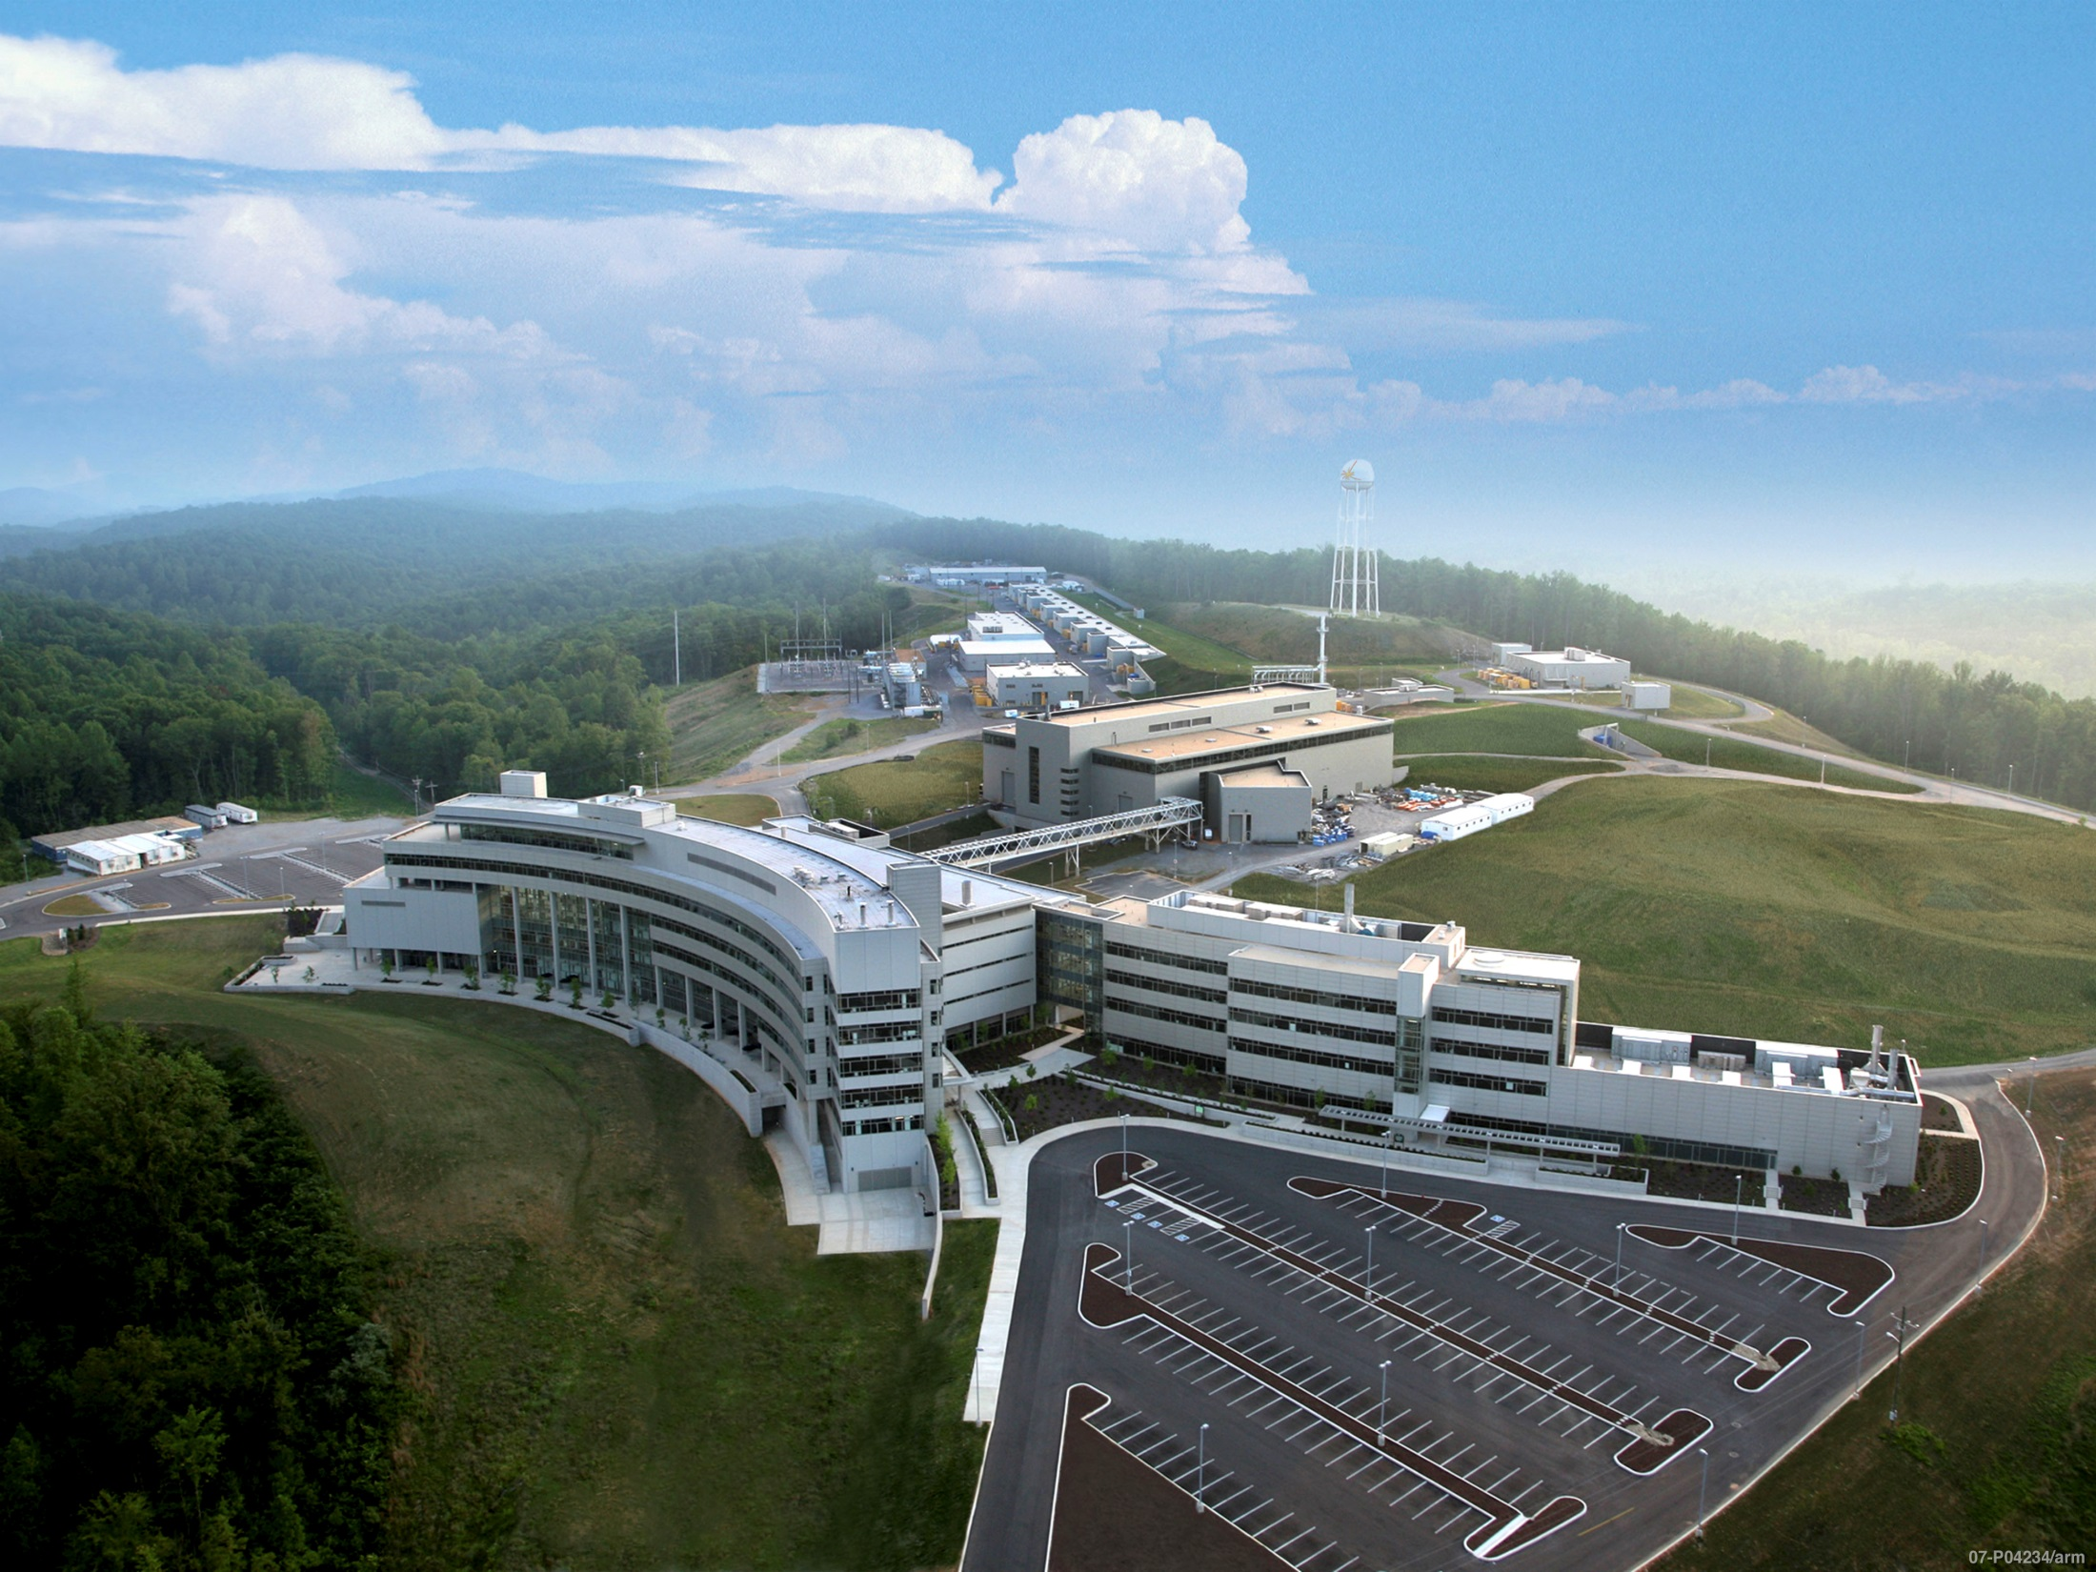
SNS – running since 2006
Mission is focused on neutron science
1.4 MW on target, 1 GeV, linac & accumulator ring, µs pulses to target at 60 Hz
Notes:
Photo has been modified

Slide 3
The master plan is for two short-pulse target stations at SNS
First target station
Mercury was chosen as the target material since high power was a priority:
  Steady state power handling allows MW-class operation
  R&D basis at the time of the decision was tenuous for what has been achieved
Rotating target was rejected due to suspected seal issues
  These issues have since been resolved
  QA program would have to be very stringent for long lifetime
Second target station
500 kW power level, short pulse, tungsten plates
Complement to the FTS/HFIR instrument suite
High brightness moderators is the emphasis

Slide 4
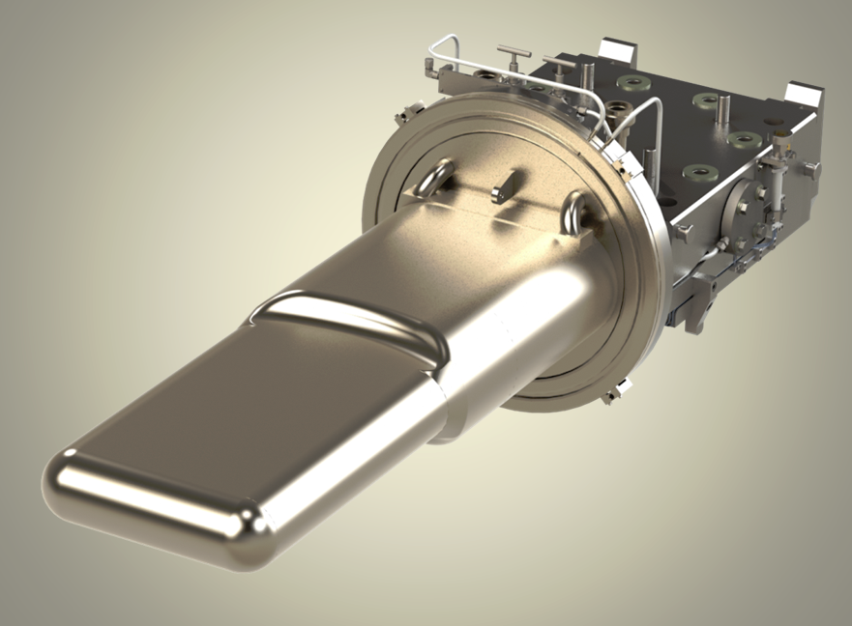
First target station SNS target module for mercury containment.
Nine targets have been used to date:
Three have been removed due to a detected leak in the mercury vessel.
Proton Beam

Slide 5
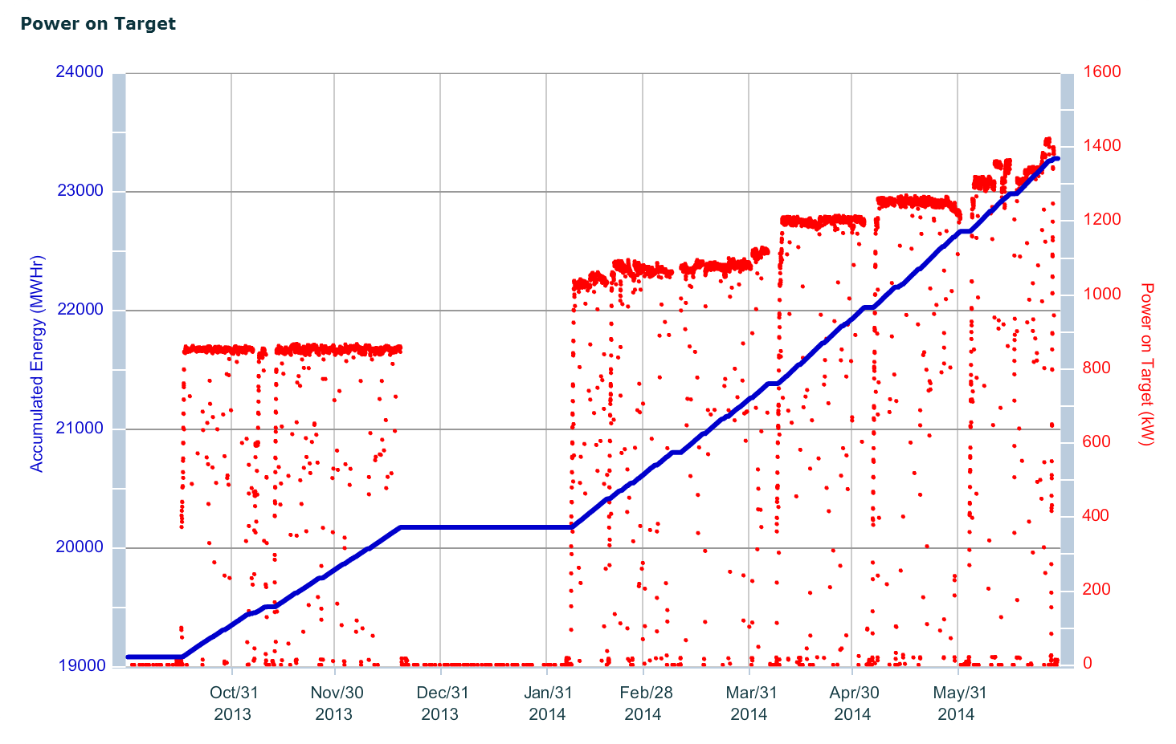
First target station has performed reliably up to design parameters.
Recently we had our first target module exceed 4000 MW-hr and sustain the 1.4 MW design power level for 1 day
Nine targets have been used to date.

Slide 6
R&D requirements for SNS First Target Station to 2MW+
Minor changes to mercury vessel to handle steady-state power – no R&D
Cavitation damage erosion (CDE) may become a limiter
  PIE has shown major damage, but no target failures have been blamed on CDE
  Reliable gas injection/recovery system needs development (collaboration with JPARC)
  Test facility for prototypic energy deposition is not currently available
Moderator enhancements – brightness for 1 of 3 Hydrogen Moderators
Lifetime extension to higher radiation damage levels beyond 10 dpa

Slide 7
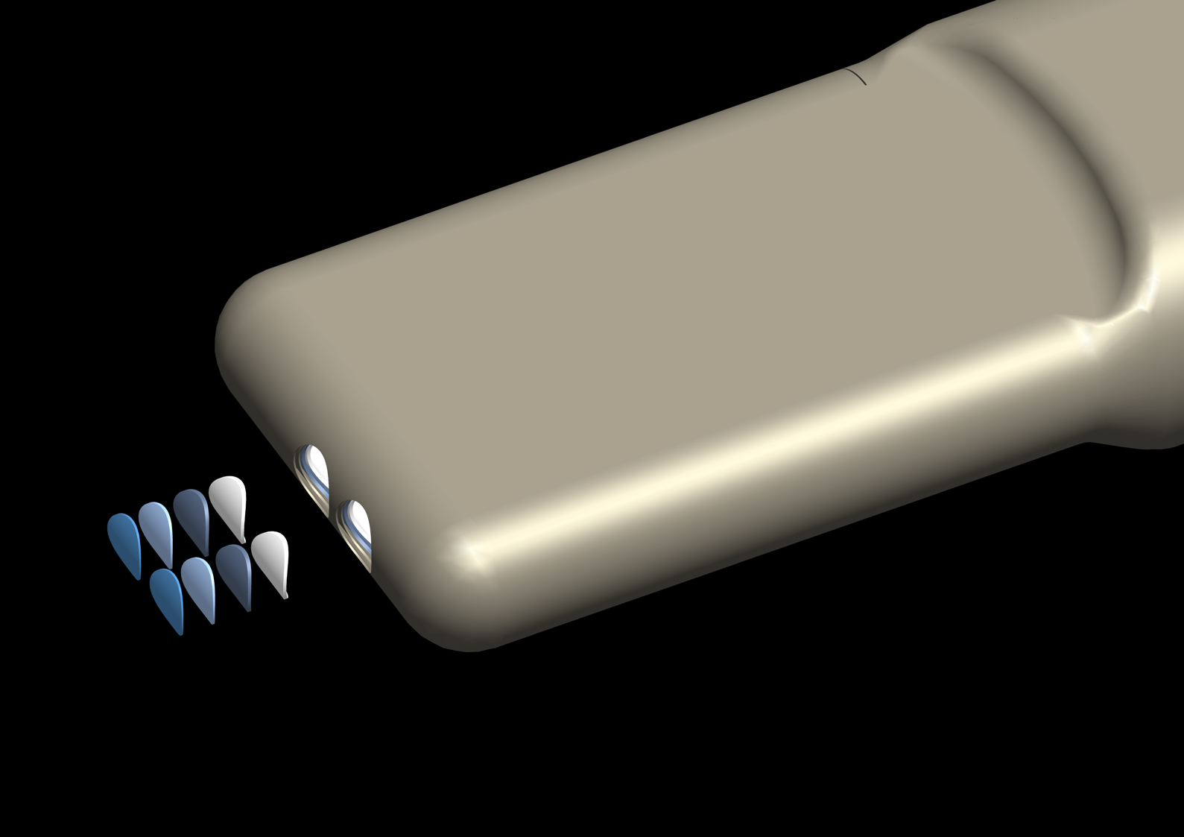
PIE: disk-shaped specimens routinely removed from the target module by each cutter
Target Specimen Identification Scheme
5
5
6
6
7
7
8
8
1
1
2
2
3
4
3
4
Figure Credit: K. Gawne

Slide 8
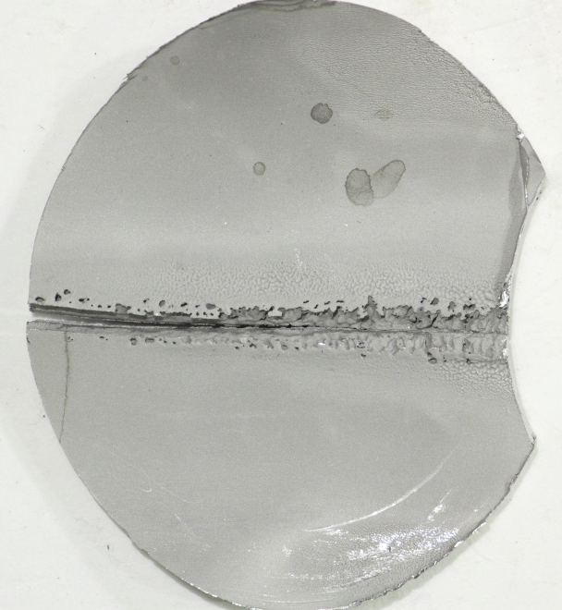
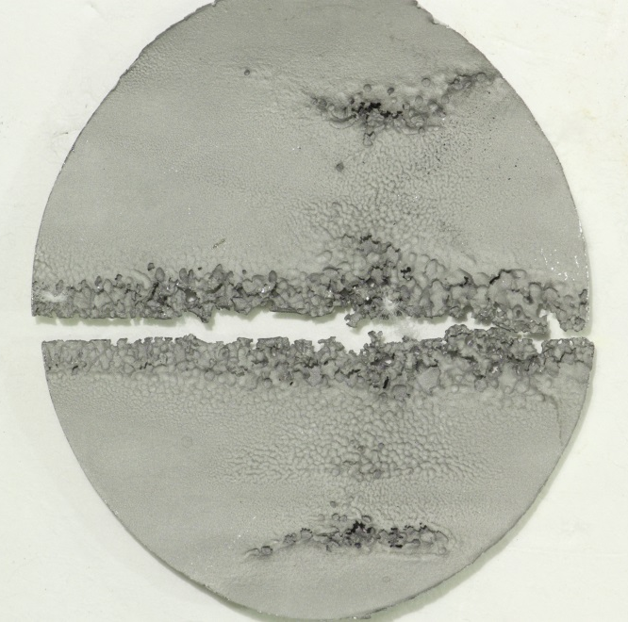
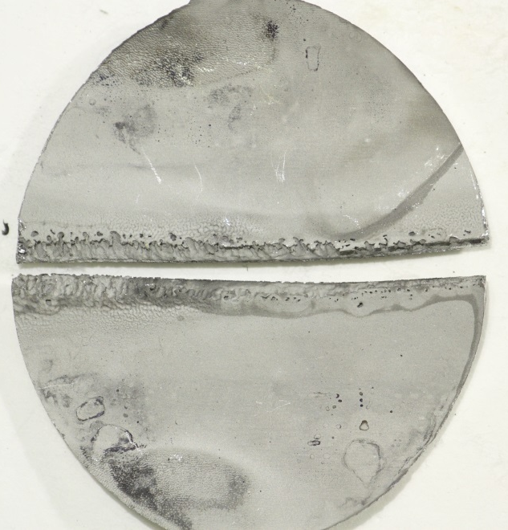
Cavitation damage is clear on an internal wall – lifetime of vessel is unclear
Target 8 mercury vessel beam entrance inner wall
Outer containment wall holds up much better
“Jet-flow” target design should reduce this damage
  Mitigation by flow – no gas injection
  First JFT is already installed
Figure Credit: D. McClintock

Slide 9
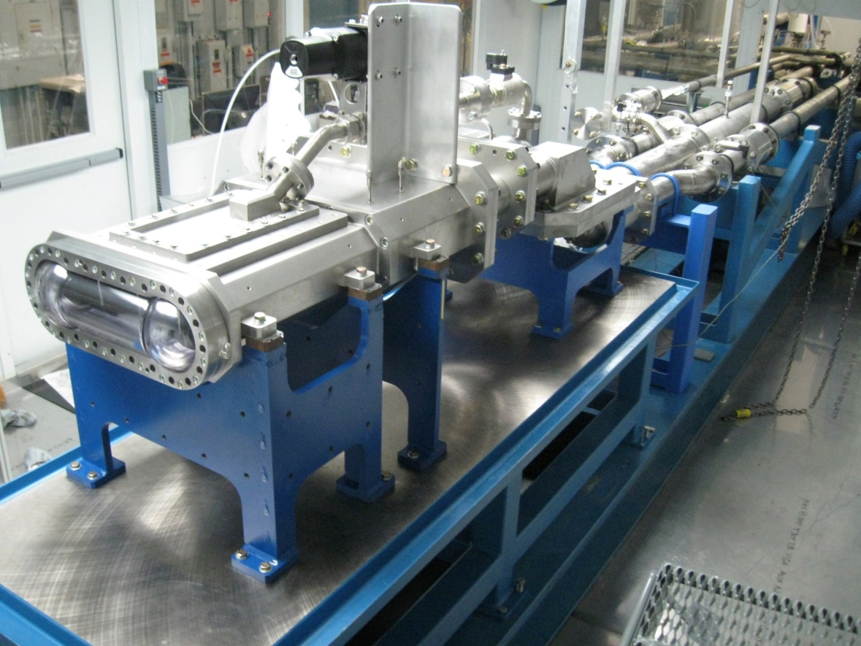
ORNL target test facility hydraulically prototypic for mercury & gas testing
No energy deposition
Gas circulating system
Gas injection location effectiveness
Target R&D was halted with early success
Now picking up some momentum with push toward higher power

Slide 10
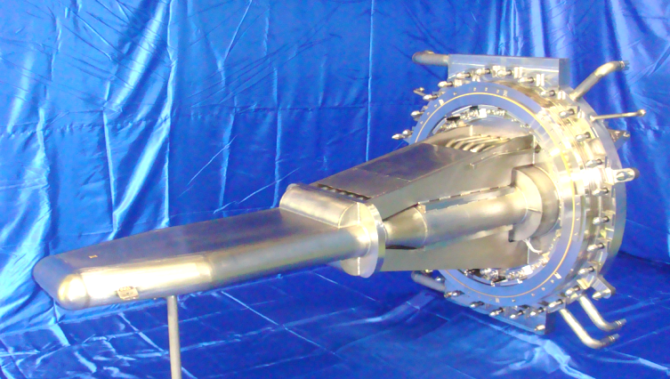
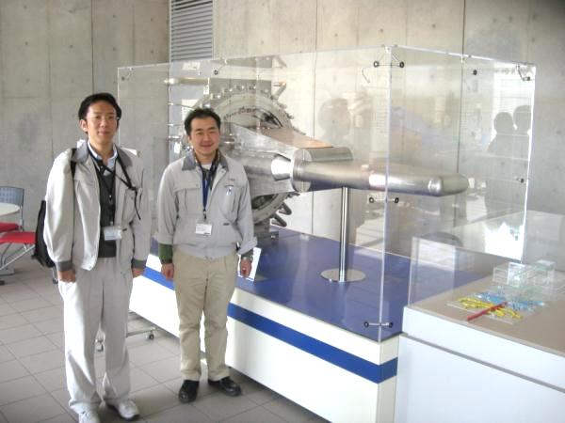
Collaborations with J-PARC on cavitation damage mitigation with gas are ongoing
3 GeV RCS, µs pulses to target at 25 Hz
Mercury, stationary SS316L vessel
Gas injection already implemented

Slide 11
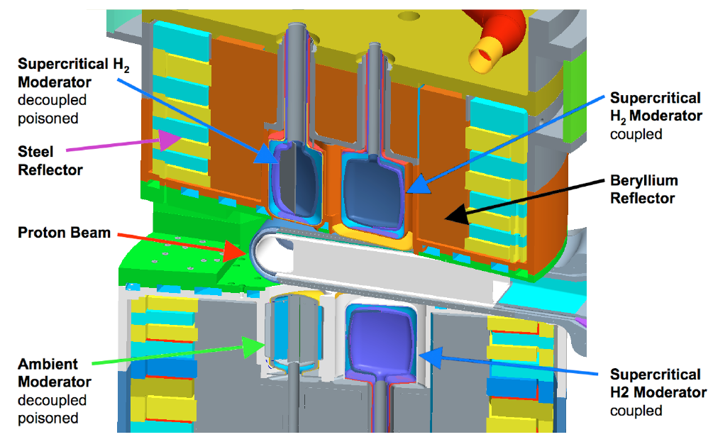
Some internal R&D funding has become available to restart moderator design effort
Upstream moderators are decoupled and poisoned
Downstream are coupled, not large; no ortho→para catalyst
  Next generation IRP to improve and enlarge top downstream moderator; catalyst equipment to be added

Slide 12
Lifetime limits at the SNS are based on different considerations
AISI 316L and Inconel 718
  Limit Basis: Maximum dpa
  Concern: Loss off fracture toughness and ductility
Aluminum PBW
  Limit Basis: He concentration
  Concern: Grain boundary embrittlement by He
Inner reflector plug (aluminum)
  Limit Basis: Burnup of gadolinium coating on the moderator poison plates
  Concern: Loss of resolution and performance of instruments serviced
 | Material | Lifetime Limit
Target | 316L | 10 dpa
PBW | Inconel 718 | 15 dpa
 | AL 6061-T651 | 2,000 appm-He
RID | 316L | 10 dpa
IRP | Gadolinium | 32,000 MW-hr
Figure Credit: D. McClintock
Notes:
Component lifetime limits are generally assigned to limit the decrease in ductility (a measure of fracture toughness) to a level that limits the risk of failure. Historically this limit has been has corresponded with a decrease in ductility to approximately 10% total elongation; below 10% total elongation is GENERALLY considered “low” ductility.
For the SNS PBW the lifetime limit is based on the He gas production from the proton beam. Previous experience with proton-irradiated aluminum suggests grain boundary embrittlement from He gas accumulation is the most probable life limiting phenomenon. The current He gas production limit of 2,000 appm He is based on the experience with the AlMg₃ target “safety hull” at the SINQ facility – which corresponds to only ~3.6 dpa.
The lifetime limit for the inner reflector plug (IRP) is based on burn up of the gadolinium poison in the moderator vessels – NOT radiation-induced changes in mechanical properties of the IRP structural materials.

Slide 13
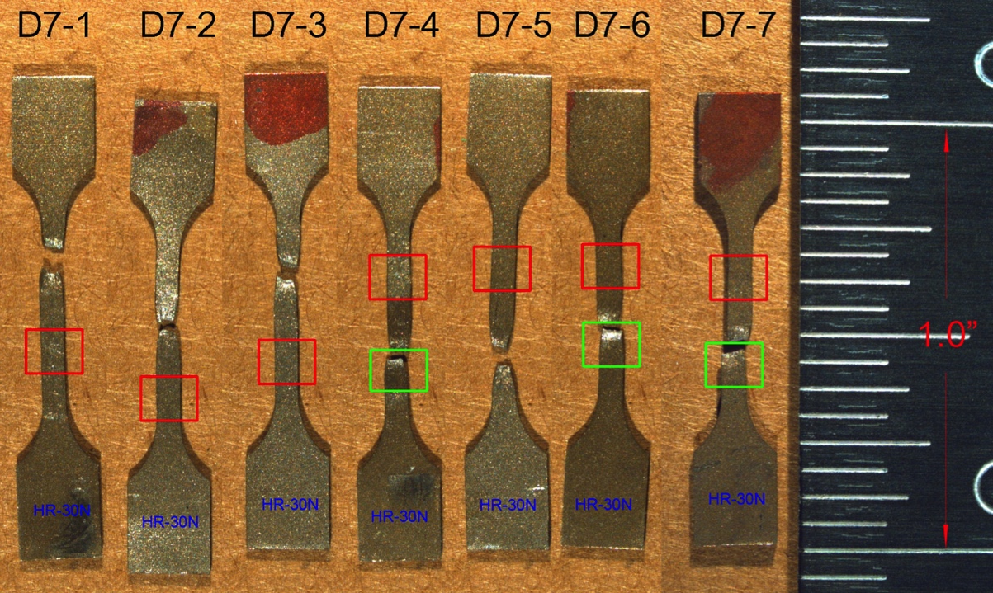
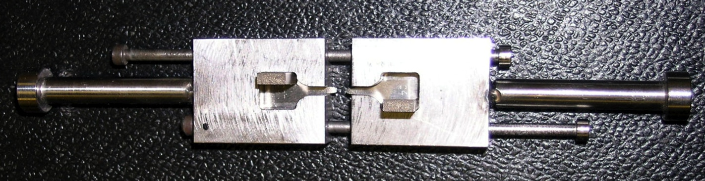
PIE program is starting to pick up momentum: goal is to extend the target module lifetime
Figure Credit: D. McClintock & B. Vevera
Notes:
Shoulder-loading was used to
Simplify specimen loading during testing
Prevent erroneous elongation values from pin-hole elongation…called footballing (in American-speak

Slide 14
316L – Target and RID Windows
316L and similar alloys have a long history in nuclear applications
Numerous 316L studies have been published on radiation-induced changes including irradiations in spallation spectrums
From: L.K. Mansur and J.R. Haines, J. Nucl. Mater. 356 (2006) 1-15.
From: S. Maloy et al., J. Nucl. Mater 296(2001) 119-128.
Notes:
On the left is fracture toughness. The two plots on the right contain data from the Fusion Materials Program Database on irradiation effects in 316xx variants, and show that during irradiation 316xx increases in strength and decreases in ductility. While, these data show a low ductility after ~10 dpa it is important to remember that this is uniform elongation and there is typically still an appreciable amount of ductility in this material; total elongation values remain between 10-40% after 5-7 dpa.
The plot on the left is fracture toughness data from irradiated components at Los Alamos. Results show that while the fracture toughness of the 3xx variants decreases with increasing dose, the fracture toughness appears to saturate between 60-75 Mpa√m

Slide 15
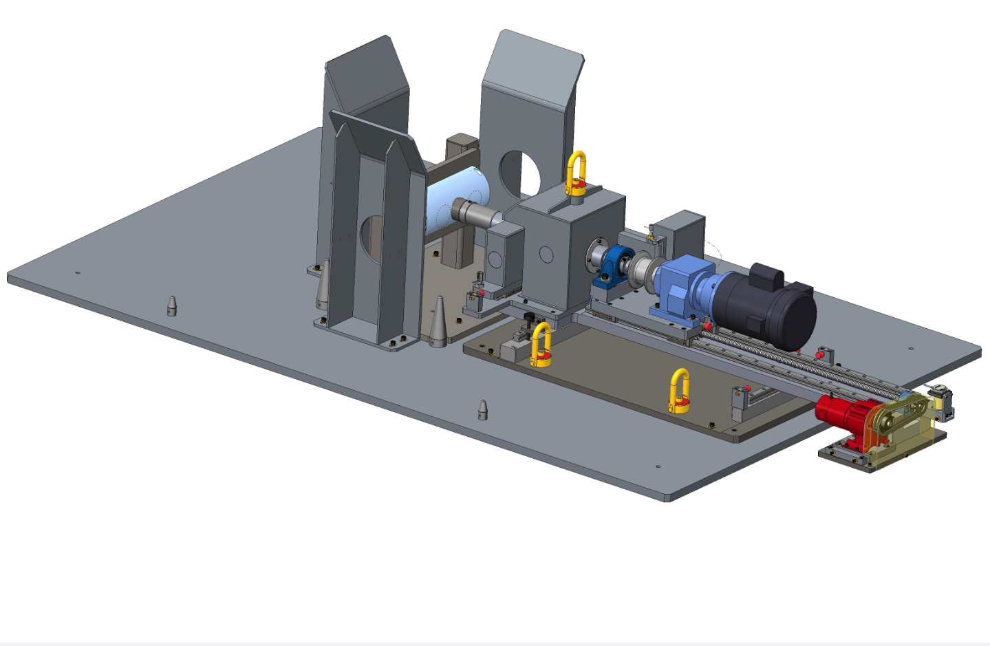
PIE is also planned this year on Inconel 718 proton beam window
Figure Credit: S. Parson

Slide 16
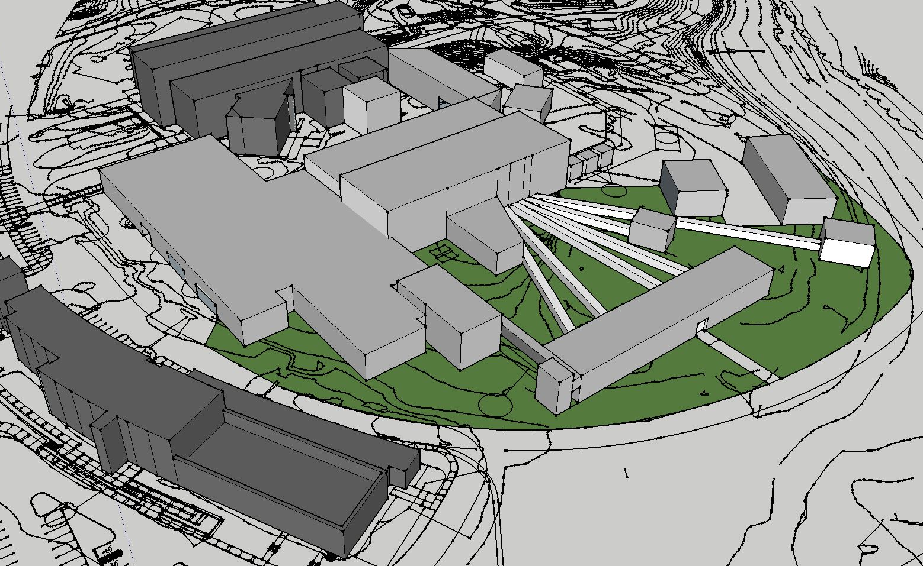
Second target station planning is underway: TDR will be issued in FY15

Slide 17
Emphasis will be laid on total optimization of the neutron source
> x100 Performance Gains
Source Parameters
Beam Transport
Sample
Detectors
Data Acquisition/Data Reduction
Data Analysis
Repetition Rate
Target
Moderators
Small Moderators to Small Samples
Size
Beam Divergence
Sample Environment
Spatial Resolution
Count Rates
Area
$$$
Integrated
Live Results
Computational Sciences
High Performance Computing
Theory
Polarization
Visualization
Figure Credit: K. Herwig
Notes:
Science mission dictates the neutron phase space that is required at the sample position.
Instruments will likely be more narrow in what they can do – but do that much better in order to obtain these types of gains (e.g. smaller samples)

Slide 18
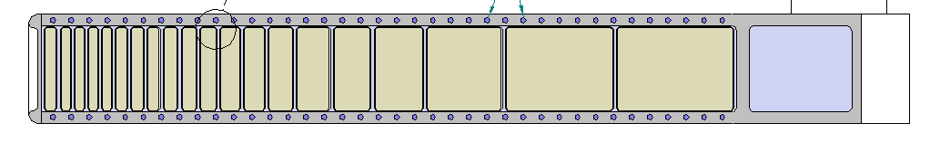
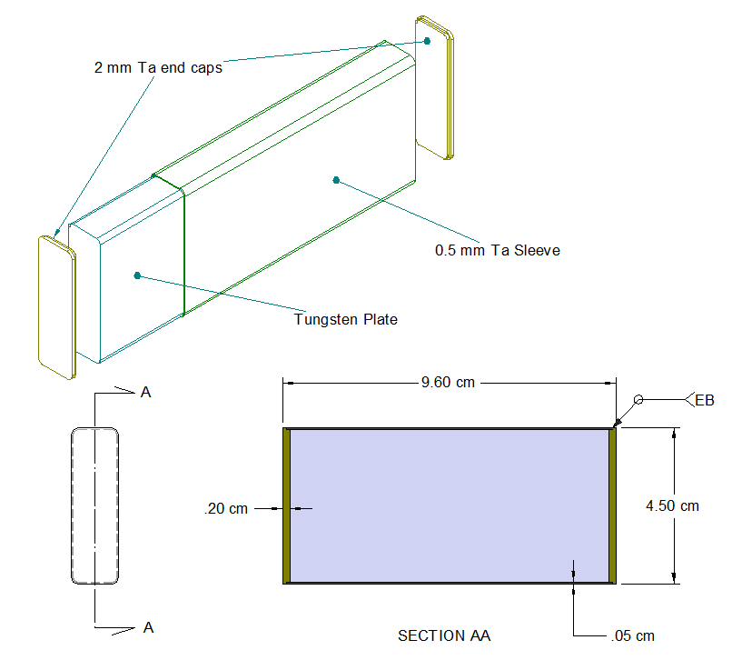
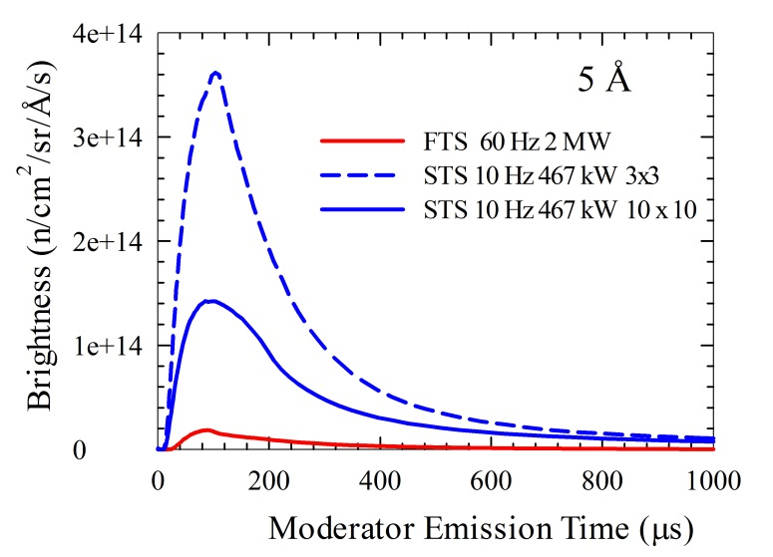
SNS Second Target Station Concept – Optimized for Highest Neutron Peak Brightness at Long Wavelengths
2.8 MW accelerator complex, 1.3 GeV protons,
60 Hz, pulse-stealing mode
  FTS – 2+ MW (5/6 pulses)
  STS – 467 kW (1/6 pulses)
Compact, high-performing target
  30 cm² proton beam cross-section (140 cm² at FTS)
  Solid Tungsten/Ta clad
Compact, high-brightness moderators
  Gains of 2 – 3 compared to large moderators
22 instrument end stations
  ≈ 11 deg separation
  Instrument length, 15 m ≤ L ≤ 120 m
proton
Cross-section

Slide 19
R&D Directions for Second Target Station
Mitigation of the safety issue for tungsten-steam interaction
  Experimental research on steam interaction with Ta clad (lower corrosion in Ta)
  Experiment to determine required Ta thickness
  Investigation of other cladding materials
  Fabrication research to determine joining process
Thermal-hydraulic experiments to confirm CFD
Moderator performance enhancements/advanced design

Slide 20
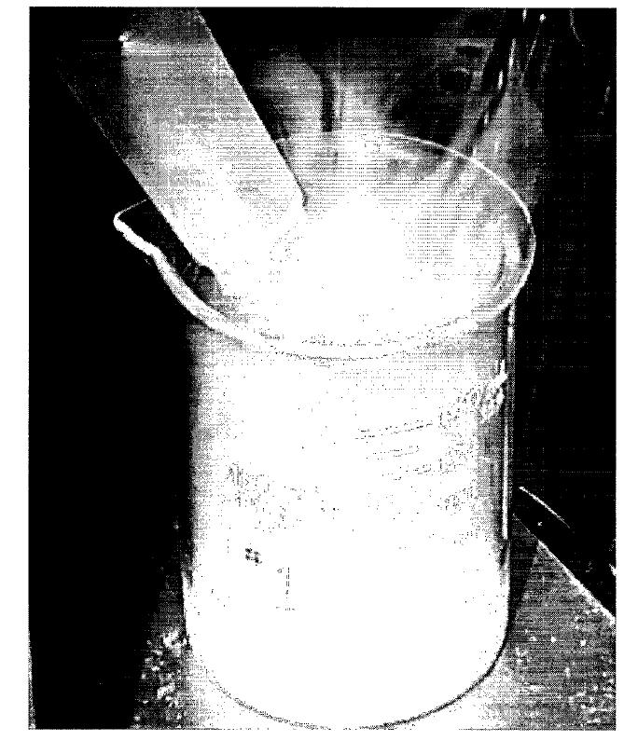
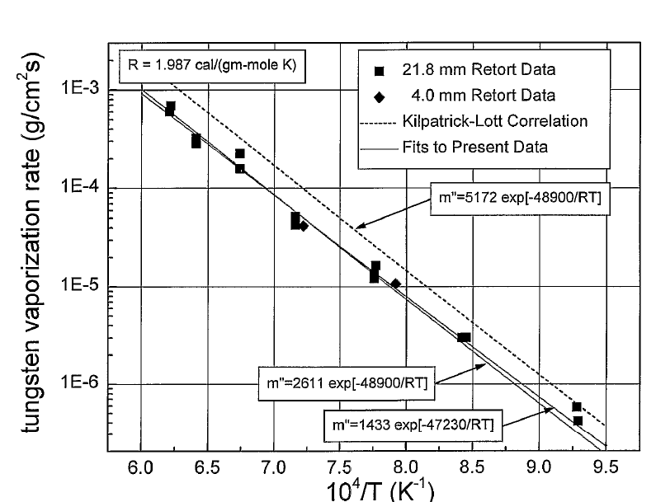
STS Safety Issue: Tungsten-Oxide Aerosol Generation
Review tantalum oxidation in steam and evaluate if the clad could be a CEC to reduce accident release dose levels and if a test program would be useful
Photograph of Tungsten-Oxide Aerosol exiting a condenser
Tungsten-metal vaporization rates in 100% steam vs. temperature
Figure Credit: T. McManamy
G.A. Greene, C.C Finfrock, Generation, transport and deposition of tungsten-oxide aerosols at 1000 ºC in flowing air/steam mixtures

Slide 21
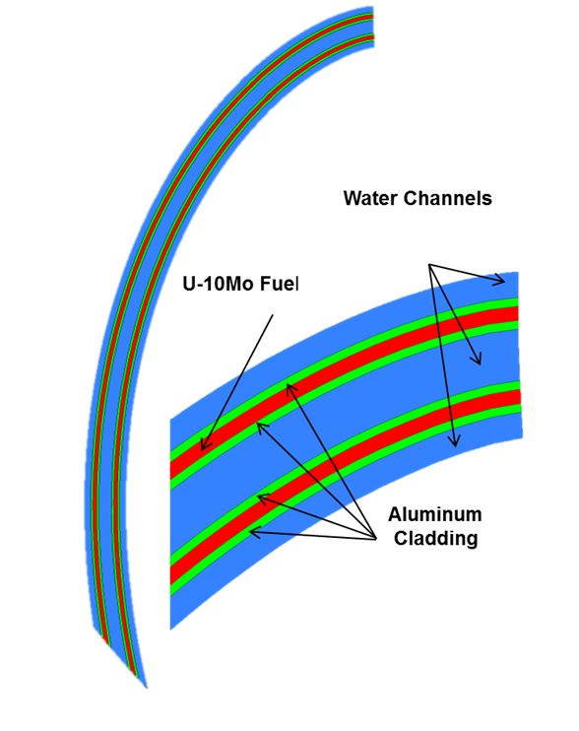
ADS option was considered for STS – analysis on fuel elements of blanket
High duty cycle for SNS/STS leads to high temperatures, and significant materials issues arise requiring too much R&D

Slide 22
SNS R&D Summary
SNS First Target Station
  Lifetime reliability and extension
  Higher power enhancements
SNS Second Target Station
  Safety case
  Performance optimization
Potential uses for right-sized beam
  Cavitation damage mitigation mechanism (geometry/flow/focus?)
  Irradiation effects on tungsten/tantalum joining

