Slide 1

DUNE Near Detectors
Kirk T McDonald, for the DUNE Collaboration
Princeton University
NuFact15
Centro Brasileiro de Pesquisas Físicas, Rio de Janeiro
(August 11, 2015)
Compiled from the LBNF/DUNE DOE CD-1 Refresh Review (July 14, 2015)
https://web.fnal.gov/project/LBNF/ReviewsAndAssessments/LBNF_DUNE%20DOE%20CD-1%20Refresh%20Review/SitePages/Agenda.aspx

Slide 2
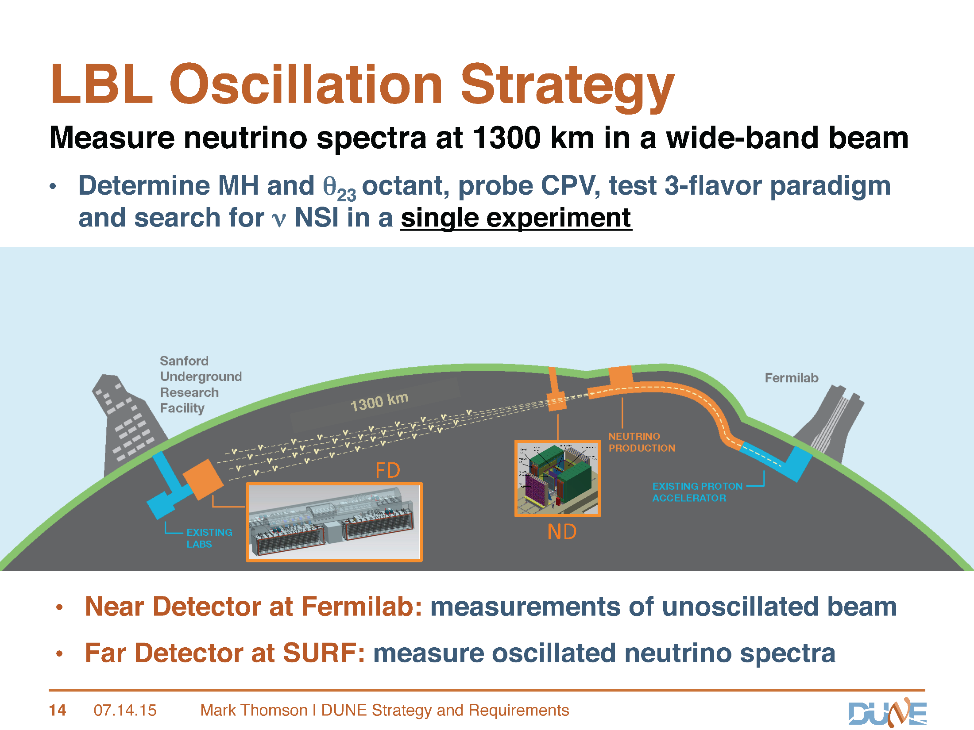

Slide 3
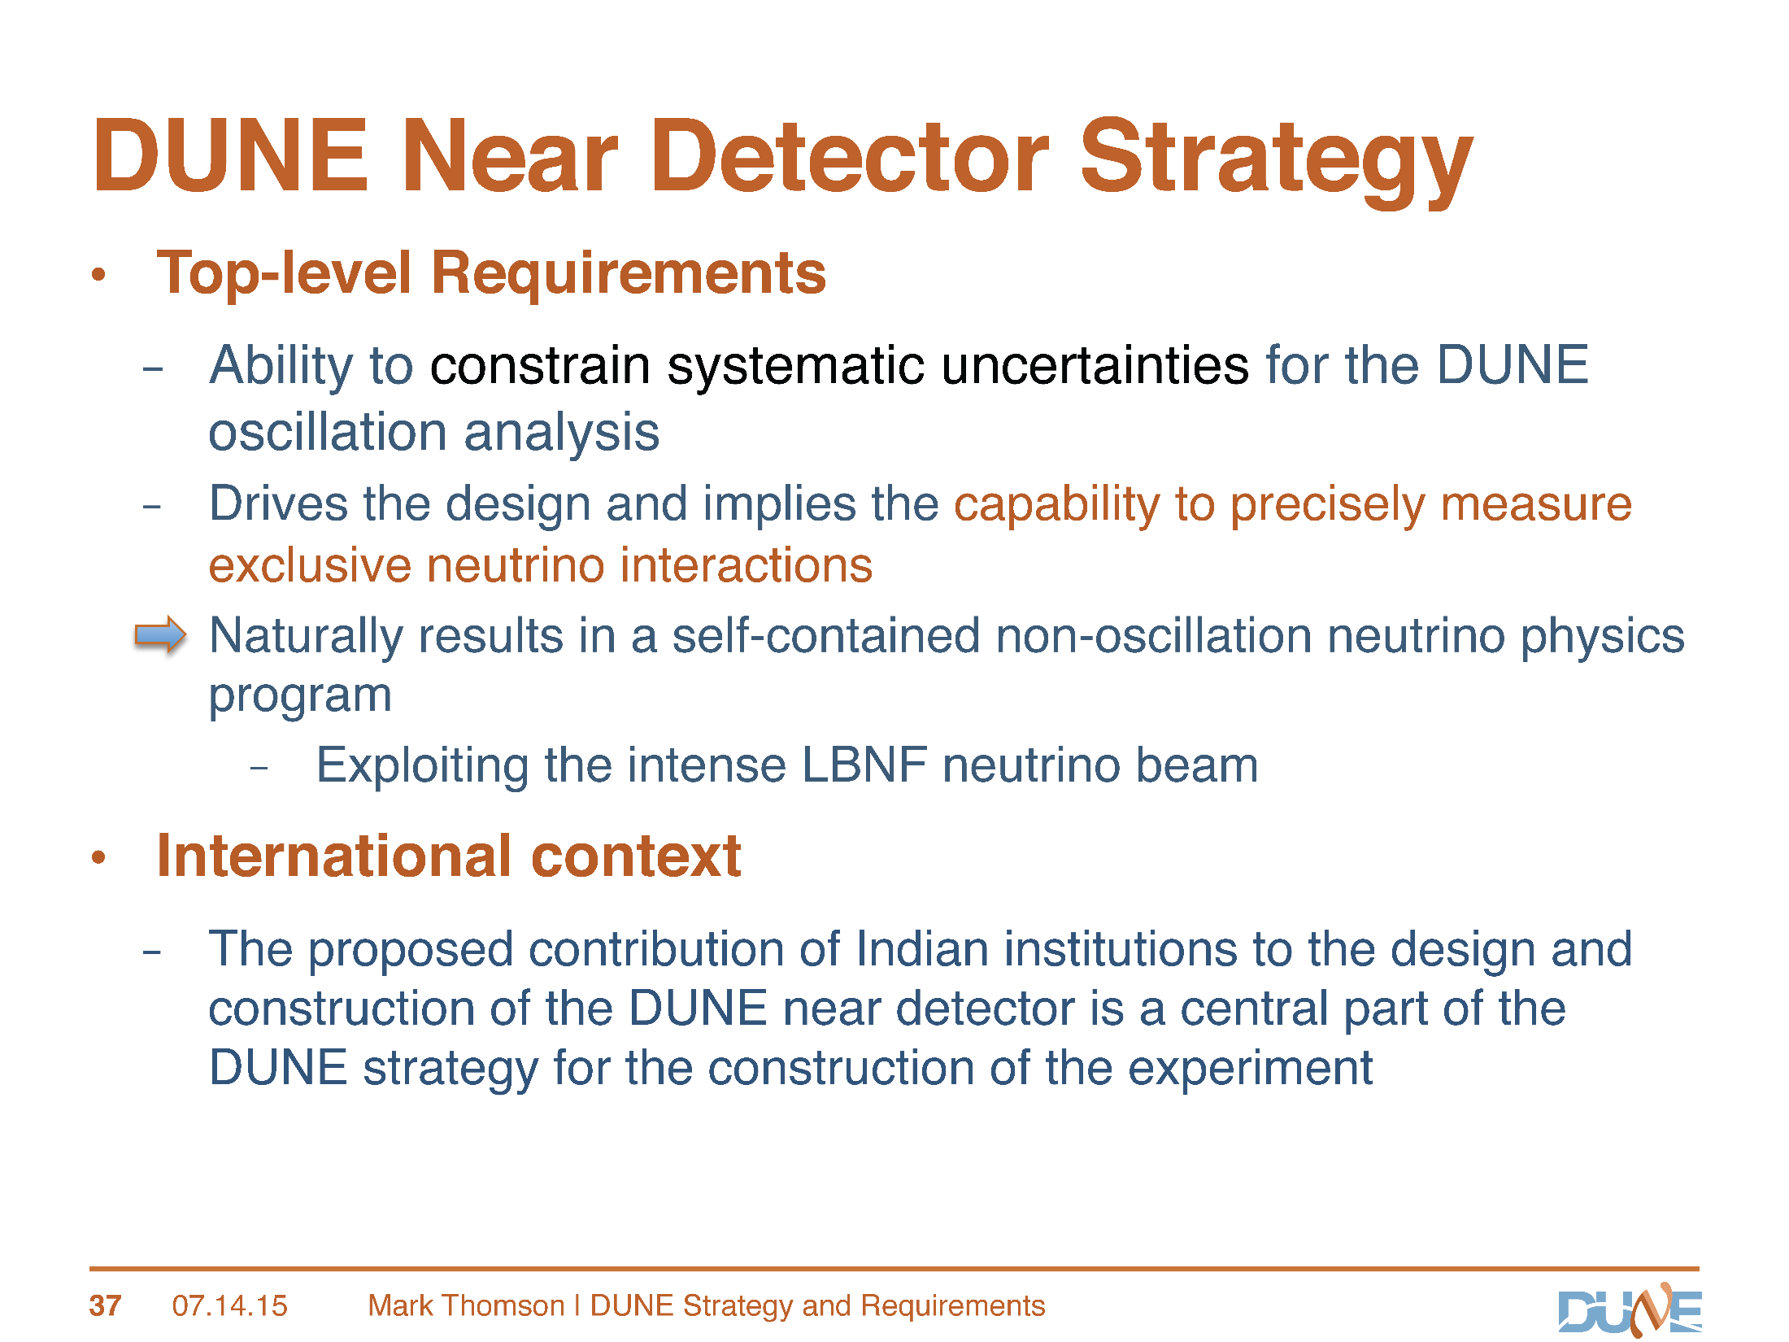

Slide 4
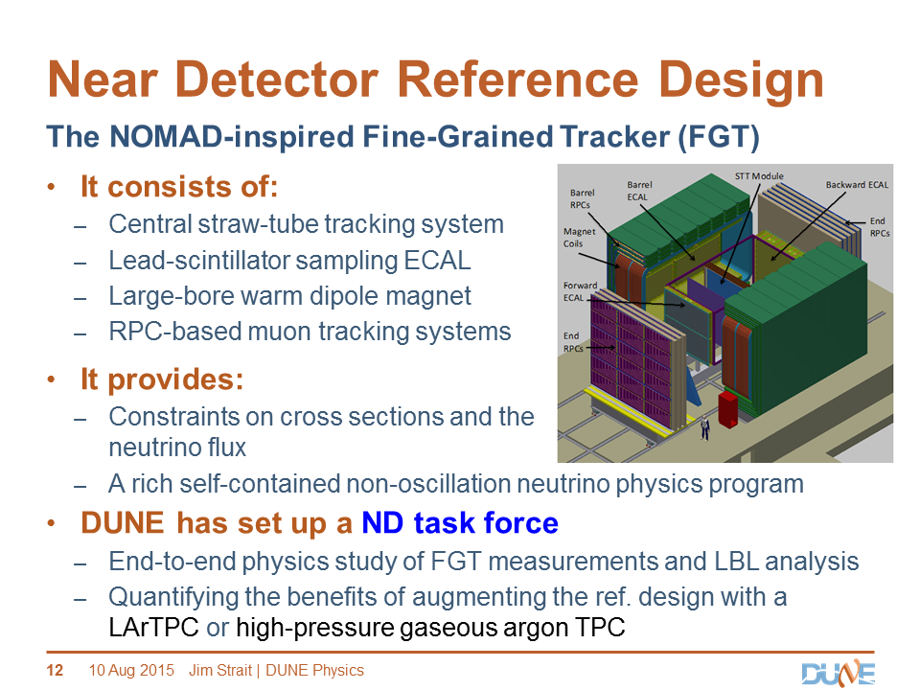

Slide 5
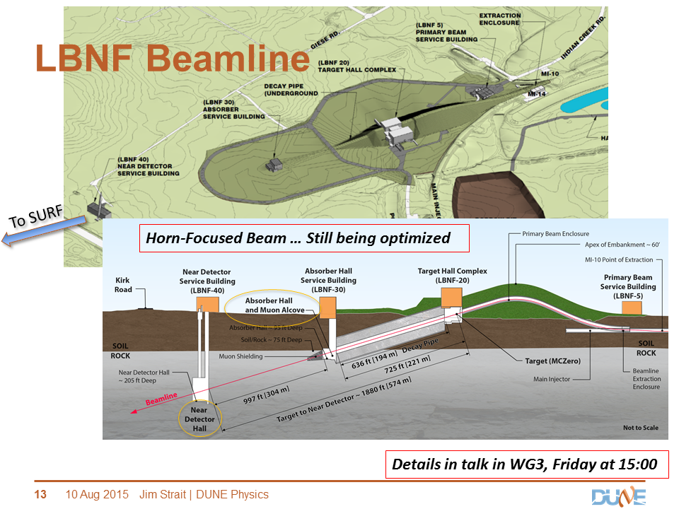
Geoffrey Mills

Slide 6
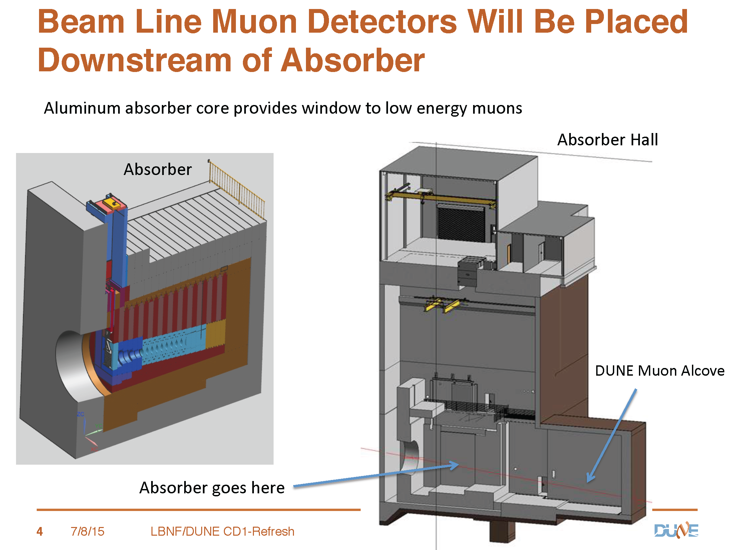
Geoffrey Mills

Slide 7
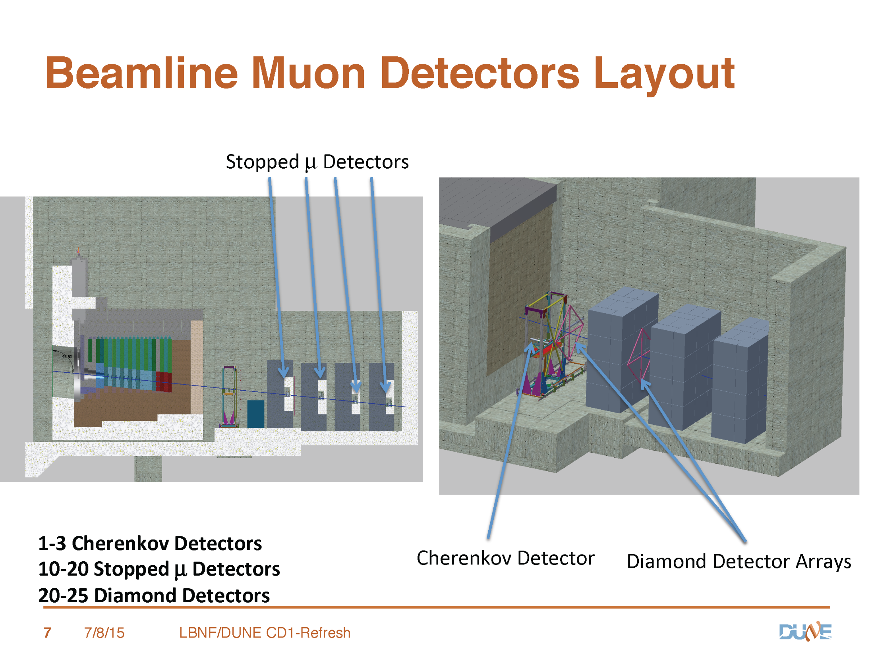
Geoffrey Mills

Slide 8
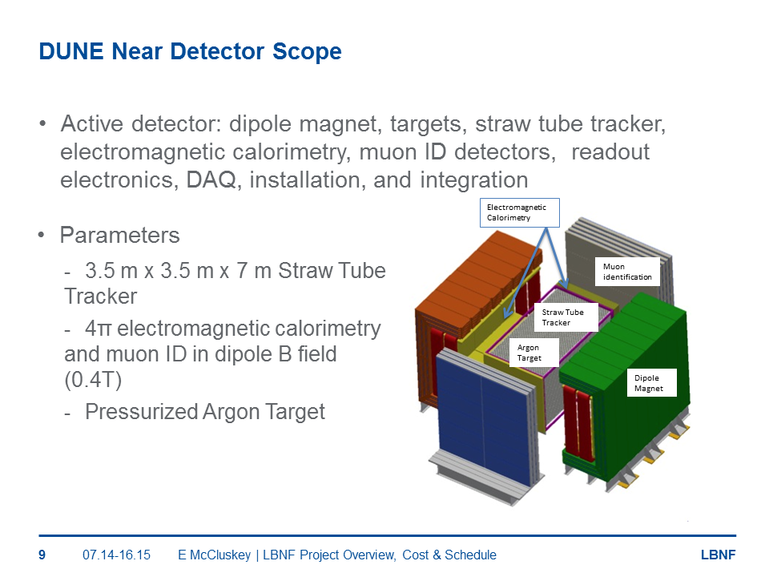

Slide 9
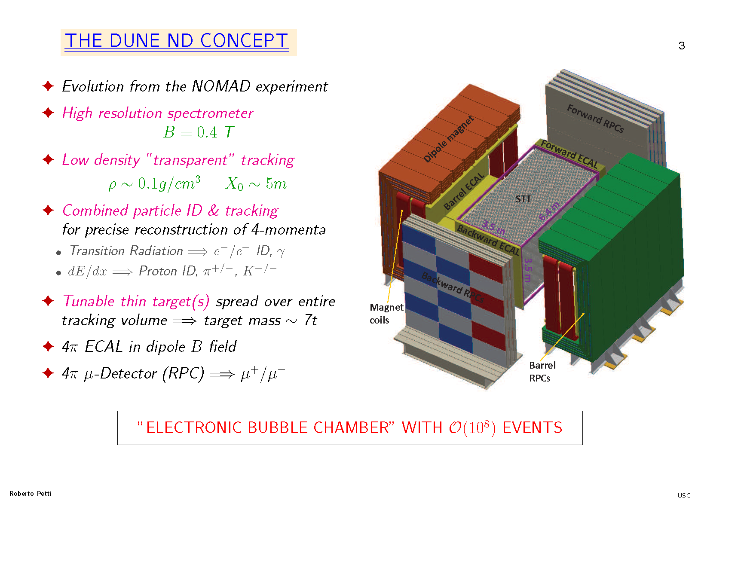

Slide 10
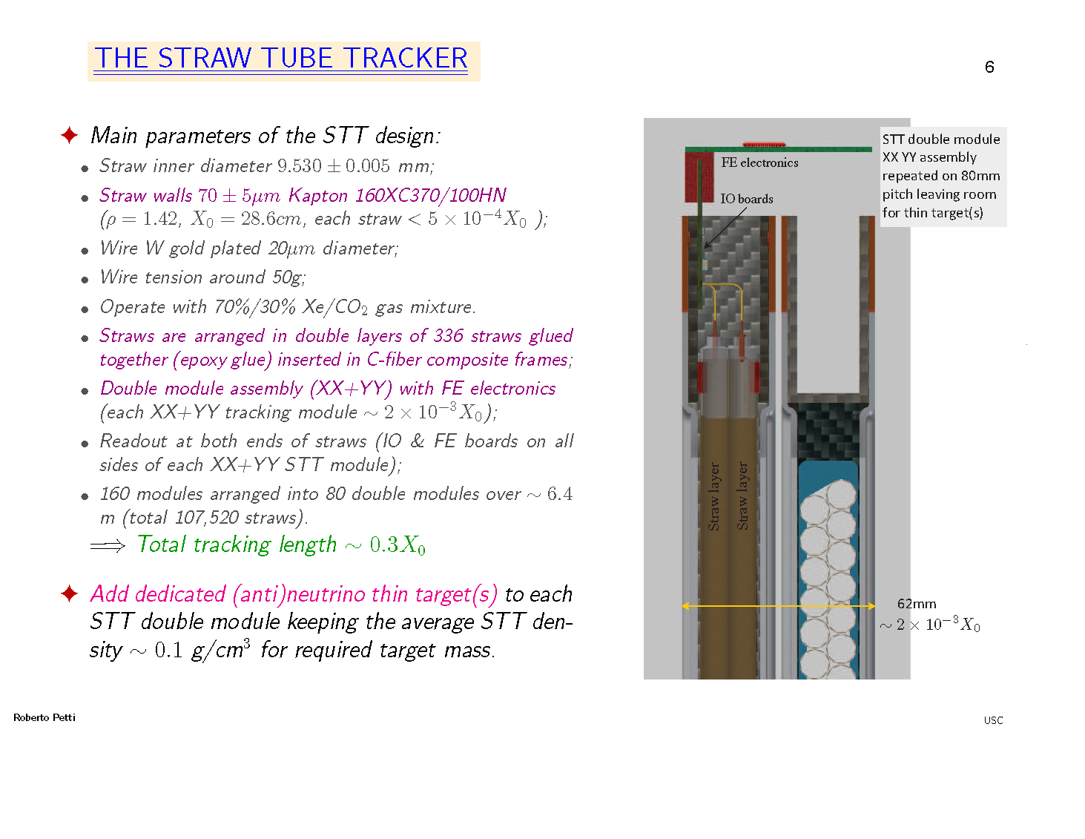

Slide 11
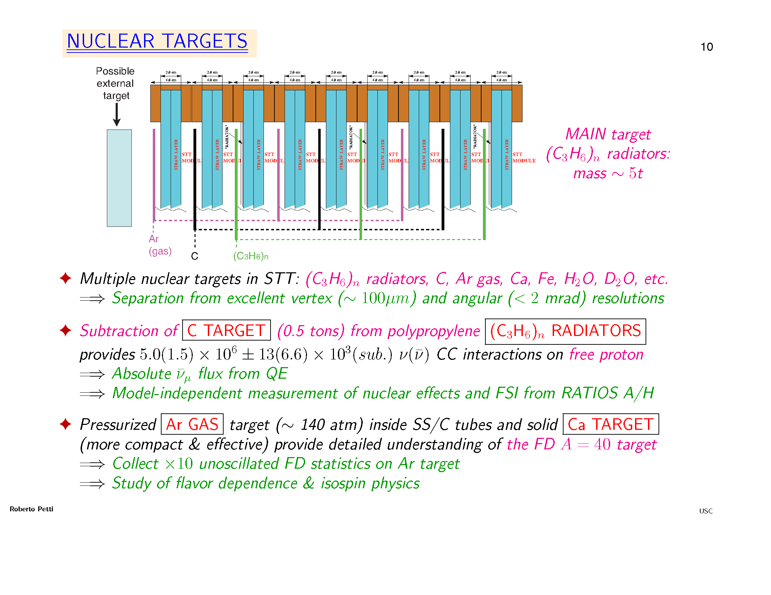
, i.e., ∼ 10⁵ of the ∼ 10⁸ ND ν events

Slide 12
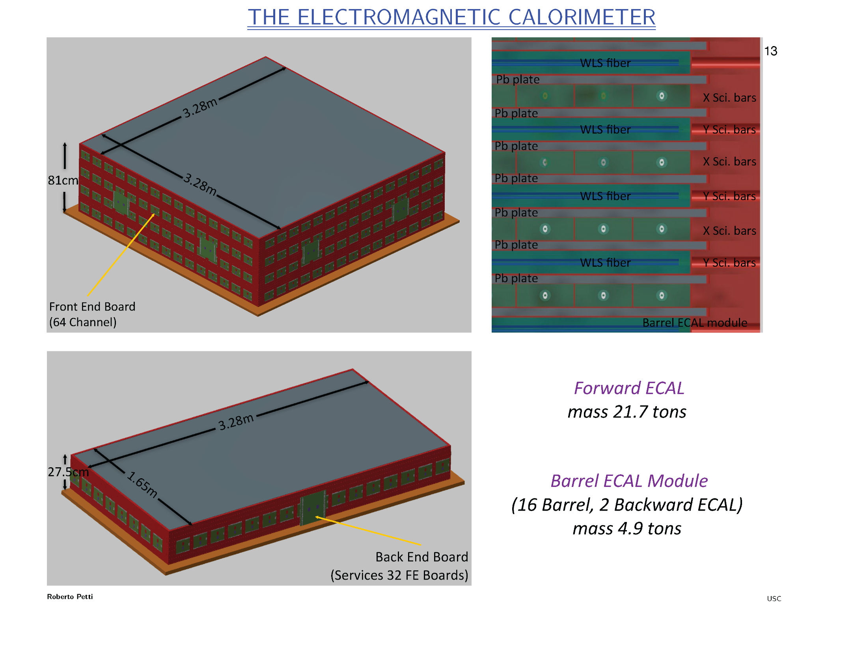

Slide 13
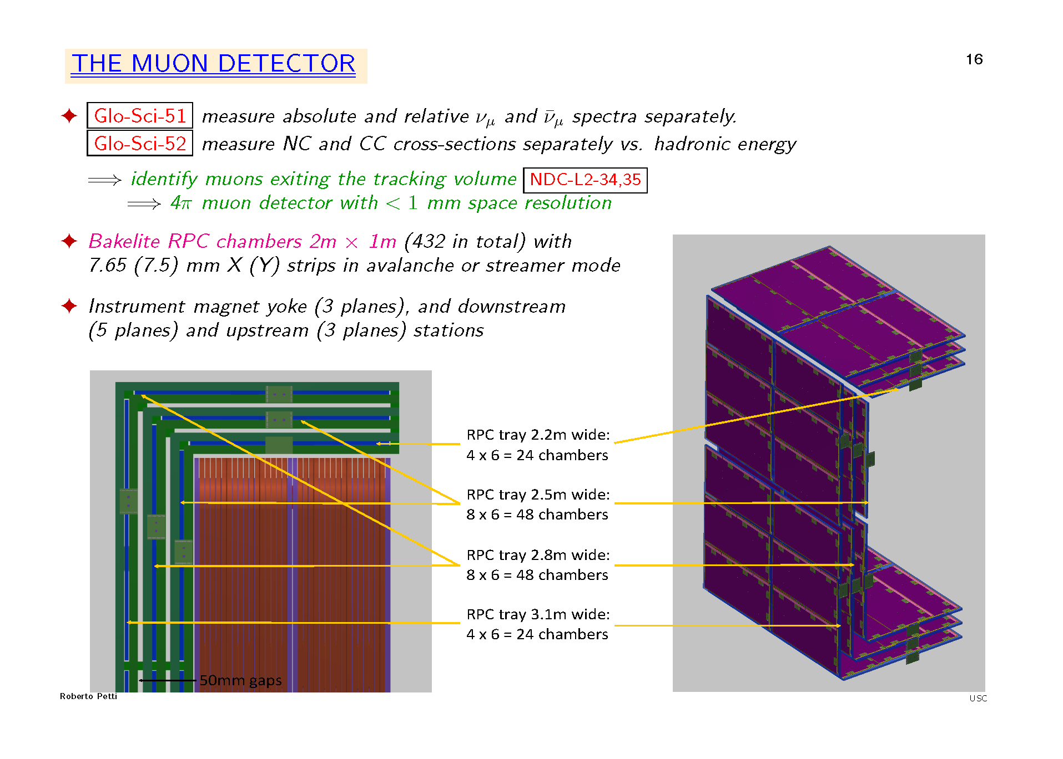

Slide 14
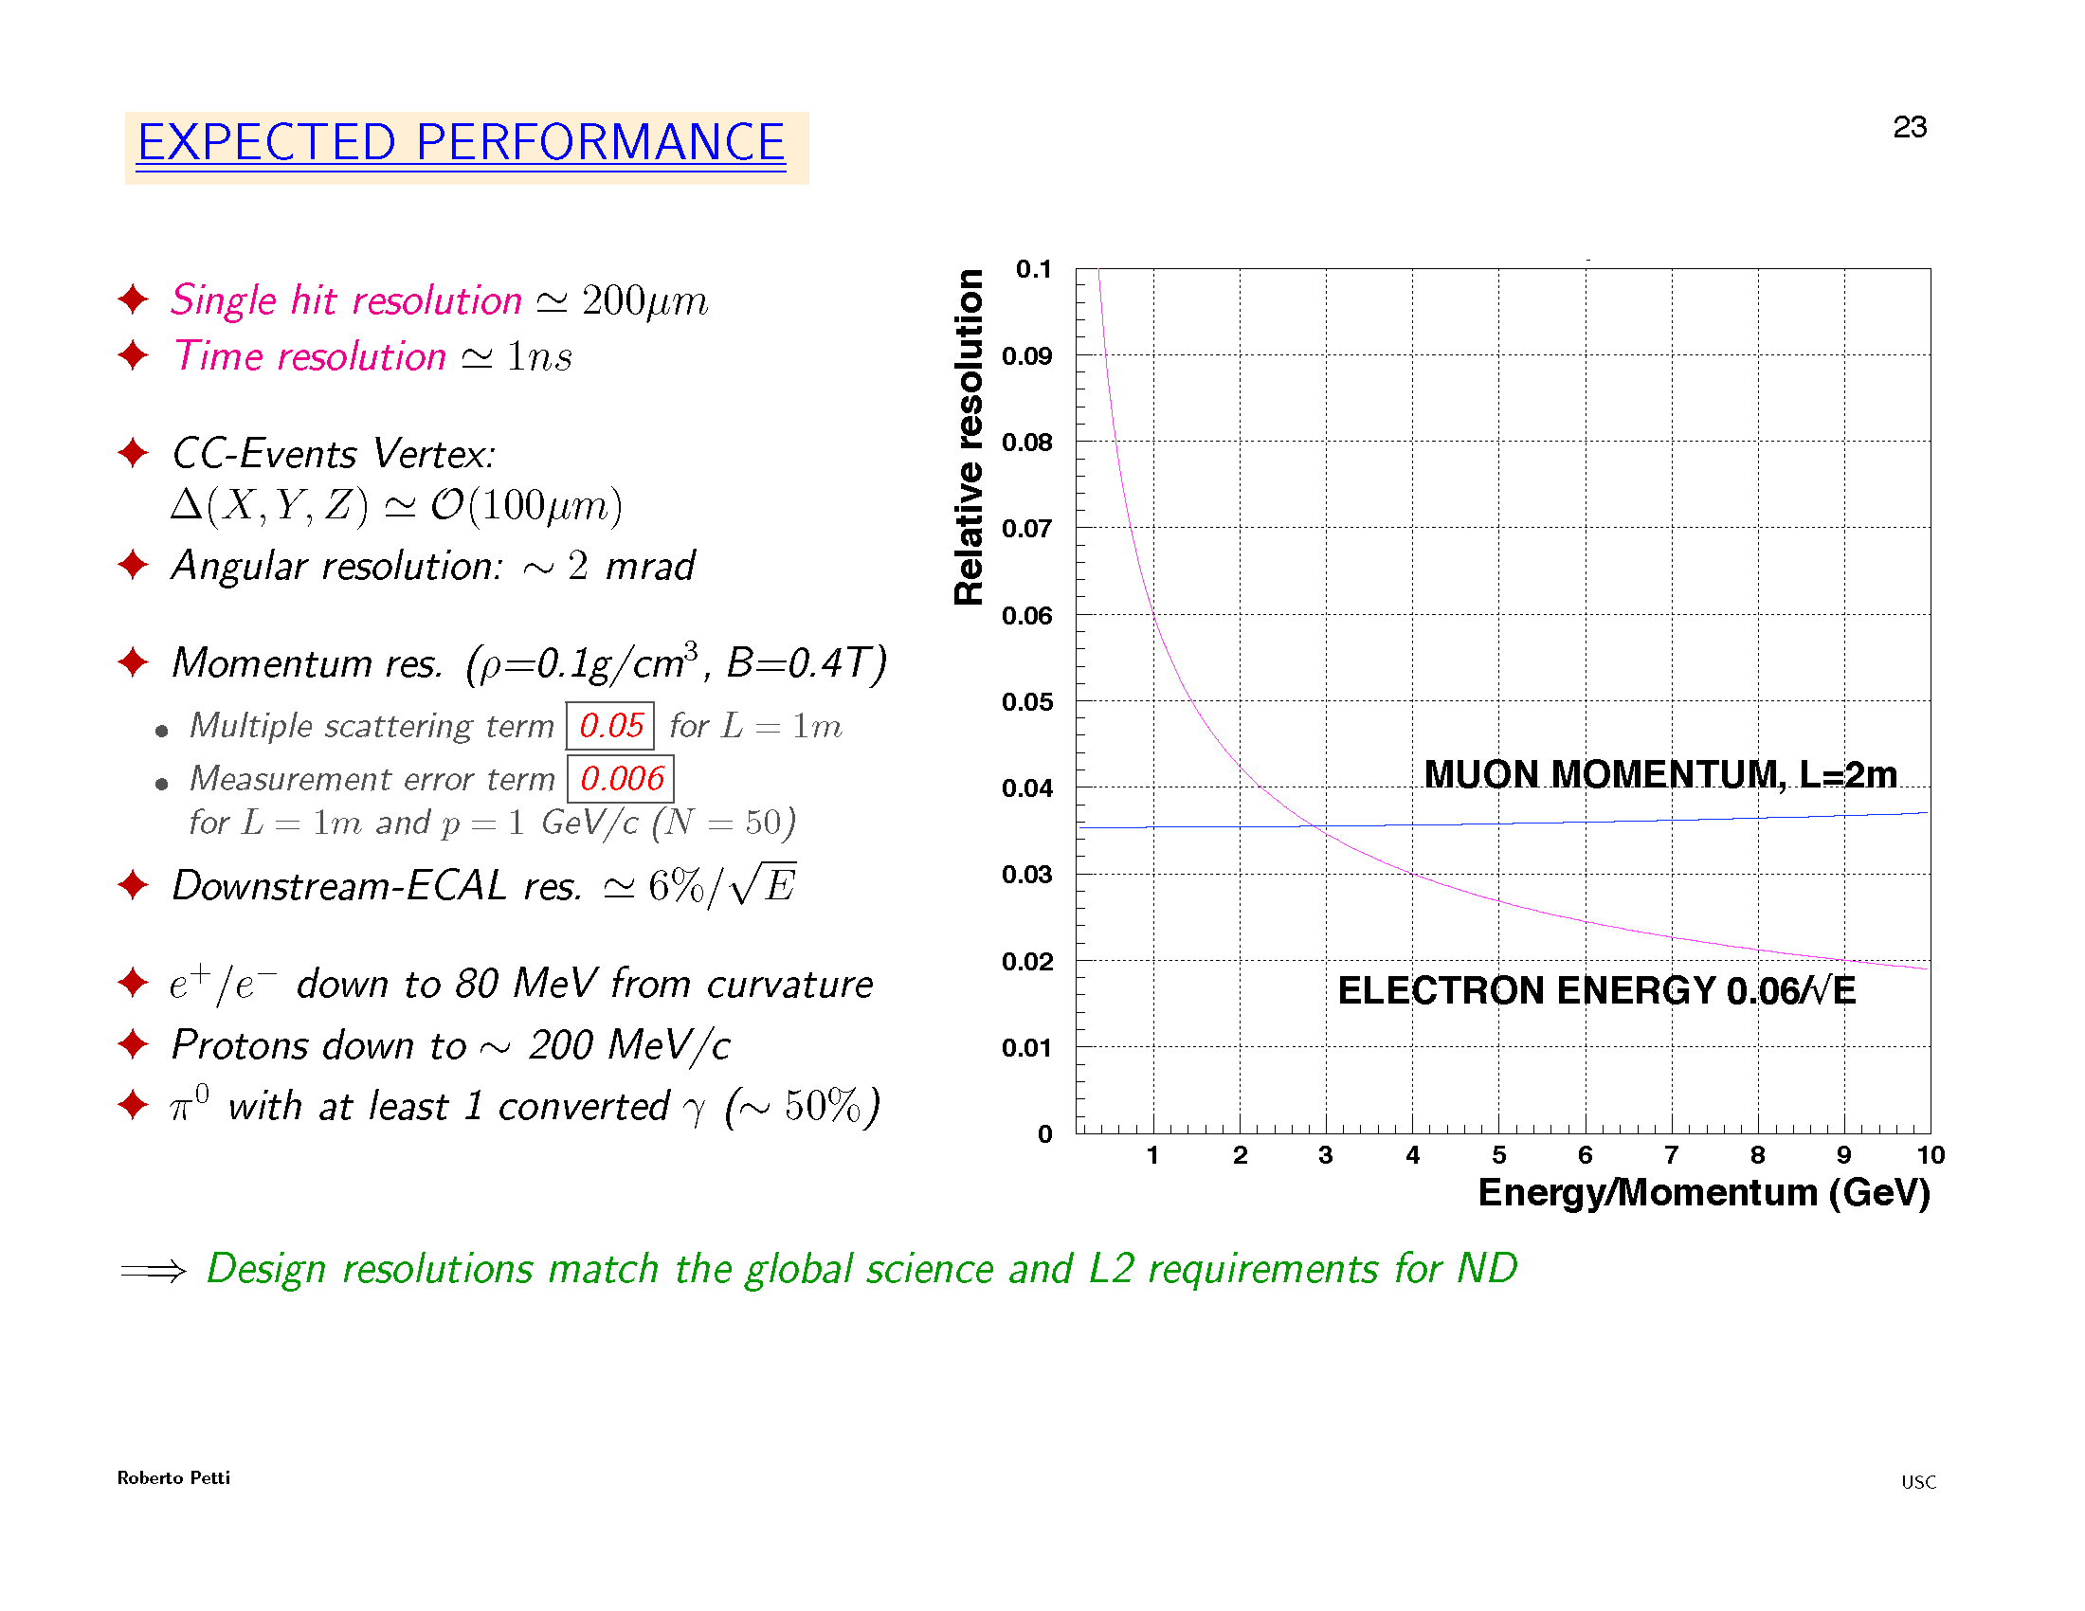

Slide 15
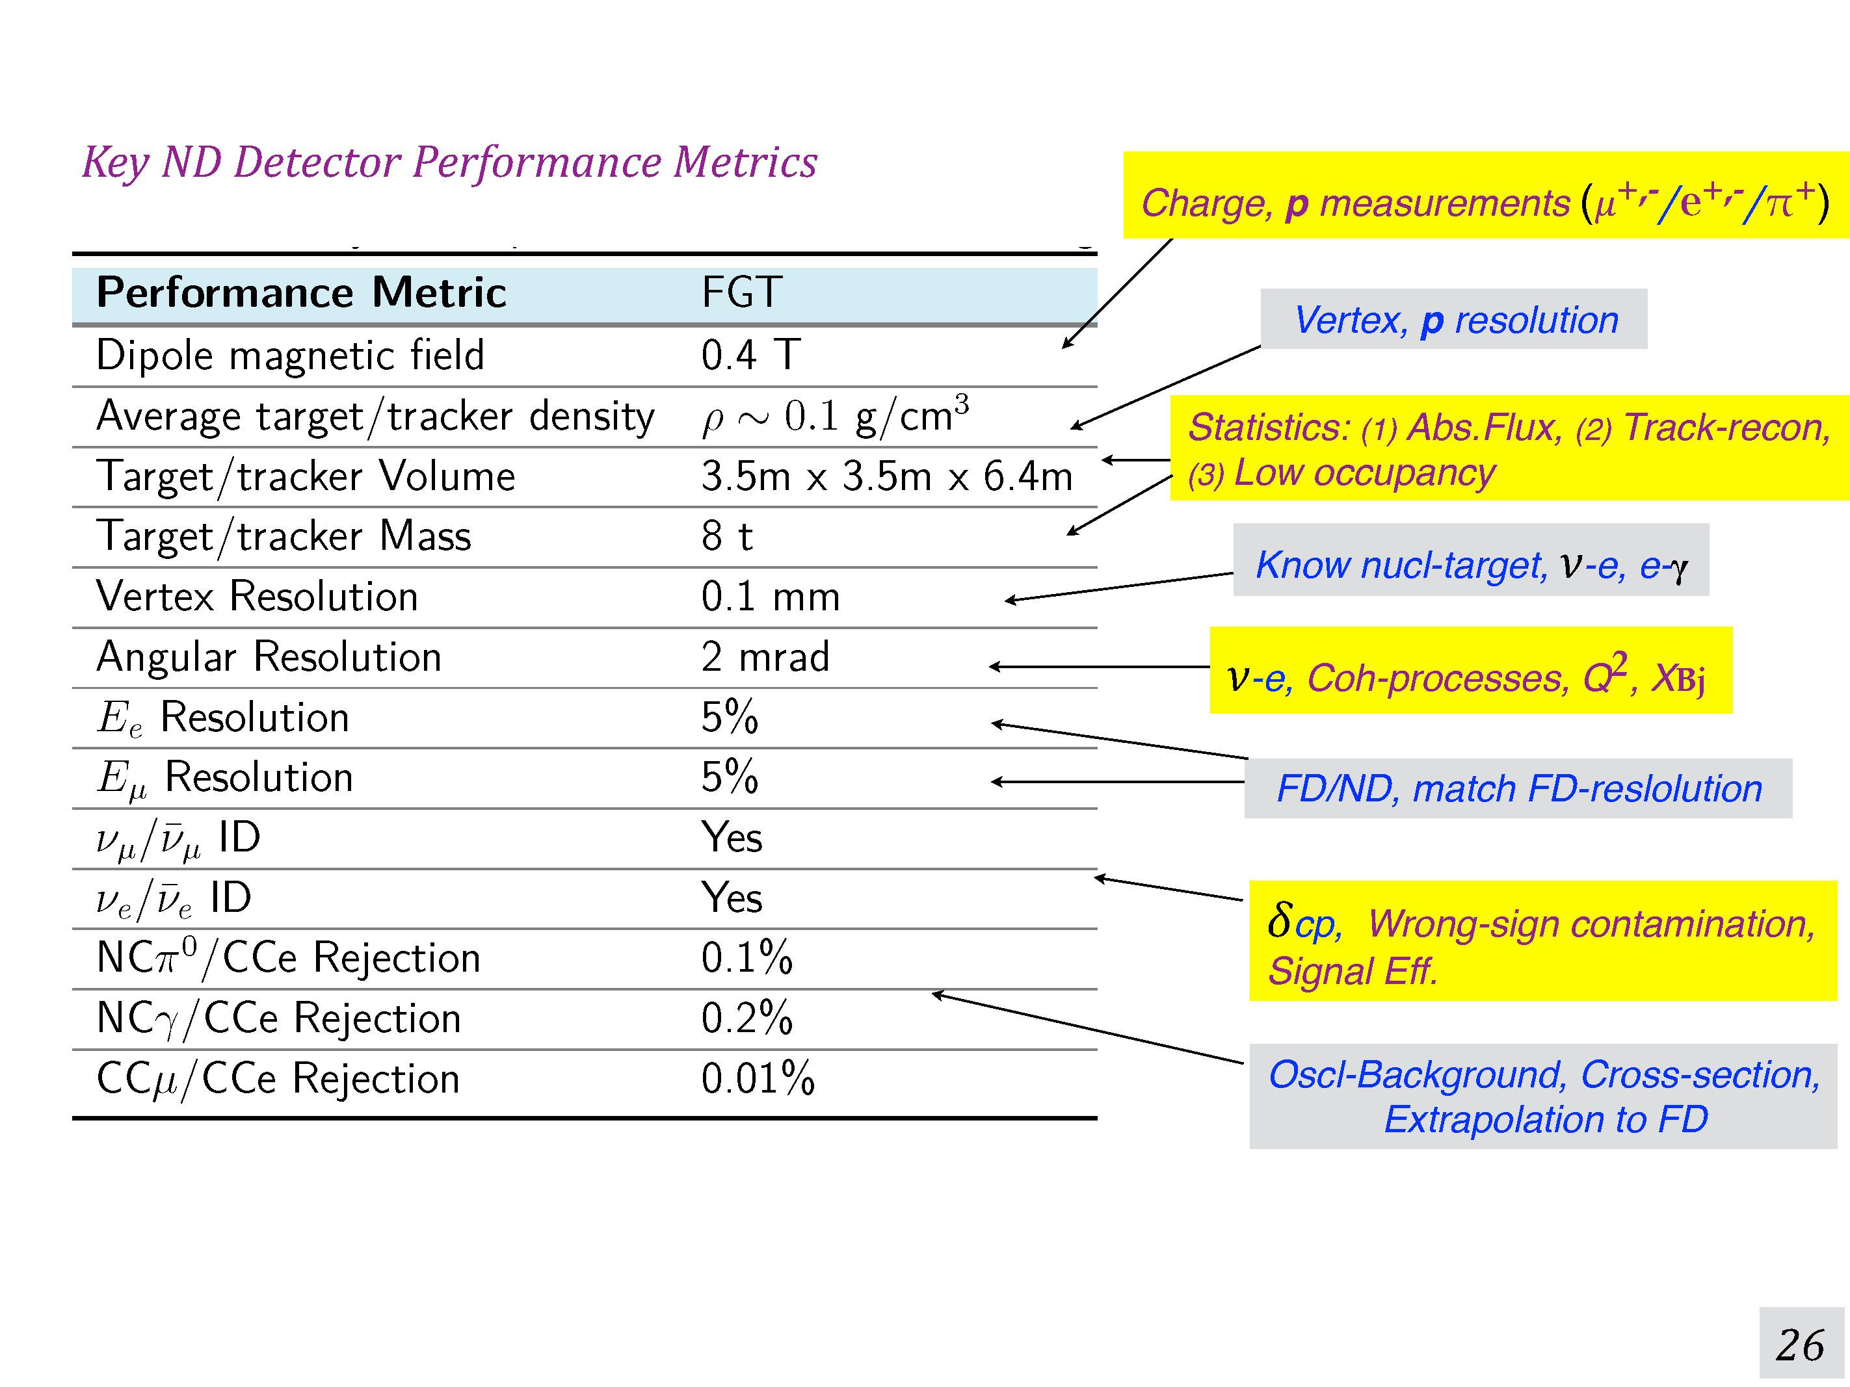
Near Detector parameter list at
http://lbne2-docdb.fnal.gov:8080/cgi-bin/RetrieveFile?docid=10873&filename=LBNF-DUNE-V1.8-parameters.xlsx&version=26
Sanjib R Mishra

Slide 16
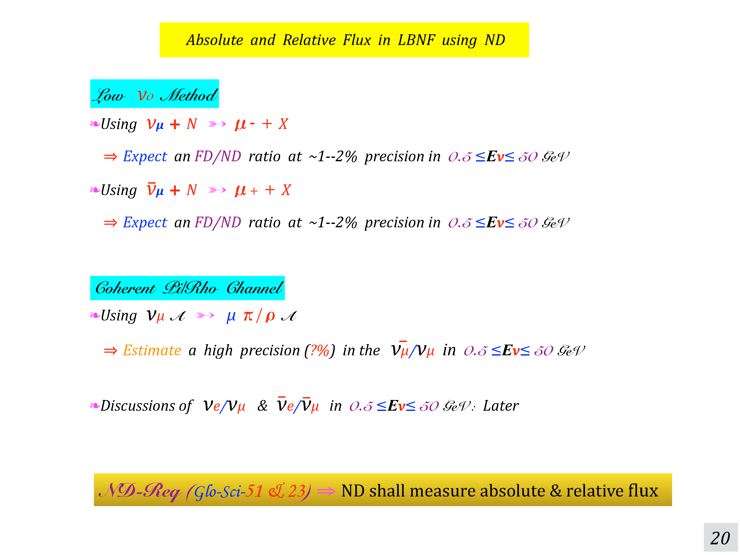
Sanjib R Mishra

Slide 17
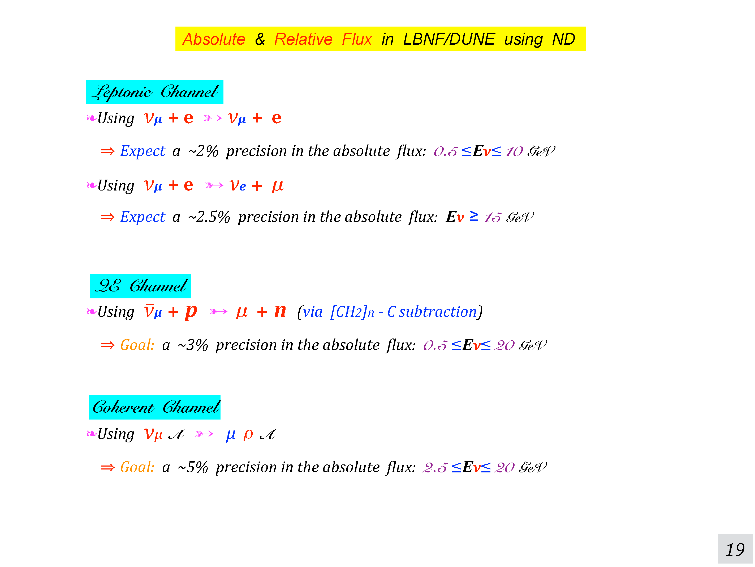
Sanjib R Mishra

Slide 18
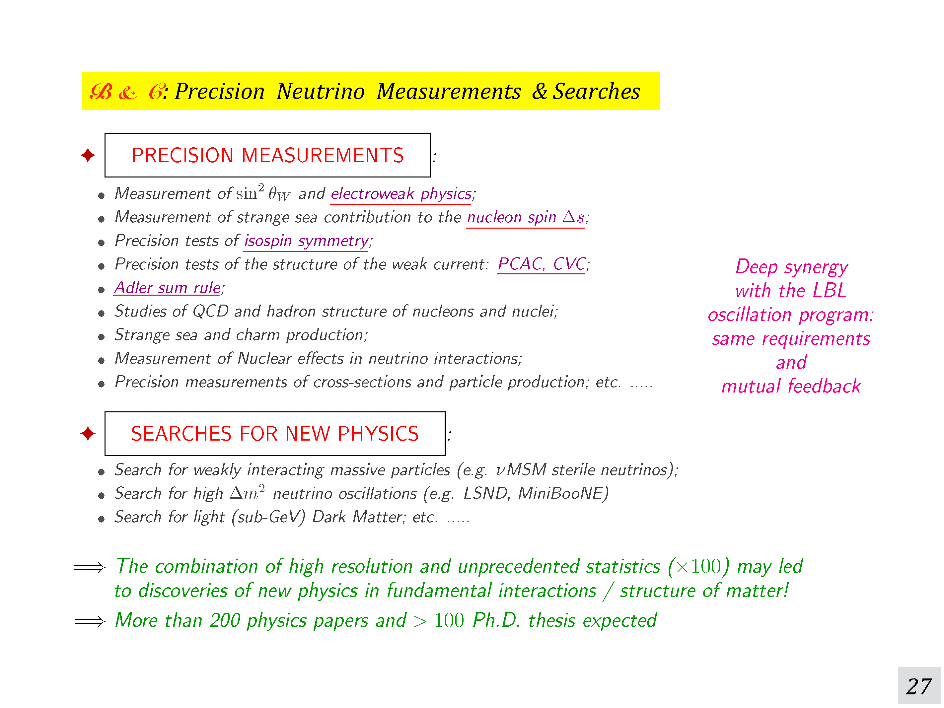
Sanjib R Mishra

Slide 19
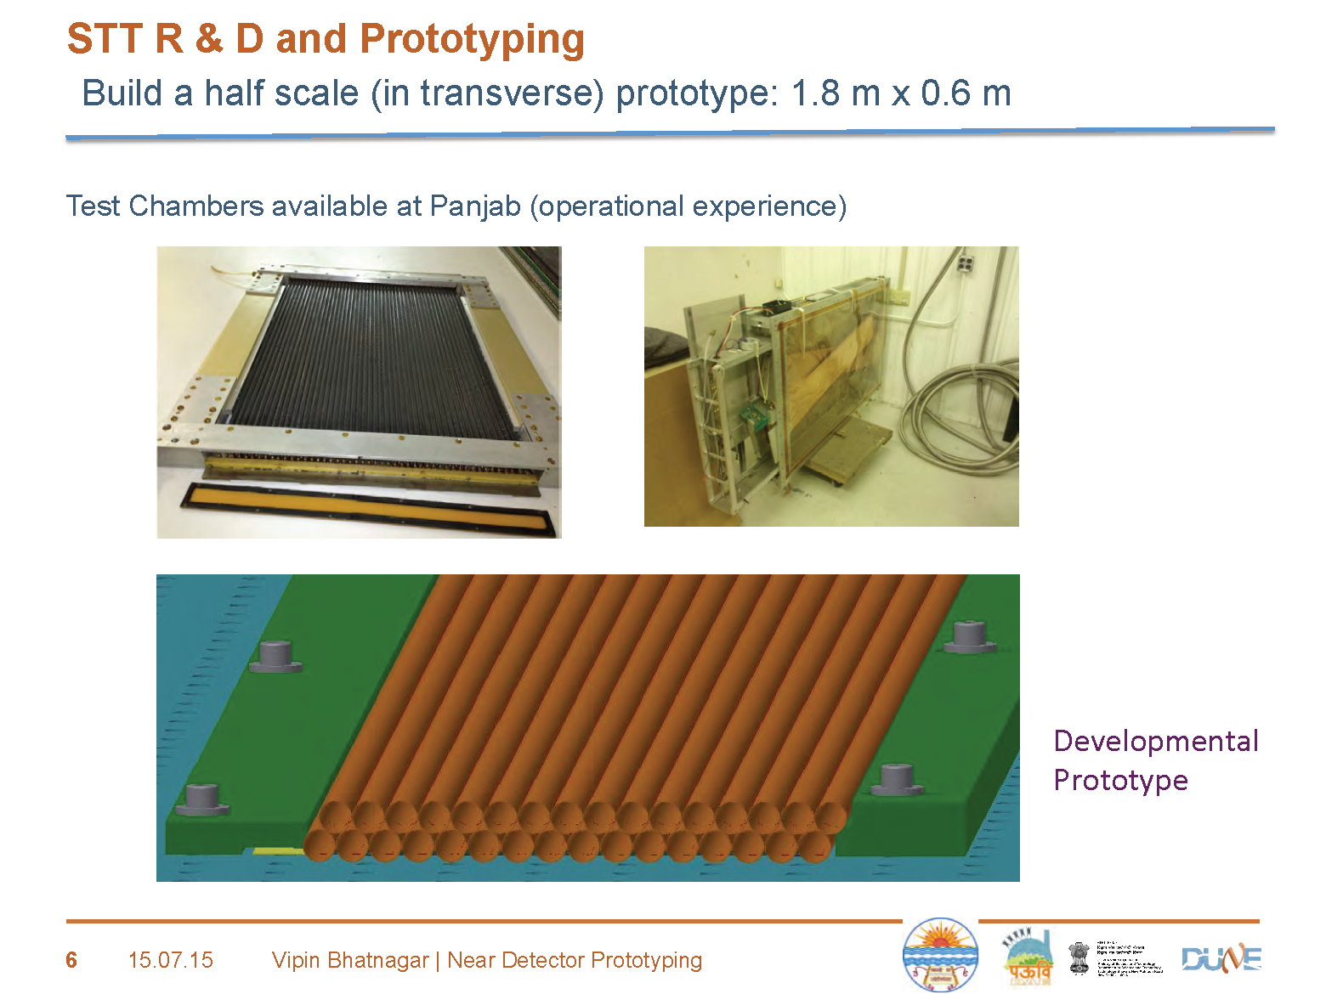

Slide 20
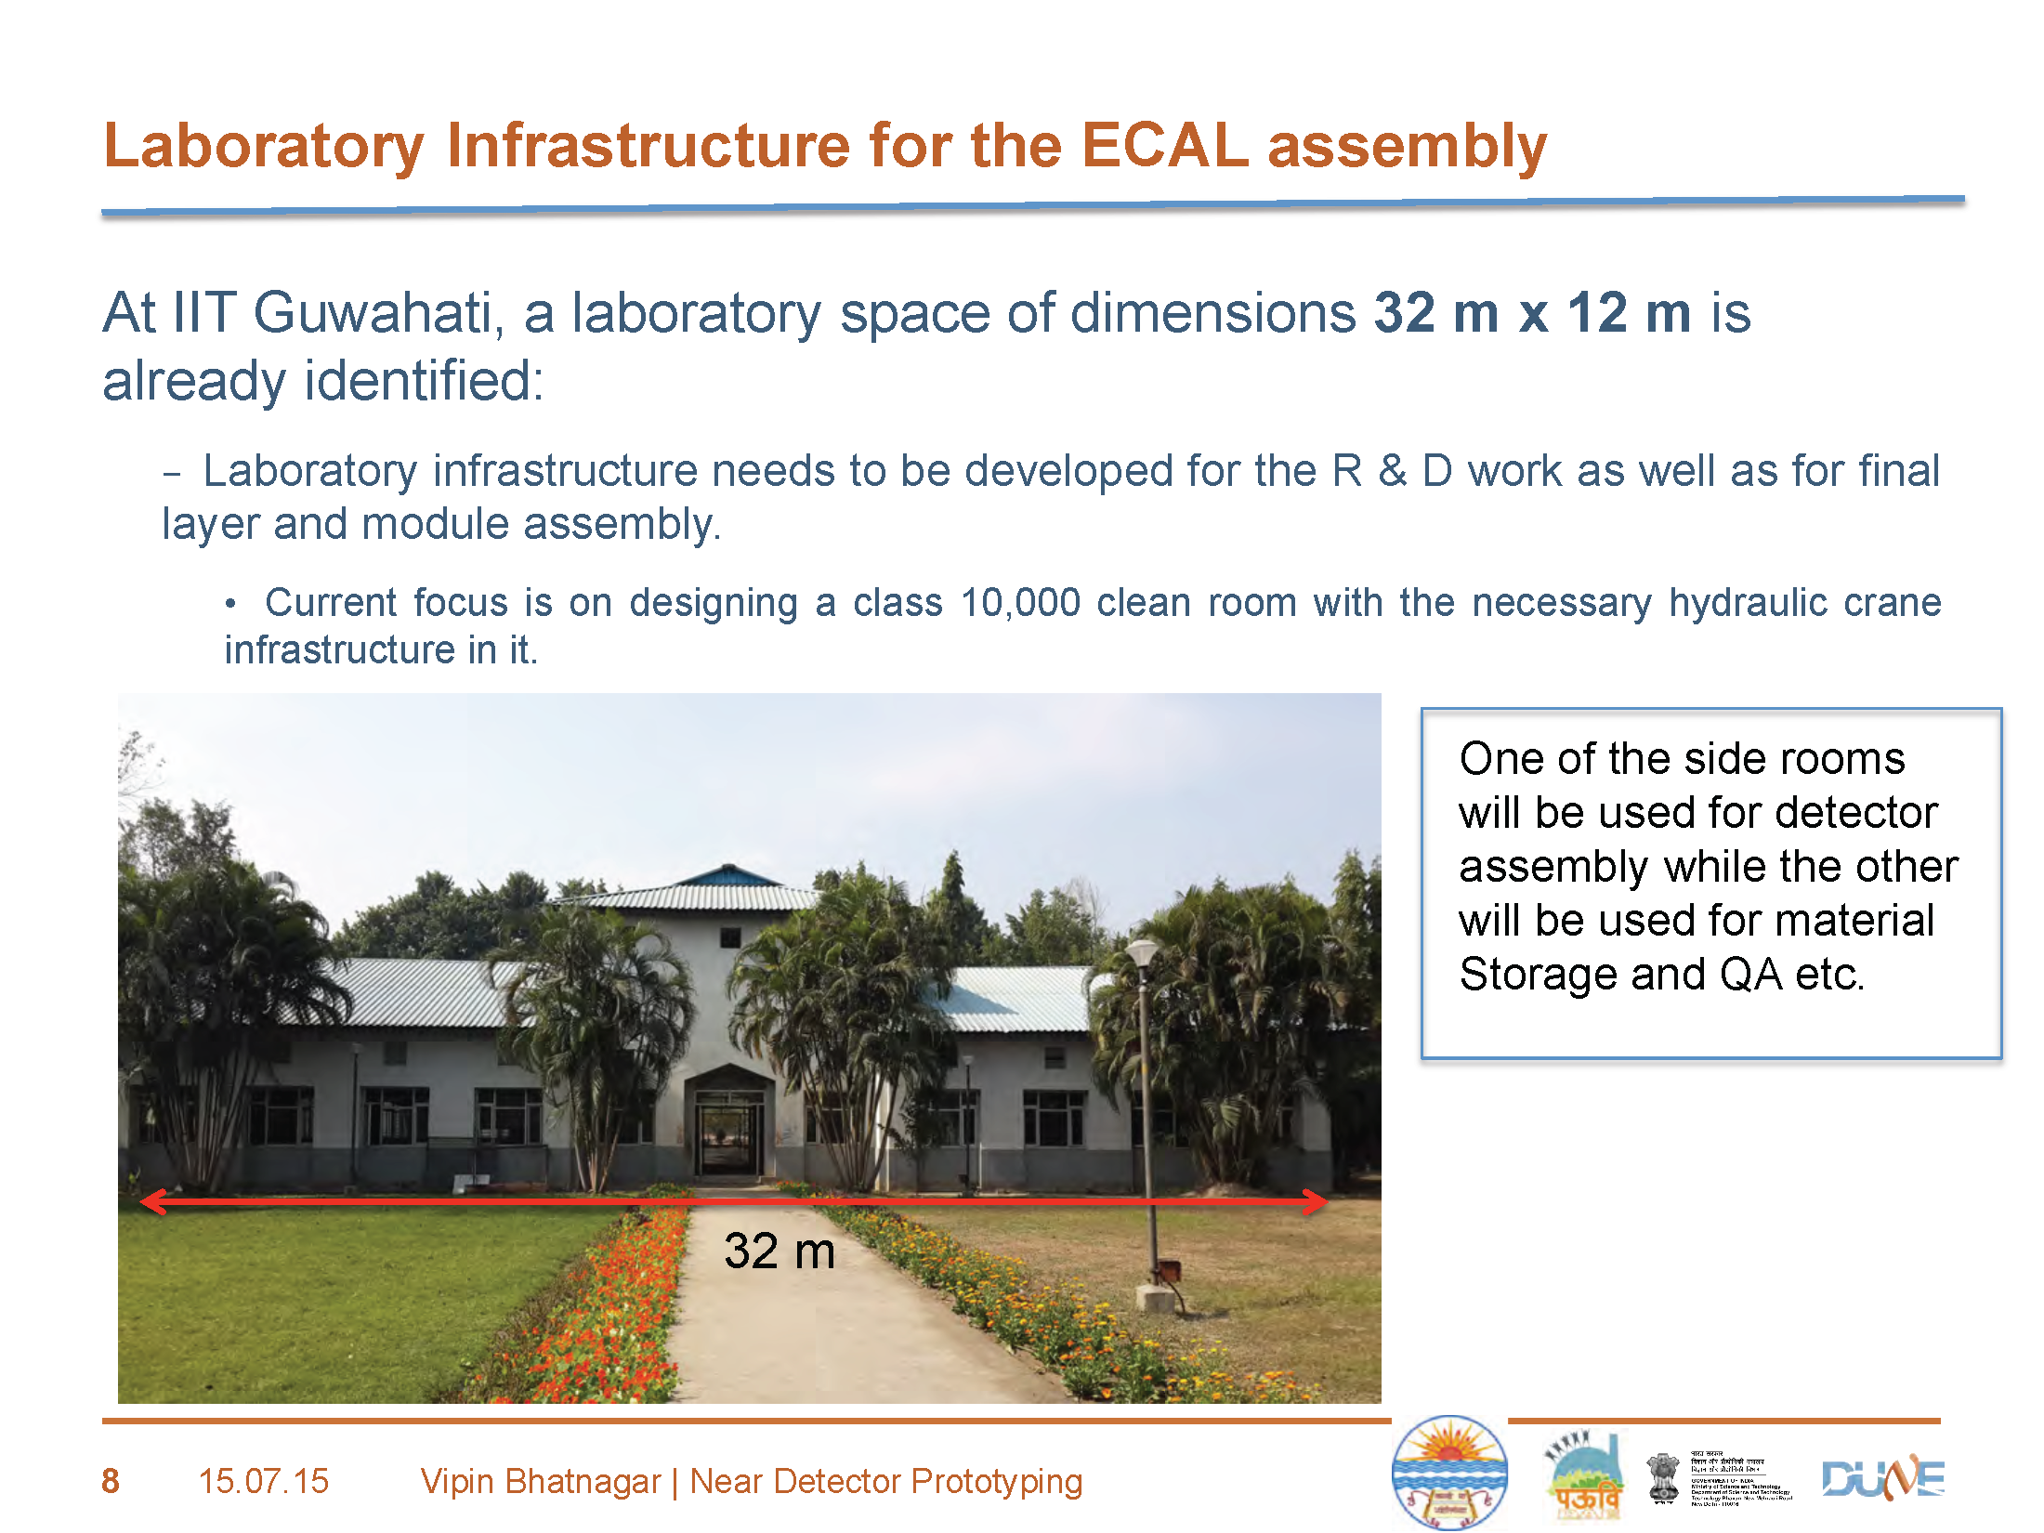

Slide 21
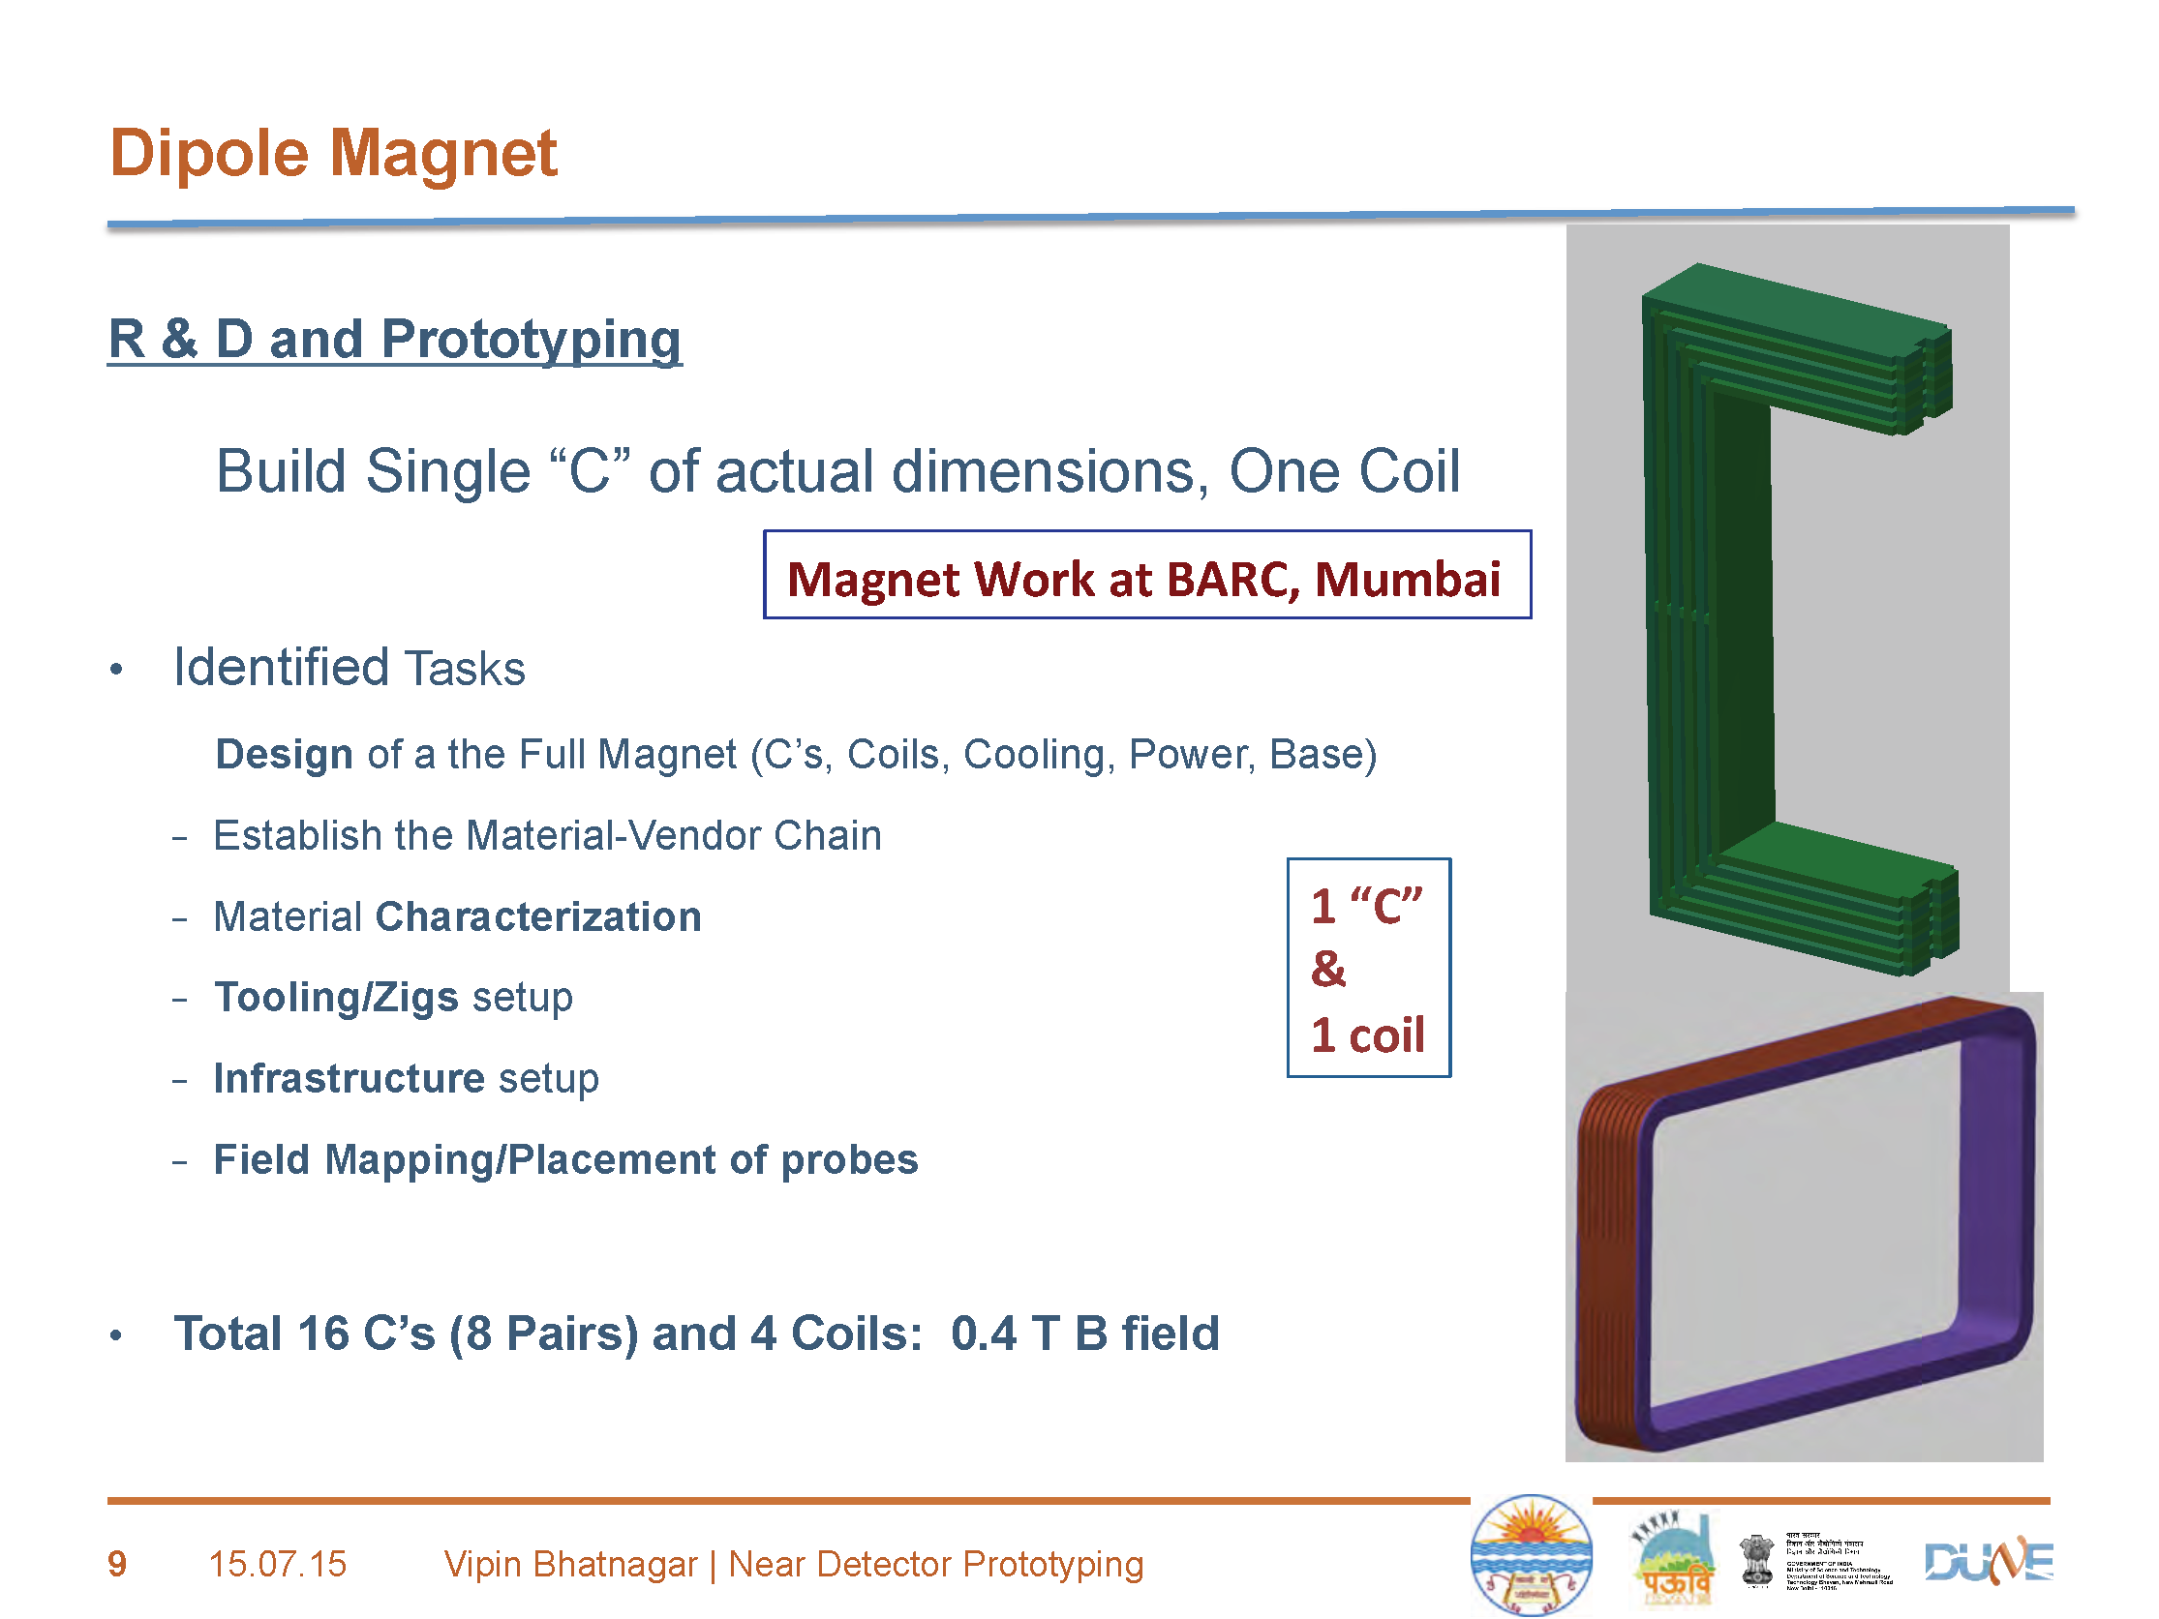

Slide 22
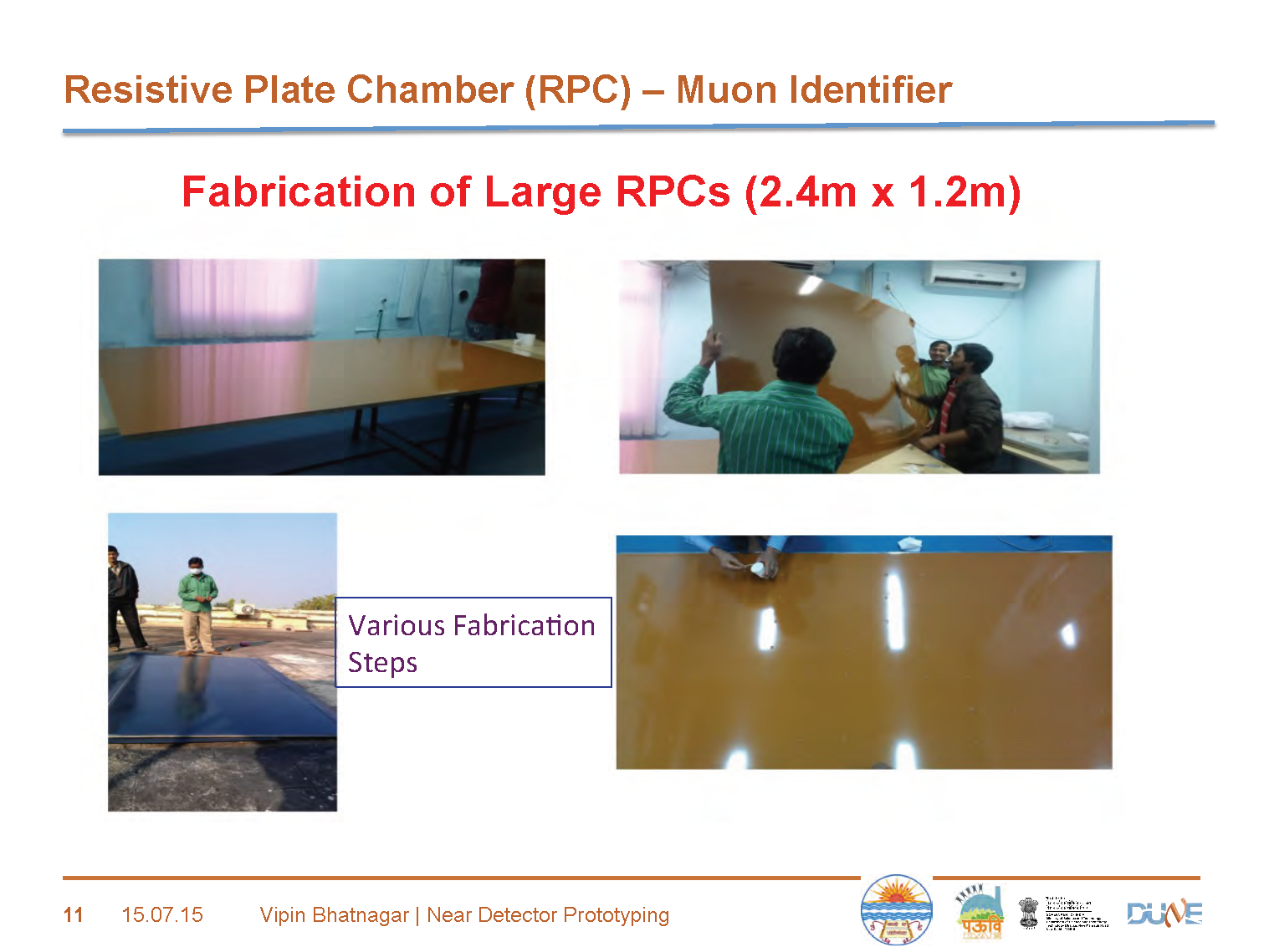

Slide 23
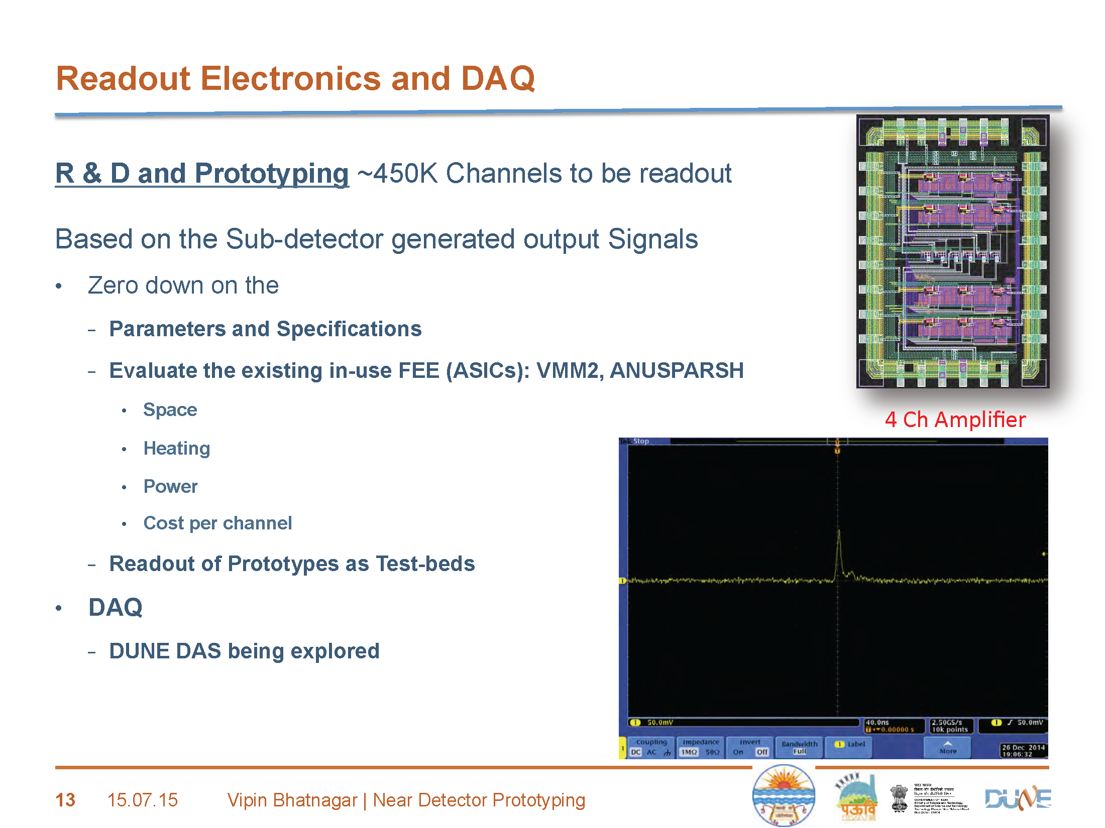

Slide 24
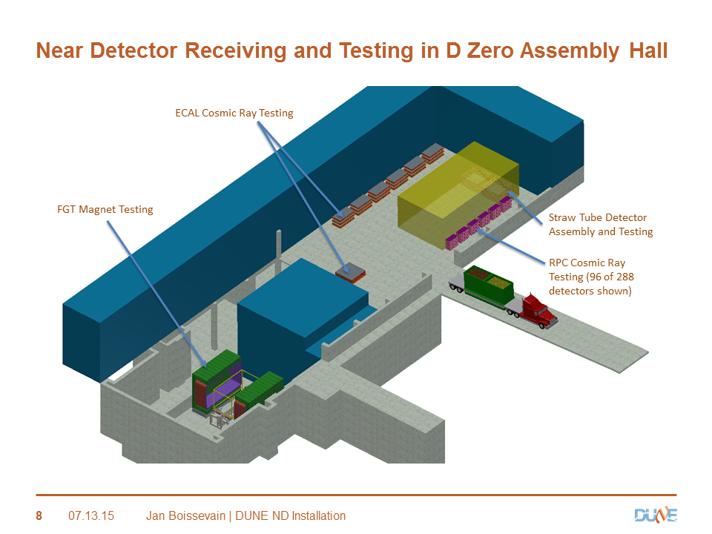
24

Slide 25
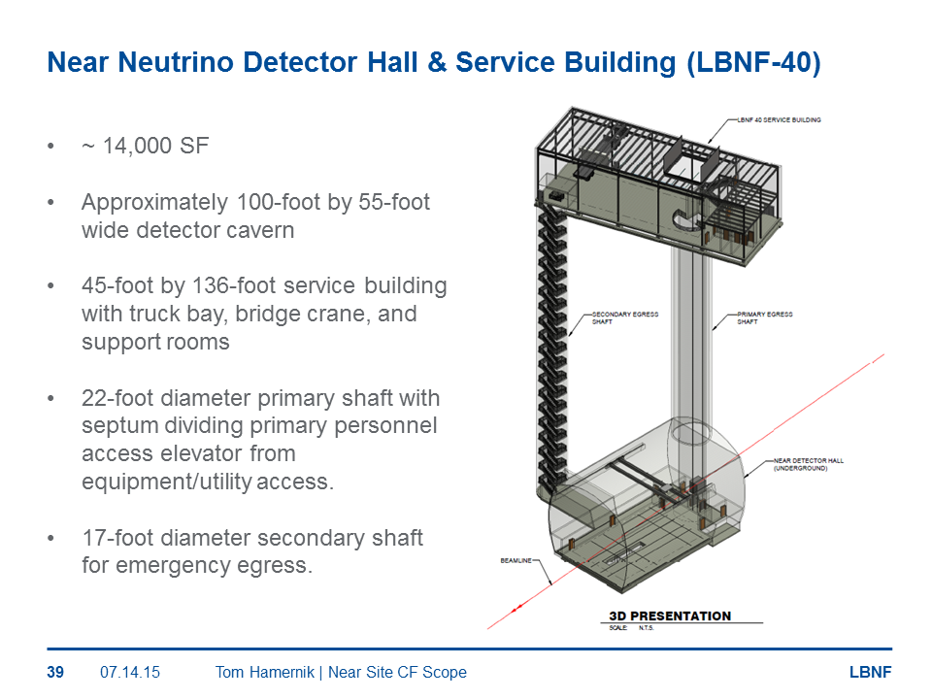

Slide 26
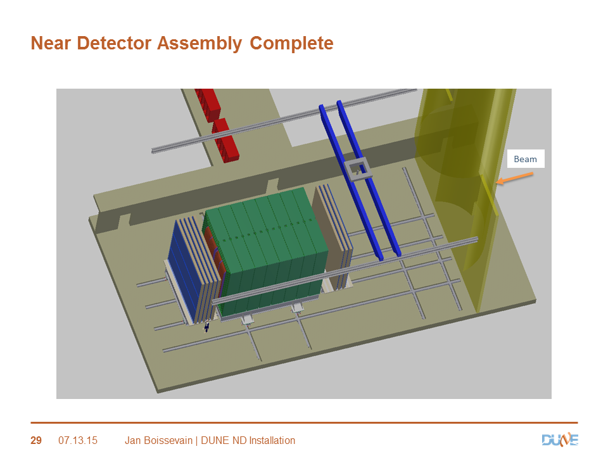

Slide 27
