Slide 1
Can Standard Model Neutrinos
Be Majorana States? and Other Puzzlers Inspired by Adrian Melissinos
KT McDonald
Princeton U.
(March 7, 2017; updated March 4, 2021)
Seminar at University of Rochester
http://kirkmcd.princeton.edu/examples/majorana_170307.pptx

Slide 2
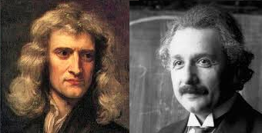
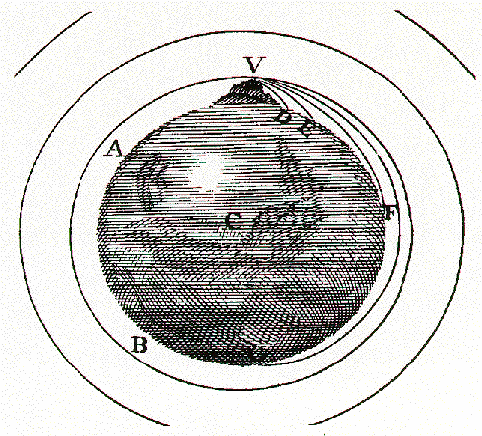
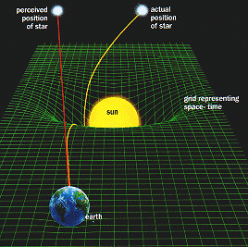
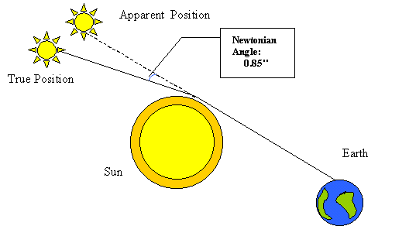
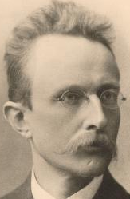
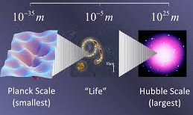
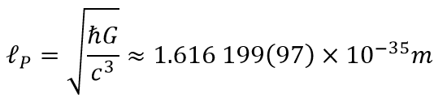
Gravity

Slide 3
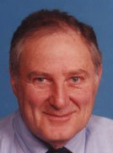
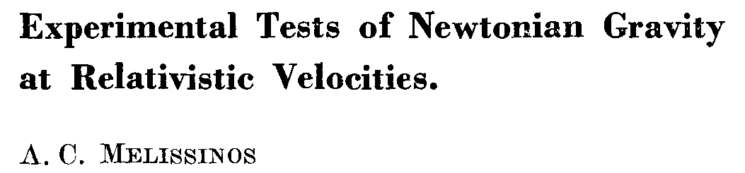
1. Acceleration of a Fast Particle at the Earth’s Surface
Nuovo Cim. 62B, 190 (1981)
What is the acceleration due to gravity of relativistic particle at the Earth’s surface?
Theorist’s answer: There is no such thing as acceleration due to gravity in Einstein’s general relativity.
Adrian’s effort was inspired in part by sec. VI-C of V.B. Braginsky, C.M. Caves and K.S.Thorne, Phys. Rev. D 15, 2047 (1977)

Slide 4
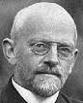
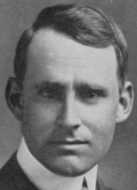

Acceleration of a Fast Particle at the Earth’s Surface
However, a computation of the radial acceleration, for geodesic motion in the Schwarzschild metric in, say, isotropic coordinates yields the result, for where is the Schwarzschild radius.
For we have as expected.
For horizontal motion with we have
while for vertical motion with we have (antigravity!).
D. Hilbert, Nachr. Gesell. Wiss. Göttingen, 53 (1917)
The result for horizontal motion implies that the gravitational deflection of light by the Earth or a star is twice the Newtonian value.
F.W. Dyson, A.S. Eddington and C. Davidson, P. T. Roy. Soc. 220, 291 (1920)
The result for radial motion was confirmed by the Shapiro time delay experiment. I.I. Shapiro, Phys. Rev. Lett. 13, 789 (1964)
But no one ever mentions the acceleration of a fast particle.
http://kirkmcd.princeton.edu/examples/gravity_moving.pdf

Slide 5
Acceleration is Velocity Dependent
Comment: In the equation for geodesic motion,
the quantities are velocities, and are accelerations.
In general, acceleration is velocity dependent!
Perhaps it should then be surprising that the geodesic equation can be equivalent to Newton’s law of gravitation (which has no velocity dependence).
If we take the parameter to be the time then the “time velocity” is 1,
and the radial acceleration, for small spatial velocities, and is just
When and/or approach 1, more Christoffel symbols contribute, and there are ≈ 100% corrections to for a spherical source-mass distribution.
Fast particles do not obey the equivalence principle!

Slide 6
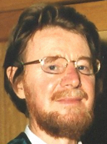
2. Do Antiparticles Experience Antigravity?
It is clear that the equation of geodesic motion is the same for particles and antiparticles (since no property of a particle except its location appears in this equation.
Yet, it is desirable to have experimental confirmation of this claim, that the force of gravity on particle and its antiparticle are related by
with for “antimatter antigravity”.
In 1960, Good gave an argument that as a moves in the Earth’s gravitational potential, if the potential energy had opposite signs for particle and antiparticle, the would evolve into a which could then decay to M.L. Good, Phys. Rev. 121, 311 (1961)
Good presumed that CP conservation held, i.e., that cannot decay to and assumed a (non-gauge-invariant) absolute value for the gravitational potential.
Hence, many people doubt the validity of his claim that
Some people claim that antimatter antigravity causes CP violation:
J.S. Bell and J.K. Perring, Phys. Rev. Lett. 13, 348 (1964) , G. Piacentino et al., INFN Group 2 Meeting Jan 30, 2017

Slide 7
Do Antiparticles Experience Antigravity?
Here we give a different argument, not involving potentials, but based on the observation of oscillations for up to 200 ns, for particles with
L.K. Gibbons et al., Phys. Rev. Lett. 93, 1199 (1993) , Figs 2 and 3, where proper time of 1 ns = 200 ns in the lab for 90-GeV Kaons.
For antimatter antigravity, the vertical separation of the and components of the neutral-Kaon wavefunction would vary as
Once the and wavefunctions would cease to
overlap, and the oscillations would decohere ↔ cease to exist.
Since oscillations are observed for up to 200 ns, we infer that
Antimatter antigravity with is strongly excluded by experiment.
http://kirkmcd.princeton.edu/examples/antigravity.pdf

Slide 8
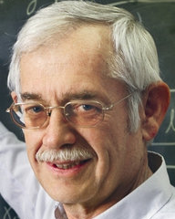
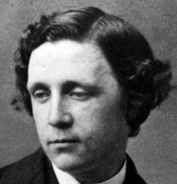
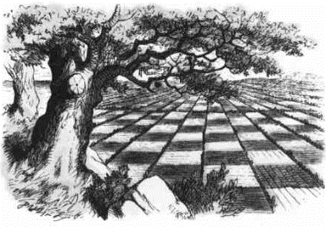
3. Does Looking thru a Window Involve Physics at the Planck Scale?
YES, according to J.D. Bekenstein: Phys. Rev. D 86, 124040 (2012)
Found. Phys. 44, 452 (2014)
C.L. Dodgson, Through the Looking Glass (1871)
Planck length: M. Planck, Sitz. K.P. Akad. Wissen. 26, 440 (1899)
When a single photon of momentum and energy enters a transparent block
of mass and index of refraction which block is initially at rest, the
momentum of the photon is reduced to and the momentum of the
block is temporarily increased to for the time interval
where is the length of the block, is the speed of light in vacuum, and
During this time interval the center of mass of the block moves along the direction
of the photon by distance
For example, if
then
(TLG, p. 30)
⇒ The Planck scale is in some way relevant to
transmission of light through a window!

Slide 9
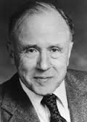
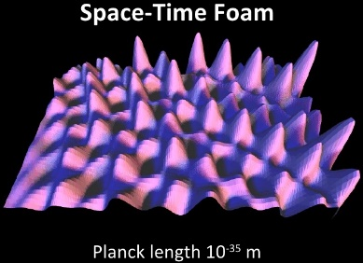
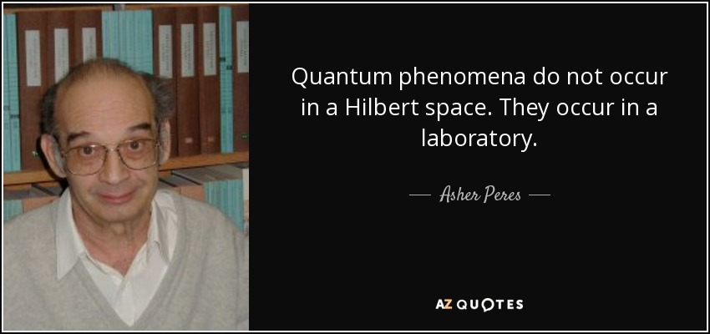
Does Looking thru a Window Involve Physics at the Planck Scale?
If space is grainy on the Planck scale (J.A. Wheeler, Geometrodynamics), a tiny displacement would be impossible, and the single photon would not be transmitted, but would be reflected (according to Bekenstein).
Hence, if the transmission coefficient of the window is smaller for a single photon than for a pulse, this could be evidence that space is grainy on the Planck scale.
But, “Unperformed experiments have no results.”
A. Peres, Am. J. Phys. 46, 745 (1978)
Quantum (gravity) factoid: Unless the experiment includes a measurement of the displacement accurate to the Planck scale, then the center of mass of the block does not actually have the tiny displacement that might be forbidden by the graininess of space.
http://kirkmcd.princeton.edu/examples/bekenstein.pdf
includes additional comments as to why the answer is NO.

Slide 10
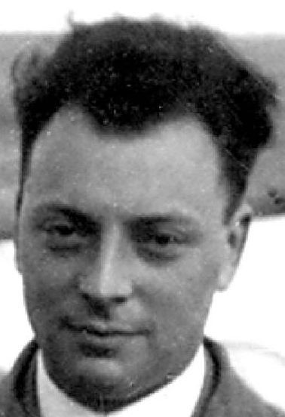
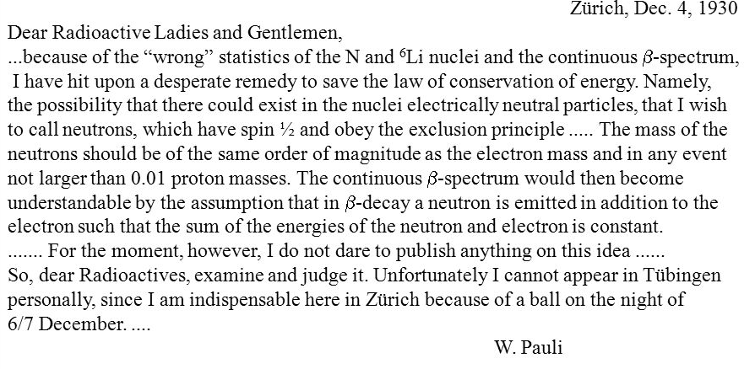
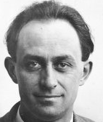
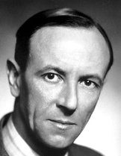
Neutrinos
1930: Pauli notes that if a new particle is produced in beta decay, this would restore conservation of energy, also Fermi statistics if the particle has spin ½.
This is the first solution to a problem in particle physics by invention of a new particle. Leverrier predicts Neptune in 1846 to conserve energy in planetary dynamics. U. Leverrier, Letter to Galle, Sept. 18, 1846
Fermi renames Pauli’s neutron as the neutrino in 1934, since Chadwick named the nuclear partner of the proton as the neutron in 1932. E. Fermi, Nuovo Cim. 11, 1 (1934)
J. Chadwick, Proc. Roy. Soc. A 136, 692 (1932)

Slide 11
4. Do Neutrino Oscillations Conserve Energy?
If neutrinos have mass, they have a rest frame.
If a neutrino oscillates and changes its mass in this rest frame, its mass/energy is not conserved! If a moving neutrino oscillated with fixed momentum, its energy would change, or if fixed energy, its momentum would change.
Is this the way neutrino oscillations work? NO!
Neutrinos are always produced together with some other state X, and if the parent state has definite energy and momentum, then so does the quantum state |ν⟩|X⟩.
If the neutrino is produced in a flavor state, it is a quantum sum of mass states,
|ν_{e}⟩ = a₁ |ν₁⟩ + a₂ |ν₂⟩ + a₃ |ν₃⟩, and the production involves an entangled state,
|ν_{e}⟩ |X⟩ = a₁ |ν₁ |X₁⟩ + a₂ |ν₂⟩ |X₂⟩ + a₃ |ν₃⟩ |X₃⟩.
The sum of the energies and momenta of ν_{i} and X_{i} equals the initial state energy/momentum, while the different ν_{i} (X_{i}) have different energies and momenta.
The coefficients a_{i} can change with time (oscillate), but the energy of ν_{i} does not change with time.
http://kirkmcd.princeton.edu/examples/neutrino_osc.pdf

Slide 12
5. Can Measurement of X Suppress Neutrino Oscillations?
YES.
If X is measured so well that we can distinguish the different X_{i} from one another, then the neutrino must be observed in the corresponding state ν_{i}.
If the neutrino is observed in a flavor state, the proportions of the 3 possible flavors are just squares of the MNS matrix elements, independent of time/distance.
However, most “observations” of state X do not determine its energy so precisely that the above scenario holds.
Example: In a nuclear beta decay, A → A’ e ν_{e}, the interaction of A’ and e with nearby atoms does not “measure” their energies precisely. Rather, the entanglement of the ν_{e} with A’ and e becomes transferred to the neighbor atoms.
Optical experiments with entangled photons illustrate how measurement of the 2nd photon of a pair can affect the quantum interference of the 1st photon.
X.-S. Ma et al., Quantum erasure with causally disconnected choice, Proc. Nat. Acad. Sci. 110, 1221 (2013)

Slide 13
6. What is Decoherence of Neutrino Oscillations?
Since the different ν_{i} have different energies, they have different velocities, such that their wavepackets no longer overlap at large enough distances, and neutrino oscillation should no longer be observable.
Can this effect ruin a long-baseline neutrino experiment, particularly one like JUNO where it is proposed to observe the ~ 15th oscillation?
NO!
That is, when the neutrinos are observed at some large, fixed distance, and one looks for evidence of oscillations in their energy spectra, if the detector resolution is good enough to resolve the oscillations, this guarantees that the wavepackets of the different ν_{i} still overlap (barely).
On the other hand, if the detector energy resolution is poor, and the oscillations can’t be resolved in the energy spectrum, the quantum description of this is that the ν_{i} have “decohered” because their wave packets don’t overlap.
Moral: If you want to see neutrino oscillations, you have to observe them with a “good enough” detector.
Neutrinos from sources at different distances are not coherent with one another, which blurs the oscillations when source size ≥ oscillation length (as for solar neutrinos and supernovae). Dirac: A photon interferes only with itself…

Slide 14
Coherence Length
We review the concept of coherence length by consideration of the neutrino types, 1 and 2,
with masses and well defined energies and momenta in the lab frame,
Physical neutrinos are not plane-wave states as above, but are wave packets with a spread of energies with time spread and spatial width
The wave packet decoheres when the packets of types 1 and 2 cease to overlap, i.e., when
C. Giunti, C.W. Kim and U.W. Lee, Phys. Lett. B 421, 237 (1998)
T. Ohlsson, Phys. Lett. B 502, 158 (2001)
M. Beuthe, Phys. Rev. D 66, 013003 (2002)

Slide 15
Oscillation Length
We also remind you of the concept of oscillation length for the case of two neutrino flavors,
and
Suppose have pure flavor state at the origin at
The spatial period of neutrino oscillations is
The period of oscillations in the neutrino energy spectrum from β-decay at fixed is
where is the average neutrino energy, etc.
Thus, at distance the number of oscillations in the energy spectrum is

Slide 16
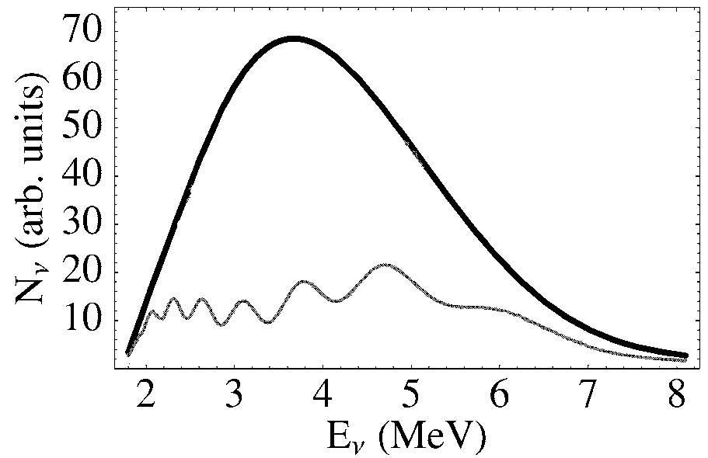
Number of Oscillations in the β-Decay Energy Spectrum
The spatial period of neutrino oscillations at fixed is
The period of oscillations in the neutrino-energy spectrum from β-decay at fixed is
  where is the average neutrino energy.
Thus, at distance the number of oscillations in the energy spectrum, of width is
If no oscillation.
If sin²2θ₁₃ = 0.05.
S.R Petcov and M Piai,
Phys. Lett. B 533, 94 (2002)

Slide 17
(Non)Decoherence in a Reactor-Neutrino Experiment
In neutrino experiments, the detector energy resolution determines in the expression for the coherence length
Some people have difficulty with this factoid, as they suppose that “decoherence” is something that happens before the neutrino is detected. We follow Bohr in noting that the apparatus plays a role in a quantum system. In particular, a neutrino detected with a nominal energy actually has energy in the range which affects the overlap of the wavepackets of different neutrino types when they have arrived at the detector.
Suppose the detector is at distance from a nuclear reactor that produces neutrinos of average energy Then, the neutrino-energy spectrum would show oscillations.
To resolve these oscillations, we need detector energy resolution
And, in this case the coherence length is
Thus, if the detector energy resolution is good enough to resolve the energy oscillations, then the coherence length is automatically long enough to avoid “decoherence”.
Moral: Decoherence is unimportant in a “good enough” neutrino experiment.
http://kirkmcd.princeton.edu/dayabay/decoherence.pdf

Slide 18
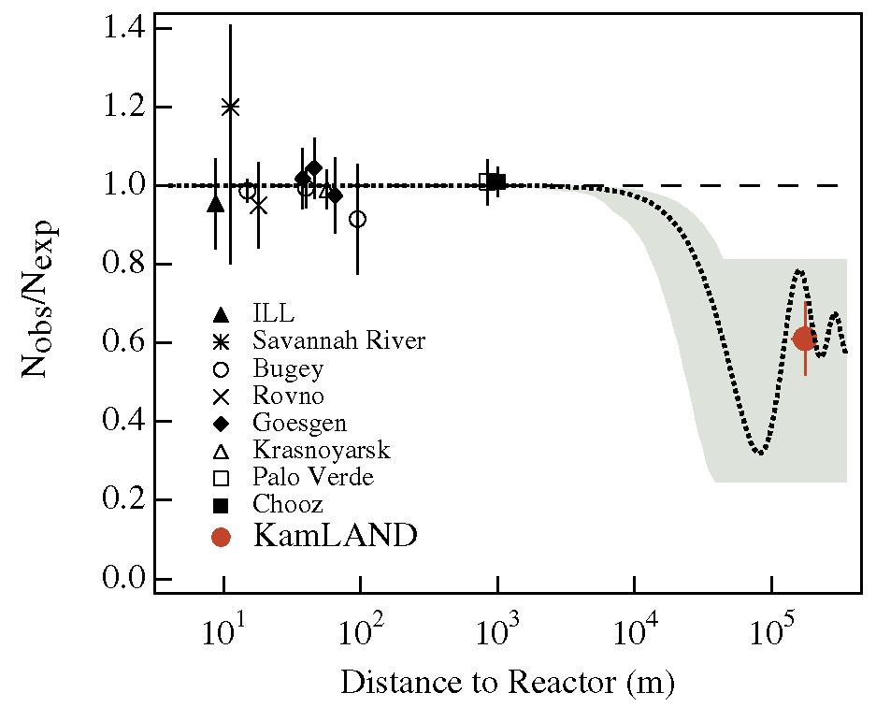
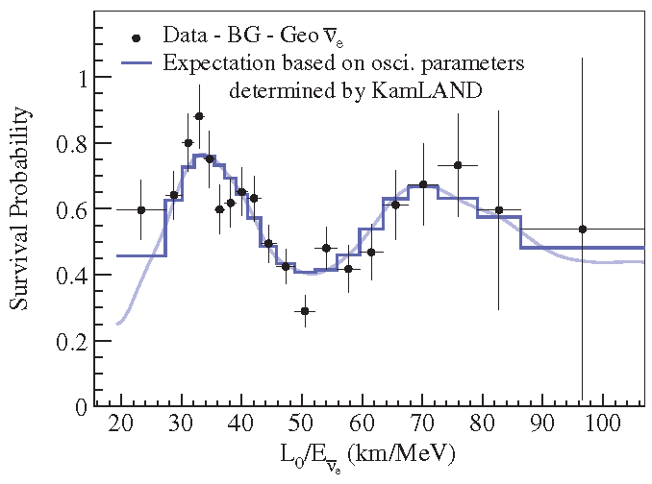
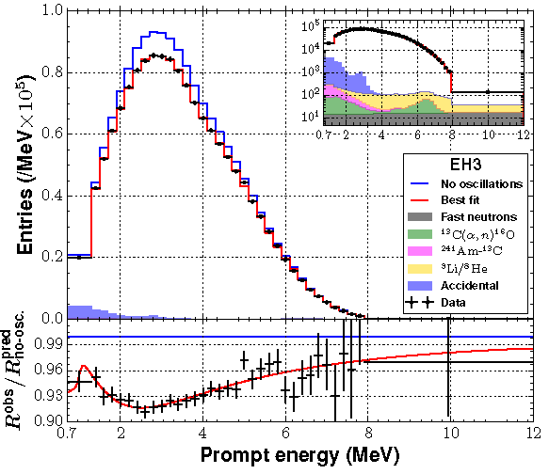
Example: The KamLAND Experiment
In their initial oscillation analysis, the KamLAND experiment ignored the neutrino energy, so that and they could only see an average effect of the first oscillation in K. Eguchi et al., Phys. Rev. Lett. 90, 021902 (2003)
In a later analysis, the neutrino energy was used, and better evidence for neutrino oscillation was obtained. S. Abe et al., Phys. Rev. Lett. 100, 221803 (2008)
Recent results from the Daya Bay experiment, where
F.P. An, et al., Phys. Rev D 95, 072006 (2017)

Slide 19
Effect of Source Size
If the neutrino source is large compared to an oscillation length, the evidence for neutrino oscillations in a detector will be “washed out.”
This is not strictly an effect of decoherence, in that neutrinos produced in different primary interactions do not interfere with one another.
For solar-neutrino oscillations, the solar-neutrino “deficit.” B.T. Cleveland et al., Ap. J. 496, 505 (1998)
J.N. Bahcall, M.H. Pinsonneault and S. Basu, Ap. J. 555, 990 (2001)
In a later analysis, the neutrino energy was used, and better evidence for neutrino oscillation was obtained.

Slide 20



7. Does the Decay Conserve Angular Momentum?
$$π^{+}→W+→ μ^{+}v$$
A spin-0, charged pion decays according to which takes place in the Standard Model via a spin-1 intermediate vector boson
Does this mean that angular momentum is not conserved in the Standard Model?
$$π^{+}→ μ^{+}v,$$
$W^{+}$.

Slide 21



Does the Decay Conserve Angular Momentum?
$π^{+}→W+→ μ^{+}$ $v$
As Peter Higgs remarked in his Nobel Lecture,
“... in this model the Goldstone massless (spin-0) mode became the longitudinal polarization of a massive spin-1 photon, just as Anderson had suggested.“
P.W. Higgs, Rev. Mod. Phys. 86, 851 (2014)
That is, in the Higgs' mechanism, the state of a boson is more or less still a spin-0 “particle.“
Likewise, Weinberg in his Nobel Lecture stated: “The missing Goldstone bosons appear instead as helicity-zero states of the vector particles, which thereby acquire a mass.”
S. Weinberg, Rev. Mod. Phys. 52, 515 (1980)
A similar view was given in N. Nakanishi, Mod. Phys. Lett. A 17, 89 (2002).
http://kirkmcd.princeton.edu/examples/pidecay.pdf
$$S_{z}=0$$
$W^{+}$.

Slide 22
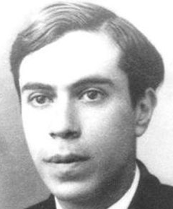
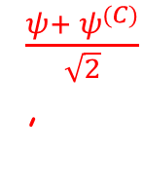
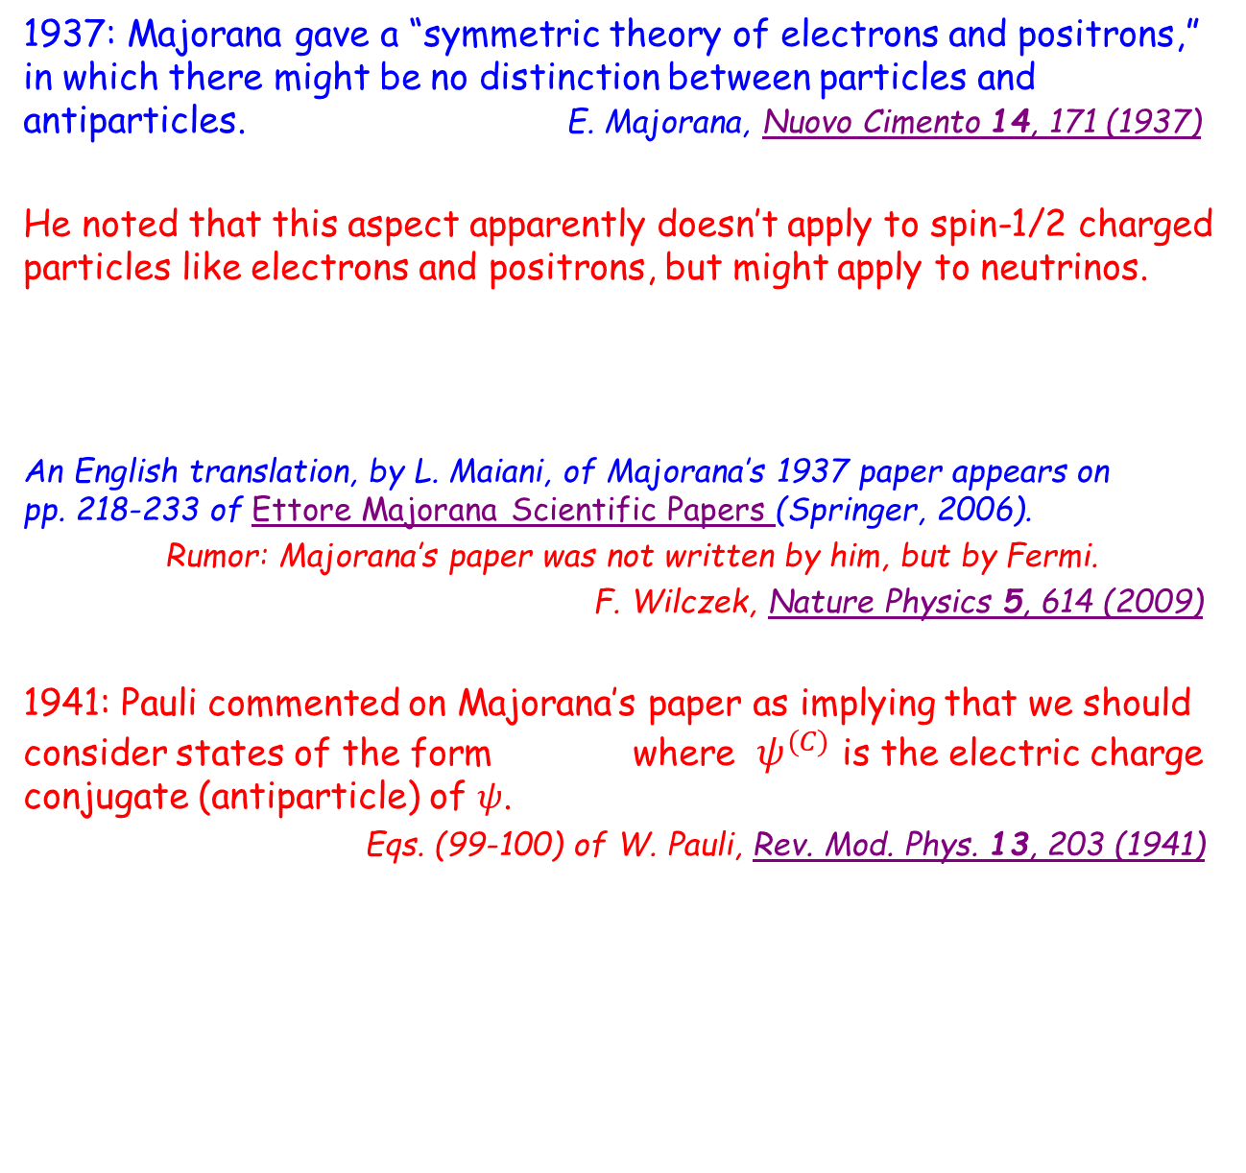
8. Can Standard Model Neutrinos Be Majorana States?
1937: Majorana gave a “symmetric theory of electrons and positrons,” in which there might be no distinction between particles and antiparticles. E. Majorana, Nuovo Cimento 14, 171 (1937)
He noted that this aspect apparently doesn’t apply to spin-1/2 charged particles like electrons and positrons, but might apply to neutrinos.
An English translation, by L. Maiani, of Majorana’s 1937 paper appears on pp. 218-233 of Ettore Majorana Scientific Papers (Springer, 2006).
Rumor: Majorana’s paper was not written by him, but by Fermi.
F. Wilczek, Nature Physics 5, 614 (2009)
1941: Pauli commented on Majorana’s paper as implying that we should consider states of the form where $ψ^{(C)}$ is the electric charge conjugate (antiparticle) of $ψ$.
Eqs. (99-100) of W. Pauli, Rev. Mod. Phys. 13, 203 (1941)
$\frac{ψ+ ψ^{(C)}}{\sqrt{2}}$,

Slide 23
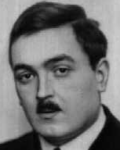
In a Gauge Theory, Interacting Fermions and Antifermions Have Opposite “Charge”
In 1926, Fock noted that gauge invariance of the electromagnetic
potentials in Schrödinger’s equation requires local phase invariance of the wavefunction Ψ. V. Fock, Z. Phys. 39, 226 (1926)
See also F. London, Z. Phys. 42, 375 (1927), p. 206 of W. Pauli, Rev. Mod. Phys. 13, 203 (1941)
In 1954, Yang and Mills inverted this to argue that local phase invariance requires “charged” fermions to interact with gauge-invariant potentials, with the “charge” of the interaction being different for particles and antiparticles.
C.N. Yang and R.L. Mills, Phys. Rev. 96, 191 (1954)
If neutrino interactions are described by a gauge theory, interacting neutrinos and antineutrinos have opposite “charges,” and cannot form a Majorana state.
Since antiparticles don’t experience antigravity, gravity cannot be described by a gauge theory. Ditto, since photons have no mass/”charge”, but are affected by gravity.
Some of the above comments are not yet “proven” mathematically, and are the topic of a
“Millenium Challenge”. A. Jaffe and E. Witten, Clay Math. Inst. (2001)

Slide 24
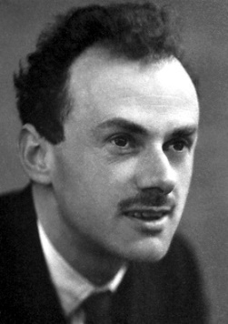
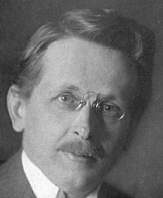
Spin-½ Particles and Antiparticles
1928: Dirac formulated a relativistic quantum theory of spin-½ particles, including negative-energy states that he first interpreted as “holes,” with “electron holes” having positive charge, so perhaps protons.
P.A.M. Dirac, Proc. Roy. Soc. A 117, 610 (1928)
P.A.M. Dirac, Proc. Roy. Soc. A 126, 360 (1930)
Only in 1931 did he identify “electron holes” as the antiparticles of electrons, now called positrons. P.A.M. Dirac, Proc. Roy. Soc. A 133, 60 (1931)
1929: Weyl noted that massless spin-½ states have only 2 independent components in Dirac’s theory, in which case the “superfluous” negative-energy states are absent. The remaining 2 components are left- and righthanded. Even for Dirac states with mass, the notion of left- and righthandedness may be useful, said Weyl.
Since mass couples to gravity, Weyl speculated that Dirac states with mass and electric charge may provide a connection between electromagnetism and gravity. In pursuit of this, he introduced the term gauge invariance. H. Weyl, Proc. Nat. Acad. Sci. 15, 323 (1929)

Slide 25




Chirality and Helicity
The concepts of right- and lefthanded spin-½ particles mentioned by Weyl in 1929 were formalized in 1957 as chirality states. For a general spin-1/2 4-spinor,
, its right- and lefthanded components are defined by
S. Watanabe, Phys. Rev. 106, 1306 (1957) , K.M. Case, Phys. Rev. 107, 307 (1957)
Helicity states (originally called spirality) are defined by the component of the spin along the direction of motion (so ill-defined for a particle at rest).
I use + and – to indicate helicity states; the positive-helicity state has spin parallel to its momentum , while the negative helicity state has spin antiparallel to its momentum.
An important factoid is that for relativistic states, with , the chirality and helicity states are approximately the same.
Since the mass of neutrinos is known to be less than 1 eV, neutrino chirality and helicity states are essentially the same in most experiments. An exception is for cosmic-microwave-background neutrinos, that are to be
studied in the PTOLEMY experiment.
$$ψ$$
$$ψ_{+}$$
p
$$ψ_{−}$$
$$E≫m$$
http://kirkmcd.princeton.edu/examples/neutrinos/tully_060815_ktm.pptx

Slide 26













Chirality and Helicity Antiparticles for Electromagnetic Interactions
Pauli introduced the concept of electric-charge conjugation in 1936, which operation takes a particle to its antiparticle (to within an overall ± sign).
W. Pauli, Ann. Inst. H. Poincaré 6, 109 (1936); Rev. Mod. Phys. 13, 203 (1941)
I write as the antiparticle (for electromagnetic interactions) of .
For spin-½ particles, I write the spinors of particles, with spacetime dependence
in case of plane waves, as , while the symbol for antiparticle spinors, with spacetime dependence , is .
For a pair of particle/antiparticle spinors
helicity antiparticles are simply related,
However, since anticommutes with
$${ ψ}^{(C)}$$
$$ψ$$
$$e^{−ipx }= e^{−i(Et −p∙x)}$$
$$v$$
$$e^{ipx }$$
$$\overline{v}$$
$$\overline{v}= v^{(C)}=i γ^{2}v^{∗},$$
$$v= {\overline{v}}^{(C)}=i γ^{2}{\overline{v}}^{∗},$$
$${\overline{v}}_{±}=v_{±}^{(C)}={(v}_{±})^{(C)}={(v}^{(C)})_{±}.$$
$${ γ}^{5}$$
$${ γ}^{2},$$
${{(v}_{R})}^{(C)}=i γ^{2}\frac{1+γ^{5}}{2}v^{∗}=\frac{1−γ^{5}}{2}{i γ^{2}v}^{∗}=\frac{1−γ^{5}}{2}\overline{v}≡{\overline{v}}_{R}$,
${(v}^{(C)})_{R}=\frac{1+γ^{5}}{2}{i γ^{2}v}^{∗}=\frac{1+γ^{5}}{2}\overline{v}≡{\overline{v}}_{L}$.

Slide 27
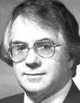
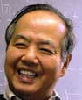
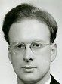
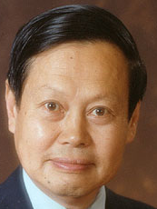


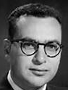
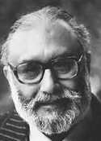
The V - A Theory of the Weak Interaction
1956: Lee and Yang argue that parity may be violated in the weak interaction, which is quickly confirmed by several experiments.
T.D. Lee and C.N. Yang, Phys. Rev. 104, 254 (1956)
1958: Feynman and Gell-Mann reformulate Fermi’s vector theory of the weak interaction as V - A, vector – axial vector, which is maximally parity violating.
Only the lefthanded components of spin-½ particles, and the righthanded components of spin-½ antiparticles, participate in the weak interaction. R.P. Feynman and M. Gell-Mann, Phys. Rev. 109, 193 (1958)
In 1960, S. Glashow postulates the weak isospin symmetry.
S.L. Glashow, Nucl. Phys. 22, 579 (1961)
1n 1967, S. Weinberg and A. Salam recast the V - A theory as a gauge theory, in which the heavy spin-1 quanta, the and bosons, get their mass via the Higgs mechanism (1964).
P. Higgs, Phys. Rev. Lett. 13, 508 (1964)
S. Weinberg, Phys. Rev. Lett. 19, 1264 (1967)
The W and Z vector bosons were first observed directly in 1983, and the Higgs (spin-0) boson was observed in 2012.

Slide 28
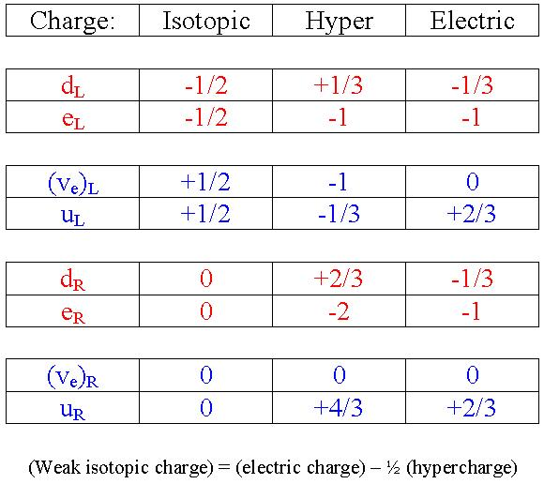
Weak Isopin and Weak Hypercharge
In 1960, Glashow postulated a new symmetry, based on weak isospin, and the conserved quantum numbers/charges and weak hypercharge,
S.L. Glashow, Nucl. Phys. 22, 579 (1961)
Hence, in the Standard Model, the interacting neutrinos and antineutrinos have different quantum numbers, and cannot form Majorana states.
Antiparticles have the opposite quantum numbers of those in the table.
where
is the weak-hypercharge-conjugation operator.
Recall that in the theory, and in the G-W-S electroweak theory, only the neutrino states and interact.
The and are sterile neutrinos.
B. Pontecorvo, Sov. J. Nucl. Phys. 26, 984 (1968)

Slide 29
Majorana Neutrino Chirality States?
Despite the incompatibility of Majorana states with Standard Model neutrinos of nonzero weak hypercharge, people consider two possibilities:
1.
based on weak hypercharge conjugation to relate particles and antiparticles.
2.
based on electric charge conjugation to relate particles and antiparticles.
Form 2 appears much more often in the literature than form 1.
All of these forms obey the coupled Dirac-like equations (recall that ),

Slide 30







Confrontation of Form 1, , with Experiment
$$ψ_{L}= \frac{v_{L}+ {\overline{v}}_{R}}{\sqrt{2}}$$
If the lefthanded-chirality neutrinos that participate in the V - A weak interaction have the form then many existing experiments exclude this.
A good place to start is the charged-pion decay, where the muon is almost at rest in the pion frame,
Then, a lefthanded chirality (or righthanded chirality ) has essentially equal probabilities to be either positive or negative helicity.
The pion has spin zero, a lefthanded neutrino has almost pure negative helicity, and a righthanded antineutrino has almost pure positive helicity.
Hence, a neutrino can only appear in the final state together with a negative-helicity muon (and an antineutrino can appear only with a positive-helicity muon).
If Form 1 holds, there would be essentially equal rates for the two decay modes
and also for the two modes
Only the first of each pair is observed in experiment!
$ψ_{L}= \frac{v_{L}+ {\overline{v}}_{R}}{\sqrt{2}}$,
$$KE_{μ} ≈4 MeV.$$
$$μ_{L}^{−}$$
$$μ_{R}^{+}$$
$π^{+} → μ_{R}^{+} v$, ${ π}^{+} → μ_{R}^{+} \overline{v},$
$π^{−} → μ_{L}^{−} \overline{v}$, ${ π}^{−} → μ_{L}^{−} v.$

Slide 31







Confrontation of Form 2, , with Experiment
$$ψ_{L}= \frac{v_{L}+ {\overline{v}}_{L}}{\sqrt{2}}$$
$ψ_{L}= \frac{v_{L}+{v_{L}}^{(C)}}{\sqrt{2}}=\frac{v_{L}+ {\overline{v}}_{L}}{\sqrt{2}}={ψ_{L}}^{(C)}$,.
Here, the supposed Majorana neutrino states are
Since the lefthanded antineutrino does not participate in the V - A weak interaction, there is no physical difference in single-neutrino interactions of a Dirac lefthanded neutrino or the above Majorana state except for the normalization factor 1/$\sqrt{2} .$
For Majorana states normalized with the factor 1/$\sqrt{2}$, rates of single-neutrino interactions with a single internal W would be down by ½ compared to those for Dirac neutrinos .
Can fix this by multiplying the electroweak coupling constant by $\sqrt[4]{2}$ .
But, then should also multiply by $\sqrt[4]{2}$ to keep the Weinberg angle the same, which would increase the predicted decay width of the by $\sqrt{2}$, in disagreement with experiment by
Existing data exclude both forms of light Majorana neutrino states!
$ψ_{R}= \frac{v_{R}+{v_{R}}^{(C)}}{\sqrt{2}}=\frac{v_{R}+ {\overline{v}}_{R}}{\sqrt{2}}={ψ_{R}}^{(C)}$.
$${\overline{v}}_{L}$$
$$v_{L}$$
$$ψ_{L},$$

Slide 32




Majorana Mass Term
“Neutrinoless” double-beta decay would not occur with Form 2, in that the righthanded (antineutrino) Majorana state produced at the “first” vertex is distinct from the lefthanded (neutrino) Majorana state needed at the “second” vertex.
This issue is fixed by the so-called Majorana mass term in the Lagrangian, that provides a coupling between the and the .
This coupling flips chirality, but with very small amplitude in most experiments.
“Conventional Wisdom”
Majorana mass terms do not require Majorana states. They can also apply to Dirac states.
That is, observation of neutrinoless double-beta decay would NOT a prove that the light neutrinos are Majorana states.
$$ψ_{R}$$
$$ψ_{L}$$
$$ψ_{L}$$
$$ψ_{R},$$

Slide 33


Where Does the “Conventional Wisdom” Come From?
As far as I call tell, the “conventional wisdom” is not really “derived” anywhere, but is stated as “easy to see by inspection” in an influential paper by Li and Wilczek. L.F. Li and F. Wilczek, Phys. Rev. D 25, 143 (1982)
From p. 144:
From the fact that X_{e}, is a Majorana field, X_{e}^{C} =X_{e}, this means that X_{e} can produce either e⁻ or e⁺, but with different chiralities. Since only the mass term can flip the chirality, in the zero-mass limit, where chirality is the same as the helicity, these two processes involving different chiralities will not interfere with each other and the Majorana field is equivalent to the Dirac field.
The Feynman rules for calculation with Majorana neutrinos of course can be read off from the above. It is then easy to see "by inspection" that even in nuclear decays like where the is very soft, there will be no detectable difference between Dirac and Majorana neutrinos. Differences only arise the neutrino and antineutrino of opposite chiralities can interfere.
$H^{3}→ {He}^{3}+\overline{υ}+e^{+}$,
$$\overline{υ}$$

Slide 34

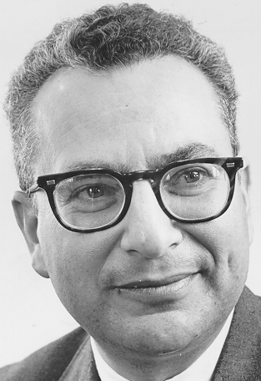
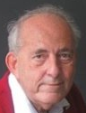
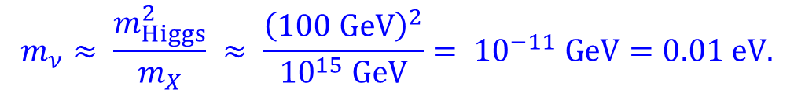


Why Do People Want to Believe the “Conventional Wisdom”?
A very interesting idea emerged in the mid 1970’s that a possible explanation for the tiny masses of the observed neutrinos is that they are Majorana states which are partners with very heavy neutrinos states , whose mass is at the grand-unification scale.
H. Fritzsch, M. Gell-Mann and P. Minkowski, Phys. Lett. B 59, 256 (1975)
Further, the mass matrix for these neutrinos might have off-diagonal terms of order of the mass of the Higgs boson, with the implication that
This is the famous “see-saw” mechanism.
Clearly, we would like to believe that it is true, so most people find it convenient to accept without much question the claim that it is impossible to determine whether neutrinos are Dirac or Majorana states via existing experiments, except for “neutrinoless” double-beta decay (which experiments are not yet sensitive enough to decide the issue).
It is not clear to me that Majorana neutrinos are required for a see-saw
mechanism to hold; Majorana mass terms are sufficient.
$$ν$$
$$X$$
$$m_{ν}≈ \frac{m_{Higgs}^{2}}{m_{X}} ≈ \frac{{\left(100 GeV\right)}^{2}}{{10}^{15} GeV}= {10}^{−11} GeV=0.01 eV.$$

Slide 35
Neutrinoless Double-Beta Decay in a Non-Gauge Theory
While the observed light neutrinos seem well described by the electroweak gauge theory with and bosons, in which theory interacting Majorana neutrinos are forbidden, it could be that there exist bosons and Majorana fermions that obey a non-gauge theory, in which neutrinoless double-beta decay is possible.
It could be that the fermions have low mass as per a see-saw mechanism.
But, the bosons would have to be heavy, as decays like seem not to be observed. Decays like would be forbidden due to violation of conservation of angular momentum, unless the bosons had spin 0.
In this case, the rate for the neutrinoless double-beta decay would be heavily suppressed.
Similarly, if the bosons were relatively light while the fermions were heavy, the decay rate would also be heavily suppressed.
IF so, neutrinoless double-beta decay is unlikely to be observed soon.

Slide 36
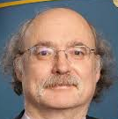
Spin-Zero Half-Fermion Electronic Majorana Modes
A remarkable achievement of contemporary condensed-matter physics is that almost any quasiparticle imaginable in some field theory can be demonstrated in the lab with sufficient effort.
In particular, quasiparticles labeled Majorana fermions have been reported.
S. Nadj-Perge et al., Science 346, 602 (2014)
A. Banerjee et al., Nature Mat. 15, 733 (2016)
These nonpropagating “Majorana zero modes” have only one spin state, with a participating electron that is shared between two surfaces of the sample.
Such states have been described as “spin-zero half-fermions,” that have only electromagnetic interactions, and are rather different entities than the weakly interacting Majorana-neutrino chirality states considered here.
F.D.M. Haldane, private communication
http://kirkmcd.princeton.edu/examples/majorana.pdf

Slide 37
Appendix: Early History of Neutrinoless Double-Beta Decay

Slide 38
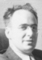


Double-Beta Decay
1939: Furry argued that a process which could occur for Majorana neutrinos, but not Dirac neutrinos, is “neutrinoless” double-beta decay,
in contrast to 2-neutrino double-beta decay,
which is allowed for Dirac neutrinos. W.H. Furry, Phys. Rev. 56, 1184 (1939)
$$\left(A,Z\right)→\left(A,Z+2\right)e^{−}e^{−}$$
$$\left(A,Z\right)→\left(A,Z+2\right)e^{−}e^{−}{\overline{v}}_{e}{\overline{v}}_{e}$$
Not yet observed.
τ > 10²⁵ yr.
Several examples observed.
τ ≈ 10²¹ yr.
Furry noted (prior to the V – A theory) that if the matrix element is similar for the two processes, the rate for “neutrinoless” double-beta decay would be much higher, due to the larger phase space of the 3-body final state (compared to that for a 5-body final state).

Slide 39
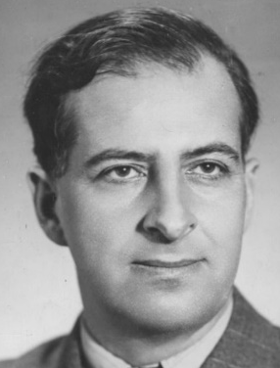
Pontecorvo
1946: Pontecorvo argued that reactor-neutrino experiments, and solar-neutrino experiments might include reactions possible only via Majorana neutrinos. B. Pontecorvo, Chalk River PD-205 (1946)
Possible diagrams in solar-neutrino experiments
Possible diagrams in reactor-neutrino experiments
The diagrams on the right, for Majorana neutrinos, have the same form at that for “neutrinoless” double-beta decay, except that the virtual neutrino lives longer.
Present conventional wisdom is that Majorana neutrinos could not contribute to these “ordinary” reactions. However, if neutrinos had form 1,
diagrams on the right could proceed, in disagreement with data.

Slide 40
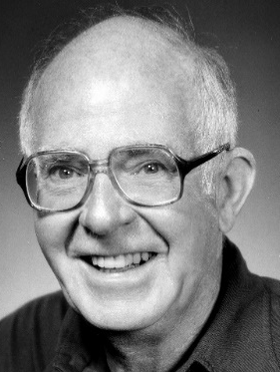
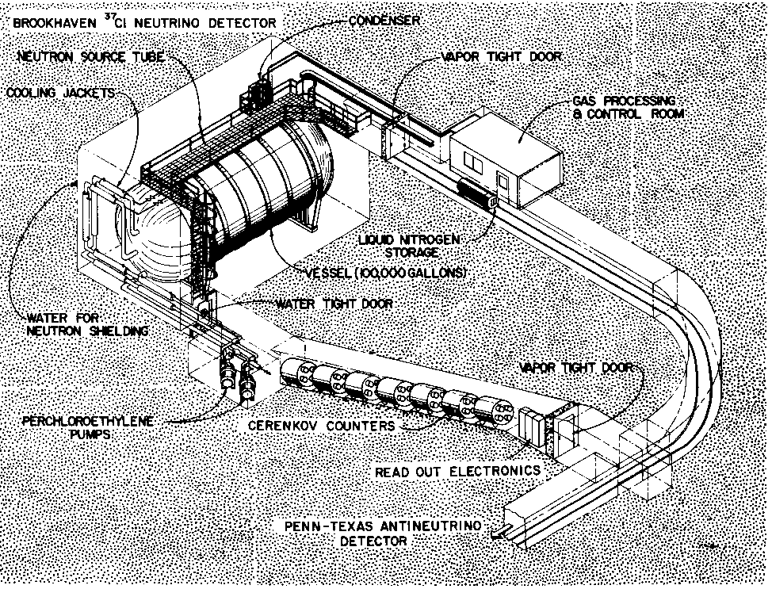

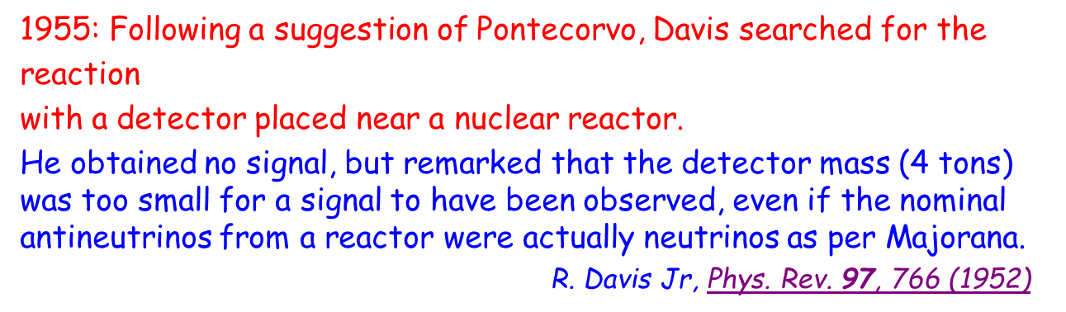
Davis
1955: Following a suggestion of Pontecorvo, Davis searched for the
reaction
with a detector placed near a nuclear reactor.
He obtained no signal, but remarked that the detector mass (4 tons) was too small for a signal to have been observed, even if the nominal antineutrinos from a reactor were actually neutrinos as per Majorana.
R. Davis Jr, Phys. Rev. 97, 766 (1952)
v + $Cl^{37}→Ar^{37}+e^{− }$
This version of Davis’ experiment has never been repeated.
Davis switched his efforts to the detection of solar neutrinos, deep underground and far from any nuclear reactor, with now-famous results. the solar-neutrino “deficit.” Cleveland et al., Ap. J. 496, 505 (1998)

Slide 41
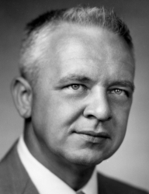





Cowan and Reines
1953: Cowan and Reines noted that a better way to detect reactor antineutrinos (produced via the beta decay )
is via the inverse-beta-decay process , using a liquid-scintillator detector that first observed the positron, and then the delayed capture of the thermalized neutron on a nucleus, with subsequent emission of γ-rays.
F. Reines and C.L. Cowan Jr, Phys. Rev. 90, 492 (1953)
They reported marginal evidence for detection of antineutrinos in 1953, and then more compelling evidence in 1956.
F. Reines and C.L. Cowan Jr, Phys. Rev. 92, 830 (1953)
C.L. Cowan Jr et al., Science 124, 103 (1956)
n $→p e^{− }{\overline{v}}_{e}$
${\overline{v}}_{e}$ p $→n e^{+ }$

Slide 42






Appendix: Why Was the Concept of Gauge Theory Slow to Be Accepted?
In 1954, Yang and Mills advocated a gauge theory of the strong interaction, based on isospin symmetry, in which the interaction was mediated by massless vector bosons (which were argued as generic to a gauge theory).
C.N. Yang and R.L. Mills, Phys. Rev. 96, 191 (1954)
At the 1955 Rochester Conference, Feynman and Oppenheimer commented that such a theory would imply the existence of a long-range force, with 1/r² dependence, similar to gravity but much stronger, as excluded by experiment.
Discussion of Yang’s theory, 1955 Rochester Conference, pp. 93-94
It took many years before Weinberg and Salam noted that the Higgs mechanism could lead to massive gauge bosons and corresponding short-range forces; and for Gross, Wilczek and Politzer to note that the strong interaction of massless vector gluons was subject to “confinement” that results in a short-range force.
S. Weinberg, Phys. Rev. Lett. 19, 1264 (1967)
A. Salam, Nobel Symposium, p. 367 (1968)
D.J. Gross and F.Wilczek, Phys. Rev. Lett. 30, 1343 (1973)
H.D. Politzer, Phys. Rev. Lett. 30, 1346 (1973)

