Slide 1
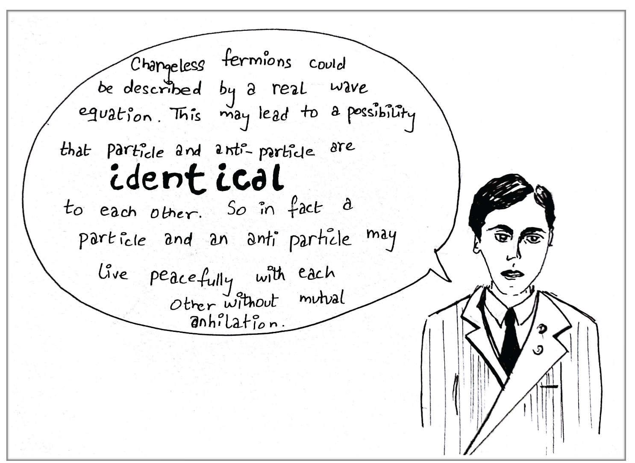
Past Experiments Exclude Light Majorana Neutrinos
(Lepton Photon 2017, August 11, Guangzhou)
U. Akhouri,¹ K.T. McDonald²
¹U Delhi, New Delhi, 10021 India, ²Princeton U, Princeton, NJ 08544 USA
http://kirkmcd.princeton.edu/examples/majorana.pdf
http://kirkmcd.princeton.edu/examples/majorana_170307.pptx
http://kirkmcd.princeton.edu/examples/majorana_poster_lp17_v9.pptx
http://kirkmcd.princeton.edu/~mcdonald/examples/majorana_170811.pptx
In 1937, Majorana gave a “symmetric theory of electrons and positrons,” in which there might be no distinction between spin-1/2 particles and antiparticles.
E. Majorana,
Nuovo Cimento 14, 171 (1937)

Slide 2
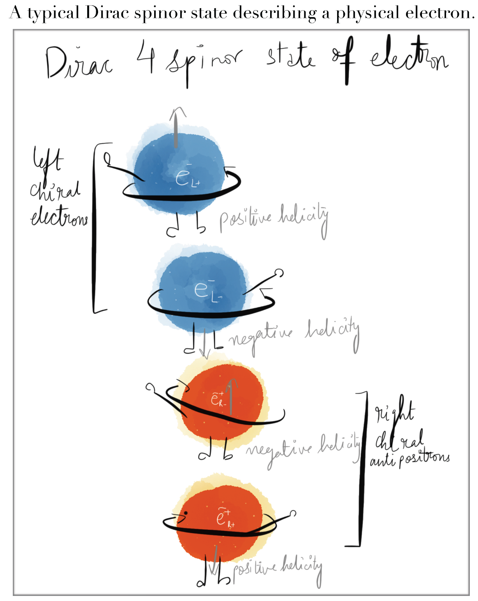
Majorana noted that this theory doesn’t apply to charged particles like electrons and positrons, but might apply to neutrinos.
However, in a gauge theory, interacting fermions and antifermions have different quantum numbers, and cannot form Majorana states.
Interacting neutrinos carry nonzero weak isospin and weak hypercharge in the Glashow-Weinberg-Salam model, and antineutrinos carry the opposite “charges”.
Hence, these neutrinos cannot form Majorana states (unless one only considers electric-charge conjugation as defining particles and antiparticles).

Slide 3
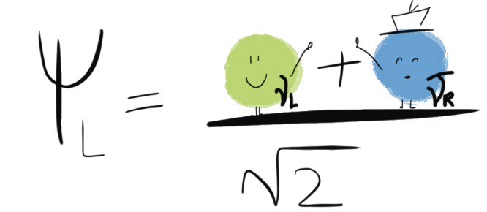
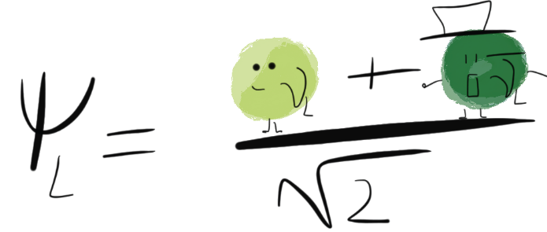
The literature appears to consider two different possible forms for the hypothetical Majorana neutrino states (in terms of 4-spinors), .
The first form would imply, for example, that the decays
could occur with roughly equal rates, and hence conventional neutrino beams would be 50:50 neutrino and antineutrino, contrary to experiment
The second form would imply that the electroweak coupling constant g would have to be
$\sqrt[4]{2}$ larger to keep the observed rates of single-neutrino interactions with an internal W the same. But the, to keep the Weinberg angle the same, the coupling constant g’ would also have to be multiplied by $\sqrt[4]{2}$ , in disagreement with the observed width of the Z⁰ by 200 σ.
Conventional wisdom is that the only experiment which could determine whether of not neutrinos are Majorana states is neutrinoless double-beta decay. However, this view was developed before the W and Z gauge bosons were discovered, and it has been overlooked that experiments on the decay of the W and Z strongly exclude that the known light neutrinos are Majorana states (while permitting Majorana mass terms, neutrinoless double beta decay, and the see-saw mechanism).
$$ψ_{L}= \frac{v_{L}+ {\overline{v}}_{R}}{\sqrt{2}}$$
$$ψ_{L}= \frac{v_{L}+ {\overline{v}}_{L}}{\sqrt{2}}$$

Slide 4
Thank you.

