Slide 1
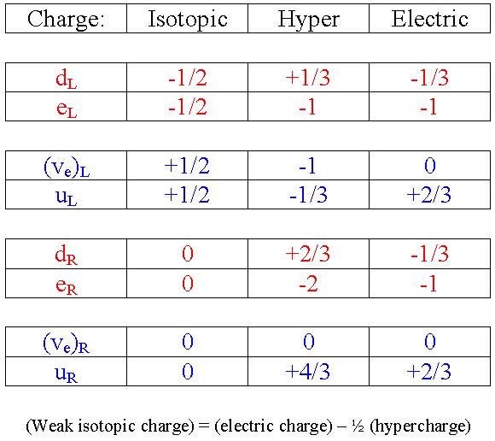
Past Experiments Exclude Light Majorana Neutrino States
(Lepton Photon 2017, August 7-12, Guangzhou; updated Mar 4, 2021)
U. Akhouri,¹ K.T. McDonald²
¹U Delhi, New Delhi, 10021 India, ²Princeton U, Princeton, NJ 08544 USA
http://kirkmcd.princeton.edu/examples/majorana.pdf http://kirkmcd.princeton.edu/examples/majorana_170307.pptx
In 1937, Majorana gave a “symmetric theory of electrons and positrons,” in which there might be no distinction between spin-1/2 particles and antiparticles. E. Majorana, Nuovo Cimento 14, 171 (1937)
He noted that this theory doesn’t apply to charged particles like electrons and positrons, but might apply to neutrinos.
However, in a gauge theory, interacting fermions and antifermions have different quantum numbers, and cannot form Majorana states (unless only electric-charge conjugation defines particles and antiparticles).
In 1960, Glashow postulated a new symmetry, based on weak isospin, and the conserved quantum numbers/charges and weak hypercharge, S.L. Glashow, Nucl. Phys. 22, 579 (1961)
Antiparticles have the opposite quantum numbers of those in the table.
where is the weak-hypercharge-conjugation operator.
Recall that in the theory, and in the Glashow-Weinberg-Salam electroweak theory, only the neutrino states and interact.
The and are sterile neutrinos and could be Majorana states. B. Pontecorvo, Sov. J. Nucl. Phys. 26, 984 (1968)
Majorana Neutrino Chirality States?
Despite the incompatibility of Majorana states with Standard Model neutrinos of nonzero weak hypercharge, people consider two possibilities:
1. based on weak-hypercharge conjugation.
2. based on electric-charge conjugation.
Form 2 appears much more often in the literature than Form 1.
$$ψ_{L}= \frac{v_{L}+ {\overline{v}}_{R}}{\sqrt{2}}$$
Confrontation of Form 1, , with Experiment
$ψ_{L}= \frac{v_{L}+ {\overline{v}}_{R}}{\sqrt{2}}$,
If the lefthanded-chirality neutrinos that participate in the V - A weak interaction had the form then many existing experiments exclude this.
A good place to start is the charged-pion decay, where the muon is almost at rest in the pion frame,
Here, a lefthanded chirality (or righthanded chirality $μ_{R}^{+}$) has essentially equal probability to be either positive or negative helicity.
The pion has spin zero, a lefthanded neutrino has almost pure negative helicity, and a righthanded antineutrino has almost pure positive helicity.
Hence, a neutrino can only appear in the final state together with a negative-helicity muon (and an antineutrino can appear only with a positive-helicity muon).
If Form 1 held, there would be essentially equal rates for the two decay modes and also for the two modes
Only the first of each pair is observed in experiment!
$$KE_{μ} ≈4 MeV.$$
$$μ_{L}^{−}$$
$π^{−} → μ_{L}^{−} \overline{v}$, ${ π}^{−} → μ_{L}^{−} v.$
$π^{+} → μ_{R}^{+} v$, ${ π}^{+} → μ_{R}^{+} \overline{v},$
$$ψ_{L}= \frac{v_{L}+ {\overline{v}}_{L}}{\sqrt{2}}$$
Confrontation of Form 2, , with Experiment
$ψ_{L}= \frac{v_{L}+{(v}_{L})^{C}}{\sqrt{2}}=\frac{v_{L}+ {\overline{v}}_{L}}{\sqrt{2}}={(ψ}_{L})^{C}$,
$ψ_{R}= \frac{v_{R}+{(v}_{R})^{C}}{\sqrt{2}}=\frac{v_{R}+ {\overline{v}}_{R}}{\sqrt{2}}={(ψ}_{R})^{C}$.
Here, the supposed Majorana neutrino states are
Since the lefthanded antineutrino does not participate in the V - A weak interaction, there is no physical difference in single-neutrino interactions of a Dirac lefthanded neutrino or the above Majorana state except for the normalization factor 1/$\sqrt{2} .$
For Majorana states normalized with the factor 1/$\sqrt{2}$, rates of single-neutrino interactions with a single internal W would be down by ½ compared to those for Dirac neutrinos .
Can fix this by multiplying the electroweak coupling constant by $\sqrt[4]{2}$ .
But, then should also multiply by $\sqrt[4]{2}$ to keep the Weinberg angle the same, which would increase the predicted decay width of the by $\sqrt{2}$, in disagreement with experiment by
Existing data exclude both forms of light Majorana neutrino states! But, Majorana mass terms can exist.
The see-saw mechanism to explain the low mass of observed neutrinos (and neutrinoless double beta decay) requires Majorana mass terms not Majorana states. H. Fritzsch, M. Gell-Mann and P. Minkowski, Phys. Lett. B 59, 256 (1975)
$${\overline{v}}_{L}$$
$$v_{L}$$
$$ψ_{L},$$

